Slide 1

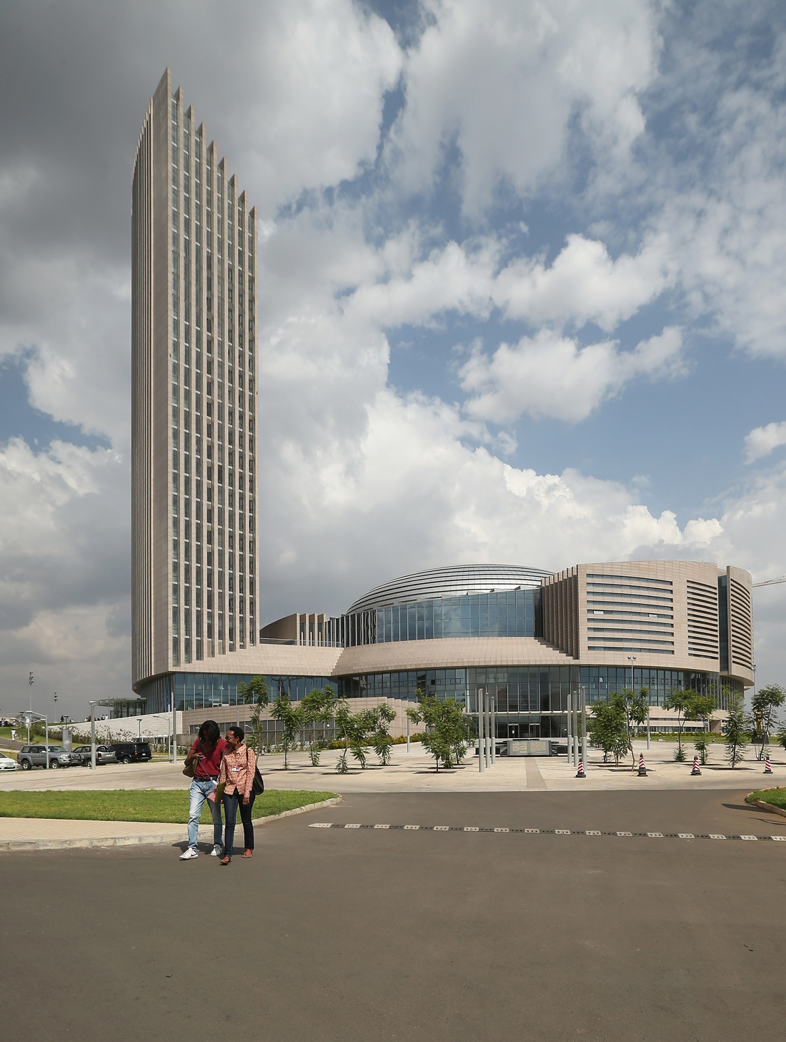




The African Pastoral Markets Development (APMD) Platform
Technical Pillar Planning and Stakeholders Engagement Workshop
21st -24th October 2024, Naivasha, Kenya.

Slide 2

Introductions
Name
Organisation / or instruction you represent
Your role in Pastoralist Markets

Slide 3

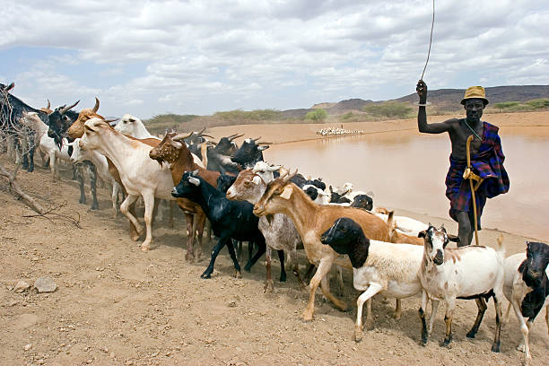
Workshop Objectives
Assess the current status of Enabling Policy Environment, Functional Data Ecosystems, and pastoralists integration into livestock marketing that supports the promotion of pastoral livestock marketing and sector transformation.
Review and finalize the priority areas of actions and interventions, and identify implementers and beneficiaries.
Answer the three Pillars’ Assessment Questionnaire and promote the stakeholder’s engagement in a baseline assessment process.
Build consensus on the formation of the “Lighthouse Technical Working Groups”: Validate the TOR for Pillar Technical Working Groups (TWGs) for each of the three (3) pillars of the APMD-Platform, and build consensus on their membership.
Build Consensus and Promote Stakeholders-Implementers Synergized Engagement: Build consensus on priority actions and interventions, and plan for across-pillar synergized engagement, of national and regional implementers, in the sustainable implementation and operationalization of the APMD Platform.

Slide 4

How are we going to achieve the objectives
..\..\..\..\..\..\..\Desktop\New folder (2)\20241019 - Technical Pillar Planning WS-Kenya-21-24 October 2024-shared.docx

Slide 5
Thank You

