Slide 1

Role of the Veterinary Education Establishments in the progression of transboundary animal disease control
Prof Dietmar Holm (University of Pretoria)
President: African Association for Veterinary Education Establishments (2A2E-V)

Slide 2
Background: the need to harmonise veterinary education and establish continental accreditation
Transboundary disease control is needed to enhance trade within the continent – Agenda 2063: The Africa we want.
A common standard of education is essential to establish and maintain relationships of trust amongst disease control authorities responsible to implement trade agreements.
Previously individual African veterinary education establishments (VEEs) networked mostly with VEEs in Europe, Americas and Australasia – These were traditionally seen as “top-down” or “giver and receiver” relationships: not sustainable.
VEEs in Africa want to change this by working together more closely (as evidenced by previous initiatives by WOAH).

Slide 3

2A2E-V established in July 2018 in Cairo, initiated by AU-IBAR through Live2Africa
What is the African Association for Veterinary Education Establishments (2A2E-V)?
Of the 55 AU member states, 26 have VEEs
North and East Africa have the most VEEs (23 each)
West and Central Africa have the most states without a VEE (11 and 7 respectively)
All African VEEs (recognised by country higher education authority) have a seat on the 2A2E-V General Assembly (GA) – biannually
At the GA, 2 representatives from each of the 5 regions of AU are elected onto the Executive Committee (EC).
EC elects a President, 2 Vice Presidents, a Secretary General and a Treasurer, representative of 5 regions

Slide 4
Objectives of 2A2E-V
To enhance collaboration among all the Veterinary Education Establishments (VEEs) in Africa.
To establish African Veterinary Academic Standards (AVAS) for accreditation.
To harmonise veterinary curricula in Africa.
To enhance dissemination of innovations and good practice among African VEEs.
To build capacity among educators in the African Veterinary Education Establishments.
To promote quality facilities at African VEEs

Slide 5
Objective 1: To enhance collaboration amongst all VEEs in Africa
Project 1:
2A2E-V collaborative online platforms:
  Working platform for the EC members (CLOSED):
    Communication platform linking to email.
    Repository for all documents, working documents as well as minutes and agendas.
  Platform for all VEEs in Africa (PUBLIC):
    Front-end like a website to find information about any VEE in Africa, or summarised per region.
    Also used for dissemination of information (such as announcements, calls for funding, study and training opportunities etc) to encourage collaboration among VEEs in Africa.
    Links to open documents of 2A2E-V such as the statutes, agendas and minutes of the GA
    Links to other websites or repositories.

Slide 6
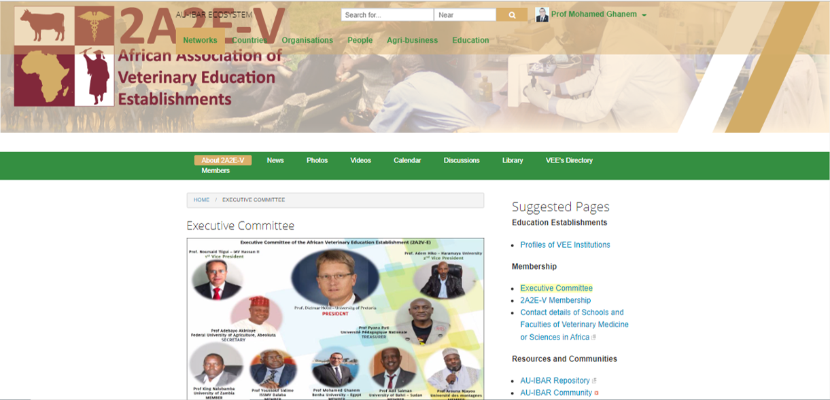

Slide 7
Objective 2: Establishing African Veterinary Academic Standards for accreditation
Project 2a:
Establishment of African Veterinary Academic Standards (AVAS):
Initial establishment of standards framework based on the Egyptian Quality Assurance Standards established in 2017
Revision and recognition of AVAS by external referees (EAVEA of AVMA) supported by AU-IBAR
Feedback from African VEEs about the AVAS
Dissemination and training on the new AVAS through VEEs

Slide 8
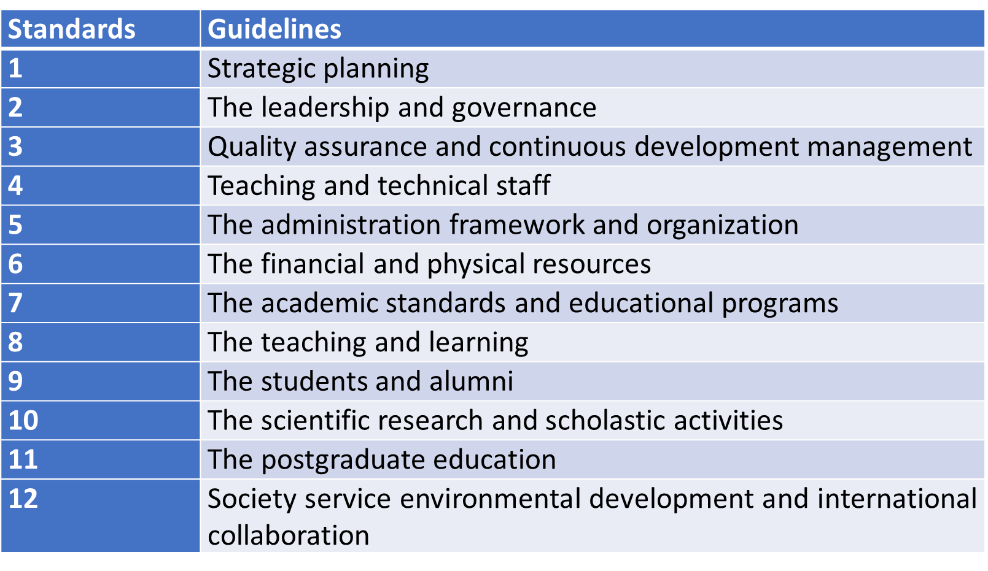
Objective 2: Establishing African Veterinary Academic Standards for accreditation

Slide 9
Objective 2: Establishing African Veterinary Academic Standards for accreditation
Project 2b:
Establishment an AVAS accreditation system for VEEs in Africa recognised by AU and AUU:
  Formulation of board (EC plus continental qualified experts from regions)
  Guidelines of the application process (required documents)
  Portal for display of the AVAS (version 1)
  Establish a platform of AVAS to provide online submission of documents
  The visitation is mostly virtual with one person on site at the institution while the rest of the team are online.
  Fees should be paid by the institutions to be accredited

Slide 10
Objective 3: Harmonisation of the Veterinary curriculum in Africa
Project 3a:
The Day 1 Competencies for African veterinarians were concluded by 2A2E-V in 2021. These were based on the OIE (WOAH) Day 1 Competencies.
These form the learning outcomes of the African Veterinary curriculum
A backward curriculum design process is promoted (Day 1 Competencies as outcome)
  Broad guidelines are given by 2A2E-V, to allow for specific differences in institutions
Step One
Learning outcomes
Exit level linked to module level linked to unit/theme/section level
Step Three
Teaching and Learning planning
Approach
Strategy
Activities
Step Two
Assessment Planning
Domains
Level
Timing
Methods
Techniques

Slide 11
Objective 3: Harmonisation of the Veterinary curriculum in Africa
Project 3a: General curriculum principles:
  Institution must be accredited by the relevant local governance structure(s)
  The veterinary programme must be accredited (academic accreditation) by the relevant higher education council or qualifications authority
  The veterinary programme must be accredited (professional accreditation) or approved by the local Veterinary Statutory Body (VSB), where this exists.
  Where VSBs don’t exists, their establishment must be promoted by the institution
  2A2E-V is concerned about the challenge created by political interference in the governance and independence of VSBs and the resulting accreditation systems involving VEEs
  The veterinary programme must articulate directly into a Masters programme at least, and preferably with options for specialisation.
  Curriculum review must happen at least once in 5 years
  The required infrastructure must be available to support the presentation of the curriculum

Slide 12
Objective 3: Harmonisation of the Veterinary curriculum in Africa
Project 3b: Provision of harmonised teaching materials for African VEEs:
Day 1 Platform: an initiative by Iowa State University, funded by the Gates Foundation
Presidents of 2A2E-V applied and received the grant (for development of bovine teaching materials) in collaboration with Ross University
Objective:
  Provide training materials on clinical cases for VEEs in Africa and the middle East.
  Day 1 Platform will be an open educational resource (OER) for Africa

Slide 13
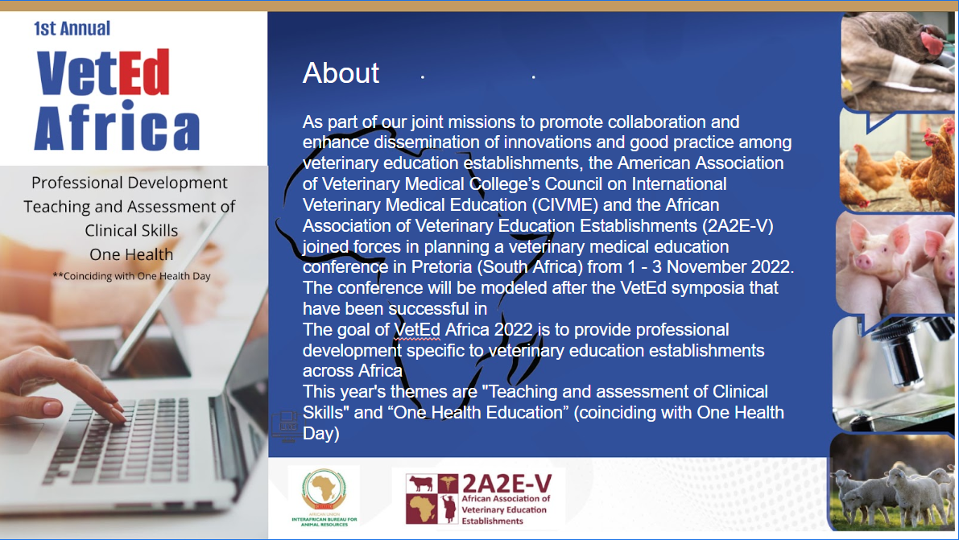
About
As part of our joint missions to promote collaboration and enhance dissemination of innovations and good practice among veterinary education establishments, the American Association of Veterinary Medical College’s Council on International Veterinary Medical Education (CIVME) and the African Association of Veterinary Education Establishments (2A2E-V) joined forces in planning a veterinary medical education conference in Pretoria (South Africa) from 1 - 3 November 2022. The conference will be modeled after the VetEd symposia that have been successful in
The goal of VetEd Africa 2022 is to provide professional development specific to veterinary education establishments across Africa
This year's themes are "Teaching and assessment of Clinical Skills" and “One Health Education” (coinciding with One Health Day)
Objective 4: To enhance dissemination of innovations and good practice among African VEEs.

Slide 14

Objective 4: To enhance dissemination of innovations and good practice among African VEEs.

Slide 15
Objective 5: To build capacity among educators in the African Veterinary Education Establishments
Project 5: Inter-African twinning programmes:
MoUs between VEEs should be signed between all members of 2A2E-V to facilitate students and staff mobility.
A draft MoU template should be designed by the 2A2E-V EC and shared through 2A2E-V platform.
Funding opportunities should be recruited by 2A2E-V EC and distributed through the platform, and members should be encouraged to apply.
AU-IBAR should assist to identify collaborators and opportunities at a higher level.
Possible opportunities: WOAH (OIE), FAO. EU. IAEA, Intra-ACP, GIZ, JICA, USAID, SIDA, Private philanthropists e.g., Bill and Melinda Gates Foundation, NGO etc

Slide 16
Objective 6: To promote quality facilities at African VEEs
Project 6: African Centres of Excellence:
Initial call yielded poor results
Re-structuring of 9 initial centres into 5 centres in order to recruit one per region of Africa:
Area 1
  1.1. Veterinary Policy, legislation and jurisprudence (Regulations and trade in animals and animal products, strategies, etc)
  1.2. Veterinary Education (pedagogical, assessment, clinical and skill training)
Area 2
  2.1. Animal welfare
  2.2. Wildlife Health and biodiversity
Area 3
  3.1. Veterinary epidemiology (Biosecurity, import and export risk analysis etc)
  3.2. Veterinary Public Health and One Health approach
Area 4
  4.1. Veterinary entrepreneurship and innovation (biotechnology, etc)
  4.2. Veterinary Drug quality and Alternative veterinary therapy
Area 5
5.1. Clinical Veterinary medicine (by discipline and species differentiation)

Slide 17
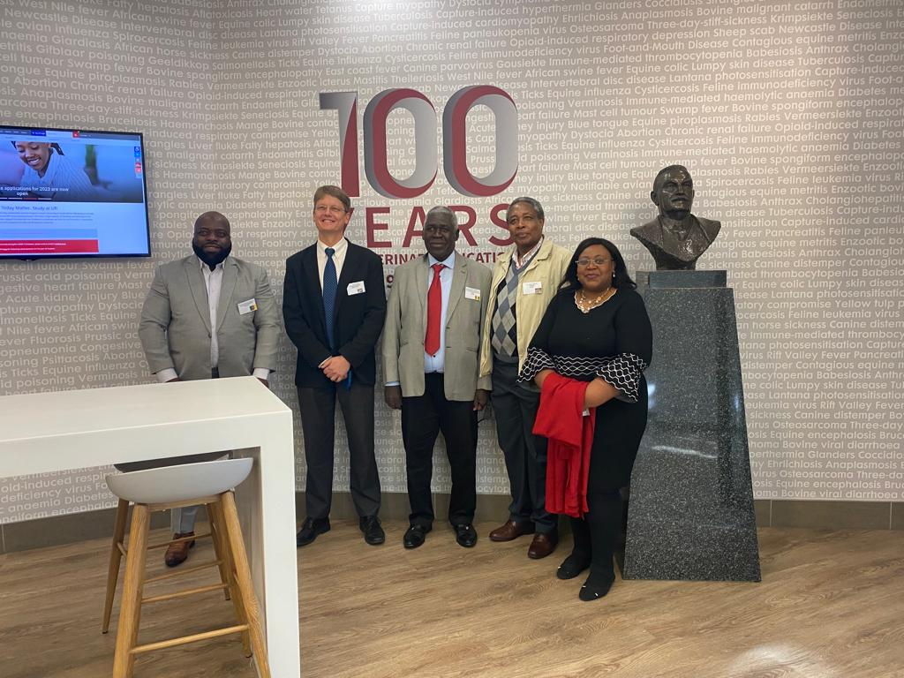
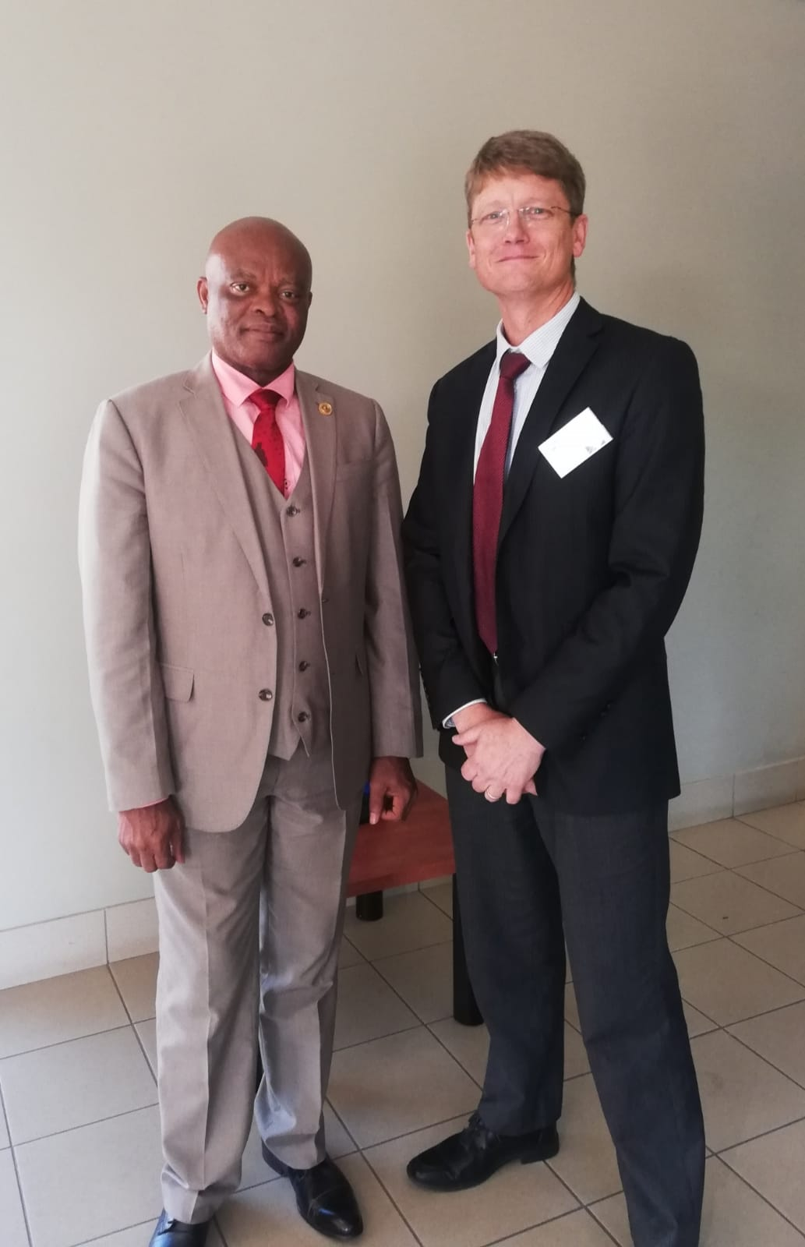
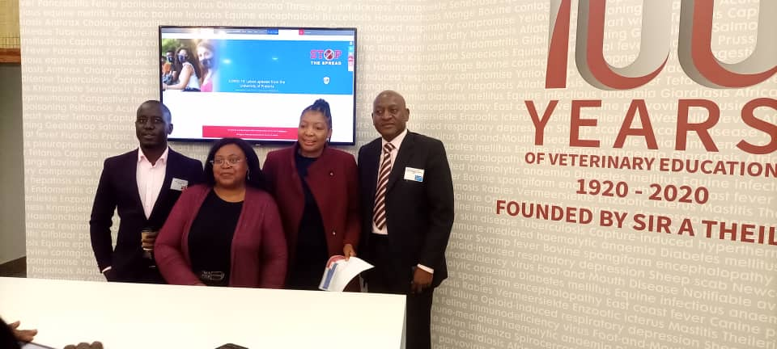
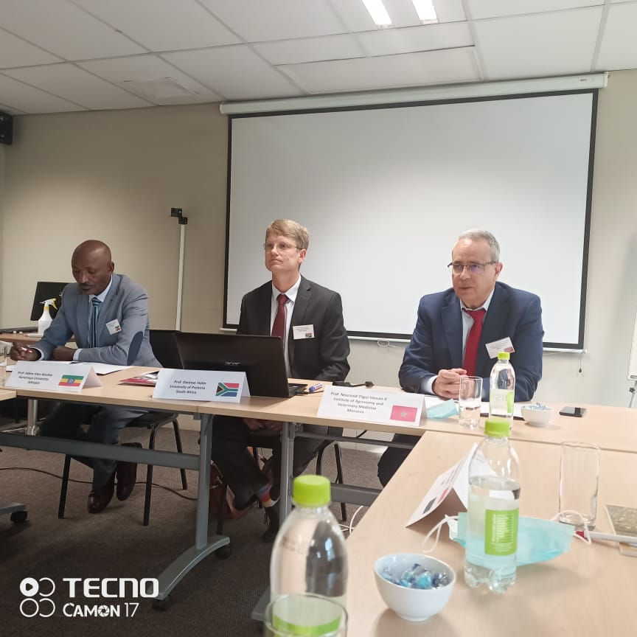
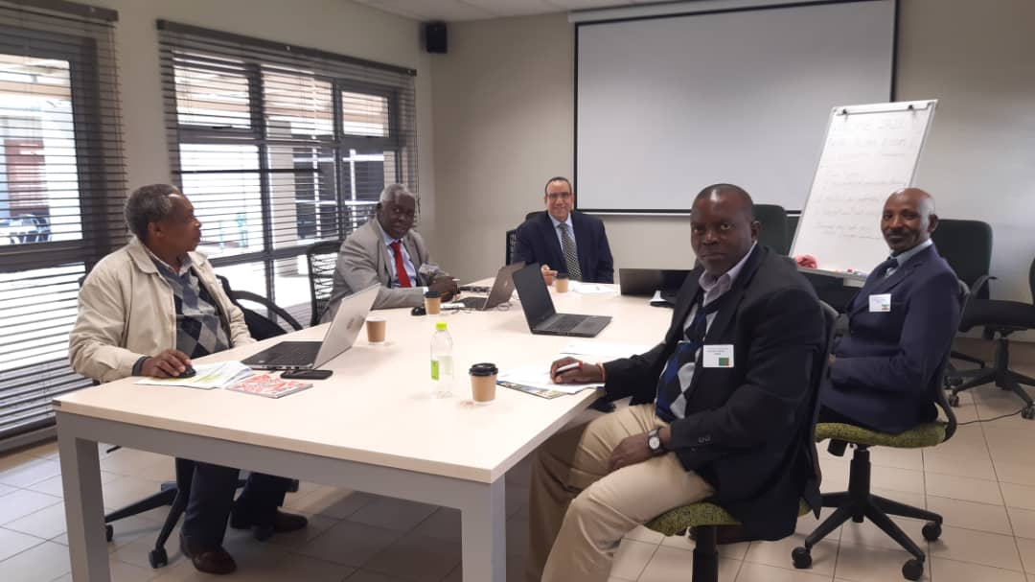
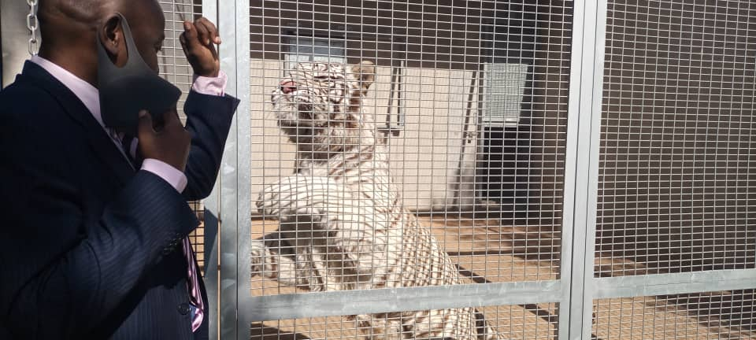
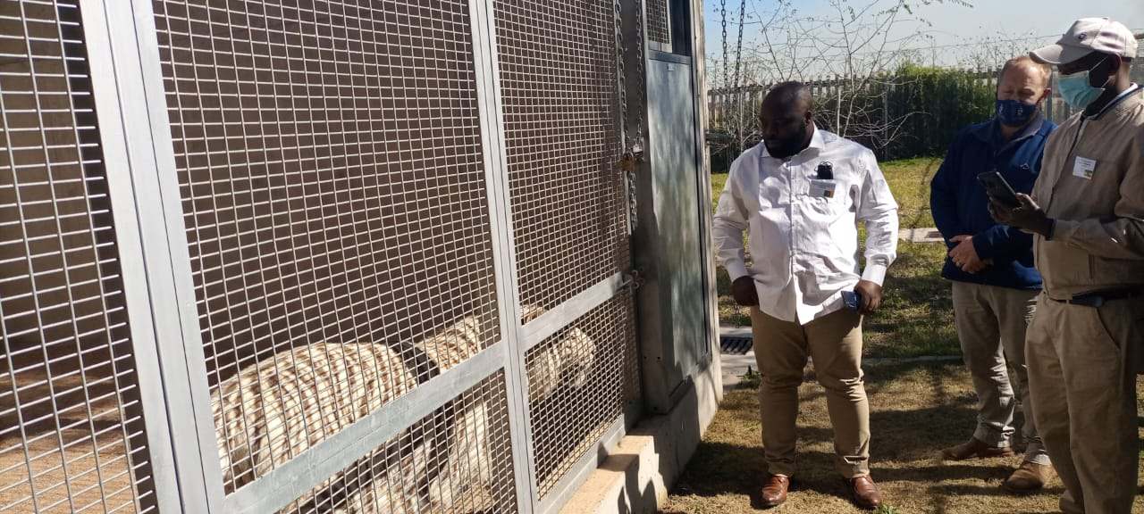
Pretoria meeting

Slide 18
Thank you

