Slide 1

The state of VPH training in Africa – capacities, gaps and opportunities
Prof Dietmar Holm, President of the African Association of Veterinary Education Establishments (2A2E-V)

Slide 2
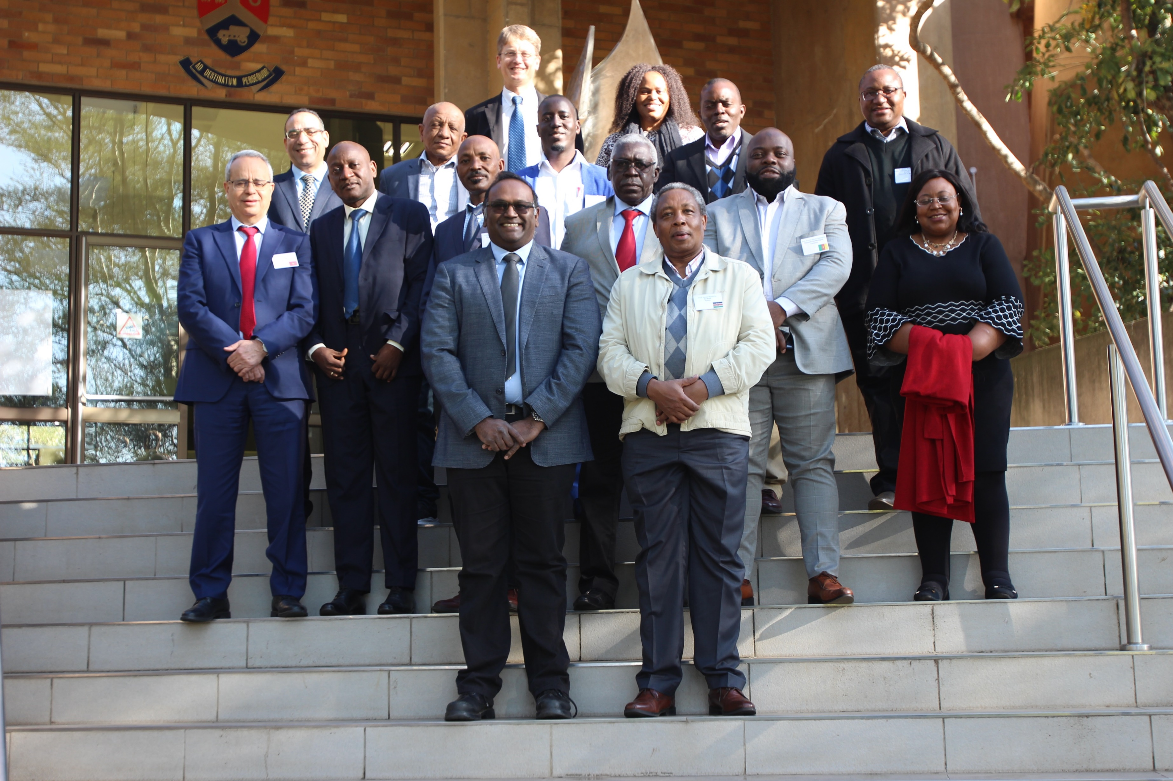

Slide 3
Who are we: 2A2E-V
Established 2018, Cairo
Executive Committee consisting of 2 representatives from each of the 5 regions.
Region of AU | Number of member states | States without a vet school | Total number of vet schools
Southern | 10 | 3 | 7
East | 14 | 6 | 23
Central | 9 | 7 | 8
West | 15 | 11 | 12
North | 7 | 2 | 23
Total | 55 | 29 | 73

Slide 4
What do we do: 2A2E-V objectives
Objective | Strategic projects
1. To enhance collaboration among all the Veterinary Education Establishments. | 1.1. 2A2E-V online portal: ensure training and use by EC members. 1.2. Sign-up of all member institutions of 2A2E-V on the portal
2. To establish continental quality assurance in veterinary education, training and research by establishing reference standards for accreditation. | 2.1. 2A2E-V accreditation of VEEs: Establishment of reference standards and accreditation system.
3. To harmonise veterinary curricula in Africa to ensure improved collaboration amongst African VEEs. | 3.1. Harmonised veterinary curriculum for Africa based on the 2A2E-V Day-1 competencies 3.2. Participation in the Day-1 platform project of Iowa State University (Gates Foundation)

Slide 5
What do we do: 2A2E-V objectives
Objective | Strategic projects
4. To enhance dissemination of innovations and good practice among African VEEs. | 4.1. VetEd Africa conference: 1 – 3 November 2022, Pretoria
5. To build capacity among educators in the African Veterinary Education Establishments. | 5.1. Inter-African VEE twinning project 5.2. AAVMC – 2A2E-V twinning project
6. To promote quality facilities at African VEEs | 6.1. AU-IBAR Centres of excellence in veterinary education

Slide 6
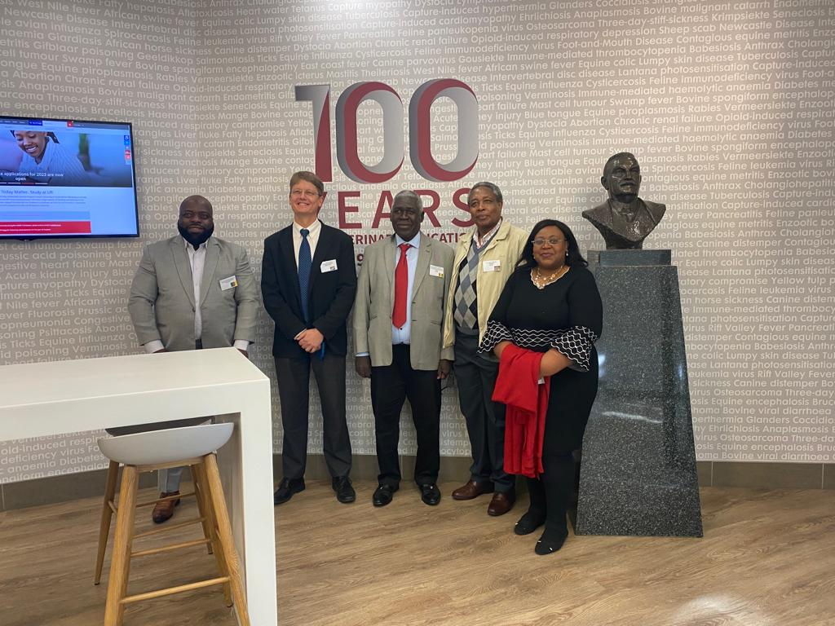
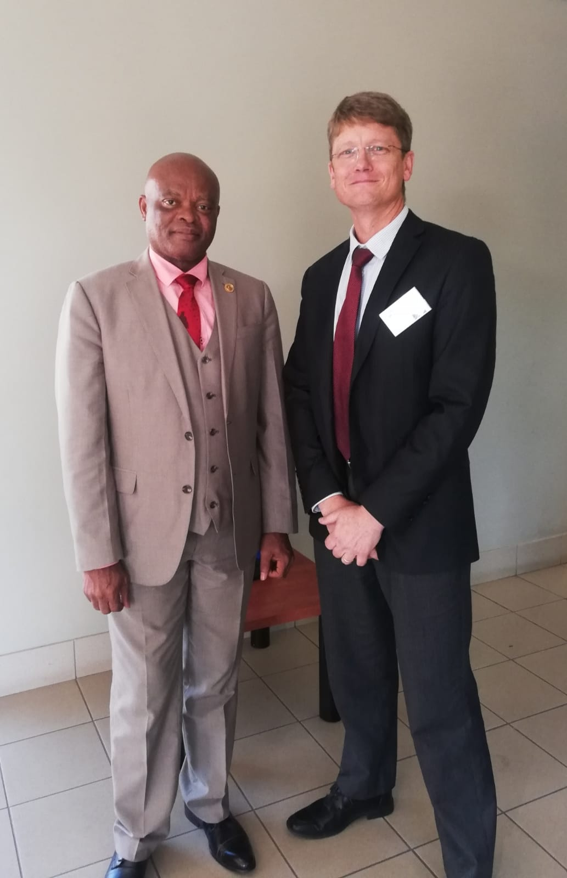
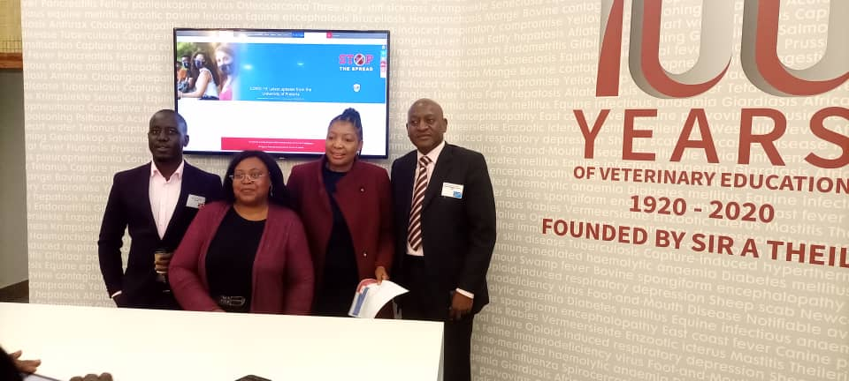
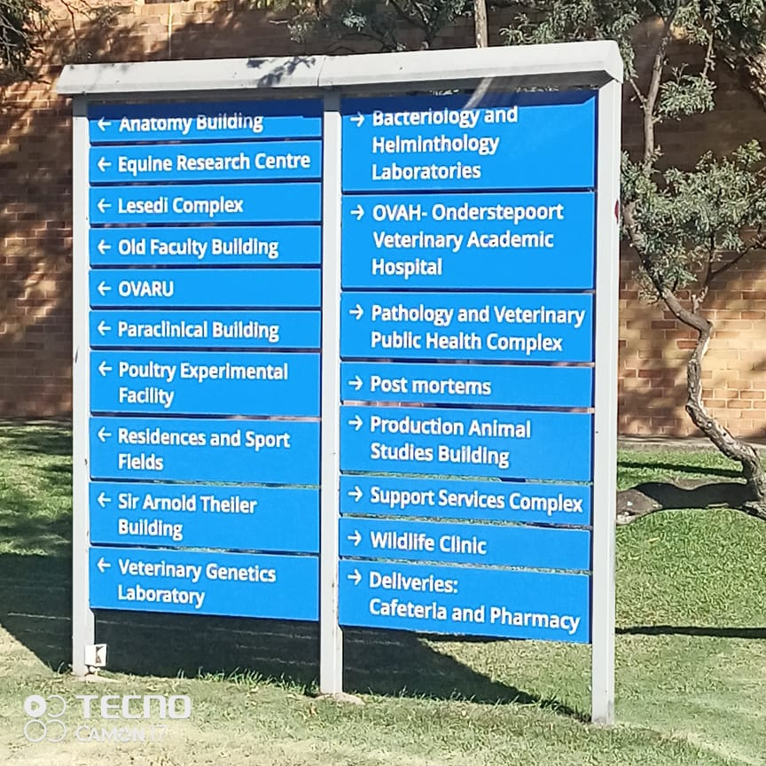

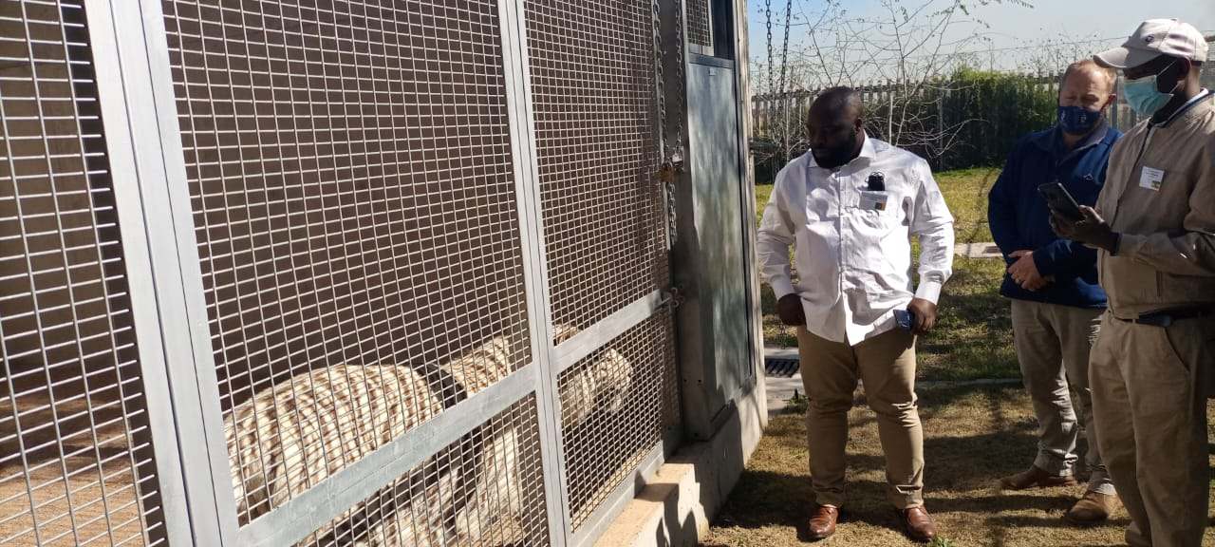
Campus Tour

Slide 7
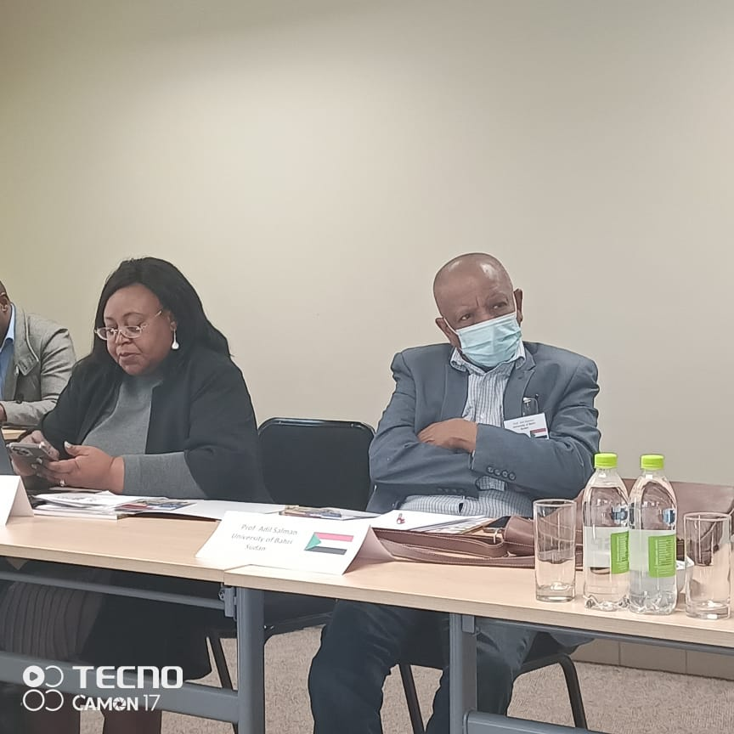
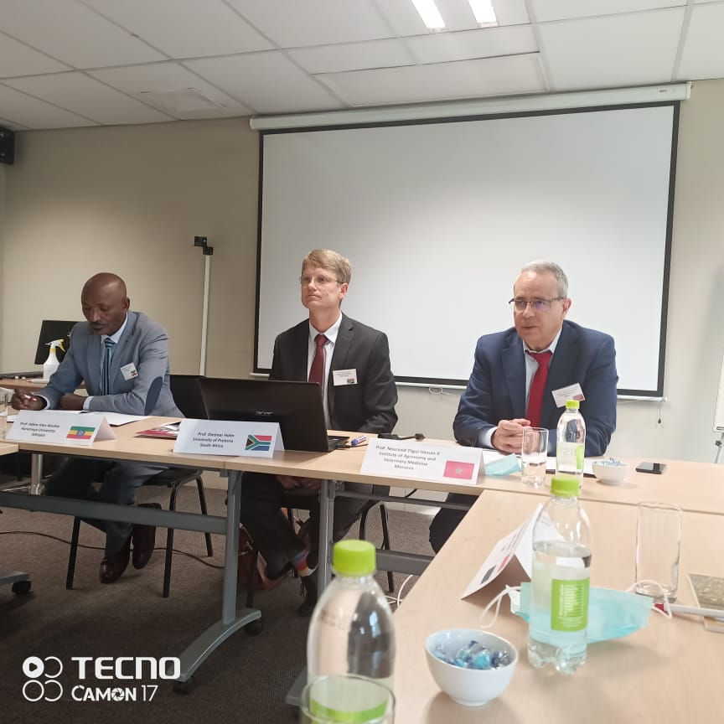
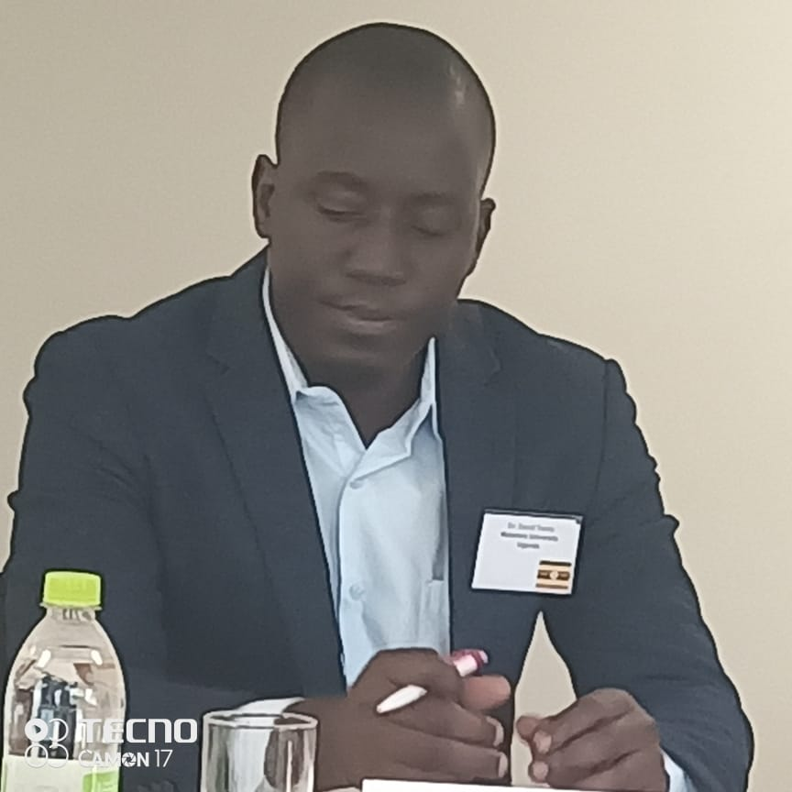
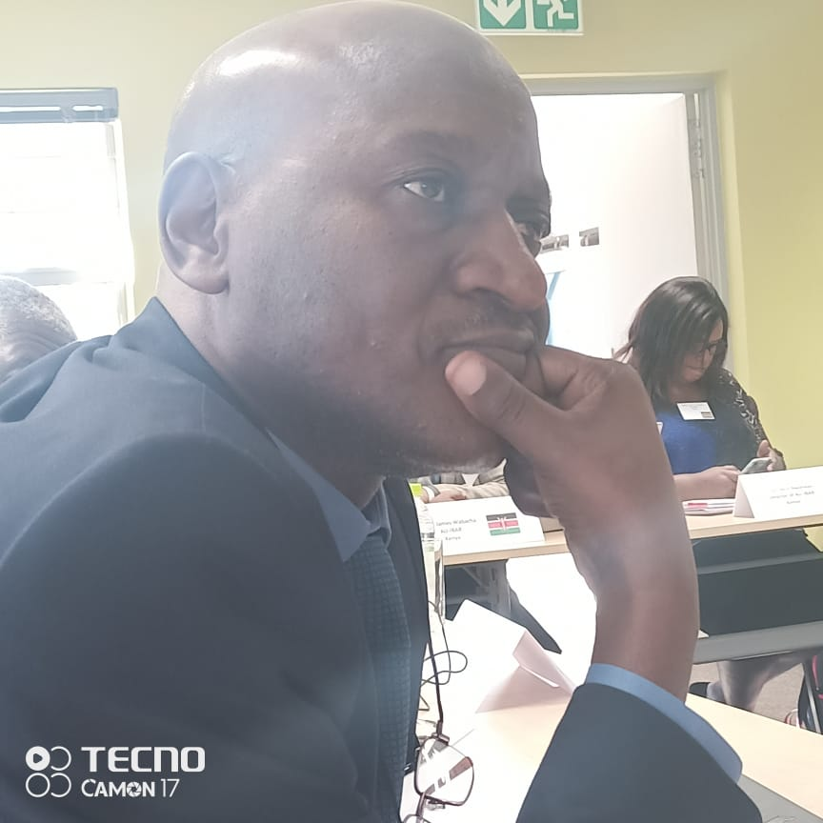

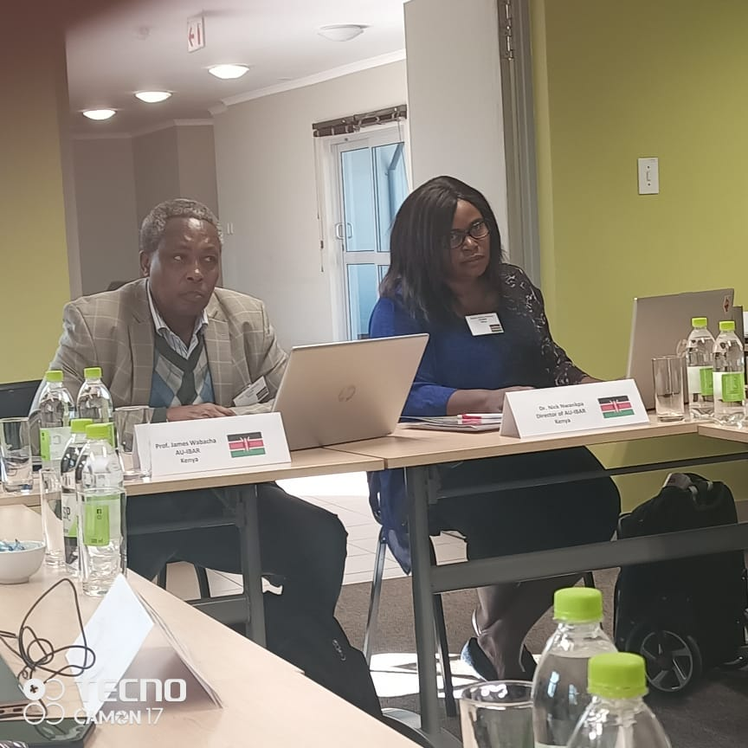
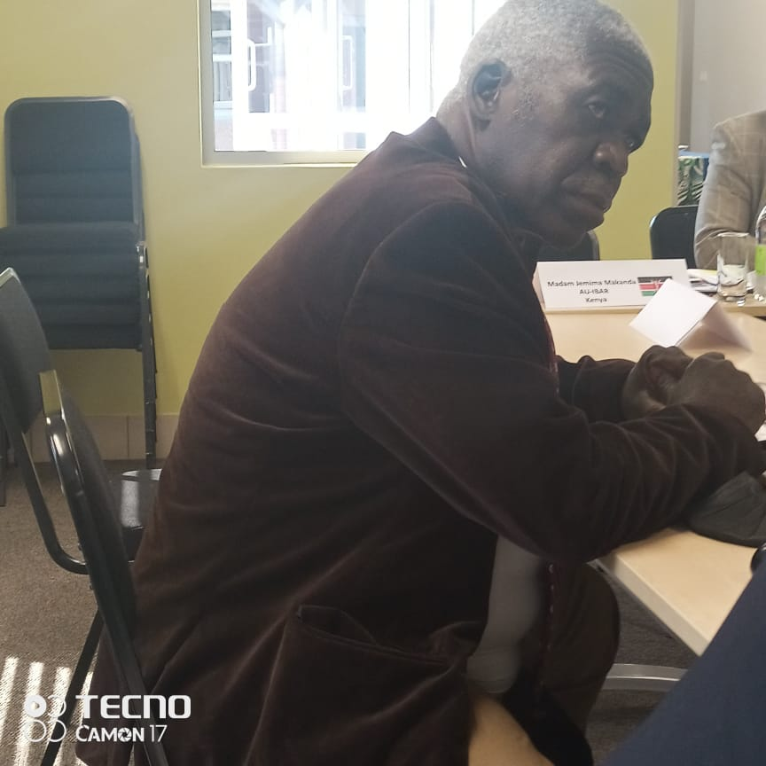
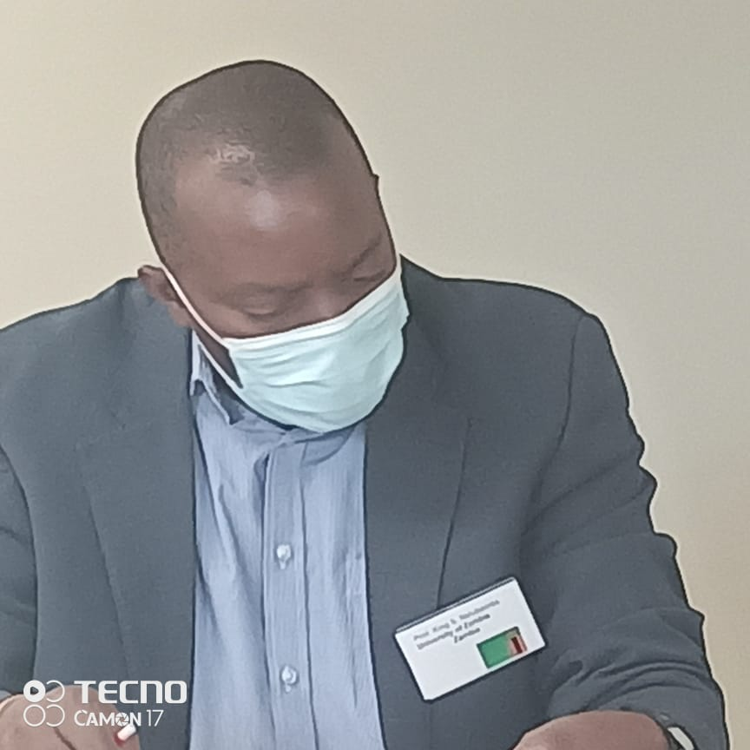
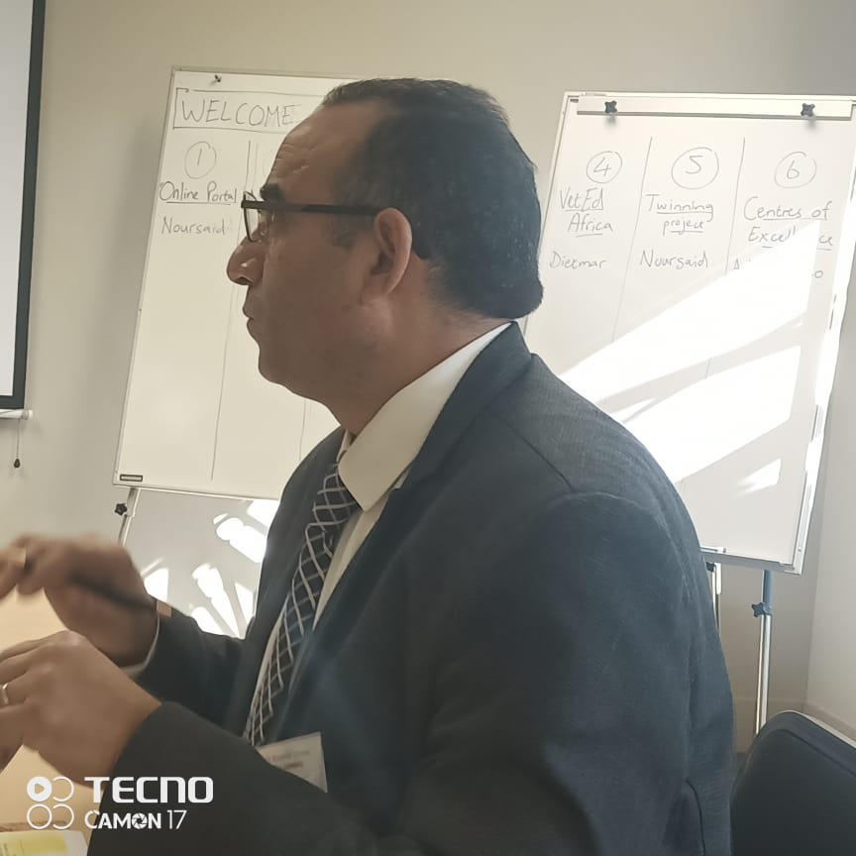
Hard at work

Slide 8
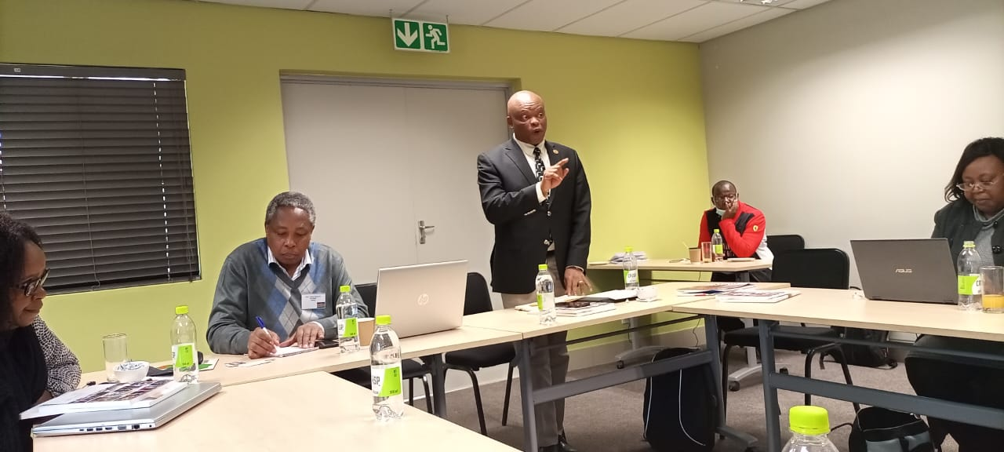
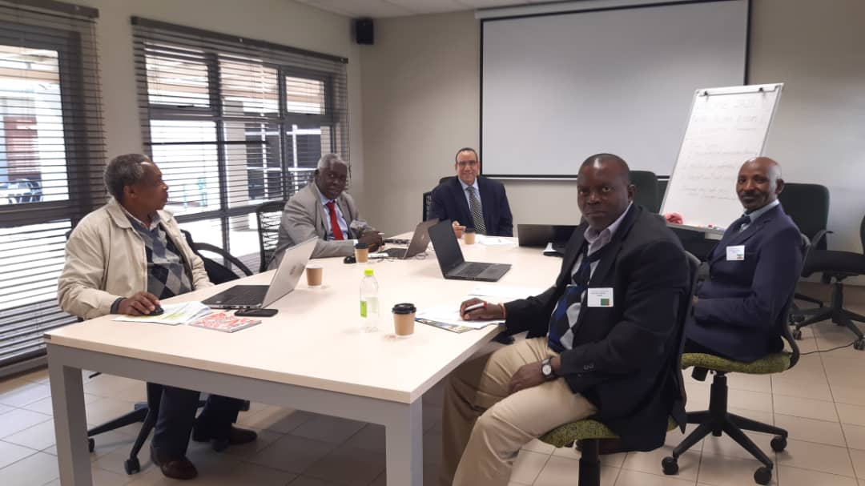
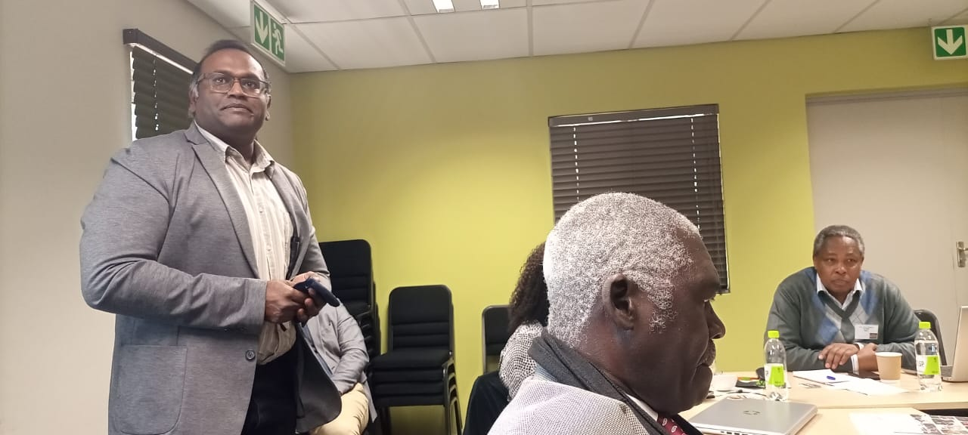

Slide 9
Case study: VPH training in Africa
Survey presented to 2 VEE’s per region of Africa
Survey distributed through 2A2E-V Executive Committee
Bias towards schools represented on 2A2E-V EC is declared
List of open-ended questions asked
Information collated and conclusions made.

Slide 10
Case study: North Africa VPH training
VEE | Institut Agronomique et Vétérinaire Hassan II, Morocco | Faculty of Vet Medicine, Benha University, Egypt
No of academic staff teaching VPH | 4 (+ 5 from other Departments) in VPH Total academic staff 43 | 58 in VPH Total academic staff 108 + 90 assistant staff
Type of applied VPH training provided | Not clearly specified, but several community campaigns are included in the training programme such as rabies vaccination, sterilisation, on-farm and in clinic post mortem, deworming campaigns etc | Abattoir training Milk safety Food processing companies (animal origin) HACCP training OneHealth
Opportunities for receiving students for VPH training | Yes, but capacity not clear. Currently 14 students registered (permanently) from other countries, mostly francophone African countries | A specific arrangement is in place for student exchange with Faculty of Veterinary Medicine, Suez Canal University
Deficiencies in VPH training noted | Shortage of clinical case load | Deficiency in hands-on training due to large student numbers (650 in year 4 and 5)
Current collaboration with other VPH institutions and other parties | Research-based collaborations involving students: Office of Food Safety (ONSSA), Universities, CNRST, and other Institutions of the Ministry of Agriculture and Fisheries. | Bilateral agreement with World fish center.

Slide 11
Case study: West Africa VPH training
VEE | School of Veterinary Medicine, KNUST, Ghana | Federal University of Agriculture, Abeokuta. Nigeria.
No of academic staff teaching VPH | 3 in VPH Total academic staff 16 | 6 in VPH Total academic staff 45
Type of applied VPH training provided | Veterinary Public Health I and II cover aspects of meat hygiene and inspection (both theory and abattoir practicals). Veterinary Epidemiology & Preventive Medicine covers theoretical principles and applications. Post graduate programme in OneHealth | Theoretical, practical, clinical application which includes abattoir practical and/or milk higiene and/or food processing plant inspection and reporting, HACCP training. Veterinary public health and preventive medicine are taught in the same department
Opportunities for receiving students for VPH training | Existing arrangements with University of Ibadan, Nigeria and Makerere University, Uganda. | Yes, 5 placements available
Deficiencies in VPH training noted | Meat and milk products quality assessment. AMR testing for meat and milk | Constant exposure to meat inspection practical training is a challenge/deficiency.
Current collaboration with other VPH institutions and other parties | Collaboration with FAO, Ghana, in training of meat inspectors, butchers, transporters and other stakeholders in the meat industry on food safety. Collaborations with the Ministry of Food and Agriculture (MoFA), and Veterinary Service Directorate (VSD). | Collaborations with state governments for meat inspection

Slide 12
Case study: West Africa VPH training
VEE | Higher institute of Sciences and Veterinary Medicine (ISSMV), Guinea
No of academic staff teaching VPH | Unclear for VPH specifically Total academic staff 54
Type of applied VPH training provided | Various theoretical and practical training opportunities in food safety and sanitary quality of food
Opportunities for receiving students for VPH training | This VEE has trained 200 non-Guinean students from various West and Central African countries. 20 placements per year, mostly for other West African countries.
Deficiencies in VPH training noted | Absence of master and doctorate Insufficient teachers at masters level Insufficient training materials and equipment Insufficient use of computer equipment Insufficient participation of foreign teachers in the programme
Current collaboration with other VPH institutions and other parties | Various governmental and non-governmental structures Agricultural institute UGANC Faculty of Medicine, Guinea Pasteur institute of Guinea Environmental, Fisheries, Agronomic, Animal Production and other government research facilities. IAV Rabat, Morocco Moscow ABMV, Russia EISMV of Dakar, Senegal CVL of Mali CSRS (Swiss) of Ivory Coast Agrarian University of Moldova

Slide 13
Case study: East Africa VPH training
VEE | College of Veterinary Medicine, University of Bahri, Sudan | College of Vet Medicine, Haramaya university, Ethiopia
No of academic staff teaching VPH | 6 in VPH Total academic staff 42 | 10 (+ 5 assistant) in VPH Total academic staff 42
Type of applied VPH training provided | Theory and practical training in zoonotic diseases, meat inspection, milk hygiene and epidemiology. Masters in Food Safety. Masters in OneHealth. CPD training in OneHealth provided to many veterinarians. | Meat hygiene and public hospitals; Abattoir designing and management training; Food processing technology (animal origin); Zoonoses research and methodology training; Chemical hazards training; Community Laboratory service on food safety; Food animal farming and zoonoses; Poultry and their product research; Pet animal and zoonoses; Dairy production and public health; Camel health and product safety; HACCP training
Opportunities for receiving students for VPH training | Yes but not utilised.
Deficiencies in VPH training noted | Risk analysis. Disease modelling. | Consumable laboratory reagents.
Current collaboration with other VPH institutions and other parties | Federal Ministry of Animal resources –Epizootic and animal health department, Central Veterinary Laboratory, Ministry of Agriculture and animal resources - Khartoum State- Slaughter houses department and the quality control Department, Alwatania University Private institute College of Public Health | Veterinary College interlink amongst 5 VEEs within Ethiopia

Slide 14
Case study: Central Africa VPH training
VEE | School of Public Health in Faculty of Medicine, University of Kinshasa, DRC | School of Public Health in Faculty of Medicine, University of Lubumbashi, DRC
No of academic staff teaching VPH | 3 in VPH | 7 in VPH
Type of applied VPH training provided | This school has 3 branches for Master degree only: Field Laboratory (Vet and Health system) Epidemiology (Vet and Health system) Health Economy | Theoretical, practical, clinical application which includes practical inspection and reporting in slaughterhouse and/or milk hygiene and/or food processing plant, inspection of meat/dairy export facilities, training HACCP, etc
Opportunities for receiving students for VPH training | At masters level only
Deficiencies in VPH training noted | Lack of specialists a major problem ` | Lack of specialists a major problem The East of DRC has no capacity for VPH training
Current collaboration with other VPH institutions and other parties | Training is provided for students from the Faculty of Veterinary Science | Training is provided for students from the Faculty of Veterinary Science.

Slide 15
Case study: Southern Africa VPH training
VEE | Faculty of Veterinary Science, University of Pretoria, South Africa | School of Veterinary Medicine, Faculty of Health Sciences and Veterinary Medicine, UNAM, Namibia
No of academic staff teaching VPH | 5 in VPH plus 1 in OneHealth Total academic staff 100 | 2 in VPH
Type of applied VPH training provided | Theoretical training (preclinical) in VPH, zoonoses, epidemiology, and OneHealth, followed by abattoir placement for 1 week during clinical training with another week for report writing, feedback and HACCP training and application. 1 week focused clinical training rotation in controlled diseases. Various post graduate options including MMedVet in VPH. | Theory and practical training; Clinical application which includes abattoir practical and/or milk hygiene and/or food processing plant inspection and reporting, meat/milk product export facility inspection; HACCP training; One Health & zoonoses
Opportunities for receiving students for VPH training | Yes, 20 placements per year, pending funding. | Yes, 4 placements available per year, pending funding.
Deficiencies in VPH training noted | Training meets government and industry requirements. Public Health policy lacking | Training geared towards export abattoirs; local abattoirs fall under Ministry of Health & Soc Serv.
Current collaboration with other VPH institutions and other parties | Specific in VPH: student exchange programmes active with Universit of Namibia, and with Utrecht University (Netherlands). Student abattoir placements sourced out to Food Safety Agency. Collaboration on VPH training with DALRRD (National Dept Agric). Undergraduate OneHealth training programme shared with Faculty of Health Sciences (medicine students) | There is collaboration with the Directorate of Veterinary Services which is the competent authority responsible for regulating export abattoirs. Collaboration with the Meat Corporation of Namibia which is the meat company running export abattoirs.

Slide 16
Case study: Southern Africa VPH training
VEE | The University of Zambia, School of Veterinary Medicine, Zambia
No of academic staff teaching VPH | 4 in VPH plus 6 other related disciplines.
Type of applied VPH training provided | THERORETICAL [ based on Four Main Components: FOOD HYGIENE & SAFETY (inclusive Meat Inspection theory and detailed Practical –both traditional and risk based Meat Inspection, Food Quality Systems – QC, GMPs, Prerequisites programs, HACCP etc), Zoonotic Diseases Component (With practical components), ENVIRONMENTAL HEALTH COMPONENT and RISK ANALYSIS component, and a practical component VMD 5004 [ Abattoir attachments, during the fifth year vacational attachment period]
Opportunities for receiving students for VPH training | Zambia has also a CROCODILE ABATTOIR at Luchinze Sinazongwe District, Three types of Slaughter facilities (Slabs, Shelters and advanced Slaughter Houses (Abattoirs), Water Reticulation facilities. The other strength is in Zoonotic Diseases (actual cases of Bovine Tuberculosis, Cyisticercosis, Brucellosis, and Rabies) and other Tropical medicine cases.
Deficiencies in VPH training noted | Delays in laboratory consumable purchase through the centralized University procurement system means delays in conducting certain laboratory sessions
Current collaboration with other VPH institutions and other parties | YES, UNZA collaborates with a wide range of Governmental, Non-governmental, Meat Based facilities, Dairy Farms, Dairy Producing Facilities, Feed producing companies (From Fish Feed companies to specialized companies able to export various animal feeds), as well as International Exchange Programs especially with Hokkaido University of Japan

Slide 17
Conclusions
VPH training in Africa is aligned with country requirements: where the country requires a high standard, the VEE provides the relevant training; and vice versa (extreme examples DRC vs Namibia).
Obstacles in effective VPH function in Africa from the VEE’s perspective, appear to be related to policy, laws, governance and institutional structure and implementation, rather than a deficiency at training level.
Capacity within Africa for student exchange opportunities in VPH training (specifically meat and milk safety practical training) exists and provides the opportunity to fast track harmonization if utilised. Funding needs to be prioritised for this.
Many VEEs have adopted and implemented OneHealth training at undergraduate and postgraduate level.
Significant research capacity exists in VPH in Africa
The most significant deficiencies in VPH training are practical training opportunities (hands-on) for students in abattoirs and food processing plants, VPH specialist recruitment and specialist training programmes (only 1 found)

Slide 18


Slide 19


Thank you
Collaborators:
• Prof Noursaid Tligui, Hassan II Institute of Agronomy and Veterinary Medicine, Morocco – 1st Vice President
• Prof Adem Hiko Woshie, Haramaya University, Ethiopia – 2nd Vice President
• Prof Adebayo Koyuum AKINLOYE, Federal University of Agriculture, Nigeria – Secretary General
• Prof PYANA PATI Patient, National Pedagogic University, DRC – Treasurer
• Prof Arouna Njayou Ngapagna, Université des Montagnes, Cameroon
• Prof Mohamed Ghanem, Benha University, Egypt
• Prof King S. Nalubamba, University of Zambia
• Prof Youssouf Sidime, Institut Supérieur des Sciences et de Médecine Vétérinaire de Dalaba, Guinee
• Prof Adil Salman, University of Bahri, Sudan
Dr Alaster Samkange, University of Namibia, Namibia – CIVME representative
Prof Nenene Qekwana, University of Pretoria (additional information)
Dr Lieza Odendaal, University of Pretoria (additional information)

