Slide 1





MONITORING AND EVALUATION
CONSERVING AQUATIC BIODIVERSITY IN THE CONTEXT OF THE AFRICA BLUE ECONOMY STRATEGY (ABES) PROJECT
By
Admore Chakadenga – AU-IBAR M&E Expert

Slide 2
AIM
“Enhancing institutional capacity of African AU MSs and RECs on the conservation and protection of aquatic biodiversity in the context of Africa Blue Economy Strategy”

Slide 3

Presentation Outline
Why M&E Framework
Approach
Role of Stakeholders in M & E
Monitoring
Evaluation
Logframe

Slide 4


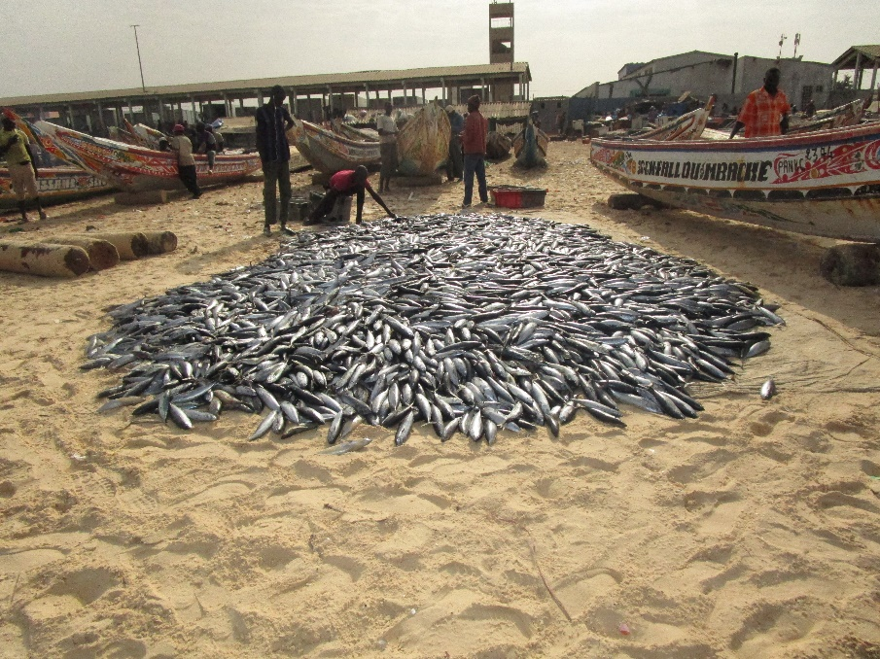
Why M&E Framework
To:
outline M&E processes and procedures
collate tools and templates
promote:
  accountability,
  leaning and Adaptation
  transparency

Slide 5
Theory of Change Approach
Problem Analysis
Response to the Problem
Expected Results

Slide 6
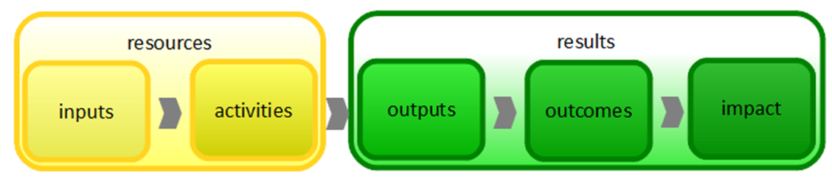
Results Based Management Approach

Slide 7




Role of Stakeholders in M&E
CONTINENTAL LEVEL
Project Steering Committee (PSC) - Oversight and Direction
Project Technical Committee
Actors: AU –IBAR and Partners
Design, Role out and Oversee the M&E system
Development of tools/ templates to be used for data collection, analysis and reporting
Ensure data quality
Sharing Knowledge, best practices and Lessons
Coordination and collaboration
REGIONAL LEVEL
RECs, Specialized Regional Institutions, Regional Organisations / NGOs
Development / Adaptation of M&E tools and data collection templates
Coordinate data collection, and analysis
Regional Level Feedback and reporting
NATIONAL LEVEL
Relevant Line Ministries / National Focal Points / Non State Actors / NGOs
Development/ Adaptation of M&E tools to context
Data collection/ collation
Feedback and reporting
Sharing knowledge, best practices and lessons
Feedback, Learning and Adaptation

Slide 8
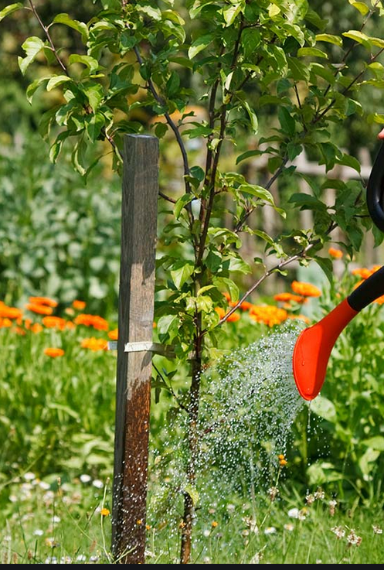
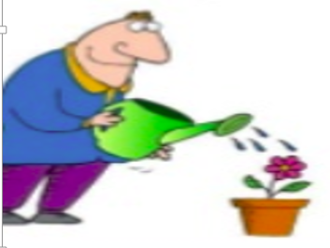

Monitoring
Ongoing continuous of feedback, learning and adaptation to:
  Establish if products/ services/ results are delivered timely in right quantities and quality as planned
  Establish if the services/ products / results are being used by beneficiaries
  Improve project programme quality
Monitoring tools and Processes
  Indicator tracking table
  Monitoring Checklist
  Online surveys
  Field missions
  Studies
Monitoring reports – to be produced when monitoring activities are carried out and consolidated annually

Slide 9

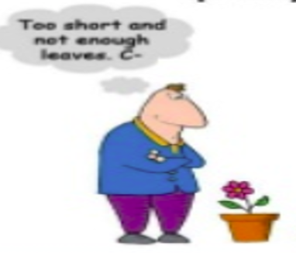
Evaluation
Done to
  To obtain feedback, learn and adapt
  Express an independent opinion on project quality
  Is usually external for independence
Baseline: Q1 2022
Mid term Evaluation: Planned for Q 2023
End of Project Evaluation: Planned for Q4 2024

Slide 10
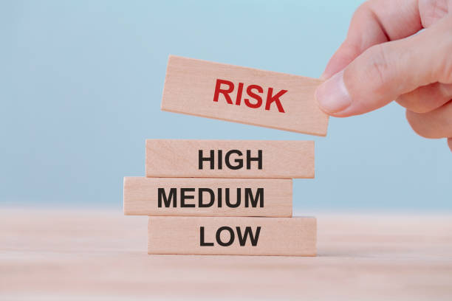
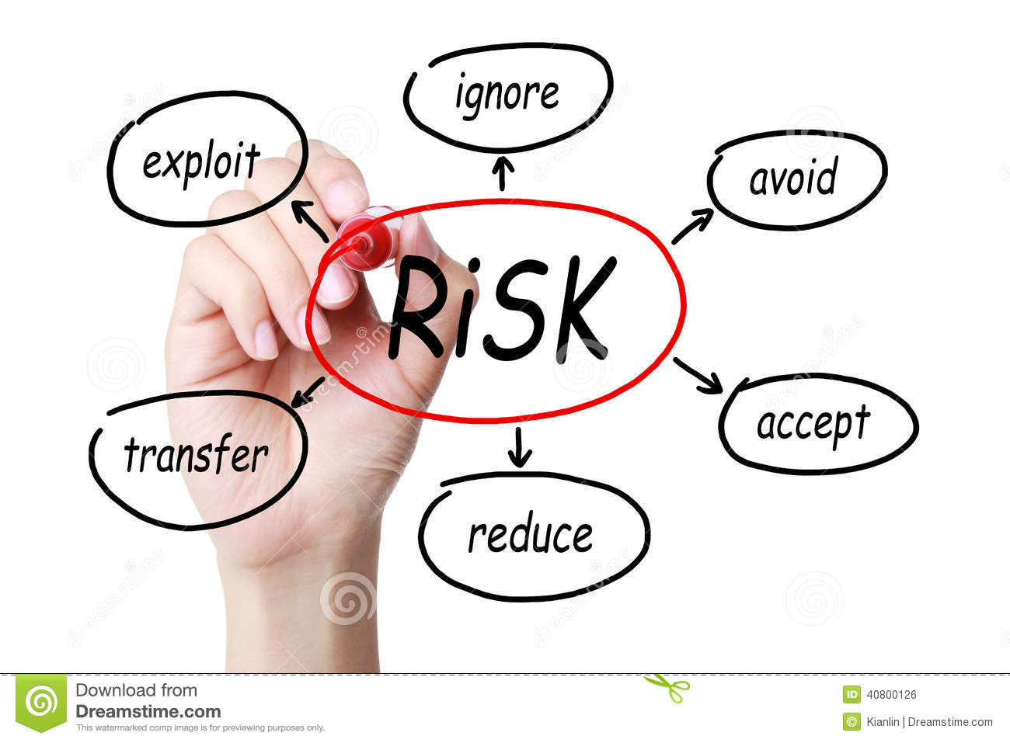
Risk Levels and Mitigation
On an ongoing and continuous basis
According to AU-IBAR Risk Management Plan ,
Reported annually.

Slide 11
Logframe
Biodiversity Conservation Logrfame Final.docx

Slide 12
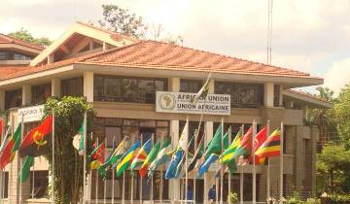
Thank You
AU-IBAR: Providing leadership in the development of animal resources for Africa

