Slide 1
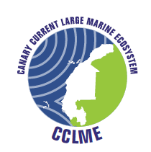
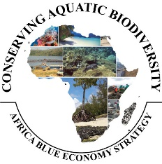
Contribution of CCLME’s Biodiversity and Ecosystem Conservation to African Blue Economy Strategy
Aboubacar Sidibé, PhD
Chief Technical Adviser
Regional Coordinator of CCLME Project
Inception Workshop for the Swedish Funded Project ‘Conserving Biodiversity
in African Blue Economy
8th – 10th December 2021 – Kenya

Slide 2
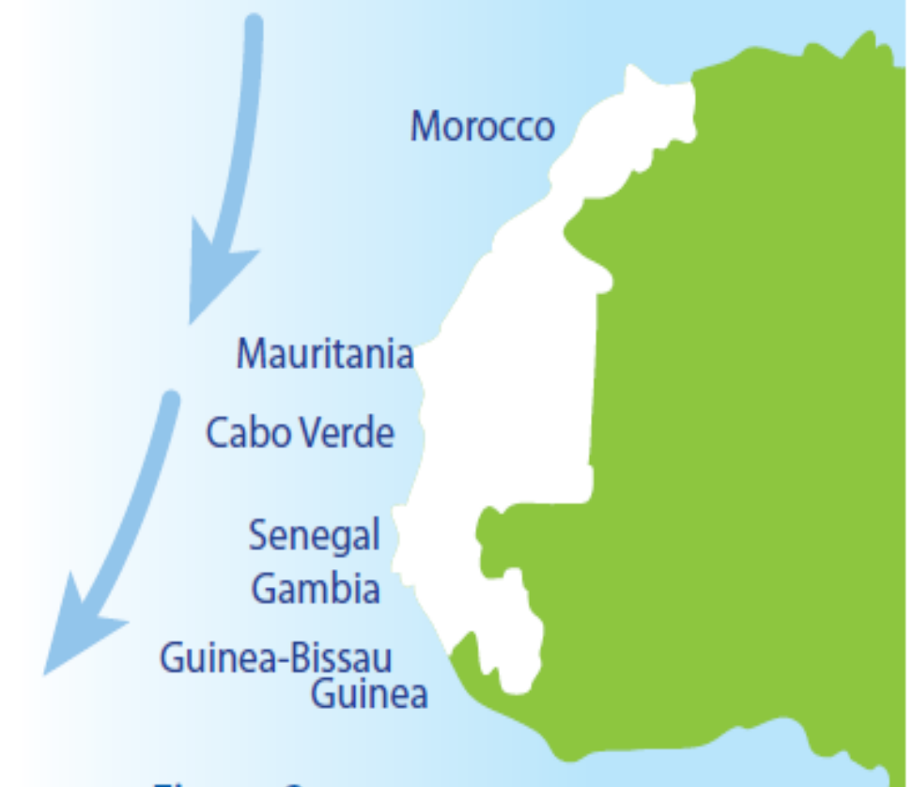
RECALL ON CCLME CONTEXT
The seven CCLME countries have a combined coastline of over 5,400 km and a maritime area of over 2 million km² (EEZs).
The majority (60%) of the 77.9 million inhabitants (UNFPA, 2021) of the CCLM countries live in coastal areas where most of the cities and industrial infrastructure are located. The economy of most countries is based on agriculture, fisheries and livestock.
CCLME Area
The CCLM is known for its high biological productivity and supports important populations of small pelagic, demersal and tuna species, which together account for about 20-30% of the world's fishery production.

Slide 3
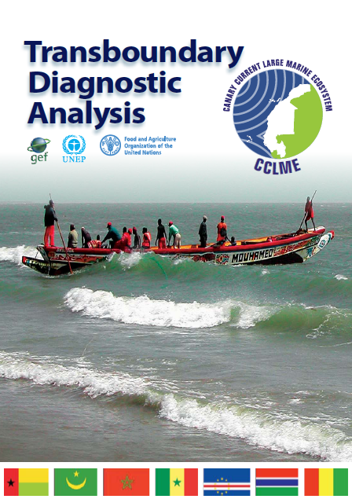
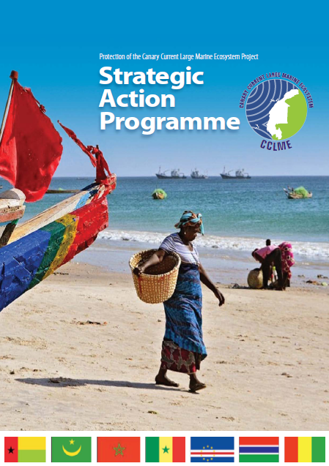
RECALL ON CCLME CONTEXT: From the Transboundary Diagnostic Analysis (TDA) to the CCLME Strategic Action Program (SAP)
The GEF investment began with the development phase of a Transboundary Diagnostic Analysis (TDA) of the CCLME through the project "Protection of the Canary Current Large Marine Ecosystem (CCLME)", implemented from 2010 to 2017.
The TDA was the scientific basis for the elaboration of the CCLME Strategic Action Program (SAP) in 2018 to address CCLME degradation caused by overfishing, habitat modification, and water quality changes.
Notes:
Project preparatory phase : 2004-2006
Implementation of the project
started on 1 April 2010
FAO and UNEP (through the Abidjan Convention) represent GEF agencies
Allocation of GEF and contribution
of countries and partners
7 Seven participating countries
in Nord West Africa
RCU in Dakar, Senegal

Slide 4
Vision and Objectives of CCLME’s SAP
Vision: A healthy ecosystem, sustainably managed, providing services and
equitable benefits for human well-being by 2030
Living marine resources |  | Habitats |  | Water quality
Ecosystem quality objective
Sustainably manage fisheries, restore degraded fish stocks and reduce threats to vulnerable species by 2030 | Rehabilitate and/or preserve critical habitats in marine and coastal areas by 2030 | Réhabiliter et/ou préserver les habitats critiques des zones marines et côtières à l’horizon 2030 | Ensure that the water quality of the CCLME is of a high standard and contributing to the good health of the ecosystem by 2030 | Ensure that the water quality of the CCLME is of a high standard and contributing to the good health of the ecosystem by 2030
Specific objectives | Specific objectives | Objectifs spécifiques | Specific objectives | Objectifs spécifiques
Sustainably manage and restore the small pelagic resources. Sustainably manage and restore the demersal resources. Reduce threats to vulnerable species and mitigate their impacts. | Restore and conserve mangroves. Sustainably manage and conserve marine and coastal wetlands. Reduce the negative impacts of human activities on the seabed and other critical habitats. | 1. Restaurer et conserver les mangroves. 2. Gérer durablement et conserver les zones humides marines et côtières. 3. Réduire les impacts néfastes des activités humaines sur les fonds marins et les autres habitats critiques. | Mitigate the negative impacts of human activities on coastal processes and sediment dynamics. Combat alien invasive species. Monitor and control the sources and levels of different types of pollution in the marine and coastal environment. | 1. Atténuer les impacts néfastes des activités humaines sur les processus côtiers et la dynamique sédimentaire. 2. Lutter contre les espèces exotiques invasives. 3. Suivre et contrôler les sources et les niveaux des différents types de pollution au sein du milieu marin et côtier.
Notes:
Project preparatory phase : 2004-2006
Implementation of the project
started on 1 April 2010
FAO and UNEP (through the Abidjan Convention) represent GEF agencies
Allocation of GEF and contribution
of countries and partners
7 Seven participating countries
in Nord West Africa
RCU in Dakar, Senegal

Slide 5
Implementation of Strategic Action Program (SAP) of CCLME
Development of the Project (MSP) : "Sustainable Management of the Canary Current Large Marine Ecosystem (CCLME) - initial support to the implementation of the Strategic Action Program (PAS)" for the transition phase aims to create favorable conditions for the effective implementation of the CCLME’s SAP
The CCLME Project is unique in its strategic combination of fisheries and environmental governance frameworks and will enable the participating countries to address priority transboundary concerns on declining fisheries, biodiversity and ecosystem degradation and water quality deterioration.
It will promote cooperation between the partners of the project and monitor the state of the CCLME based on scientific results.
The expected duration of this transition phase is 18 months with FAO serving as implementation agency of GEF.
Notes:
Project preparatory phase : 2004-2006
Implementation of the project
started on 1 April 2010
FAO and UNEP (through the Abidjan Convention) represent GEF agencies
Allocation of GEF and contribution
of countries and partners
7 Seven participating countries
in Nord West Africa
RCU in Dakar, Senegal

Slide 6
Contribution of CCLME to African Blue Economy Strategy
Sustainable Management of the Canary Current Large Marine Ecosystem (CCLME) :
Restore degraded fish stocks and reduce threats to vulnerable species (Biodiversity)
Rehabilitate and/or preserve critical habitats in marine and coastal areas
Ensure that the water quality is of a high standard and contributing to the good health of the ecosystem
Protection and conservation of aquatic biodiversity and ecosystems in Africa Blue Economy Strategy (ABES):
Fishery and Aquaculture,
Shipping and maritime trade,
Energy and mining.
Coastal tourism
Notes:
Project preparatory phase : 2004-2006
Implementation of the project
started on 1 April 2010
FAO and UNEP (through the Abidjan Convention) represent GEF agencies
Allocation of GEF and contribution
of countries and partners
7 Seven participating countries
in Nord West Africa
RCU in Dakar, Senegal

Slide 7





CCLME’s planned activities on management of aquatic biodiversity and environmental sustainability (1)
Actions planned for Sustainably manage fisheries, restore degraded fish stocks and reduce threats to vulnerable species by 2030:
Support to maintain the abundance and biomass of all small pelagic and demersal fish stocks at/above ecologically sustainable level.
Strengthen implement of the scientific recommendations of CECAF working groups and responsible national institutions.
Reduce the catch of juvenile fish and vulnerable species, including marine mammals and sea turtles.
Notes:
Project preparatory phase : 2004-2006
Implementation of the project
started on 1 April 2010
FAO and UNEP (through the Abidjan Convention) represent GEF agencies
Allocation of GEF and contribution
of countries and partners
7 Seven participating countries
in Nord West Africa
RCU in Dakar, Senegal

Slide 8
CCLME’s planned activities on management of aquatic biodiversity and environmental sustainability (2)
Actions planned for Rehabilitate and/or preserve biodiversity of critical habitats in marine and coastal areas by 2030:
Develop actions to restore degraded mangrove areas and conserve intact mangrove areas.
Support actions to reverse the degradation of mangroves.
Strengthen the protection and management of marine, coastal and wetlands.
Through the effective implementation of EAF and existing guidelines reduce impacts on critical habitats in at least three CCLME countries.
Reduce eutrophication in some key lagoons and estuaries by 50 percent.
Reduce coastal erosion in some key sites.
Notes:
Project preparatory phase : 2004-2006
Implementation of the project
started on 1 April 2010
FAO and UNEP (through the Abidjan Convention) represent GEF agencies
Allocation of GEF and contribution
of countries and partners
7 Seven participating countries
in Nord West Africa
RCU in Dakar, Senegal

Slide 9
CCLME’s planned activities on management of aquatic biodiversity and environmental sustainability (3)
Actions planned for Ensure that the water quality of the CCLME is of a high standard and contributing to the good health of the
ecosystem by 2030:
Strengthen water quality monitoring and surveillance activities to meet the requirements of international conventions and protocols.
Adopt and put in place an operational emergency plan to combat oil pollution and reduce the concentration of nitrates and phosphates in marine and coastal waters.
Reduce the level of plastic pollution, solid waste and harmful effects of wastewater.
Promote the use of Environmental and Social Impact Assessment (ESIA) approach in the coastal zone by CCLME countries with appropriate tools.
Notes:
Project preparatory phase : 2004-2006
Implementation of the project
started on 1 April 2010
FAO and UNEP (through the Abidjan Convention) represent GEF agencies
Allocation of GEF and contribution
of countries and partners
7 Seven participating countries
in Nord West Africa
RCU in Dakar, Senegal

Slide 10
CCLME’s ongoing activities on management of aquatic biodiversity and environmental sustainability
Implementation of the MSP project
"Sustainable Management of the Canary Current Large Marine Ecosystem (CCLME) - initial support to the implementation of the Strategic Action Program (PAS)" for the transition phase aims to create favorable conditions for the effective implementation of the CCLME’s SAP.
Inception Workshop was organized on 4 & 5 November 2021
Notes:
Project preparatory phase : 2004-2006
Implementation of the project
started on 1 April 2010
FAO and UNEP (through the Abidjan Convention) represent GEF agencies
Allocation of GEF and contribution
of countries and partners
7 Seven participating countries
in Nord West Africa
RCU in Dakar, Senegal

Slide 11
CCLME’s ongoing activities on management of aquatic biodiversity and environmental sustainability
Building consortium and partnership agreement to support SAP of CCLME implementation, clarifying responsibilities of partners related terms of reference.
Developing a multi-sectoral financing strategy involving national, public and private partnerships, bilateral and multilateral donors pledging financial support for full SAP implementation.
Elaboration of an agreed operational plan to implement the CCLME SAP and to strengthen the capacities and investments by the countries to address priorities linked to the development of National Action Plans (NAPs).
Strengthening awareness-raising and information sharing between the scientific community and stakeholders in the region through existing and new platforms.
Notes:
Project preparatory phase : 2004-2006
Implementation of the project
started on 1 April 2010
FAO and UNEP (through the Abidjan Convention) represent GEF agencies
Allocation of GEF and contribution
of countries and partners
7 Seven participating countries
in Nord West Africa
RCU in Dakar, Senegal

Slide 12
CCLME’s ongoing activities on management of aquatic biodiversity and environmental sustainability
Support CCLME countries to enable the implementation of the ecosystem approach to fisheries for transboundary fisheries management.
Elaboration of capacity development programme designed for fishing communities, with a particular focus on promoting gender equality.
Develop, update and implement a communication strategy and tools for knowledge management.
Establish an operational monitoring and evaluation system and providing routine information on progress in meeting output and outcome targets.
Notes:
Project preparatory phase : 2004-2006
Implementation of the project
started on 1 April 2010
FAO and UNEP (through the Abidjan Convention) represent GEF agencies
Allocation of GEF and contribution
of countries and partners
7 Seven participating countries
in Nord West Africa
RCU in Dakar, Senegal

Slide 13
Conclusion
Strengthen collaboration between AU-IBAR and CCLME in frame of management of aquatic biodiversity and environmental sustainability by generating complementarity and synergies in the implementation of activities on:
Fishery and Aquaculture
Shipping and maritime trade
Energy and mining
Coastal tourism
AU-IBAR/ABES
Rebuild fish stocks et restore biodiversity
Reverse habitat degradation
Improve water quality
FAO/CCLME
Notes:
Project preparatory phase : 2004-2006
Implementation of the project
started on 1 April 2010
FAO and UNEP (through the Abidjan Convention) represent GEF agencies
Allocation of GEF and contribution
of countries and partners
7 Seven participating countries
in Nord West Africa
RCU in Dakar, Senegal

Slide 14

Thanks for your kind attention

