Slide 1

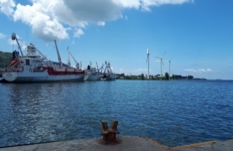
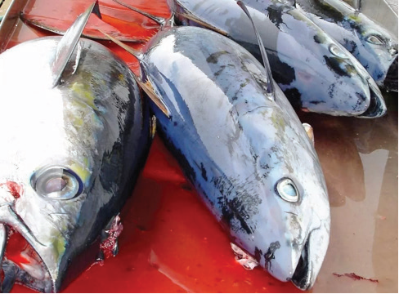
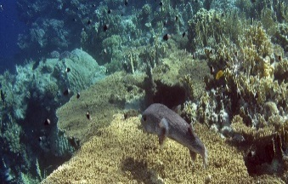
Impacts of Coastal and Marine Tourisms on Mining, Gas, Oil, Exploration on Biodiversity and Strategy for Sustainable Tourisms or Mining, Gas, Oil Exploration
CONSERVING AQUATIC BIODIVERSITY IN AFRICA BLUE ECONOMY
8-10 DECEMBER 2021
NAIVASHA, KENYA
Date: 08-10 December 2021
Patrick Karani
BEA International
Email: pkarani@beainternational.org; Tel: +254 715 899 237
www.BEAINTERNATIONAL.ORG

Slide 2
Impacts of Coastal and Marine Tourism
Coastal and Marine pollution come from a wide variety of sources, from non-point sources (e.g., agriculture, stormwater runoff) to point sources (e.g., wastewater, solid waste, fishing gear). Preventing waste from entering the oceans therefore requires a systemic approach that considers both land-based and ocean-based sources
Plastic bottles
Plastic bags
Plastic bottle caps
Plastic wrappers and packaging
Flip-flops
Sports fishing gear
World Bank (2020): Socioeconomic impact of pollution in coastal ecosystems

Slide 3
Various Transportation Pathways of Litter
Pathways and movement of litter in coastal and marine ecosystems

Slide 4
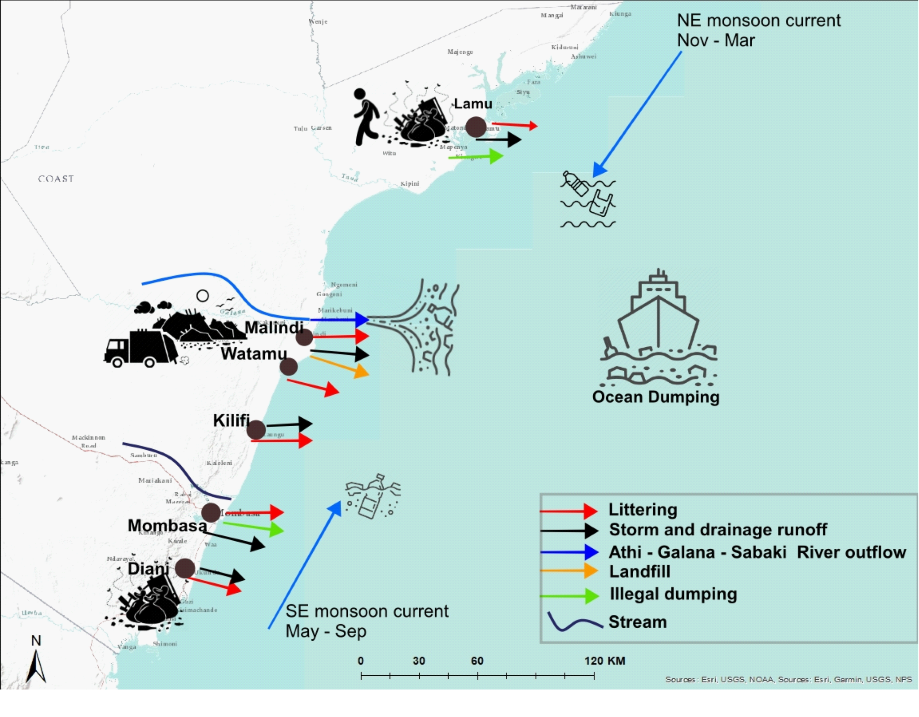
Movement of Litter along the Kenyan coastline
Most litter from tourism activities in coastal areas

Slide 5
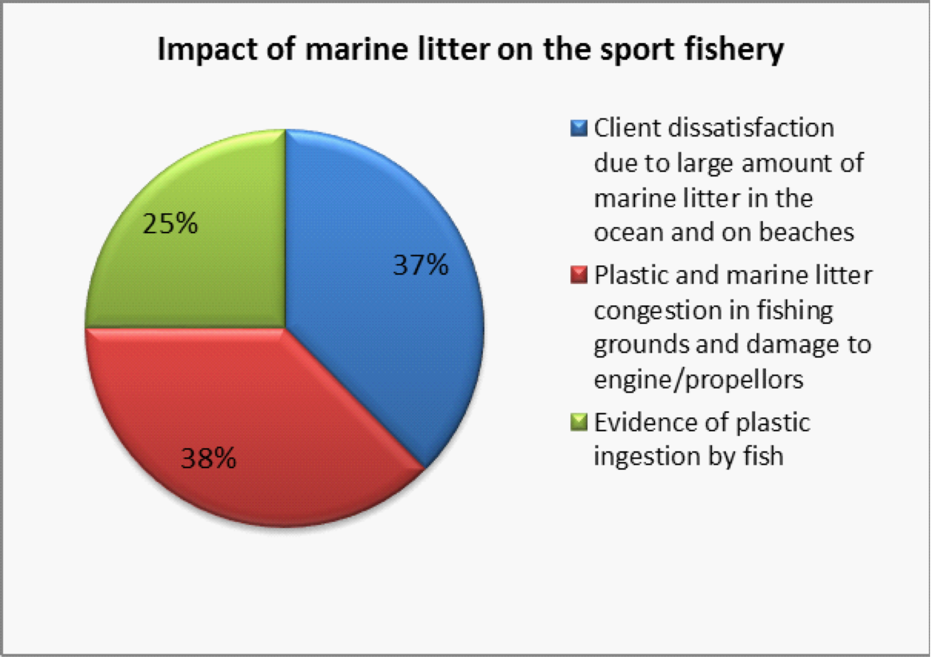
Impacts of disposable waste on Coastal and Marine Ecosystem
Impacts of Litter on Marine Ecosystem and Sport Fishing

Slide 6
Impacts of mining, gas and oil exploration
Pollution impacts communities
Dangerous emissions fuel climate change
Oil and gas development can damage wetlands ecosystems
Fossil fuel extraction turns visitors away
Drilling disrupts wildlife habitat and biodiversity
Oil spills, gas leakage and discharge of chemicals can be deadly to animals and biodiversity
Light pollution impacts wildlife and wetlands

Slide 7
Factors influencing biodiversity loss
deforestation, wetland degradation due to population growth and encroaching human settlements, selective tree harvesting for wood products, poaching and inappropriate fishing gears and techniques such as use of poisonous chemicals
wide array of resource management policies put in place that have contributed to the gradual loss of indigenous knowledge, particularly in agriculture, forestry, and wildlife
removal or introduction of organisms in ecosystems that disrupt biotic interactions or ecosystem processes (invasive species)
Influx of tourists
extractive industries (mining, gas and oil exploration)

Slide 8
Target priorities in Africa Region
Summary Table
Type of Activity | Ocean Service | Industry | Drivers of Growth | ICZM Priorities
Harvest of living resources | Seafood | Fisheries Aquaculture | Food Security Demand for Protein | Governance Institution
 | Marine biotechnology | Pharmaceuticals, chemicals | R&D for healthcare and industry | Technological advancement
Extraction of non- living resources, generation of new resources | Minerals | Seabed mining | Demand for minerals | Economic incentives
 | Energy | Oil and gas Renewables | Demand for alternative energy sources | Economic incentives
 | Fresh water | Desalination | Demand for fresh water | Economic incentives
Commerce and trade in and around the oceans | Transport and trade | Shipping Port infrastructure and services | Growth in seaborne trade; International regulations | Management tools
 | Tourism and recreation | Tourism Coastal Development | Coastal urbanization Domestic regulations | Management tools
Response to ocean health challenges, ecosystem and marine services | Ocean monitoring and surveillance | Technology and R&D | R&D in ocean technologies | Technological advancement
 | Carbon Sequestration | Blue Carbon | Growth in coastal and ocean protection and conservation activities | Climate Change mitigation adaptation resilience
 | Coastal Protection | Habitat protection and restoration | Mangrove forests | Management tools
 | Habitat protection and restoration | Assimilation of nutrients and wastes | Sea grass, coral reefs, sea beds | Management tools

Slide 9
Strategy for Sustainability
Increased understanding and knowledge about the opportunities and value of environmental services made possible by conservation measures:
    Enhanced health and livelihood of people; and,
    Adoption and utilisation of skills and technologies;
    Improved conservation of ecosystems, especially the soil resource
Improved valuation and thus knowledge and information on the values (costs and benefits) and distribution pattern of environmental services, and
Adaptation of fair and equitable system for sharing the benefits and costs among those who contribute to the realisation of environmental and ecosystem services and those who benefit.
Policy and Regulatory Mechanisms
    Baseline Surveys
    Environmental Monitoring Plan
    EIA and SEA
    Capacity for institutional abilities and human technical capabilities
    Convention on Biodiversity (CBD): protection, restoration, integrated spatial management, governance, sustainable management of natural resources, reduction of local pressures
    Alignment with Paris Agreement (Climate Change Convention—NDCs)

Slide 10
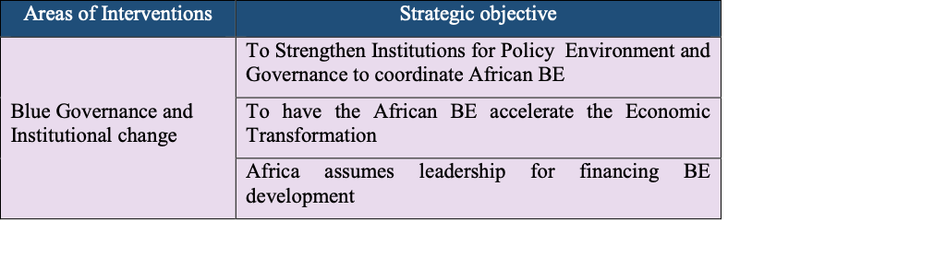
Recommendations

Slide 11
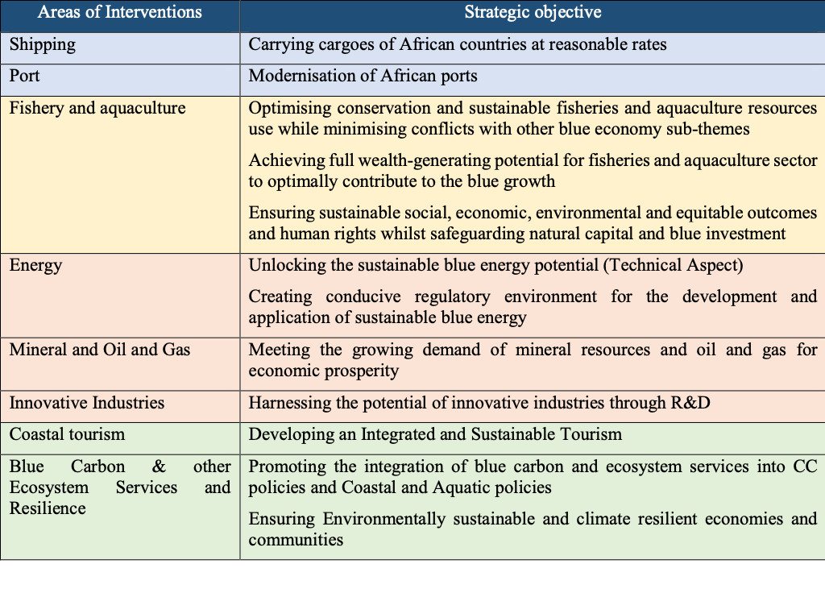
Specific areas of interventions

Slide 12


