Slide 1

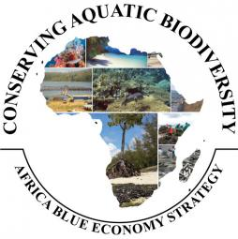

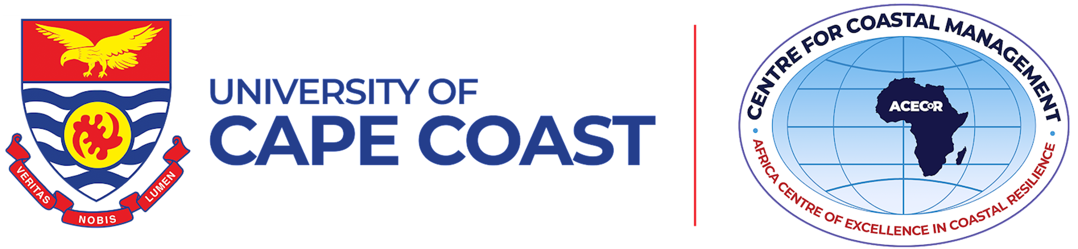
CONSERVING AQUATIC BIODIVERSITY IN AFRICAN BLUE ECONOMY
INCEPTION MEETING
ROLE OF WOMEN IN CONSERVATION OF AQUATIC BIODIVERSITY AND ECOSYSTEMS
By: DR. ALBERTA A. SAGOE
Centre for Coastal Management – Africa Centre of Excellence in Coastal Resilience University of Cape Coast
10/12/2021, Naivasha - Kenya

Slide 2
OUTLINE
Introduction
Role of women in conservation
Barriers to active participation of women in conservation
Addressing the barriers for sustainable development

Slide 3
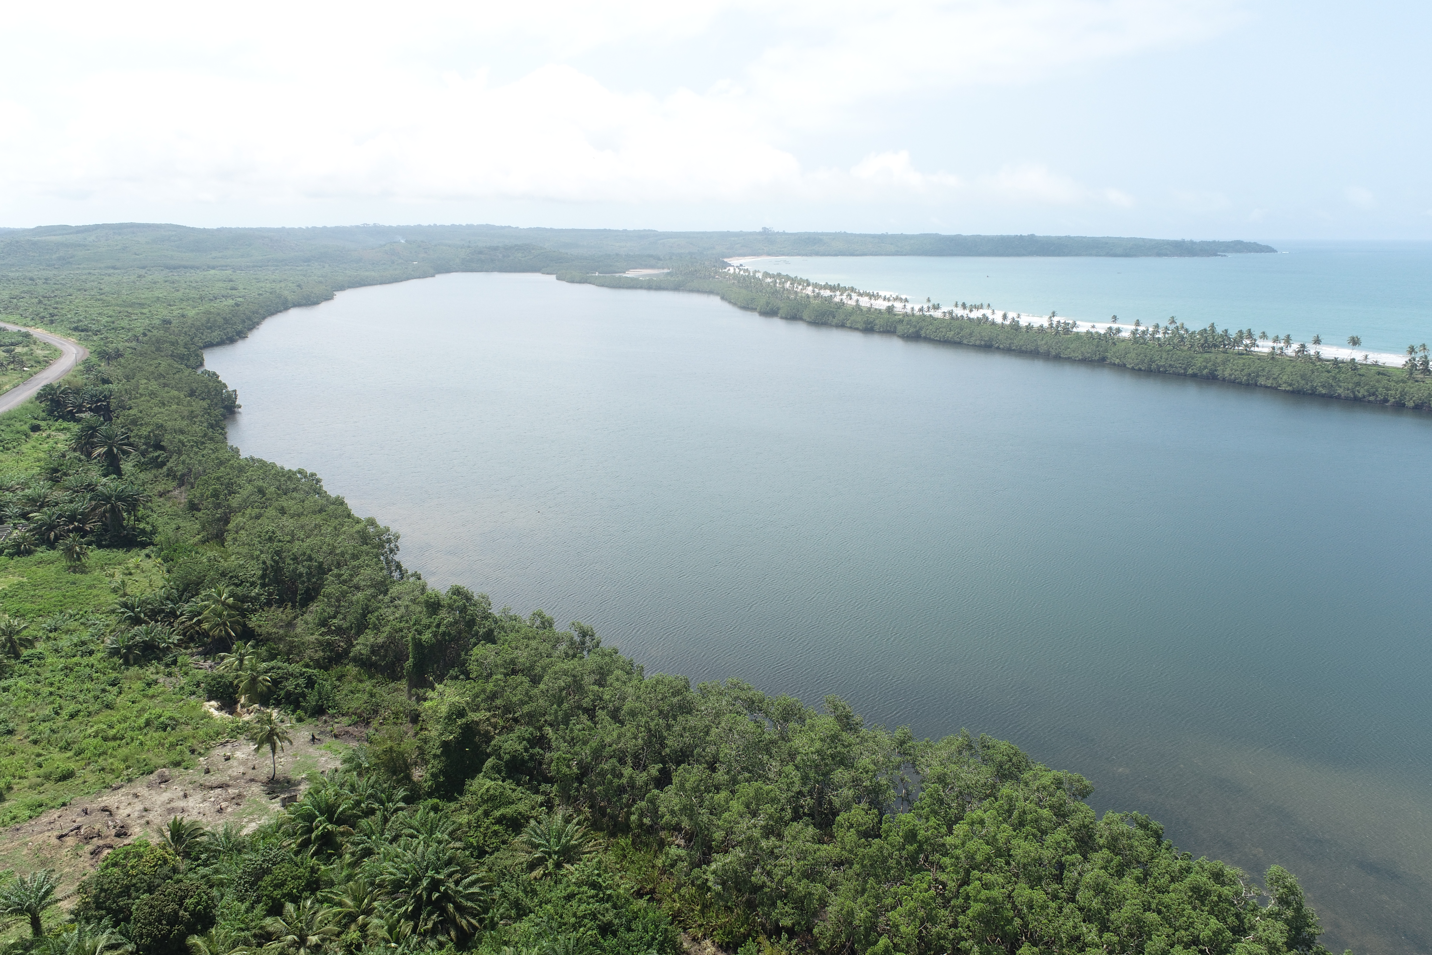
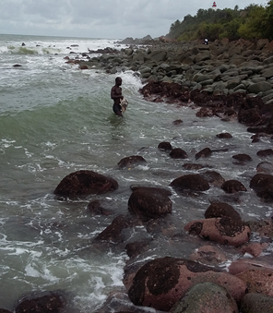
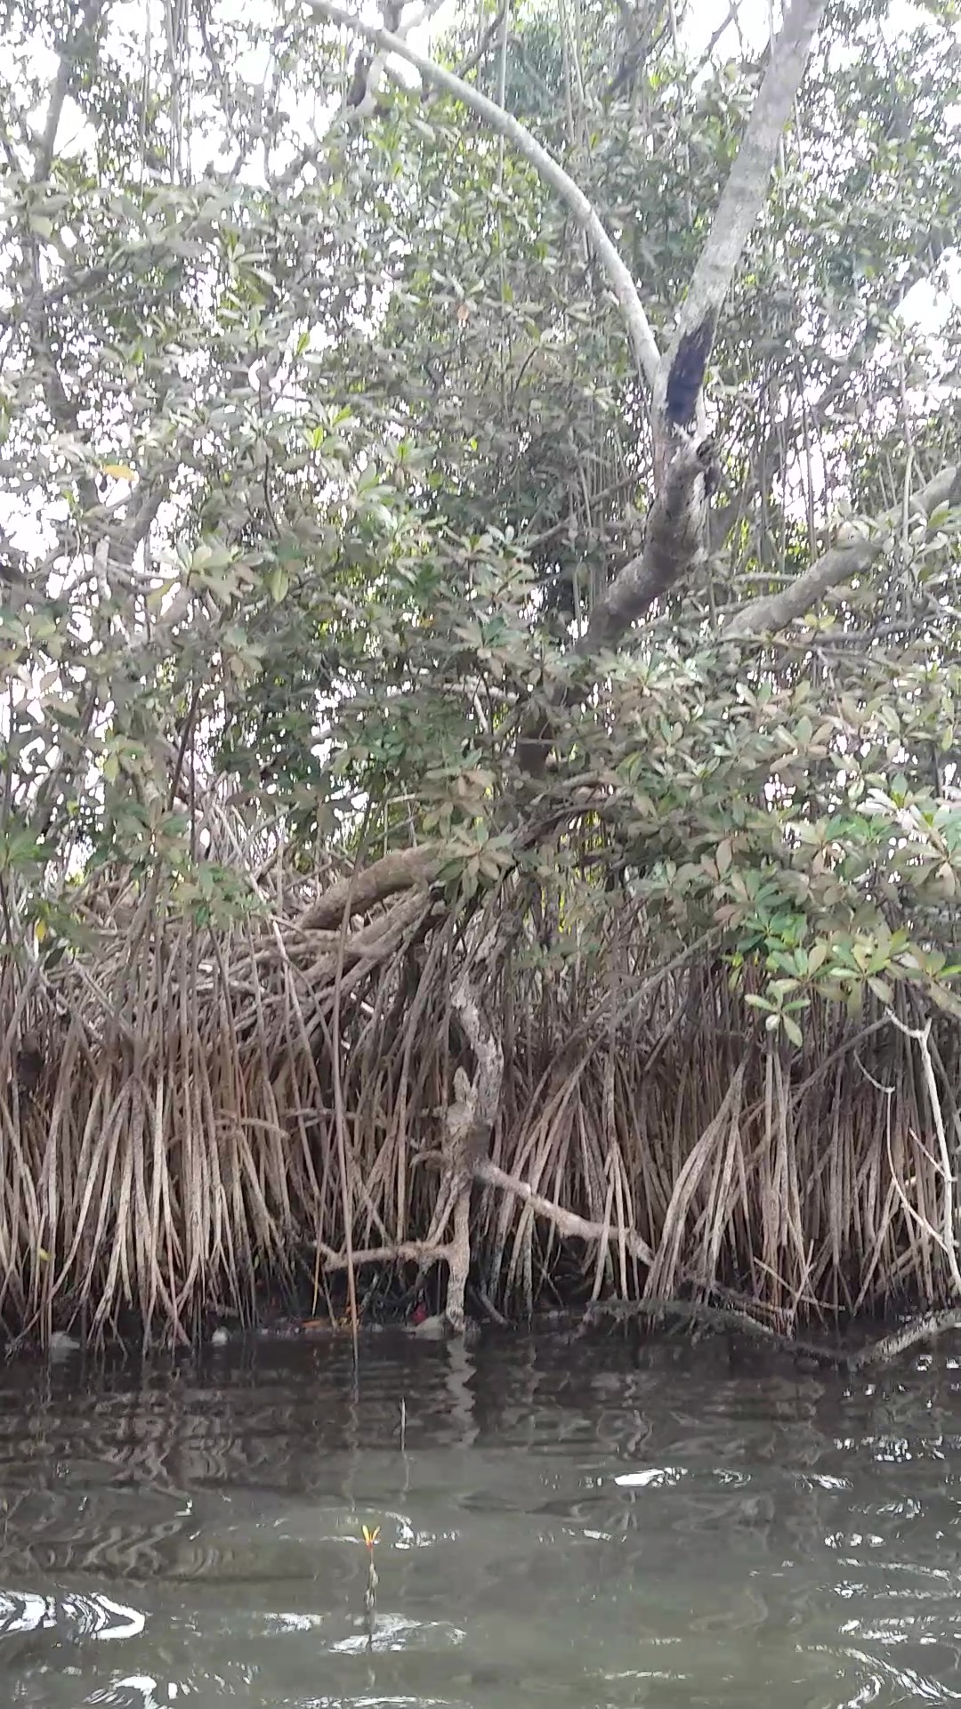
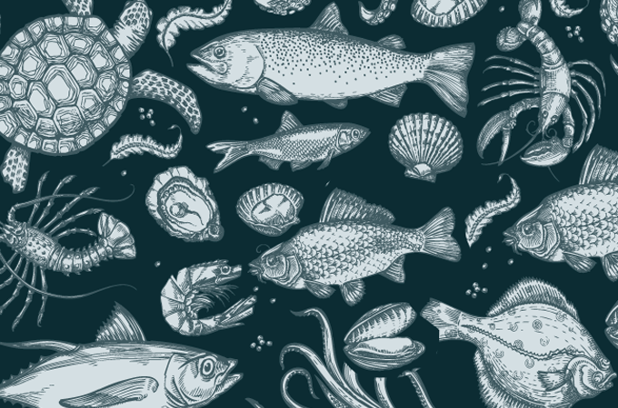
Introduction
Importance of aquatic biodiversity and ecosystems
Human life has been closely associated with the water bodies since the ancient times.
Aquatic and marine resources play a crucial role in supporting an array of economic sectors that provide livelihoods and employment opportunities: Fisheries and aquaculture, Tourism, Oil and Gas exploitation, Maritime transportation, Pharmaceuticals, Mining

Slide 4
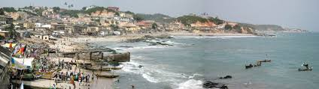
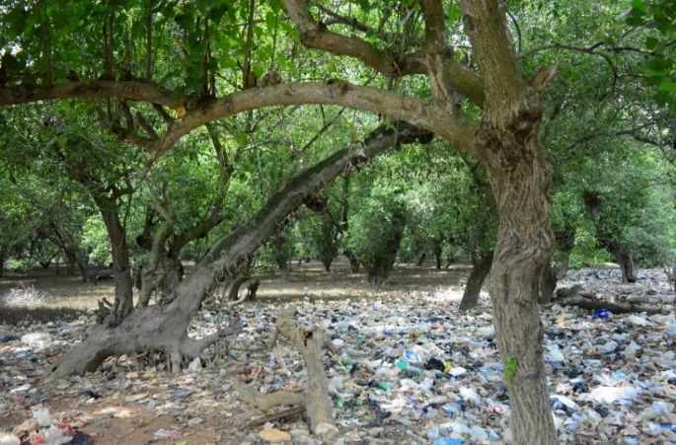
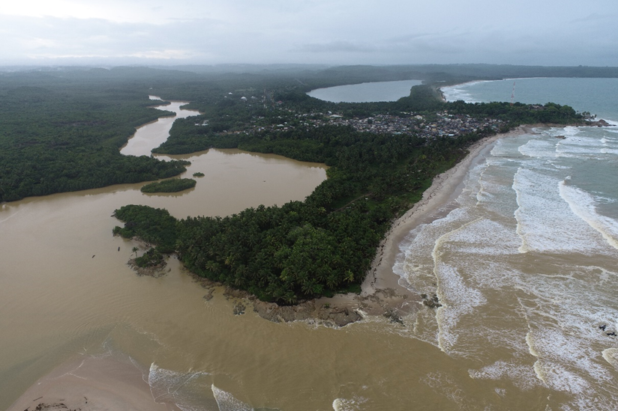
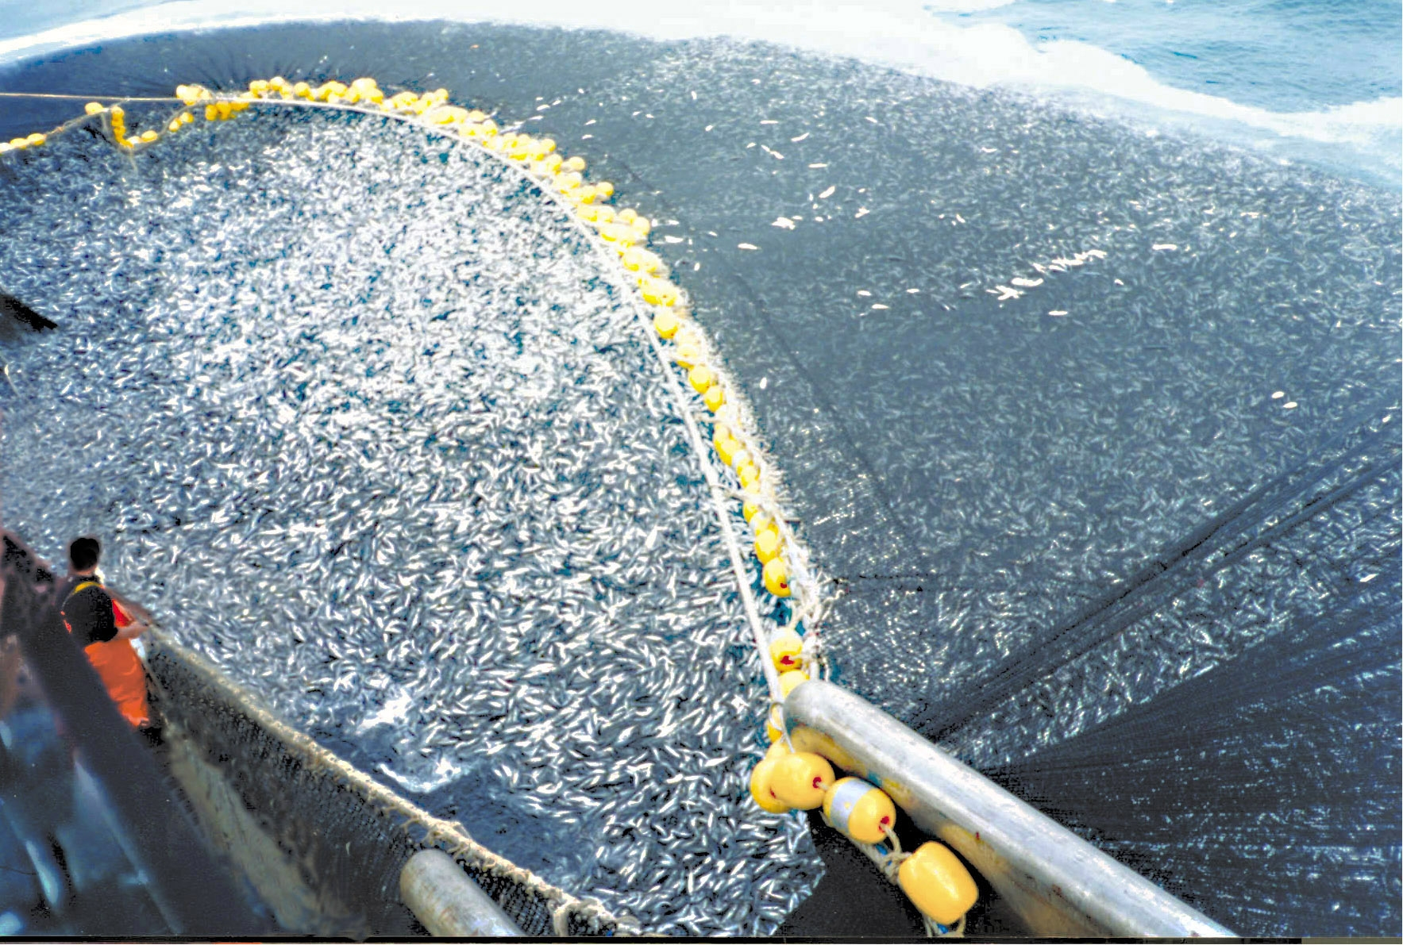
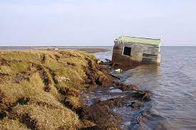
The need for conserving aquatic biodiversity and ecosystems
Aquatic ecosystems are highly vulnerable to various stressors stemming from human activities.
African countries are undergoing rapid population growth, urbanization, coastward migration, and associated socioeconomic growth, causing dramatic coastal change, with increased pressure on aquatic ecosystems.

Slide 5
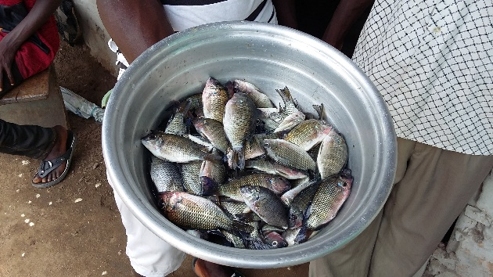
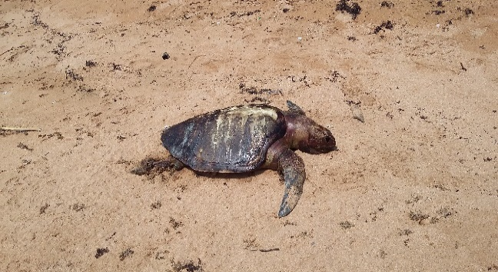
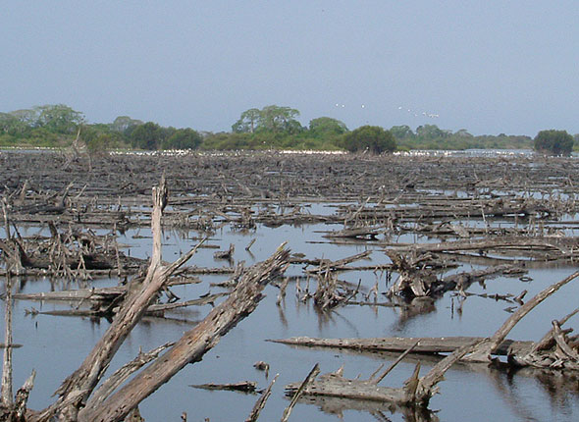
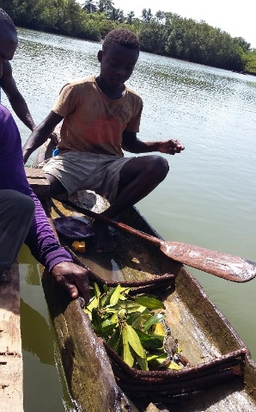
The need for conserving aquatic biodiversity and ecosystems cont’d…
Sustainable management of aquatic ecosystems as “development spaces” is imperative.
The UNCLOS places a universal duty on countries to cooperate in the conservation of aquatic resources and ecosystems.

Slide 6
Approaches for conserving aquatic biodiversity and ecosystems
International measures
The United Nations Convention on Biological Diversity, 1992
Sustainable Development Goals / Global Goals (SDGs), 2015 – Goal 14
IUCN Redlist of Threatened Species
World Heritage Convention, 1972
The Ramsar Convention on Wetlands of International Importance especially as Waterfowl Ecosystem, 1971
UNESCO’s Man and Biosphere (MAB) programme, 1971 (Biosphere Reserves)

Slide 7
Regional and National Strategies
Economic Commission for Africa’s Blue Economy Policy Handbook
African Union’s Agenda 2063
African Union’s 2050 Africa Integrated Maritime Strategy
Regional Fisheries Management Organizations (RMFO’s)
National – level Natural Resources Management Plans and Policies

Slide 8

Traditional Management Approaches
Tedious traditional procedures for access or exploitation of some resources
Total ban on fishing activities for various periods prior to and during annual festivals
Close down of fishing activities when there are other social activities such as funerals
COMMUNITY NORMS, BELIEFS AND CUSTOMS
Observation of non-fishing day in a week (Thursday)

Slide 9
Community based/ co-management arrangement
The partnership arrangement in which the community of local resource users, government, other stakeholders (investors, resource traders, business people, etc.) and external agents (researchers, NGOs, etc.) share the responsibility for the management of resources (FAO 2006)
Coastal communities are empowered politically and economically to manage their resources
Communities develop a management strategy which meets its own particular conditions

Slide 10
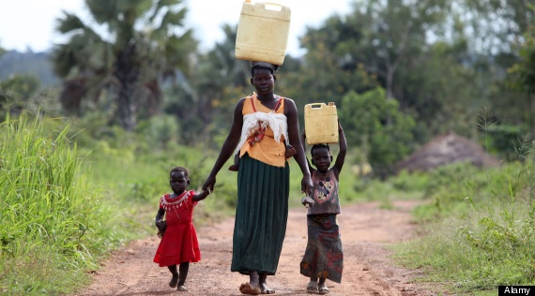
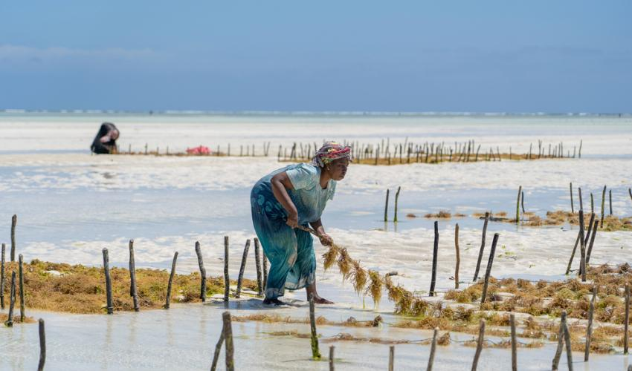
Role of women in conservation
In most communities in the developing world, women act as primary caretakers and natural resource managers –
Lead role in household /community management by controlling consumption patterns, collecting firewood for fuel and cooking, managing household waste, and providing healthcare through traditional medicines.
Control as much as 60-80% of the world’s food production and play a role in both water management and forestry.
Women are in full control of some aquatic ecosystem-based livelihoods in Africa

Slide 11
Women participation in conservation
Women have few legal rights to land and globally women own less than 2% of the world’s titled land.
Women are underrepresented in the conservation world.
Men comprise 70% of the members of the International Union for Conservation of Nature Species Survival Commission
Less than 30% of the world’s researchers are women

Slide 12
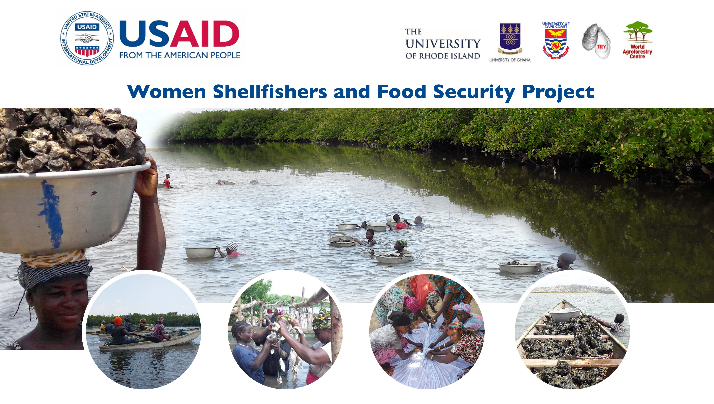
Densu Delta
Credit: Ernest Chuku

Slide 13
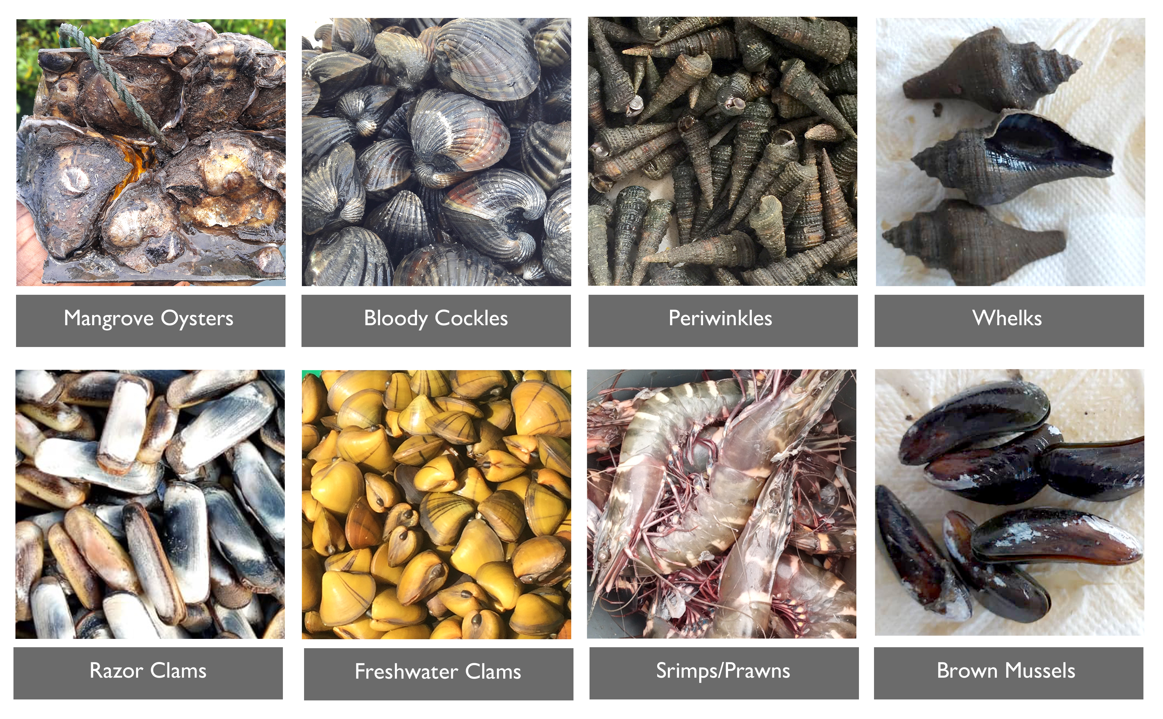
Some shellfish species assessed under the project
Credit: Ernest Chuku

Slide 14
Gender dominance of shellfish harvesters along the value chain of different shellfisheries along the West African coast. (Chuku et al., 2021)
Shellfish group/fishery | Dominant gender at different nodes of the value chain
 | Harvesting | Processing | Marketing | Transportation [during harvest]
Bivalves | Females | Females | Females | Females
Gastropods | Females | Females | Females | Females
Crustaceans | Males | Females | Females | Males
Cephalopods | Males | Females | Females | Males
Credit: Ernest Chuku

Slide 15
Women’s conservation roles are directly related to their livelihoods
The Tanbi wetlands co-management plan by TRY Oyster Women’s Association – Gambia
Saloum Delta
Tanbi Wetlands
The Densu Delta oyster co-management plan by Densu Oyster Pickers Association
Densu Delta
Chuku et al. (2021)

Slide 16
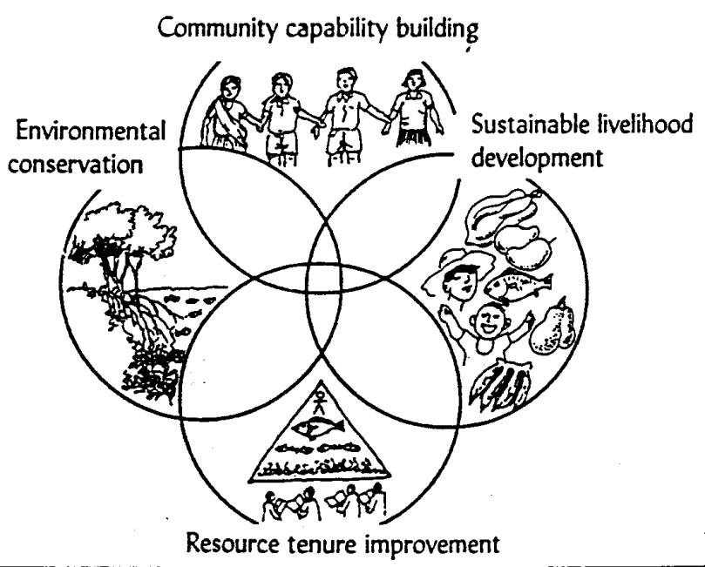
Components Co-management
Empowering the community through education, training and organizational development
Protection of natural ecosystems and resources through sustainable use
The main point of interaction between the fisher and the coastal resource. May involve introduction of alternative/supplementary livelihoods
Gaining access and management over resources

Slide 17
Barriers to active participation of women in conservation
Certain cultural and social norms and practices which marginalize women in access and decision-making
Unequal and insecure rights over land and other natural resources
Women’s limited access to education
Women also fall well behind men in achieving paid employment in natural resource management sectors – notably agriculture, fisheries, and forestry – in both developing and developed countries.

Slide 18
Addressing the Barriers for Sustainable Management
Promote gender equality and women’s empowerment by grounding ecosystem management programs in a gender and social context analysis that considers gaps and opportunities to address them.
Targeted policy formulation for inclusion of women in aquatic biodiversity and ecosystem conservation
Education
Livelihoods empowerment

Slide 19
Conclusion
Empowering every man and woman to play a role in conserving aquatic biodiversity and ecosystems is our best bet.

Slide 20
References
Al-Hamndou Dorsouma (2020). Why should biodiversity be Africa’s top priority?
https://blogs.afdb.org/climate-change-africa/why-should-biodiversity-be-africa%E2%80%99s-top-priority-279
IUCN (2020). Gender and the environment: What are the barriers to gender equality in sustainable ecosystem management?
https://www.iucn.org/news/gender/202001/gender-and-environment-what-are-barriers-gender-equality-sustainable-ecosystem-management
UNEP (2021). A gender-based approach to biodiversity management in the Mediterranean.
https://www.unep.org/unepmap/news/news/IDB2021-gender-based-approach-biodiversity-mediterranean
http://wedo.org/wp-content/uploads/Gender_and_Biodiversity_WEDO.pdf
RAZAN AL MUBARAK (2021). Why women have an essential role in biodiversity conservation
https://racetozero.unfccc.int/why-women-have-an-essential-role-in-biodiversity-conservation/
Palmer, C.P. (2018) The role, influence and impact of women in biodiversity conservation
https://www.iied.org/role-influence-impact-women-biodiversity-conservation

Slide 21


