Slide 1







OBJECTIVES OF THE MEETING
“CONSERVING AQUATIC BIODIVERSITY IN AFRICAN BLUE ECONOMY”
THIRD PROJECT STEERING COMMITTEE MEETING
09 OCTOBER 2024
MOMBASA, KENYA
By: Ms. Stephanie Achieng
Gender Policy and Strategy expert

Slide 2





BACKGROUND
Conserving Aquatic Biodiversity in the Context of the Africa Blue Economy Strategy Project (2021 – 2024/ 2025)
To enhance the policy environment, regulatory frameworks and institutional capacities of AU Member States and Regional Economic Communities to sustainably utilize and conserve aquatic biodiversity and ecosystems.
Regional cooperation
Stakeholder engagements
Technical support
Policy review/ development
Info. sharing & Knowledge mgt.

Slide 3

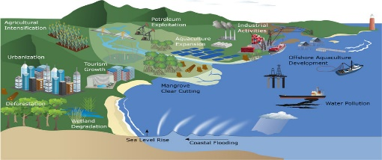
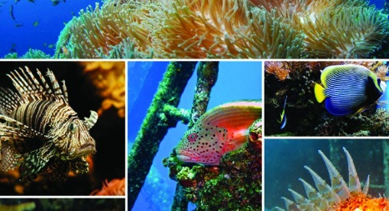
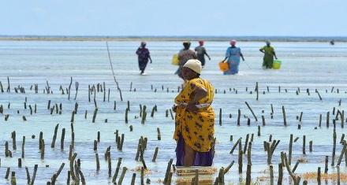
STRATEGIC OBJECTIVES OF THE PROJECT
Support AU–MS to ratify and/or align with relevant International/Regional Instruments related to blue economy themes (with specific reference to protecting and conserving biodiversity)
SO1
Optimize conservation and sustainable use of biodiversity while minimizing conflicts among blue economy sub–themes
SO2
Strengthen measures for mitigating the negative impacts of coastal and marine tourism, oil, gas, deep sea mining and climate change on aquatic biodiversity and environment
SO3
Strengthen gender inclusivity in aquatic biodiversity conservation and environmental management
SO4

Slide 4
STRUCTURE OF THE PROJECT
Conserving Aquatic Biodiversity in the Context of the Africa Blue Economy Strategy Project
Project Technical Committee
Ensures coherence in the implementation of activities between the related projects, key implementing partners and relevant institutions at national, regional and continental levels.
The PTC shall have the mandate to ensure informed, evidence-based decision making by the Project Steering Committee (PSC) meeting
Develops recommendations for deliberation by the high-level PSC meetings.
Project Steering Committee
- An advisory body
- Gives overall strategic direction and policy orientation of the project implementation.
- Responsible for adoption of annual work-plans and approval of related implementation reports

Slide 5

PROJECT STEERING COMMITTEE MEETINGS
ANNUAL MEETINGS
Advise the project management on strategy, taking an overview of the shape, direction and implementation of the project to meet its objectives;
Review and endorse annual work plans as well as periodic reports, and;
Review and advice on the strategic direction of the project to ensure project’s activities are in synergy and are complementary with other related ongoing initiatives.

Slide 6
THIRD PROJECT STEERING COMMITTEE MEETING
Overall objective: The overall objective of the third Project Steering Committee (PSC) is to inform the membership on the progress of implementation since the second PSC, cardinal achievements, emerging issues or challenges and to seek policy and strategic guidance from the PSC members. The specific objectives include the following:
  To brief the PSC members on progress of implementation of the 2023 – 2024 project work plan, challenges and emerging issues.
  To share information project no-cost extension activities and the workplan for 2024 – 2025 extended period.
  To review and adopt the recommendations from the 3rd Project Technical Committee.
  To brief members on project midterm evaluation and exit strategy.
  To provide recommendations on strategic direction in project implementations.

Slide 7
OUTCOMES OF THE MEETING
PSC members adequately informed on progress of project implementation, achievements and emerging issues
PSC members sensitized on activities in No-cost extension and associated work plan and budget
Recommendations from third PTC meeting endorsed
PSC members briefed on outcomes or progress of project midterm evaluation and exit strategy
PSC members develop strategic recommendations

Slide 8

Thank You
AU-IBAR: Providing leadership in the
development of animal resources for Africa

