Slide 1


THIRD PROJECT TECHNICAL COMMITTEE MEETING ON CONSERVING AQUATIC BIODIVERSITY IN AFRICAN BLUE ECONOMY
Progress on Project Implementation
7-8 October 2024 Mombasa, Kenya
Presentation by;
Dr. David Charles Simiyu (PhD)
Lecturer and researcher, University of Dar es Salaam, Tanzania.
Technical expert at Zanzibar Seaweed Cluster Initiative (ZaSCI)

Slide 2
The project
Title | Mainstreaming Climate and Environment Considerations in Seaweed Farming in Zanzibar
Duration | JUNE 2024 - MAY 2026
Budget | 44,000 USD
Implementor | Zanzibar Seaweed Cluster Initiative (ZaSCI)
 | Flower Msuya, Amelia Buriyo, Olivia Kalokora, David Simiyu, Issa Muharami, Abdalla Hemed
Location | Zanzibar (United Republic of Tanzania)
Funder | AU-AIBAR

Slide 3
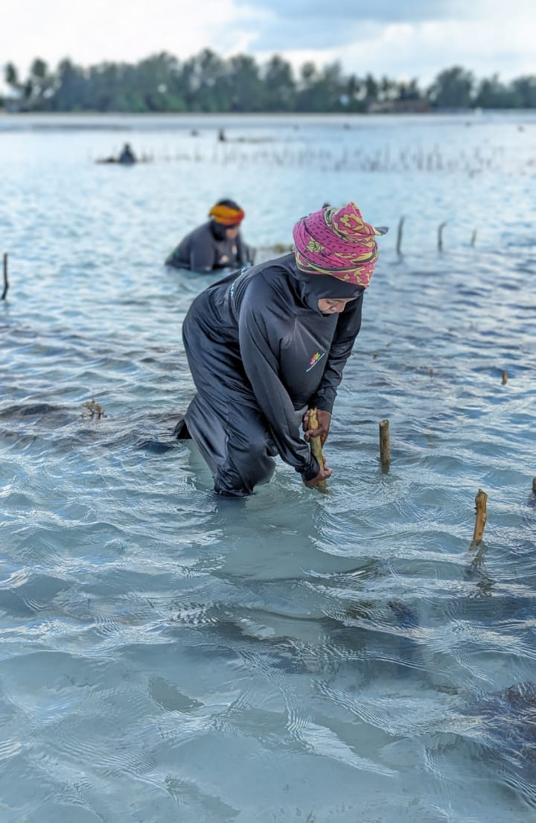
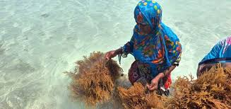
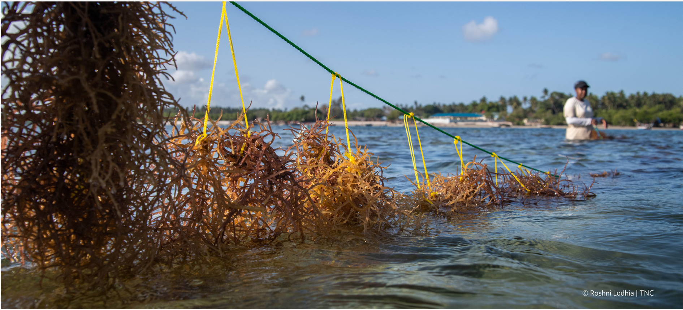
Background
Cultivation and usage of Seaweed
©F.E. Msuya
The Nature Conservancy, 2023
Cultivation:
Done using nylon ropes and pegs from nearby trees
Dominated by female farmers
©Issa Muharami

Slide 4
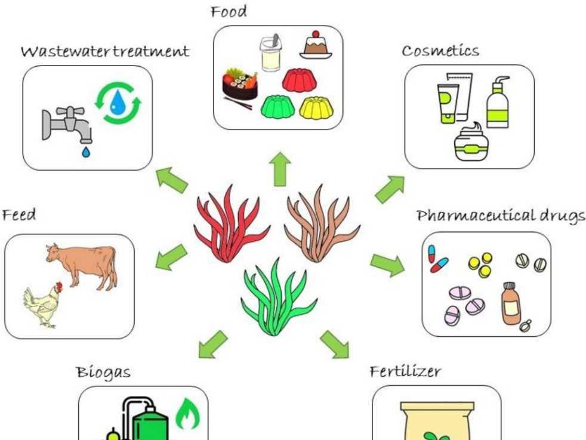
Background
Application of seaweeds
https://www.lifeasible.com/applications-of-seaweed/

Slide 5
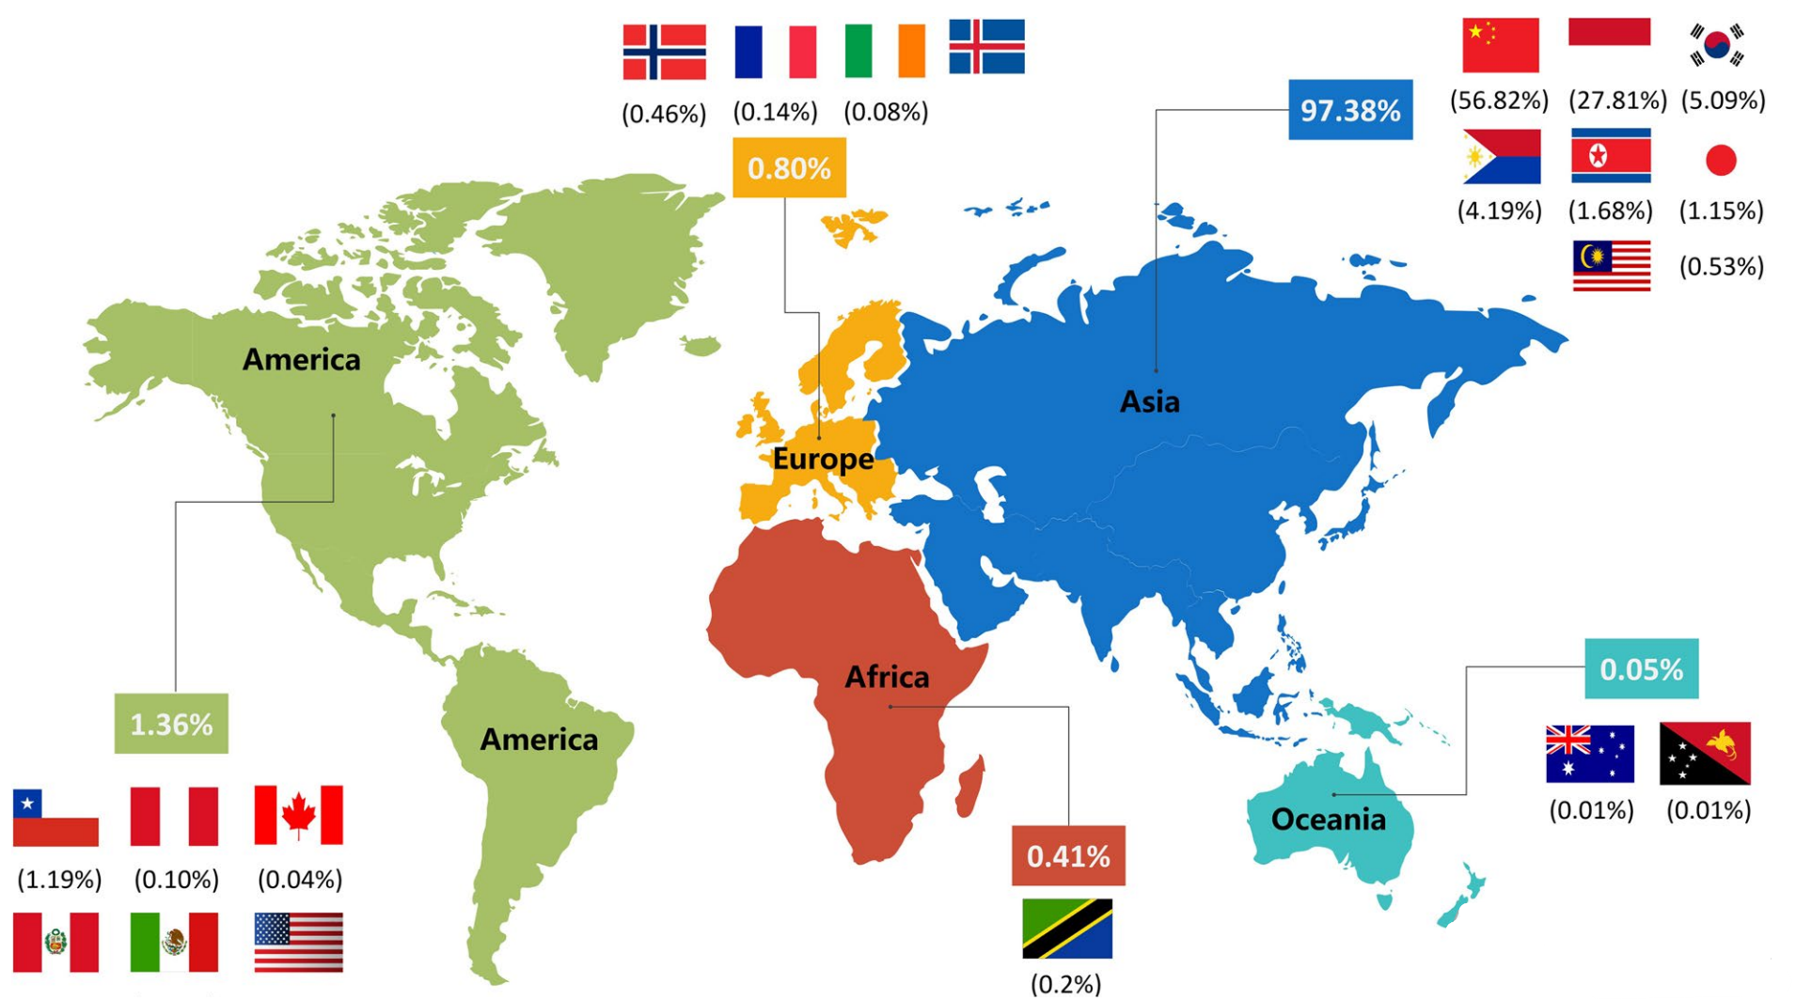
Background
Seaweed Producing countries. (FAO, 2019)
Map adapted from Zhang et al. 2022. Food Production, Processing and Nutrition
>90% of Tanzania’s seaweeds are cultivated in Zanzibar

Slide 6
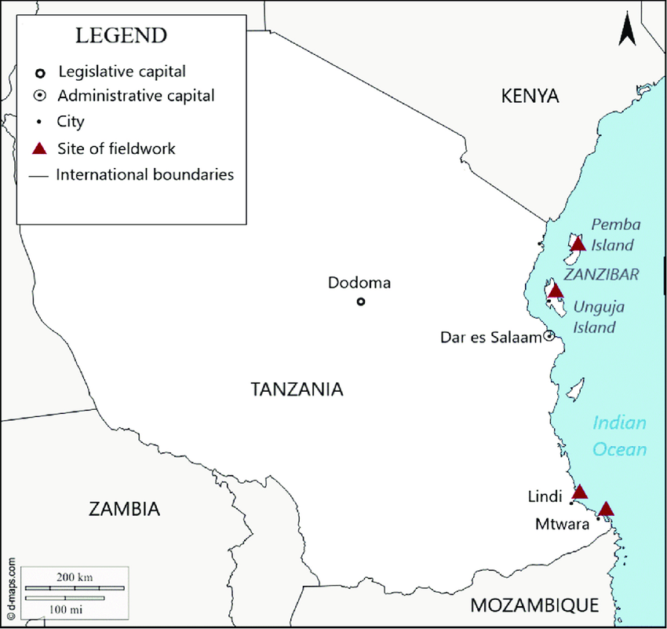
Background
Matoju et al. 2022. Applied Phycology

Slide 7
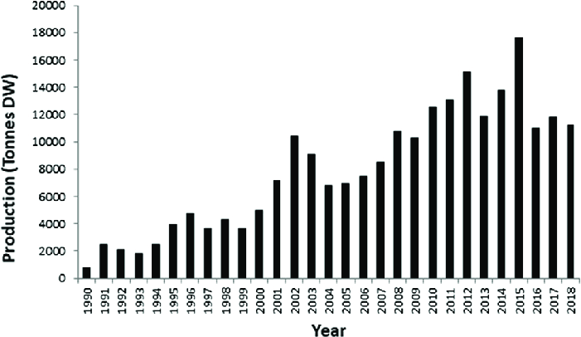
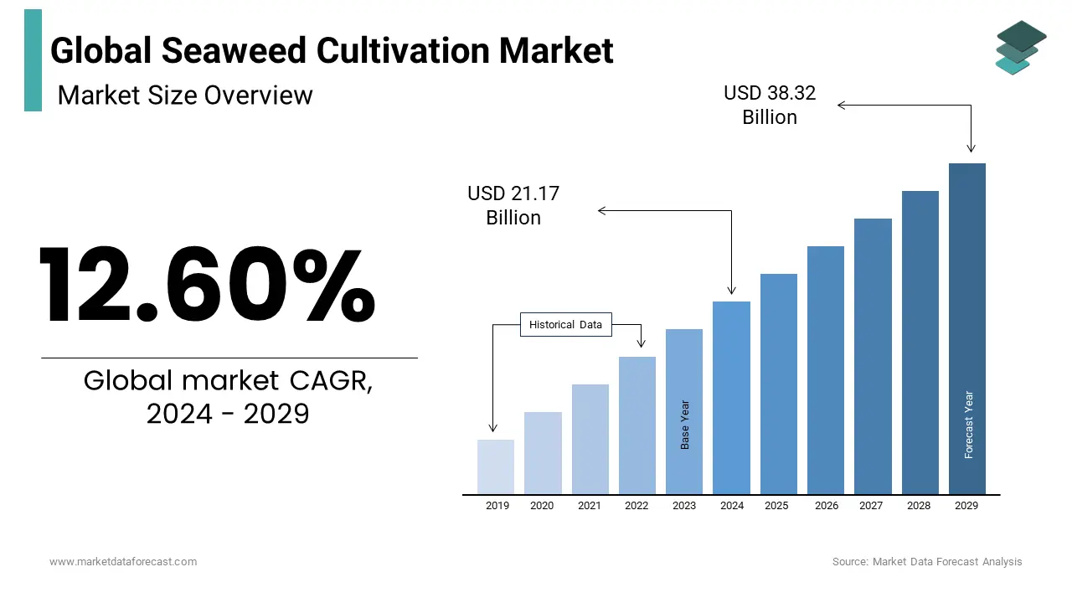

Background
Production of seaweeds in Zanzibar.
Ndawala et al. 2021. Environmental Challenges
Pressure on marine environment and ecosystem

Slide 8
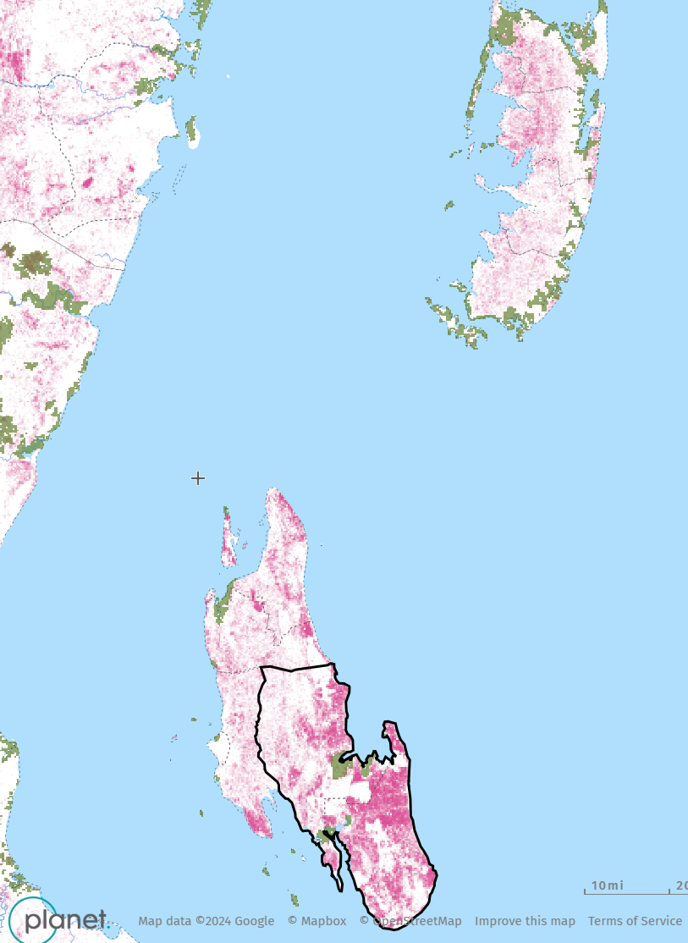
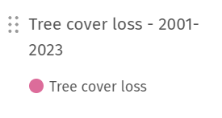
Background
Seaweed farming threats
Increased cutting of trees including mangroves for pegs.
Increased plastic wastes from seaweed farming
Climate change impacts (diseases, low biomass)
https://gfw.global/3MSTiK6

Slide 9
Objectives of the project
General objective:
To promote environmental protection strategies among seaweed farming communities in Zanzibar
Specific objectives:
Characterize the current and potential environmental threats caused by seaweed farming in Zanzibar.
Establish and demonstrate to seaweed farmers the waste management strategies during farming and harvesting of seaweeds.
Promote sustainable harvesting methods of coastal forests and environmentally friendly seaweeds farming practices.
Establish land-based tree nurseries near seaweed farming villages in Zanzibar.

Slide 10
Activities conducted and results
Characterizing the current and potential environmental threats caused by seaweed farming in Zanzibar.
Makangale
Kiuyu Mbuyuni
Tumbe
Micheweni
Fundo Island
Chokocho
Eleven villages/shehia were visited in both Unguja and Pemba islands.
A total of 280 respondents
Pwani Mchangani
Pongwe
Villages visited
Bweleo
Paje
Muungoni
https://gfw.global/3MSTiK6

Slide 11
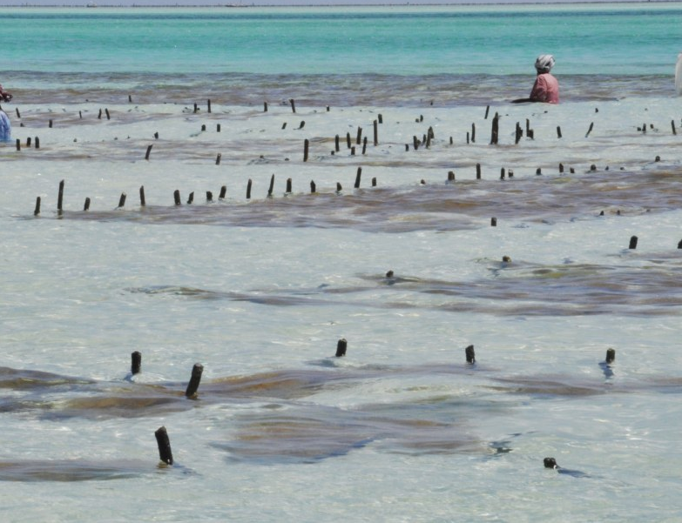
Activities conducted and results
List of Tree species used as pegs in Zanzibar seaweed farms
Local name | Scientific name
Mkole | Grewia bicolor
Mkwamba | Flueggea virosa
Mzindigwi | Sideroxylin inerme
Mtumbika | Mallotus oppositifolius
Mlapaa/Mgudi | Polysphaeria parvifolia
Mkunguni | Terminalia boivinii
Mjenga uwa | Gliricidia sepium
Msiliza | Euclea natalensis
Mbebeta | Psiadia punctulata
Mkonge | Pyrostria bibracteata
Mvinje/Mvuma | Casuarina equisetifolia
Mdimu msitu | Suregada zanzibariensis
Image www.allafrica.com
Most farmers use pegs harvested from nearby forests
Total of 94 different plant species were mentioned to be used by seaweed farmers.
Most durable tree species become rarer year by year

Slide 12
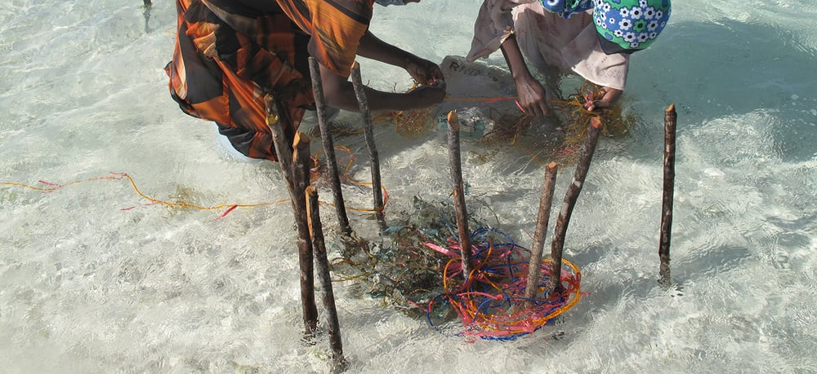
Activities conducted and results
Image by Joanna Lipper available at https://www.lensculture.com/projects/191022-seaweed-farmers-in-zanzibar
Dominant pollutants emanating from seaweed farms are
Old pegs
Tie-tie remains
Sacks (used to carry seeds or harvests)

Slide 13
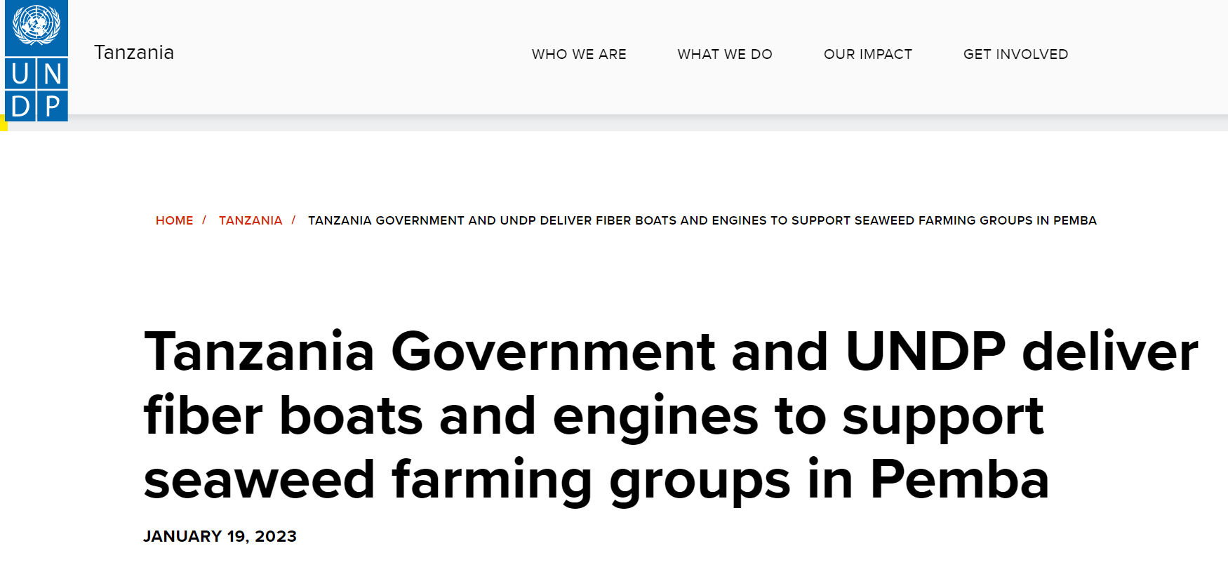
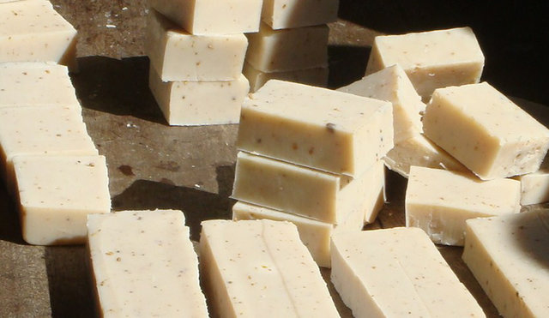
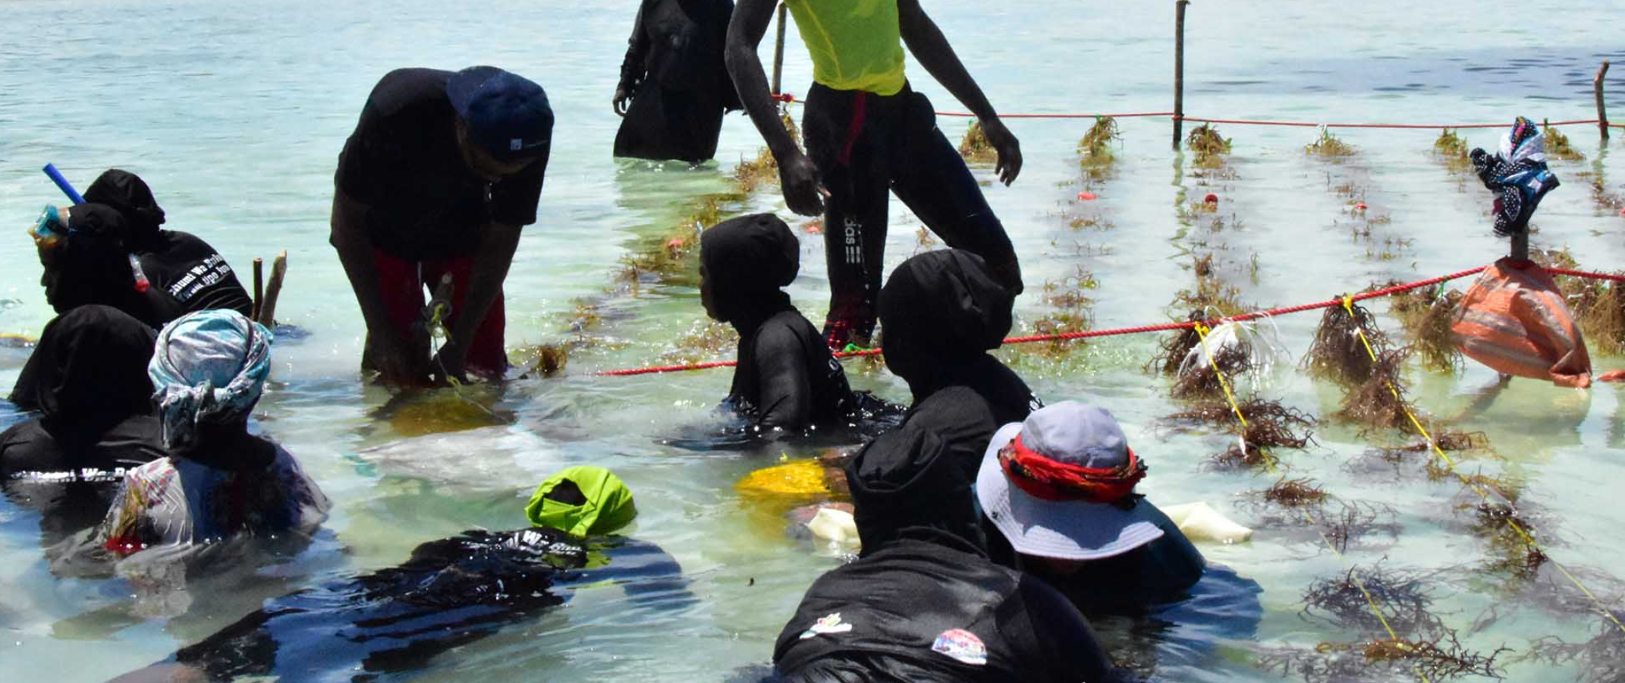
Activities conducted and results
2. Identifying existing efforts that aim at boosting nature-based solutions to climate change and climate change mitigation
1. To access deep water farming
Boats are provided
Swimming lessons given
Soap bars made from seaweed Image by Flower Msuya
2. To increase income from smaller farms
Training on value addition
Image by Milele Foundation Zanzibar

Slide 14
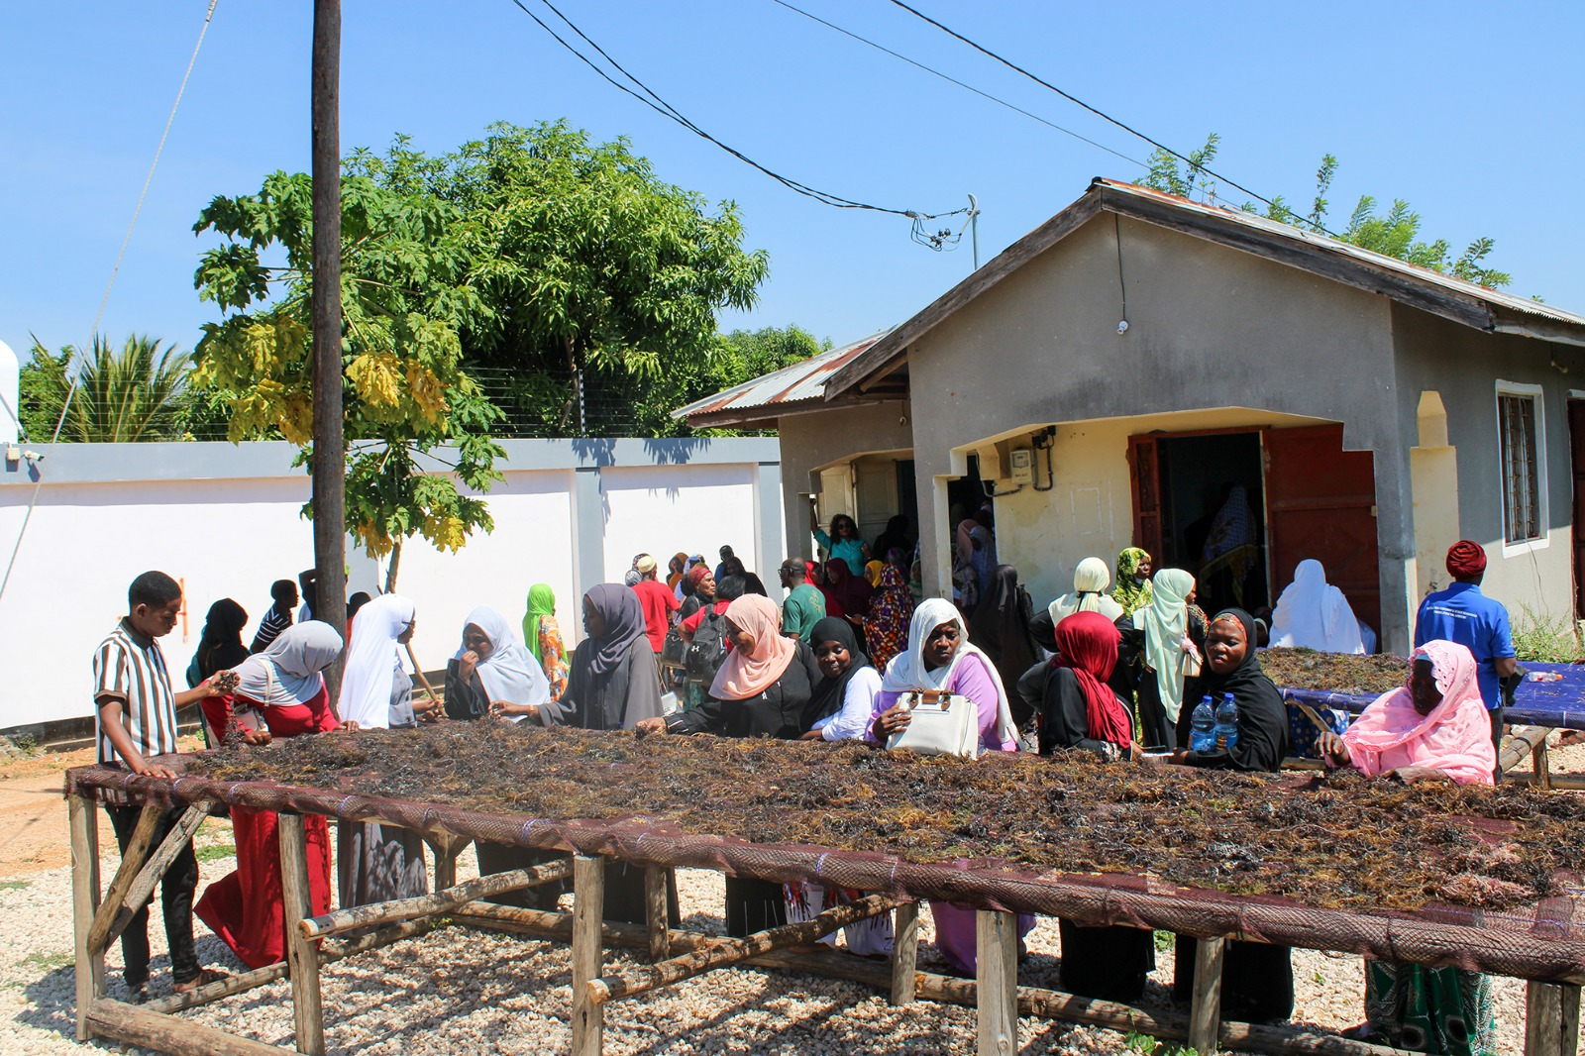
Activities conducted and results
3. Raising awareness on the importance of climate-change impacts mitigation in seaweed farming communities
Farm visits were organized during seaweed day. Stakeholders (researchers, media, government officials) got firsthand experience directly from farmers and farms.
Different seaweed stakeholders visiting a seaweed processing facility in Zanzibar during seaweed day. The field trip was organized by ZaSCI and AU-AIBAR.

Slide 15
General observations and way-forward
The current pace of pegs harvesting threatens coastal forest resources
Farmers lack training on environment-friendly farming practices.
Only small percent of farmers have equipment and skills to access deep water farming
Establish tree nurseries guided by the most used tree species
Train farmers on best seaweed farming practices.
Assist available efforts that promote nature-based solutions to climate change

Slide 16
Next phase
Characterize the current and potential environmental threats caused by seaweed farming in Zanzibar.
Establish and demonstrate to seaweed farmers the waste management strategies during farming and harvesting of seaweeds.
Promote sustainable harvesting methods of coastal forests and environmentally friendly seaweeds farming practices.
Establish land-based tree nurseries near seaweed farming villages in Zanzibar.

Slide 17


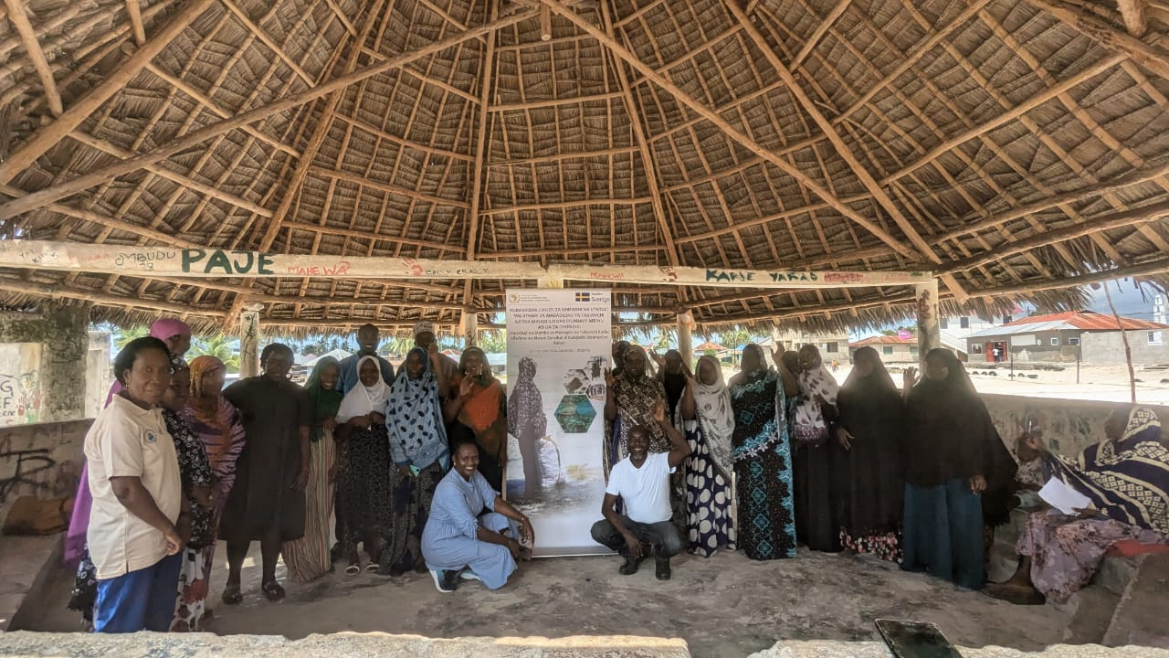


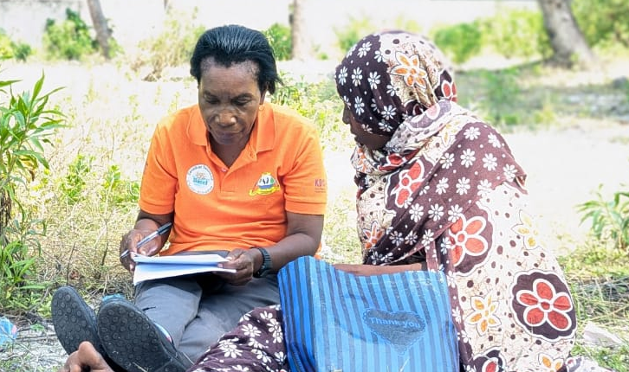
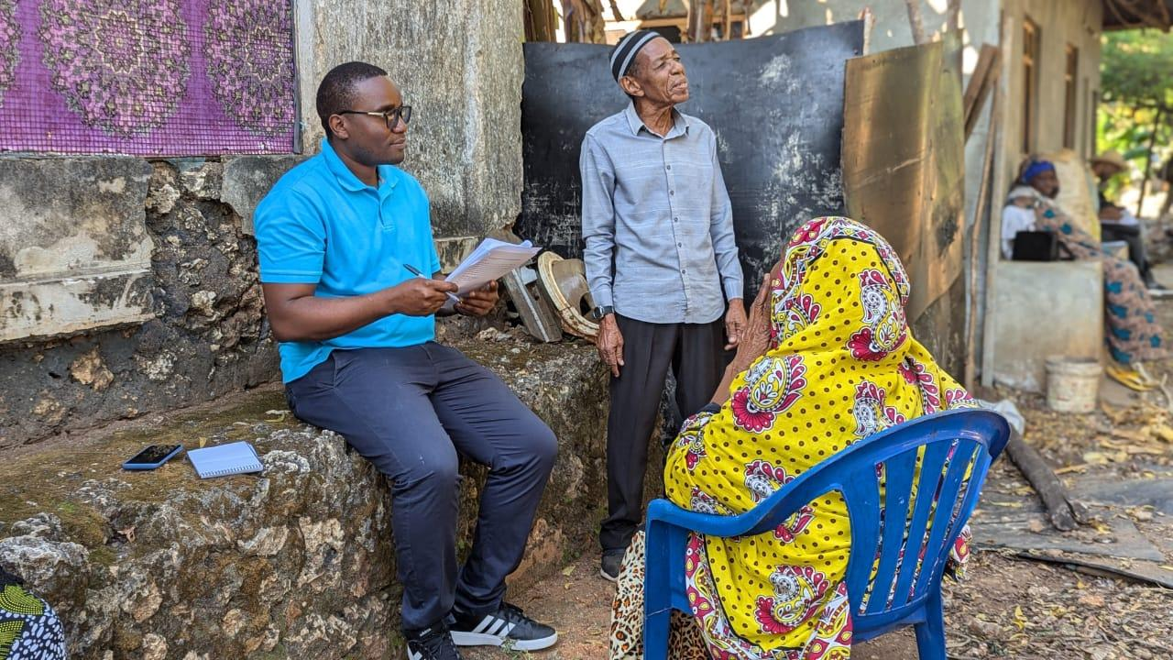
THANK YOU

