Slide 1






THIRD PROJECT TECHNICAL COMMITTEE MEETING ON CONSERVING AQUATIC BIODIVERSITY IN AFRICAN BLUE ECONOMY
Mombasa-Kenya
07-08 October 2024

Slide 2
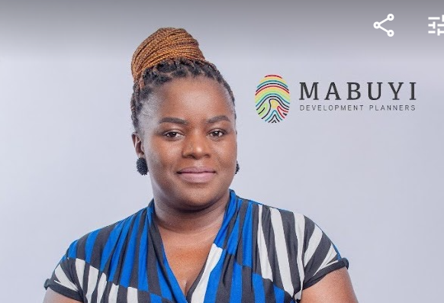
CONSULTANCY TO DEVELOP A GENDER PLAN OF ACTION FOR NGO’S IN SMALL SCALE FISHERIES
Presentation by: Ms. Zintle Lushaba - South Africa
Professional Town&Regional Planner
A/1847/2014 (SACPLAN)

Slide 3

Background
1
Project objectives
2
Agenda
Project work plan
3
Online Marketing
Expected outputs
4
PRESENTATION OUTLINE
Progress on outputs
5
6
Findings

Slide 4
Feedback on key issues
7
Workshop outcomes
8
Agenda
Support requirements
Online Marketing
9
Recommendations
PRESENTATION OUTLINE
10
Way forward
11

Slide 5
1. BACKGROUND
Aquatic biodiversity conservation and the blue economy are critical aspects of sustainable development, encompassing the protection and management of marine ecosystems and the responsible use of ocean resources.
However, achieving sustainable outcomes in these areas requires the active involvement and empowerment of women.
Women have long played essential roles in coastal communities and possess a deep understanding of the marine environment.
Yet, they often face numerous barriers and challenges that hinder their participation and contributions.

Slide 6
1. BACKGROUND
In this regard, AU-IBAR is implementing a three-year project on “Conserving Aquatic Biodiversity in African Blue Economy”, with support from the Swedish International Development Agency (SIDA).
The project is supporting the implementation of the African Blue Economy Strategy (ABES) which was endorsed by the African Heads of State and Government at a Summit held in Addis Ababa-Ethiopia, in February 2020.
The Project is designed to enhance the policy environment, regulatory frameworks and institutional capacities of African Union member states and Regional Economic Communities to sustainably utilize and conserve aquatic biodiversity and ecosystems.

Slide 7
1. BACKGROUND
An important area that the project seeks to address is strengthening gender-sensitive work plans to enhance the role of women and youth in biodiversity protection and environmental governance in aquatic ecosystems, which support economic activities and livelihoods of women and youth in AU member states.
To address this, AU-IBAR commissioned a study to identify priority issues and actions that will enhance the role of women in aquatic biodiversity and environmental management in AU-MS; and to design a continental strategy that guides gender mainstreaming in conservation programmes and initiatives.
In this regard, AU-IBAR is implementing a three-year project on “Conserving Aquatic Biodiversity in African Blue Economy”, with support from the Swedish International Development Agency (SIDA).

Slide 8
1. BACKGROUND
The project is supporting the implementation of the African Blue Economy Strategy (ABES) which was endorsed by the African Heads of State and Government at a Summit held in Addis Ababa-Ethiopia, in February 2020.
It is designed to enhance the policy environment, regulatory frameworks and institutional capacities of African Union member states and Regional Economic Communities to sustainably utilize and conserve aquatic biodiversity and ecosystems.
The Continental Gender Strategy on Aquatic Biodiversity Conservation was developed and endorsed by the Summit of the African Heads of States and Governments in February 2024.

Slide 9
1. BACKGROUND
Within the provision of the Aquatic Biodiversity Project, selected environmental-based NGOs in Africa, working at the interface of coastal communities, were proposed to be supported to develop or strengthen their all-inclusive gender strategies.
The African Union – Inter African Bureau for Animal resources called for a consultancy to undertake a gender assessment and develop a plan of action to promote gender equality in the activities of the non-governmental organization(s) working with small-scale fishers and aquaculture producers in the Western Indian Ocean area of South Africa.
Ms. Zintle Lushaba, a professional and registered Town and Regional Planner within the terms of the South African Council of Planners (A/1847/2014), under the auspices of her company Mabuyi Development Planners (Pty) Ltd, was awarded the contract after a competitive selection process.

Slide 10
2. PROJECT OBJECTIVES
Identify a beneficiary NGO that conducts its activities with small-scale fishers and aquaculture producers;
Undertake a gender assessment to document the gender situation by Reviewing relevant policies, frameworks, strategies and or legislations which have implications to the social and economic conditions of women in coastal communities.
The assessment will identify key barriers faced by women in the sector and identify key opportunities for the improvement of the role and engagement of women in the sector.
Conduct consultative workshops with the beneficiary NGO, women of coastal communities, government officials and other relevant stakeholders.
Develop a plan of action to address gender challenges.

Slide 11
2. PROJECT OBJECTIVES
The plan of action will focus on:
Mechanisms on effective Integration of gender equality in the activities and governance structures and instruments of the identified NGO.
Approaches aimed at addressing gender equality and social integration including marginalization, equality, equity, justice and gender socio-economic issues in the affairs of the NGO identified during the gender assessment as well as during the stakeholder’s consultation workshops;
Defining approaches that strengthen the inclusion and participation of women in SSF and aquaculture, particularly in the fisheries market value chain including harvesting and post-harvest activities (processing and marketing);

Slide 12
2. PROJECT OBJECTIVES
Identification of areas for capacity building, knowledge management, communication, advocacy and transfer to enhance gender equality and women empowerment;
Develop a gender plan of action and Memorandum of Understanding(MoU) and lastly;
Develop gender-sensitive monitoring and evaluation indicators that will be integrated into the overall Monitoring & Evaluation framework for the NGO.

Slide 13
3. PROJECT WORKPLAN
PHASE 1:
PHASE 2:
PHASE 4
PHASE 3:
Draft and final report
Development of Gender plan of action and validation workshop
Stakeholder Consultation
Gender Assessment Report/ Memorandum of Understanding
Client Liaison and Project Inception
PHASE 5

Slide 14
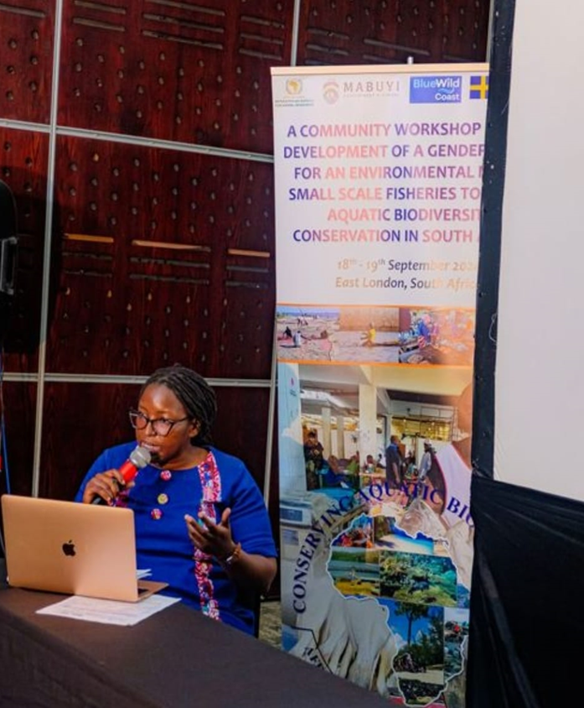
4. EXPECTED OUTPUTS
Inception Report;
Gender Assessment / Analysis Report and Draft MOU;
Draft Gender Plan of Action / Policy (Consultation phase);
Comprehensive Report of the Consultancy;

Slide 15
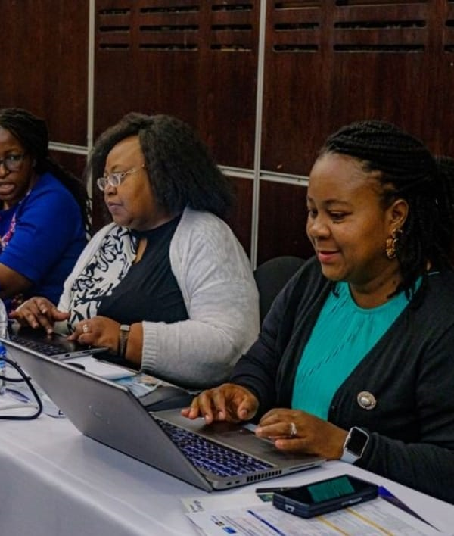
5. PROGRESS ON OUTPUTS
Inception meeting and report- Completed/Submitted.
Gender Assessment / Analysis Report and Draft MOU
Completed/ Submitted.
Draft Gender Plan of Action / Policy
Completed/ Submitted.
Comprehensive Report of the Consultancy
Completed/ Submitted.

Slide 16
6. FINDINGS
Thematic Area | Findings
Legislative provisions and short-comings | Lack of gender policies that facilitate women participation. Municipal planning tools in the study areas are silent on gender mainstreaming. Lack of implementation of policies that address the correction of historical racial and gender imbalance.
Economic challenges | Annual and temporary permits are purchased and the communities are mostly unemployed and cannot access finance from financial institutions. Gender disparities in employment, income, and economic opportunities are prevalent.
Infrastructure | Existing infrastructure is dilapidated and the only boat was damaged during floods.

Slide 17
6. FINDINGS
Access to markets | Haphazard selling of goods with no structured contracts for sustainable income.
Education and training | The communities also lack knowledge around fishing licenses and information on the management of marine fishing licenses. Lack of knowledge on the specific regulations for different types of fishing that exist. Ad-hoc training workshops have previously been offered depend on indigenous knowledge and lack formal training
Political participation | Lack of political support and involvement by councillors, etc.
Social norms and practices | Societal attitudes and norms that limit gender equality Men are considered to play a more important role, i.e. fishing and women fall at the tail end of the value chain.

Slide 18
6. FINDINGS
Institutional challenges | Weak environment for change due to poor community involvement during policy compilation by government. Inefficient policy instruments characterized by weak administrative rules, laws, regulations, standards, and other formal incentives that should guide marine activities which should lead to local economic development, especially for women. Ineffective organizational arrangements caused by conflicting authorizations by different government entities.

Slide 19
7. FEEDBACK ON KEY ISSUES/CHALLENGES
Financial resources
Insufficient government funding and shrinking budget allocations to departments limits the implementation of effective ocean governance.
Infrastructure
Inadequate physical infrastructure which include but not limited to:
Storage and cooling units
Harbours of slip ways
Accessible roads

Slide 20
7. FEEDBACK ON KEY ISSUES/CHALLENGES
  Governance and Leadership
Weak governance structures, policy uncertainty, and poor leadership in government departments impact the management of and support to the various groups/agencies that operate within the aquatic biodiversity space.
  Information and Communication Technology (ICT)
Limited access to modern ICT tools and systems delay communication and also affect data management, communication, and overall productivity.

Slide 21
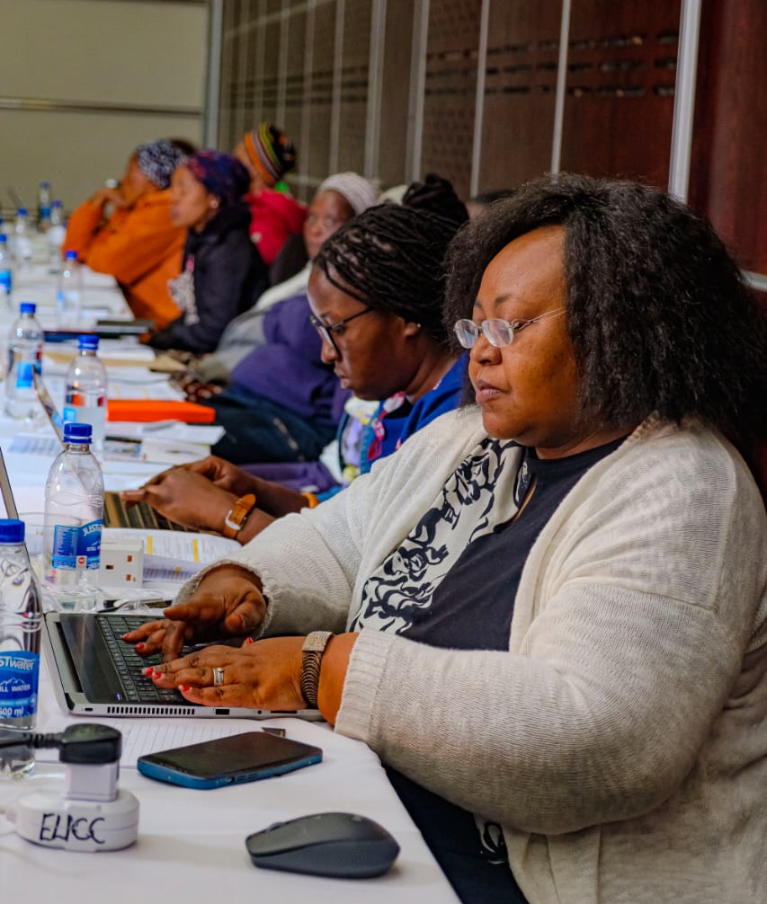
8. WORKSHOP OUTCOMES
INTERGOVERNMENTAL SUPPORT
REGIONAL COOPERATION
GENDER-MAINSTREAMING
STAKEHOLDER PARTICIPATION
COMMITMENTS FROM VARIOUS SECTORS
MOU’S WITH COOPERATIVES/NPO

Slide 22
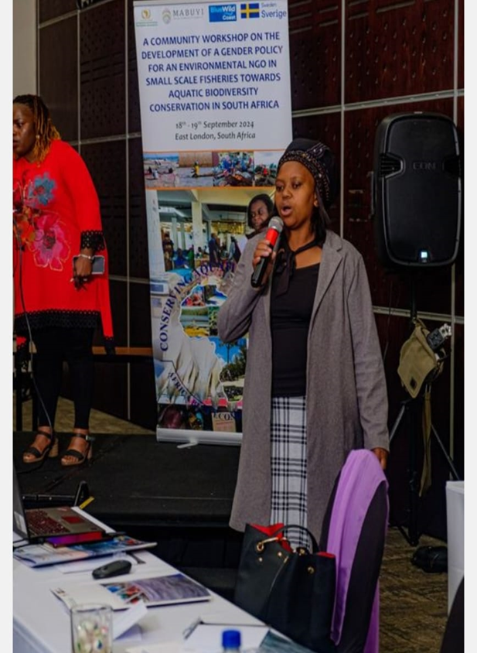
9. SUPPORT REQUIREMENTS
INFRASTRUCTURE DEVELOPMENT
SKILLS UPLIFTMENT FOR WOMEN
YOUTH PROGRAMS/DOCUMENTARY
SUPPORT WITH TOOLS OF TRADE
ACCESS TO MARKETS

Slide 23
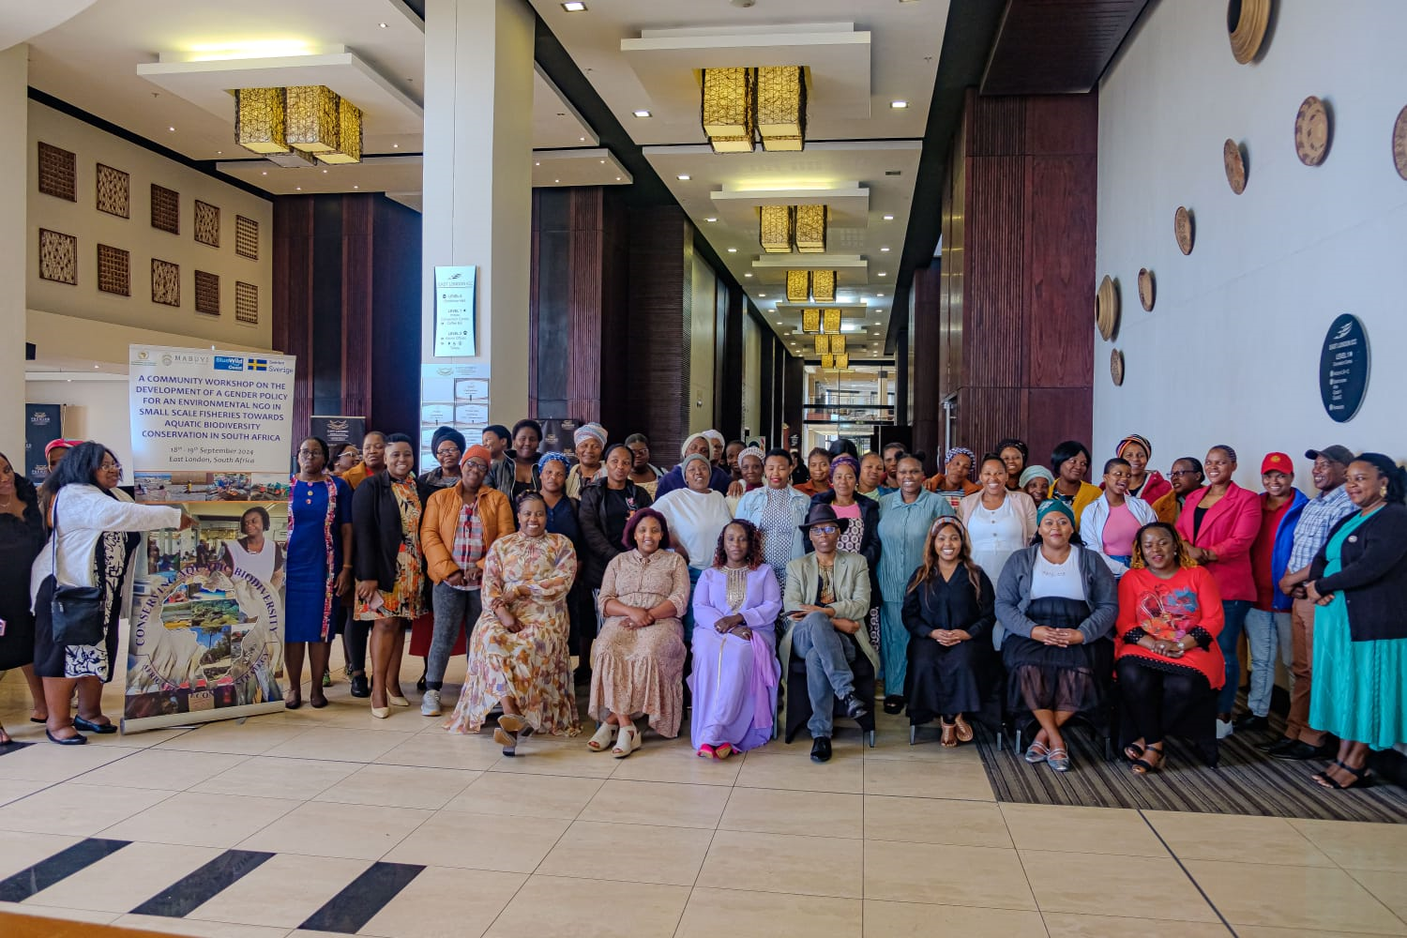
RECOMMENDATIONS
INFRASTRUCTURE DEVELOPMENT
SKILLS UPLIFTMENT FOR WOMEN
YOUTH PROGRAMS/DOCUMENTARY
SUPPORT WITH TOOLS OF TRADE
ACCESS TO MARKETS

Slide 24
10. RECOMMENDATIONS
Key result area | Recommendation
Alignment of authorisations | Align municipal planning legislation with policies that govern aquatic biodiversity/ fisheries. The latter would facilitate joint monitoring of aquatic biodiversity practices by municipalities (In line with section 2 (2) of the Spatial Planning and Land Use Management Act, Act 16 of 2013). Due to the Wall-to-Wall schemes that were introduced through SPLUMA, alignment of authorisations must be prioritised to facilitate effective monitoring and biodiversity protection.
Strengthened Intergovernmental relations | The latest government intervention, The District Development Model (DDM) may be used as a platform to facilitate better intergovernmental coordination is this regard. Gender mainstreaming in aquatic biodiversity should be a standing agenda item in coastal districts across the republic.

Slide 25
10. RECOMMENDATIONS
Key result area | Recommendation
Policy interventions/ Government intervention/Special programs | A lack of skills is one of the most prominent challenges that negatively impact fisheries sector in the study areas. It is therefore recommended that skills programmes be implemented to the targeted groups in this regard. Implementation of interventions that will be outlined in the Gender policy would be of key importance.

Slide 26
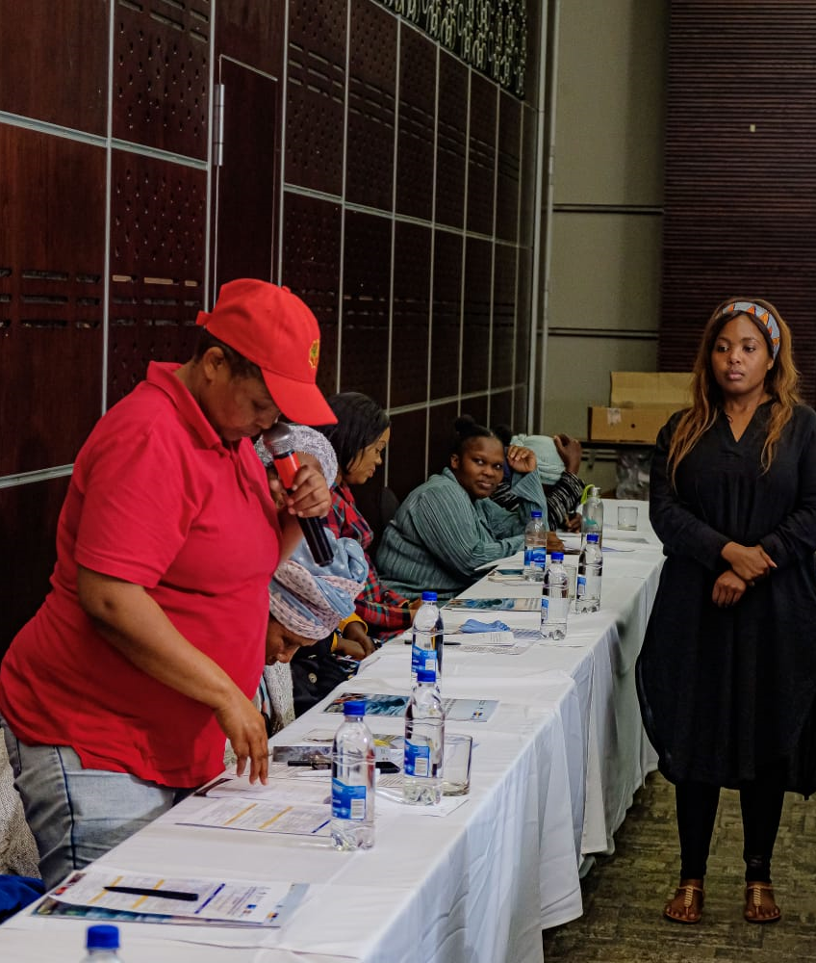
10. RECOMMENDATIONS
It is recommended that the committee notes:
Progress made in supporting BWC NPO on compilation of a ‘Gender Plan of Action’.
The intervention made by the AU-IBAR in strengthened IGR for SA.
The required support to facilitate sustainability of this intervention.

Slide 27
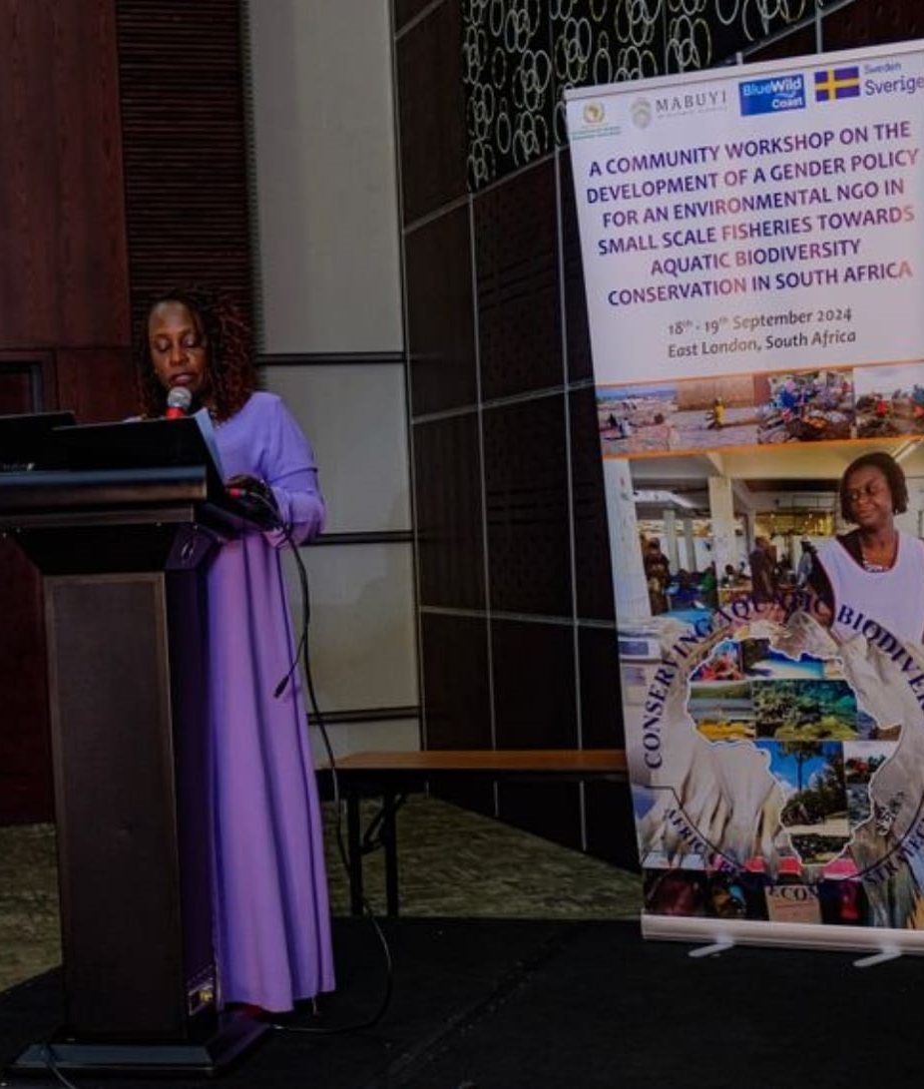
11. WAY FORWARD
MoU’S with key stakeholders
Consideration of set performance targets and implementation of the Gender Plan of action
Monitoring and evaluation of progress
Review of commitments made

Slide 28

Thank You
Zintle Lushaba (A/1847/2014)
083 527 0673 / 079 777 6898
info@mabuyi.co.za

