Slide 1



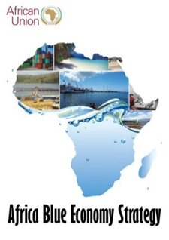


CONSERVING AQUATIC BIODIVERSITY IN AFRICAN BLUE ECONOMY
Third Project Technical Committee Meeting
STATUS OF IMPLEMENTATION
7-8 October 2024
Mombasa, Kenya

Slide 2
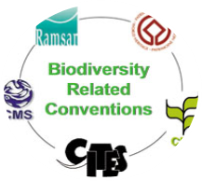
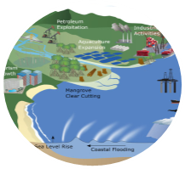
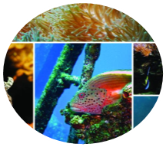
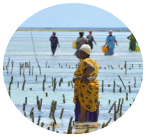
Strategic Objectives of the Aquatic Project
OBJECTIVE
To enhance the policy environment, regulatory frameworks and institutional capacities of AU Member States and Regional Economic Communities to sustainably utilize and conserve aquatic biodiversity and ecosystems.
Support AU–MS to ratify and/or align relevant International/Regional Instruments related to blue economy themes (with specific reference to protecting and conserving biodiversity)
Optimizing conservation and sustainable use of biodiversity while minimizing conflicts among blue economy sub-themes
Strengthening measures for mitigating the negative impacts of coastal and marine tourism, oil, gas, deep sea mining and climate change on aquatic biodiversity and environment
Strengthening gender inclusivity in aquatic biodiversity conservation and environmental management

Slide 3
2023 Workplan
Driving implementation of Project’s Strategic Objectives
SO1: Ratify and/or Align relevant international/regional instruments - 2 Outputs:
  Mechanisms for active participation of MSs in continental and global initiatives developed;
  Ratification and implementation of conventions and agreements supported;
SO2: Optimizing conservation and sustainable biodiversity - 3 Outputs:
  Enforceable regulatory frameworks for effective MCS systems developed;
  A framework for establishing national, regional and transboundary cooperation
  Capacities for restoring and conserving threatened aquatic biodiversity and environment strengthened.
SO3: Strengthening measures for mitigating the negative impacts of coastal and marine tourism, oil, gas, deep sea mining and climate change -2 Outputs:
  Measures for minimizing the negative impacts of climate change on biodiversity ;
  Strategies for an integrated framework for sustainable coastal and marine tourism and mining developed ;
SO4: Strengthening gender inclusivity in aquatic biodiversity conservation and environmental management-1 Output:
  Continental strategy for gender inclusivity in aquatic biodiversity and environmental management developed ;

Slide 4
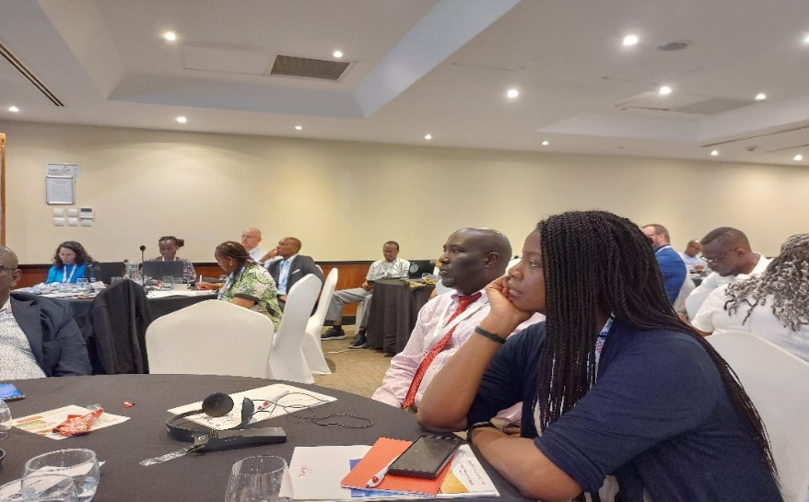
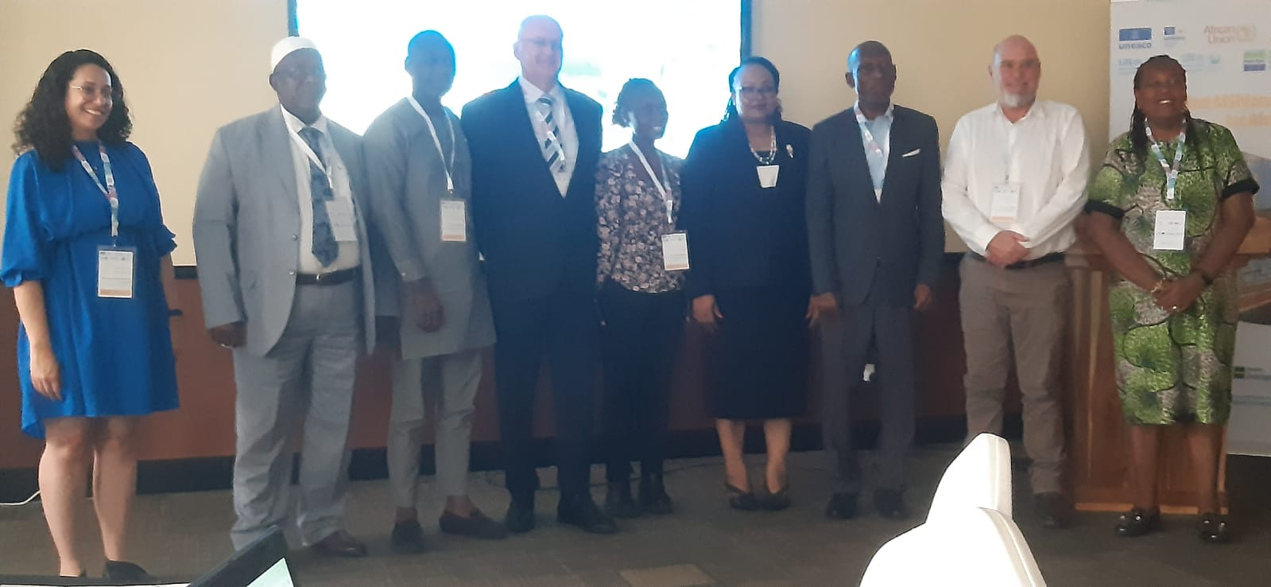
SO1: Ratify and/or Align relevant international/regional instruments related to blue economy themes (with specific reference to conserving biodiversity)–
Output/Activity | PROGRESS TO DATE
Output 1.1: Mechanisms for active participation of MSs in continental and global initiatives developed
The project sponsored the participation of experts from DR Congo and Kenya to the 2nd MSP forum in Dar Es Salam; to share information on the status of MSP in the continent, for different players in MSP to profile their contribution and aspirations towards MSP Contribution by the project to the forum: Shared perspective on ABES and MSP as enabler of blue economy; for instance, the ABES urged Member States to institutionalize MSP to allocate specific spaces for maritime activities and ecosystem conservation 2. Guided stakeholders on issues of regional MSP processes, roles of regional institutions (e.g. RECs), mechanism of engagement with policy makers on MSP processes; data for MSP

Slide 5
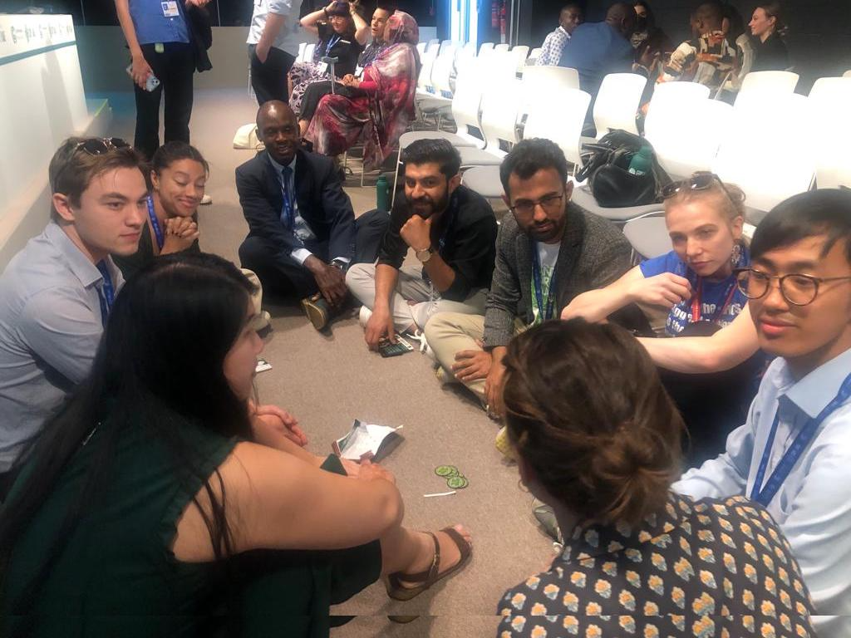
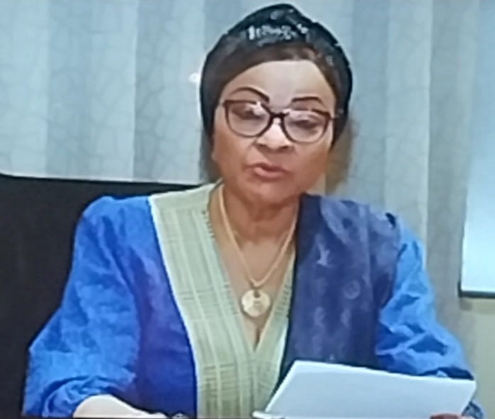
SO1: Ratify and/or Align relevant international/regional instruments related to blue economy themes (with specific reference to conserving biodiversity)–
Output/Activity | PROGRESS TO DATE
Output 1.1: Mechanisms for active participation of MSs in continental and global initiatives developed
The project supported the participation of: experts from Kenya, Togo and Zimbabwe) to the UNFCCC COP 28 side events– in United Arab Emirates dates, 9-10 December 2023 ii. high level AU personnel, in the person of HE, Amb Yosefa Sacko; who gave a presentation on AU perspectives on and progress being made to address climate change Project resource persons engaged AU stakeholders at the following side events? Empowering Youth on Climate Leadership, Access to Climate Finance, Capacity Building and Technology AUC Climate Finance for Agriculture and Food Security: Implementation of Nairobi Declaration on Climate Finance and Green Growth in Africa AfDB Insurance for Climate Change Adaptation: advancing partnerships and resource mobilization for the Africa Climate Risk Insurance Facility for Adaptation African Group of Negotiators Briefing on the African Common Position at UNFCCC COP28.

Slide 6
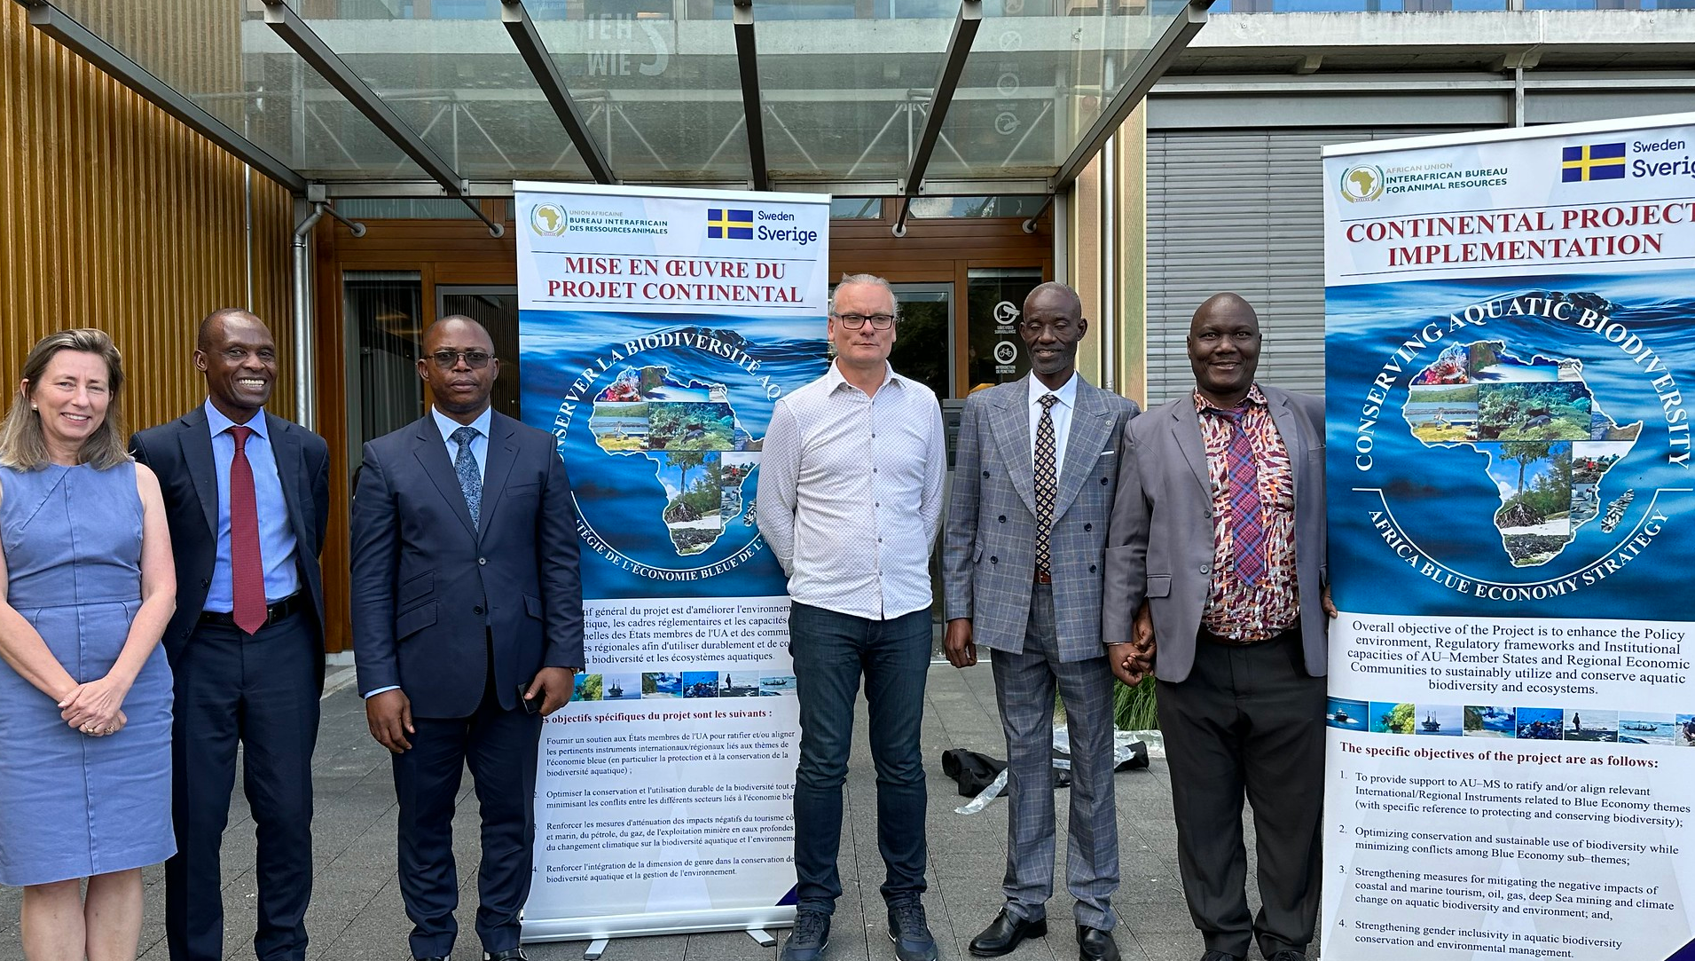
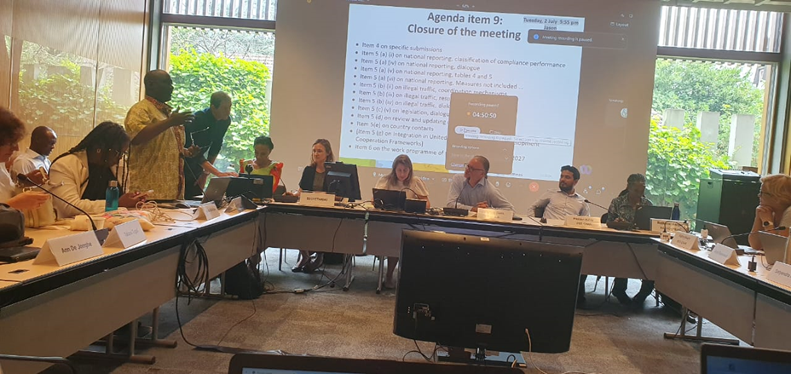
SO1: Ratify and/or Align relevant international/regional instruments related to blue economy themes (with specific reference to conserving biodiversity)–
Output/Activity | PROGRESS TO DATE
Output 1.1: Mechanisms for active participation of MSs in continental and global initiatives developed
Participation in the 16th meeting of the Committee on administering the Mechanism for Promoting Basel convention on 28th June 2024- 3rd July 2024 Geneva, Switzerland. The main aim of the Basel convention is to protect human health and the environment against the adverse effects that may result from the generation, transboundary movements and management of hazardous and other wastes AU-IBAR was officially given Observer Status Sensitized the Compliance Committee the impact of plastics pollution on aquatic biodiversity conservation and environment in Africa aquatic ecosystems AU-IBAR interacted and provided guidance and support to the delegates from DR Congo and the Rep of Uganda for informed positions into the final adopted report of the meeting of the Compliance committee | At the Basel Convention Secretariat; increasing visibility of AU-IBAR, project and donor AU AU-IBAR consultant making a case to the compliance committee on impacts of wastes (e.g. plastic wasteas and other hazardous materials) on African aquatic ecosystems and associated biodiversity | At the Basel Convention Secretariat; increasing visibility of AU-IBAR, SIDA project and donor AU-IBAR making a case to the compliance committee on impacts of. plastic wastes on African aquatic ecosystems and associated biodiversity

Slide 7
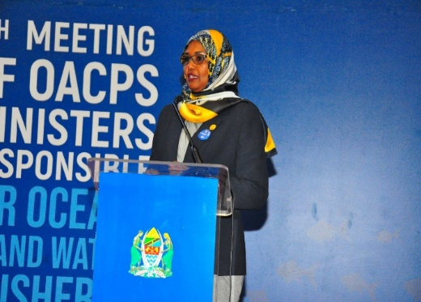
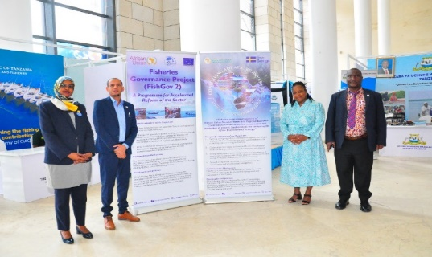
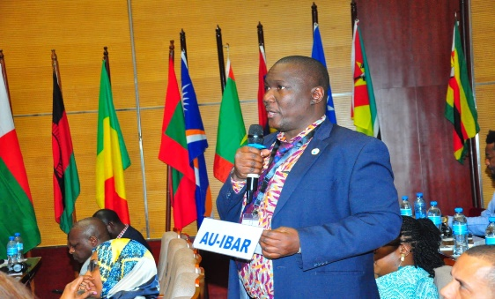
SO1: Ratify and/or Align relevant international/regional instruments related to blue economy themes (with specific reference to conserving biodiversity)–
Output/Activity | PROGRESS TO DATE
Output 1.1: Mechanisms for active participation of MSs in continental and global initiatives developed
8th Session of (OACPS) of Ministers responsible for Oceans, inland waters and fisheries, Dar es Salaam, Tanzania, 9-11th September, 2024 -AU-IBAR informed on the activities of AU-IBAR with regards fisheries, aquaculture and aquatic conservation on the African continent and recommendations on mechanism of enhancing collaboration with the Secretariat of OACPS - AU-MS to ratify, domesticate and implement the UN Treaty on Biodiversity Beyond National Jurisdiction (BBNJ). AU-IBAR established contacted with and had a fruitful discussion with the representative of CITES (Convention of International Trad in Endangered Species; the discussions initiated collaborative arrangements to support AU members on issues of Aquatic biodiversity conservation. GLOBAL REGIMES SEEKING COLLBORATION TO SUPPORT AU MEMBER STATES in CITES; RAMSAR, MALPOL GLOBAL REGIMES SEEKING COLLBORATION TO SUPPORT AU MEMBER STTAESCITES; RAMSAR, MALPOL | At the Basel Convention Secretariat; increasing visibility of AU-IBAR, project and donor AU AU-IBAR consultant making a case to the compliance committee on impacts of wastes (e.g. plastic wasteas and other hazardous materials) on African aquatic ecosystems and associated biodiversity

Slide 8
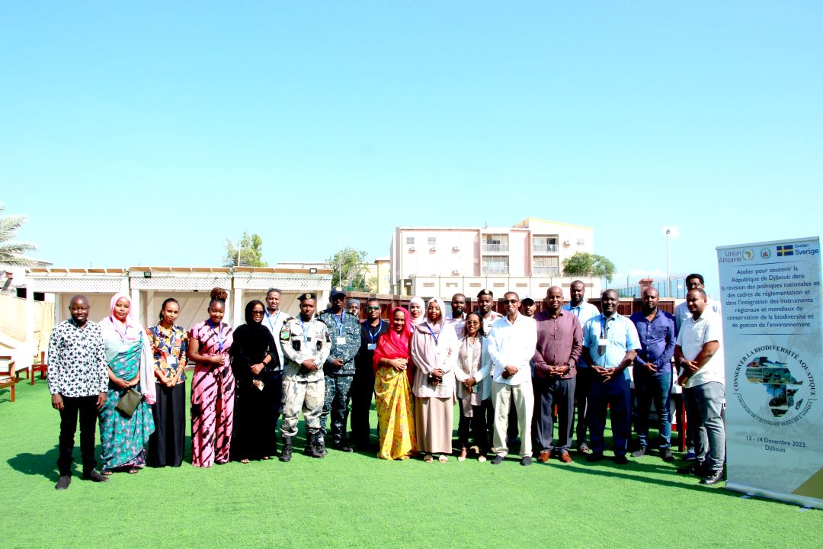
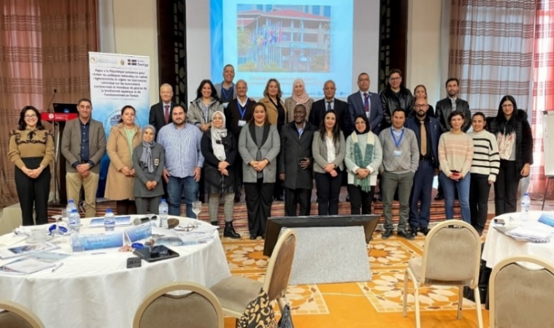
SO1: Ratify and/or Align relevant international/regional instruments related to blue economy themes (with specific reference to conserving biodiversity)–Cont’d
Output/Activity |  | PROGRESS TO DATE
Output 1.2. Ratification and implementation of conventions and agreements related to conservation of aquatic biodiversity e
AU-IBAR provided support to the Republic of Djibouti and Tunisia to review and align National Policies, Regulations and align National Instruments with relevant Global biodiversity and environmental management Instruments; | Delegates at the Djibouti meeting, 13th – 14th December, 2023 Delegates at the Tunisia meeting, 21st – 22nd February, 2024 | Delegates at the Djibouti meeting, 13th – 14th DECEMBER, 2023 Delegates at the Tunisia meeting, 21st – 22nd February, 2024

Slide 9
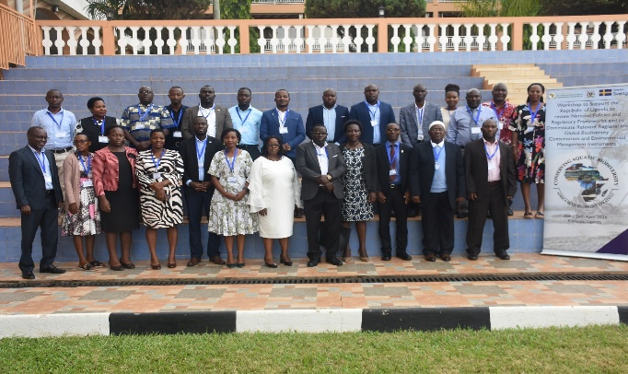
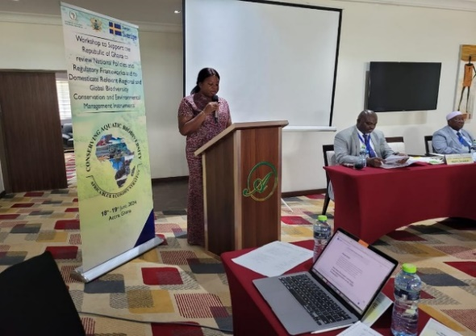
SO1: Ratify and/or Align relevant international/regional instruments related to blue economy themes (with specific reference to conserving biodiversity)–Cont’d
Output/Activity | PROGRESS TO DATE
Output 1.2. Ratification and implementation of conventions and agreements related to conservation of aquatic biodiversity –
The Project supported the Republic s of Uganda and Ghana to align and domesticate relevant Global and Continental Instruments related to aquatic biodiversity conservation and environmental management Ongoing planning to support Lesotho and other AU member states | Delegates at the meeting, 25th – 26th April, 2024 Kampala , Her excellence Ophelia M. Hayford–the Hon. Minister for Ministry of Environment, Science Technology and Innovation – Government of the Republic of Ghana during the Opening session | Delegates at the meeting, 25th – 26th April, 2024 Kampala , Her Excellency Ophelia M. Hayford–the Hon. Minister for Ministry of Environment, Science Technology and Innovation – Government of the Republic of Ghana during the Opening session

Slide 10
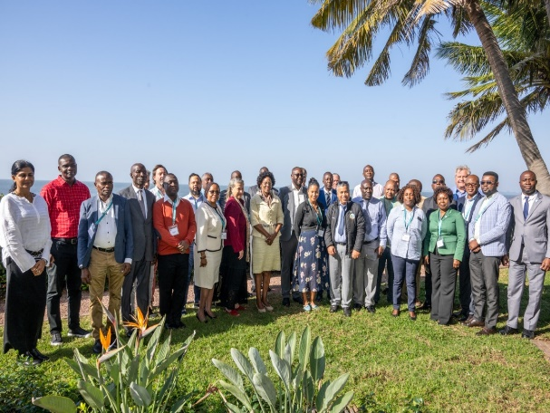
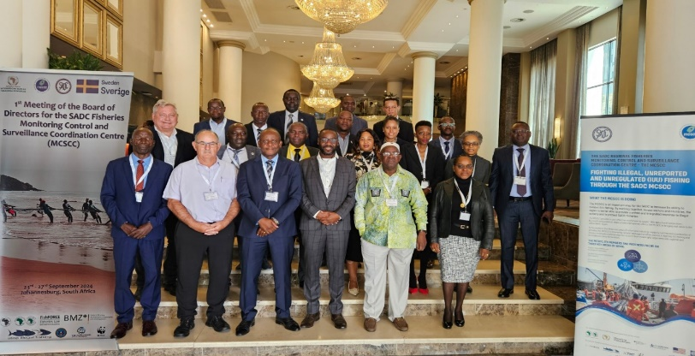
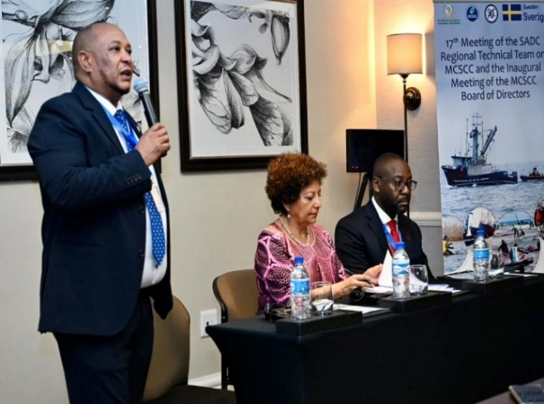
SO2: Optimizing conservation and sustainable biodiversity while minimizing conflicts among users of blue economy resources.–
Output/Activity | PROGRESS TO DATE
Output 2.1 Enforceable regulatory frameworks for effective and sustainable regional Monitoring Control and Surveillance (MCS) systems developed
In collaboration with the SADC Secretariat, supported the orientation meeting and first meeting of the newly appointed Board of Directors of the SADC (MCSCC) on key documents (e.g. development of two-year workplan, terms of reference for the staff at the secretariat of the MCSCC). Outstanding : to support purchase of equipment, development of strategic plan, operationalization of Regional technical team and board meeting | MCSCC BOD including the regional technical team (RTT) of the SADC region posing for a group photo. Dr. Motseki Hlatshwayo giving introductory remarks during the SADC BOD meeting in Maputo, 19/06/2024; Center - The Minister for Sea, Inland waters and Fisheries, Dr Lidia Cardoso and right – Mr Stanley Ndara, incoming chairman of the BOD of Directors. | MCSCC BOD including the regional technical team (RTT) of the SADC region posing for a group photo. Dr. Motseki Hlatshwayo giving introductory remarks during the SADC BOD meeting in Maputo, 19/06/2024; Center - The Minister for Sea, Inland waters and Fisheries, Dr Lidia Cardoso and right – Mr Stanley Ndara, incoming chairman of the BOD of Directors.

Slide 11
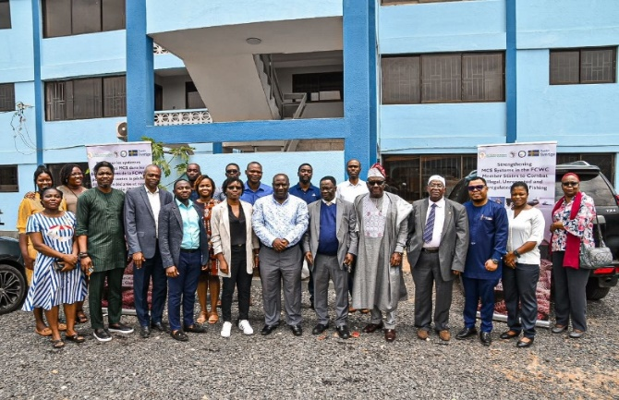
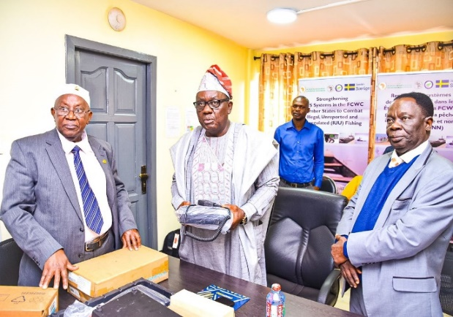
SO2: Optimizing conservation and sustainable biodiversity while minimizing conflicts among users of blue economy resources
Output/Activity | PROGRESS TO DATE
Output 2.1 Enforceable regulatory frameworks for effective and sustainable regional Monitoring Control and Surveillance (MCS) systems developed
Purchase and handed over MCS equipment to FCWC to enhance capacity of the West African regional MCS coordinating centre as well as the 6 constituent member states (Benin, Cote D’Ivoire, Nigeria, Liberia, Togo and Ghana) to effectively combat IUU and protect aquatic biodiversity Equipment included: SSB, VHF, HF, GPS, mobile phones and tables Outstanding: Training CMAs in the 6 AU MSs on use of the equipment and on their role in aquatic biodiversity conservation and environment | Group photo with the Hon. Minister in charge of agriculture and fisheries in Benin Handing over the MCS equipment to the Hon. Minister in the presence of the Secretary, FCWC | Group photo with the Hon. Minister in charge of agriculture and fisheries in Benin Handing over the MCS equipment to the Hon. Minister in the presence of the Secretary, FCWC

Slide 12
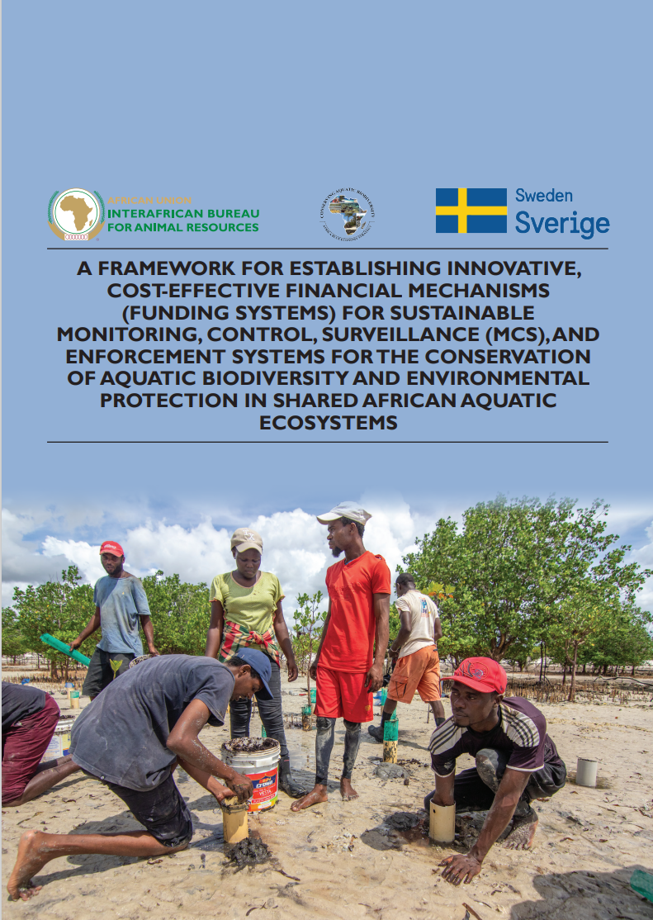
SO2: Optimizing conservation and sustainable biodiversity while minimizing conflicts among users of blue economy resources.–
Output/Activity | PROGRESS TO DATE
Output 2.1 Enforceable regulatory frameworks for effective and sustainable regional Monitoring Control and Surveillance (MCS) systems developed
Framework for Sustainable financing mechanism for Regional MCS centre in South-East Africa National governments fund MCS activities through regular contributions from their own budget; Contributions from the local or foreign fishing industry; Revenue from Distant Water Fishing Nations Foreign licensing fees or contributions from FPA Payment from users of MCS services, such as fishing vessels for the use of VMS; Port and bunkering services at harbour Outstanding: roll-out the report in two regional institutions

Slide 13
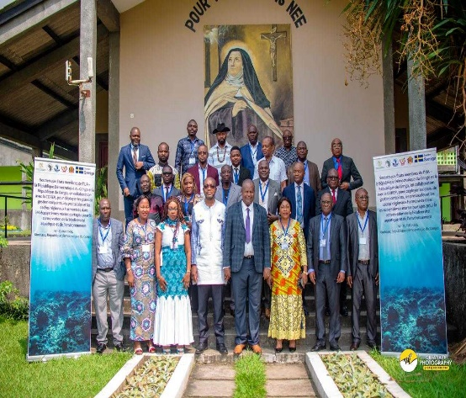
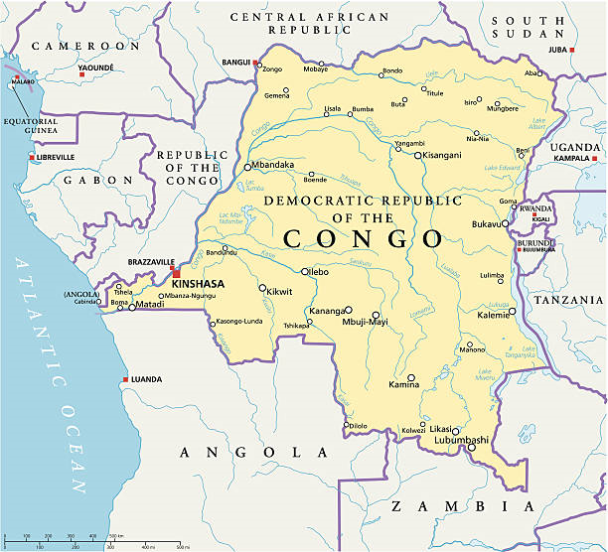
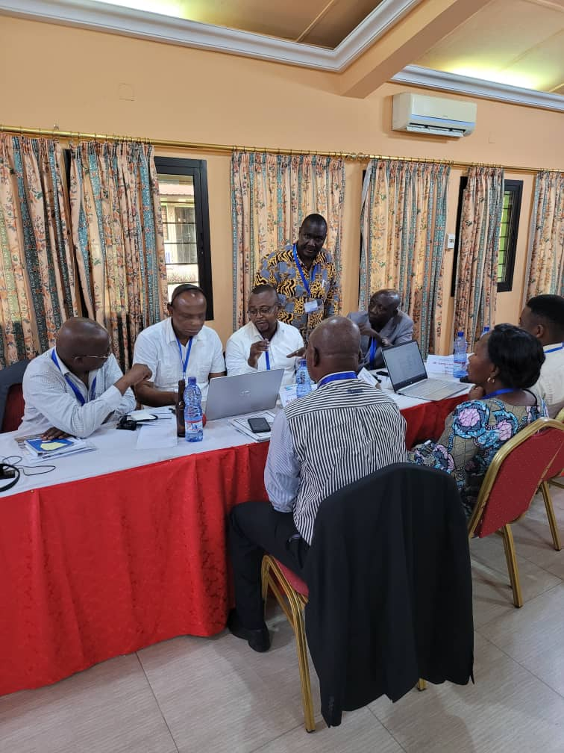
SO2: Optimizing conservation and sustainable biodiversity while minimizing conflicts among users of blue economy resources.–
Output/Activity | PROGRESS TO DATE
Output 2.2. A framework for establishing national, regional and transboundary cooperation on Africa Blue Economy Strategy Thematic Areas established
In collaboration with COREP, the project supported the Republic of Congo and the DR Congo to develop harmonized national strategies for management of transboundary marine ecosystems shared between the two countries Map of the Shared marine ecosystems in the Gulf of Guinea between the two countries | Group photo; In Kinshasa to support DR Congo Congo for harmonized management of shared marine ecosystems Group discussions: Participants from DR Congo and Republic of Congo Congo.

Slide 14
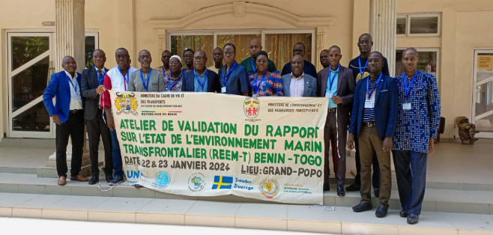
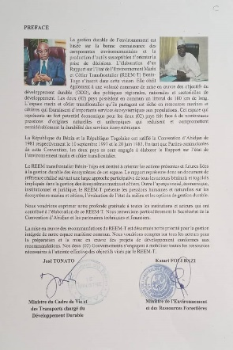
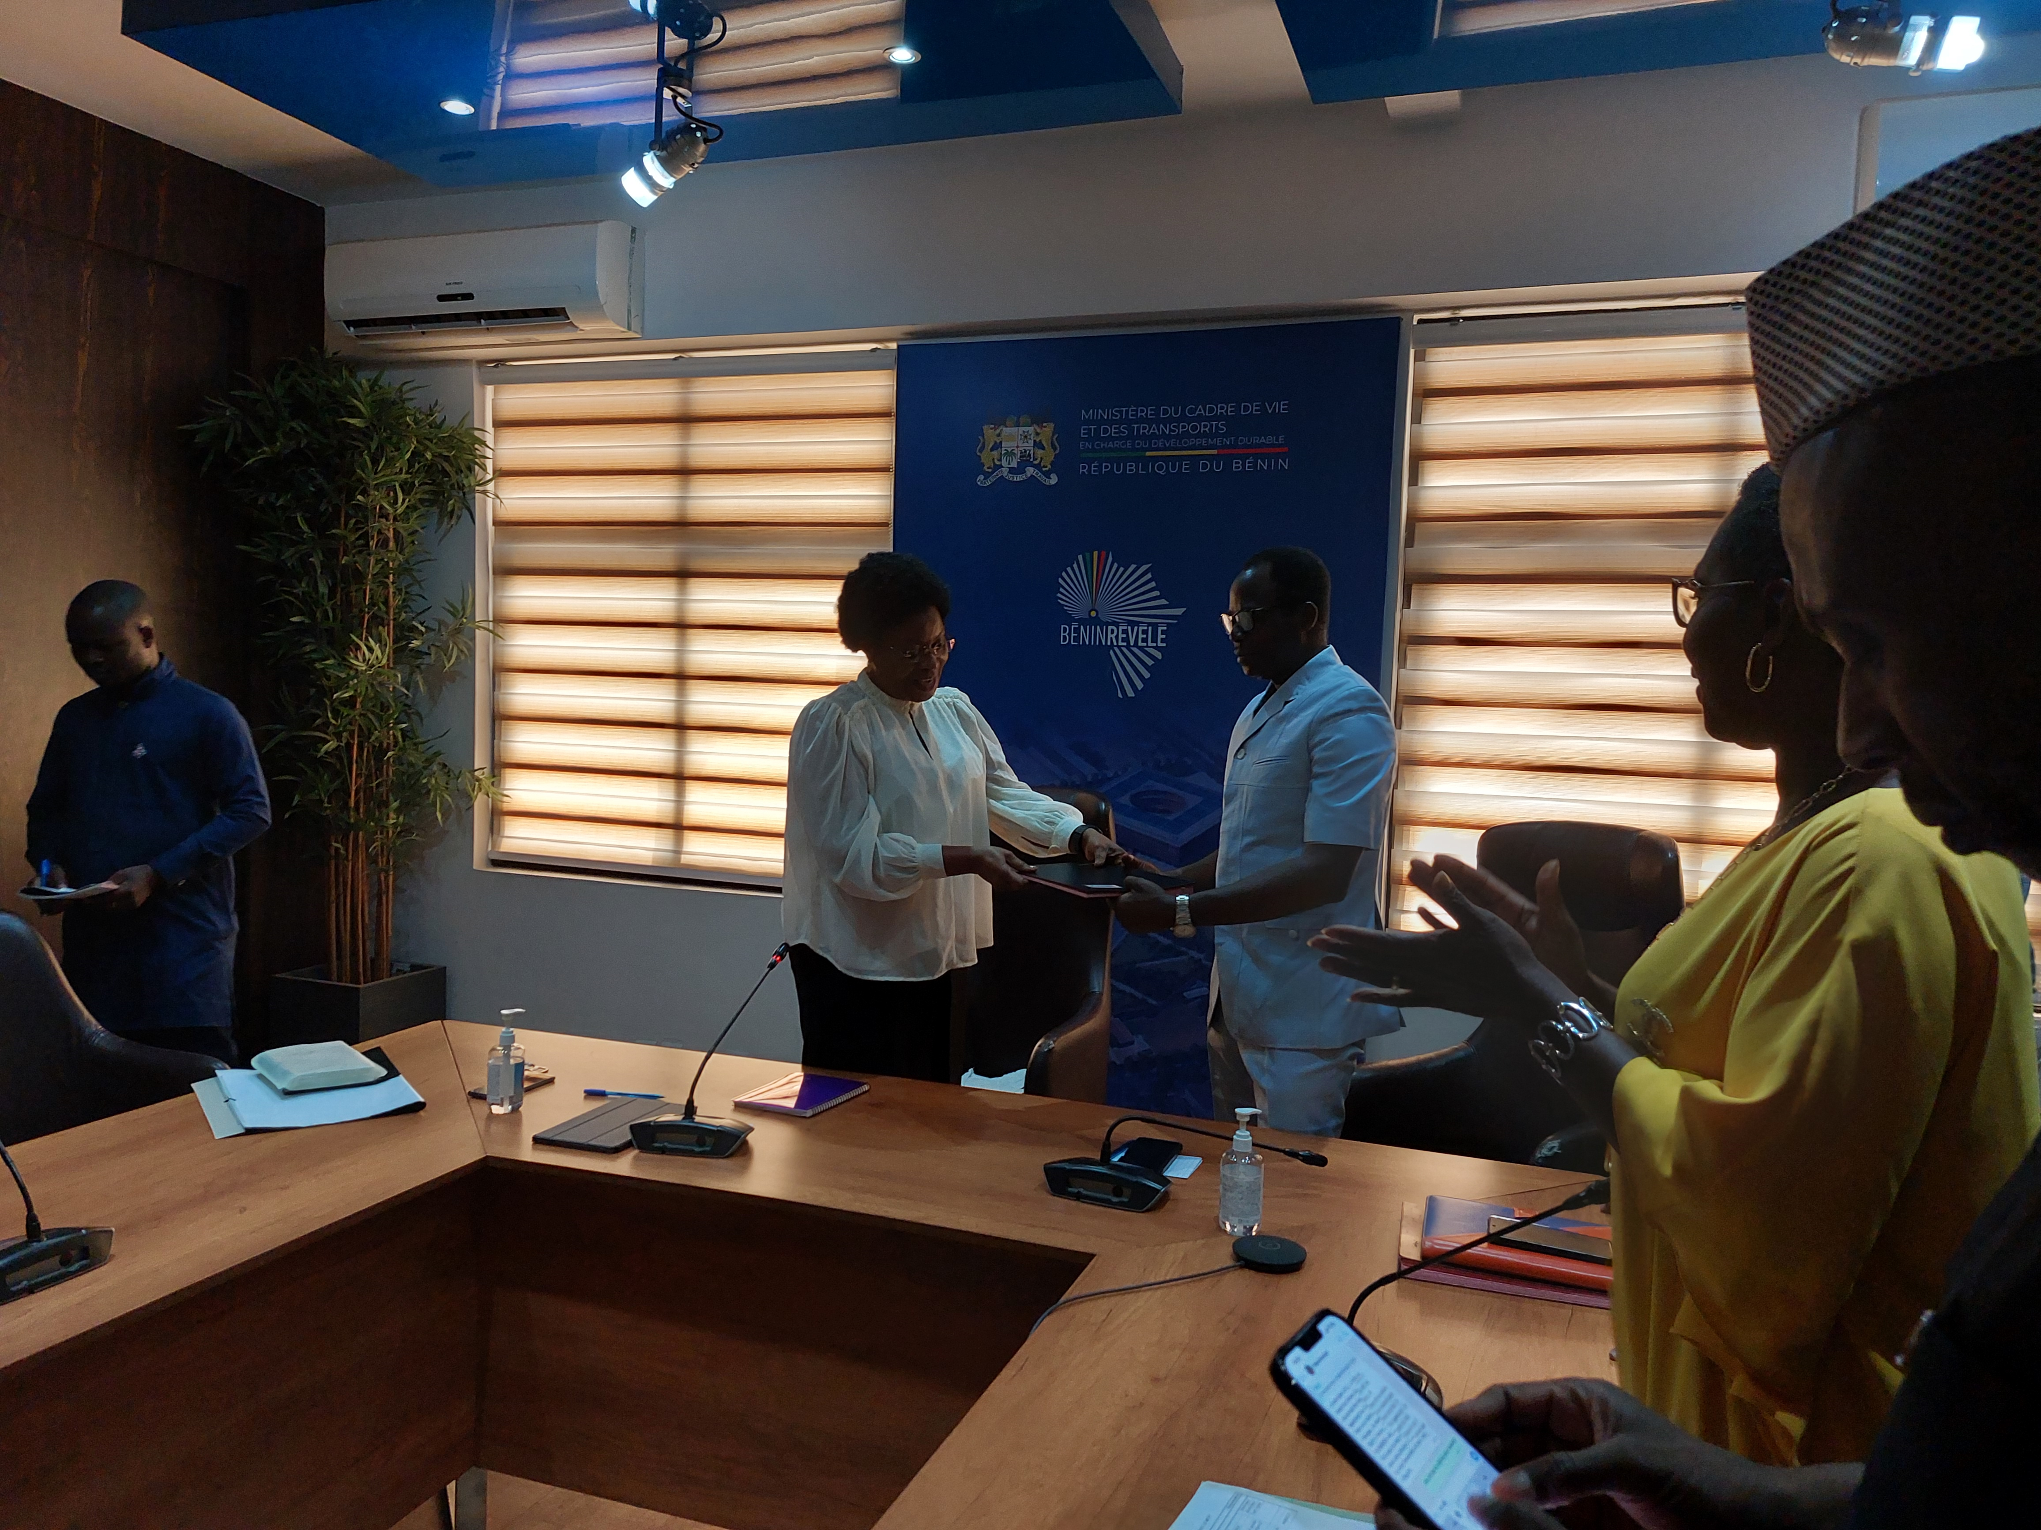
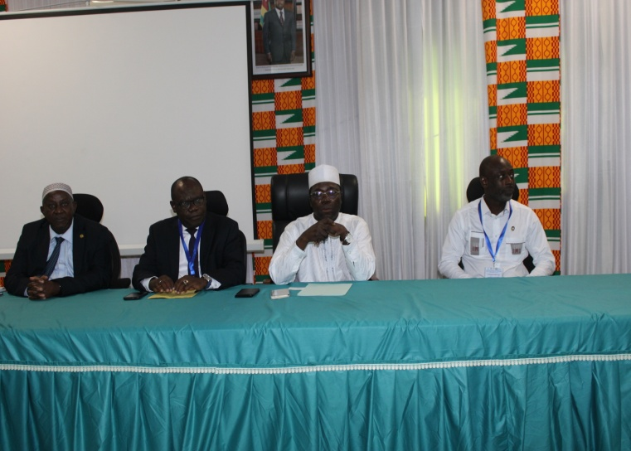
SO2: Optimizing conservation and sustainable biodiversity while minimizing conflicts among users of blue economy resources.–
Output/Activity | PROGRESS TO DATE
Output 2.2. A framework for establishing national, regional and transboundary cooperation on Africa Blue Economy Strategy Thematic Areas established - 2.2.2. Formulate mechanisms to institutionalize Marine Spatial Planning (MSP) at national and regional levels
The Project collaborated with Abidjan Convention to support : Two technical consultations in Benin and Togo to review the Report on the State of the Transboundary Coastal and Marine Environment (SoME) to obtain national perspectives Joint technical consultation to technically validate the report Ministerial endorsement of the report which is a critical step in the transboundary MSP |  | The Benin-Togo cross-border marine and coastal zone is very rich in biodiversity but under pressure of pollutions, unsustainable practices

Slide 15
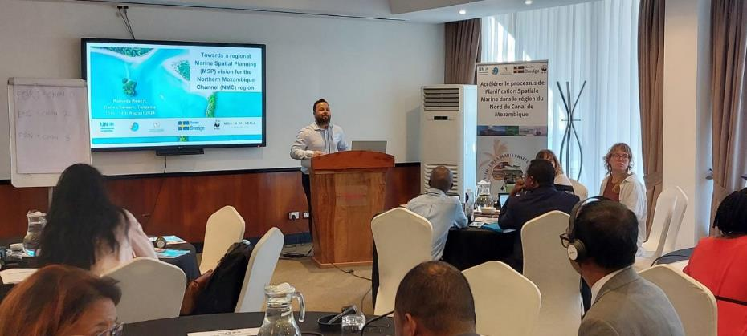
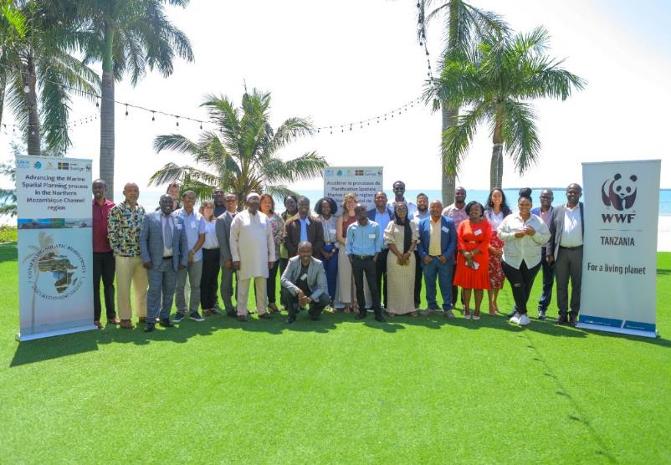
SO2: Optimizing conservation and sustainable biodiversity while minimizing conflicts among users of blue economy resources.–
Output/Activity | PROGRESS TO DATE
Output 2.2. A framework for establishing national, regional and transboundary cooperation on Africa Blue Economy Strategy Thematic Areas established -2.2.2. Formulate mechanisms to institutionalize Marine Spatial Planning (MSP) at national and regional levels
The project collaborated with WWF and Nairobi Convention to advance the MSP process in the Northern Mozambique channel (NMC) in the Indian by ocean shared Mozambique, Madagascar, Tanzania and Comoros. The meeting received feed back from stakeholders and validated on common NMC MSP vision and roadmap. Discussed and ascertained boundaries of the NMC region; identified regional authorities and technical WGs for the MSP process Reviewed and expert validation of the technical regional guidelines for the MSP in the NMC AU-IBAR shared the continental guidelines on MSP The (NMC – a recognised ecologically or biologically area of significant importance – has long been a haven for marine and coastal biodiversity. orthern Mozambique Channel | Ed Representative of WWF- Mr Eduardo Group photo of delegates at the MSP meeting on NMC | Ed Representative of WWF- Mr Eduardo Group photo of delegates at the MSP meeting on NMC

Slide 16
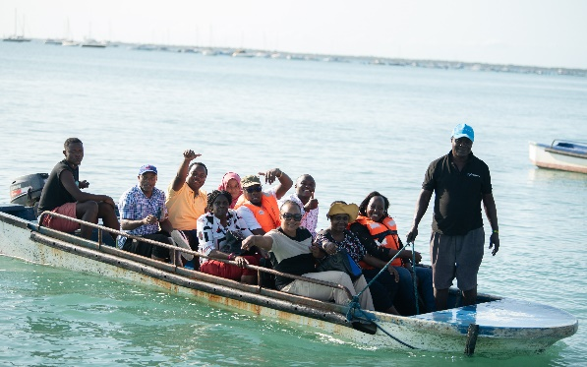
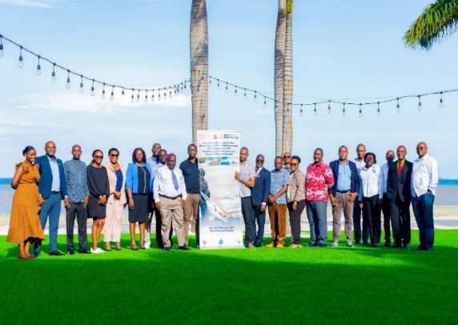
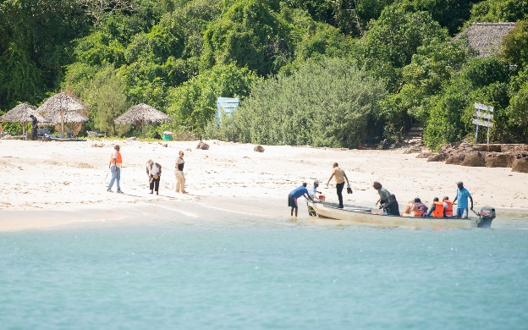
SO2: Optimizing conservation and sustainable biodiversity while minimizing conflicts among users of blue economy resources.–
Output/Activity | PROGRESS TO DATE
Output 2.3. Capacities for restoring and conserving threatened aquatic biodiversity and environment strengthened; 2.3.1 Support rehabilitation of depleted aquatic biodiversity and habitats (MPA)
Project supported Kenya and Tanzania) towards joint management of transboundary marine conservation area (TBCA). Expert national consultative processes separate in Kenya and Tanzania to develop a country roadmap for TBCA Joint technical meetings; mixture of technical and legal experts to identify elements MOU to operationalize joint management Meeting of legislators or parliamentarians from both countries | Hon. Members of Parliament in Tanzania and Kenya and other participants visited the transboundary marine reserve to assess and also view other livelihoods options

Slide 17
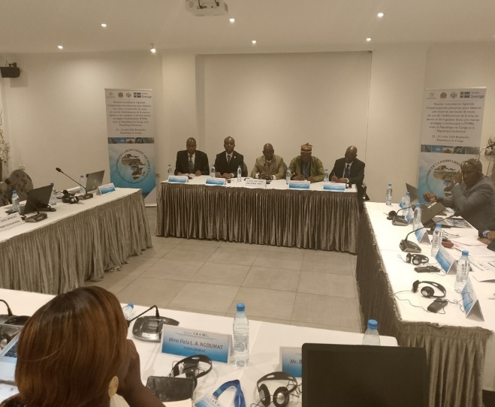
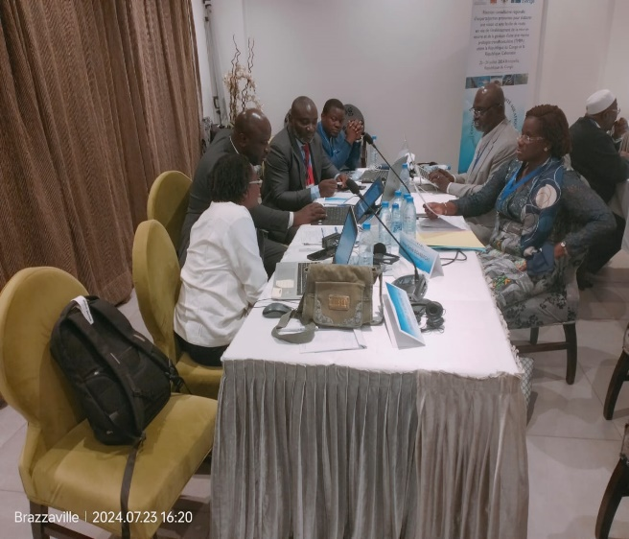
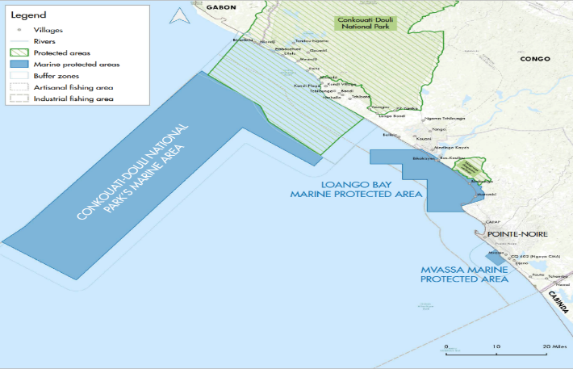
SO2: Optimizing conservation and sustainable biodiversity while minimizing conflicts among users of blue economy resources.–
Output/Activity | PROGRESS TO DATE
Output 2.3. Capacities for restoring and conserving threatened aquatic biodiversity and environment strengthened; 2.3.1 Support rehabilitation of depleted aquatic biodiversity and habitats (MPA)
In collaboration with COREP, the developed A Roadmap for Enhanced Governance of The Transboundary MPA (TMPA) Between Republics of Congo and Gabon in the binational Mayumba Conkouati shared area The protected area is home to extraordinarily diverse range of fauna, with marine species such as manatees, turtles, dolphins and whales The consultative identified challenges and priority issues for enhancing joint governance of the TMPA; developed a common vision and roadmap towards enhancing the joint management | Hon. Members of Parliament and other participants being taken to Bomoyo island within the transboundary marine reserve to assess and also view other livelihoods options

Slide 18
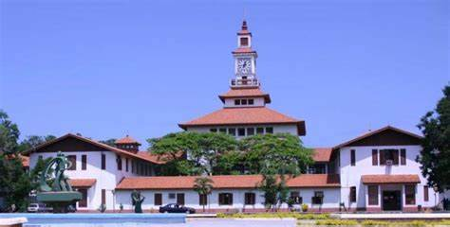
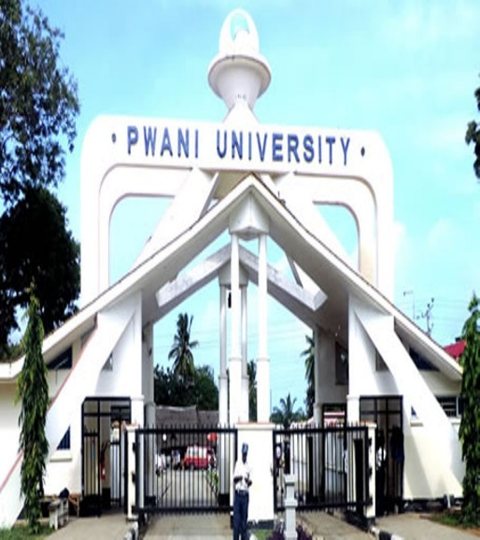
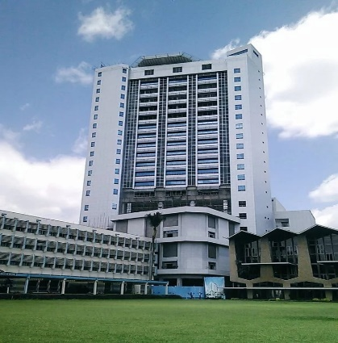
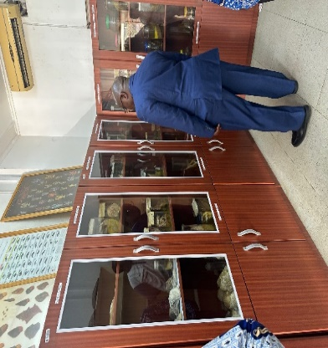
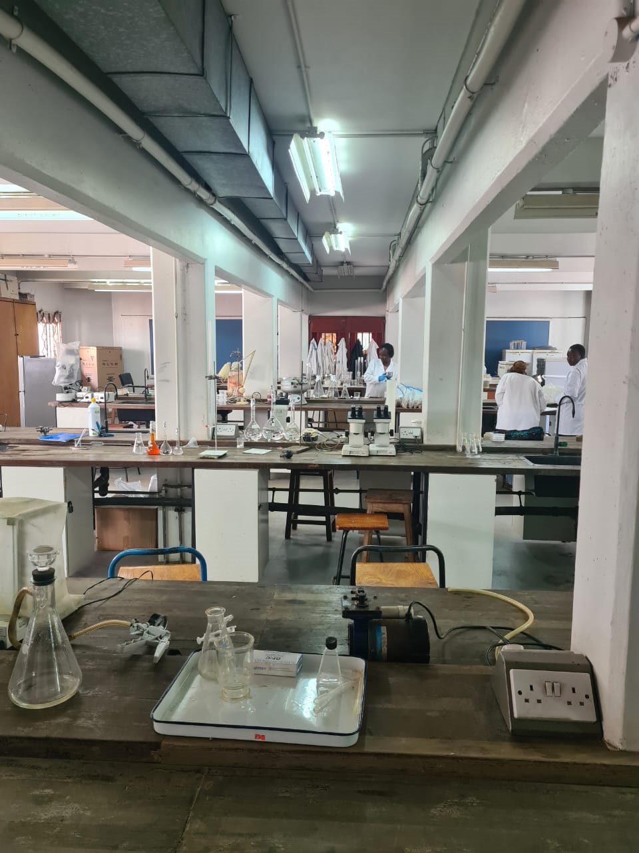
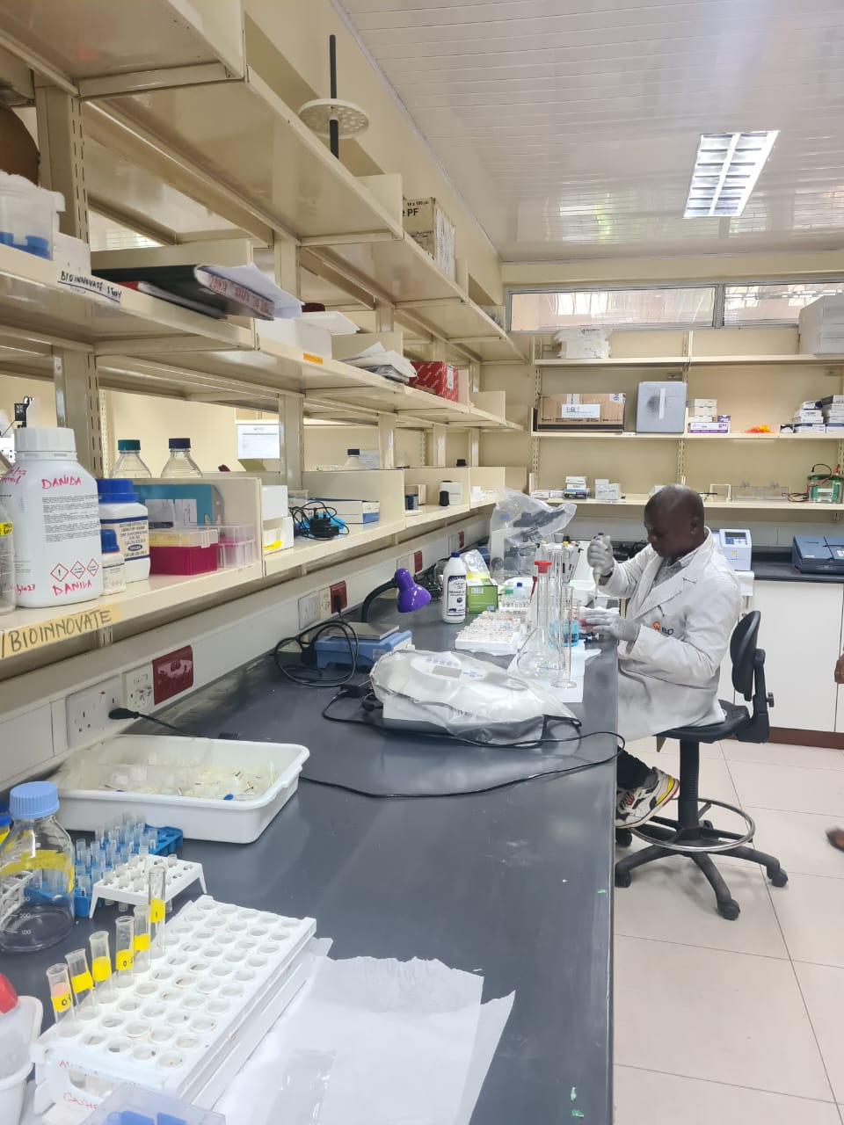
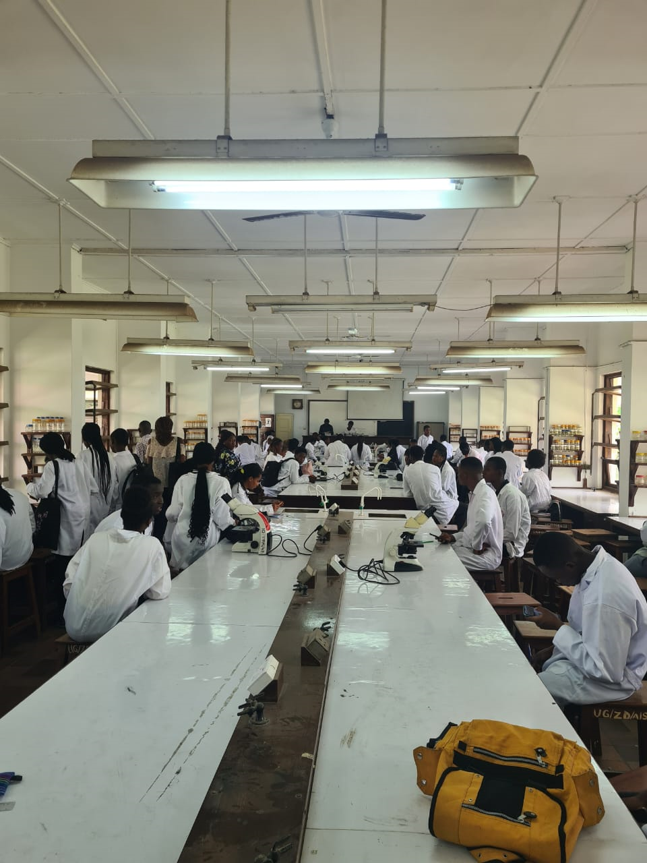
SO2: Optimizing conservation and sustainable biodiversity while minimizing conflicts among users of blue economy resources.–
Output/Activity | PROGRESS TO DATE
Output 2.3. Capacities for restoring and conserving threatened aquatic biodiversity and environment strengthened; Establish Continental Centres of Excellence for capacity building on aquatic biodiversity
University of Ghana Pwani University | Hon. Members of Parliament and other participants being taken to Bomoyo island within the transboundary marine reserve to assess and also view other livelihoods options | University of Nairobi

Slide 19
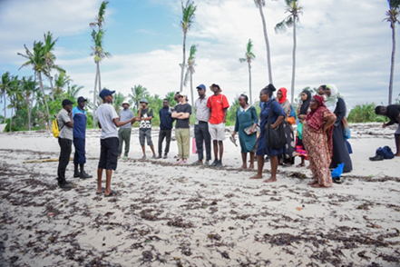
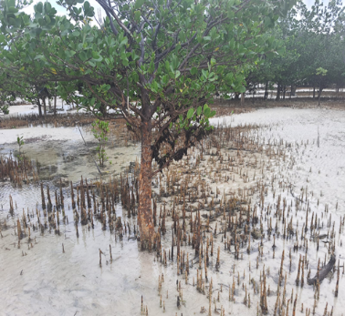
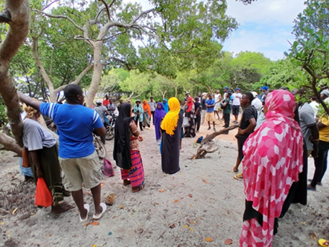
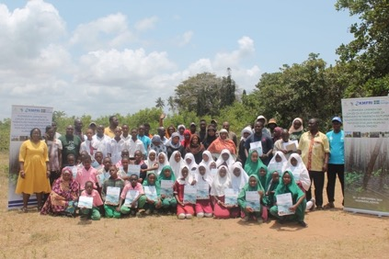

SO3. Strengthening measures for mitigating the negative impacts of coastal and marine tourism, oil, gas, deep sea mining and climate change on aquatic biodiversity and environment
Output/Activity |  | PROGRESS TO DATE
Output 3.1 Measures for minimizing the negative impacts of climate change on biodiversity and environment strengthened and implemented - 3.1.1. Mitigate the impact of climate change on aquatic biodiversity: Gazi bay Community
In collaboration with KEMFRI, the project conducted trained 50 community members in the Gazi Bay on nature-based solutions on ecological restoration of mangrove forests towards aquatic biodiversity conservation Restoration of degraded mangrove areas in Gazi Bay Ecological restoration techniques, carbon trading, alternative livelihoods, ecotourism, aquaculture farming, and beekeeping. Community woodlot establishment and orchid cultivation.

Slide 20



SO3. Strengthening measures for mitigating the negative impacts of coastal and marine tourism, oil, gas, deep sea mining and climate change on aquatic biodiversity and environment
Output/Activity |  | PROGRESS TO DATE
Output 3.1 Measures for minimizing the negative impacts of climate change on biodiversity and environment strengthened and implemented - 3.1.1. Mitigate the impact of climate change on aquatic biodiversity: ZANZIBAR SEAWEED
In collaboration with Zanzibar Seaweed Culture initiative, the project organized a field mission to strengthen conservation and climate change mitigation efforts among Seaweed Farming communities in Zanzibar Jointly prepared a National Seaweed Day where an Expert presentation for sensitization of seaweed farmers on environmental climate change issues during the National Seaweed Day.

Slide 21




SO3. Strengthening measures for mitigating the negative impacts of coastal and marine tourism, oil, gas, deep sea mining and climate change on aquatic biodiversity and environment
Output/Activity | PROGRESS TO DATE
OUTPUT 3.2. Strategies for an integrated strategic framework for sustainable coastal and marine tourism and mining developed
The Project collaborated with the Governments of Egypt and Angola to develop master plan to strengthen regulatory frameworks for environmental sustainability and aquatic biodiversity conservation in the Arab republic of Egypt - to mitigate the impacts of marine and coastal tourism, mining , oil and gas exploration | Dr. Sayed of the National Environment Agency (NEPA) leading her team during groupwork discussion to identify priority issues and actions in the CMT sector

Slide 22



SO4. Strengthening gender inclusivity in aquatic biodiversity conservation and environmental management
–
Output/Activity | PROGRESS TO DATE
Output 4.1 Continental strategy for gender inclusivity in aquatic biodiversity and environmental management developed
The Project supported the Government of Core D’Ivoire to provide technical support to strengthen or develop an all-inclusive and deliberate strategy for mainstreaming gender in aquatic biodiversity conservation and environmental management in Cote D’Ivoire.

Slide 23


SO4. Strengthening gender inclusivity in aquatic biodiversity conservation and environmental management
– USD 60000 – cont 1.
Output/Activity | PROGRESS TO DATE
Output 4.1 Continental strategy for gender inclusivity in aquatic biodiversity and environmental management developed
In collaboration with IUCN, the project supported the Community Resource Management Area (CREMA) on gender mainstreaming and socio -economic livelihoods assessment in the Keta Lagoon complex Ramsar site in the Volta Region, Ghana Identified prioritized livelihoods options by the communities and adopted by the community.

Slide 24


SO4. Strengthening gender inclusivity in aquatic biodiversity conservation and environmental management
– USD 60000 – cont 1.
Output/Activity | PROGRESS TO DATE
Output 4.1 Continental strategy for gender inclusivity in aquatic biodiversity and environmental management developed
The Project collaborated with Mabuyi Development Planners (In South Africa) to strengthen governance instruments of environmental NGO-based organization NGO (Blue Wild Coast NPO (Non-Profit Organization), working in small-scale fisheries communities in South Africa The Project supported the NGO to develop Gender- sensitive A gender-sensitive policy and Plan of Action.

Slide 25
Challenges and Emerging Issues
The implementation of the project continues according to the workplan but there are challenges.
The difficulty encountered in identification of suitable experts in the first year to conduct studies has hugely impacted progress in the second year.
These studies were mainly designed to inform or guide the intervention of the project in supporting regional or national institutions.
Piloting of critical outcomes of studies have therefore been delayed
Thus it is fair to state the implementation of certain activities or concluding the implementation of certain activities would certainly go beyond the current implementation period of the project.
.

Slide 26
Challenges and Emerging Issues Cont’d
Demand on the project: due to limited number of member states or regiomal intitutions in which the results of the project are piloted, there is increasing demand by AU member states and regional institutions for support to enhancing aquatic biodiversity conservation and environmental management
Utilizing project outcomes for policy reform in conservation of aquatic biodiversity: With the finalization of various study reports, a key strategic challenge is utilization of project results for policy reform in AU member states or institutions for aquatic biodiversity conservation and environment. Studies and expert consultative processes have been effectively leveraged upon to achieve project results. However, requests for broader stakeholders consultation were very frequent and loud
The project realized that concepts, such as MSP, has remained an academic concept in most AU MSs and regional institutions. The initiative on MSP is still at a rudimentary level and substantial support is needed to address technical that are constraining MSP institutionalization at national and transboundary levels
Also, interventions regarding transboundary issues, management of shared ecosystems requires total political commitments or consensus among participating countries
The issue of interagency cooperation at national level is vital to successful aquatic biodiversity conservation e.g. agencies for fisheries , environment, mining, oil, gas sector, tourism sector etc

Slide 27
Recommendations
To expand the project scope to cover studies and implementation of recommendations in more countries and regional institutions
To allow more time for project implementation in order to consolidate achievements and also address gaps or emerging issues
To enhance political ownership through support for broader consultative processes at national and regional levels for reports that have been validated by experts
Develop addendum to factor in budget for production and dissemination of report or publications
Allow for new phase of the project to ensure comprehensive implementation for the socio-economic benefits of the citizens of this continent

Slide 28
LOOKING AHEAD
Enhancing capacity and mechanisms for harmonized management of shared or transboundary aquatic ecosystems and their biodiverse resources; Regional or Subregional level support
Increasing sustained capacity on the continent for conservation of aquatic biodiversity and ecosystems – selecting, strengthening and engaging appropriate institutions as centres of excellences on aquatic biodiversity and ecosystems – at least one each in the five regions of the continent. This would go a long way to sustain the project’s outcomes
Enhancing capacity and support to full functioning and operationalization of existing regional initiative, in five regions of the continent, on transboundary arrangements for monitoring, control and surveillance systems to combat, deter, eliminate IUU, piracy and protect aquatic biodiversity
Continental awareness, sensitization and capacity on community engagement on nature-based solutions to mitigating climate change
Building coalition on aquatic biodiversity regional value chain (e.g. coastal finfish fisheries / shellfish fisheries – Octopus, oysters, clams ; where women dominate and mainstreaming issues of gender mainstreaming, climate change and environmental consideration
Contribute to positioning of Africa global for a on issues elated to aquatic biodiversity conservation

Slide 29

THANK YOU
Providing Leadership in the Development of Animal Resources for Africa

