Slide 1







OBJECTIVES OF THE MEETING
“CONSERVING AQUATIC BIODIVERSITY IN AFRICAN BLUE ECONOMY”
THIRD PROJECT TECHNICAL COMMITTEE MEETING
07 - 08 OCTOBER 2024
MOMBASA, KENYA
By: Ms. Stephanie Achieng
Gender Policy and Strategy Expert

Slide 2





BACKGROUND
Conserving Aquatic Biodiversity in the Context of the Africa Blue Economy Strategy Project (2021 – 2024/ 2025)
To enhance the policy environment, regulatory frameworks and institutional capacities of AU Member States and Regional Economic Communities to sustainably utilize and conserve aquatic biodiversity and ecosystems.
Regional cooperation
Stakeholder engagements
Technical support
Policy review/ development
Info. sharing & Knowledge mgt.

Slide 3

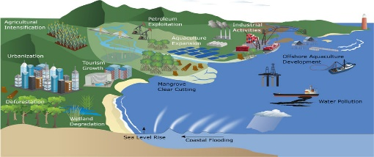
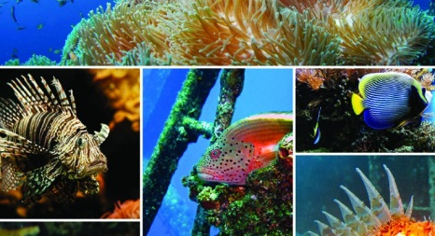
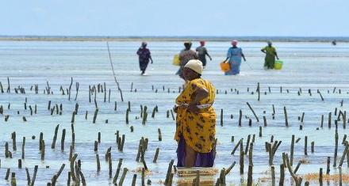
STRATEGIC OBJECTIVES OF THE PROJECT
Support AU–MS to ratify and/or align with relevant International/Regional Instruments related to blue economy themes (with specific reference to protecting and conserving biodiversity)
SO1
Optimize conservation and sustainable use of biodiversity while minimizing conflicts among blue economy sub–themes
SO2
Strengthen measures for mitigating the negative impacts of coastal and marine tourism, oil, gas, deep sea mining and climate change on aquatic biodiversity and environment
SO3
Strengthen gender inclusivity in aquatic biodiversity conservation and environmental management
SO4

Slide 4
STRUCTURE OF THE PROJECT
Conserving Aquatic Biodiversity in the Context of the Africa Blue Economy Strategy Project
Project Technical Committee
Ensures coherence in the implementation of activities between the related projects, key implementing partners and relevant institutions at national, regional and continental levels.
The PTC shall have the mandate to ensure informed, evidence-based decision making by the Project Steering Committee (PSC) meeting
Develops recommendations for deliberation by the high-level PSC meetings.
Project Steering Committee
- An advisory body
- Gives overall strategic direction and policy orientation of the project implementation.
- Responsible for adoption of annual work-plans and approval of related implementation reports

Slide 5

PROJECT TECHNICAL COMMITTEE MEETINGS
ANNUAL MEETINGS
Act as the project planning, monitoring and coordination platform;
Conduct interactive discussions on project activities, including the annual workplans, budget, M&E framework, communication strategy and make recommendations to the PSC; and,
Ensure coherence in the implementation of activities by the implementing partners and other institutions.

Slide 6
THIRD PROJECT TECHNICAL COMMITTEE MEETING
Overall objective: To inform and update the members on current status and progress on implementation of project activities and develop inputs for informed decision making by the Third project steering committee meeting. The specific objectives include the following:
  To brief PTC members on the progress of implementation of recommendations from the second PTC meeting.
  To apprise PTC members on progress of implementation of the 2023-2024 work plan approved by the second PTC, mainly achievements, challenges and emerging issues.
  To disseminate information on current status of collaboration and partnerships and to develop complementarities and minimize duplications in implementation of activities.
  To convey stakeholders’ demand for the next steps.
  To present the No-cost extension workplan (October 2024 – December 2025) project work plan for discussion and approval.
  To develop recommendations for consideration by the Project Steering Committee members.

Slide 7
OUTCOMES OF THE MEETING
PTC members are adequately briefed on the current status of implementation of the project and mechanisms are developed for enhanced implementation.
No-cost extension project work plan approved for consideration by the third project steering committee meeting.
Recommendations are developed for consideration by the third Project Steering Committee meeting.
Synergies and complementarities in Project implementation (activities and partners) are generated.

Slide 8

Thank You
AU-IBAR: Providing leadership in the
development of animal resources for Africa

