Slide 1







OVERVIEW
Recommendations from the 2nd PSC and Status of Implementation.
At the 3rd PSC of the Aquatic Biodiversity Conservation Project,
9th October, 2024.
BY: Joel Mokenye

Slide 2
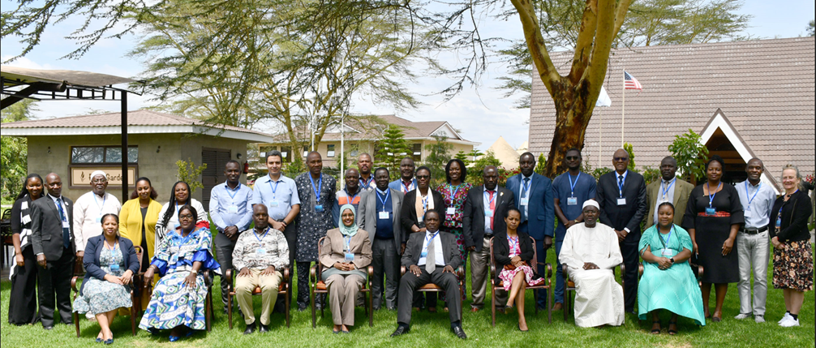
About the 2nd PSC
15TH SEPTEMBER, 2023
NAIVASHA, KENYA
AIM: Acquaint the membership on the progress of implementation, cardinal achievements and emerging issues or challenges since the first PSC, and to seek policy and strategic guidance from the PSC members.

Slide 3
The following milestones were achieved at 2nd PSC:
The PSC members were adequately briefed on progress of implementation of the 2022 – 2023 project work plan and emerging issues;
The 2023 – 2024 project work plan activities was shared with the PSC members;
Recommendations from the 2nd Project Technical Committee (PTC) meeting were reviewed and adopted by the PSC;
The PSC members were made aware of strategic collaborations and partnerships formed in the implementation of the Project;
Recommendations on the strategic direction of the Project’s implementation were developed.

Slide 4
Recommendations from the 2nd PSC and Status of Implementation.

Slide 5
1. No-cost-extension requested by the PTC should be accompanied by a narrative, budget and workplan for consideration by SIDA.
The workplan was developed, with activities and budget.
A narrative was also developed to accompany the request for no-cost extension.
Approval was given for 14 months by SIDA, effective 15th October 2024 to 14th Dec, 2025

Slide 6
2. Project outcomes should be communicated effectively at the community level.
The Climate change mitigation strategy is communicated at community levels in Gazi bay, where communities, including women and youth have been trained on ecosystems restoration and nature-based solutions;
Continental gender strategy, endored by AU Policy Organ, was utilized to mainstream gender in CREMA in Ghana coastal locationa
The project outcome on gender strategy is being rolled out in South- Africa small-scale fishing communities;
Climate change mitigation measures developed by the Project were implemented at community level among Zanzibar seaweed farmers towards conserving aquatic biodiversity conservation and environmental management
There is an ongoing proposal, with FCWC, to engage CMA on community-based MCS in Liberia.

Slide 7
3. The yearly project implementation should be presented in a format that captures planned, achieved, outstanding activities and challenges.
The 2024 annual detailed report outlined planned activities, progress made and outstanding activities, emerging issues and challenges
The presentation on progress to members of the project technical and steering communities would also adopt this format.

Slide 8
4. The project should strengthen the capacities of AWFISHNET on the blue economy concepts.
AU-IBAR collaborated with AUDA-NEPAD to strengthen capacities of Awfishnet members on critical issues and tools for inclusive and sustainable blue economy development;
gender mainstreaming and climate change mitigation through seaweed farming; e.g. Tanzania meeting in collaboration with AUDA
Global processes SDGs, global instruments; awfishnet invited in Kampala, Cameroon meetings
Blue Governance coordination mechanism e.g. Awfishnet participated in Addis Ababa meeting (Eric attended)
MPA and MSP concepts – during validation processes, involving also awareness enhancing and hence capacity building; awfishnet members participated
National blue economy validation processes in AU member states
Awfishent represented at the Knowledge share fair where issues on BE concepts were explained

Slide 9
5. A need to consider flexibility to accommodate new initiatives (such as MCS, Aquaculture, pollution) in the no-cost-extension.
The following activities have been considered in the no-cost extension phase of the project:
Strengthening capacity on MCS;
Seaweed farming;
Formulation of continental strategy in plastics and microplastics pollution.

Slide 10
6. The project should engage the private sector and showcase activities implemented.
Private sector engaged
i. Consultative processes to develop masterplans
Egypt
Angola
2. Private sector represented at:
PTC and
PSC meetings
3. Knowledge share fair
Cite more examples

Slide 11

Thank You
AU-IBAR: Providing leadership in the
development of animal resources for Africa

