Slide 1
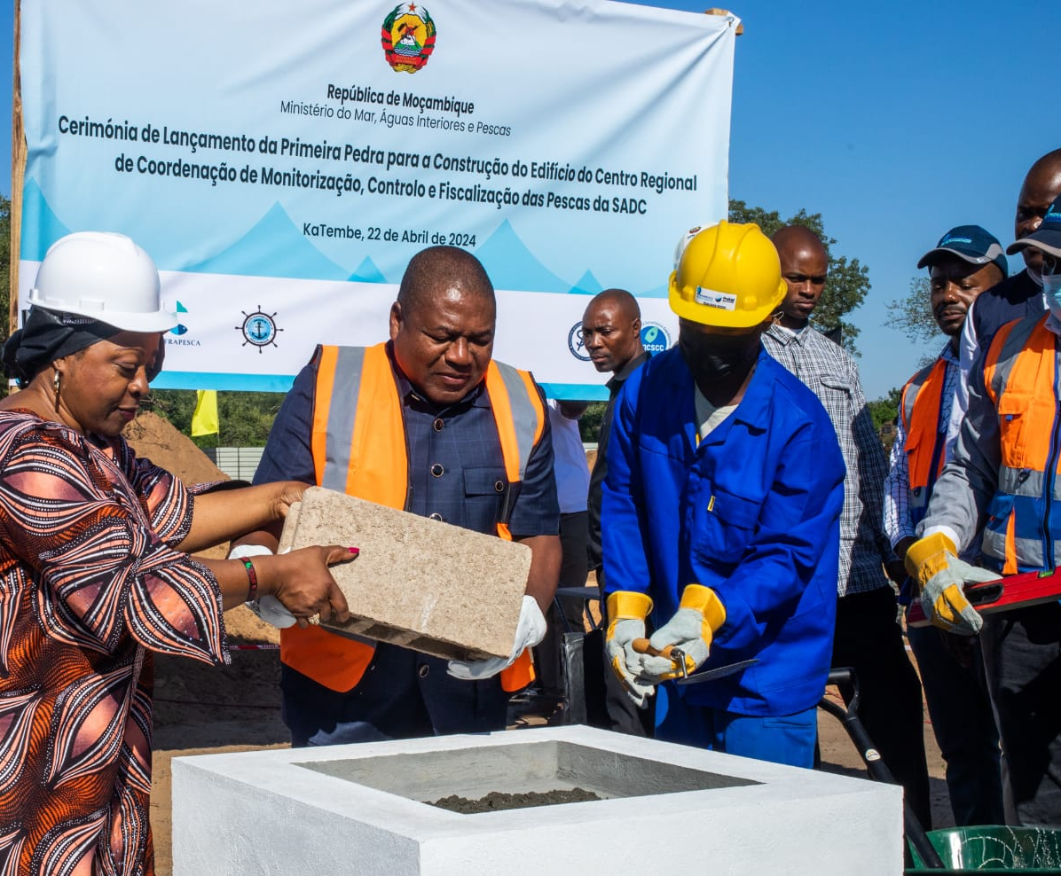

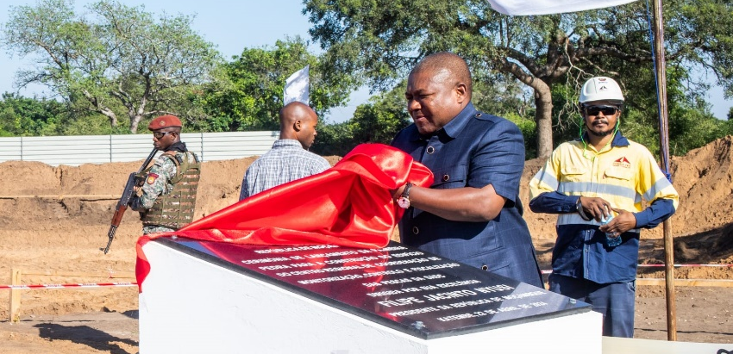
Support to Operationalize SADC Regional MCSCC- Regional effort for combating IUU fishing and protection of aquatic biodiversity
By: Stanley Ndara
Chairperson: MCSCC Board of Directors
Mombasa, Kenya
7 October 2024

Slide 2

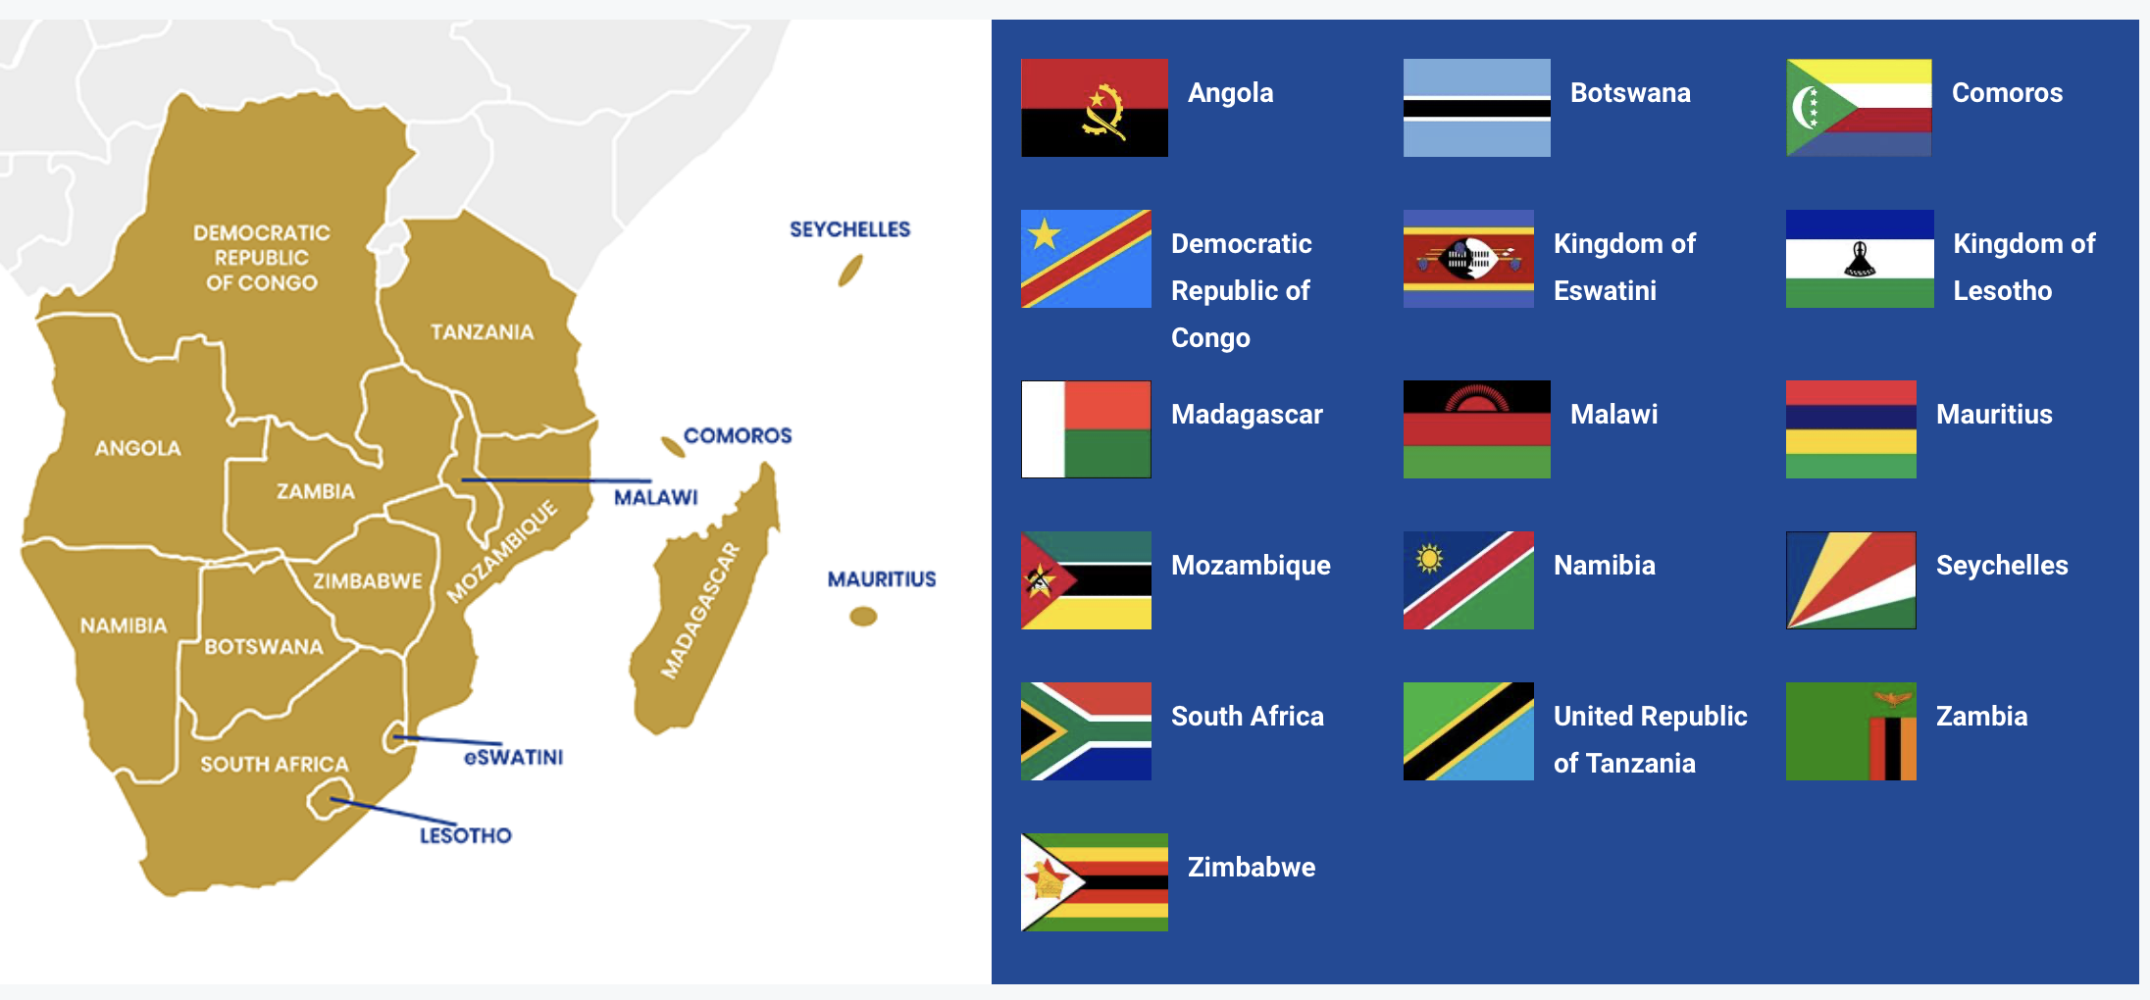
Countries that Signed the MCSCC Charter

Slide 3
The MCSCC BACKGROUND
  The Fisheries Monitoring, Control and Surveillance Coordination Centre (MCSCC) is a Regional Organisation established in 2023 through the Charter by Member States of the Southern African Development Community (SADC).
  The MCSCC Board of Directors were appointed through a competitive process
  The HQ of MCSCC is in Maputo, Mozambique. MCSCC has a mandate of coordinating measures to improve fisheries monitoring, control and surveillance (MCS) to combat illegal, unreported, and unregulated (IUU) fishing in the SADC region.
  The principal function of the MCSCC is to exchange and share Data and Information with Member States through the SADC MCSCC Basecamp Platform;

Slide 4
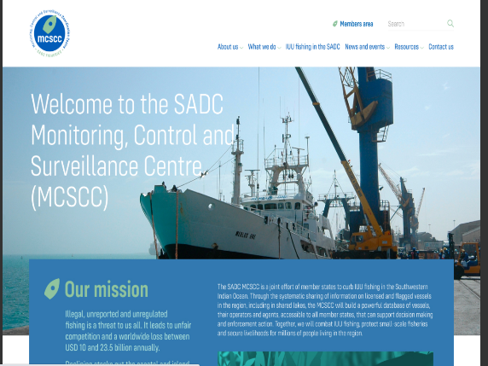
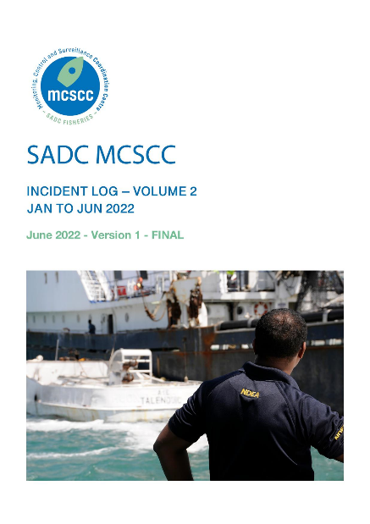
MCSCC key Services (9)
1. Develop a regional fishing vessel register;
2. Monitor vessel activity (Seavision AIS, VMS);
3. Share MCS Data and information;
4. Host and facilitate information and communication portal - web based place to access MCS Information;
5. Build and support national MCS capacity;
6. Coordinate regional fisheries surveillance; crimes
7. Regional Fisheries observer coordination;
8. Provide support for fisheries law enforcement and legal expertise;
10. Support port state measures implementation.

Slide 5
Support to MCSCC
AU-IBAR, in collaboration with the SADC Secretariat, supports the operationalization of the SADC Regional Fisheries Monitoring Control and Surveillance Coordination Centre (MCSCC) to combat IUU fishing and protect aquatic biodiversity and the environment in the coastal and marine waters of SADC countries.
During the 17th meeting of the SADC Regional Technical Team for the newly appointed members of the Board of Directors (BoD), held from June 19th to 21st, 2024, in Maputo, Mozambique, the primary objective was to induct the new BoD members of the SADC MCSCC.

Slide 6
Objectives
i. Providing essential information on the MCS Coordination Center;
ii. Outlining the roles and responsibilities of board members;
iii. Developing a roadmap for strengthening the institutional mechanisms and structures of the SADC MCSCC to effectively coordinate fisheries MCS and law enforcement initiatives;
iv. Receiving updates on pertinent activities conducted by regional partners in MCS and fisheries governance;
v. Conducting a familiarization visit to the IPMU and MCSCC construction sites in Ka-Tembe.

Slide 7
Key outcomes
i. The inauguration of the Board of Directors (BOD) for the SADC Fisheries Monitoring Control and Surveillance Coordination Centre (MCSCC).
ii. Conducting an orientation for BOD members during the first meeting, facilitated by a regional legal expert.
iii. Providing support for board members to visit the Ka-Tembe site in Maputo, where the MCS Centre is currently under construction.

Slide 8

Key outcomes cont..
In a collaborative effort to enhance regional MCS systems for the conservation and protection of fisheries, aquatic biodiversity, and environmental management in the SADC region, AU-IBAR and the SADC Secretariat directed additional support towards the inaugural meeting of the Board of Directors for the SADC MCSCC.

Slide 9
Objectives
(i) Review the draft Annual Work Plan and Budget (AWP&B) for the MCSCC, covering the period from April 2024 to March 2026.
(ii) Examine MCSCC operational policy documents, including the draft BoD Remuneration Policy, Governance Manual, and the Secretariat’s Organizational Chart with respective job descriptions and salary structure.
(iii) Develop terms of reference (TORs) and designate members for BoD sub-committees covering Programs, Human Resources and Governance, and Finance, Audit, Risk, and Compliance.
(iv) Review reports from the MCSCC and its associated projects to be presented to the BoD.

Slide 10
Key outcomes
1. Draft Annual Work Plan and Budget (AWP&B) for the MCSCC covering April 2024 to March 2026 has been formulated.
2. Development of the Draft MCSCC Board of Directors (BoD) Remuneration Policy, MCSCC Governance Manual, and the Secretariat’s Organizational Chart, which includes comprehensive job descriptions and a detailed salary structure.
3. Terms of Reference (TORs) for and designation of members to BoD Sub-Committees focusing on Programmes, Human Resources and Governance, and Finance, Audit, Risk, and Compliance have been established.
4. Receipt of updates from the MCSCC and its associated projects.
5. Completion of the MCSCC BoD responsibilities as outlined in Article 15 of the MCSCC Charter in relation to the second BoD meeting

Slide 11
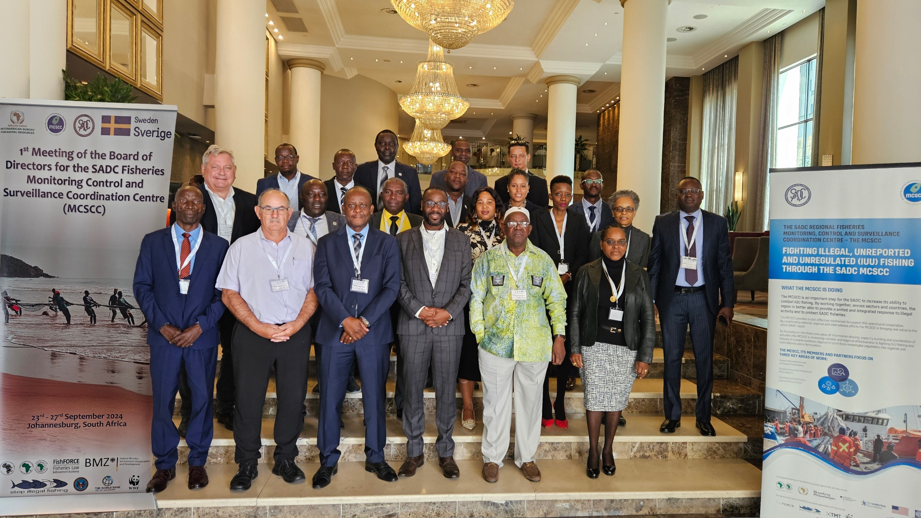

Slide 12
Challenges in the Region
Inadequate enforcement, and IUU fishing are of concern in many of the region’s industrial fisheries.
Price increases- declining fish availability drives up prices/affordability
Fish caught through IUU may land in European and other markets.
Sub Saharan Africa loses about 10 billion USD through IUU fishing.
Fisheries Crimes, cross-border issues
Vast coastlines
Limited resources

Slide 13
Opportunities to overcome IUU fishing
Regional cooperation and collaboration
AU-IBAR support
Investment in resources and technology
Strengthen legal frameworks (Lacey-type legislation)

Slide 14
Critical MCSCC Requirements
Quantity | Equipment | Amount | Years
1 | Starboard AIS Subscription | 10.000
2 | Laptop + Software | 3.000
1 | Desktop + Software | 1.500
1 | Projector Wall | 2.000
1 | Printer (professional) | 3.000
2 | Scanner | 1.000
 | Internet subscription | 2.500 | 2 Years
 | Software Training Courses | 3.000
 | Analytical and operational support mentoring | 30.000 | 1 year

Slide 15
Merci Beaucoup
Thank You Very Much
Muito Obrigada
Asante Sana

