Slide 1



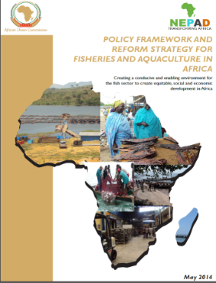



“CONSERVING AQUATIC BIODIVERSITY IN AFRICAN BLUE ECONOMY”
^{AQUATIC BIODIVERSITY PROJECT}
3rd PTC & 3rd PSC,
07-09 October 2024
Mombasa, Kenya
NCE WORK PLAN OCT 2024 – DEC 2025
Rasugu K. Oroko – AU-IBAR, Planning & Monitoring

Slide 2
Presentation Outline
Overview of the Aquatic Biodiversity Project
Our Approach
Work Plan Oct 2024 – Dec 2025

Slide 3
Overview of the Aquatic Biodiversity Project
The Aquatic Biodiversity Project:
A 36-month 5.5 M USD Project (15th Oct. 2021 – 14th Oct. 2024); Has received a 14-month NCE to Dec 2025
Key Areas of intervention:
Supporting the Ratification and/or alignment with relevant Blue Economy-related international/regional instruments;
Optimizing the conservation and sustainable utilization of biodiversity;
Strengthening measures for minimizing the negative effects of Coastal and Marine Tourism, oil, gas, deep sea mining, and Building Climate Change on aquatic biodiversity and ecosystems;
Enhancing gender inclusivity (women and youth) in aquatic biodiversity and environmental management

Slide 4
Our Approach
Undertaking studies (mainly through Consultancies):
    provide a baseline assessment of the current situation across the continent, and
    lay ground for evidence-based intervention by the project
Continental validation and awareness enhancing workshops for stakeholder:
    Enrichment
    Participation
    Ownership
Support AU MSs & RECs to review and align national policies, regulations and instruments with continental/regional instruments;
Developing frameworks and models;
Pilot and operationalize recommendations;

Slide 5
Oct. 2024 – Dec. 2025 Work Plan

Slide 6
Key Thrusts of the NCE Work Plan
Pilot the mechanism for effective participation in relevant aquatic biodiversity and environmental fora
Ratification of instruments related to conservation of biodiversity
Enhance MCS Systems for combatting IUU fishing /protecting biodiversity
Develop a roadmap for effective implementation & governance of MPAs
Develop continental strategies on:
  nature-based solutions for combatting biodiversity loss and climate change in aquatic ecosystems
  mitigating plastic and microplastic pollution and minimizing the impact on aquatic biodiversity and environment
Implementation Plan for the continental gender inclusivity in aquatic biodiversity and environmental management
Regional Blue Economy VCs
  Identify BE VCs that will create employment for women and youth.
  Identify for strengthening women, youth and private sector organizations along the regional blue chain in aquatic biodiversity
  -

Slide 7
SO1: Ratify and/or align relevant international/regional instruments related to Africa Blue Economy Strategic Areas (with specific reference to protecting and conserving biodiversity) 1
Output/Activity | Tasks | Timeframe
 |  | Q4’24 | Q1’25 | Q2’25 | Q3’25 | Q4’25
Output 1.1 Mechanisms for active participation of MSs in regional and global initiatives related to aquatic biodiversity and environmental regimes are developed.
1.1.1. Pilot the AU endorsed mechanism for effective participation in relevant aquatic biodiversity and environmental fora | Support 6 AU MSs (and 2 trained negotiators) to 2 events to participate in relevant aquatic biodiversity conservation & environ. Mgmt fora - 2(3MSs + 1 Negotiator to provide technical guidance in support of coordinated African Position or Voice)

Slide 8
SO1: Ratify and/or align relevant international/regional instruments related to Africa Blue Economy Strategic Areas (with specific reference to protecting and conserving biodiversity) 2
Output/Activity | Tasks | Timeframe
 |  | Q4’24 | Q1’25 | Q2’25 | Q3’25 | Q4’25
Output 1.2. Ratification and implementation of conventions and agreements related to conservation of biodiversity in AU MSs and RECs supported
1.2.1. Identify continental and global biodiversity and environmental instruments relevant to sustainable management of Africa blue economy resources | Support one AU MS to review national policies, regulations and align national instruments with relevant continental and global aquatic biodiversity and environmental instruments.
 | Organize national validation workshops in an AU member state to review and endorse the reviewed national policies

Slide 9
SO2: Optimizing conservation and sustainable biodiversity while minimizing conflicts among users of blue economy resources 1
Output/ Activity | Tasks | Timeframe
 |  | Q4’24 | Q1’25 | Q2’25 | Q3’25 | Q4’25
Output 2.1: Enforceable Regulatory frameworks for effective and sustainable regional MCS (monitoring, control and surveillance) systems developed
2.1.1 Enhance Sustainable Monitoring Control and Surveillance (MCS) Systems for conservation and protection of biodiversity: combat IUU and protect aquatic biodiversity | Recruitment of resource person to develop training materials on MCS for effectively combating IUU and protection of aquatic biodiversity and environment
 | Training of MCS personnel on measures for effective combat of IUU fishing, ABC & EM; Continuing consultative process on mechanism to establish / strengthen regional MCS systems in Central African Region
 | Purchase of equipment to strengthen two newly identified regional MCS centres

Slide 10
SO2: Optimizing conservation and sustainable biodiversity while minimizing conflicts among users of blue economy resources 2
Output/Activity | Tasks | Timeframe
 |  | Q4’24 | Q1’25 | Q2’25 | Q3’25 | Q4’25
Output 2.3. Capacities for restoring and conserving threatened aquatic biodiversity and environment strengthened (Marine Protected Areas)
2.3.1 Support the protection and rehabilitation of depleted aquatic biodiversity and habitats (Marine Protected Areas - MPAs) in AU MSs | Hire three consultants to develop a roadmap for effective implementation and governance of Marine Protected Areas (MPAs)
 | Organize three national consultative workshops to validate the three MPA roadmaps
2.3.2 Establish Continental Centres of Excellence for capacity building on aquatic biodiversity | Purchase of equipment to support newly recognized CoEs for Training and Research in Fisheries, Aquaculture, ABC & EM

Slide 11
SO3. Strengthening measures for mitigating the negative impacts of coastal and marine tourism, oil, gas, deep sea mining and climate change on aquatic biodiversity and environment 1
Output/Activity | Tasks | Timeframe
 |  | Q4’24 | Q1’25 | Q2’25 | Q3’25 | Q4’25
Output 3.1 Measures for minimizing the negative impacts of climate change on aquatic biodiversity and environment strengthened and implemented
3.3.1. Mitigate the impact of climate change and pollution on aquatic biodiversity and environment - Continental strategy on nature-based solutions for combatting biodiversity loss and climate change in aquatic ecosystems | Hire a consultant to conduct field assessments and develop an evidence-based continental strategy on nature-based solutions for combatting biodiversity loss and climate change in aquatic ecosystems
 | Facilitate the consultant to conduct field visits to collate information and perspectives on nature-based solutions before the development of the strategy
 | Hold a virtual continental stakeholders’ consultation to validate the draft strategy

Slide 12
SO3. Strengthening measures for mitigating the negative impacts of coastal and marine tourism, oil, gas, deep sea mining and climate change on aquatic biodiversity and environment 2
Output/Activity | Tasks | Timeframe
 |  | Q4’24 | Q1’25 | Q2’25 | Q3’25 | Q4’25
OUTPUT 3.2. Strategies for an integrated strategic framework for sustainable coastal and marine tourism and mining developed
3.2.1. Mitigate the impact of plastics and microplastic pollution on aquatic biodiversity and environment - Continental strategy on mitigating plastic and microplastic pollution and minimizing the impact on aquatic biodiversity and environment | Hire a consultant to assess marine waste or debris on aquatic biodiversity and environment and develop an evidence-based continental strategy on mitigating plastic and microplastic pollution and minimizing the impact on aquatic biodiversity and environment
 | Facilitate the consultant to conduct field visits to collate information and perspectives on plastic and microplastic pollution before developing the strategy
 | Hold a virtual consultation to validate the draft strategy

Slide 13
SO4. Strengthening gender inclusivity in aquatic biodiversity conservation and environmental management 1
Output/Activity | Tasks | Timeframe
 |  | Q4’24 | Q1’25 | Q2’25 | Q3’25 | Q4’25
Output 4.1. Implementation Plan for the continental strategy on gender inclusivity in aquatic biodiversity and environmental management developed
4.1.1. Support AU member states to develop / strengthen gender dimensions in aquatic biodiversity and environmental management - IP to operationalize the continental strategy for gender inclusivity in ABC & EM | Hire a consultant to develop an implementation plan for the operationalization of the continental strategy for gender inclusivity in aquatic biodiversity and environmental management
 | Organize a virtual continental stakeholders’ validation workshop to validate the draft implementation plan
 | Support two AU MSs to develop continental strategy for gender-inclusivity-aligned national strategies for gender-inclusivity,

Slide 14
SO4. Strengthening gender inclusivity in aquatic biodiversity conservation and environmental management 2
Output/Activity | Tasks | Timeframe
 |  | Q4’24 | Q1’25 | Q2’25 | Q3’25 | Q4’25
Output 4.1. Implementation Plan for the continental strategy on gender inclusivity in aquatic biodiversity and environmental management developed 2
4.1.1. Support AU member states to develop / strengthen gender dimensions in aquatic biodiversity and environmental management - Regional Blue Economy Value Chains | Hire a consultant to assess regional (blue economy) value chain that will create opportunities for employment, especially women and youth
 | Facilitate the consultant to conduct field visits to collate information and perspectives among stakeholders and ongoing activities on regional (blue economy) value chains
 | Organize a virtual continental stakeholders’ workshop to: Validate the draft regional (blue economy) value chain that will create opportunities for employment, especially women and youth. Identify / establish or strengthen stakeholder's organizations (women, youth and private sector) along the regional blue chain in aquatic biodiversity

Slide 15
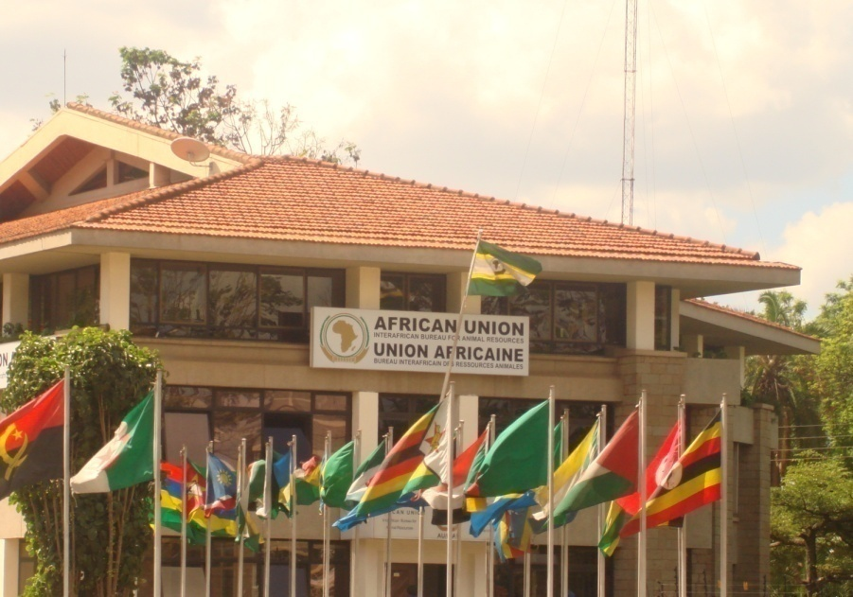
THANK YOU
Providing Leadership in the Development of Animal Resources for Africa

