Slide 1



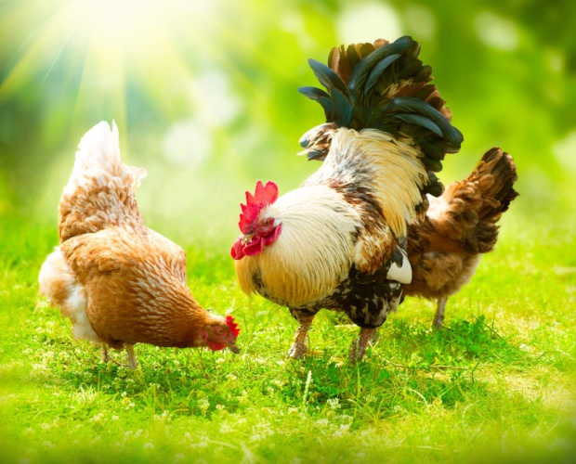
Writeshop for a harmonized poultry regional strategy
Dynamics and prospects of the
West Africa Poultry value chain
in the regional, continental & global context
28-30 March, 2023
Abidjan, Côte d’Ivoire
Ariong Abbey
Lead Regional Facilitator

Slide 2


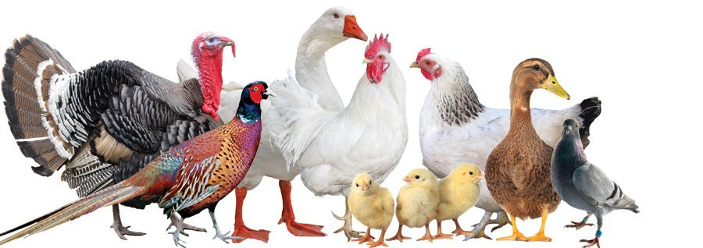
Scene setting outline:
Value & Value chains
Poultry meat production: Global, Africa & West Africa
Consumption and the global retail market
Poultry meat trade
Value chain relationships
Poultry in ECOWAS
Focus:
Poultry meat

Slide 3
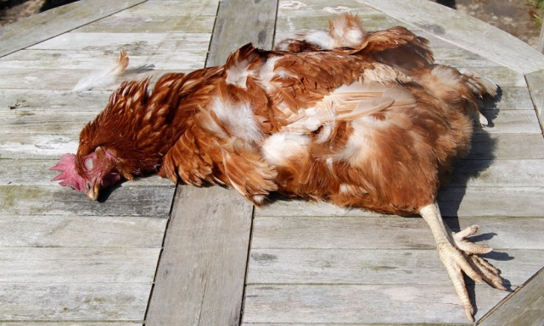



Who determines the value of a product ?
Does the cost of production plus profit really mean the “value” of that product?
Does “value addition” really mean “value” of the product?
No buyers
Value-less
There are buyers
Value-able
Value is ultimately determined by the end market.
Notes:
We frequently to talk about
Value addition
Costs of production
Price/trade unfairness

Slide 4

The End Market
as a starting point
Value chain commercialization & transformation...
Catalytic strategies must be directly an clearly linked to end market opportunities
Identify and quantify end market opportunities
End markets are not homogeneous – price, product, quality etc segments.
Critical Success Factors (CSF’s) vary widely.
Market entry through a collective effort using a Unique Selling Proposition (USP) based on comparative advantages.

Slide 5
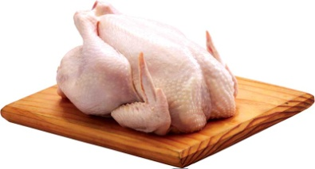
The Value Chain
Entails 3 key elements – Who, What & Why (Micro level)
Relies on support services (Messo level)
Operates in an enabling environment canvas (Macro level)
1
Who?
2
What?
3
Why?
An Alliance of
_____________
Collaborating and Connected Actors
Involved in
_____________
Processes and Linkages
Required to
_____________
Bring a product from production to consumers
The Value Chain

Slide 6
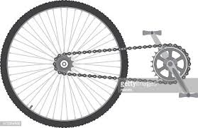

The Regional Value Chain
Primary components
  Coordination & Linkages
  Policies & Protocols
  Technologies
  Exports & Imports
  Skills development
Separate but inter-linked and Coordinated chain activities across geographies
It targets several market segments simultaneously to reduce dependency risks
How can the Poultry development Plans/Priorities be synchronized

Slide 7

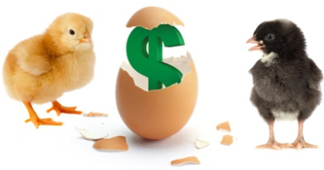

Value chain Vs Supply chain
Basic difference is the fundamental shift in focus
FROM : Supply base and producers - Supply push
TO: End Market base and consumers - Product pull
Product Value chain End market
Consumer demand pull
Competitive advantage
Supply push
Product Supply chain Customer
Customer request

Slide 8
Global Poultry in figures
World total 121.6 billion tons
Africa Total 7.3 billion tons
West Africa total 0.9 billion tons (FAOSTAT 2021)
China, US, Brazil South Africa & Mexico have the largest share of production growth
Asia is highest – 61% of World total
Africa - 8% of World total
West Africa – 3% of World total
(FAOSTAT 2021)
Significant investments
Bumper corn harvest
Low feed costs
Food service sales
World total 27.6 billion heads
Africa Total 2,2 billion heads
West Africa total 0.7 billion heads (FAOSTAT 2021)
Growth drivers
Source: FAOSTAT, 2021

Slide 9
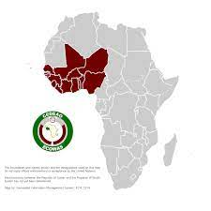
Poultry meat production in Africa & ECOWAS
11%
Produced in ECOWAS
Africa Total 7.3 billion tons
ECOWAS total 0.9 billion tons
(FAOSTAT 2021)

Slide 10
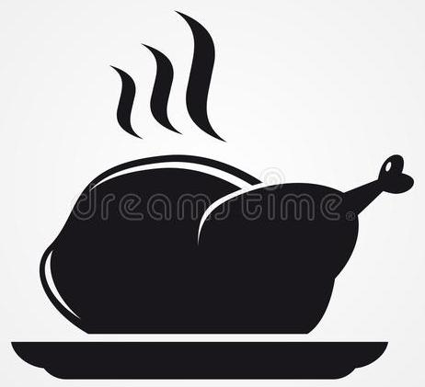

World & ECOWAS: Poultry meat consumption break down 2018
World Average
15.79 kg/capita/year
ECOWAS Average
5.4 kg/capita/year
Based on a comparison of 161 countries in 2020;
Israel was highest with 68.9 kg followed by Trinidad and Tobago and USA.
Chad was lowest with 0.480 kg, Burundi with 0.560 kg and Ethiopia with 0.590 kg.
Source: Helgilibrary, 2020

Slide 11


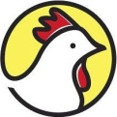
Global Poultry meat market
310.7 Billion USD
40%
17m
3.3%
World Poultry sector market value 2019
Largest world poultry meat Markets - China 20m, US 19m & Brazil 12m tonnes
Trade growth (2009-2019)
Tons global traded internationally/year
25.7 billion USD
World Poultry meat export value, 2019
Top Exporters:
Brazil – 24%
US – 22%
Netherlands – 9%
Poland – 9%
3.8%
7.0%
CAGR
Past & Projected
422.97 billion USD
Projected Market in 2025
Sources: IndexBox & FAOSTAT 2021

Slide 12
Source: OECD/FAO (2021)

Slide 13
Source: OECD/FAO (2021),

Slide 14
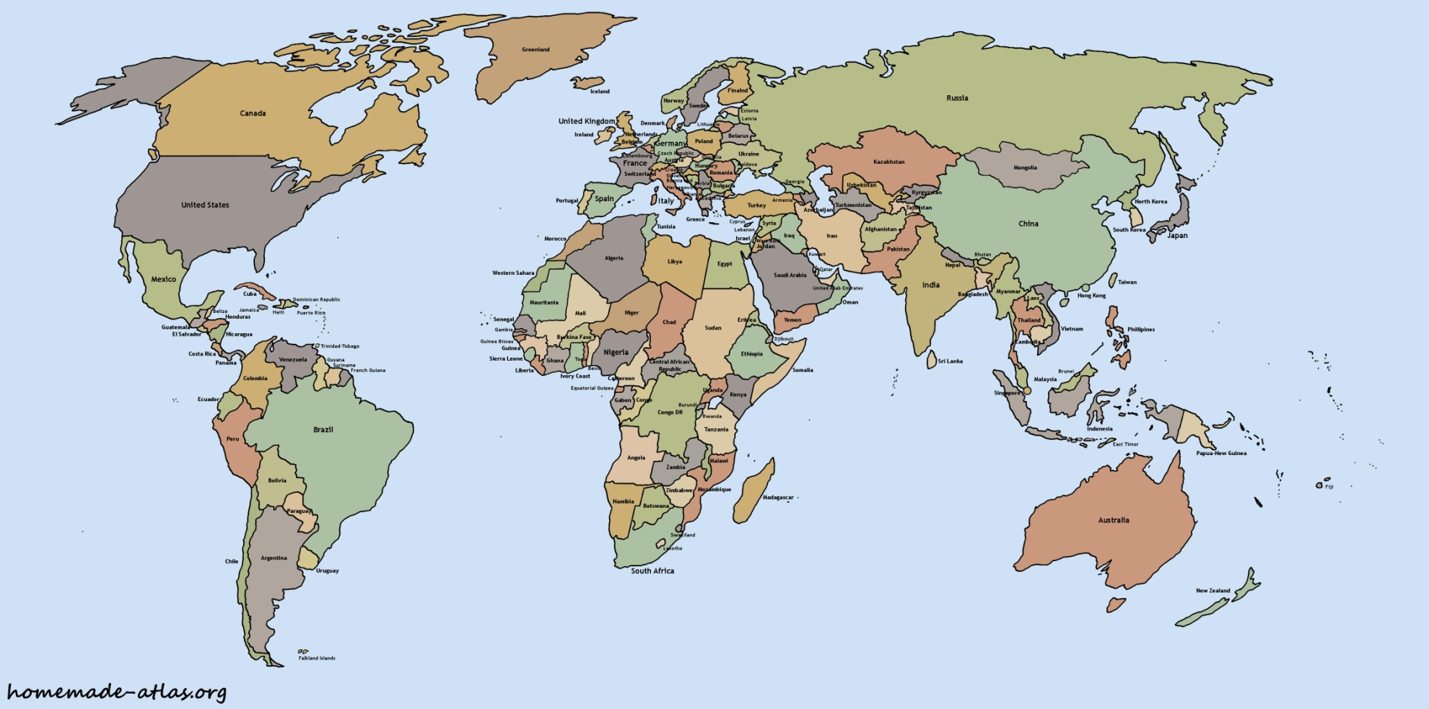
Production, export & import leaders
Value of Exports US$ 25.7 bn
Africa exports i% % of Global
(notable is South Africa $ 72.1m)
Leading Producer
& Export areas
Leading import areas
Value of Imports US$ 25.1 bn
Africa imports 11.9 % of Global (notable is Ghana)
Notes:
Dairy farmers have a weak and vulnerable socioeconomic position in the dairy market with limited and slow ability to adjust.
They improve their value chain position by forming cooperatives that often have different and varied functions.
Africa is a rather small global player in milk production. African countries are pursuing extensive growth strategies, which are increasingly facing natural resource constraints and competitive disadvantages compared to the leading dairy exporter regions
More than 50% of the global milk volume is produced in Southeast Asia, the EU, and the U.S.
Data Source: FAOSTAT, 2015

Slide 15
Global poultry value chain relationships
Demand majorly Europe, Russia, Middle East
Others – Mexico, Japan, Hong Kong, Cuba, Ghana
Geographically spread &Takes place in-country
Industry globally fragmented-protective trade policies.
Imports
Poultry Production
Poultry meat Processing
Distribution
Trade Markets
Poultry farmers small & medium position - weak & vulnerable
Farmers form National Associations to improve positioning
Africa-small global player, with natural resource & competitive advantage constraints
60% global volumes produced by, Brazil, US, China, Netherlands, Poland
Exports
Critical elements; 1) Trade agreements (AcFTA); 2) Retail network; 3) Efficient cold chain.
Supermarket chains
Retailers
Convenient stores & etc
Controlled by 7 top countries;
US, Brazil, China, Mexico, Netherlands, Poland, South Africa

Slide 16


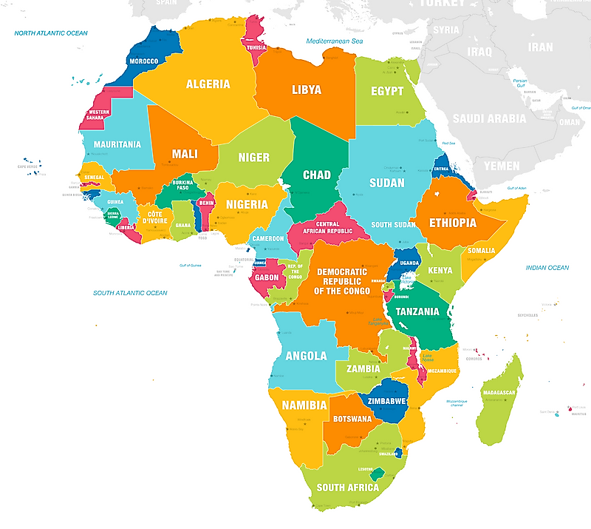





Africa: 7 Poultry leading firms - by # of broilers slaughtered (2021)
Egypt
58 million
Morocco
30 million
Egypt
90 million
Nigeria
20 million
South Africa
228.2 million
South Africa
260 million
South Africa
74 million
Source: Fairplay, 2021

Slide 17
Business Orientation
Reconfiguring regional trade relationships and strengthening Value Chain partnerships.
    Process, market and product orientation capabilities in processing to build strong relationships
Market Orientation
Harmonized strategies
among
countries
Strong
Distribution
network
Product Orientation
Innovation
and
branding
Process Orientation

Slide 18
Business- Orientation & Value Chain Capabilities
Product oriented
Market oriented
Process oriented
+ Trust based relationships with poultry suppliers -
-Reach & scope of distribution network +
- Reach & scope of distribution network +
+ Innovation and branding -
+ Trust based relationships with Poultry suppliers -
- Reach & scope of distribution network +

Slide 19
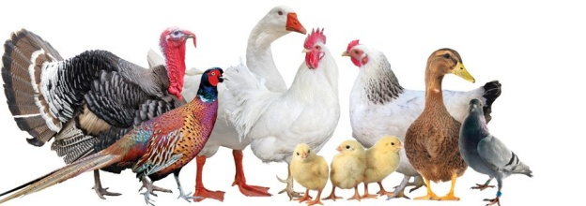




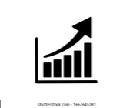

Poultry industry in ECOWAS – in figures
688.6 Million Chickens
413.9 Million consumers
11% of the Continents Poultry meat production
680 Million tons production of poultry meat/year
1, 400 Million tons of chicken meat consumed/year
3-6% Annual growth rate
5.4 Average per capita consumption
1,750 FCFA production costs per kg of live chicken

Slide 20
Opportunities
Competitive market prices above world levels
High regional market demand for poultry products
Increasing market demand (Population Growth, Urbanization, change in nutrition pattern, growth in income..)
Attractiveness of the poultry industry-Profitability
Existing regional support programmes and initiatives
Huge opportunity for regional trade.
Competitive opportunities for small holder participation
Flexible private sector investment
12% - 70%
CIV, GN, Ml, NI

Slide 21
The Generic poultry value chain in ECOWAS
Poultry Feeds
Transporters
Producer groups & Associations
Live bird markets
Exports
Day old Chicks
Small Producers
Input supply
Production
Abattoirs
Processors
(Macro & Micro)
Marketing
End Users
/Consumers
Medium scale/ Contract growers
Macro
Vet drugs & Services
Own Slaughter house
Food Industry
Parent stock farmers
Micro
Household
Large broiler Producers
Traders
Cottage
Corporate &
Institutions
Hatcheries
Brokers
Enabling environment, support and financial services
Cross Cutting - Women & Youth participation

Slide 22
Indigenous poultry value chain in ECOWAS
(Short value chain)
Food waste & forage
Transporters
Live bird markets
Household producers
Traders
Household
Input supply
Production
Abattoirs
Processors
(Macro & Micro)
Marketing
End Users
/Consumers
Medium scale growers
Vet drugs & Services
Corporate &
Institutions
Own Slaughter house
Brokers
Food Industry
Improved Local breeds
Enabling environment, support and financial services
Cross Cutting - Women & Youth participation

Slide 23



Recent trends
Increasing liberalization of markets
Global poultry meat supply surge
Increased poultry meat price volatility
Target to create a US$ 2.5 trillion market by removing trade barriers
The poultry meat industry has bounced back from effects of Covid-19

Slide 24
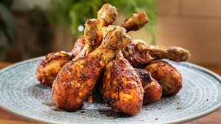

Enjoy
Thank you!

