Slide 1
HPAI Risk Situation and the Socioeconomic Impacts on the Poultry Sector, Nigeria, Ghana, Liberia
Presented by
Olasoju Taiwo I.M
08034917865, 7taiwo@gmail.com

Slide 2
OUTLINE
HPAI Risk situation and Socioeconomic impact assessment in Nigeria
HPAI Risk situation and Socioeconomic impact assessment in Liberia
HPAI Risk situation and Socioeconomic impact assessment in Ghana

Slide 3
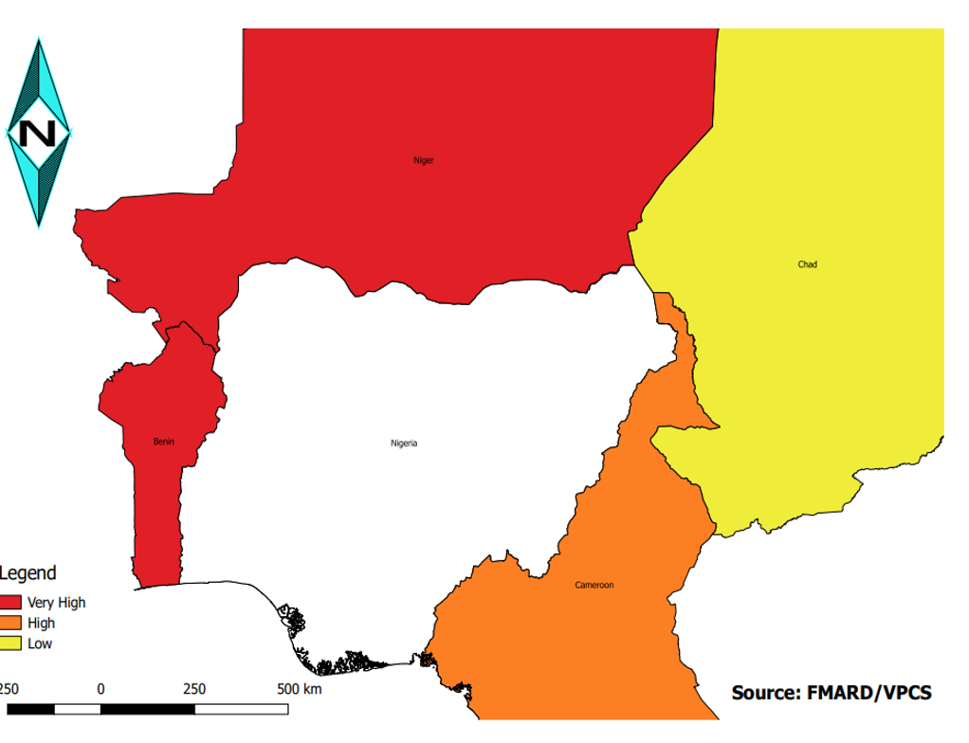
NIGERIA:
Risk factors
HPAI Status:
Ongoing
Risk of Introduction:
high to low {Niger, Benin VH, Cameroun-H (low LoU), Chad low (high LoU Chad assessment)}
Risk of spread:
Very high (28 states fell within VH/H, 32 out of 36 states + FCT already affected)
Risk factors identified:
High poultry density, LBMs(Collection, Terminal, Distribution), Accessibility, use of unvalidated vaccine, density of wetlands, Backyard poultry (about 60% of the poultry farms in Nigeria)

Slide 4
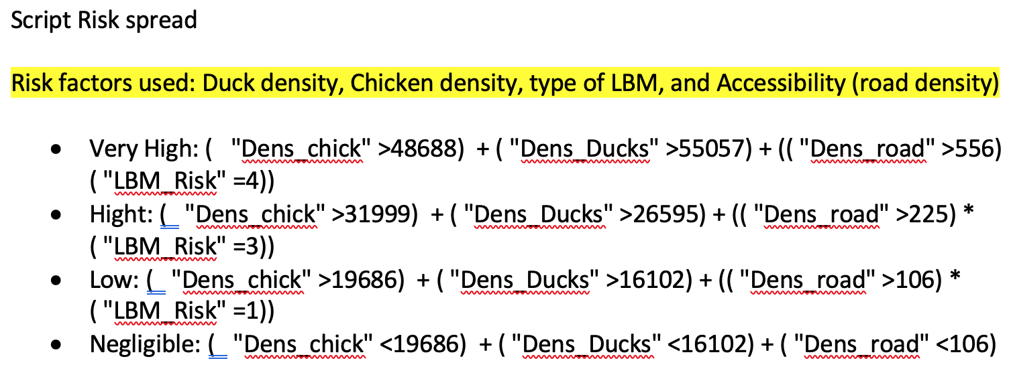
RISK FACTORS
(CONT’D)

Slide 5
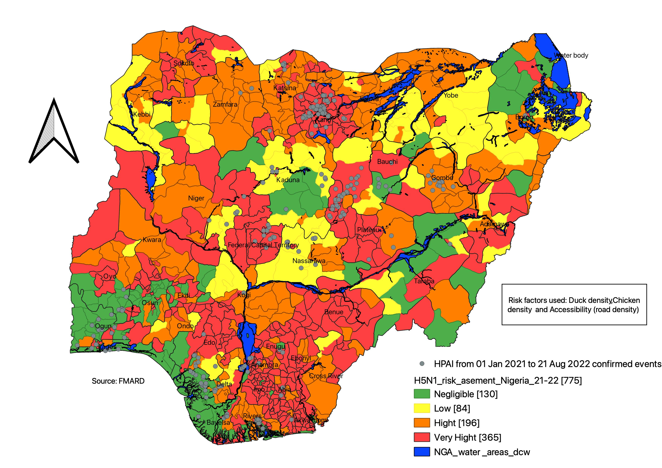
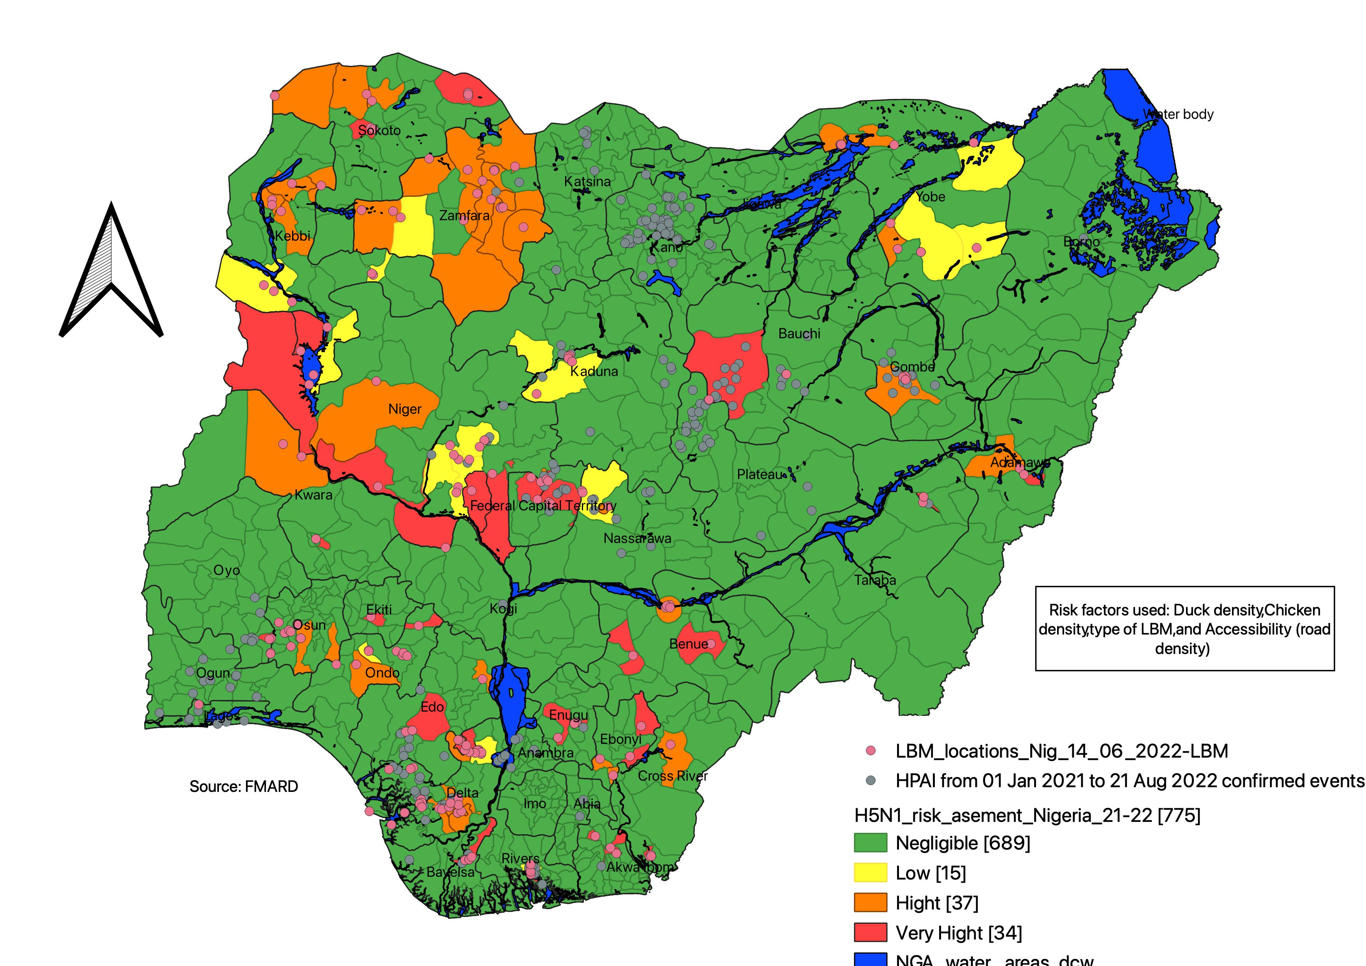
RISK OF SPREAD

Slide 6
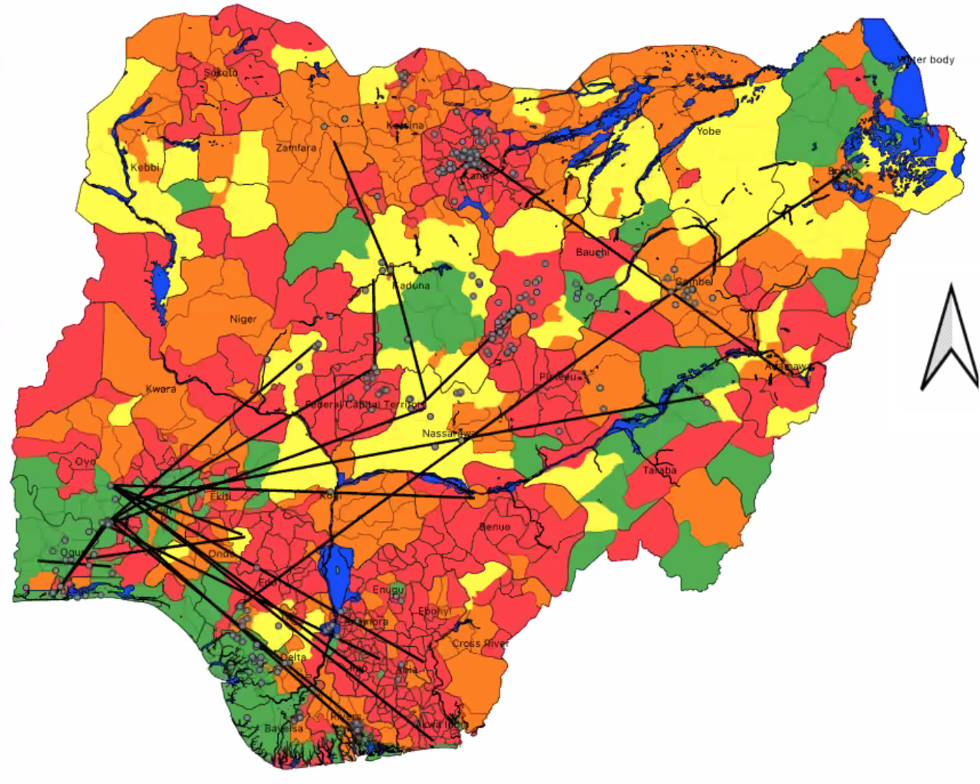
RISK OF SPREA: Social network
South west with highest flow/conc of points

Slide 7
LIVE BIRD MARKETS
Collection Markets
More in the villages: sellers pick birds from backyards to the village markets
Distribution Markets
More in the LGA hqrters (collects from commercial farms, and collection markets)
Terminal Markets
Buyers purchase and leave for consumption
Presence of all the three: 4 (VH)
Collection and Distribution Markets = 3 (H)
Terminal = 1 (low)

Slide 8
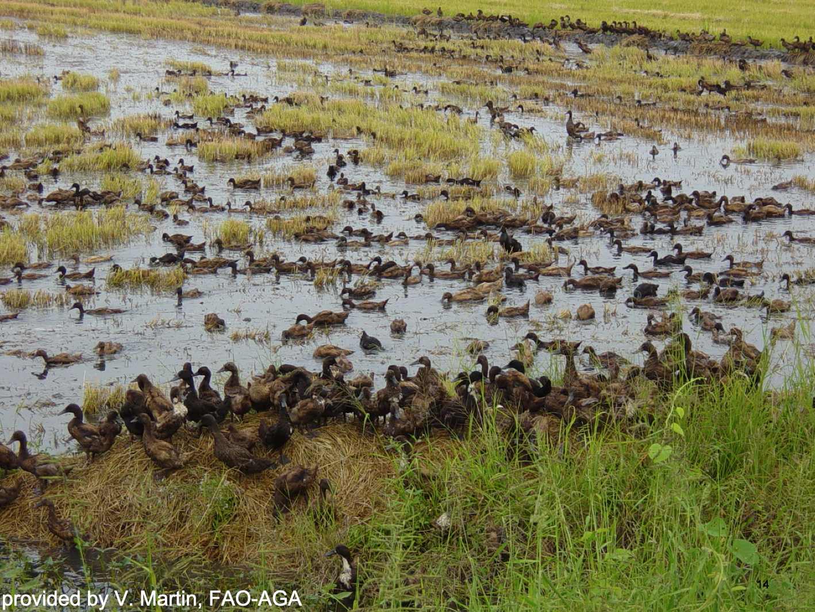
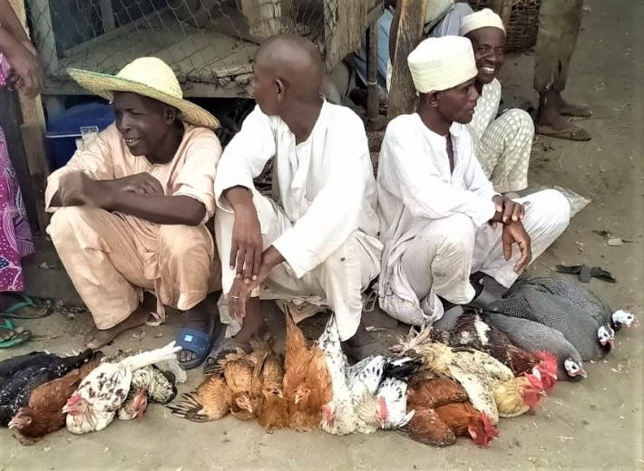
RISK OF INTRODUCTION

Slide 9
SOCIOECONOMIC IMPACT (CURRENT OUTBREAK - 2022)
The total income foregone from bird sales due to mortality and culling of birds is estimated at ₦11.3 Billion
Total weekly income loss from egg sales due to mortality and culling: ₦910 Million
The monthly income loss from manure across the country is estimated at ₦9 Million
Impact on livelihood: about 68% of farmers laid off workers

Slide 10
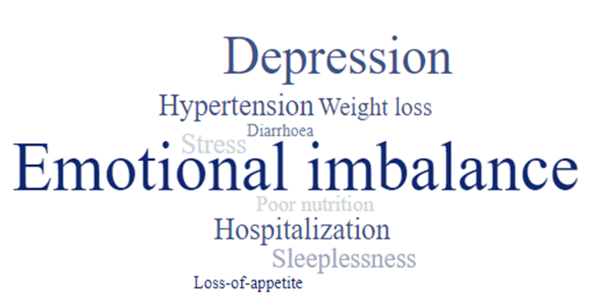
Social impacts of HPAI (Herd level)
Impact on health of farmer

Slide 11
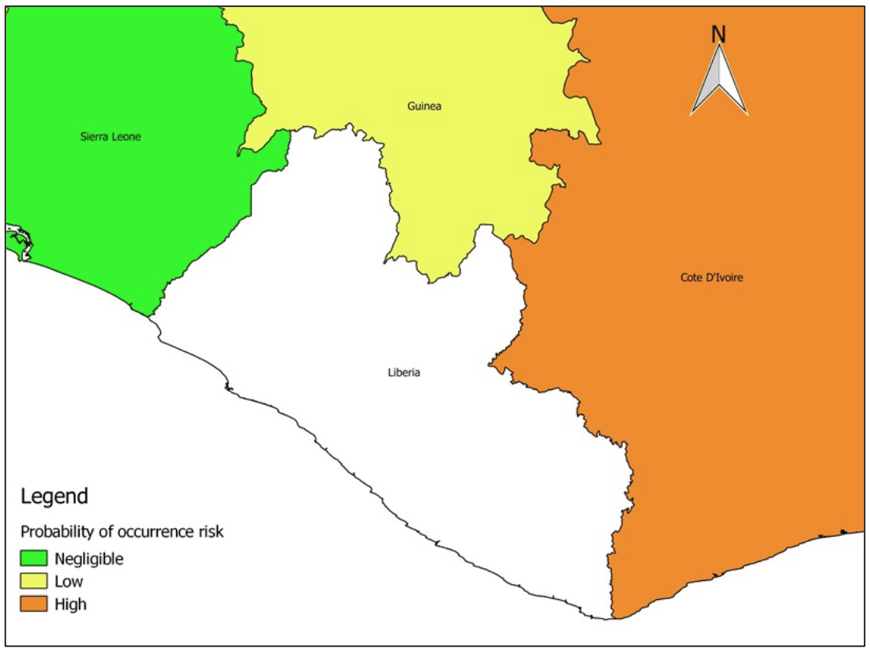
LIBERIA:
Risk status
Risk of Introduction (from neighbouring country):
high to negligible - 2020
Risk of spread:
Negligible (low population of poultry)
Risk of occurrence:
low (low poultry density and low border transaction)
Risk factors:
Infected neighbouring countries, wetlands

Slide 12
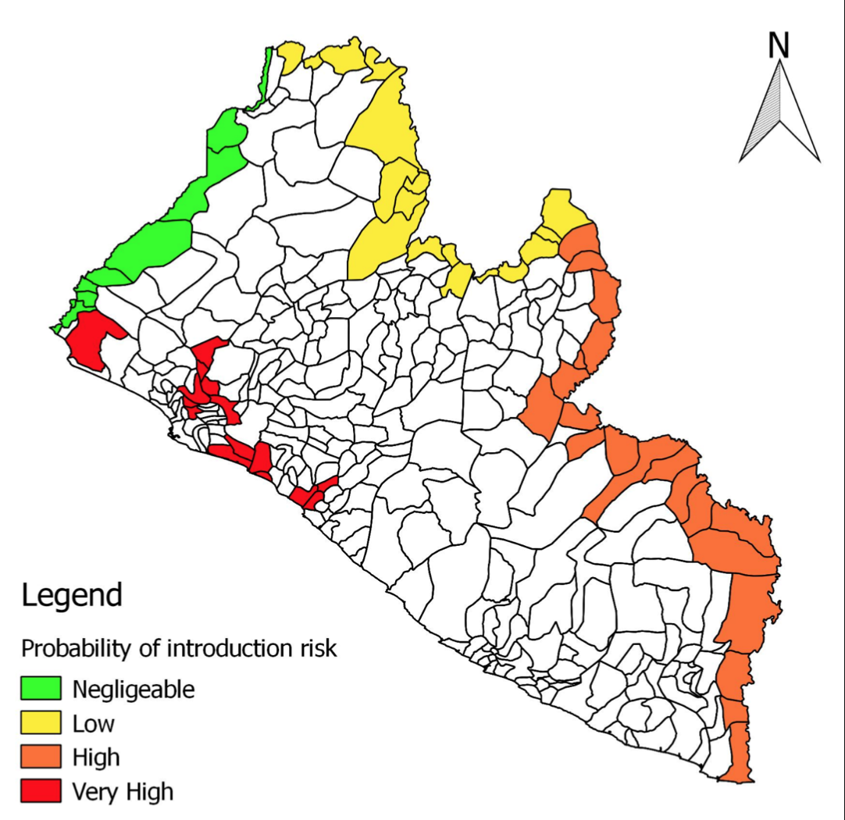
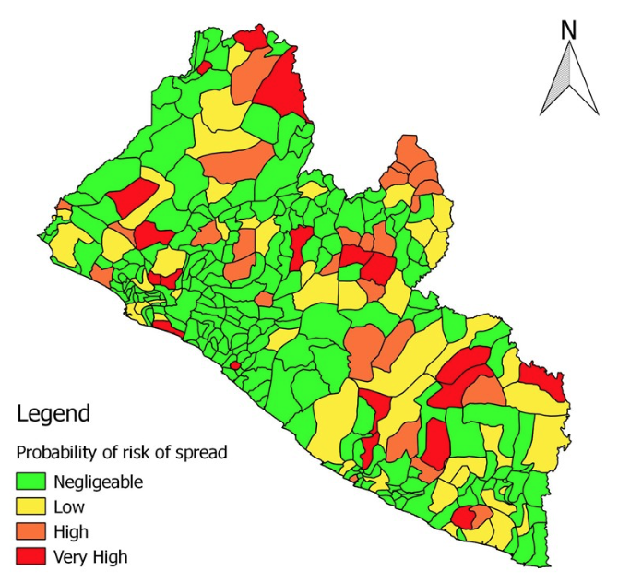
RISK OF INTRODUCTION/SPREAD

Slide 13
GHANA
Risk status
Risk factors:
Cross border trade in live birds and poultry products, fomites, presence of the virus in neighbouring countries
Risk of introduction:
Risk of spread:

Slide 14
Thank you

