Slide 1
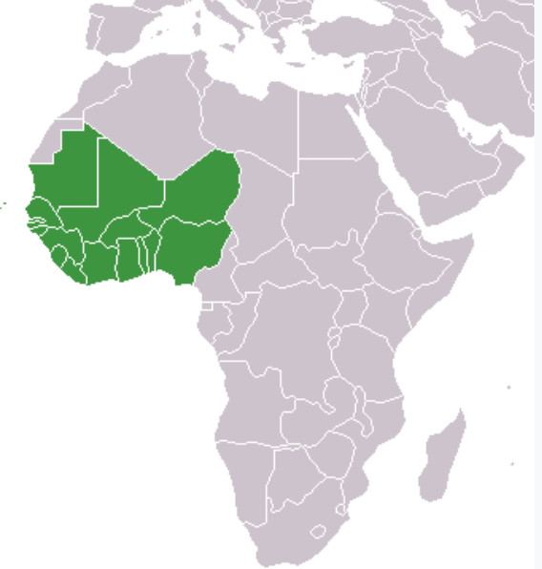
Resurgence, Risk Factors and Socioeconomic Impact of HPAI in West Africa Poultry Sector
Olasoju Taiwo I.M
+22348034917865, 7taiwo @gmail.com

Slide 2
OUTLINE
Introduction
Resurgence
Risk factors
Socioeconomic impact

Slide 3
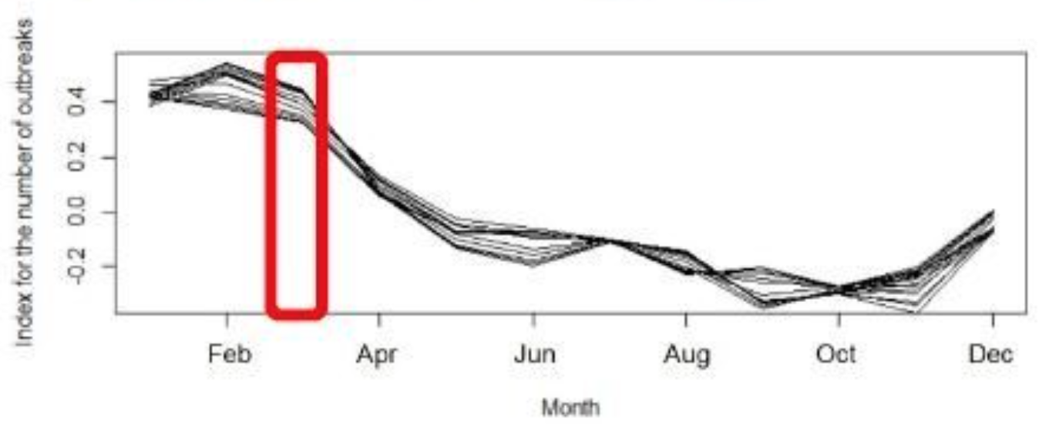
INTRODUCTION
2005 to 2019, 76 countries/territories reported 18,620 outbreaks to WOAH
Lowest in September, begins to rise in October and peaks in February – WOAH
Nineteen subtypes detected:
    The most commonly detected subtypes was H5N1. followed by H9N2, H5N2, H5N8 and H6N2 (mostly detected in domestic poultry)
    H1N6, H3N6, H4N6, H4N8, H9N1 and H11N9 were exclusively detected in wild birds.
    Meanwhile, H5N1, H5N2 circulates among wild and domestic birds

Slide 4
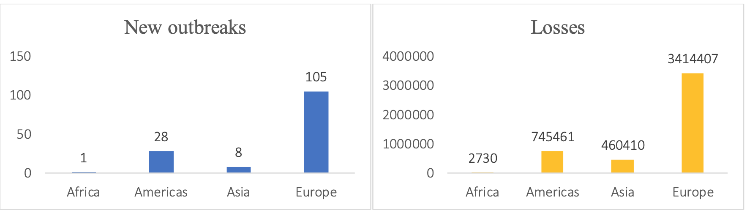
INTRODUCTION
(CONT’D)
Recent, as at 15/11/2022 by 16 countries, 142 outbreaks
Number of new outbreaks and associated losses by geographical region (WOAH)

Slide 5
RESURGENCE
2006 – 2008 wave of the outbreak affected 8 of the West African countries, including:
  Niger, Burkina Faso, Cote D’Ivore, Ghana, Togo, Benin, Nigeria, Cameroun
Since then, several West African countries have continued to experience sporadic outbreaks of the disease
  2006 – first reported in Nigeria (H5N1)
  Eradicated after 2 years
  Re-introduced in 2015 (H5N1)
  Re-introduced 2016 – 2019

Slide 6
RISK FACTORS
Categorized under 3 broad subheadings
  Risk of introduction
  Risk of Exposure
  Risk of spread

Slide 7
RISK FACTORS
(CONT’D)
Risk of Introduction
  Porous borders
  Trade in poultry and poultry products
  Fights cocks
  Land border: country sharing land border with an infected country

Slide 8
RISK FACTORS
(CONT’D)
Risk of Exposure
  Chicken and duck density
  Biosecurity awareness and practice
    Good biosecurity practice increases with level of intensification
    the more the number of backyard poultry the more the risk of exposure
    Presence of wild/migratory birds
    Capacity for detection

Slide 9
RISK FACTORS
(CONT’D)
Risk of spread
Capacity for detection (laboratory capacity)
Reporting timeliness (reporting officers)
  at all levels/points in the risk pathway e.g Nigeria’s present outbreak scenario
Active surveillance, not survey (difference) among both domestic and wild
Passive surveillance

Slide 10
SOCIOECONOMIC IMPACT
Considerable loss of production and livelihood to vulnerable people
Prolonged financial drain for control in several countries where it is already endemic
disruption in participation in international trade in poultry and poultry products
Significant threat to animal health and welfare
Constitutes significant threat to public heath and livelihoods of some of the world’s poorest farmers

Slide 11
CONCLUSION
The virus is now 20 years old now (since 2003) on the globe and seems growing stronger with several siblings (subtypes)
If this scourge with huge socioeconomic consequences is not well managed now, it might spell the next pandemic

Slide 12
THANK YOU

