Slide 1
Discussions on Approach to Conducting Rapid Risk Assessment on HPAI
Taiwo Olasoju I.M
08034917865, 7taiwo@gmail.com

Slide 2
Outline - 1
Introduction
Scope of the Assessment
Identify risk factors
Risk pathway and animal mobility
Risk questions
Methodology

Slide 3
Introduction
ECOWAS member countries at more risk of the outbreak because of the free movement of people and goods

Slide 4
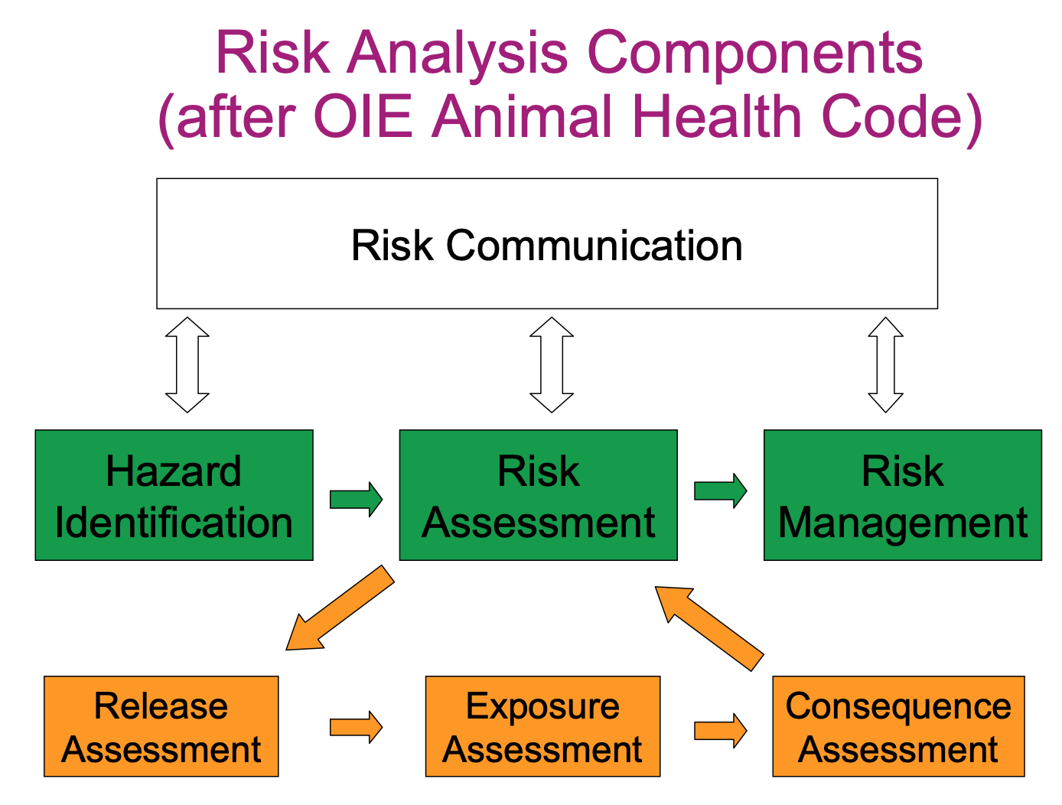

Slide 5
Scope of the Assessment
Scope of the assessment
Type of assessment (qualitative/ or quantitative)
Type and period of data available,
Aim: to determine the risk of introduction, exposure, Occurrence, spread
  To throw light into effective control measures in the light of the risk factors and incriminating unhealthy practices identified

Slide 6
Hazard Identification
Epidemiology of the disease
Strain
Occurrence
Spread
Host, vector, spp of birds

Slide 7
Risk questions
Formulate the risk questions e.g
What is the likelihood of HPAI introduction from neighbouring countries to country D through bordering farms and LBMs
What is the likelihood of HPAI introduction to country D via migratory birds
If HPAI gets introduced through the above pathways, what is the likelihood of spread within the country

Slide 8
Draw risk pathways
Hand-draw or use computer using the various value chain
Northern to southern pathways
Farm/LBM/Hatchery pathways (Risk of introduction/spread)
Migratory pathway (introduction/spread)
Identify the risk factors
Literature review
Expert opinion

Slide 9
Collect data/Field work
Develop questionnaire to collect data based on the risk factors identified
  To substantiate the risk factors
  On animal mobility
  You may include data on the impact of the outbreak

Slide 10
Methodology
Do the risk factor combinations for the different risks: (introduction (release)), exposure, occurrence, spread
Define the likelihood level
State the levels of uncertainty

Slide 11
Methodology Cont’d
What do you want to do?
Risk of introduction
Risk of exposure
Risk of occurrence
Risk of spread

Slide 12
Methodology Cont’d
Risk of exposure
If HPAI enters country A What is the likelihood that the virus will infect a susceptible spp of poultry
Density of poultry/poultry producing country
Biosecurity awareness and practice

Slide 13
Methodology Cont’d
Risk of spread (table for risk of spread)
HPAI virus has just been detected in country A, what is the likelihood that it will spread to other parts of the country.
Capacity for detection(lab capacity)
Reporting timeliness
Active surveillance

Slide 14
Methodology Cont’d
Risk of occurrence
Risk of introduction + risk of spread
  Risk matrix

Slide 15
HPAI Risk Combinations
Risk factors considered: density of poultry and ducks, accessibility, wild bird density
Group A
Very high
Density of poultry and ducks (high)
Or
Poultry movement (high) & accessibility (high)
Or
LBM (high) & Accessibility (high)
Or
Wild bird density(high) & accessibilty (high)

Slide 16
HPAI Risk Combinations Cont’d
Group B
High
Density of poultry and ducks (moderate)
OR
Poultry movement (high) & LBM (high)
Or
LBM (moderate) & accessibility (high)
Or
Wild birds density (moderate) & density of poultry and ducks (high)

Slide 17
HPAI Risk Combinations Cont’d
Group C
Low
Density of poultry and ducks (low)
Or
Wild birds density (Low) & LBM (low)
Or
LBM (moderate) & Accessibility (low)
Or
Poultry movement (low) & lbm (low

Slide 18
Basic Risk Assessment of the HPAI Outbreak in Nigeria
Risk Question |  | Assessment |  | Risk Level | Remark
 |  | Likelihood | Consequences
Potential risk for human health in Nigeria? | National | Likely | Minor | Moderate | It’s zoonotic. One human fatality recorded in the 2006 – 2008 outbreak
Risk of event spread in Nigeria? | National | Likely | Major | High | Already in all the geo-political zones in Nigeria. Requires a number of control measures which need significant resources to implement
Risk of insufficient control capacity with available resources in Nig? | National | Likely | Moderate | High | No compensation paid yet: this is already aiding the virus spread

Slide 19
THANK YOU

