Slide 1
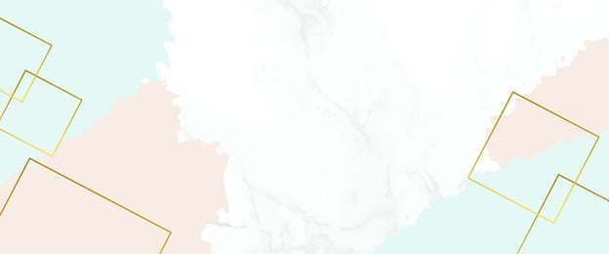


Project: Enhancing sustainable fisheries management and aquaculture development in Africa: A programme for accelerated reform of the sector (FISHGOV2)
Consultancy to commission studies on identification of sources of fisheries, aquaculture, socioeconomics and environmental related data (research and statistics) in North Africa.
Prof. Dr. Refaat M. A. El-Gamal
Director, Aquaculture Centre of excellency AU-IBAR in Egypt
Director, Central Laboratory for Aquaculture Research (CLAR)
Board Member, lakes & Fish Resources production &Development Agency Egypt
Member, Working Group of The African Fisheries Reform Mechanism (AFRM)

Slide 2
The North African region is made up of 5 countries namely: Algeria, Egypt, Libya, Morocco, and Tunisia. The region is mostly arid or semi-arid but has extensive coastlines and includes a wide range of different economies from high income, hydrocarbon-rich countries to low-income states
Aquaculture production from Near East and North Africa (NENA) was worth USD 2.3 billion in 2018, two-thirds of which came from Egypt and around one-quarter from Saudi Arabia. Aquaculture Production in Northern Africa Region has grown rapidly since the 1980s, more than doubling over ten years and increasing by 50 percent over the five years preceding 2018 to reach 1.7 million tones. Egyptian fish farms accounted for 92 percent of production, Tunisia (21 826 tones), Algeria (5 100 tones).

Slide 3
Climate change and the associated alterations in distribution patterns pose significant threats to catch potential, as well as the security of coastal communities. Healthy ecosystems are essential to ecosystem services, especially for fisheries. However, reductions in water quality through pollution, habitat destruction, and unsustainable and destructive fishing practices imperil the ability of ecosystems to support fisheries.
North African countries such as globe catches, and the impacts of the COVID-19 pandemic in 2020. This decline was compensated for by a continued growth of aquaculture, albeit at a slower yearly rate in the last two years.

Slide 4

The purposes of this is to review
Identification of sources of fisheries, aquaculture, socio-economics and environmental related data in North Africa
Best practices for promoting and implementing fisheries and aquaculture technology in the Northern Region of Africa
National and regional fisheries and aquaculture sectoral plans

Slide 5

Data collection was depended on
Previous editions of World Fisheries and Aquaculture reported by FAO and World Bank.
Direct interviews with officials who represent national authorities and institutions involved in fisheries and aquaculture management and planning, environmental management in the selected countries
Survey to be shared with representatives (officials, researchers, and stakeholders) from the selected countries.
Focus groups discussions (virtual) with groups of stakeholders from the selected countries.

Slide 6
Status of North African fish production in the continental and Global context

Slide 7
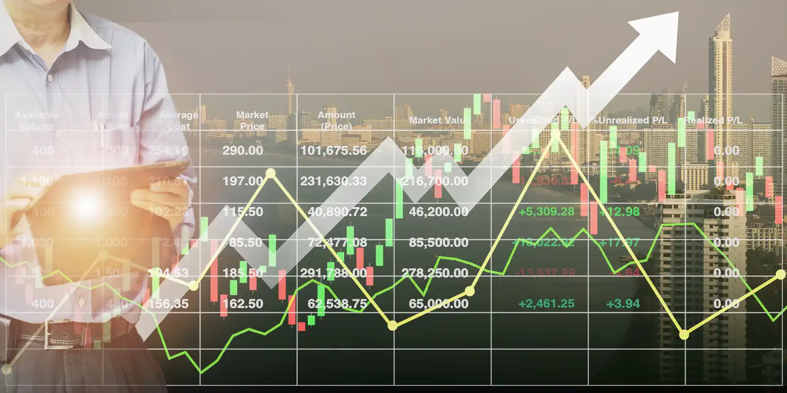
The total first sale of the global production of fisheries and aquaculture was estimated at, 110.7 million ton at 1990 fisheries was measured 88.9 million ton and aquaculture was 21.8 million ton. The total production was 177.8 million ton during 2020. The quantity was changed to be 90.3 million ton fisheries and 87.5 million ton aquaculture (United Nations 2022).

Slide 8
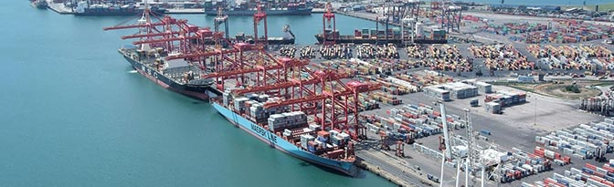
Africa harbors a rich biological diversity of native fish resources. Recognition of the potential to use these resources to make significant contributions towards improving Africa’s food security through aquaculture has existed for some time.

Slide 9
Land and water for aquaculture in North Africa region

Slide 10
Most North Africa region states are arid or semi-arid, with low or intermittent rainfall, limited freshwater resources, large areas of desert and extensive coastlines.
Freshwater resources such as the major rivers or groundwater have long been harnessed for irrigation, while many natural inland lakes are saline or highly seasonal.
Marginal land is readily available in several North Africa countries but land with easily available water is in very short supply and expensive.

Slide 11
Aquaculture production

Slide 12
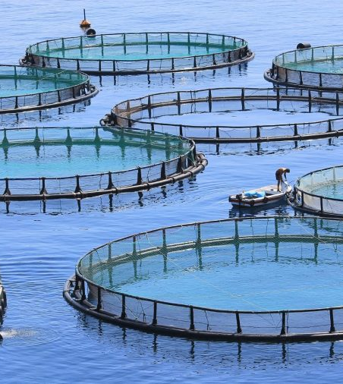
The aquaculture sector is also growing in several other countries, although from a relatively small base. Tunisia has built significant production capacity for marine cage-based aquaculture of European seabass and gilthead seabream, including the leading marine fish hatchery in North Africa, Tunisian Aquaculture, producing around 20 million fingerlings annually for domestic and export markets (World Bank 2022).

Slide 13
Aquaculture production by countries and territories in North Africa from 2011–2020 (tones)
Country/ territory | 2011 | 2012 | 2013 | 2014 | 2015 | 2016 | 2017 | 2018 | 2019 | 2020
Algeria | 2,246 | 2,644 | 2,193 | 2,411 | 1,333 | 1,376 | 1,416 | 5,100 | 4,835 | 5,436
Egypt | 986,820 | 1,017,738 | 1,097,544 | 1,137,091 | 1,174,831 | 1,370,660 | 1,451,841 | 1,561,457 | 1,641,949 | 1,591,896
Libya | 10 | 10 | 10 | 10 | 10 | 10 | 10 | 10 | 10 | 10
Morocco | 617 | 693 | 988 | 1,189 | 1,050 | 1,150 | 1,270 | 1,267 | 1,598 | 1,618
Tunisia | 8,126 | 8,577 | 12,184 | 11,279 | 14,425 | 16,183 | 21,930 | 21,826 | 22,913 | 23,486
Total | 997,819 | 1,029,662 | 1,112,919 | 1,151,980 | 1,191,649 | 1,389,379 | 1,476,467 | 1,589,660 | 1,671,305 | 1,622,446
Source. World Bank 2022

Slide 14
North Africa production by Species

Slide 15
Forty-three species of finfish, shellfish and aquatic plants were produced through aquaculture in the North Africa region in 2018. Tilapia was the most farmed fish in the region and was produced in all countries. The main species grown was Nile tilapia, Oreochromis niloticus.
The second-ranked farmed species group in 2018 was mullets (mainly flathead grey mullet, Mugil cephalus and thinlip grey mullet, Chelon ramada) (World Bank 2022).

Slide 16
Aquaculture Production in North Africa in relation to environment

Slide 17
Aquaculture production environments are categorized as freshwater, brackish water and marine. Most freshwater production in the North Africa region is in ponds and cages for carp, African catfish, and tilapia, although there are also farms using intensive tanks.
Commercial marine aquaculture systems in North Africa are mainly used to grow barramundi, European seabass, gilthead seabream, meager, sobaity seabream and shrimp.

Slide 18
Aquaculture production in 2018 by environment in North Africa countries/territories (tonnes)
Country/Territory | Fresh water | Brackish water | Marine
Algeria | 3,016 | 2,084 | 0
Egypt | 271,384 | 1,290,073 | 0
Libya | 10 | 0 | 0
Morocco | 660 | 356 | 251
Tunisia | 881 | 20,935 | 10
TOTAL | 275,951 | 1,313,448 | 261
Source: FAO, 2020c.

Slide 19
FISHERIES SECTOR IN NORTH AFRICA

Slide 20
Fishery resources continue to decline due to overfishing, pollution, poor management, and other factors, but the number of landings from biologically sustainable stocks is on the rise.
The fraction of fishery stocks within biologically sustainable levels decreased to 64.6 percent in 2019, 1.2 percent lower than in 2017. However, 82.5 percent of the 2019 landings were from biologically sustainable stocks, a 3.8 percent improvement from 2017.

Slide 21
SOCIAL AND ECONOMIC BACKGROUND OF THE REGION

Slide 22
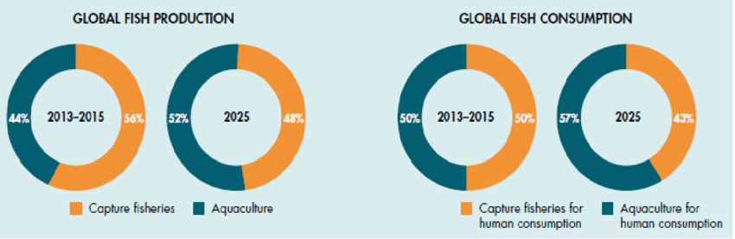
Global fish production is increasing and was estimated to have reached 179 million tones (excluding aquatic plants) in 2018 with a total first sale value of USD 401 billion, of which 82 million tones worth USD 250 billion came from aquaculture that considering the main direct affecting on the social and economic background of many countries and especially African one.

Slide 23
  Food security and aquaculture

Slide 24
Fish availability in countries/territories of the near east and north Africa region in 2017
Country/territory | Food fish supply (tonnes) | 2017 population (million persons) | Per capita fish availability (kg/yr)
Algeria | 159,662.00 | 41.40 | 3.90
Egypt | 2,285,151.00 | 96.40 | 23.70
Libya | 98,016.00 | 6.60 | 14.90
Morocco | 692,674.00 | 35.60 | 19.50
Tunisia | 147,342.00 | 11.40 | 12.90
Total NENA | 3,382,845.00 | 191.40
Source: FAO, 2020d

Slide 25
  Aquaculture employment

Slide 26
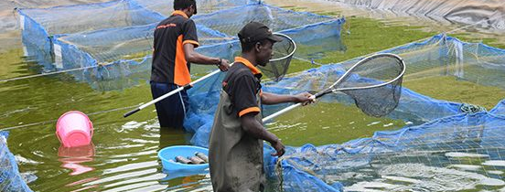
Aquaculture provides employment, not just on fish farms but along value chains. Recent estimates of employment levels in aquaculture indicate that the total number of fish farmers in the North Africa countries reached about 264 800 individuals

Slide 27
Number of fish farmers in the near east and north Africa region in 2018
Country | Female | Male
Algeria | 2,166 | 2,321
Egypt | 24,724 | 22,801
Libya | 232 | 248
Morocco | - | 377
Tunisia | - | 1,000
Source: FAO, 2020d

Slide 28
AQUACULTURE AND ENVIRONMENTAL INTEGRITY

Slide 29
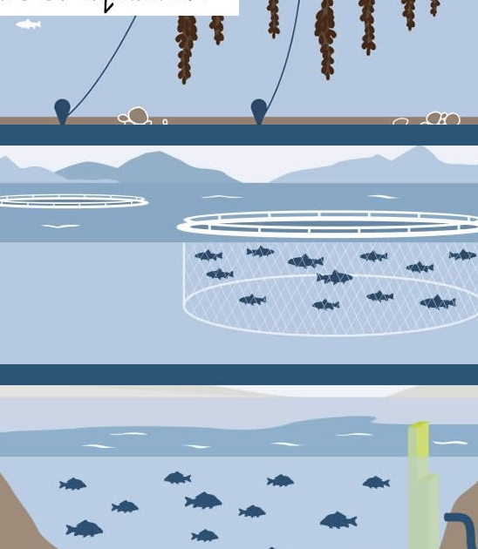
Most forms of aquaculture are affected by environmental conditions and in turn have an impact on the surrounding environment.
For example, the quality of incoming or surrounding water affects farming practices while the application of feeds and the metabolic processes of the aquaculture species may impact nearby lakes, rivers or surrounding water bodies.

Slide 30
The Fisheries and Aquaculture sector in Africa has a number of identified challenges including lack of data and scientific knowledge on the state and management of the resources for optimum utilization.
Public sector actors at national level are primarily Ministries, Departments and Agencies (MDAs) of AU Member States with mandates for management and development of fisheries and aquaculture programmes.
The research institutions (universities, research centers) are tasked with building long-term in-country capacities to manage fish resources and provide scientific and socio-economic data to guide fisheries management.

Slide 31
EXTERNAL PRESSURES ON
THE SECTOR

Slide 32
COVID-19
Rapid spread of the newly identified coronavirus COVID-19 in 2020 has had severe impacts around the world. In relation to aquaculture and markets for seafood products, the main initial impact has been through the disruption of markets due to measures taken by different governments to contain the virus
Climate change
The greatest impact of warming on aquaculture in the region is likely to be on pond-based aquaculture systems, such as those in Egypt. On the positive side, warmer temperatures should extend the growing season, allowing farmers to grow more than one crop per year. However, peak summer temperatures in these pond systems are already above 30 °C, so fish farmers will have to provide aeration during critical periods.

Slide 33
Forwarded work
Now we are waiting for individual countries reply for completing the general report form

Slide 34

Thank you

