Slide 1





Consultative Workshop of Stakeholders on The Use of Fisheries and Aquaculture Database and The Validation of the Consultancy Reports for Sources of Data, Best Practices from Outcomes of Fishgov1 and Fish Trade Projects’ Implementation
OBJECTIVES OF THE WORKSHOP a presentation of
THE AFRICAN UNION -INTERAFRICAN BUREAU FOR ANIMAL RESOURCES
(AU-IBAR)
29-31 May. 2023
Cairo, Egypt

Slide 2

INTRODUCTION
Fisheries Governance project phase 2 (FishGov 2)
The overall objective is to improve food security, livelihoods and wealth creation in sustainable fisheries and aquaculture, aligned with AU Agenda 2063. The specific objectives are:
Fisheries and aquaculture policies in Africa are coherent with the PFRS and other AU priorities and coordinated at continental, regional and national levels
Africa is adequately represented and effectively participates in international fisheries and aquaculture fora and ably domesticates and effectively implements relevant global instruments
African Union decisions on sustainable fisheries and aquaculture policies are evidence-based

Slide 3
CHALLENGES IN DATA COLLECTION & SYSTEM
Funds for fisheries-independent data collection through scientific surveys are limited and often donor dependent;
Limited/lack of funding and staff allocations provided by national governments;
Knowledge of and capacity available for the design and implementation of sample-based surveys and their statistical requirements are limited; sample-based surveys are essential for small-scale fisheries;
Weak institutional arrangement at national level, e.g. the fisheries line institutes, responsible for fisheries and aquaculture data collection, are not well linked to national statistics bureaus,
Reported figures often do not include gender-disaggregated data, subsistence or occasional fishers who, during parts of the year, often depend on the fisheries resources as part-time fishers;
For aquaculture, limited sampling frame providing information on the number of aquaculture units, culture characteristics, area coverage and geographical positions.
AFA data-collection systems are not performing satisfactorily & do not deliver all the information required for
  assessing the appropriateness of fisheries and aquaculture policy and management decisions, and for tracking the status of exploitation of fishery resources (FAO, 2020)
  Overall performance of existing fishery management measures

Slide 4
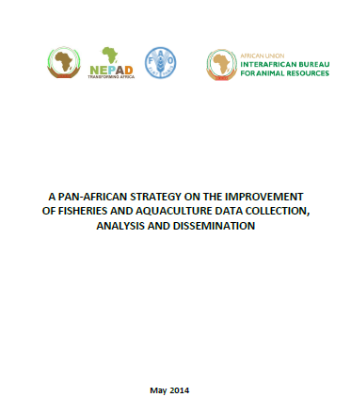
WHY AFRICA F&A STRATEGY & DATABASE
CAMFA 2010 Decisions to “improve scientific knowledge and build capacity => requirement to ensure adequate informed decision making
Objective of the strategy => provide a framework and guidelines that should lead to improvements in the availability and quality of national and regional data to support fisheries management, aquaculture development and policy development in Africa.
AFA DATABASE- DFAS-UCC
Objective => enhance effective F&A data management systems/practices for AU stakeholders, and to have access to quality knowledge products on African F&A

Slide 5
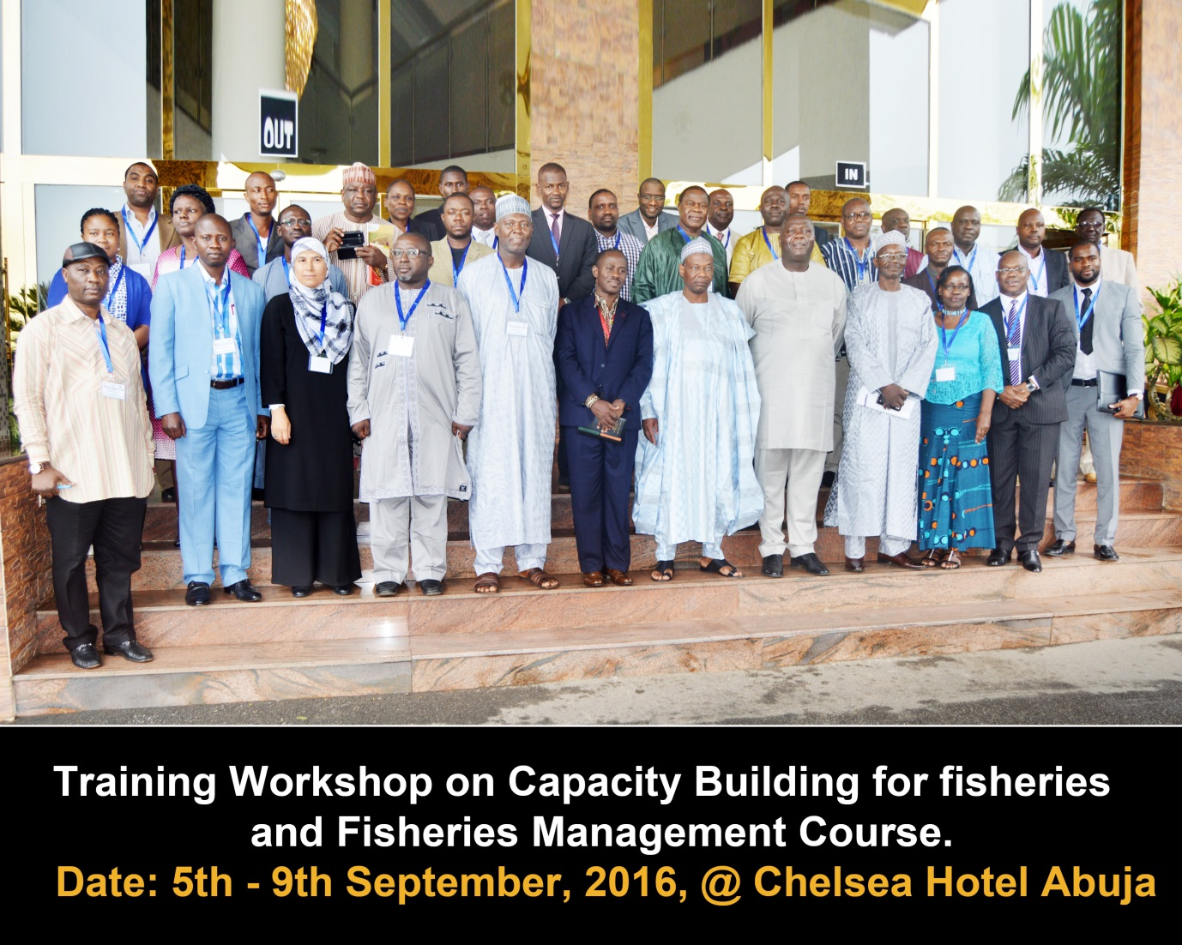
FISHERIES MANAGERS TRAINING GUIDE
FISHERIES MANAGERS TRAINING GUIDE: A TECHNICAL GUIDE TO HARMONISED FISHERIES DATA COLLECTION, MANAGEMENT AND ANALYSIS FOR THE AFRICAN UNION (AU-IBAR, 2016)

Slide 6
AFA DATABASE
F
Continental level
Pan-African Strategy on the Improvement of F&A Data Collection, Analysis and Dissemination
AFA database
Capacity building & resource mobilization
Reporting:
PFRS
Malabo commitment
Biennial Review Report CAADP
biennial Africa fisheries and aquaculture report
Data collection, analysis & dissemination (Domestication of strategy)
Timely reporting on AFA-Data
Capacity building
Status Reports
Fisheries mgt plans- shared
Human & financial resources
Regional level
National level
Data collection, analysis & dissemination (Domestication of strategy)
Timely reporting on AFA-Data
Capacity building
Status Reports
Fisheries management plans
National Statistical Systems and the National Strategy for the Development of Statistics
sufficient financial and human resources
Notes:
enhance effective fisheries and aquaculture data management systems/practices for AU stakeholders, and to have access to quality knowledge products on African fisheries and aquaculture

Slide 7
Guiding principles for collecting, analyzing and disseminating F&A information
Sustainability: arrangements for collecting, analysing and disseminating information should be viable in the long term. Adequate funding should be provided at the national level.
Cost Effectiveness: Budget limitations for data collection, arrangement= cost effective and concentrate on essential, core data.
Best Scientific evidence: contribute to the best scientific evidence that can be made available. Protocols for assuring the quality and accuracy of the data collected and disseminated should be applied wherever and whenever practical and appropriate.
Participatory and Cooperative: inclusive + states should provide feedback on the status and trends of fisheries to all relevant participants.
Comparability: Indicators used should be comparable across countries and regions.
Objectivity and Transparency: contribute to the provision of the best scientific evidence that can be made available, and to transparency, while respecting any confidentiality requirements. Any uncertainty associated with status and trends information should be pointed out.
Timeliness
Flexibility: flexible enough to permit adjustments as necessary to ensure that they effectively support fishery policy making and management through the provision of appropriate information.
Ownership: part of national priorities.

Slide 8
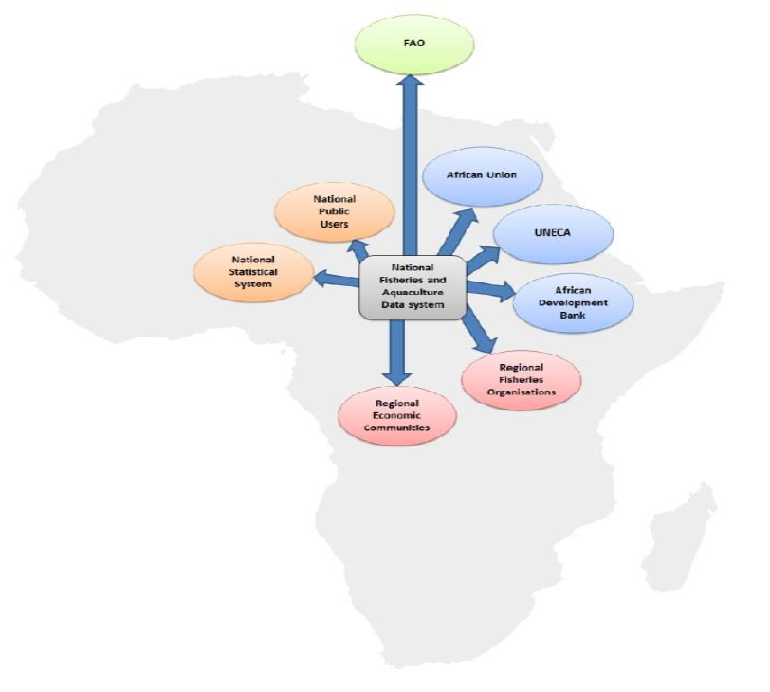
Information sharing flow
AU and FAO (2014)

Slide 9
CONSULTANCIES BY CoE
Develop and Update Database on Fisheries & Aquaculture including Mechanism for Data Management
Identification of Sources of Fisheries, Aquaculture, Socio-economics and Environmental Related Data in East and Southern Africa
Identification of Sources of Fisheries, Aquaculture, Socio-economics and Environmental Related Data in the North
Identification of Sources of Fisheries, Aquaculture, Socio-economics and Environmental Related Data in West and Central Africa
Promoting Uptake & Implementation of Knowledge, Innovations and Best Practices (Fishgov1 & Fish Trade) To Inform Policy Change in Fisheries Management & Aquaculture
Documentation of lessons learnt and best practices for informed and rational interventions in the fisheries and aquaculture sector in Africa

Slide 10
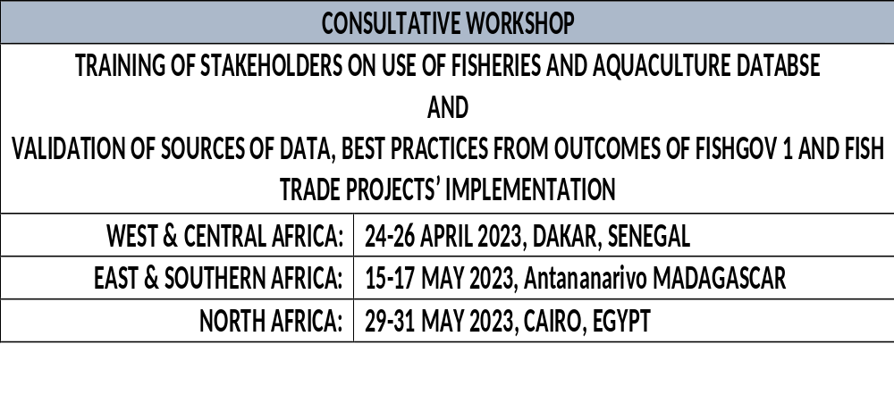
REGIONAL WORKSHOPS
Validation of the consultancy on documentation of lessons learnt and best practices for informed and rational interventions in the fisheries and aquaculture sector in Africa

Slide 11
OBJECTIVES OF THE MEETING
OVERALL OBJECTIVE = build capacity of stakeholders on the use of the developed database and to validate consultancies on the sources of data; best practices identified from reports of FishGov 1 and FishTrade implementation; documentation of lessons learnt and best practices for informed and rational interventions in the fisheries and aquaculture sector in Africa
SPECIFIC OBJECTIVE
Introduce the database and integrity to the AU stakeholders
Train stakeholders on the use of the database for data inputting or transmission, retrieval
Solicit inputs from stakeholders to improve the database
Illustration on use or the utilization of data to determine fisheries management parameters (projections, prediction and forecasting)
Review and validate the identified sources of data and data types
Review and validate the best practices generated from FishGov 1 and Fish Trade implementation reports
Presentation on report on lessons and best practices on emerging or contemporary issues on other related ongoing regional initiatives by key partners.

Slide 12
EXPECTED OUTCOMES
BUILT CAPACITY OF STAKEHOLDERS ON THE USE OF THE DEVELOPED AFA DATABASE
Validated consultancy reports
Sources of data Fisheries, Aquaculture, Socio-economics and Environmental Related Data in East and Southern Africa
Best practices identified from reports of FishGov 1 and FishTrade implementation
Documentation of lessons learnt and best practices for informed and rational interventions in the fisheries and aquaculture sector in Africa

Slide 13

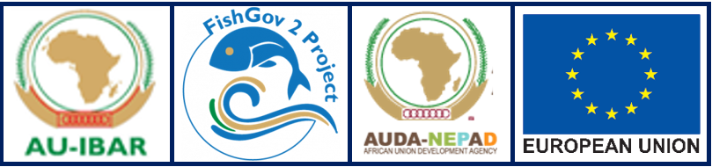
Thank You
AU-IBAR: Providing leadership in the development of animal resources for Africa

