Slide 1

PROMOTE UPTAKE AND IMPLEMENTATION OF KNOWLEDGE, INNOVATIONS AND BEST PRACTICES (INCLUDING THOSE GENERATED BY FISHGOV1 AND FISH TRADE PROJECTS) TO INFORM POLICY CHANGE IN FISHERIES MANAGEMENT AND AQUACULTURE DEVELOPMENT AT NATIONAL AND REGIONAL LEVELS IN AFRICA
BY
NATIONAL FISHERIES RESOURCES RESEARCH INSTITUTE (NaFIRRI)
Notes:
PROMOTE UPTAKE AND IMPLEMENTATION OF KNOWLEDGE, INNOVATIONS AND BEST PRACTICES (INCLUDING THOSE GENERATED BY FISHGOV1 AND FISH TRADE PROJECTS) TO INFORM POLICY CHANGE IN FISHERIES MANAGEMENT AND AQUACULTURE DEVELOPMENT AT NATIONAL AND REGIONAL LEVELS IN AFRICA

Slide 2
PRESENTATION LAYOUT
Background
Purpose of the Consultancy
Expected Results
Scope of work
Study Approach
Key findings

Slide 3
BACKGROUND
FishGov 1 – “Strengthening institutional capacity to enhance governance of the fisheries sector in Africa” was encompassing 55 AU Member States and 8 RECs (2014 – 2018)
Thematic areas for which interventions were made:
Strengthening regional cooperation and institutions collaboration in the sector
Enhancing coordination among actors in intervention in the sector
Strengthening coherence in polices and regulatory frameworks
Building capacity for negotiating sustainable partnerships agreements and strengthening common African positions in addition to fisheries monitoring, control and surveillance systems and fostering regional cooperation on MCS, minimum access conditions
Strengthening fisheries management plans for shared fisheries in transboundary freshwater and marine ecosystems
Notes:
Strengthening institutional capacity to enhance governance of the fisheries sector in Africa) (FishGov 1), was s to enhance the
contribution of fisheries resources to food security and economic growth in Africa.

Slide 4
Background
Thematic areas for which interventions were made:
6) Environmental management in aquatic production systems
7) Enhancing for aquaculture business development and extension services
8) Enhancing the capacity and coordination of non-state actors for increased participation in fisheries and aquaculture management decision making
9) Establishing an enabling environment for market led sustainable aquaculture industry;
10) Built capacity in aquatic animal disease control and surveillance; strengthened regional and continental aquaculture networks;

Slide 5
BACKGROUND
FishTrade – generate evidence to enhance the understanding of the inter-and intra-regional fish trade and extent of informal cross-border trade(2013 – 2018)
.
Key outputs:
Socio-economic benefits of intra- and inter-regional fish trade within Africa proved to be highly significant to the economies of African countries
Strategies for catalyzing and facilitating fish trade were developed and tested in some regional economic communities (RECs).
Strong partnerships with African universities across the continent
Findings and lessons learnt used to implement future activities
Notes:
generated evidence to enhance the understanding of the inter- and intra-regional fish trade and the extent of informal cross-border trade.

Slide 6
BACKGROUND
PROBLEM : Utilisation of the outputs from the two projects to guide policy reform for the sustainable fisheries and aquaculture in AU- Member States. The utilisation of the outcomes of these projects for policy reforms has not been very successful
Therefore, it is imperative to identify a mechanism to facilitate utilisation of outcomes from the two projects by AU- MS and regional insitutitons for evidence-based fisheries reforms
.
AU-IBAR contracted NaFIRRI to undertake the consultancy
Notes:
The FishGov 1 generated massive amount of information that are available in various reports and publications.

Slide 7
OBJECTIVE
To promote, uptake and implementation of knowledge, innovations and best practices (including those generated by FishGov1 and Fish Trade Projects) to inform policy change in fisheries management and aquaculture development at national and regional levels in Africa.

Slide 8
PURPOSE OF THE CONSULTANCY
Examine relevant reports and the main outcomes from implementation of FishGov 1 and Fish Trade projects
Identify from the reports and evaluate and assess relevant issues for the formulation of best practices and policy messages that are crucial to support rational governance of the sector by AU member states and regional institutions
Formulate best practices and key policy messages based on identified issues for policy reform in AU member states and relational institutions
Facilitate regional stakeholders’ validation workshops in 5 Regions (West, Central, Eastern, Southern and Northern Africa) for the consolidated best practices and key messages on issues from review of outcomes from the Fishgov1 and Fish Trade projects
Develop recommendations of facilitating the utilization of documented lessons and best practices in AU member states and regional institutions to effect policy reforms.

Slide 9
EXPECTED RESULTS FROM THE CONSULTANCY
Result 1: Review of activities conducted based on reports from implementation of FishGov 1 and Fish Trade projects and critical issues identified for formulation of best practices and key policy messages for fisheries and aquaculture reform
Result 2: Formulation of best practices and key messages crucial to improved reform of the fisheries and aquaculture management;
Result 3: Preparation of relevant documentation to support Three regional stakeholders’ validation workshops facilitated

Slide 10
SCOPE OF THE WORK
Theme: within the overall broad thematic area of FishGov 2 project on developing capacities and provide technical support to MS and RECs to develop strategies and investment plans
Geographical Area to be covered: Continent-wide and in liaison with 55 AU-MS, relevant regional institutions including 8 RECs and RFBs, RSCs, Water basin Commissions, NSAs in Africa.
Target group: AU member states, Regional Economic Communities (RECs) and Regional Fisheries Bodies (RFB; Regional Seas Conventions (RSC), water basin Commission, Partners, Non-State actors

Slide 11
SCOPE OF THE WORK
Specific work:
Inception briefing with relevant AU-IBAR staff to agree on expectations and provide clarity on any outstanding issues.
Design a questionnaire to obtain views and perspectives; from the relevant national authorities and key stakeholders of AU MS and regional institutions (e.g. regional fisheries organizations, regional economic communities, etc.)
Review reports from FishGov 1 and Fish Trade projects: -
Identify, extract and analyze crucial issues from reports of the projects relevant to enhance sustainable, rational fisheries management and responsible aquaculture development in AU member states and at regional level
Generate, consolidate and document best practices and key policy messages from the outcomes of FishGov 1 and FishTrade projects
Develop recommendations on mechanisms to fast tract utilizations of the documented best practices

Slide 12
STUDY APPROACH
ToR#1: Review relevant reports and the main outcomes from implementation of FishGov 1 and Fish Trade projects NaFIRRI will organize zoom meetings with selected authorities in relevant organizations, at national, regional and continental level.
ToR#2: Identify from the reports, evaluate and assess relevant issues for the formulation of best practices and policy messages that are crucial to support rational governance of the sector by AU member states and regional institutions.
ToR#3: Formulate best practices and key policy messages based on identified issues for policy reform in AU member states and relational institutions.
ToR#4: Facilitate regional stakeholders’ validation workshops in five (5) Regions (West, Central, Eastern, Southern and Northern Africa) for the consolidated best practices and key messages on issues from review of outcomes from the FishGov1 and Fish Trade projects.
ToR#5: Develop recommendations of facilitating the utilization of documented lessons and best practices in AU member states and regional institutions to effect policy reforms.

Slide 13
KEY AREAS REVIEWED UNDER FISHGOV1
Monitoring Control and Surveillance (MCS) specifically Illegal unreported and unregulated fisheries (IUU).
Ecolabeling and Fisheries Improvement projects (FIP),
Expert consultative;
Performance review of the Regional Fisheries bodies (RFBs);
Fisheries Management issues in shared lakes and rivers ;
Negotiating fisheries access arrangements-regional approach;
Governance of LME and Fisheries Management approaches and practices;
Coordination and regional cooperation in fisheries management.

Slide 14
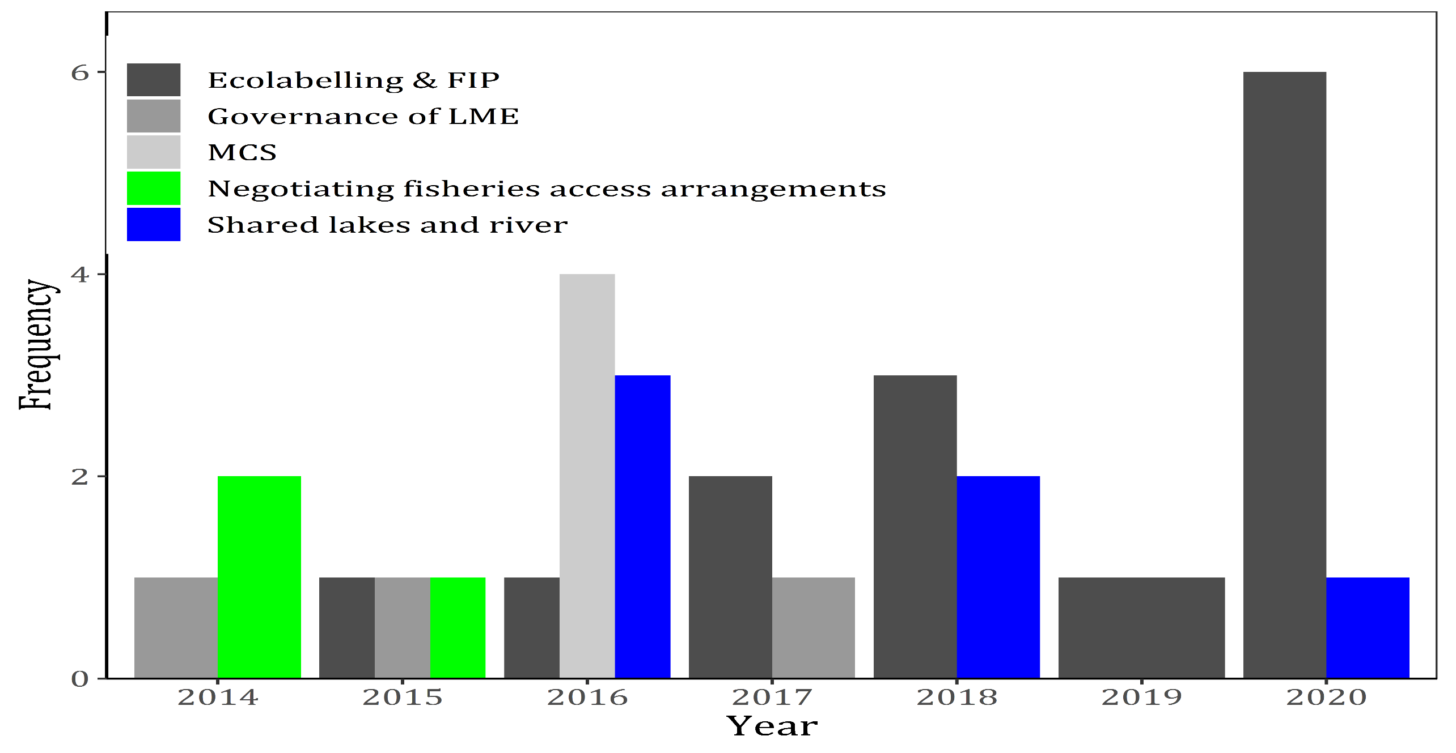
REVIEW DOCUMENTS UNDER FISHGOV1
N=36

Slide 15
FISH TRADE PROJECTS
Inter and intra-regional fish trade
Engagement of women and youth along fisheries and aquaculture value chain.
AQUACULTURE DEVELOPMENT
Aquaculture production, extension practices in aquaculture systems
2. Ornamental fish exploitation and trade

Slide 16
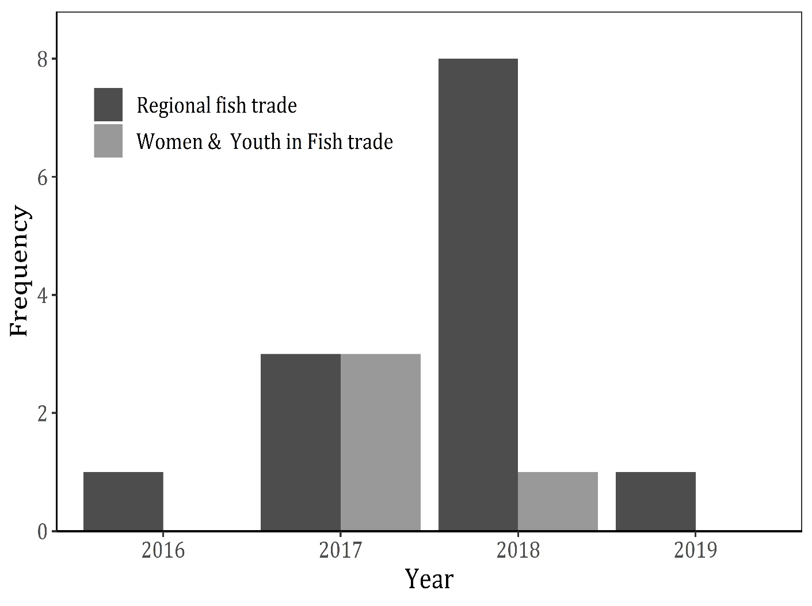
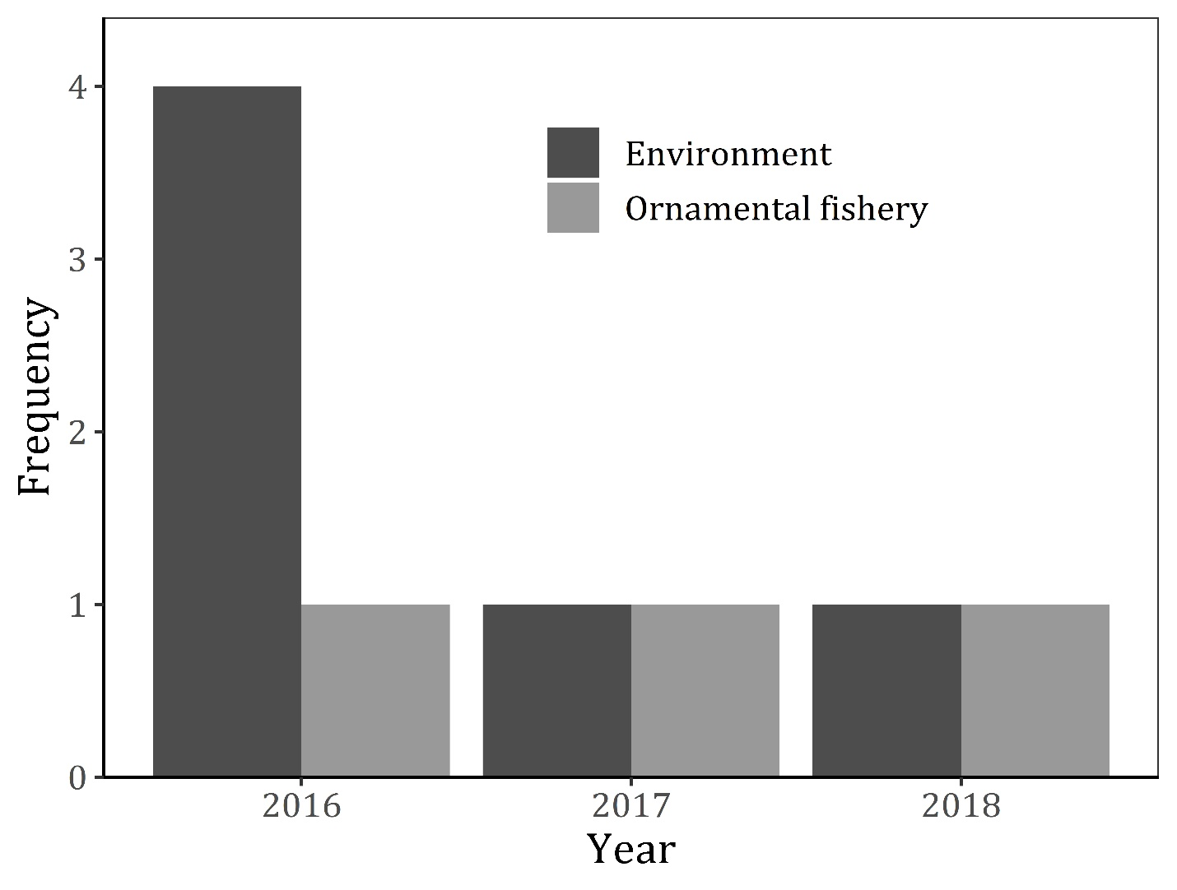
REVIEW DOCUMENTS UNDER FISH TRADE (A)& AQUACULTURE (B)
A
B
N=17
N=9

Slide 17
MONITORING CONTROL AND SURVEILLANCE
Issue | Remarks
1. Enactment of fisheries regulations with MCS provisions to combat IUU | Varied level of legal framework/implementation across countries (ranging from weak to strong); Not all aspects of MCS are incorporated
2. Weak governance | 1. Increasing link between IUU fishing and transactional organised crime (especially non African fleets from the East)
National Plan of Action (NPOA) to deter IUU fishing | 1. Only Namibia has finalised its NPOA

Slide 18
MONITORING CONTROL AND SURVEILLANCE
Issue | Remarks
1. Observers not included on vessels smaller than 24 meters | Management and control IUU on such vessels
2. Lack of co-management in small scale fisheries | 2. Increased IUU
3. Poor management of ecosystems along the length of the Southern African coastline | 3. Increased IUU on the coastline
4. Regionally implementation and management of Fisheries and Management Control systems, such as IT infrastructure, integration of data, sharing of information | 4. Poor data sharing both regional and national

Slide 19
RECOMMENDATIONS FOR MONITORING CONTROL AND SURVEILLANCE
1. A need to address the issue of inclusion of the observers on fleets less than 24 meters hence the government and efficiency of the MCS in the system.
2. The open access character for capture fisheries small scale fisheries, inadequate or weak governance thus; quota system be advocated
3. Need to have a common front on the nautical miles of operations in the MCS for each country area.

Slide 20
Ecolabelling & Fisheries Improvement
Issue | Remarks
1. Certification by accredited sources | Lack of awareness of ecolabelling certification process Lack of capacity and resources hence lagging behind of African fisheries
2. Strengthen capacities for access to market’ in fish trade | 3. Due poor improvement programs for eco-labelling certification.
3. Adhering of the policy framework and reform strategy for fisheries and aquaculture in Africa on ecolabelling and fisheries improvement regionally and nationally | 4. Adherence is not followed regionally.
4. Eco-Labelling Certification towards sustainable Fisheries and Market access is a key in the African region to meet the demands and supply value chain | 5. Meet the demands and supply value chain in the internationally;

Slide 21
Recommendations for Ecolabelling & Fisheries Improvement
1. Ecolabeling and Fisheries Improvement Projects (FIP) in Africa it would be good on the scale of the pilots, Member States should be open to both small-scale and large scale fisheries
2.Traceblity of Aquaculture products regionally

Slide 22
Performance Review of RFBs
Issue | Remarks
1. Limited resources to conduct institutional functions | Arrears in remittance of country contributions/heavy reliance on external support
2. Limited capacity | Approved technical positions remain vacant
3. Lack of political commitment by members of some RFBs | 2. RFBS to develop be able to implement their activities effectively (memberstate).
4. Limited international cooperation between RFBs, RECs, RSCs | 3. Limited resources among the institutions
5. Overlap of institutional mandate
6. Delayed Capacity building efforts | 4.Proposed training depend on scholarships
7. Effectiveness of RFBs | 4. Their role is advisory and can not impose obligations on MS
8. Policy frame works strategy (PFRS) not fully domesticated among MS

Slide 23
Recommendations of Performance Review of RFBs
1. Strengthen of the bodies such as ECOWAS and other bodies in fisheries and aquaculture approaches
2. Countries with shared fisheries resources need to come up into stronger terms in signing agreements that are bidding for the management of the fisheries stock to avoid collapse.

Slide 24
Fisheries Management issues in shared Lakes and Rivers
Issue | Remarks
1. Legal Framework Fisheries Management Plan (FFMP) for the transboundary fishery resources | Institutions such as LVFO and other RFBs FMP III was not developed through a participatory process with the active involvement of the stakeholders
2. Regulation of mesh size for harvest such as Nile perch | 3. Harmonization of size at first capture regionally need to be addressed
3. Vessel Monitoring System (VMS), control of landings | 4. Better control of landings
4. Limitations on catches, protection of spawning areas, | 5. Decline in stock levels regionally

Slide 25
Recommendations of the Fisheries Management issues in shared Lakes and Rivers
1. There is need to promote the participatory process with the active involvement of the stakeholders.
2. Open access fishery the quota system could be the alternative for the sustainability of the resources and better management.

Slide 26
NEGOTIATING FISHERIES ACCESS ARRANGEMENTS-REGIONAL APPROACH;
Issue | Remarks
1. Establishment of exclusive economic zones (EEZs) in the region. | Ensure sustainable utilization of the fisheries resources in conjunction to the conservation measures of the fisheries.
2. Negotiations and the formulation of fisheries agreements | 2. Review of Previous and Current Fisheries Agreements Concluded by AU Member States in West and Central Africa” such as Guard oneself against the risk of an accident (The Principal bears the risk). 3. Vessel Charter Agreement”; the charter contract involves the provision to a fishing company in a coastal country (charterer) of one or more vessels by a foreign fishing vessel owner(lessor), in exchange for remuneration

Slide 27
NEGOTIATING FISHERIES ACCESS ARRANGEMENTS-REGIONAL APPROACH;
Issue | Remarks
3. Defining the surplus for each species involved in the absence of a scientific evaluation and fisheries development plans | 4. West African, this notion cannot be pelagic fisheries, in particular tuna and tuna-like species and oceanic migratory fish in West Africa have a challenge
4. Broad participation of the interested parties in fisheries and aquaculture | 5. Member States would ensure judicious choices in the design of the plan and provide legitimacy to the output and is likely to facilitate its implementation

Slide 28
RECOMMENDATIONS OF THE NEGOTIATING FISHERIES ACCESS ARRANGEMENTS-REGIONAL APPROACH;
Allocation of fishing rights may be approached from two different angles (with variants). Relying on the prevailing practice in the Pacific Ocean, namely an allocation of fishing efforts between parties to the convention and it is left to them to in turn allocate parts or all this effort to foreign fleets according to the daily fishing mechanism (DFM) at a price agreed upon by all the parties. Using a mechanism for the allocation of efforts (DFM) or another one for catches made accompanied by a single or gradual payment schedule.
2. establish some accountability in fishing efforts by foreign ships in the EEZ of each coastal State, to pay dividends to each coastal State.

Slide 29
GOVERNANCE OF LME AND FISHERIES MANAGEMENT APPROACHES AND PRACTICES
Issue | Remarks
1. Compliance in fisheries and aquaculture transhipment | Limited compliancy such as the Ocean Tuna Commission (IOTC).
2. Information sharing: national and regional database | 2Approaches and practices such as; Better operational coordination of the monitoring and control actions
3. Strong (bilateral and regional) cooperation and coordinated mechanisms among RECs, RFBs and LME-based commissions. | 3. Build on the strengths and complementary resources of each Member State; Use of new control technologies against illegal fishing;
4. Ocean governance | 4. The ocean requires a collective approach based on the provisions of international law and with the UN Convention on the Law of the Sea (UNCLOS) at its core.

Slide 30
RECOMMENDATIONS FOR GOVERNANCE OF LME AND FISHERIES MANAGEMENT APPROACHES AND PRACTICES
1. Develop coordinated mechanisms among RECs, RFBs and LME-based commissions to ensure coherence of fisheries policies and aquaculture
2. Develop or improve regulatory frameworks and strategies for Aquaculture and/or Mariculture.
3. New control technologies against illegal fishing is paramount in order to reduce illegalities and bycatches

Slide 31
FISH TRADE
Issue | Remarks
1. Poor level of structuration and organization of women into formal, legally recognized entities such as Small and medium enterprise SMEs; | Adoption and use of EFMIS and Good infrastructure that is gender sensitive and that easily facilitates value addition, processing and fish trade.
2. Difficulty to access to credit for financing their activities (Women and youth) | 2. Empower women and youths to participate in gainful processing and trade then enhance literacy level
3. Poor fish processing techniques leading to Hazardous, unhealthy and unfair working conditions;

Slide 32
FISH TRADE
4. The multiplication of barriers (taxes, taxes etc.) to the marketing; | 4. Framework sets objectives
5. Fishing industry, women are poorly represented in decision making spaces and management positions | 5. Regular Access to credit to facilitate fish processing and trade for both the women and the youth will help them to improve their trade system, income and livehood.
6. Map and control all the fish border crossings | 6. A Basis for continuous capacity building and growth in Fish trade

Slide 33
RECOMMENDATIONS OF FISH TRADE
1. Improvements in the documentation of fish trade and data collection in order to facilitate estimation of trade flows especially the informal trade
2. Skilling of the women and the youth through training and also sensitise in areas of fish trade and biosecurity
3. Government to support credit access for women and youths for business operations in fisheries.

Slide 34
AQUACULTURE PRODUCTION, & ORNAMENTAL FISH EXPLOITATION AND TRADE
Issue | Remarks
1. Access to quality fingerlings and feed | Standards and code of practice for fish handling, processing and distribution for use across the continent
2. Technology transfer from research to farmers | 2. Market information sharing access and trade.
3. Food Safety and Bios-Security | 3. Inclusion of MCS in the Aquaculture systems.
4. Insurance and use of fish movement permits | 4. Government should monitor and regulate Aquaculture
5. Guidelines for aquaculture waste disposal | 5. Weak human and institutional capacity(improvement).
6. Technology transfer from research to farmers | 6. Adoption of improved technology to enhance Fisheries and Aquaculture management
7. Food Safety and Bios-Security | 7. live fish transfers and importations threaten bio-security

Slide 35
RECOMMENDATION FOR AQUACULTURE PRODUCTION AND EXTENSION PRACTICES
1. Train staff on issues of bio-security on imports, exports, live fish transfers and trans-boundary diseases
2. Government to put in place import certification programmes and enhance security at the borders for movement of fish
3. Establish training needs and provide technical support to aquaculture technical personnel in the specialised centres for aquaculture sector

Slide 36
THANK YOU

