Slide 1
Final Report
Consultancy to Develop and Update Database on Fisheries and Aquaculture and Develop Mechanisms for Data Management
Noble K. Asare (PhD)
AU Centre of Excellence in Marine Fisheries and Coastal Zone Management, University of Cape Coast, GHANA
Cairo, Egypt
(29 – 31st May 2023)

Slide 2
Outline
  1. Introduction
  2. Objectives
  3. Work Packages
  4. Summary of Methods
  5. Results and Outputs
  6. Recommendations

Slide 3
1. Introduction
Despite the immense contribution of the fisheries and aquaculture sector to African countries, the sector is faced with numerous challenges that hinder its growth and development
Efforts to address these challenges led to the development of the policy framework and reform strategy for fisheries and aquaculture in Africa (PFRS)

Slide 4
1. Introduction
To address these challenges, the AU implemented the FishGov I Project with the support of the European Union
As a continuation, the FishGov 2 project was designed to focus on targeted priority areas, with an overall objective of improving food security, livelihoods and wealth creation in sustainable fisheries and aquaculture, aligned with AU Agenda 2063

Slide 5
2. Objectives
The overarching objective of the consultancy is to:
Conduct studies targeted at enhancing effective fisheries and aquaculture data management systems/practices for AU stakeholders to have access to quality knowledge products on African fisheries and aquaculture

Slide 6
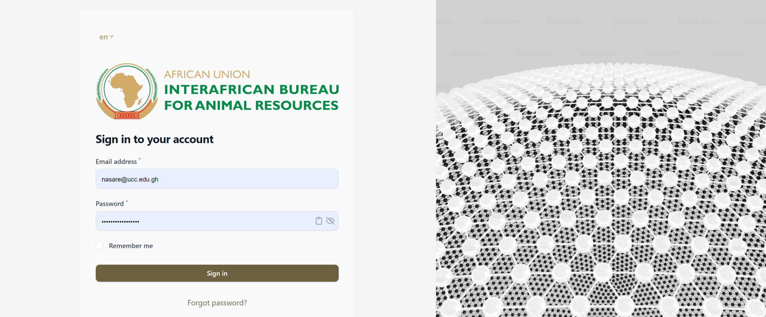
2. Objectives
Specific objective 1:
Establish a central repository for storage, retrieval and dissemination of relevant statistical and research data on fisheries, aquaculture and environment among others.

Slide 7
2. Objectives
Specific objective 2:
Undertake studies to improve and update database on fisheries and aquaculture and formulate effective mechanism for efficient fisheries and aquaculture data management

Slide 8
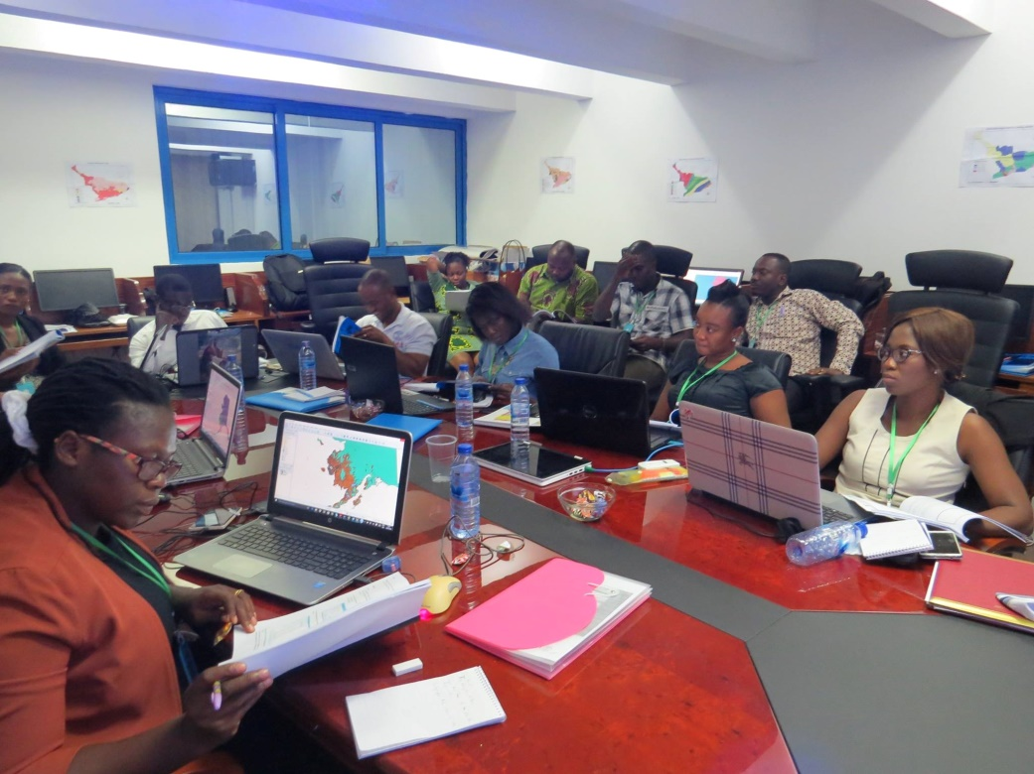
2. Objectives
Specific objective 3:
Conduct training on utilization and management of the established database

Slide 9
Consultancy to Develop and Update Database on Fisheries and Aquaculture and Develop Mechanism for Data Management
3. Work Packages
Activities were categorised under 4 work packages based on the expected result areas

Slide 10
Consultancy to Develop and Update Database on Fisheries and Aquaculture and Develop Mechanism for Data Management
3. Work Packages
WP 1:
Develop and update a database on fisheries and aquaculture
Brief Description
This WP sought to improve data accessibility through the development of a continental fisheries and aquaculture database due to the lack of regional and continental level fisheries data access, harmonisation and dissemination.

Slide 11
Consultancy to Develop and Update Database on Fisheries and Aquaculture and Develop Mechanism for Data Management
3. Work Packages
WP 2:
Develop mechanisms for data management
Brief Description
This WP defined the data management mechanisms including the models, policies, rules, and standards that govern the data entry, retrieval, updating, storage, arrangement, integration, and use of data throughout the database.

Slide 12
Consultancy to Develop and Update Database on Fisheries and Aquaculture and Develop Mechanism for Data Management
3. Work Packages
WP 3:
Identify sources of fisheries, aquaculture, socio-economic and climate/environmental related data (research and statistics) in AU-MS
Brief Description
The WP identified key sources of fisheries, aquaculture, socio-economics and environmental/climate related data (research and statistics) from AU-MS.

Slide 13
Consultancy to Develop and Update Database on Fisheries and Aquaculture and Develop Mechanism for Data Management
3. Work Packages
WP 4:
Strengthen the capacity of AU-MS on the utilization of database and data management
Brief Description
This WP focused on developing a training manual for conducting training of AU-MS on the use of the developed database including data entry, storage, retrieval, and sharing.

Slide 14
Consultancy to Develop and Update Database on Fisheries and Aquaculture and Develop Mechanism for Data Management
4. Summary of Methods
An assessment of the existing AU-IBAR’s database infrastructure was conducted through series of meetings and an onsite visitation.
A schema and facets of the database were designed and developed through consultative meetings with AU-IBAR.
The database was then built using a web database application according to the agreed schema.

Slide 15
Consultancy to Develop and Update Database on Fisheries and Aquaculture and Develop Mechanism for Data Management
4. Summary of Methods
The mechanisms for data entry, retrieval, storage, sharing & updating was also developed through consultative meetings.
Relevant data sources, types, forms and structure were identified through desktop reviews.
A training curriculum on the use of database platform was tailored and developed using existing structures.

Slide 16
Consultancy to Develop and Update Database on Fisheries and Aquaculture and Develop Mechanism for Data Management
4. Summary of Methods
A training manual covering the curriculum was developed, reviewed and produced.
AU-IBAR supported with technical backstopping in organising and conducting training sessions using the training manuals.

Slide 17
Consultancy to Develop and Update Database on Fisheries and Aquaculture and Develop Mechanism for Data Management
5. Results and Outputs
A centralised continental fisheries and aquaculture database produced

Slide 18
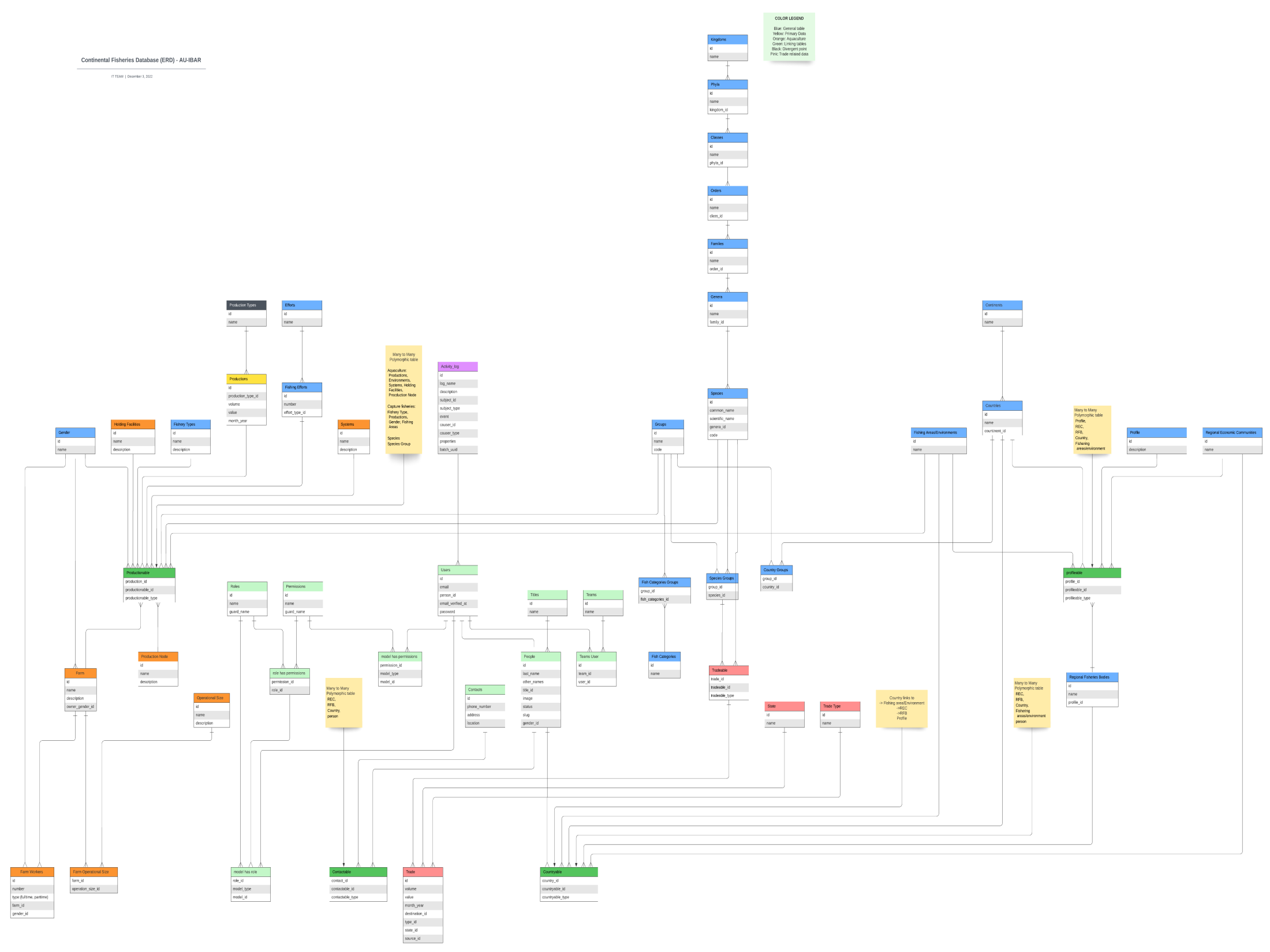
Consultancy to Develop and Update Database on Fisheries and Aquaculture and Develop Mechanism for Data Management

Slide 19
Consultancy to Develop and Update Database on Fisheries and Aquaculture and Develop Mechanism for Data Management
5. Results and Outputs
A centralised continental fisheries and aquaculture database
Due to the complexity of the data types, the database has been developed with two main data facets;
Capture Fisheries (Production and Trade)
Aquaculture (Production and Trade)

Slide 20
Consultancy to Develop and Update Database on Fisheries and Aquaculture and Develop Mechanism for Data Management
5. Results and Outputs
A centralised continental fisheries and aquaculture database
Other supporting data types are environment, fish taxonomic groups, gender and fish farms

Slide 21
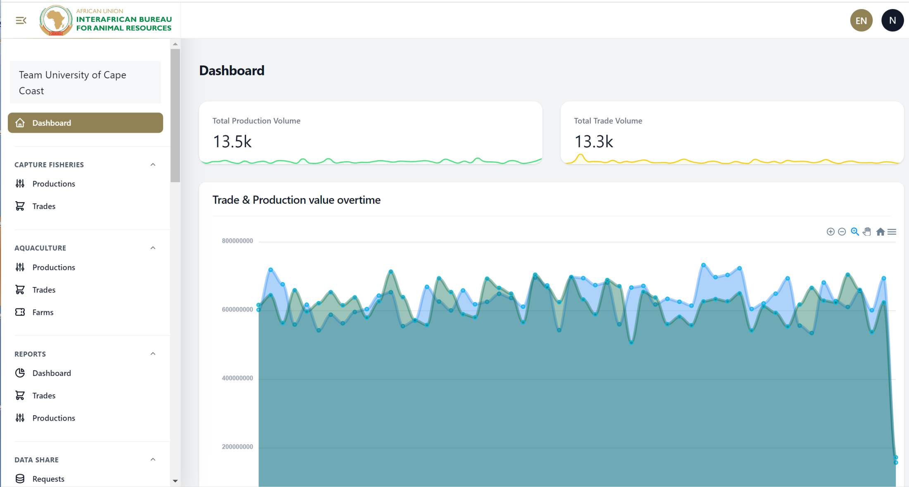
Consultancy to Develop and Update Database on Fisheries and Aquaculture and Develop Mechanism for Data Management

Slide 22
Consultancy to Develop and Update Database on Fisheries and Aquaculture and Develop Mechanism for Data Management
5. Results and Outputs
Sources and types of fisheries, aquaculture, socio-economics and environmental related data from AU-MS

Slide 23
Consultancy to Develop and Update Database on Fisheries and Aquaculture and Develop Mechanism for Data Management
5. Results and Outputs

Slide 24
Consultancy to Develop and Update Database on Fisheries and Aquaculture and Develop Mechanism for Data Management
5. Results and Outputs

Slide 25
Consultancy to Develop and Update Database on Fisheries and Aquaculture and Develop Mechanism for Data Management
5. Results and Outputs

Slide 26
Consultancy to Develop and Update Database on Fisheries and Aquaculture and Develop Mechanism for Data Management
5. Results and Outputs

Slide 27
Consultancy to Develop and Update Database on Fisheries and Aquaculture and Develop Mechanism for Data Management
5. Results and Outputs

Slide 28
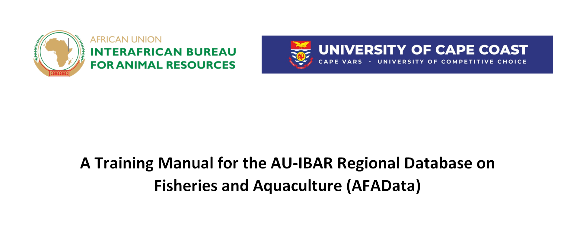
Consultancy to Develop and Update Database on Fisheries and Aquaculture and Develop Mechanism for Data Management
5. Results and Outputs
Training manual on database utilization

Slide 29
Consultancy to Develop and Update Database on Fisheries and Aquaculture and Develop Mechanism for Data Management
Units | Description | Contents
Chapter 1 | Introduction | Brief background to the database Objective of manual
Chapter 2 | Registration Process and Account Management | User account Switching between languages Password policy Addressing challenges during account creation
Chapter 3 | User Dashboard | Features on dashboard Creating new users Reports Management options

Slide 30
Consultancy to Develop and Update Database on Fisheries and Aquaculture and Develop Mechanism for Data Management
Units | Description | Contents
Chapter 4 | Data Entry | Data standardization Units and rates of measurement Entering production data Entering trade data Editing uploaded data
Chapter 5 | Data Retrieval | Exporting production data Exporting species data Exporting trade data

Slide 31
Consultancy to Develop and Update Database on Fisheries and Aquaculture and Develop Mechanism for Data Management
6. Recommendations
The Consultant recommends that:
the domain name and hosting of the database be transferred to AU-IBAR after inputs from all regional trainings have been incorporated.
AU-IBAR consider including advance fisheries data analytics (e.g. from a third party app) as a utility to the database.

Slide 32
Consultancy to Develop and Update Database on Fisheries and Aquaculture and Develop Mechanism for Data Management
Inception Activities
Activities | Tasks | Status
Inception and familiarization | An inception briefing with relevant AU-IBAR staff to agree on expectations and provide clarity on any outstanding issues | Completed
 | Familiarization with AU policy instruments and strategies relevant to this consultancy | Completed

Slide 33
Consultancy to Develop and Update Database on Fisheries and Aquaculture and Develop Mechanism for Data Management
WP 1:
Activities | Tasks | Status
Develop and update a database on fisheries and aquaculture | Assessment of existing database infrastructure | Completed
 | Mapping of sampled assessed data based on regional blocs | Completed
 | Harmonization of database requirements from existing databases | Completed
 | Developing a data model/schema for the database | Completed

Slide 34
Consultancy to Develop and Update Database on Fisheries and Aquaculture and Develop Mechanism for Data Management
WP 1:
Activities | Tasks | Status
Develop and update a database on fisheries and aquaculture | Implementing model/schema | Completed
 | Developing an application for data collection, retrieval and archiving | Completed
 | Integration of developed protocols into the database | Completed
 | Setting up of database infrastructure | Completed
 | Updating and upgrading of database | Ongoing

Slide 35
Consultancy to Develop and Update Database on Fisheries and Aquaculture and Develop Mechanism for Data Management
WP 2:
Activities | Tasks | Status
Develop mechanisms for data management | Developing a mechanism for data entry, retrieval, storage & updating | Completed
 | Transfer database hosting to AU-IBAR | Pending

Slide 36
Consultancy to Develop and Update Database on Fisheries and Aquaculture and Develop Mechanism for Data Management
WP 3:
Activities | Tasks | Status
Identify sources of fisheries, aquaculture, socio-economic and climate/environmental related data (research and statistics) in AU-MS | Development of framework for data types and sources | Completed
 | Desktop survey to identify key institutions engaged in data collection (fisheries-aquaculture-socioeconomic-environmental/climate-related data | Completed

Slide 37
Consultancy to Develop and Update Database on Fisheries and Aquaculture and Develop Mechanism for Data Management
WP 4:
Activities | Tasks | Status
Strength the capacity of AU-MS on the utilization of database and data management | Developed a training curriculum on the use of database platform | Completed
 | Developing a training manual for conducting training of AU-MS | Completed
 | Supporting AU-IBAR to plan and organise regional trainings for AU-MS | Ongoing

Slide 38
Consultancy to Develop and Update Database on Fisheries and Aquaculture and Develop Mechanism for Data Management
Reporting
Activities | Tasks | Status
Reporting | Submission of inception report | Submitted
 | Submission of interim report | Submitted
 | Submission of final report | Submitted

Slide 39
Questions

