Slide 1


Open data sharing and its role in the conservation of freshwater biodiversity: experiences from open data interventions in Uganda
Vianny Natugonza
Email: viannynatugonza@yahoo.com; Tel: +256775241484; WhatsApp:+3547642102; Twitter: @bito_vianny
Senior Lecturer, Busitema University https://busitema.ac.ug/
Co-founder: Africa Lakes Network (Aflanet): http://www.aflanet.org/
Editor: Freshwater Biodiversity Portal for Uganda: https://freshwaterbiodiversity.go.ug/

Slide 2

State of freshwater biodiversity

Slide 3
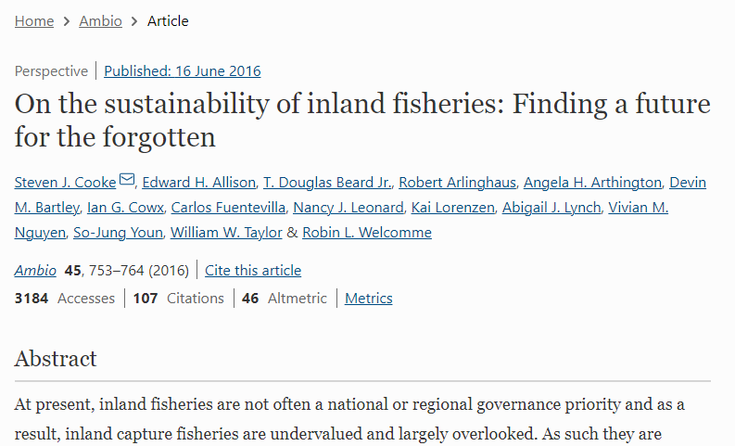
…and this crisis is not fully captured in national and global priorities. Reason? Inadequate data and information (Cook et al. 2016)

Slide 4
Freshwater biodiversity data and information access in Uganda by 2017
Occurrence records for Uganda within the Map of Life.
Source: https://mol.org/regions/?region=Uganda
GBIF- https://www.gbif.org/ (2018)
Taxa | Occurrence records in map of life
Birds | 1,134
Mammals | 357
Turtles | 10
Amphibians | 91
Sphingid moths | 176
Dragonflies | 280
Cacti | 1
Conifers | 4
Underwater invertebrates | 0
Chromista (Algae) | 0
Fish | 0
Country total | 2,053
Taxa | Species occurrence records in GBIF | Published by Ugandan institution
Chromista (algae) | 585 | 0
Zooplankton | 0 | NA
Macroinvertebrates | 854 | 0
Fish | 4,969 | 0
Country total (including terrestrial taxa) | 416,830 | 0
<1%

Slide 5
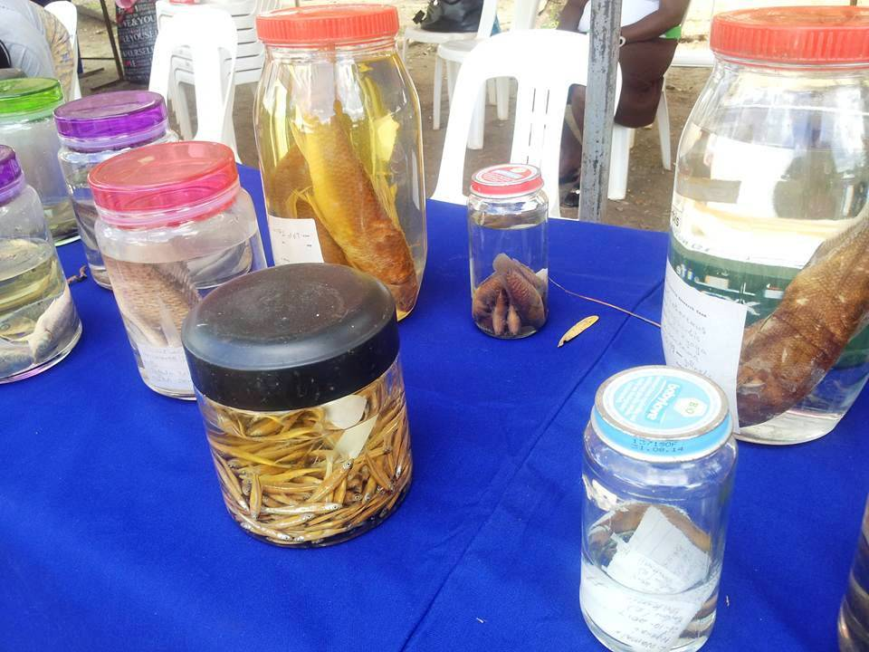
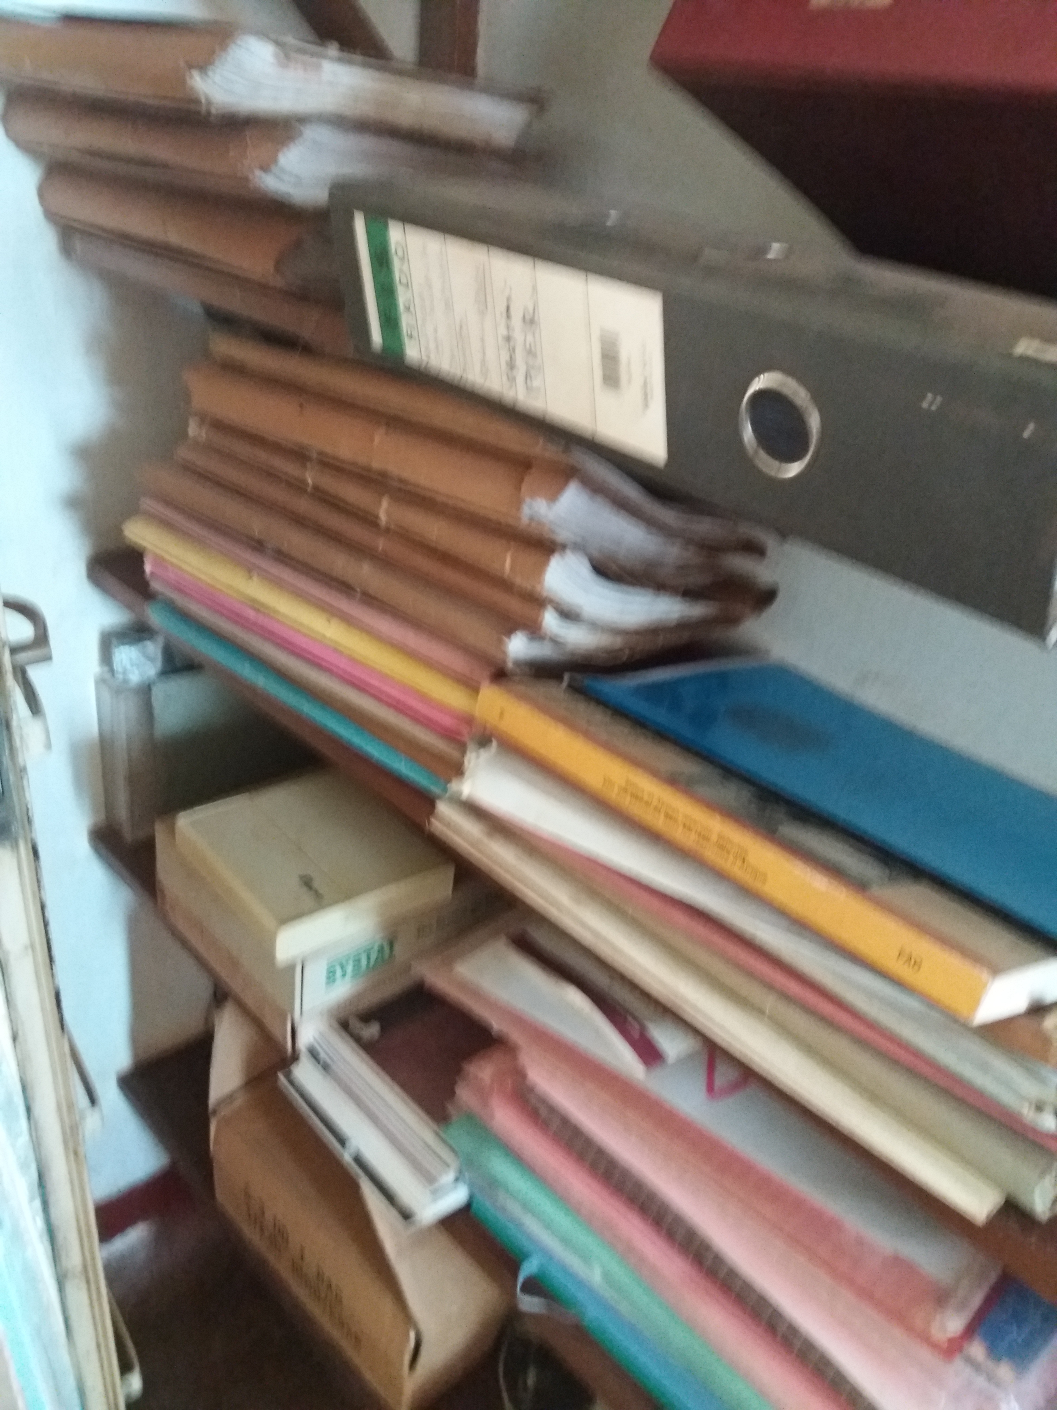
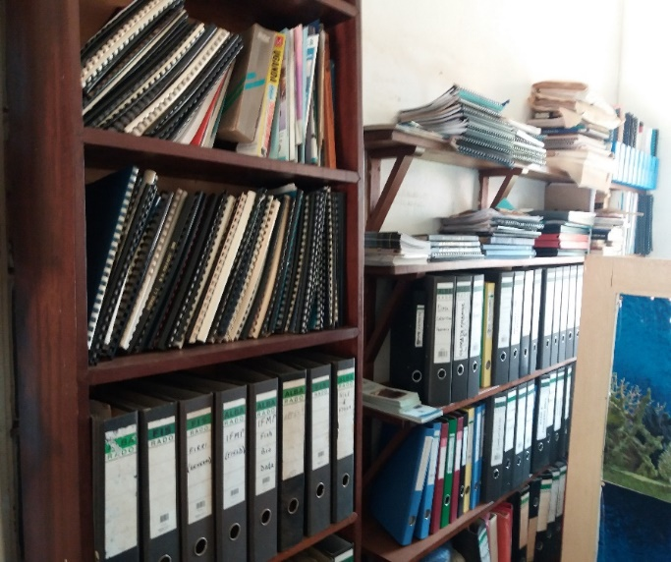
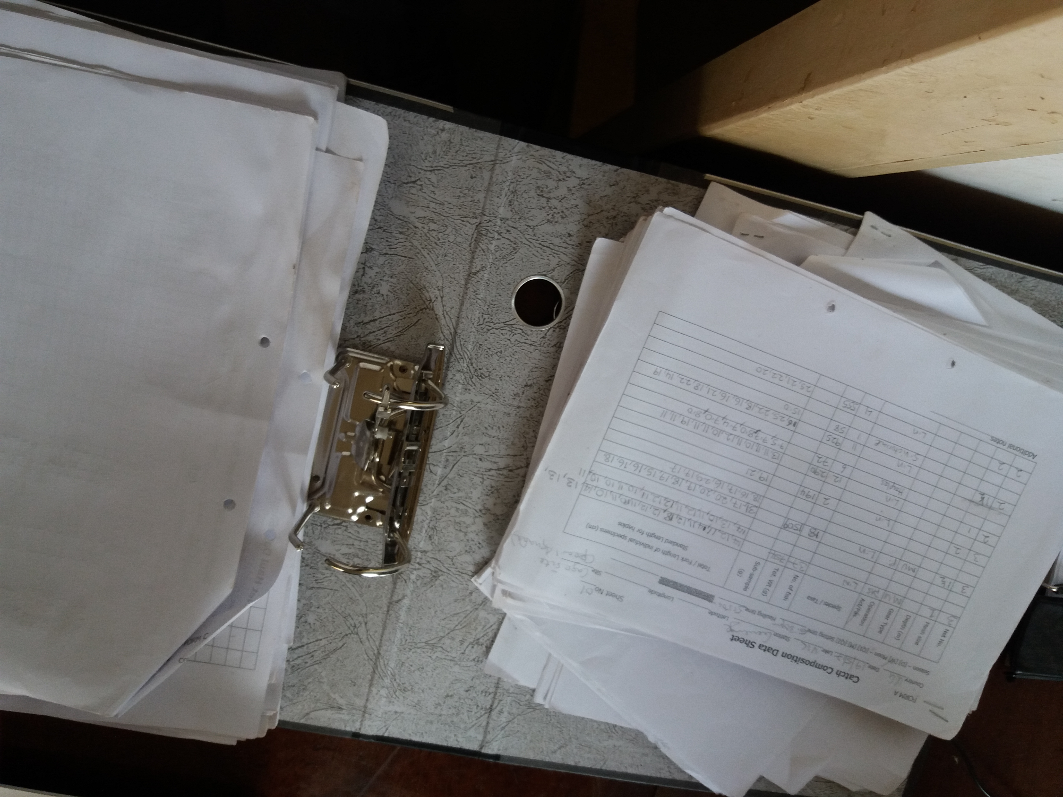
Where/How is freshwater biodiversity data stored?

Slide 6
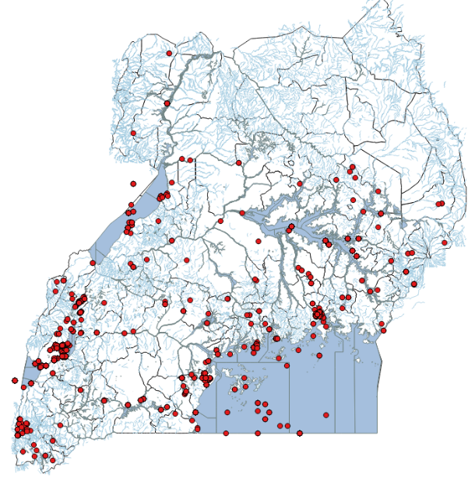
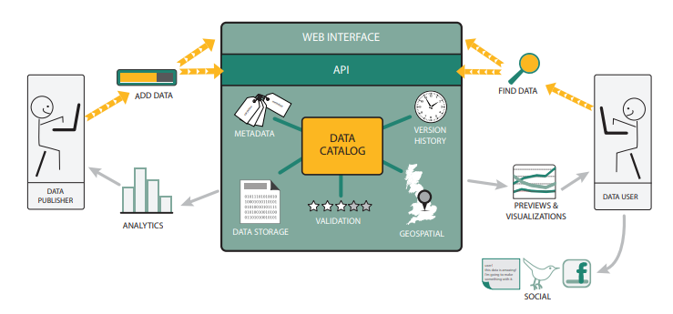
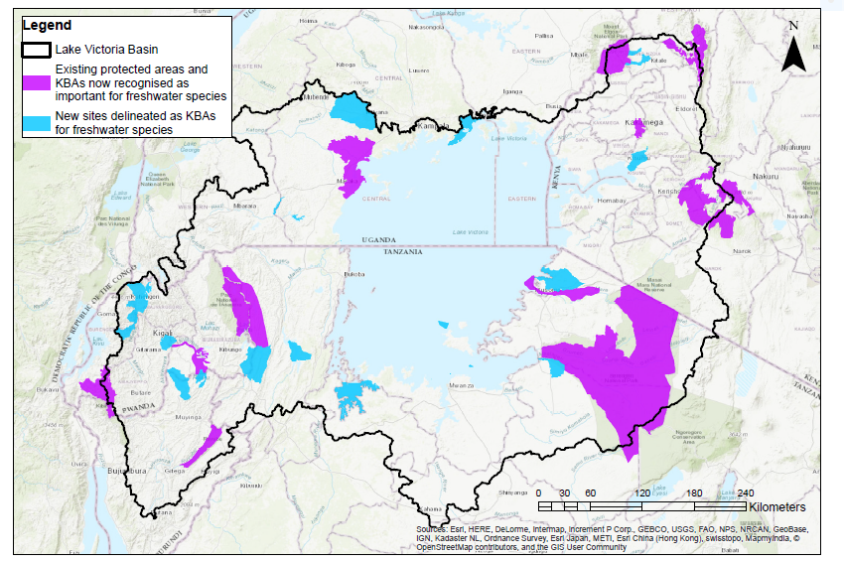
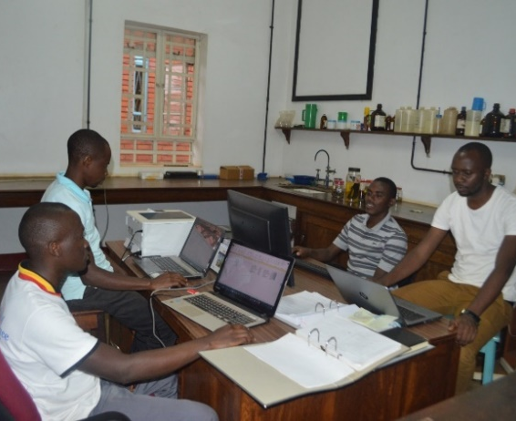
Our solutions
1. Mobilize and publish data open access
2. Develop a digital platform for mass data storage and sharing
3. Generate biodiversity information products to guide conservation planning
3. Capacity building

Slide 7
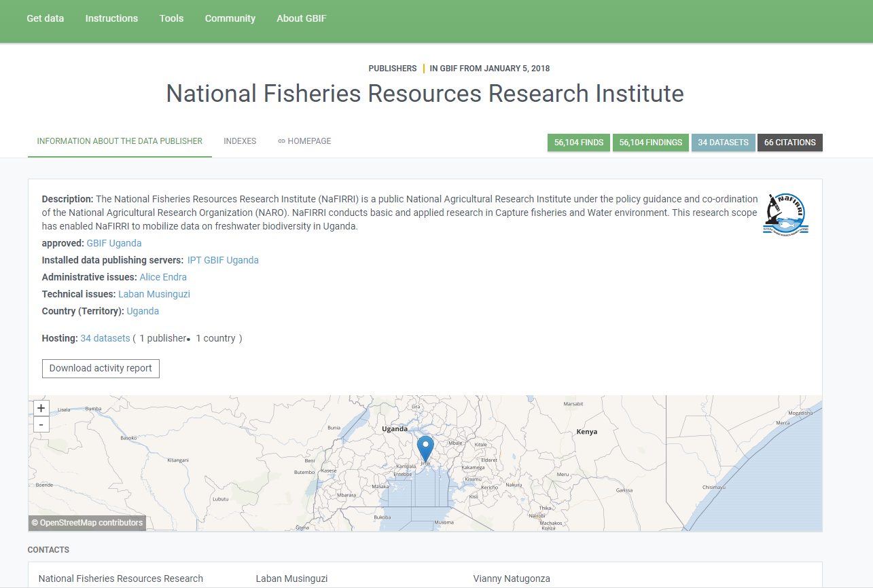
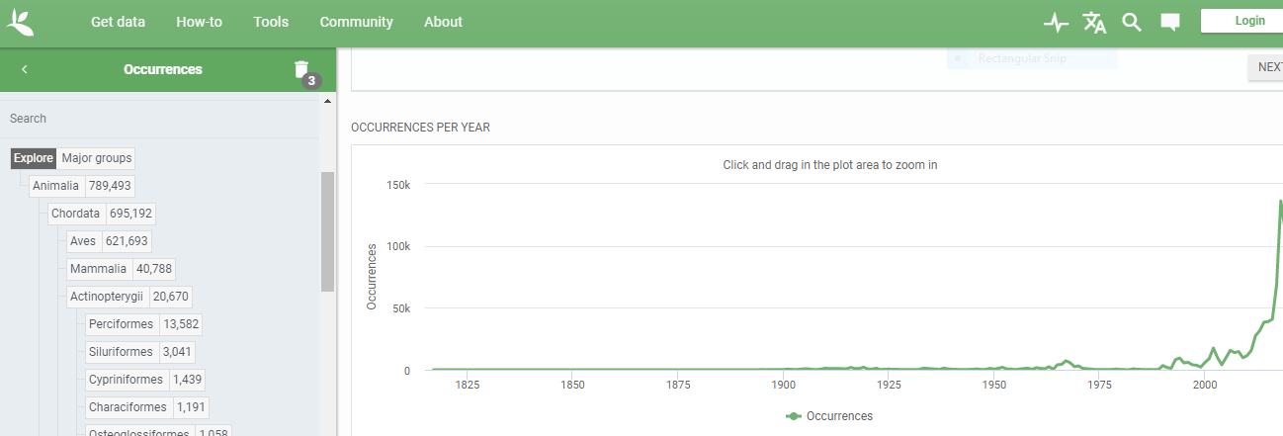
Progress on data mobilization and publishing (1.)
From https://www.gbif.org/en/analytics/uganda

Slide 8
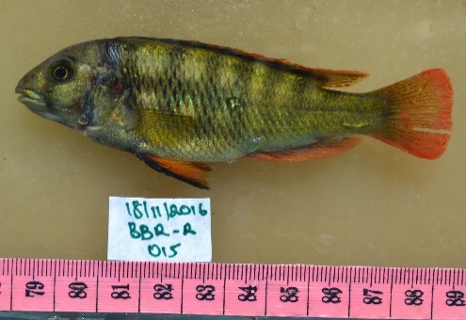
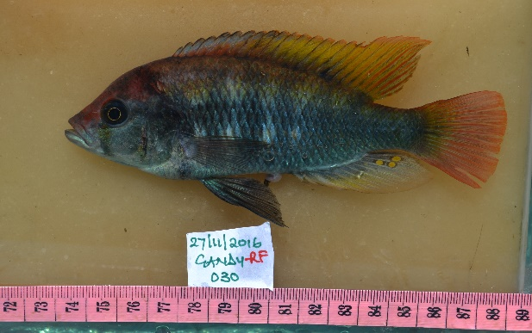
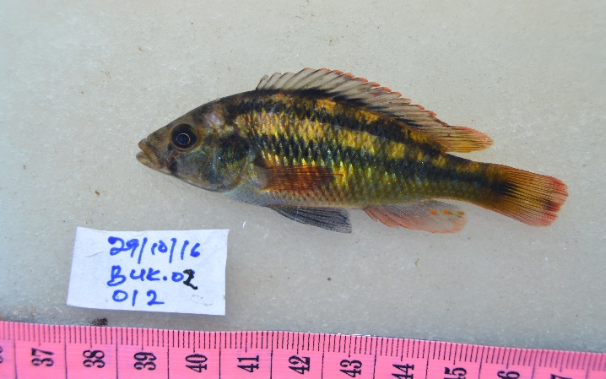
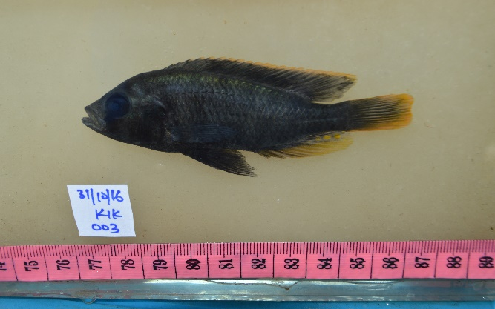
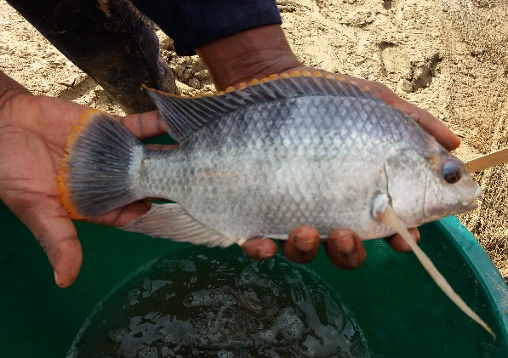
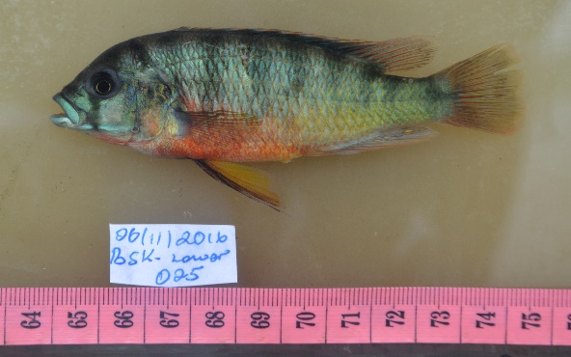
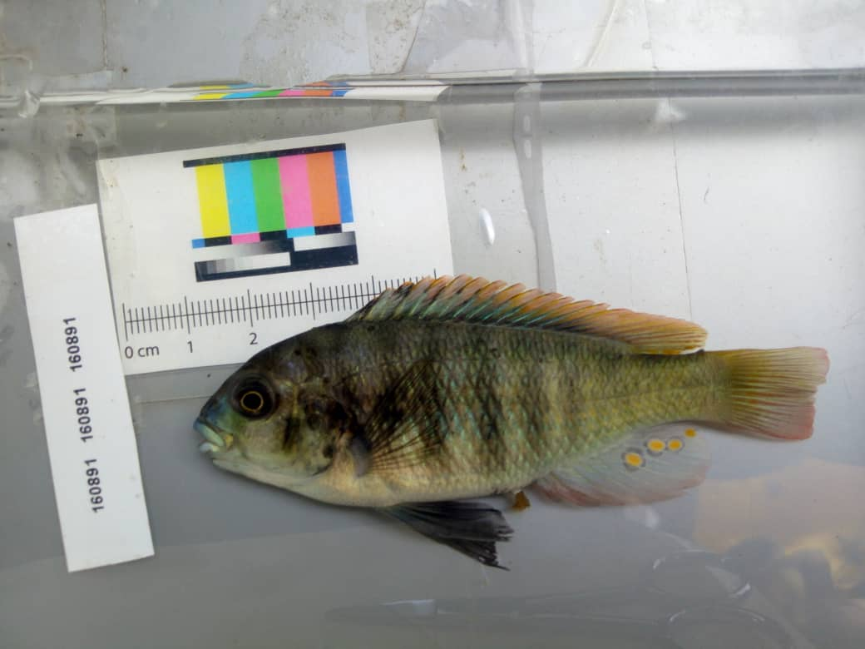
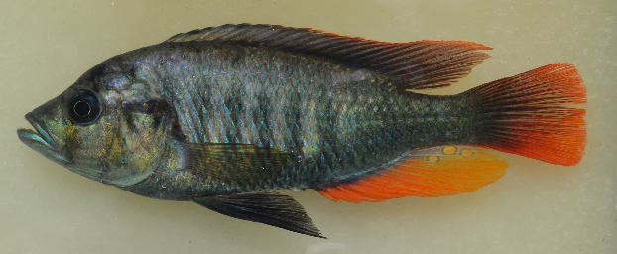
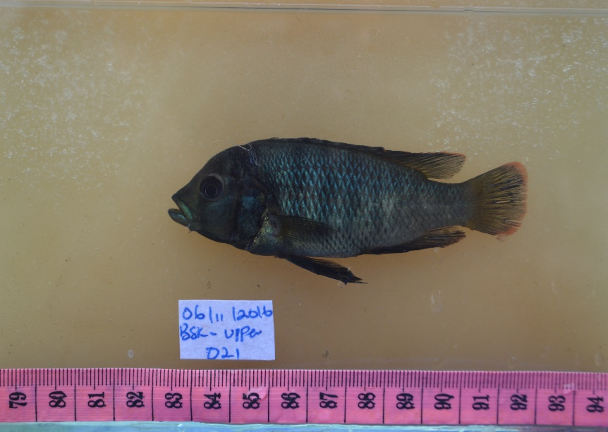
But what about information that is not compatible with GBIF?

Slide 9
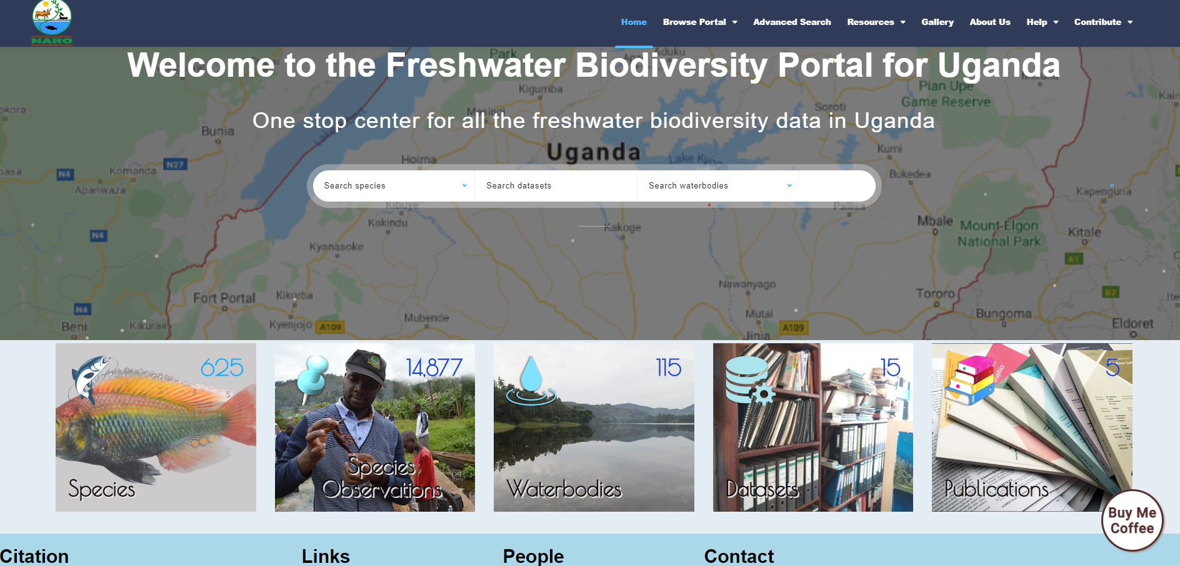
Progress on the freshwater biodiversity portal (2.)
https://freshwaterbiodiversity.go.ug/

Slide 10
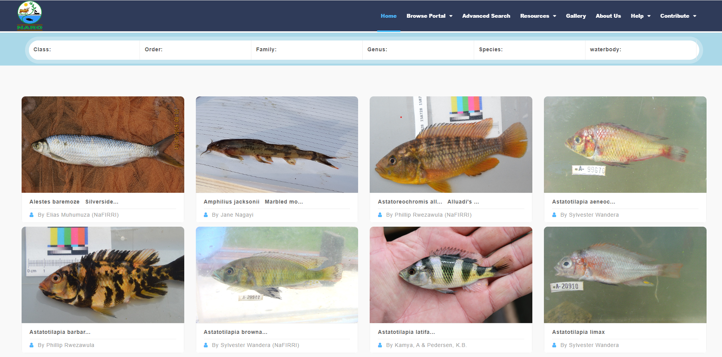
Application: Education, Research and training
Online Data portal with pictorial identification guides for fishes of Uganda

Slide 11
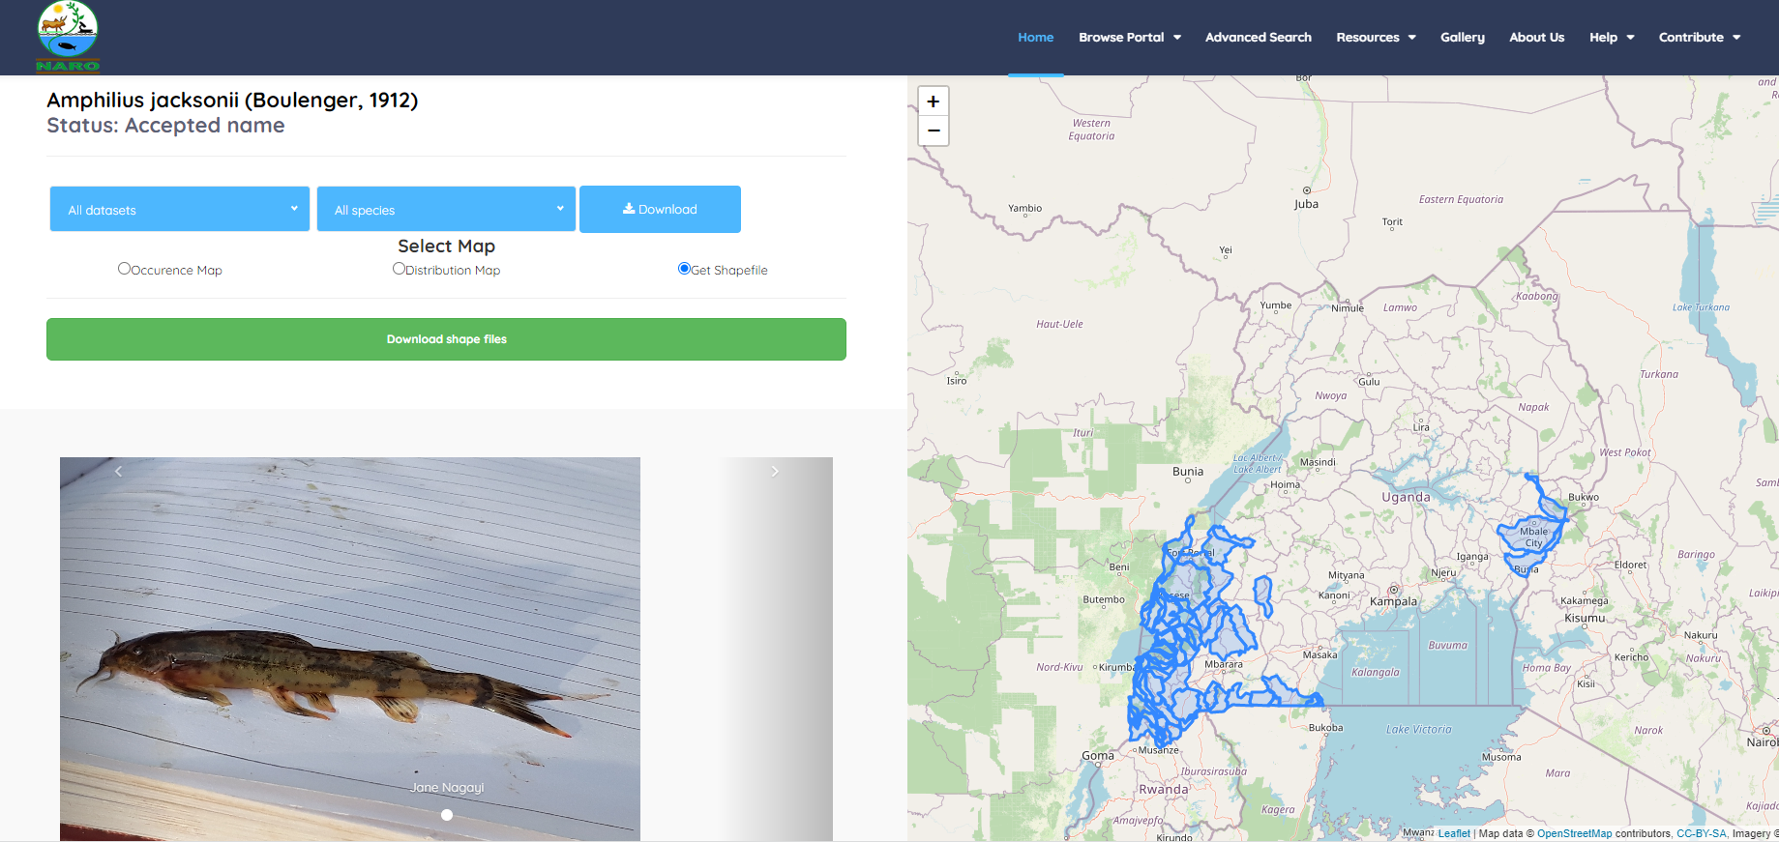
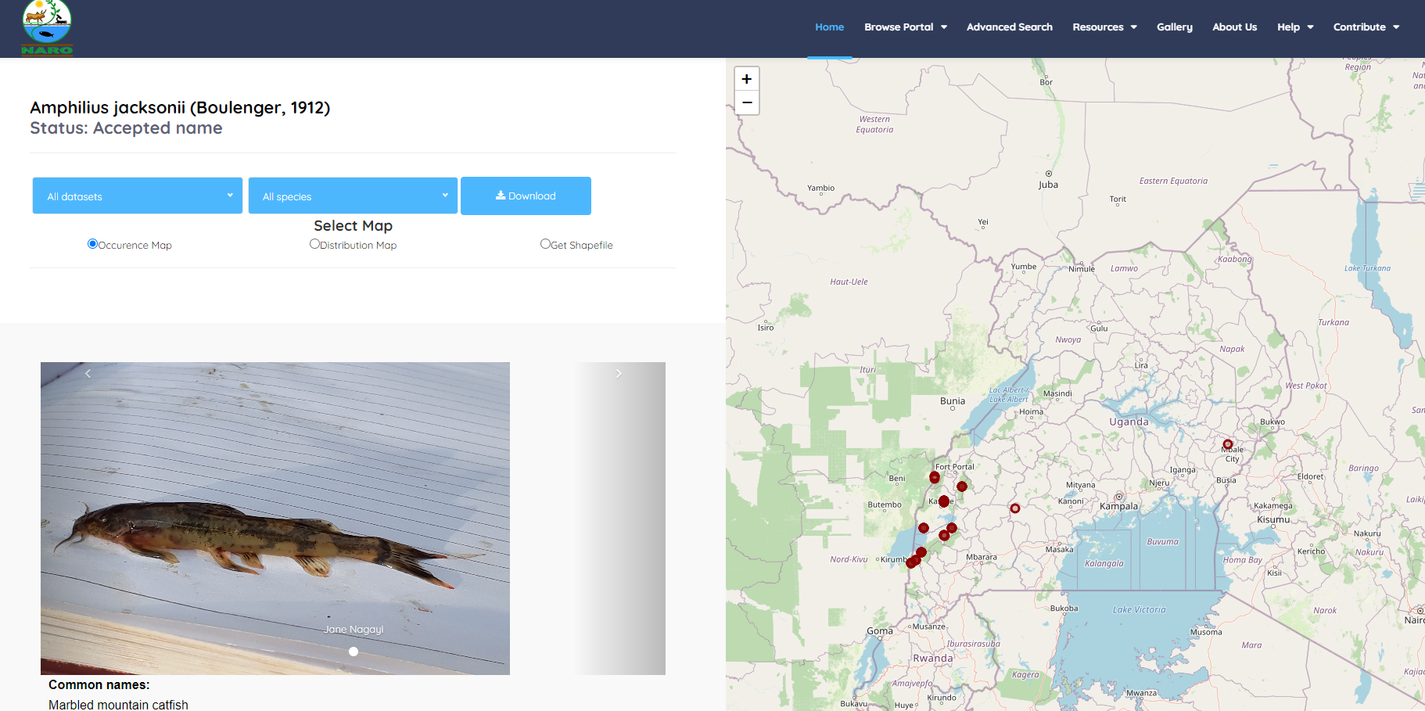
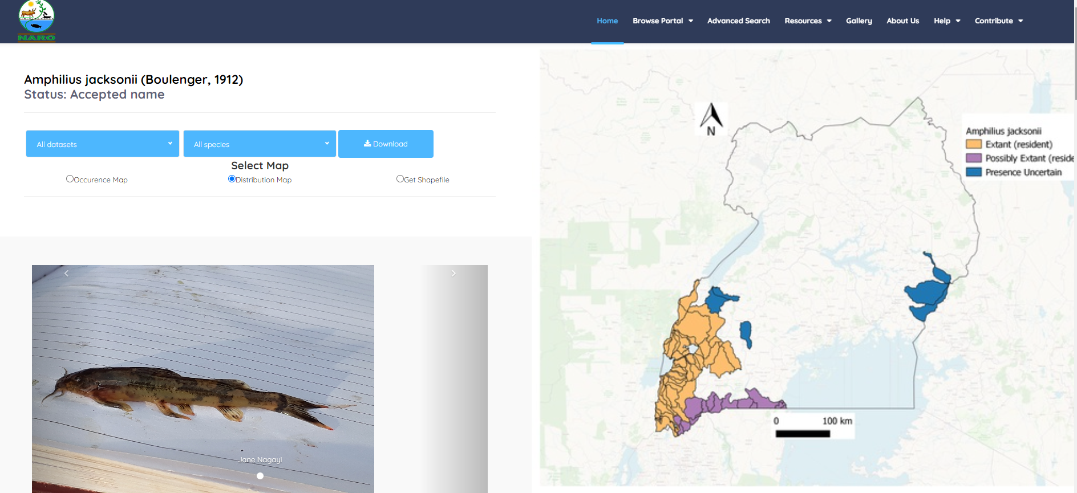
Identification of critical habitats for monitoring and conservation
https://freshwaterbiodiversity.go.ug/species/?code=R1UYNA56

Slide 12
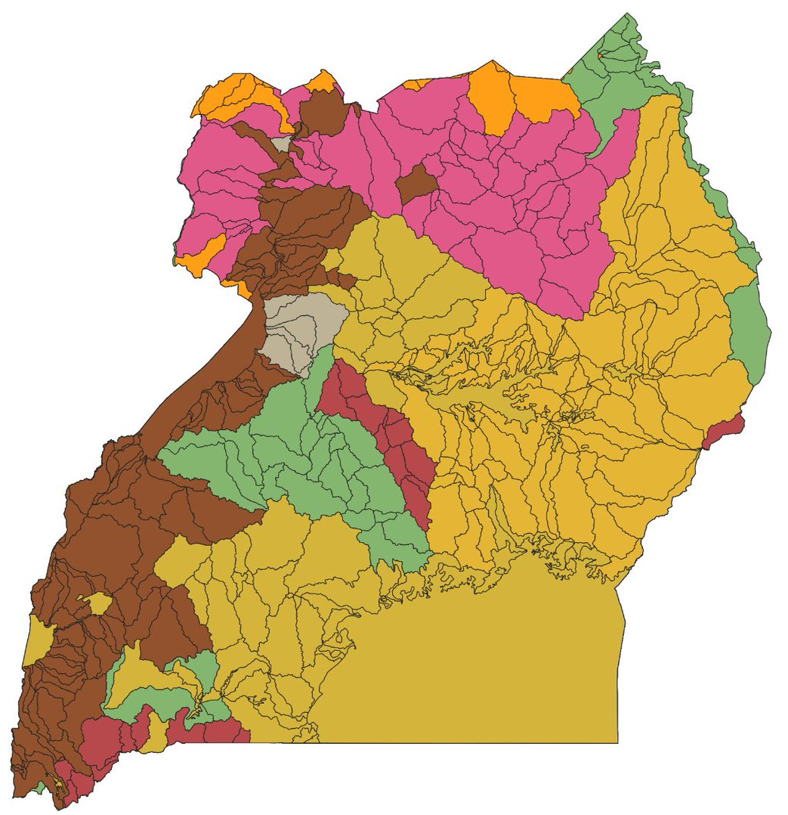
Biodiversity information products (3.)
Mapped occurrence and distribution of 300 fish species in Uganda, with attributes of origin, presence, status, and more
Accessible through the portal (https://freshwaterbiodiversity.go.ug/)

Slide 13
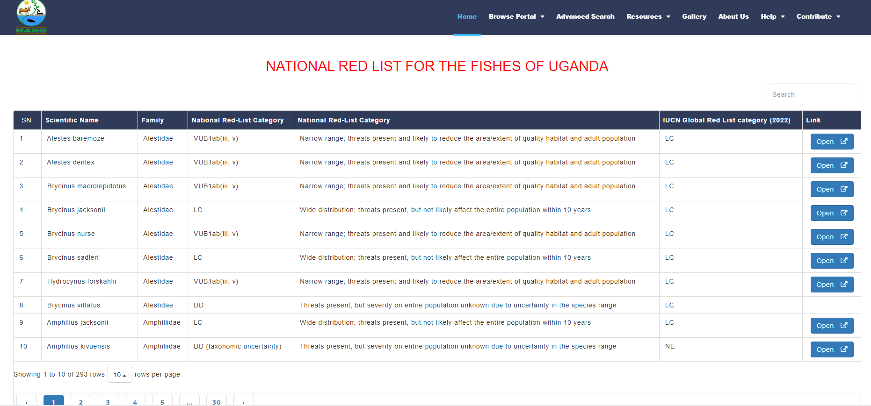
Extinction risk assessment of fish of Uganda at National level
Developed a national red list for all the 300 fish species in Uganda
https://freshwaterbiodiversity.go.ug/iucn_assessment/

Slide 14
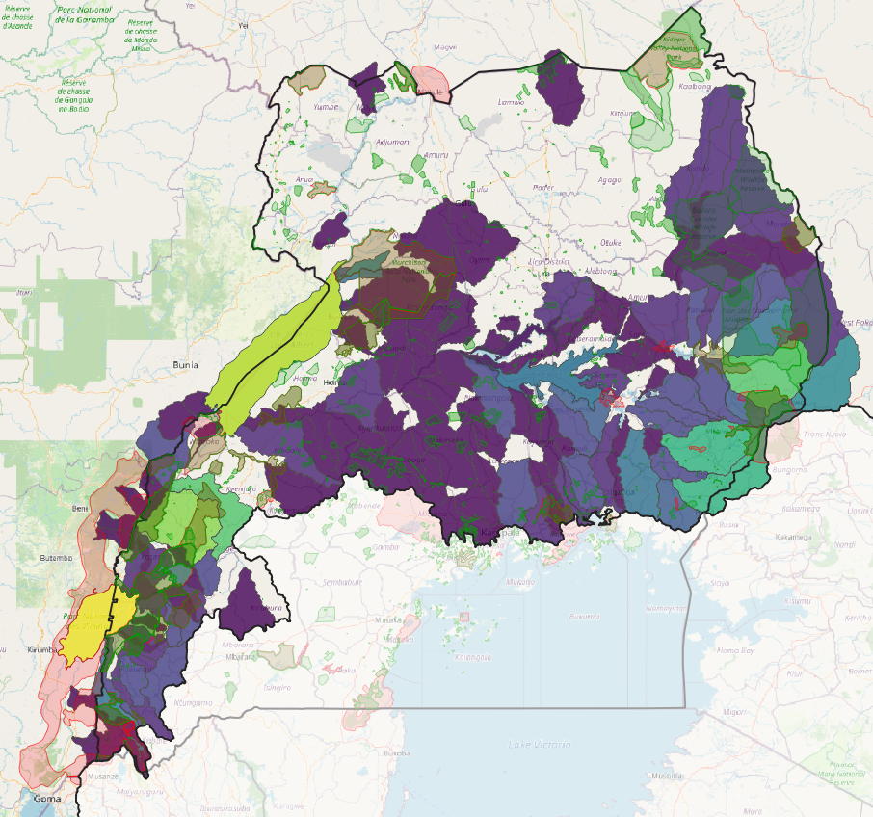
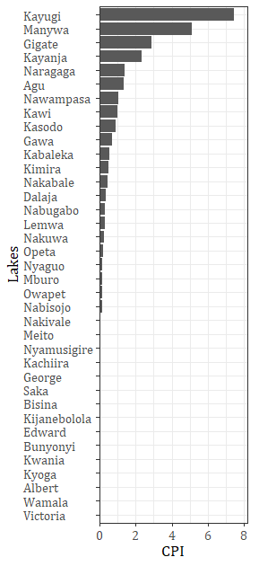
Identification of freshwater Key Biodiversity Areas
Basooma et al. (2022). A novel index to aid in prioritizing habitats for site‐based conservation. Ecology and Evolution, 12(3), e8762.

Slide 15
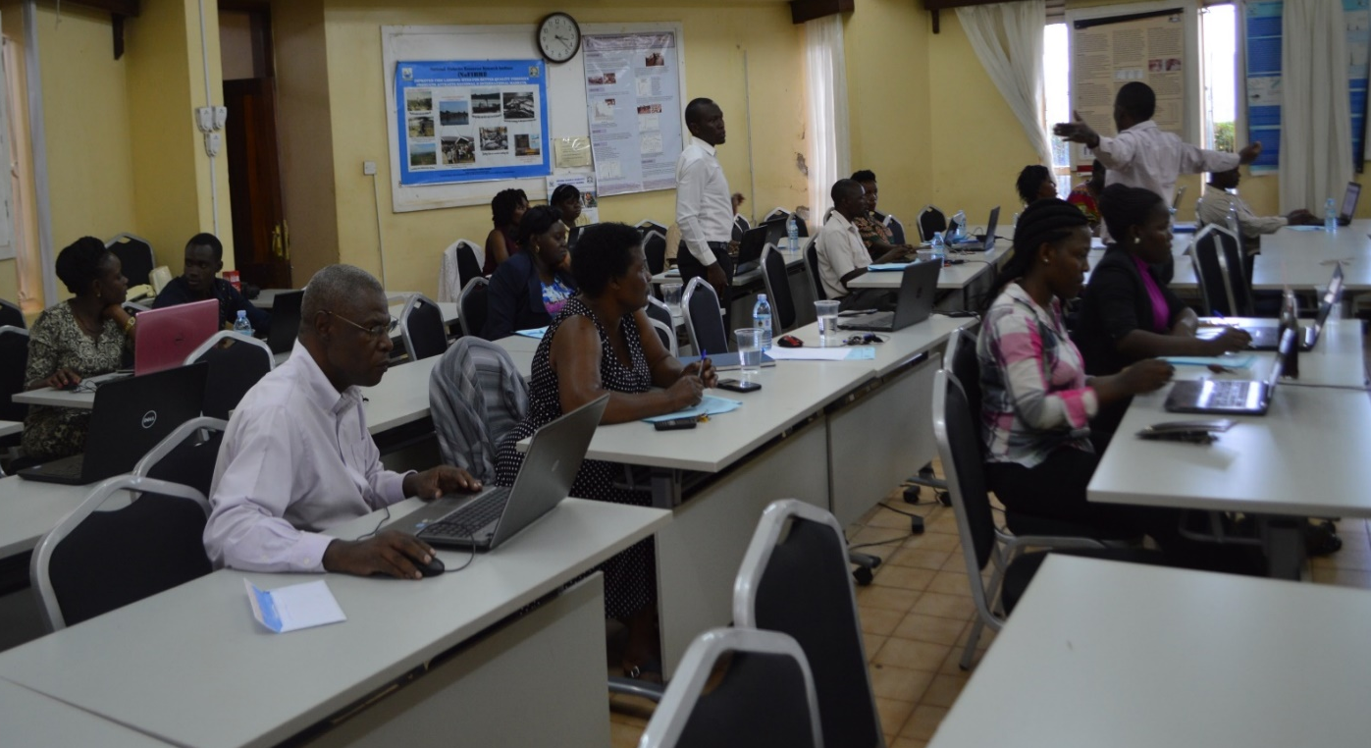
Progress on capacity building (4.)
How do Africans best access foreign expertise and maintain control?
Partnerships and networking- to consolidate skills from abroad to work on local solutions

Slide 16
Which support do we need from you?
Linking freshwater biodiversity information to policy

Slide 17




THANK YOU
This programme is funded by the European Union

