Slide 1








PRESENTATION OF THE PROJECT AND AWARENESS ENHANCING ON THE IMPORTANCE OF
“CONSERVING AQUATIC BIODIVERSITY IN AFRICAN BLUE ECONOMY”
AND
Objectives of the Workshop
“Rolling-out the joint Management Plans and Protocols and the Harmonized Regional Frameworks for conserving aquatic biodiversity for Kenya, Uganda and Tanzania”
By Nadiope Eric
Aquatic Biodiversity Conservation Policy, Legal and Institutional Processes Expert, AU-IBAR

Slide 2
Background
The African Continent is adjacent to highly productive marine ecosystems including the seven African Large Marine Ecosystems (LMEs) viz., Agulhas Current LME, Benguela Current LME, Guinea Current LME, Canary current LME, Mediterranean Sea LME, Red Sea LME and Somali Current LME;
The Continent is also endowed with networks of Rivers and Lakes;
These African aquatic ecosystems inhabit living and non-living resources;
However the unsustainable exploitation of these resources are threatening the biodiversity, resources and environmental sustainability;
Several factors are threatening aquatic biodiversity in Africa aquatic ecosystems;
These include overexploitation of Living Resources, pollutions from several sources (land-based municipal and agricultural activities), uncontrolled introduction of Exotic/Alien species in aquaculture and aquatic ecosystems, effluents from mining activities;
Other threats to aquatic biodiversity include urban development and resource-based industries, coastal tourism activities, coastal infrastructure development that destroy or reduce natural habitat;
In addition, air and water pollution, sedimentation and erosion, and climate change also pose threats to aquatic biodiversity; and,
Also of significance is the threat to youths and women’s livelihoods and the imperative need to safeguard the vulnerable and marginalized groups, that is implement adequate compensation systems.

Slide 3
BASIC PROJECT INFORMATION
Title | CONSERVING AQUATIC BIODIVERSITY IN AFRICAN BLUE ECONOMY
Implementing Agency | African Union- Interafrican Bureau for Animal Resources (AU-IBAR); speculated technical office of DARBE of the African Union Commission
Funding Agency | Swedish International Development Cooperation Agency (SIDA)
Duration | 3 years; started 15th October, 2021
Budget | USD 5,496,119
Collaborating partners and beneficiaries | AU Member States, Specialized Regional institutions (Regional Economic communities, Regional Sea Conventions, Environmental-based organizations, LME-based institutions, Regional fisheries organizations, water-basin commission), Swedish Agency for Marine and Water Management, Universities, Research institutes, NGO-based organizations, Non-State actors
Coverage | 55 AU member states; 8 RECs in the five Regions of Africa (West, Central, East, Southern and North)

Slide 4





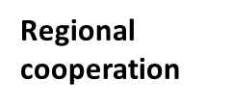
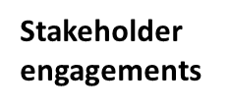

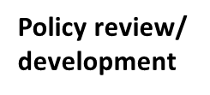
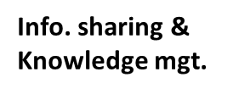
Conserving Aquatic Biodiversity in the Context of the Africa Blue Economy Strategy Project (2021 – 2024)
AU-IBAR => Project with support by SIDA, 3 years of implementation;
Oct, 2021 – Sept, 2024.
Overall objective:
Enhance the Policy environment, Regulatory Frameworks and institutional capacities of AU Member States and Regional Economic Communities to sustainably utilize and conserve aquatic biodiversity and ecosystems.

Slide 5
OBJECTIVES
Strategic objectives =>
Ratify and / or align relevant International / Regional Instruments related to blue economy themes (with specific reference to protecting and conserving biodiversity)
Optimizing conservation and sustainable use of biodiversity while minimizing conflicts among Blue Economy sub-themes
Strengthening measures for mitigating the negative impacts of coastal and marine tourism, oil, gas, deep Sea mining and climate change on aquatic biodiversity and environment
Strengthening Gender inclusivity in aquatic biodiversity conservation and environmental management

Slide 6
STRATEGIC OBJECTIVE 1
RATIFY AND / OR ALIGN RELEVANT INTERNATIONAL / REGIONAL INSTRUMENTS RELATED TO BLUE ECONOMY THEMES

Slide 7
SO 1: OUTPUTS AND ACTIVITIES
OUTPUTS | ACTIVITY | SUB-ACTIVITIES
Output 1.1 Mechanisms for active participation of MSs in Regional and Global initiatives related to aquatic biodiversity and environmental regimes (ABNJ, CITES, COP meetings relating to CC, BRS, etc.) developed. | 1.1.1. Enhancing effective role and participation in Continental and Global aquatic biodiversity and environmental related regimes | 1.1.1.1. Undertake studies and develop a mechanism for enhancing effective role and participation in Regional and Global biodiversity and environmental related regimes.
 |  | 1.1.1.2. Organize Continental validation and awareness enhancing workshop among stakeholders on the relevant provisions, challenges and mechanisms for effective role and participation in these Global regimes.
 |  | 1.1.1.3. Conduct a workshop for identified negotiators to technically support AU MSs in Global negotiations e.g. CC COP meetings, CITES
 |  | 1.1.1.4. Support the participation of 5 AU MSs in relevant aquatic biodiversity and environmental fora
Output 1.2. Ratification and implementation of Conventions and Agreements related to conservation of biodiversity in AU MSs and RECs supported | 1.2.1. Identify Continental and Global biodiversity and environmental Instruments relevant to sustainable management of Africa Blue Economy Resources. | 1.2.1.1. Conduct assessment of relevant Continental and Global biodiversity and environmental Instruments to develop priority actions for enhanced ratification and implementation.
 |  | 1.2.1.2. Conduct two virtual validation and Regional awareness enhancing workshops on identified documents including key provisions and benefits.
 |  | 1.2.1.3. Support 10 AU Member States to review National Policies, Regulations and align National Instruments with relevant Regional and Global biodiversity and environmental Instruments.
 |  | 1.2.1.4. Conduct National level validation workshops to validate the reviewed Policies

Slide 8
STRATEGIC OBJECTIVE 2
OPTIMIZING CONSERVATION AND SUSTAINABLE BIODIVERSITY WHILE MINIMIZING CONFLICTS AMONG USERS OF BLUE ECONOMY RESOURCES.

Slide 9
SO 2: OUTPUTS AND ACTIVITIES
OUTPUTS | ACTIVITY | SUB-ACTIVITIES
Output 2.1: Enforceable Regulatory frameworks for effective and sustainable Regional MCS systems developed. | 2.1.1 Enhancing Sustainable Monitoring Control and Surveillance (MCS) Systems for conservation and protection of biodiversity: | 2.1.1.1. Conduct a study to assess the status of MCS for combating unsustainable practices of fishing and other Blue Economy Resources in AU Member States and Regional Economic Communities and develop mechanism to strengthen MCS; identifying capacity and weaknesses
 | 2.1.2. Support the establishment of cost-effective and sustainable financial arrangements for effective Regional cooperation on MCS and enforcement in selected Regions | 2.1.2.1 Develop framework for establishing functional financial and sustainable Regional MCS systems
 |  | 2.1.2.2. Organize two virtual Regional workshops to validate findings and recommendations of the studies in 2.1.1.1. and 2.1.2.1.
 |  | 2.1.2.3. Pilot and operationalize the recommendations (in 2.1.1.1. and 2.1.2.1.) in 2 Regional institutions;
 |  | 2.1.2.4 Support to implementation of cost-effective sustainable financial systems.

Slide 10
SO 2: OUTPUTS AND ACTIVITIES
OUTPUTS | ACTIVITY | SUB-ACTIVITIES
Output 2.2. A framework for establishing National, Regional and transboundary cooperation on Africa Blue Economy Strategy Thematic Areas established | 2.2.1. Establish Regional cooperation on transboundary issues in shared aquatic ecosystems towards; formulating harmonized Regional frameworks on aquatic biodiversity conservation. | 2.2.1.1. Conduct integrated assessment of two identified transboundary aquatic ecosystems to identify critical aquatic environmental issues affecting biodiversity and develop mechanisms for joint management plans and protocols in shared Blue Economy Resources; towards developing harmonized Regional Frameworks for aquatic biodiversity conservation
 |  | 2.2.1.2. Conduct two virtual validation and awareness enhancing workshops on critical environmental issues in 2 transboundary ecosystems and the draft harmonized Regional Frameworks for aquatic biodiversity conservation
 |  | 2.2.1.3. Support to provide technical assistance to five AU Member States to rollout the joint management plans and protocols and the harmonized Regional frameworks for conserving aquatic biodiversity;
 | 2.2.2. Formulate mechanisms to institutionalize Marine Spatial Planning (MSP) at National and Regional levels | 2.2.2.1. Conduct an assessment to map MSPs in Africa, document lessons, best practices and develop guidelines for their institutionalisation at National and Regional levels.; current management Strategies and identification of elements pertinent for the Regional MSP
 |  | 2.2.2.2. Convene two virtual Regional Think Tank meetings on MSP implementation and governance to validate the findings of the consultants
 |  | 2.2.2.3 Support to Regional institutions to strengthen identified transboundary MSPs;

Slide 11
SO 2: OUTPUTS AND ACTIVITIES
OUTPUTS | ACTIVITY | SUB-ACTIVITIES
Output 2.3. Capacities for restoring and conserving threatened aquatic biodiversity and environment strengthened. | 2.3.1 Support rehabilitation of depleted aquatic biodiversity and habitats | 2.3.1.1. Conduct a Continental review of existing Marine Protected Areas (MPAs), document lessons, best practices and formulate guidelines for their sustainable implementation and governance.
 |  | 2.3.1.2. Convene two virtual Regional Think Tank meetings on MPA implementation and governance to validate the findings of the consultancies 2.3.1.1
 |  | 2.3.13. Based on the outcomes of the studies on review of existing MPA initiatives, the project would provide technical and direct support to two specialized Regional institutions; to establish or strengthen climate resilient transboundary MPA
 | 2.3.2 Establish Continental Centres of Excellence for capacity building on aquatic biodiversity | 2.3.2.1. Support the establishment of two Continental Centres of Excellence on aquatic biodiversity; This activity is supporting the implementation of 2014 Ministerial Decision to identify Centres of Excellence in relevant aquatic fields including biodiversity
 |  | 2.3.2.2. Strengthen capacity of two identified Centres of Excellence - based on identified gaps (equipment and training materials);

Slide 12
STRATEGIC OBJECTIVE 3
Strengthening measures for mitigating the negative impacts of coastal and marine tourism, oil, gas, deep sea mining and climate change on aquatic biodiversity and environment.

Slide 13
SO 3: OUTPUTS AND ACTIVITIES
OUTPUTS | ACTIVITY | SUB-ACTIVITIES
Output 3.1 Measures for minimizing the negative impacts of climate change on biodiversity and environment strengthened and implemented | 3.1.1. Mitigate the impact of climate change on aquatic biodiversity | 3.1.1.1. Conduct studies on the negative impact of climate change on aquatic biodiversity and environment and recommend mitigation and Adaptation Strategies
 |  | 3.1.1.2. Conduct a virtual Continental validation workshop on the studies on impact of climate change on aquatic biodiversity, their environment and develop recommendations
 |  | 3.1.1.3 The project would support to strengthen conservation and climate change impact mitigation efforts for identified ongoing initiatives on ecosystems restoration (mangroves, Sea grass) on mitigation of climate change impact (increasing carbon sink); also including projects on conservation of coral reefs
OUTPUT 3.2. Strategies for an integrated Strategic Framework for sustainable coastal and marine tourism and mining developed | 3.2.1. Identify priority issues and actions for sustainable coastal and marine tourism and mining activities on aquatic biodiversity and environment and develop guidelines. | 3.2.1.1. Conduct studies to identify priority issues and actions for sustainable coastal, marine tourism and mining activities for aquatic biodiversity conservation and environment protection
 |  | 3.2.1.2. The studies would be followed by five National stakeholder’s consultation to develop National Master Plans on sustainable coastal and marine tourism and mining development for biodiversity conservation and environmental protection; the private sector would be part of the sector holder's workshop.
 |  | 3.2.1.3. Based on the identified priority issues in the National Master Plan, the project would support development or (strengthening), monitoring and Regulatory Frameworks in 5 AU Member States for sustainable coastal and marine tourisms and mining for biodiversity conservation and environmental protection

Slide 14
STRATEGIC OBJECTIVE 4
Strengthening Gender inclusivity in aquatic biodiversity conservation and environmental management

Slide 15
SO 4: OUTPUTS AND ACTIVITIES
OUTPUTS | ACTIVITY | SUB-ACTIVITIES
Output 4.1 Continental Strategy for Gender inclusivity in aquatic biodiversity and environmental management developed | 4.1.1. Support development of a Continental Strategy for inclusion of Gender in aquatic biodiversity and environmental management | 4.1.1.1. Convene an Expert Consultative meeting to identify priority issues and actions for enhancing the role of women in aquatic biodiversity and environmental management; hire facilitator
 |  | 4.1.1.2. Convene a virtual Continental think tank stakeholders consultation workshop on identified priority issues and actions for enhancing the role of women in biodiversity and environmental management
 |  | 4.1.1.3. Technical support would be given to selected AU MS to develop all inclusive and deliberate biodiversity Strategies as important entry points for women’s empowerment; for enhancing the role of women and youth in inclusive aquatic biodiversity and integrated environmental management; opportunities to build on women’s specific roles and capacities in biodiversity and environmental management
 |  | 4.1.1.4. Mapping of ongoing environmental based-NGOs focusing on conserving biodiversity and environment protection would be conducted and technical support provided by the project to develop or strengthen gender-sensitive workplans to enhance the role of women and youth in biodiversity protection and environmental governance (NGOs include Non-State Actors, CSOs, Private sector involved in environmental management)

Slide 16
Sustainability Mechanisms: for the Project outcomes
Development of exit Strategy;
Creating a space for soliciting inputs by stakeholders, including organizing inception so that stakeholders would have opportunities to review the activities;
Intensive stakeholders’ consultations, involving public institutions at National and Regional levels, in the implementation of project activities;
Integrating capacity building activities for stakeholders on conservation of aquatic biodiversity, including development of knowledge-products (Publications of Reports, Policy Briefs, Information Notes, Advocacy Notes), establishing Centres of Excellence in relevant fields (aquatic biodiversity);
Collaboration with RECs and specialized Regional Bodies enhance and strengthening linkages between RECs and specialised Regional institutions would ensure sustainability;
The support to actualization or practical demonstration of projects’ recommendations such as MSP, MPAS, climate change mitigation Strategies;
Engaging stakeholders, including NGOs, Women and Youths; and,
Support to implementation of Decisions of AU Policy Organs on issues such as establishing Centres of Excellence on aquatic biodiversity (2014 Joint Ministerial); strengthening inclusiveness along value chains (Malabo)

Slide 17
AREAS OF COLLABORATION WITH RECs and SRIs
MAINLY ON TRANSBOUNDARY ISSUES
Support to RECs would go towards strengthening Regional (2) MCS Centres or initiatives;
Strategy for sustainable (cost-effective) financing of MCS and support to implementation of the Strategy;
Regional Frameworks for aquatic biodiversity in transboundary context;
Support to strengthening and/or establishing identified Transboundary MSP initiative;
Support to strengthening and/or establishing identified Transboundary MPA initiative;
Regional mechanism and guidelines (e.g. coastal and marine tourisms;
Regional strategies on women empowerment and effective engagement in biodiversity and ecosystem conservation (Gender inclusivity); and,
Regional environmental monitoring programs.

Slide 18

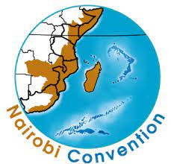
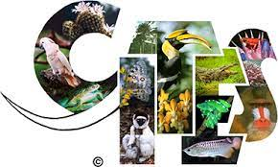
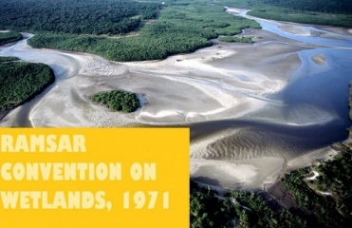



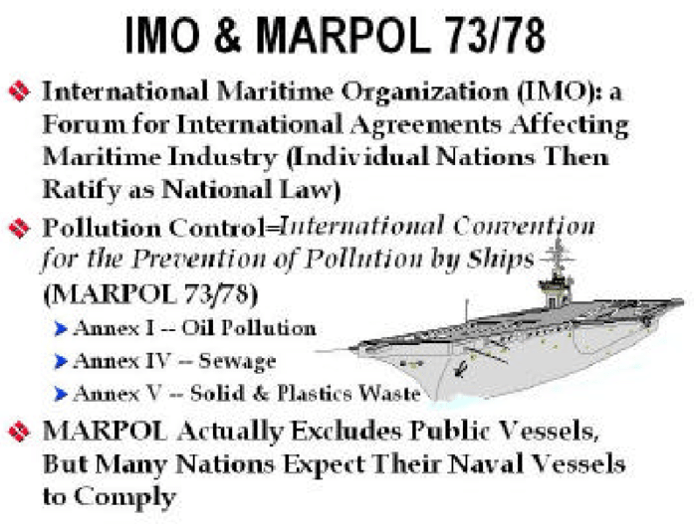

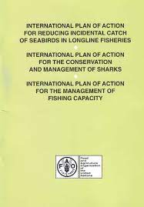


ROLE OF AU MS
AU MS are envisaged to play the following roles in the project implementation:-
Ratify and implement Conventions and Agreements related to conservation of aquatic biodiversity from perspectives of ABES thematic areas
Review and align National Policies and Instruments with relevant Regional and Global Instruments
Participate in relevant aquatic biodiversity and environmental fora for strengthening coherent Africa or common African positions on biodiversity, environmental management

Slide 19
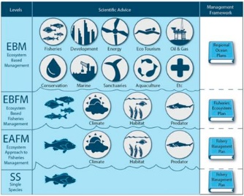
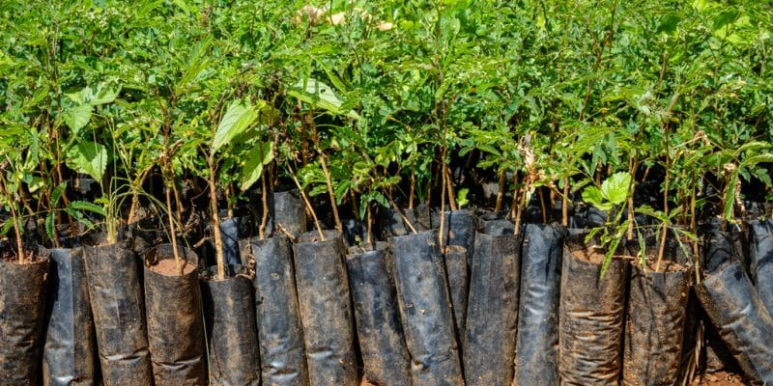
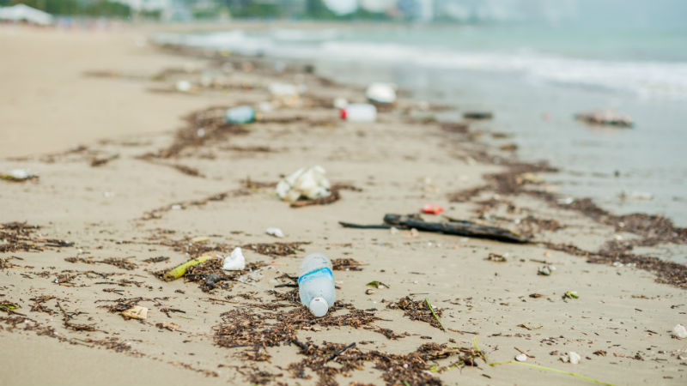
ROLE OF AU MS cont.
Build capacity in fisheries management approaches or tools and aquaculture practices => Policy Briefs, Advocacy Notes, access to quality data and information and foresight studies
Actualization or practical demonstration of projects’ recommendations such as MSP, MPAS, climate change mitigation Strategies
Implement Regional Strategy for enhancing the role of Women and Youths in aquatic biodiversity and integrated environmental management
Build capacities on conservation and utilization of aquatic biodiversity (MPAs, MSPs, AU CoEs)
Pilot recommendations on mitigating the negative impacts of climate change
Pilot guidelines on sustainable marine and coastal tourisms to ensure biodiversity and environmental conservation

Slide 20
ROLE OF OTHER STAKEHOLDERS
Environmental based NGOs supporting conservation efforts at Regional level
  Supporting implementation of activities especially at Regional levels
  implement gender sensitive (Women and Youths) work-plans in biodiversity protection and environmental governance (esp. NSAs, CSOs, Private sector)
  participation and engagement of Women and Youth in aquatic biodiversity conservation and environmental management
Experts
  African experts trained in negotiation skills and techniques
  establish a mechanism for providing technical support to AU MS for effective participation in these Global fora
Highlighting the role of RECs and Specialized Regional Institutions in supporting project implementation

Slide 21
IMPLEMENTATION MECHANISMS
The Regional Institutions will be both beneficiaries as well as partners in the implementation.
The capacity of the Regional institutions will be strengthened in aquatic biodiversity conservation, environmental management, climate resilience, sustainable coastal tourism and infrastructure development etc.
The institutions will act as an interface or conduit in delivery support to the AU Member States.
In view of their role in facilitating Regional integration, the identified activities shall be undertaken with the involvement of the institutions, including implementation of activities on Marine Spatial Planning, Regional environmental monitoring programmes, Regional Strategies on coastal tourism, climate smart and resilient coastal infrastructure, Regional Strategies on Women empowerment and effective engagement in biodiversity and ecosystem conservation

Slide 22
REGIONAL INSTITUTIONS
The project works through Regional Economic Community Institutions (Regional Fisheries Bodies and AU Centers of Excellence) that have the mandate for Regional integrations.
Eight recognized Regional Communities by African Union:
  Arab Maghreb Union (UMA)
  Common Market for Eastern and Southern Africa (COMESA)
  Community of Sahel–Saharan States (CEN–SAD)
  East African Community (EAC)
  Economic Community of Central African States (ECCAS)
  Economic Community of West African States (ECOWAS)
  Intergovernmental Authority on Development (IGAD)
  Southern African Development Community (SADC)

Slide 23
Specialized Regional Institutions
Lake Victoria Fisheries Organization (LVFO)
Lake Tanganyika Authority (LTA)
Lake Chad Basin Commission (LCBC)
Sub Regional Fisheries Commission (SRFC)
Regional Fisheries Commission for the Gulf of Guinea(COREP)
The Nairobi Convention
The Abidjan Convention
The Fisheries Committee for West Central Gulf of Guinea (FCWC)
There are also environmental based NGOs supporting conservation efforts in various Regions of the Continent. The project would collaborate with these various organizations for the implementation of project activities especially at Regional levels.

Slide 24
The Objectives of this Workshop
To Roll-out the joint Management Plans and Protocols and the Harmonized Regional Frameworks for conserving aquatic biodiversity for EAC.
Specifically
ENHANCING AWARENESS ON THE IMPORTANCE OF
“CONSERVING AQUATIC BIODIVERSITY IN AFRICAN BLUE ECONOMY’’
Enhance awareness among EAC AU Member States on priority issues for conservation of aquatic biodiversity, climate Change Mitigation and Adaptation and environment management.

Slide 25
Develop harmonized National / Regional Strategies for transboundary cooperation on conservation of aquatic biodiversity and environmental management in Lake Victoria ecosystems
Come up with recommendations on conservation of aquatic biodiversity, Climate Change mitigation and Adaptation and environmental management for Lake Victoria Region and also propose the Next steps.

Slide 26

Thank You
AU-IBAR: Providing leadership in the
development of animal resources for Africa

