Slide 1



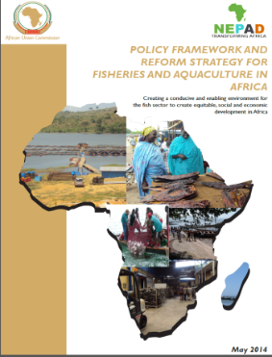
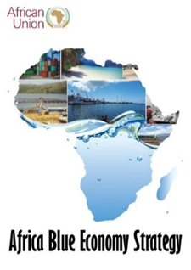


STATUS OF IMPLEMENTATION OF THE PROJECT
“CONSERVING AQUATIC BIODIVERSITY IN AFRICAN BLUE ECONOMY”
22nd MARCH 2022 – KAMPALA, UGANDA
Assessment of Transboundary Environmental Issues Affecting Biodiversity in Selected Shared Freshwater Ecosystems
Dr. Asmah Ruby

Slide 2
PRESENTATION OUTLINE
General Introduction
Objectives
Methodology
Survey Results
Key environmental issues identified
Recommendation

Slide 3
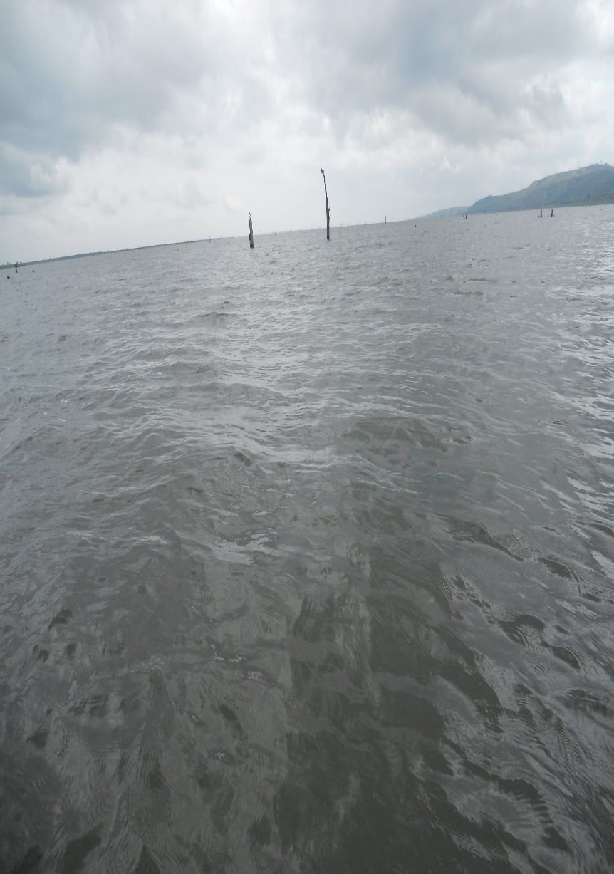
INTRODUCTION
Transboundary freshwater basin account for about 60% of global freshwater
Cuts across over 150 countries
Covers 46% of the world’s land area
Serves about 42% of the world’s population (over 3 billion)
America 45%, Asia 23% Africa 9%.
Freshwater covers less than 1% of earth’s surface but has 10% of biodiversity

Slide 4
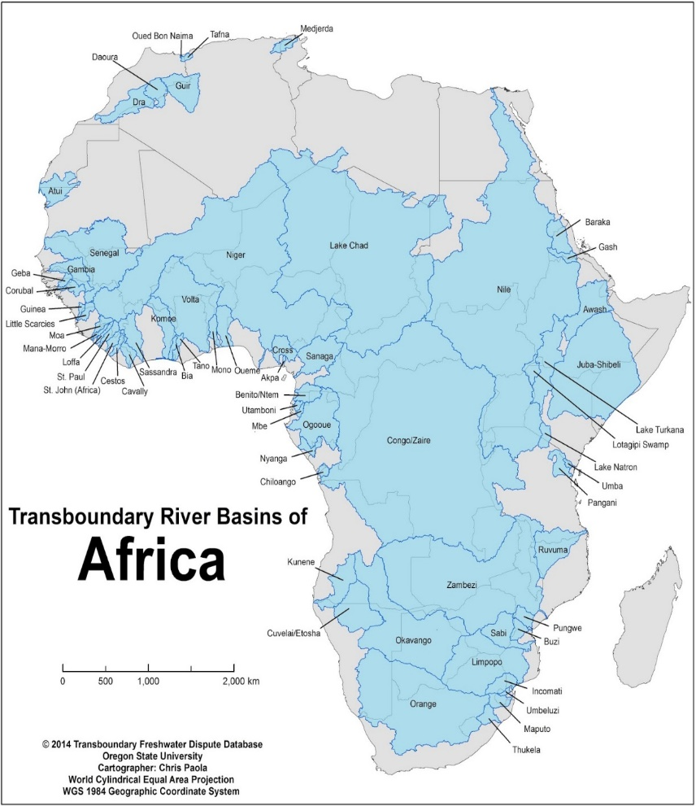
TRANSBOUNDARY BASINS IN AFRICA
African Continent has 68 transboundary basins
Represents 22% of global transboundary river basins
Covers 64% of the continent’s land area
Serves 60% of the continent’s population (over 800 million)
Main uses: agriculture, mining, hydropower, tourism, fishing, navigation, potable water supply

Slide 5
OBJECTIVES OF THE STUDY
The overall objective of the consultancy is to assess selected transboundary freshwater aquatic ecosystems to identify critical aquatic environmental issues and sources affecting aquatic biodiversity and develop regional protocol and strategy for conservation of aquatic biodiversity and joint action plans.

Slide 6
METHODOLOGY AND APPROACH
Literature search;
Stakeholder engagements through questionnaire survey and field visits;
Analyses of data and Preparation of management framework and protocols.

Slide 7
RESULTS FROM SURVEY
Responses were received from:
  Lake Victoria
  Lake Chad Basin
  Volta Basin in Ghana
  Lake Tanganyika
  Niger River Basin
  Fisheries Committee for West Central Gulf of Guinea
  Lake Malawi
  Nile Basin (in South Sudan)

Slide 8
Identified Environmental and Social Stressors
Illegal Unregulated Unreported fishing
Changing climate
Over-exploitation of freshwater resources.
Pollution from point and non-point sources
Destruction of habitats
Invasion of exotic species and emergence of diseases that affect freshwater biota especially fish.

Slide 9
Identified Environmental and Social Stressors
Artificial channeling of rivers
Weed growth
Introduction of alien species (aquaculture)
Wetland drainage or lowered water levels for both agriculture and urban purposes
Flow modification (water obstruction and reduced flows)
Uncontrolled access

Slide 10
EXISTING REGIONAL MANAGEMENT FRAMEWORK/AGREEMENTS
75% of basin respondents had some form of basin management agreement or framework.
Regional Instruments Include:
  The African Convention on the Conservation of Nature and Natural Resource.
  West Africa Water Resources Policy
  East Africa Community Treaty, 1999
  The Protocol on Environment and Natural Resources Management
  The East African Community (EAC) Regional Environment Impact Assessment Guidelines for shared Ecosystems
  Lake Victoria Fisheries Organisation

Slide 11
EXISTING MANAGEMENT FRAMEWORK/AGREEMENTS (II)
Global Instruments
  The United Nations Framework Convention on Climate Change (UNFCCC)
  The Convention on Biological Diversity (CBD)
  The Convention on International Trade in Endangered Species (CITES)
  The Convention on Wetlands of International Importance especially as Waterfowl Habitat (Ramsar Convention)
  The Stockholm Convention on Persistent Organic Pollutants
  UNECE Water Convention

Slide 12
CHALLENGES TO FRESHWATER BASIN MANAGEMENT
Lack of resources to support national and regional strategies
No designated protected areas
Unregulated access to resources
Inadequate governance
Bad riparian community organizations

Slide 13
OUTLINE OF REGIONAL BIODIVERSITY STRATEGY FRAMEWORK
https://d.docs.live.net/65535f2855075107/Documents/AU%20IBAR/Consultancy/FRESHWATER%20BIODIVERSITY/Presentation%20Tables.docx

Slide 14
CONCLUSIONS
Freshwater basins in Africa play key economic roles in riparian states
Biodiversity stressors are increasing in the basins
Most basins have various management frameworks, but enforcement is low due to low commitment of resources
Poor and irregular monitoring of the basins resources (water quality, fisheries, etc)

Slide 15

Thank You
AU-IBAR: Providing leadership in the
development of animal resources for Africa

