Slide 1


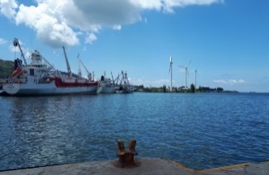
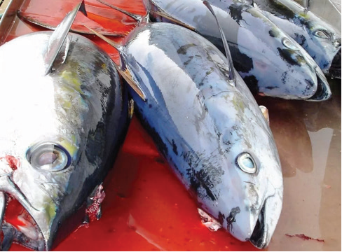
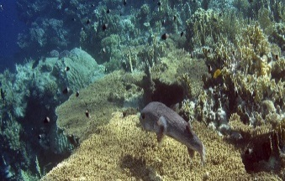
Africa Blue Economy Strategy
Awareness Enhancing on Africa Blue Economy Strategy and Implementation Mechanism
Patrick Karani
AU-IBAR
Technical Expert, Environment

Slide 2
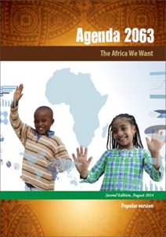
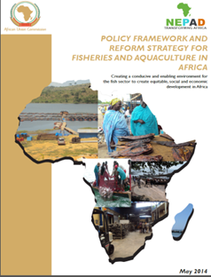
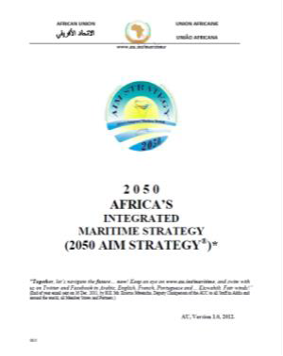

Underpinning AU instruments
A key goal for Africa’s transformation and renaissance is harnessing the potential of Africa’s aquatic endowments for Blue economy growth – this is set as goal for the attainment of Aspiration 1 in the Agenda 2063 (A prosperous Africa based on inclusive growth and sustainable development) for the Africa we want!
Other AU instruments that laid the foundation for blue economy development of the continent:
Policy Framework and Reform Strategy for fisheries and aquaculture in Africa
African Integrated Maritime Strategy
Lomé Charter

Slide 3
Conceptual Definitions of BE
Blue Economy: includes a variety of activities ranging from fisheries and aquaculture; and ecosystem services such as carbon sequestration, coastal protection and biodiversity. The ecosystem plays a major role in climate change mitigation and adaptation through absorption of carbon dioxide (CO2), coastal habitats such as mangrove forests, sea grass beds sequester carbon and help to protect coastlines, prevent soil erosion from floods and storms (World Bank, 2016)
Blue Governance: Refers to reform of policies, building public sector capacity, aligning economic interests with long-term sustainability, and promoting conditions that encourage business growth in a sustainable seafood sector. Public-private dialogue, stakeholder inclusion and strategic partnerships with donors, technical expertise, the private sector and clients help shape the fisheries agenda and position fisheries as central to today’s development challenges – poverty alleviation, climate change, and food security

Slide 4

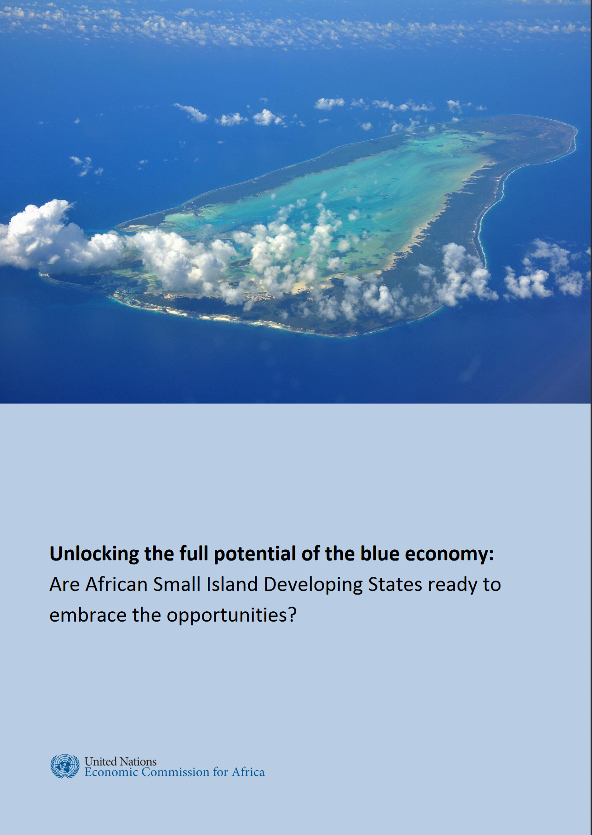
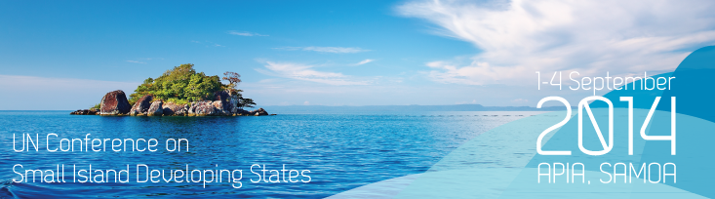

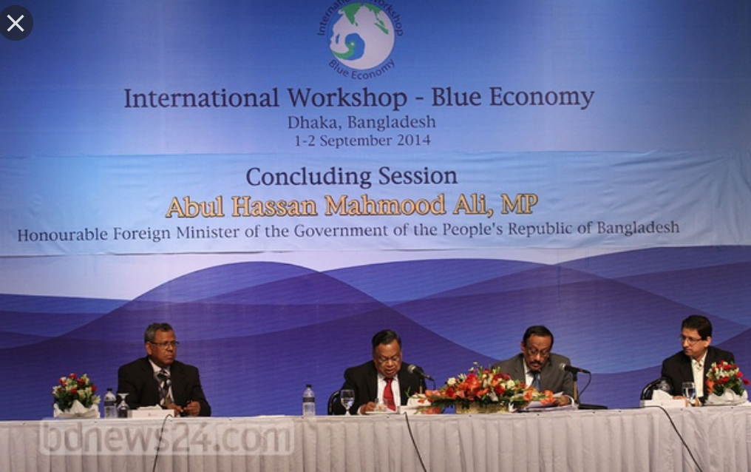

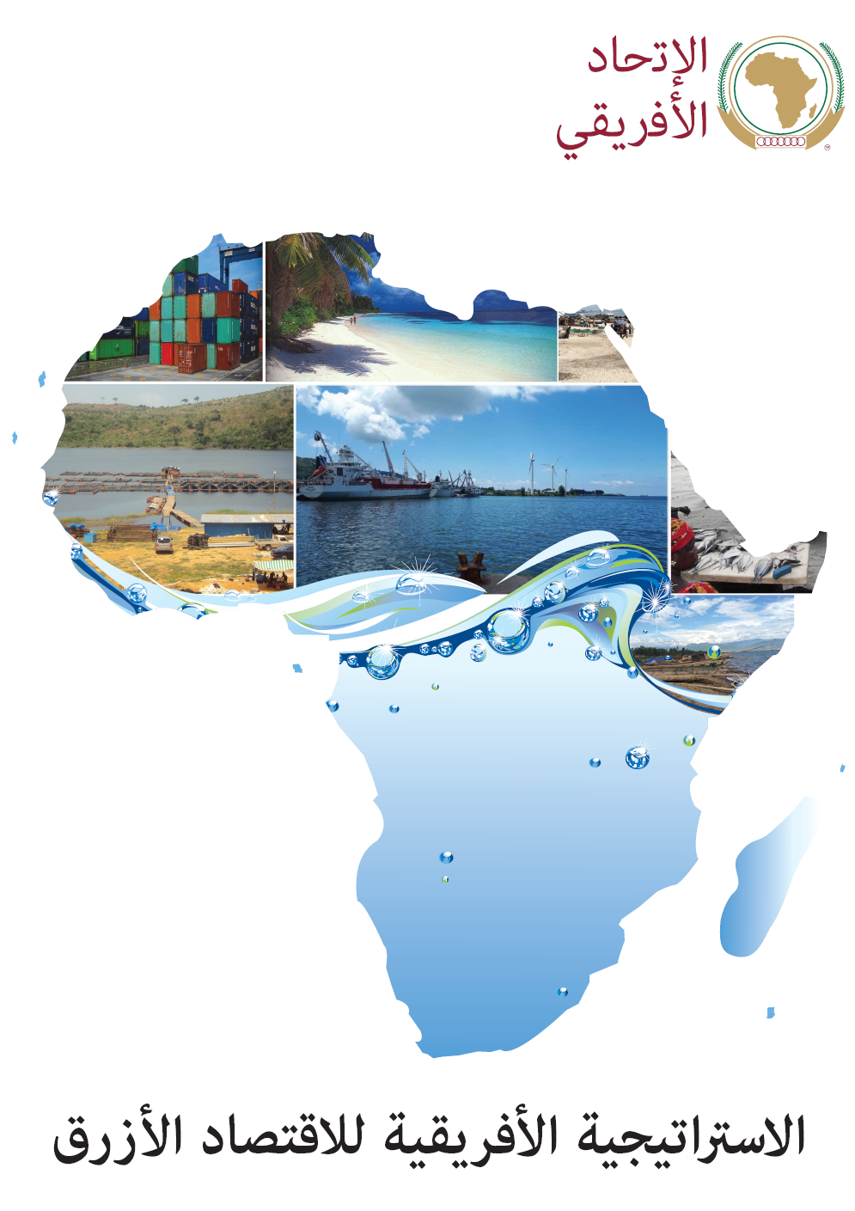

Blue Economy concept….
SIDS support and push
(SAMOA pathway)
Sustainability concept
Bangladesh … new way
Green Economy …. Blue Economy Concept
In the meantime, many other initiatives = Derived and Associated products:
Blue Growth,
Ocean economy
Ocean Governance
Blue Governance
Blue Carbon
Blue Guardians
Blue Finance
Blue Bonds
Blue Belt…
Sustainable development goals … no mention of Blue Economy
Sustainable Blue Economy
(ocean based [blue] economy)

Slide 5
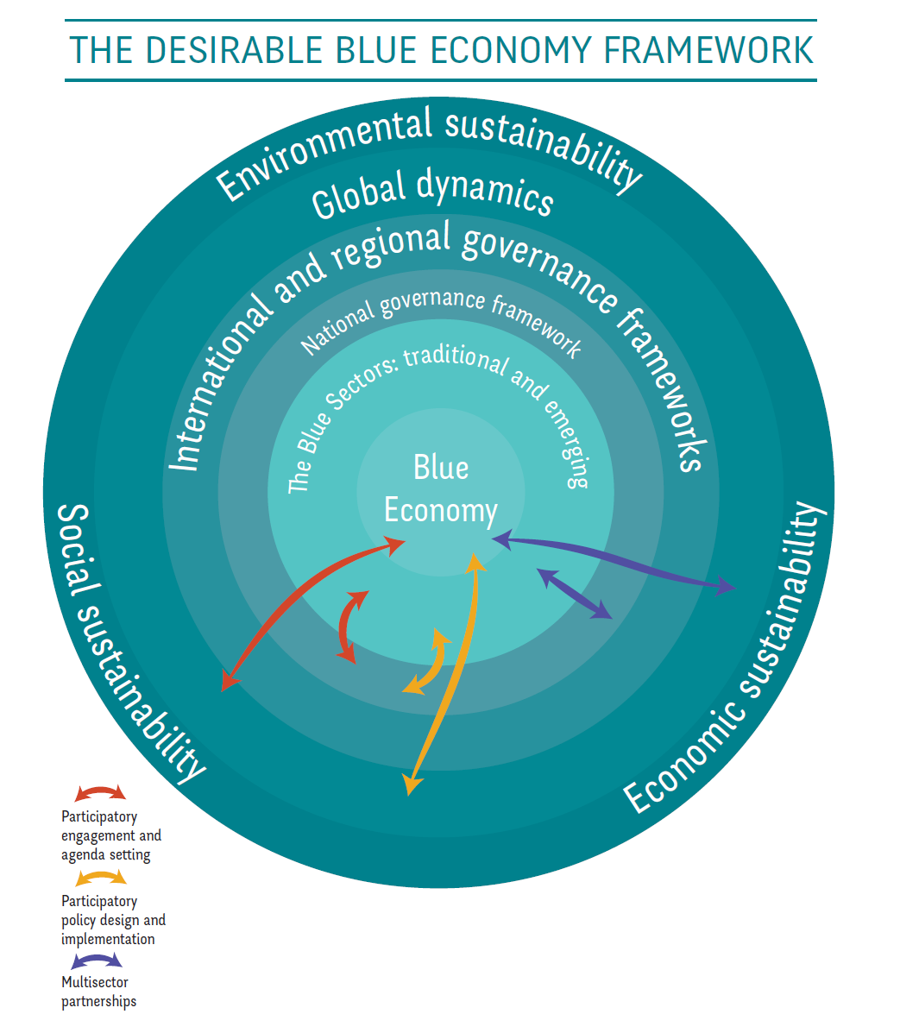
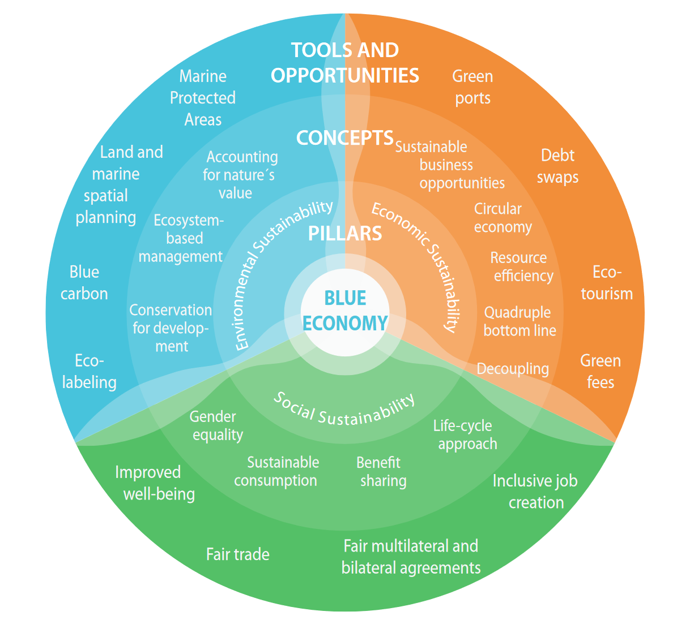
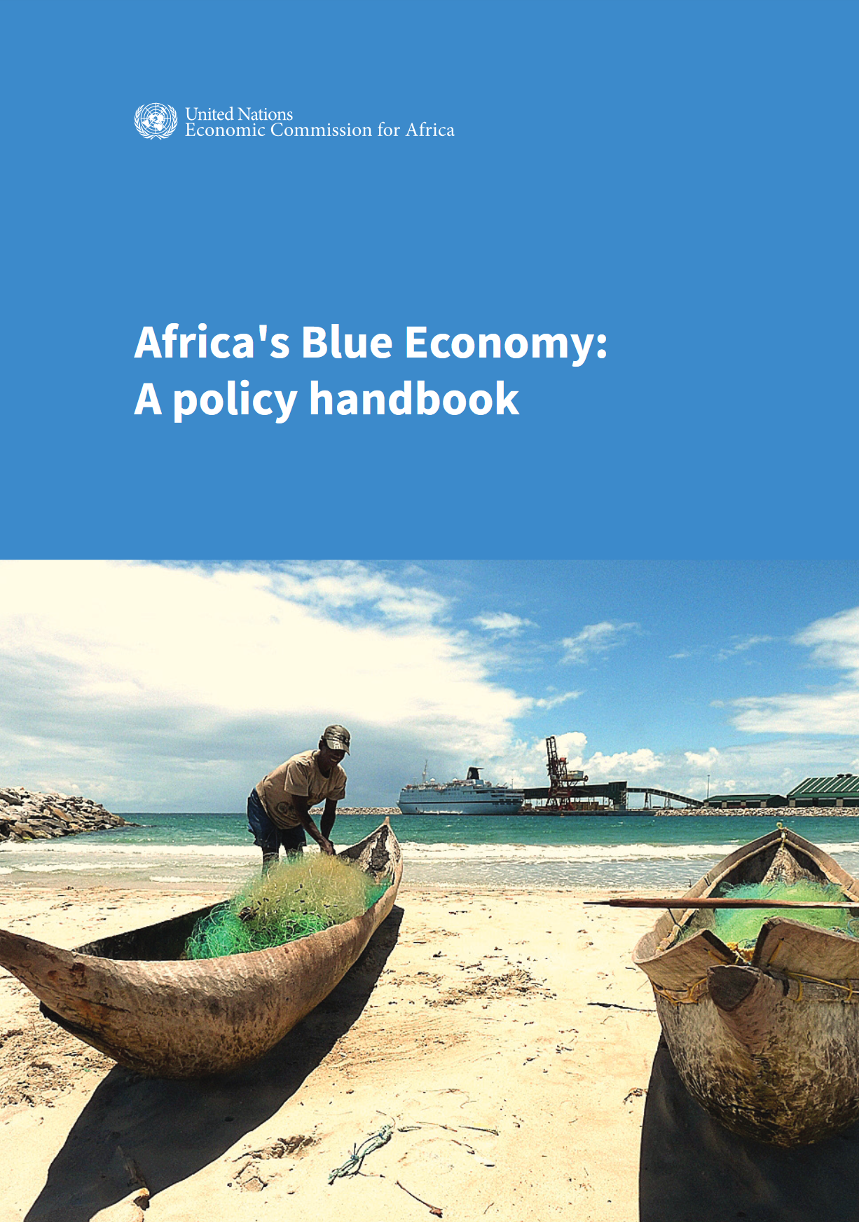
Blue Economy in theory

Slide 6
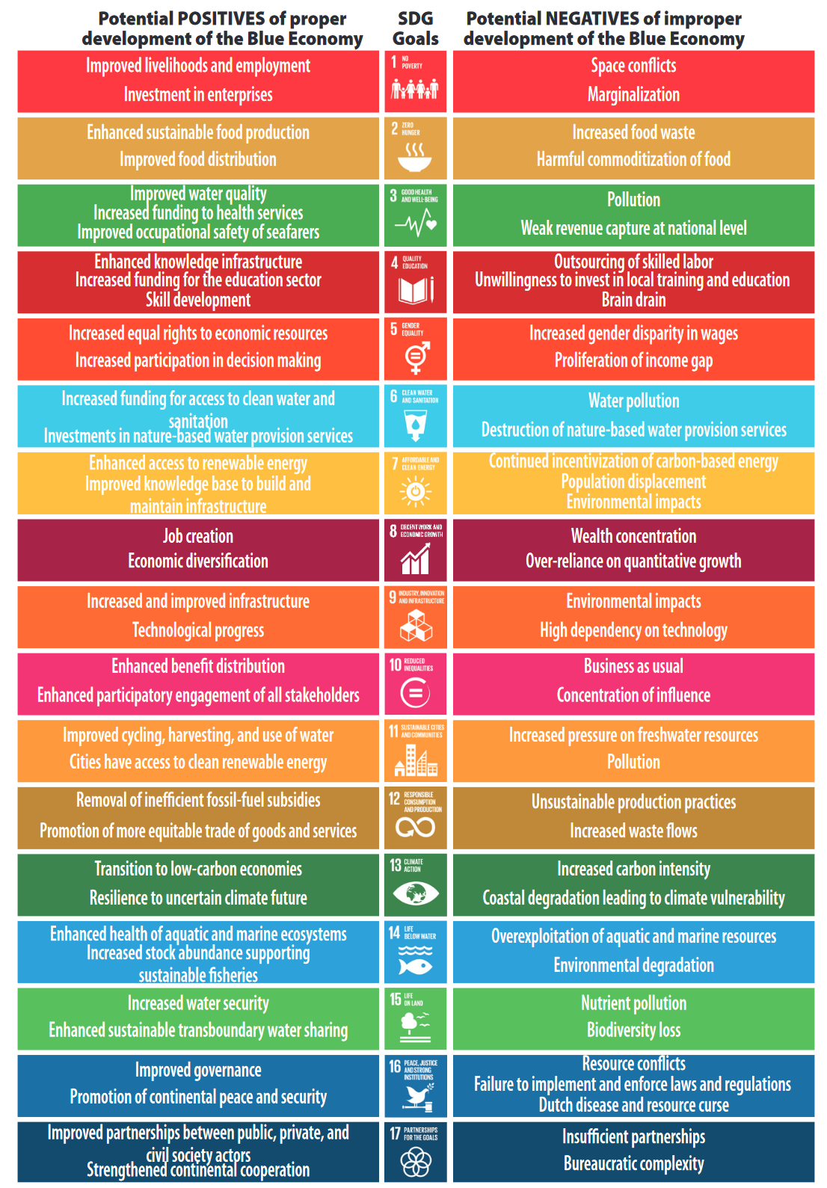
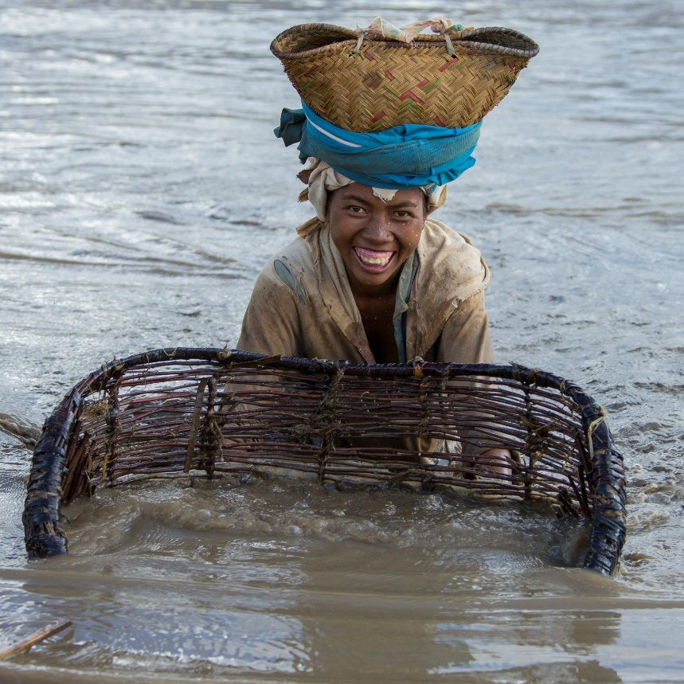
BE in the context of SDG…
Ocean, lakes, rivers, ponds, and all water bodies are at the heart of most of the SDGs… They should deserve a better recognition

Slide 7
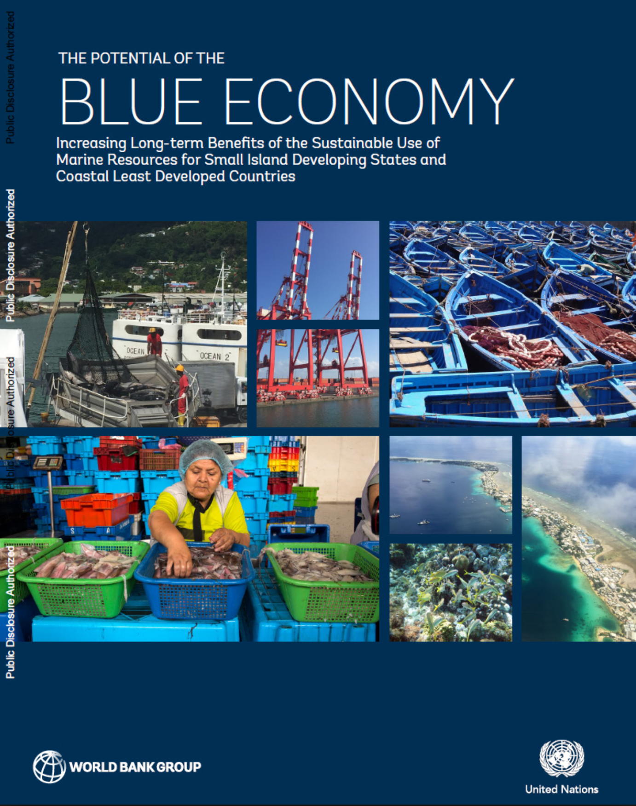
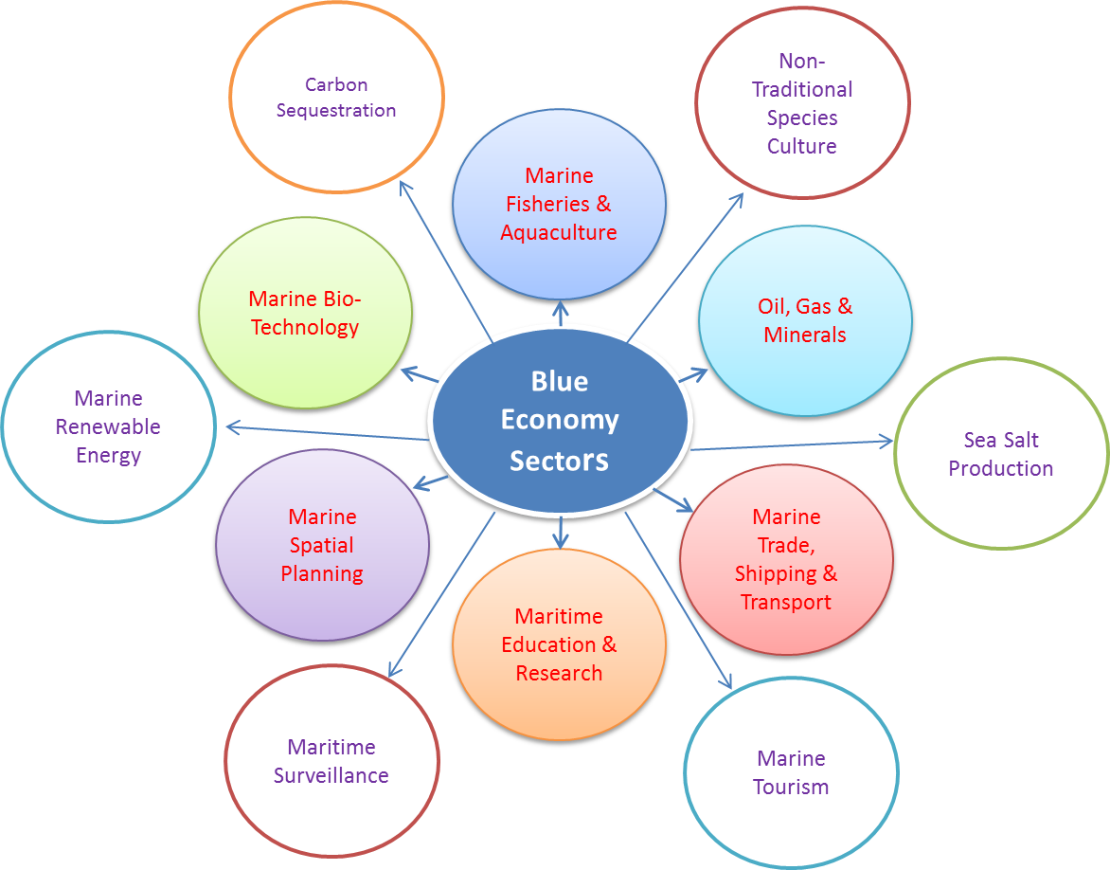
Blue Economy in Practice….
Still very sectorial approach
¨
➔ Still no value of coordination efforts and synergies
Standard Development Approach = More economic benefits
Notes:
WB/UN report : one page on

Slide 8
Rationale and Potential for BE
Rationale
Africa’s oceans, seas, lakes, rivers source of wealth and livelihoods
Untapped, yet could increase jobs, improve GDP, climate change benefits
Africa’s structural transformation: fisheries, mining, shipping, tourism, trade
Creating institutional and sectoral linkages; emerging and frontier sectors; social considerations, gender, youth, food and water security, poverty alleviation, wealth and job creation.
Nairobi …..
BE Potential
A development strategy
A tool for economic diversification, innovation, investment in human capital, regional and international trade integration
Management tool for Africa’s aquatic resources and ecosystems: safeguard against pollution and overexploitation
Strengthens governance, enhance the quality of public services and improve the business climate

Slide 9
Blue Print of Africa’s Blue Economy
Defined by 5 thematic reports:
Fisheries, aquaculture, conservation and sustainable aquatic ecosystems
Shipping/transportation, trade, ports, maritime security, safety and enforcement
Coastal and maritime tourism, climate change, resilience, environment, infrastructure
Sustainable energy and mineral resources and innovative industries
Polices, institutional and governance, employment, job creation and poverty eradication, innovative financing
Relies on:
Desk work
Scoping missions to selected countries
Stakeholders’ Consultative Workshop attended by 125 delegates, 30-31 August 2019 in AU-IBAR Office in Nairobi, Kenya
Third Ordinary Session of the Specialised Technical Committee on Agriculture, Rural Development, Water and Environment: 21-25 October 2019 In Addis Ababa, Ethiopia

Slide 10
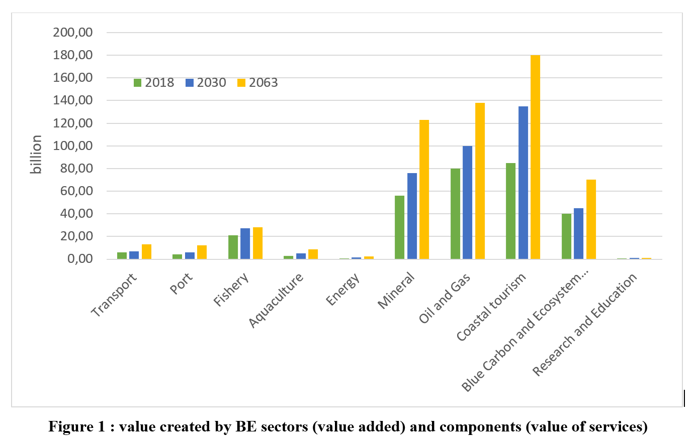
Value added of BE Sectors and Value of BE components (Ecosystems Services, education, Research, etc.) from 2018 to 2063
African BE sectors and components generate today a value of USD 296 billion. It is projected that by 2030, figures will be USD 405 billion while in 2063 estimates would be USD 576 billion of value created.

Slide 11
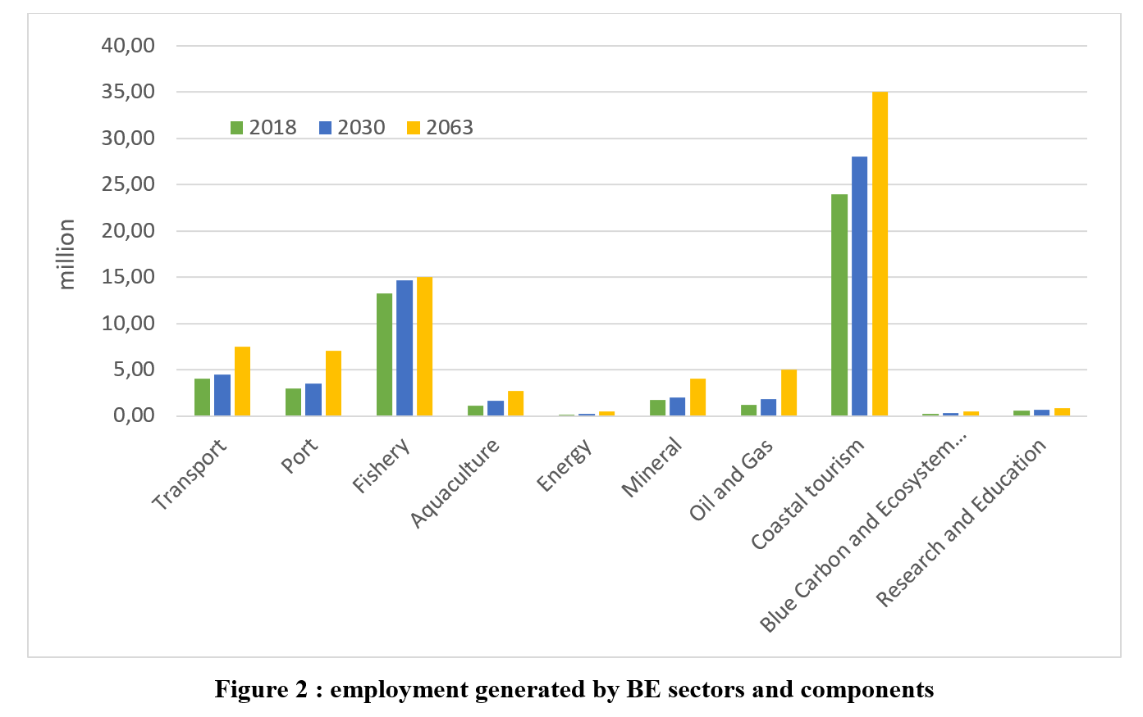
Employment, from 2018 to 2063
African BE sectors and components generate today 49 million jobs. It is projected that by 2030, figures will be 57 million while in 2063 estimates would be 78 million.

Slide 12
Key drivers of change
African population growth and demand ⎯ With an estimated population of almost 3 billion in 2063, goods and services need will be multiplied by 2.5.
Regional/international Economic integration ⎯ AfCTA, EPA, Chinese Trade Pacts and other trade agreements will concur to ease the move of goods and services within the African continent and with the rest of the world.
Nationally Determined Contributions ⎯ NDCs should be framed as an essential component of the Blue Economy in adaptation and mitigation measures in carbon capture and storage.
Environment and biodiversity protection ⎯ Conservation investments will be increased in the future to contribute to enhancing the carbon sink function of watersheds.
Sustainable Blue Energy for Addressing Energy Demand ⎯ To meet the increasing energy demand and achieve Africa Union’s 2063 objectives, unlocking the huge untapped potential and integrating sustainable blue energy resources in the national energy mix is essential.
Ocean Mining for Meeting Global Demand and National Economic Development ⎯ Deep-seabed mining is becoming an attractive frontier to meet the demand.
Innovative Industries for Accelerating Economic Development Benefits ⎯ will substantially expedite the creation of prosperous Africa based on advanced technologies.
Large companies and Countries transport strategies ⎯ with the modernization of ports to accommodate the latest generation ships, development of transport infrastructure in the framework of the PIDA project and consultations for the creation by private operators of sub-regional cabotage companies.

Slide 13
Vision and Purpose of the BE Strategy
Vision
The Vision of the BE Strategy is an inclusive and sustainable blue economy that significantly contributes to Africa’s transformation and growth
Purpose of the African BE strategy
The objective of the BE Strategy is to guide the development of an inclusive and sustainable blue economy that becomes a significant contributor to continental transformation and growth, through advancing knowledge on marine and aquatic biotechnology, environmental sustainability, the growth of an Africa-wide shipping industry, the development of sea, river and lake transport and fishing; and exploitation and beneficiation of deep-sea mineral and other resources.

Slide 14

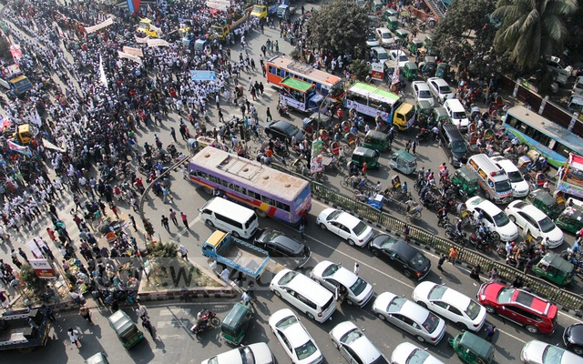
Major Constraints
Lack of Planning
Marine Spatial Planning (MSP) has not yet planned and designed in coordination with various stakeholders in Southern countries while MSP should be integrated and multi-objective, strategic and future oriented, and continuous and adaptive to use all marine resources for sustainable blue growth ➔ Secure Investments and reduce negative externalities
Lack of Coordination
Between administrative and research institutions
Between administration and private sectors
Inter-ministerial coordination is very much vital to bring forward all the relevant developmental issues related to the SBE
Lack of consideration for ecosystem services and climate change effects
Ecosystem services are not taken into account (as well coastal and marine environment) into Ocean based economic development policies
Climate change not [enough] integrated in SBE strategies
Lack of Blue Economy Development Bank
To bring the financial support at the level needed
To contribute to ensure the sustainability of BE development

Slide 15
Challenges
Strategic challenges
  Blue governance
  Economic and social
  Nutritional
  Environmental and climate change
Technical challenges
  Assessing the Blue Potential
  Accounting BE activities and components for better governance
  Maritime spatial planning (MSP) and better coordination and synergy
  Integrated and prospective approach to marine ecosystems
  Increasing safety and security though an integrated maritime surveillance
  Value addition

Slide 16
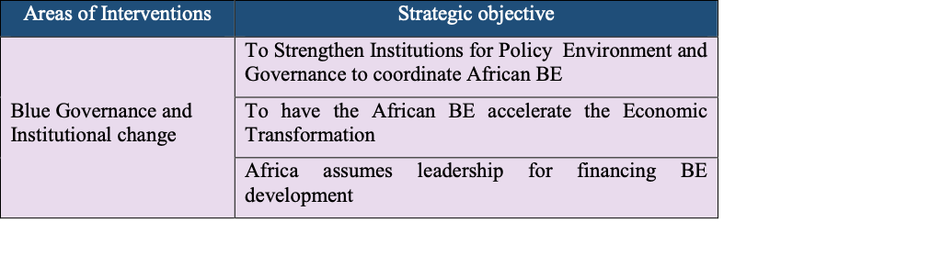
Areas of intervention
Goal 6 of the Agenda 2063 and Goal 14 of the UN Agenda 2030
Blue governance and institutional changes is a cross-cutting areas

Slide 17
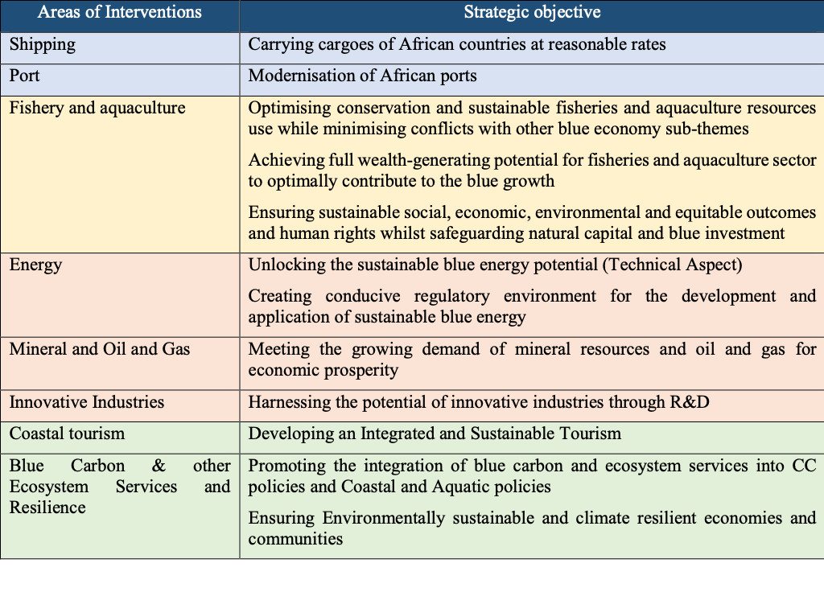
Specific areas of interventions

Slide 18

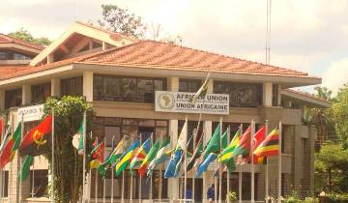
AU-IBAR: Providing leadership in the development of animal resources for Africa

