Slide 1



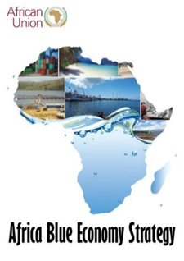


FISHERIES GOVERNANCE PHASE 2 (FISHGOV 2)
“Enhancing sustainable fisheries management and aquaculture development in Africa: A programme for accelerated reform of the sector”
Envisaged roles and Benefits of RECs – In Project Implementations
Mrs Hellen Moepi-Guebama
29 November 2021

Slide 2
PFRS POLICY ARENA
POLICY ARENA | OBJECTIVE | STRATEGIC ACTION
Strengthened Regional and Sub-regional Cooperation | To strengthen South-South (bilateral and regional) cooperation, and develop coordinated mechanisms among RECs and RFBs to ensure coherence of fisheries policies and aquaculture development and their adoption and adaptation | Increase strategic cooperation in capture fisheries and aquaculture development needs Create synergies and complementarities in programmes at regional level Establish and reinforce the role of RECs and RFBs in regional economic integration

Slide 3

ROLES OF RECs
Political mandate for
  regional integration agenda
  enhancing regional cooperation
  regional policy coherence
  Inter/intra regional trade

Slide 4
ANTICIPATED ROLES OF RECs IN PROJECT IMPLEMENTATION
Project would leverage on their political mandate (in collaboration with RFBs, other specialized regional institutions).
Monitoring the implementation of PFRS by AU member states
Mainstreaming fisheries and aquaculture in NAIPs and RAIPs and establishing the monitoring and evaluation mechanism
Promoting domestication of continental frameworks and programs and monitoring the implementation of policy organs’ decisions
Identification and development of regional value chains in fisheries and aquaculture
Promoting regional harmonization on trade certification and SPS issues in line with AfCFTA agreement
Support the functions and institutionalization of regional NSAs, platforms and other regional networks

Slide 5
ANTICIPATED ROLES OF RECs IN PROJECT IMPLEMENTATION
Communication conduit between AU and AU MS
Promoting regional institutional coordination amongst RECs and Regional fisheries organisations (APRIFAAS)
Advocating for enhancing the investment in the sector at both regional and national level
Capacity building at AU MS level (utilization of fisheries mgt tools, methodology and approach of data collection and analysis
Institutional anchorage between RECs and RFBs/RSC
Conduct regional meetings (validation, RAIPS, CAADP BR)
COEs/ specialized knowledge-based institutions- contracted to carry out policy-oriented studies and RECs would be utilized to facilitate the conduct of these studies.

Slide 6
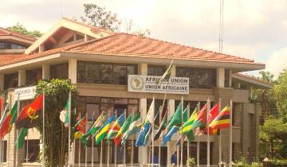
Thank You
AU-IBAR: Providing leadership in the development of animal resources for Africa

