Slide 2
DIALOGUE WITH REGIONAL ECONOMIC COMMUNITIES (RECS)
ON IMPLEMENTATION OF THE FISHERIES GOVERNANCE PROJECT PHASE 2 (FISHGOV 2)
29th November – 1st December 2021, Naivasha, Kenya
ACTIVTITIES OF EAC IN FISHERIES AND AQUACULTURE
David Balikowa
Senior Livestock Officer
Presented by:

Slide 3
OUTLINE OF THE PRESENTATION
Background;
Activities of EAC (LVFO) in fisheries and aquaculture;
Some specific aquaculture activities;

Slide 4
BACKGROUND
Fisheries and aquaculture sector is central to social and economic transformation of the EAC Region;
Regional is located in the great lakes region and a host to the major fresh water bodies on the African Continent;
A major producer of fisheries sources, both capture fisheries and aquaculture;
Well developed fish consumption culture;
Fish trading, both local and export are major economic activities

Slide 5
BACKGROUND
Fisheries and aquaculture sector is central to social and economic transformation of the EAC Region;
A major contributor to nutrition and food security;
A major source of employment in fisheries and aquaculture value chains;
Major source of foreign exchange through export of fish;
A major contributor to the national GDP

Slide 6
BACKGROUND
Interventions in the fisheries and aquaculture sector are guided by:
    Treaty for Establishment of the EAC;
    Protocol on Establishment of the EAC Common Market;
    Convention for the Establishment of the Lake Victoria Fisheries Organisation, 1994, amended in 1998 and in 2016;
    EAC Fisheries and Aquaculture Policy;
    Continental Policy Framework and Reform Strategy (PFRS) and CAADP process;

Slide 7
BACKGROUND
EAC TREATY
  Article 9 (3) Established Lake Victoria Fisheries Organisation (LVFO) as an Institution of the Community;
  Article 110 (f) mandates Partner States to develop marine and inland aquaculture and fish farming;
  Article 114 (2) (b) mandates Partner States to cooperate in management of their water and marine resources, including adoption of common policies and regulations for the conservation, management and development of fisheries resources and the establishment of a body for management of Lake Victoria;

Slide 8
BACKGROUND
Article 45 (3) (f) ) of EAC Common Market Protocol mandates the Partner States to develop, promote, manage and conserve fisheries resources on a sustainable basis within the Community;
The 1994 Convention for establishment of LVFO, was amended in 1998 and 2016 to widen the scope and mandate of the Organisation;
  to include all EAC Partner States;
  to expand the geographically coverage to beyond Lake Victoria; and
  to address aquaculture and postharvest issues;

Slide 9
BACKGROUND
The 2016 amendment to the convention provided for establishment of four main programme areas to guide the sustainable management and development of fisheries and aquaculture resources;
  Fisheries Management and Development;
  Aquaculture Management and Development;
  Fisheries Resource Monitoring and Research;
  Fish Quality Assurance, Trade and Marketing of fish and fishery Products;

Slide 10
ACTIVITIES OF EAC (LVFO) IN FISHERIES AND AQUACULTURE
1. Evaluate and review existing management plans and/or develop and support the implementation of new management plans for species and/or fisheries of regional interest;
Conducted a study on enhancement of the institutional, structural and legal frameworks of LVFO against the backdrop of expanded scope and mandate;
Reviewed the performance of Lake Victoria Fisheries Management Plan-III (2016-2020) and Drafted Lake Victoria Fisheries Management Plan-IV (2021-2025) now ready for approval by FASCOM

Slide 11
ACTIVITIES OF EAC (LVFO) IN FISHERIES AND AQUACULTURE
2. Promote coherent regional registration and licensing frameworks in the small-scale inland and marine fisheries;
Convened a regional workshop to harmonise annual registration/licensing of fisheries, fishing boats and gears;
Expanded the regional database;
3. Support the adoption and implementation of management measures aiming at protecting marine biodiversity with regional impacts;
Mark and protect biodiversity hotspots and breeding/nursery areas in selected areas
Developing guidelines for management of fish breeding areas;

Slide 12
ACTIVITIES OF EAC (LVFO) IN FISHERIES AND AQUACULTURE
4. Improve data collection and data management in support of more evidence based regional policies;
Conducting CAS, trawl frame survey, hydroacoustic surveys to monitor stocks, catches and fishing efforts on Lake Victoria;

Slide 13
ACTIVITIES OF EAC (LVFO) IN FISHERIES AND AQUACULTURE
5. Establishing and implementing a regional monitoring, control and surveillance (MCS) system that encompasses among others, the development of regional guidelines or framework on fisheries licensing, the establishment of user rights-based management systems (control of open access)
Conducting regional consultative high level multi-stakeholders meeting to harmonize MCS operation on Lake Victoria;
Planning the implementation of regional MCS operations to have harmonised approaches, time, capacity needs;
Conducting MCS operations on Lake Victoria using interagency approaches;

Slide 14
ACTIVITIES OF EAC (LVFO) IN FISHERIES AND AQUACULTURE
6. Building capacity to implement regional, cost effective inland monitoring and surveillance programmes;
Procurement and maintenance of equipment to support MCS operations
7. Supporting capacity building in Enforcement, Compliance and Prosecution procedures in the fisheries sector at national levels;
Training in enforcement, compliance and prosecution procedures in enforcement, compliance and prosecution procedures;

Slide 15
ACTIVITIES OF EAC (LVFO) IN FISHERIES AND AQUACULTURE
8. Building capacity at base of the pyramid for value addition targeting women and youth
Training of youth and women groups in the region on small pelagic fish handling, processing, packaging and marketing;
Promoting technologies for value addition;

Slide 16
ACTIVITIES OF EAC (LVFO) IN FISHERIES AND AQUACULTURE
9. Strengthening quality assurance for fish exports and linkage for fish marketing
Training fisheries officers and inspectors in fish quality assurance and regulation;
Developing guideline for fish quality assurance and regulation;
10. Strengthening fisheries co-management in the region
Developing regional guidelines and policies for fisheries co-management;
Supporting capacity building programs;
11. Fisheries and aquaculture resource monitoring and research;

Slide 17
SOME SPECIFIC AQUACULTURE ACTIVITIES
i) Development of a cage fish farming policy of the EAC;
ii) Training of trainers (ToT) of cage fish farming in good management practices and biosecurity measures;
iii) Development of regional guidelines for the certification of fish seed and fish feed in the East African Community;
iv) Training needs assessment (TNA) for targeted institutions (RIAT, FTI & NFFI);

Slide 18
SOME SPECIFIC AQUACULTURE ACTIVITIES
v) Conducting baseline aquatic animal health self-assessments;
vi) Reviewing and planning the framework for the establishment of the aquaculture zoning on the Lake Victoria;
vii) Conducting a tailor-made course on molecular biology and bioinformatics for Junior Scientists from Burundi, Kenya, Uganda and Tanzania, in collaboration with WorldFish, and hosted at BecA-ILRI Hub in Nairobi, Kenya;

Slide 19
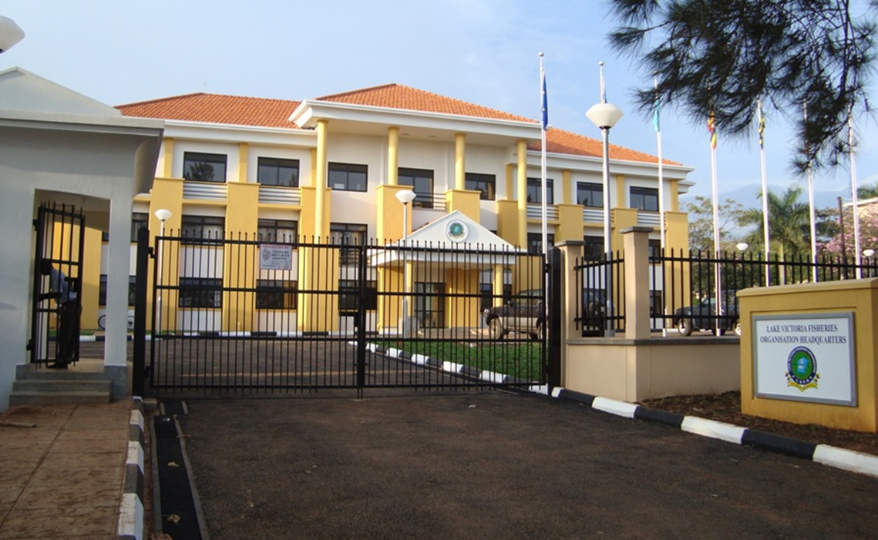
Thank you for your kind Attention

