Slide 1




MONITORING AND EVALUATION
FRAMEWORK FOR FISHGOV 2 PROJECT
By Admore Chakadenga – M&E Expert AU-IBAR

Slide 2

Presentation Outline
Introduction
Approach used
  Problem,
  Response
  Results)
M&E Framework
Role of Stakeholders
Monitoring
Evaluation
What is done so far

Slide 3

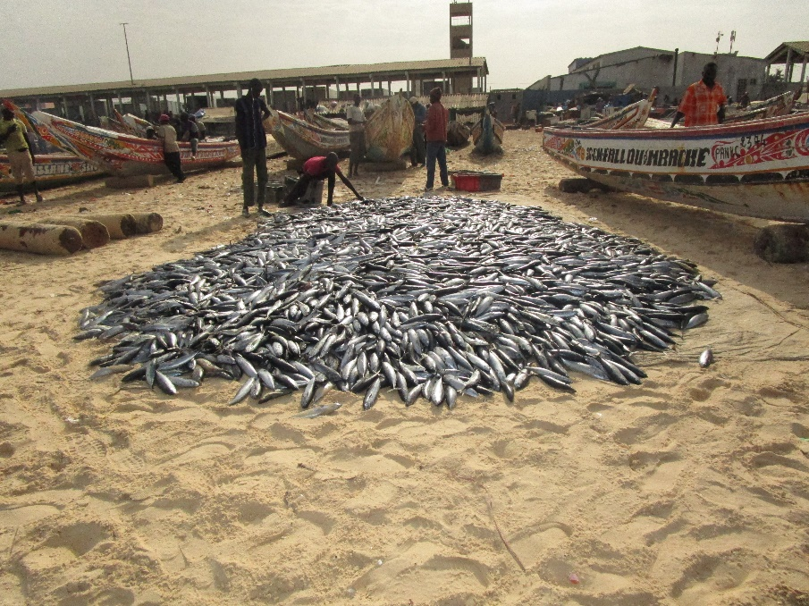
1. Introduction
To outline planned M&E processes and procedures
Aim to promote:
  Accountability,
  Leaning and
  Adaptation
Used the theory of Change Approach
Developed M&E Framework and Full Logframe
Cognizant of FishGov1 achievements

Slide 4
2. Approach Used
Problem Analysis
Response to the Problem
Expected Results

Slide 5
2. a. Problem Analysis
Causes
Data and information
Weak Partnerships
Policies and regulations
Human and Institutional capacities
Limited Resources
Weak African voice
Core Problem
Weak contribution of fisheries and aquaculture
Effects
Low contribution of Fisheries and Aquaculture to food and nutritional security
Livelihoods
Wealth creation
Unsustainable conservation and utilization

Slide 6
2. b. RESPONSE TO THE PROBLEM
1.To ensure that African Union Decisions on sustainable fisheries and aquaculture are evidence based.
2.To ensure that Fisheries and aquaculture policies are coherent with the PFRS and other AU priorities and coordinated at Continental, Regional and National Levels
3.To ensure that Africa is adequately represented and effectively participates in international fisheries and aquaculture fora and ably domesticates and implements global instruments
GOAL: To enhance the contribution of fisheries and aquaculture to food and nutritional security, livelihoods and wealth creation in line with Agenda 2063 aspirations.

Slide 7
2. c. Expected Results
IMPACT: Enhanced contribution of fisheries and aquaculture to livelihoods, food and nutritional security and wealth creation due to its sustainable conservation and utilization
Specific Outcomes:
1.AU Decisions on fisheries and aquaculture are evidence based
2.Fisheries and Aquaculture policies in Africa are coherent with the PFRS and other AU priorities and coordinated at Continental, Regional and National Levels in order to maintain health resilient marine, coastal and fresh water ecosystems in the context of climate change
3.Africa is adequately represented and effectively participates in international fisheries and aquaculture fora and ably domesticates relevant global instruments

Slide 8
2.c.Expected results continued
OUTPUTS:
  1.1 AU stakeholders have access to quality knowledge products on African fisheries and aquaculture
  1.2 Existing platforms and networks are reviewed, rationalised and operationalized for effective participation of stakeholders in policy development and implementation
  1.3 A solid reporting system to STC on the implementation of the PFRS is put in place and integrated to CAADP process
  1.4 Mechanisms are developed to ensure that sustainable fisheries and aquaculture are mainstreamed in the development of AU policies / initiatives affecting the sector.
  1.5 Advocacy is improved and awareness created about the importance of sustainable fisheries and aquaculture

Slide 9
2.c. Expected results continued …
Outputs
2.1 Capacities and systems for regional collaboration and integration regarding shared fisheries and aquaculture resources management are improved and linkages with environmental governance frameworks are enhanced
2.2 Capacities of Member states, RECs and RFBs to develop realistic sustainable fisheries and aquaculture policies in coherence with PFRS are strengthened
2.3 Capacities are strengthened to facilitate intra and inter regional fish trade in line with the regional integration trade agenda and the Protocol on Trade in Goods of the ACFTA

Slide 10
2.c. Expected Results Continued…
Outputs
3.1 Capacity of AU Member States – incl. SIDS – in terms of international negotiations are increased and a mechanism is put in place to coordinate positions
3.2 Mechanisms are put in place to encourage and facilitate the domestication of global instruments and initiatives at continental, regional and national levels
3.3 Capacities of AU Member States are strengthened to effectively articulate African positions on fisheries and aquaculture in the AU-EU dialogue

Slide 11
3. Monitoring and Evaluation Framework
Reference document for Fishgov2 M&E Activities whose objectives are to:
  Provide guidance for the monitoring and evaluation of FishGov2 project;
  Outline the theory of change, results frame, indicators, targets and milestones for implementation progress measurement;
  Outline systems and methods data collection methods, and frequency of measurement and reporting;
  Provide a mechanism for fostering transparency and accountability among stakeholders during the implementation of; and
  Promote the use of M&E results as feedback for improved efficiency, effectiveness, learning and experience sharing

Slide 12
4. Role of Stakeholders in M&E
CONTINENTAL LEVEL
Project Steering Committee (PSC) - Oversight and Direction
Actors: AUC, AU –IBAR, AUDA/Nepad
Design, Role out and Oversee the M&E system
Development of tools/ templates to be used for data collection, analysis and reporting
Ensure data quality
Sharing Knowledge, best practices and Lessons
Coordination and collaboration
REGIONAL LEVEL
Actors: Centres of Excellence, RECs, RFBs, RFMBs
Development / Adaptation of M&E tools and data collection templates
Coordinate data collection, and analysis
Regional Level Feedback and reporting
NATIONAL LEVEL
Relevant Line Ministries / National Focal Points
Development/ Adaptation of M&E tools to context
Data collection/ collation
Feedback and reporting
Sharing knowledge, best practices and lessons
Feedback, Learning and Adaptation

Slide 13
Logframe
Tracking a total of 25 Indicators;
  (4 Impact level
  8 Outcome Level and
  13 Output Level
Considered Overarching Frameworks (Agenda 2063 and CAADP Indicators)
For each indicator we have determined the baselines and targets
FishGov2 project logframe

Slide 14



4. Monitoring
Ongoing continuous of feedback, learning and adaptation aimed:
  To see if products/ services/ results are delivered timely in right quantities and quality as planned
  To see if the services/ products / results are being used by beneficiaries
  Improve project quality
Monitoring tools
  Indicator tracking table
  Online surveys
  Field missions
  Monitoring Checklist
Monitoring reports – to be produced when monitoring activities are carried out and consolidated annually

Slide 15

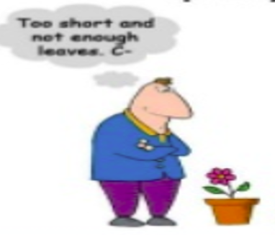
5. Evaluation
Done to
To obtain feedback, learn and adapt
Express an independent opinion on project quality
Is usually external for independence
Baseline:
Send a questionnaire to obtain missing baselines in Q1 2022
Mid term Evaluation
Planned for 2023
End of Project Evaluation planned for 2025

Slide 16
6. Planned activities
Developed the M&E Framework
Developed the logframe which is scheduled to be finalized in the second technical committee meeting
Monitoring
  Obtained feedback from Regional Non State Actors Platforms PRAPAC, SANSAFA, WANSAFA, MOSFA, LVFO, EARFISH, Plateforme Maghrébine de la Perche Artisanale, COMHAFAT
  Obtain feedback from RECs in this meeting. A link is to be circulated by Jemima
Baseline Studies – will be commissioned in the first quarter of 2022

Slide 17
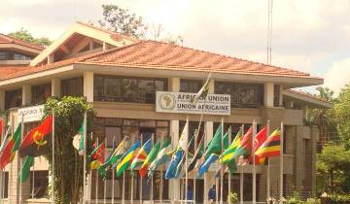
Thank You
AU-IBAR: Providing leadership in the development of animal resources for Africa

