Slide 1
FISHERIES GOVERNANCE PROJECT PHASE 2
URBANIZATION AND HUMAN SETTLEMENTS DEVELOPMENT
AUC- Political Affairs , Peace and Security
( Housing and Urban Development Expert)

Slide 2
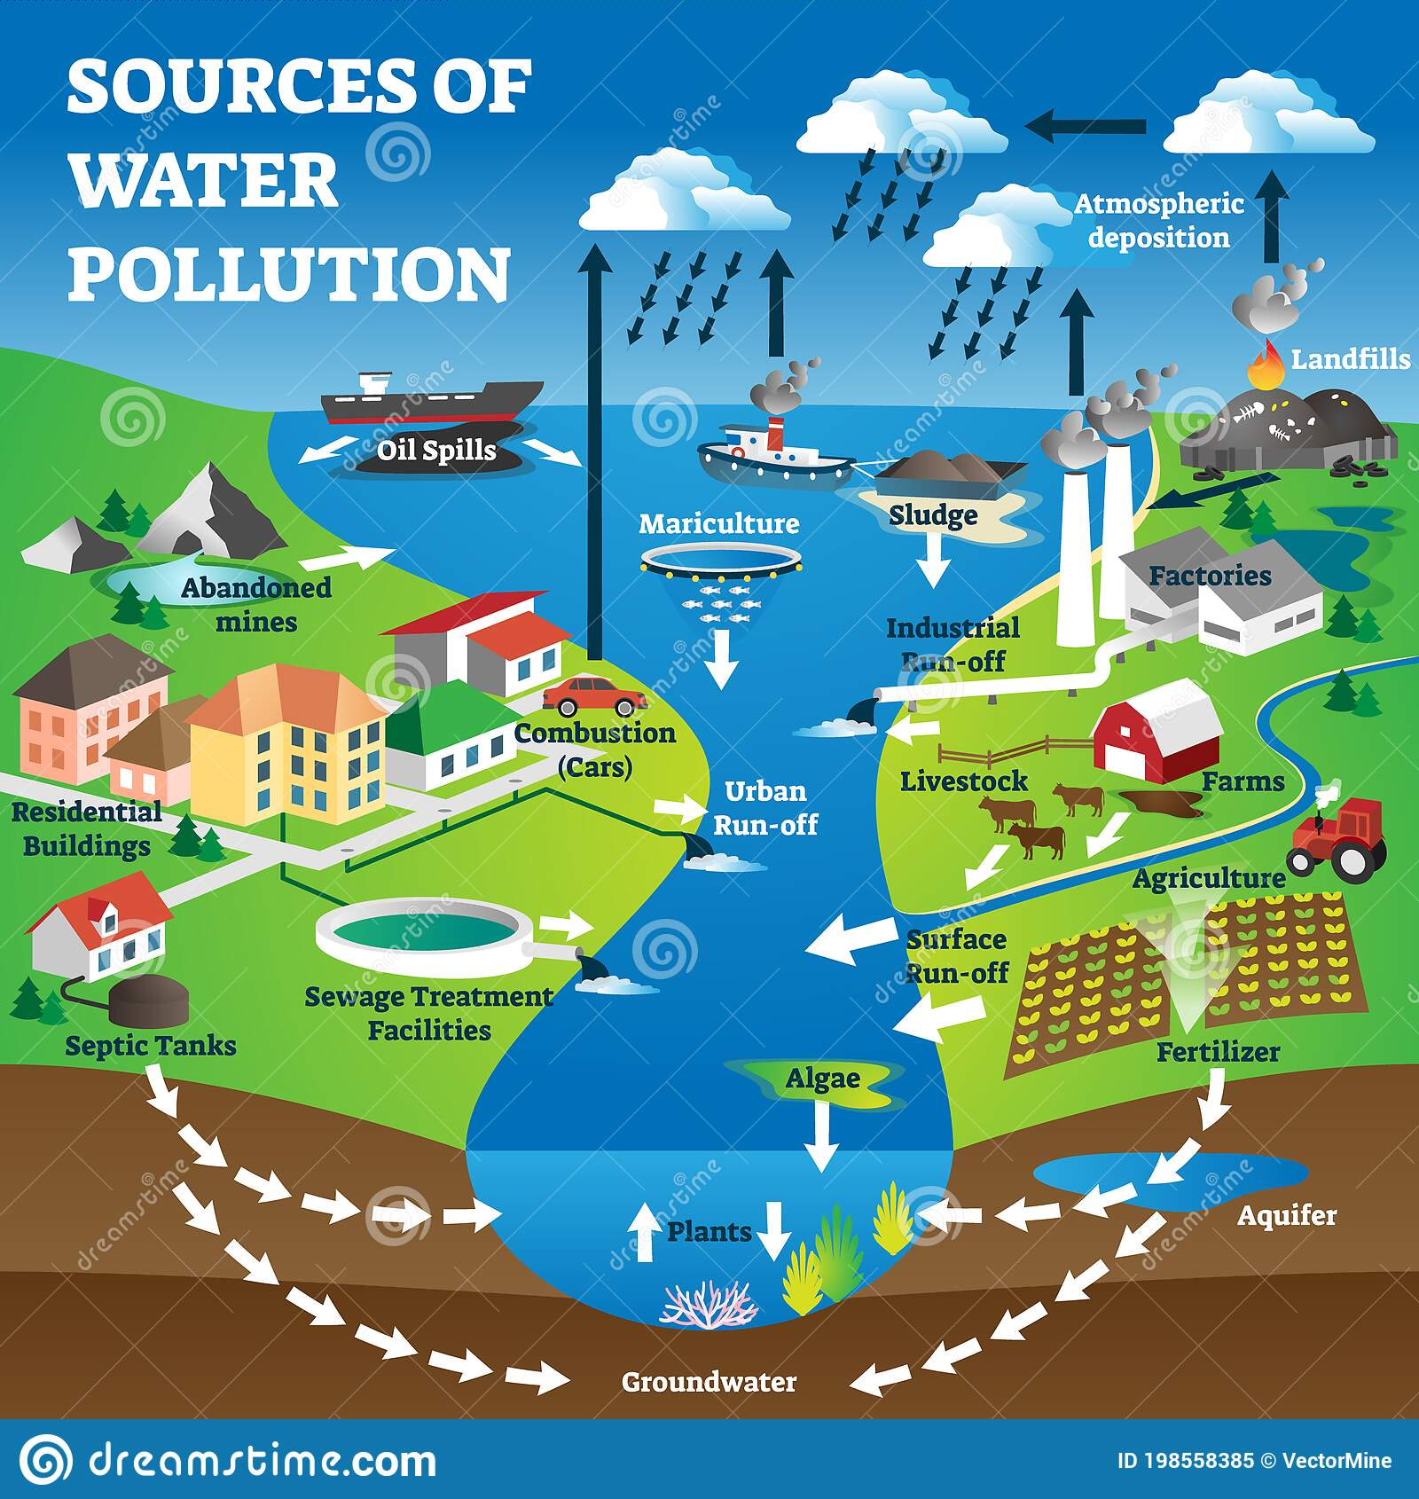
URBANIZATION AND HUMAN SETTLEMENTS DEVELOPMENT NEAR WATER SYSTEMS
Urban run-off into the water system;
(Septic tanks, water treatment plants, surface runoff, pollution, car combustion, industrial runoff, sludge runoff, oil spills from ship, etc.

Slide 3

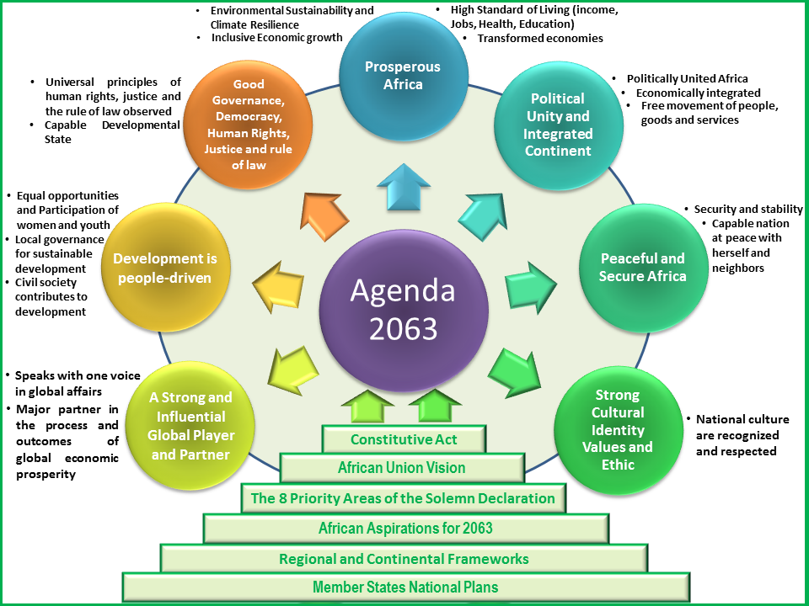



INTERVENTION; HARMONIZED REGIONAL FRAMEWORK FOR IMPLEMENTING URBAN ASPECTS OF AGENDA 2063
Anchored on the aspirations and Goals of Agenda 2063, as they have been elaborated in the pronouncements and Decisions adopted by the various Organs of the African Union.
Derived from commitments and action points from global commitment including ; the New Urban Agenda, 2030 Agenda and the SDG’s, Addis Ababa Action Agenda, Paris Agreement and Sendai Framework.

Slide 4
MANDATE ; Decision of the AUC- S TC.N08
Called on by the decision of the Second Ordinary Session of the AU-STC.N08- to the Africa Union Commission:
“….to spearhead, supported by its partners, the development of a coherent and harmonized strategic framework for the follow-up of EX.CL/Dec.933 (XXIX) regarding the Common African Position on the Third United Nations Conference on Housing and Sustainable Urban Development (Habitat III)
UN-Habitat Governing Council, through its resolution 26/8 of May 2017 -
“….the ED to further develop the action framework for the implementation of the New Urban Agenda.
The 2nd session of the Committee on Gender and Social Development of UNECA
……requested the Commission to support the implementation of the NUA in Africa”

Slide 5
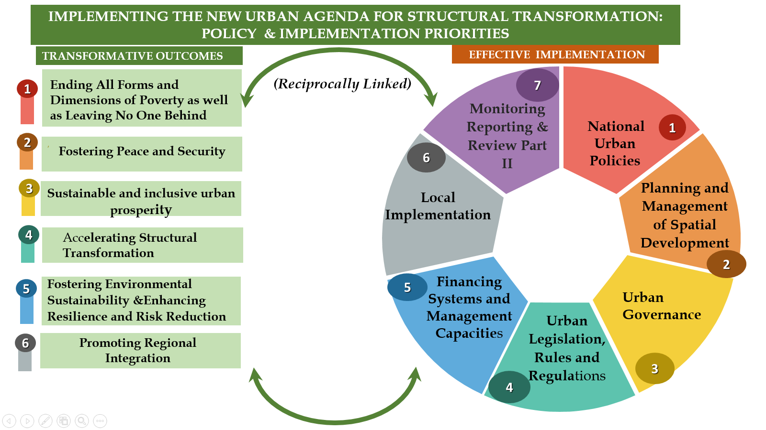
AFRICA’S PRIORITISED TRANSFORMATIVE OUTCOMES

Slide 6
OUTCOME PRIORITY 5; FOSTERING SUSTAINABILITY AND ENHANCING RESILIENCE AND RISK REDUCTION – STRATEGIC ACTIONS
5.1. Ensure environmental sustainability by: Protecting ecosystems and biodiversity, including adopting healthy lifestyles in harmony with nature; Promoting sustainable consumption and production patterns and; Building urban resilience
5.2.Promoting (regional), national, subnational and local climate action, including climate change adaptation and mitigation, and to supporting the efforts of cities and human settlements, their inhabitants and all local stakeholders to be important implementers in building resilience and reducing emissions of greenhouse gases from all relevant sectors.
5.3. Strengthen resilience and adaptive capacity to climate-related hazards and natural disasters in all countries.
5.4. Improve education, awareness-raising and human and institutional capacity on climate change mitigation, adaptation, impact reduction and early warning.
5.5. Promote mechanisms for raising capacity for effective climate change-related planning and management in least developed countries and small island developing States, including focusing on women, youth and local and marginalized communities.

Slide 7
OUTCOME PRIORITY 5; FOSTERING SUSTAINABILITY AND ENHANCING RESILIENCE AND RISK REDUCTION – STRATEGIC ACTIONS – Continued
5.6. Promoting sustainable land use, combining urban extensions with adequate densities and compactness to prevent and contain urban sprawl, as well as preventing unnecessary land use change and the loss of productive land and fragile and important ecosystems.
5.7 Promoting environmentally sound waste management and to substantially reducing waste generation by reducing, reusing and recycling waste, minimizing landfills and converting waste to energy.
5.8. Develop sustainable, renewable and affordable energy, energy-efficient buildings and construction modes; and to promoting energy conservation and efficiency.
5.9. Strengthening the resilience of cities and human settlements, including through the development of quality infrastructure and spatial planning, by adopting and implementing integrated, age- and gender-responsive policies and plans and ecosystem-based approaches in line with the Sendai Framework for Disaster Risk Reduction for the period 2015–2030.
5.10. Mainstreaming holistic and data-informed disaster risk reduction and management at all levels to reduce vulnerabilities and risk, especially in risk-prone areas of formal and informal settlements, including slums, and to enable households, communities, institutions and services to prepare for, respond to, adapt to and rapidly recover from the effects of hazards, including shocks or latent stresses.
5.11. Moving from reactive to more proactive risk-based, all-hazards and all-of-society approaches

Slide 8

EFFECTIVE IMPLEMENTATION
To increase the number of cities and human settlement adopting and implementing integrated policies and plans towards inclusion, resource efficiency mitigation and adoption.
.
3.1 Set up a planning and design process that is evidence based, integrated and participatory.
3.2 Plan and define the urban area as well as water and natural protection areas.
3.4 Promote sustainable density and mixed use and reduce urban sprawl.
4.1 National capacity of local Government.
4.2 Revenue generation & financial mgnt
4.3 Inclusive LED
4.4 Proper access and affordability to basic services
Normative: Costs benefit analysis of planned city extension, finance for city leaders, rapid planning assessment, Economic Foundations for Urbanization.
Results: Bankable projects with costs benefit analysis, realistic urban planning projects, improved technical capacity.
^{URBAN LEGISLATION RULES &} ^{REGULATIONS}
PLANNING AND MANAGEMENT OF SPATIAL DEVELOPMENT
FINANCING SYSTEMS AND MANAGEMENT CAPACITIES
^{INTEGRATED IMPLEMENTATION}
^{NATIONAL URBAN POLICIES}
1. Integrate national development plans with urban plans (e.g. energy, water, transportation and other infrastructural corridors)
  2.1 Establish impact assessment,
  2.2 Recognize and regulate urban development,
  2.3 Enact effective law for the definition, acquisition and protection of water systems.

Slide 9
ROLES AND RESPONSIBILITIES
Continental level implementation and coordination ( AUC, ECA, UNHABITAT, ADB, UCLGA)
Sub-Regional level implementation and coordination ( REC’’s and other Specialized Agencies and Institutions)
National level implementation and coordination ( National Governments and Statutory agencies including sub-national/local Government entities in conjunction with civil society organizations, the Private Sector, higher education , scientific and research groupings communication bodies and other stakeholders).
Sub-National/Local level implementation and coordination ( traditional authorities, CBO, Neighborhoods associations, higher education institutions, cultural groups, multi assistance associations, NGO’s , faith based Org and private entities.
MONITORING AND REPORTING

