Slide 1
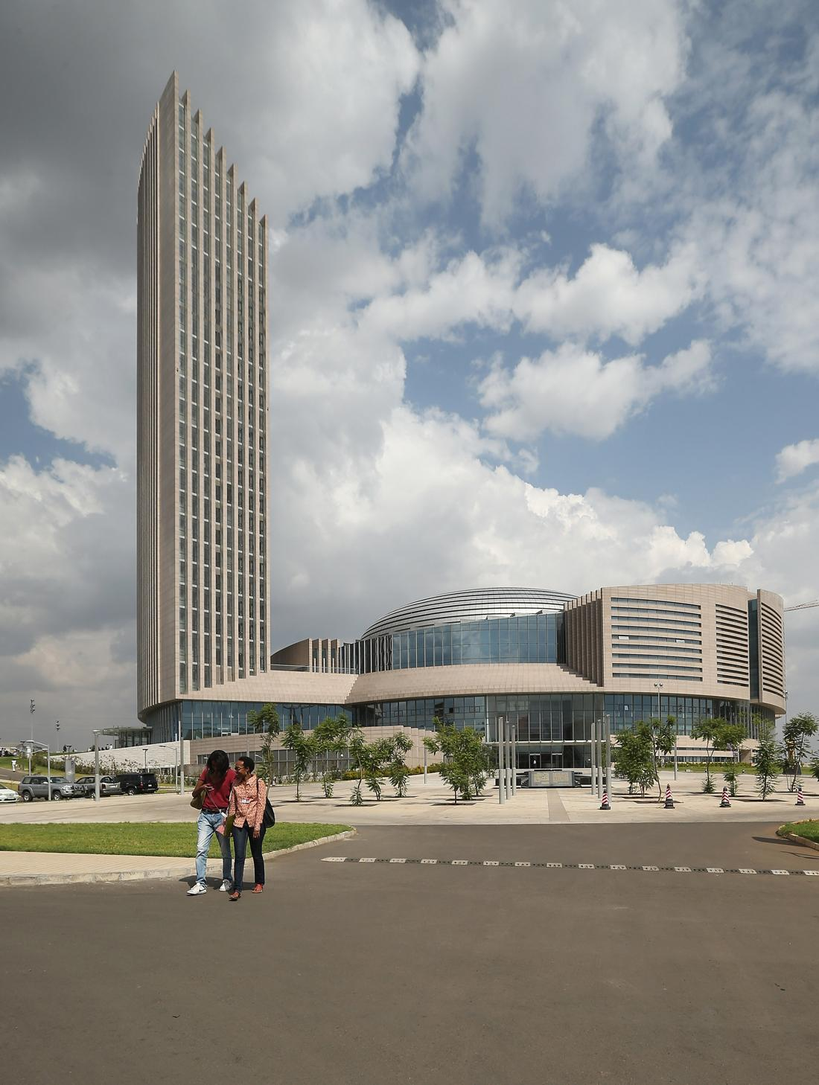


Department of Education, Science Technology and Innovation (DESTI)

Slide 2

Grants
    African Union Research Grant
    The Global Monitoring for Environment and Security and Africa (GMES and Africa)

Slide 3

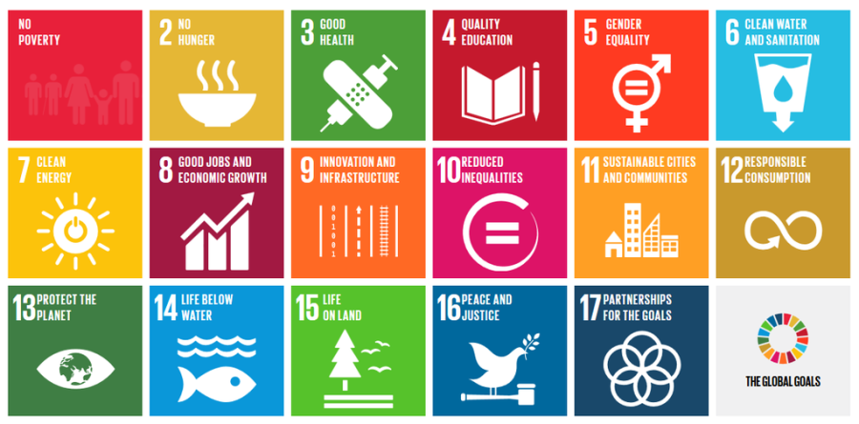
Goals
STI as a “catalyst” for its sustainable development in Africa
Building Africa’s research capacities through direct funding
Full participation of the African Member States and African researchers in the implementation of the STISA-2024 , Agenda 2063, SDGs
Promotion of Inter-Africa and international cooperation in research and capacity building.
To strengthen and develop infrastructure for Use of earth observation data, technologies and services

Slide 4
AURG Open Call history and Funding and allocation
2012 Call for Proposal
2016 Call for Proposal
$8,500,000
Post-harvest and Agriculture
Renewable and Sustainable Energy
Water and Sanitation
$9,000,000
Food, Nutrition Security and Sustainable Agriculture-sustainable Agricultural Intensification
2018 Call for Proposal
$9,000,000
Food, Nutrition Security and Sustainable Agriculture Focus-Agriculture and food systems for nutrition
Grants to 10 Institutions – 28 countries
Grant to 9 institutions – 18 countries
2011 Call for Proposal
Grants to 10 Institutions – 19 Countries
Water and Sanitation
Renewable and Sustainable Energy
Post-harvest and Agriculture
$8,500,000
Grant to 10 institutions – 18 countries
    35 Million USD given out for research
Action Locations from all Calls
36 African Countries

Slide 5
Support to Institutions dealing with Fish under AURG
National Institute of Oceanography and Fisheries (NIOF) Egypt Improved management and technological innovation in African tilapia farms and hatcheries 2. University of Makerere Development of bacteriophage cocktails as disease biocontrol agents for improved aquaculture productivity, food and nutrition safety in Ghana and Uganda

Slide 6
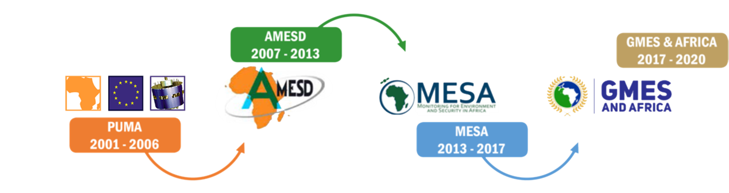
AU-EU Collaboration on Space applications
A unique historical continuity
Phase 1
Dec. 2016 – Dec. 2021
Phase 2
Dec. 2021 – Dec. 2025
GMES & Africa supports local capacities, institutional, human and technical resources for access to and exploitation of EO-based services on an operational basis for sustainable development in Africa.

Slide 7
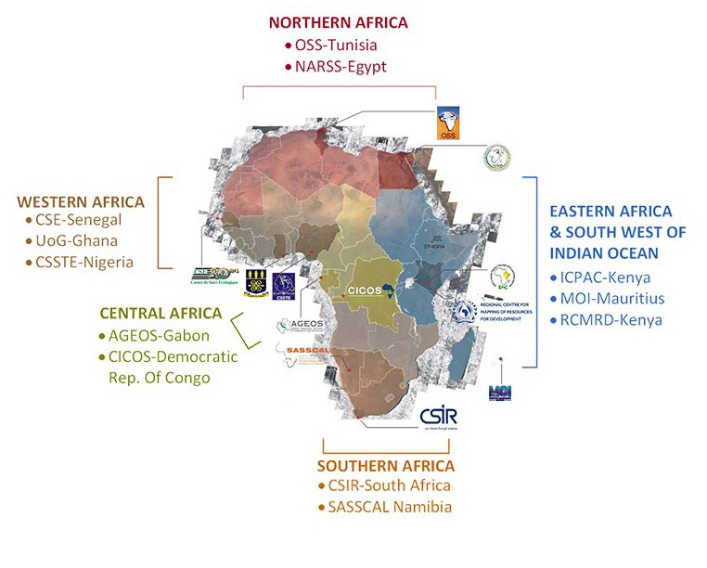
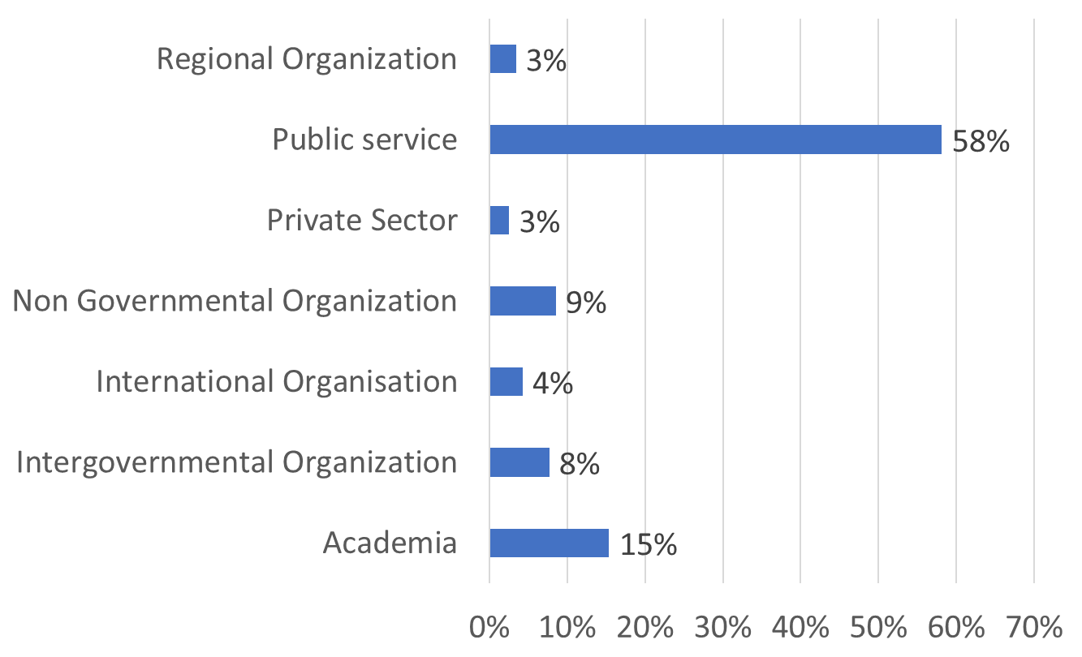
GMES & AFRICA Phase 1 AT A GLANCE
Based on the mandatory principle of consortium.
12 consortia including 122 institutions in 45 African countries
7 types of institution

Slide 8
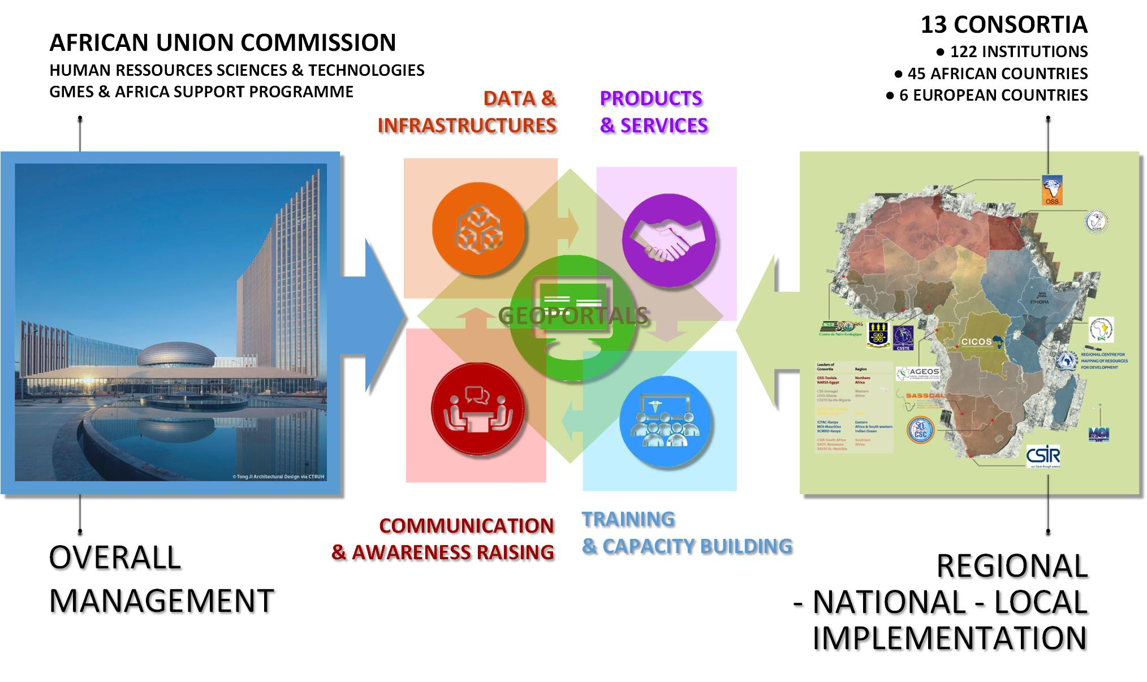


STAKEHOLDERS, MECHANISMS OF IMPLEMENTATION

Slide 9

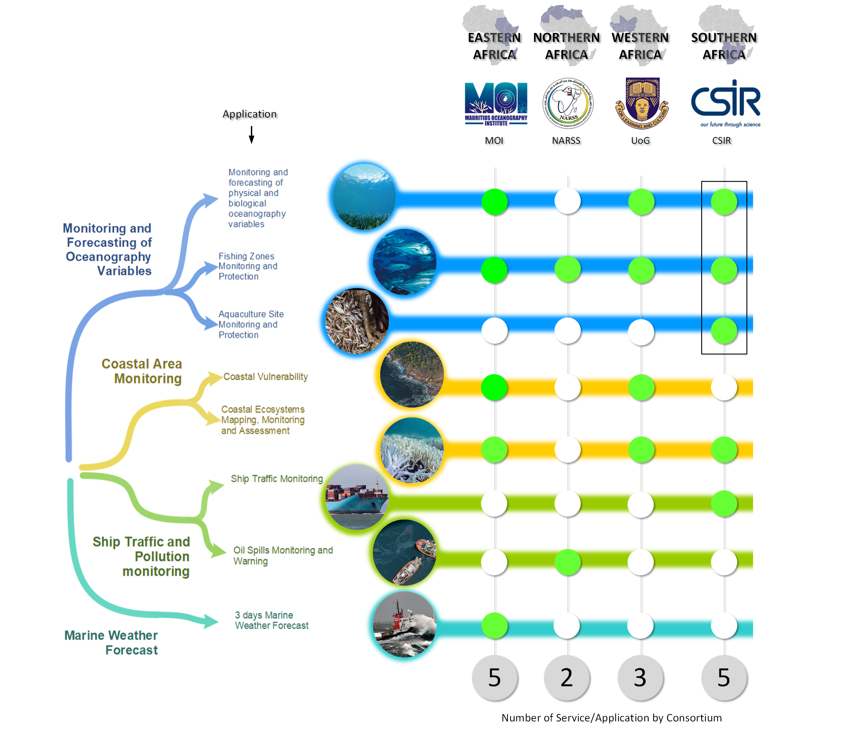

13 « Marine & Maritime" applications, delivered by 4 consortia (28 Institutions), active in 4 African regions
MARINE AND COASTAL AREAS SERVICE

Slide 10
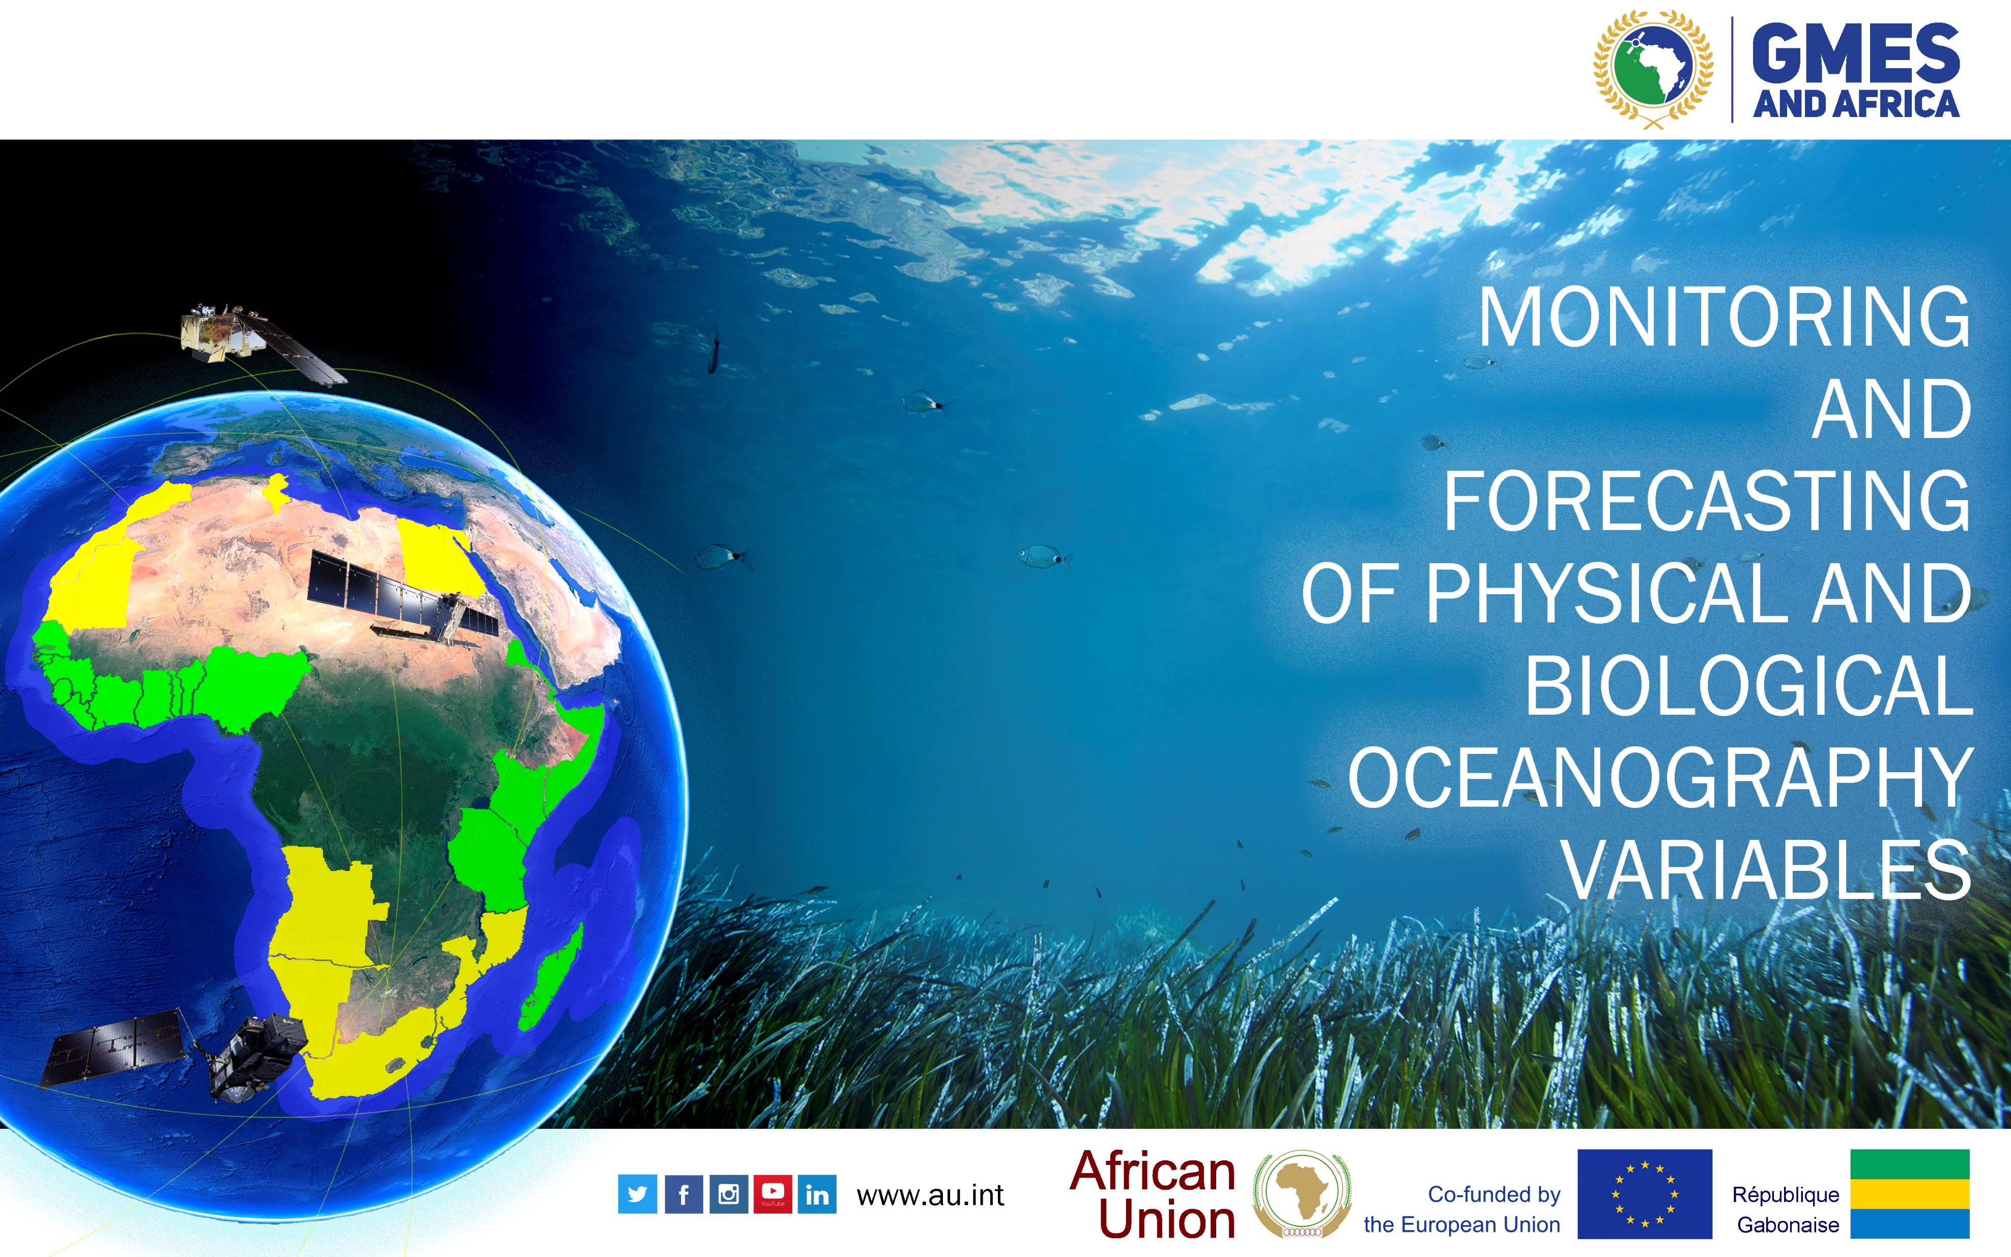

Slide 11
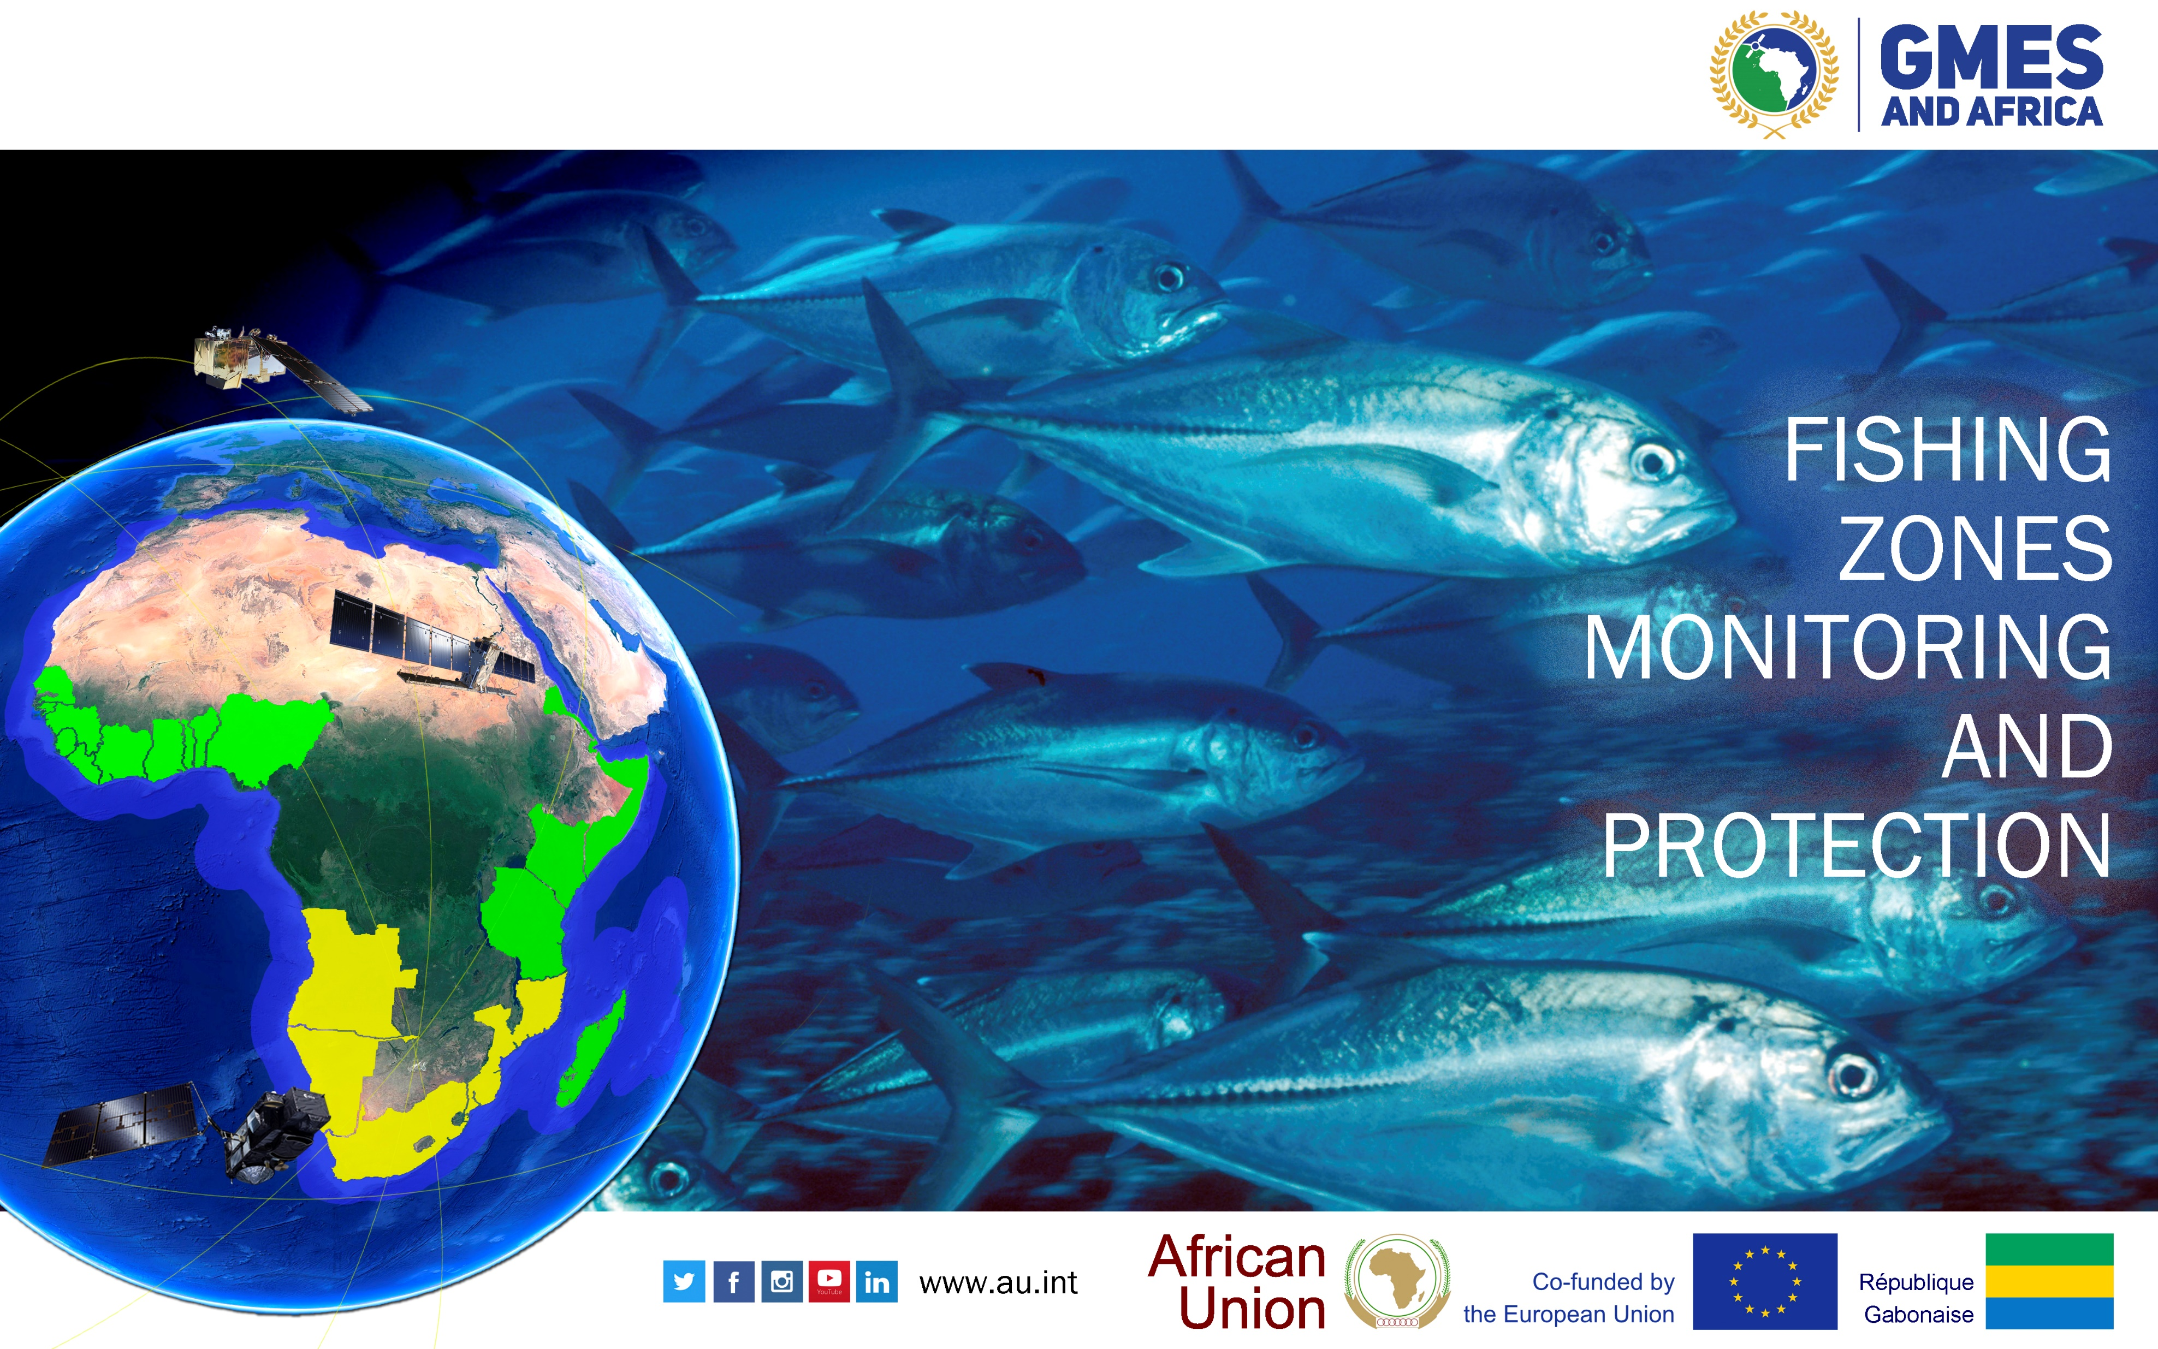

Slide 12
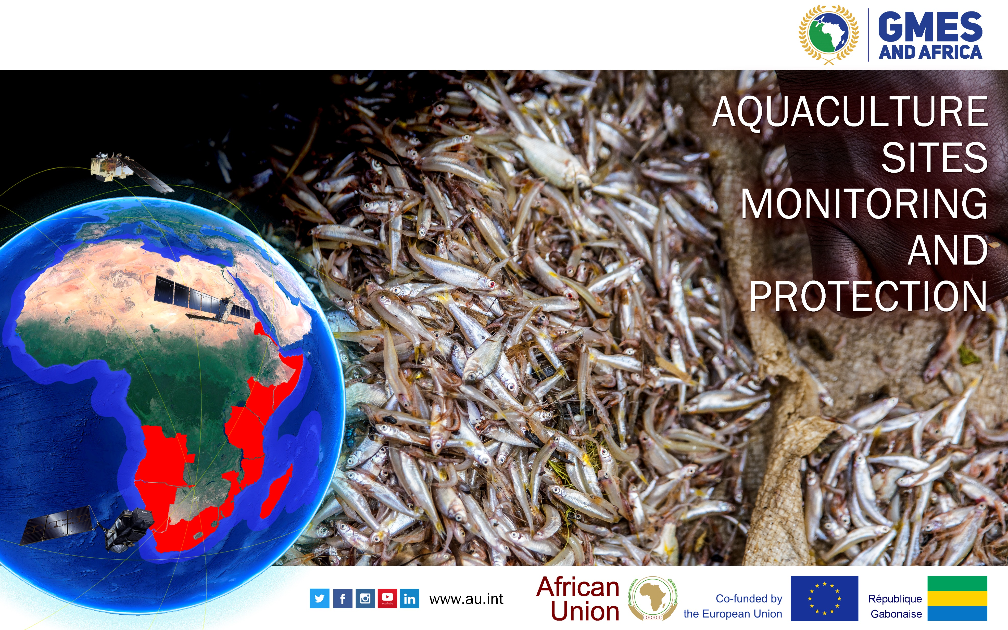

Slide 13
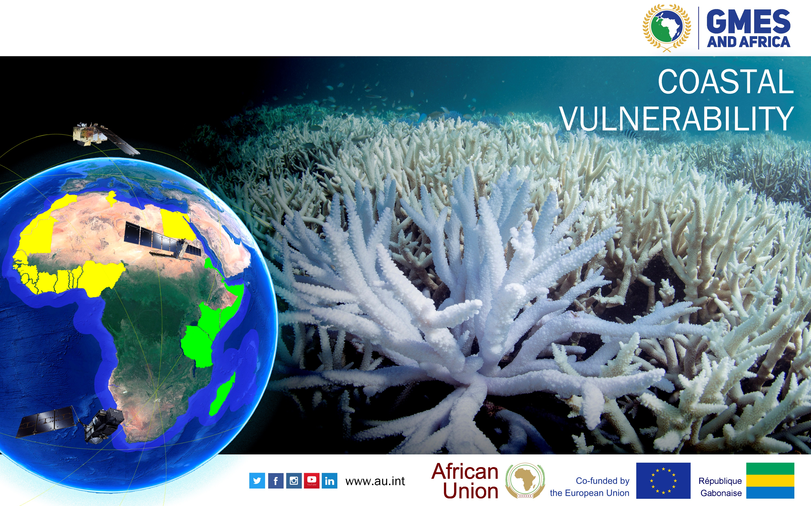

Slide 14
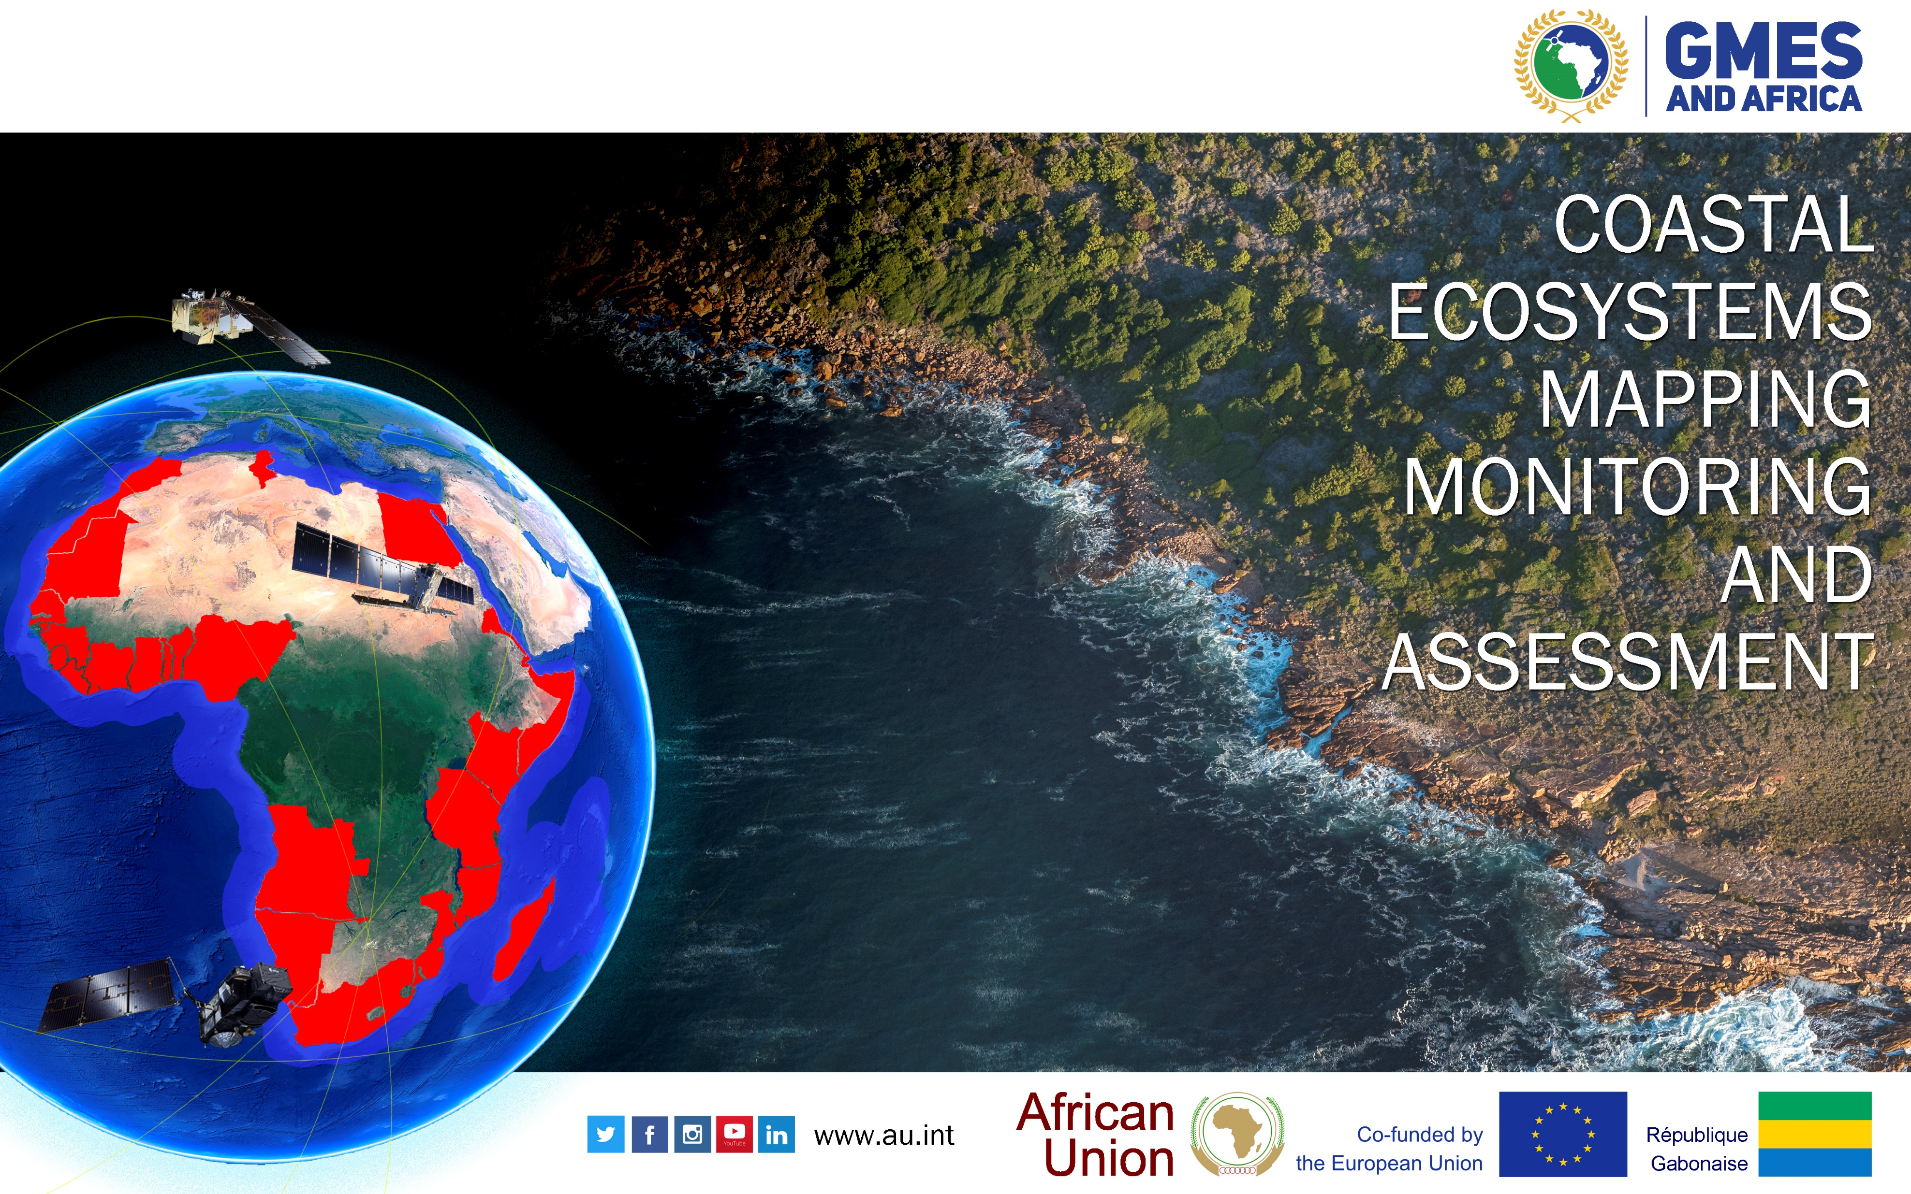

Slide 15
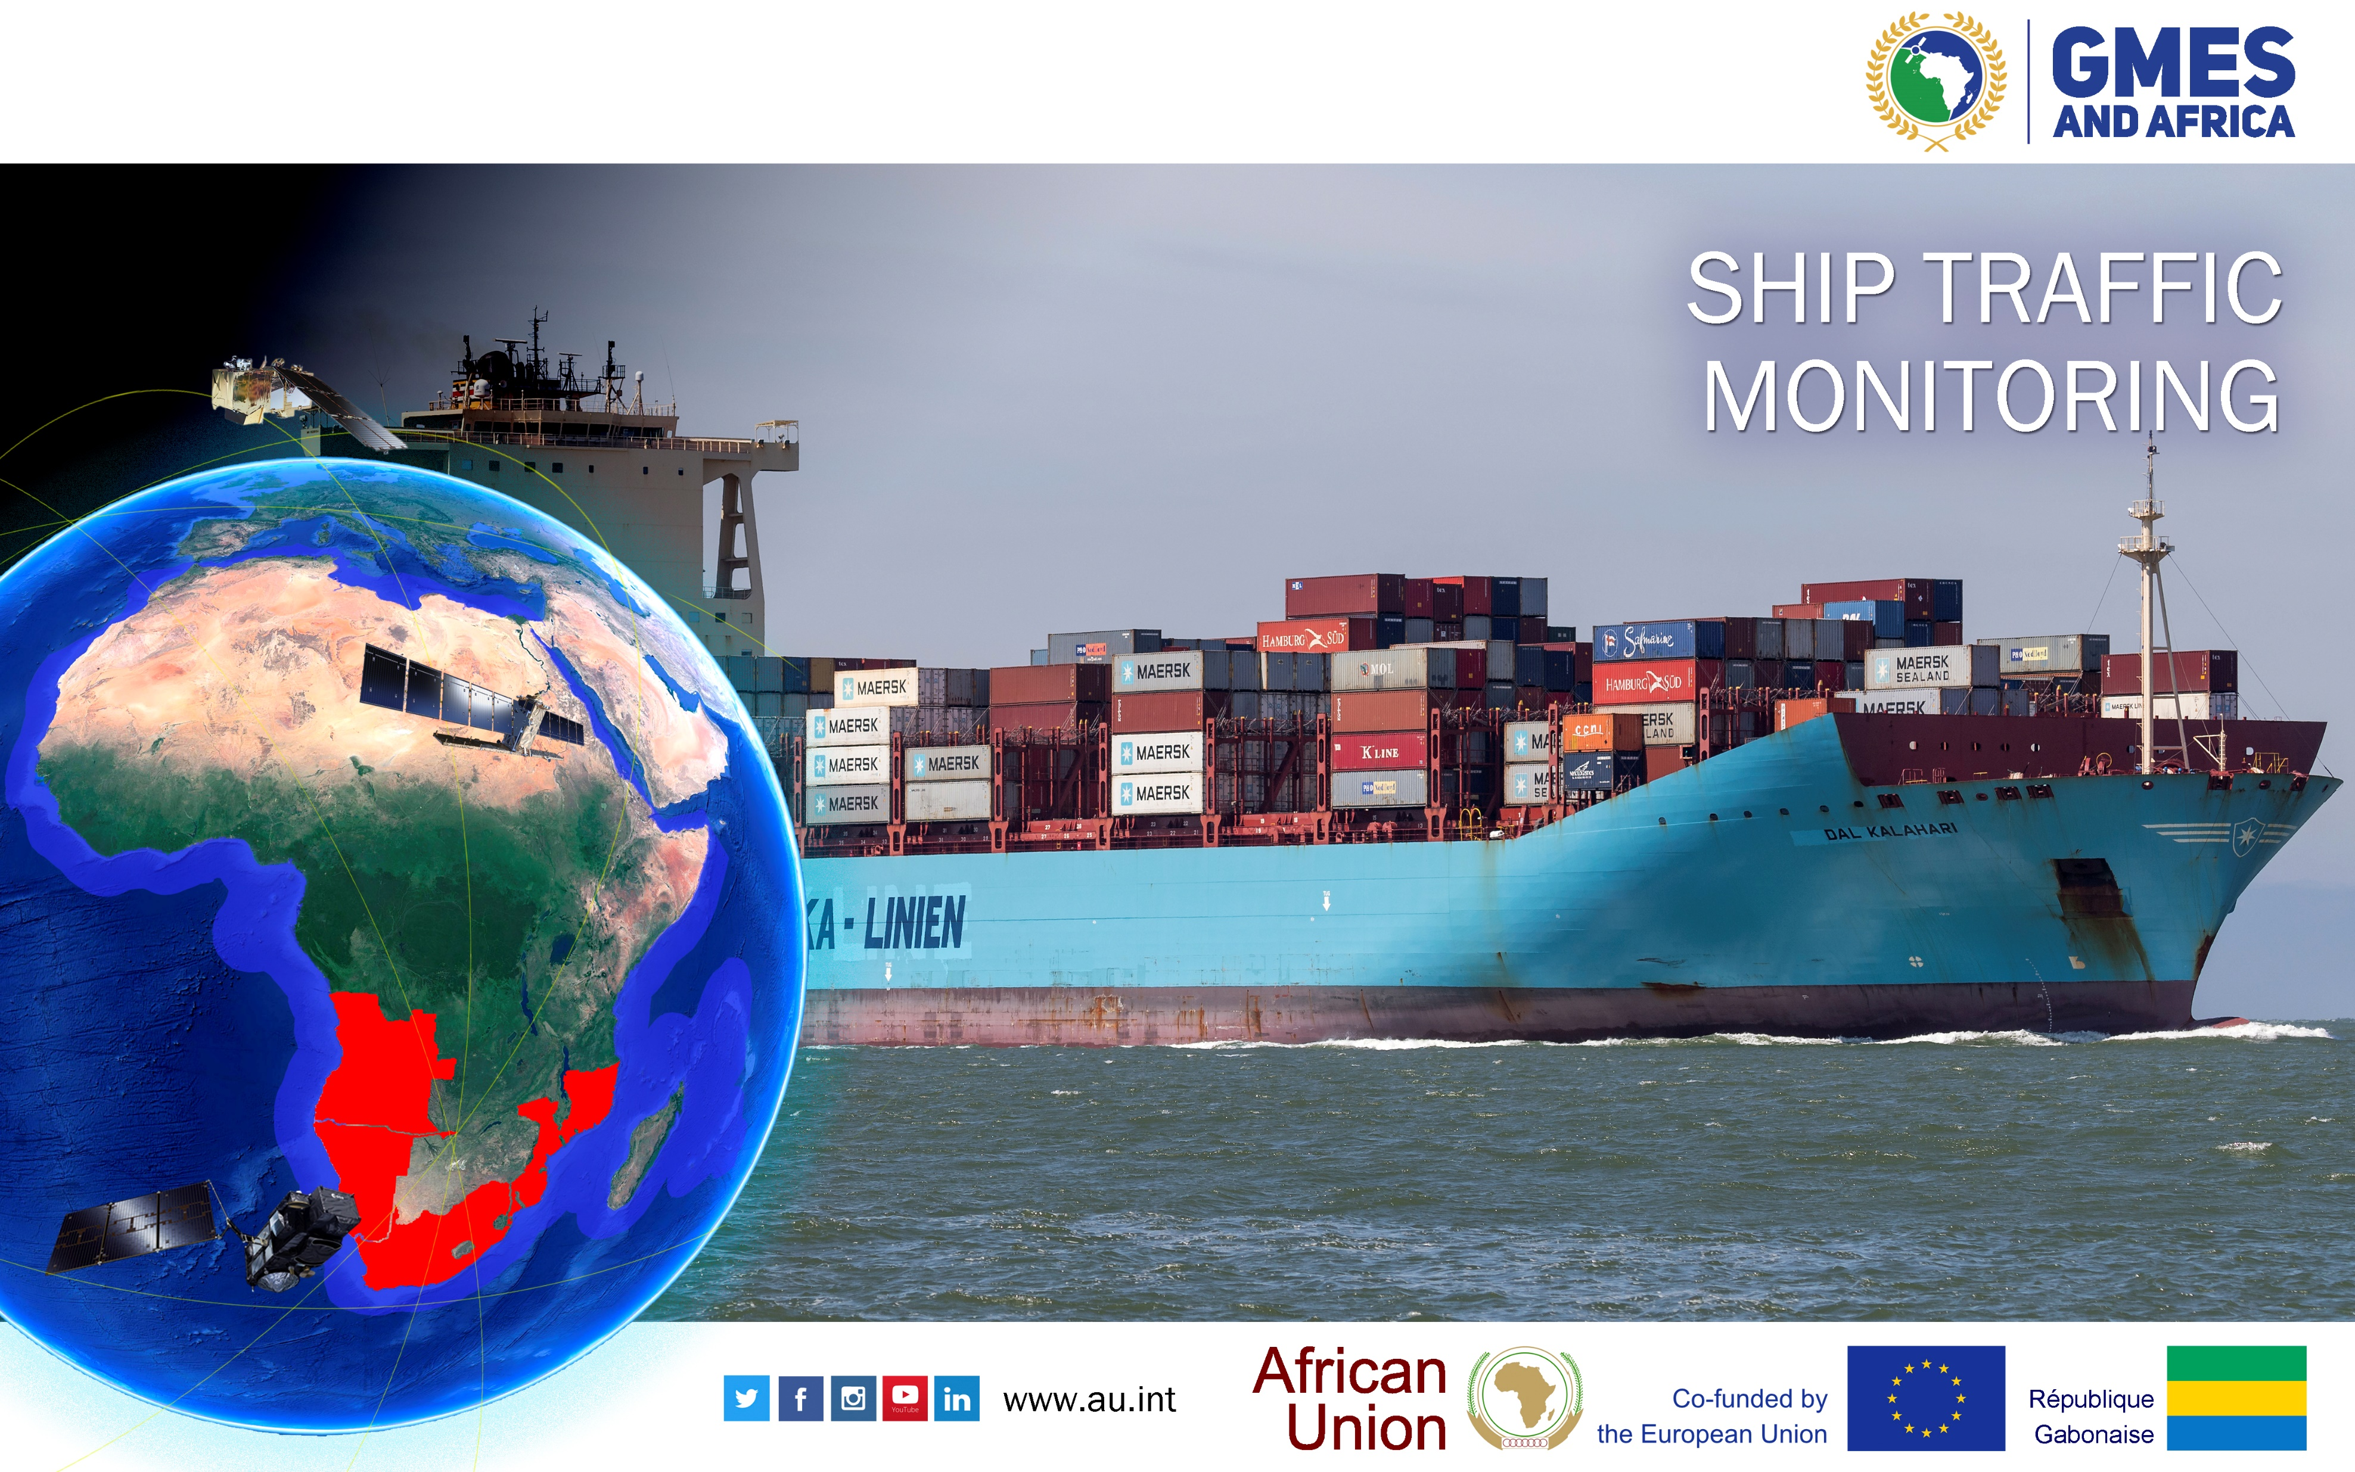

Slide 16
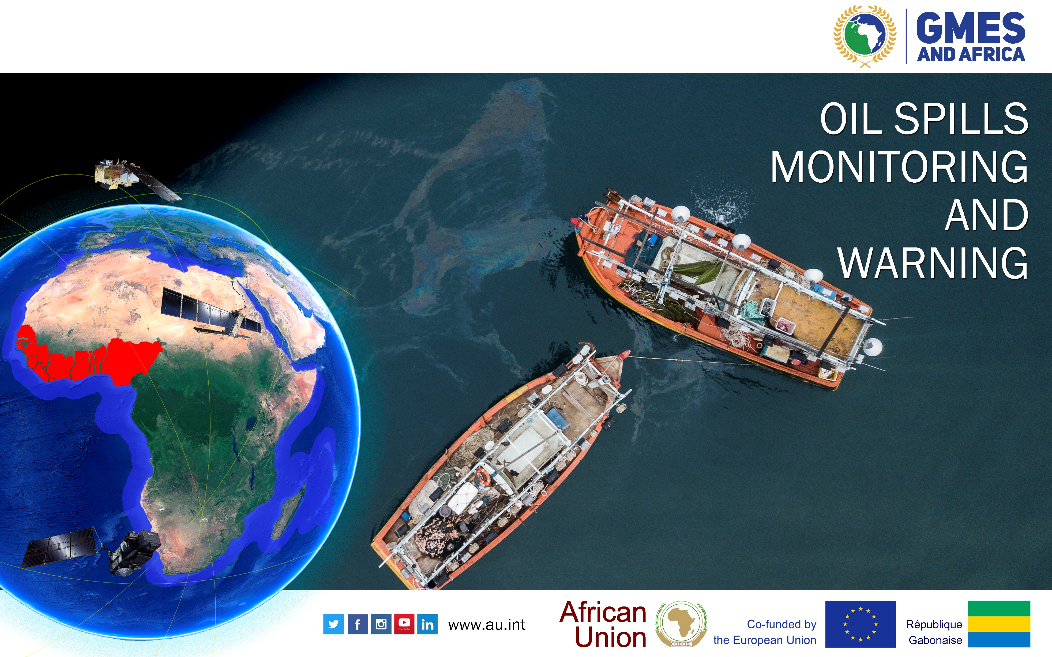

Slide 17
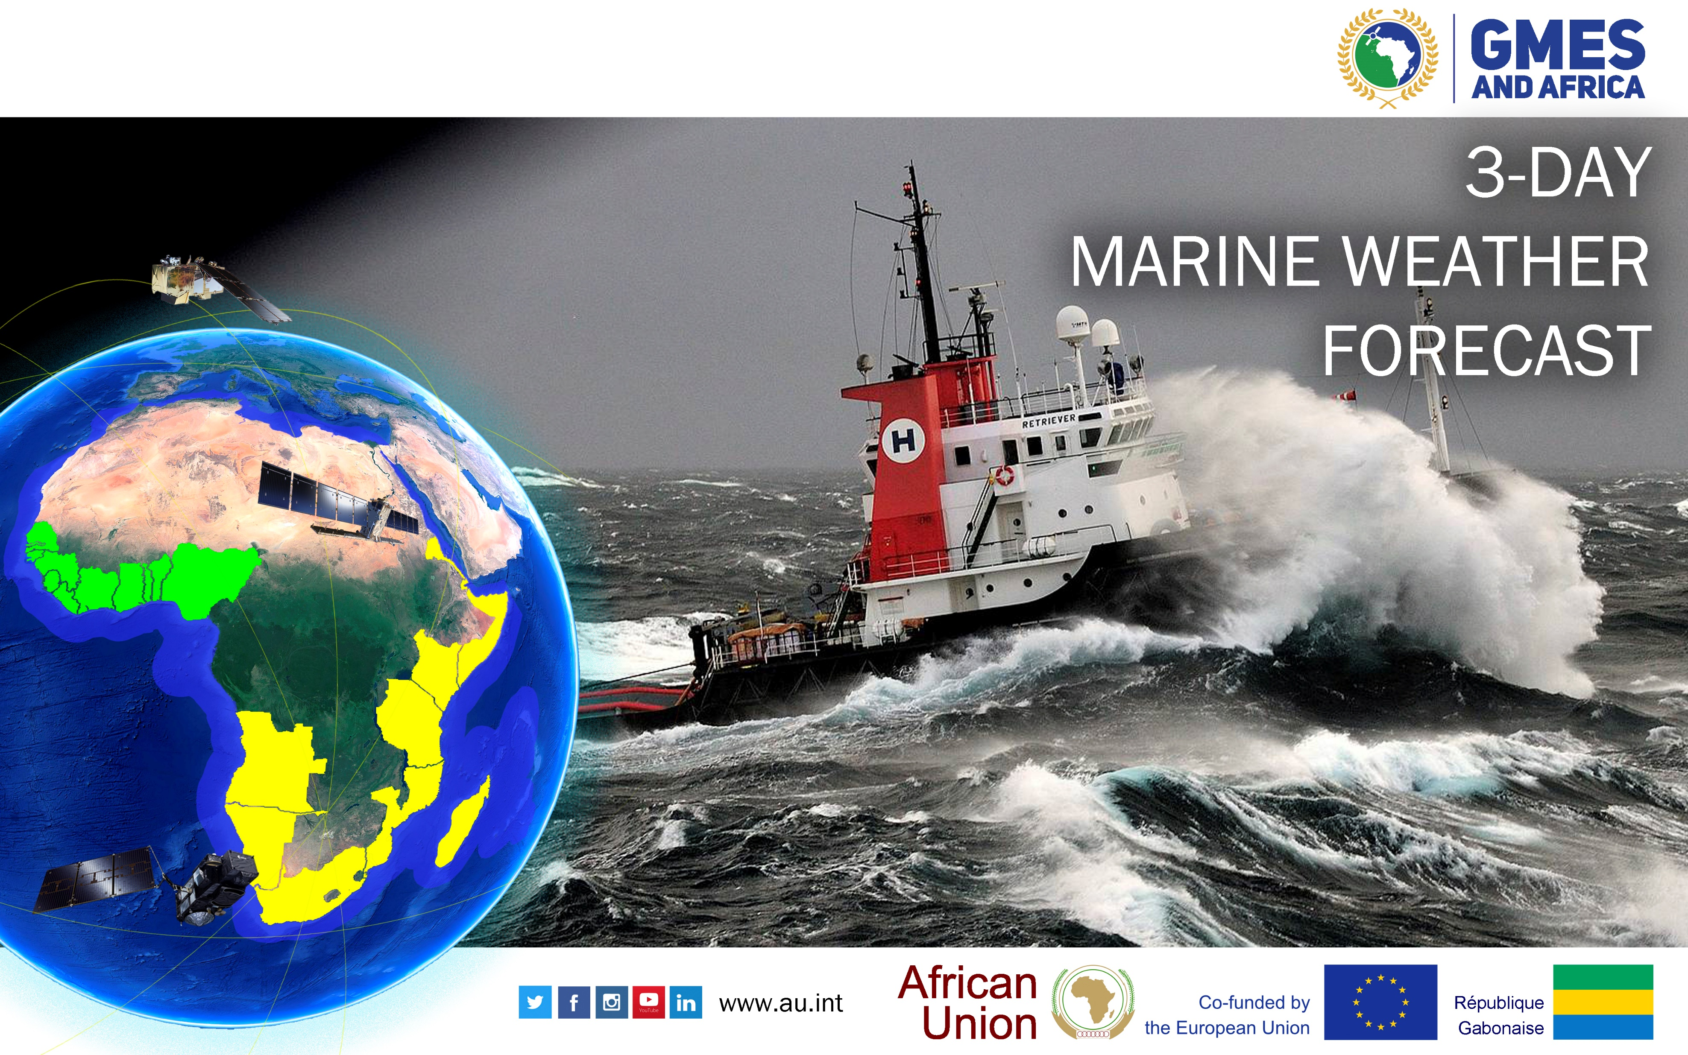

Slide 18

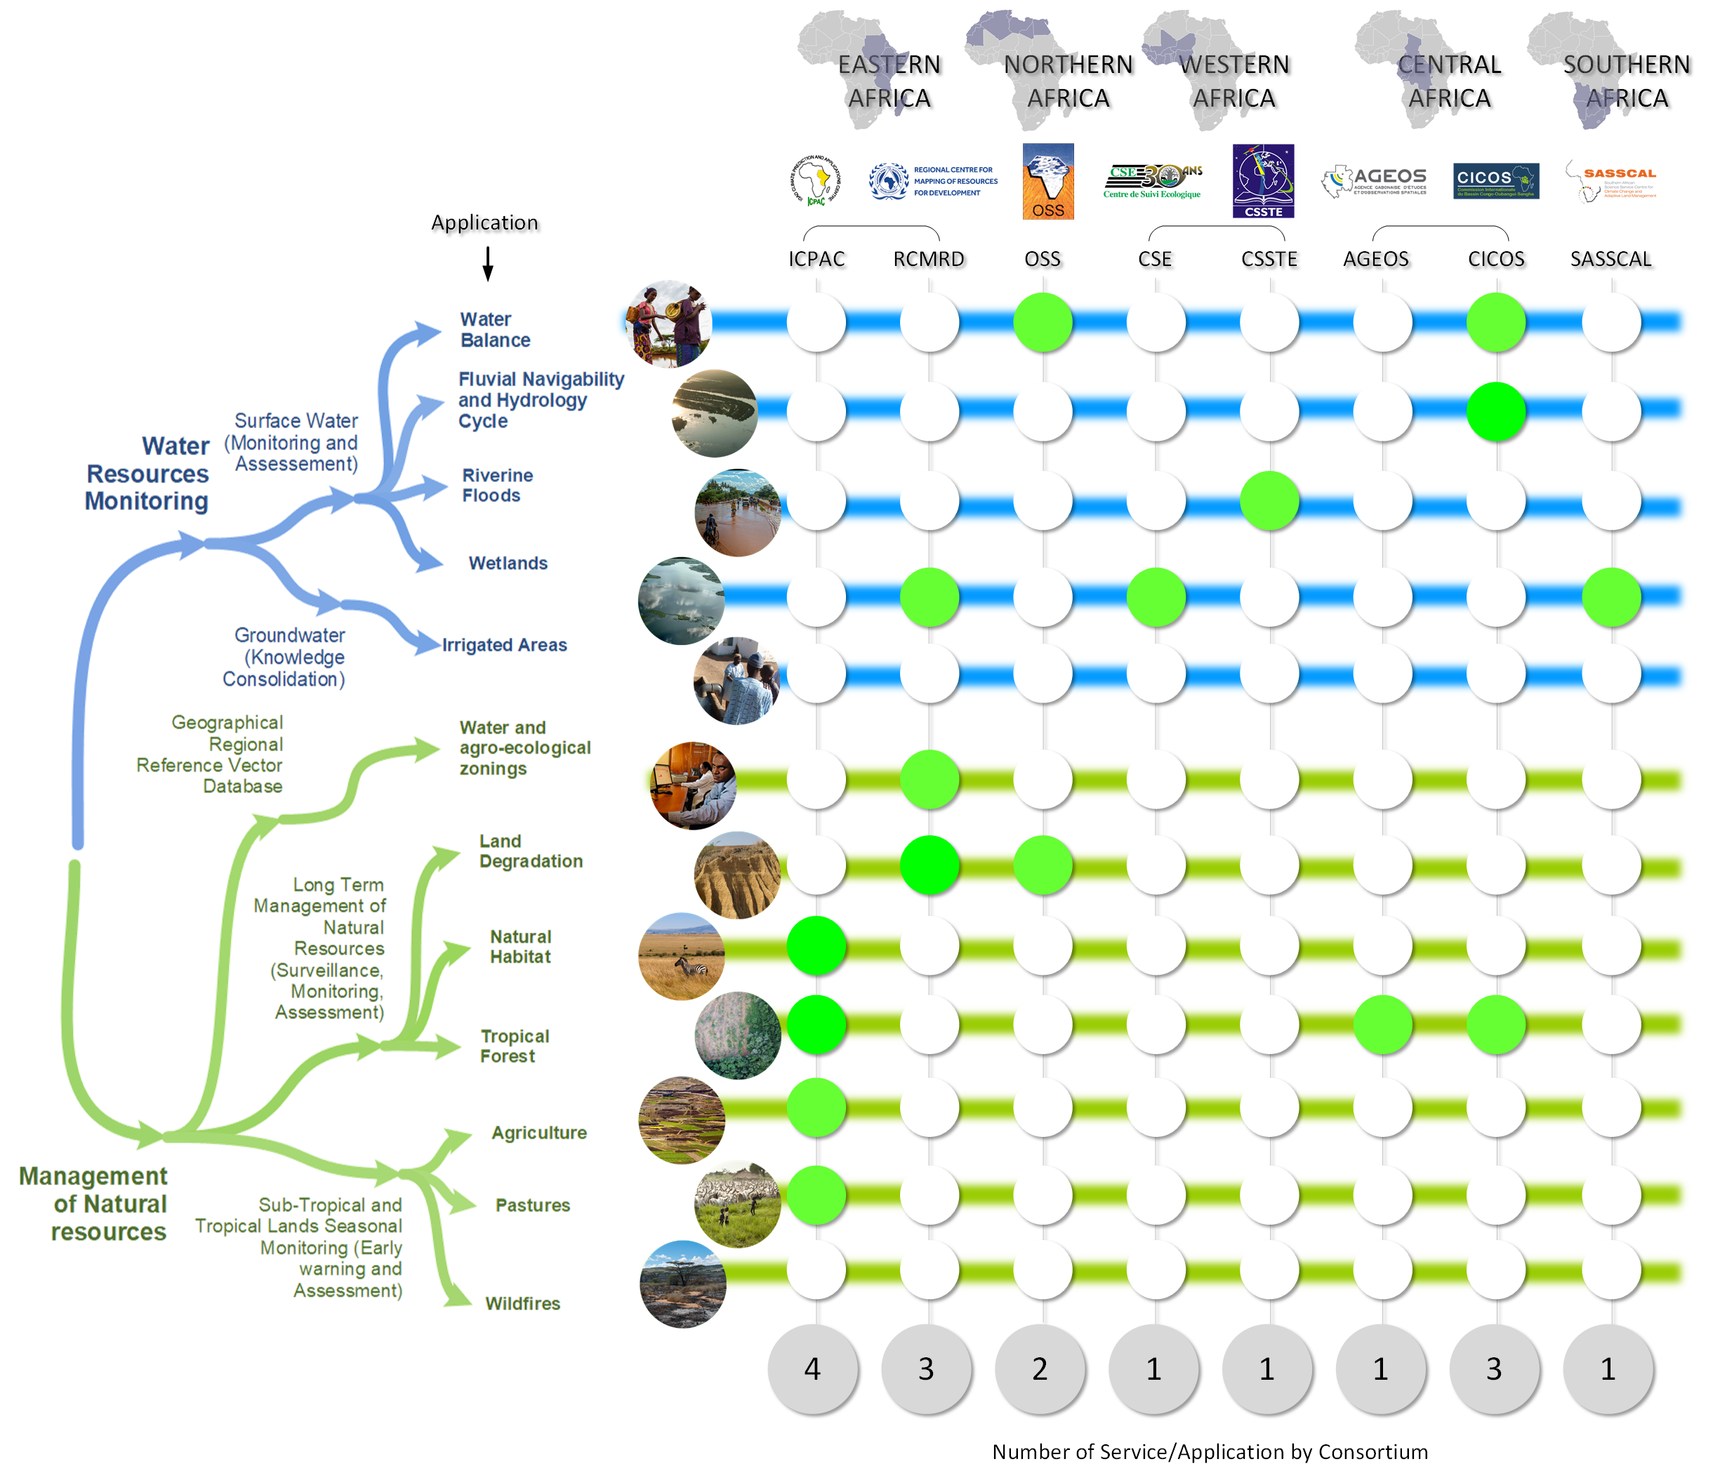
16 "EARTH" applications, served by 8 consortia (94 Institutions), active in 5 African regions
NATURAL RESOURCES AND WATER SERVICE

Slide 19
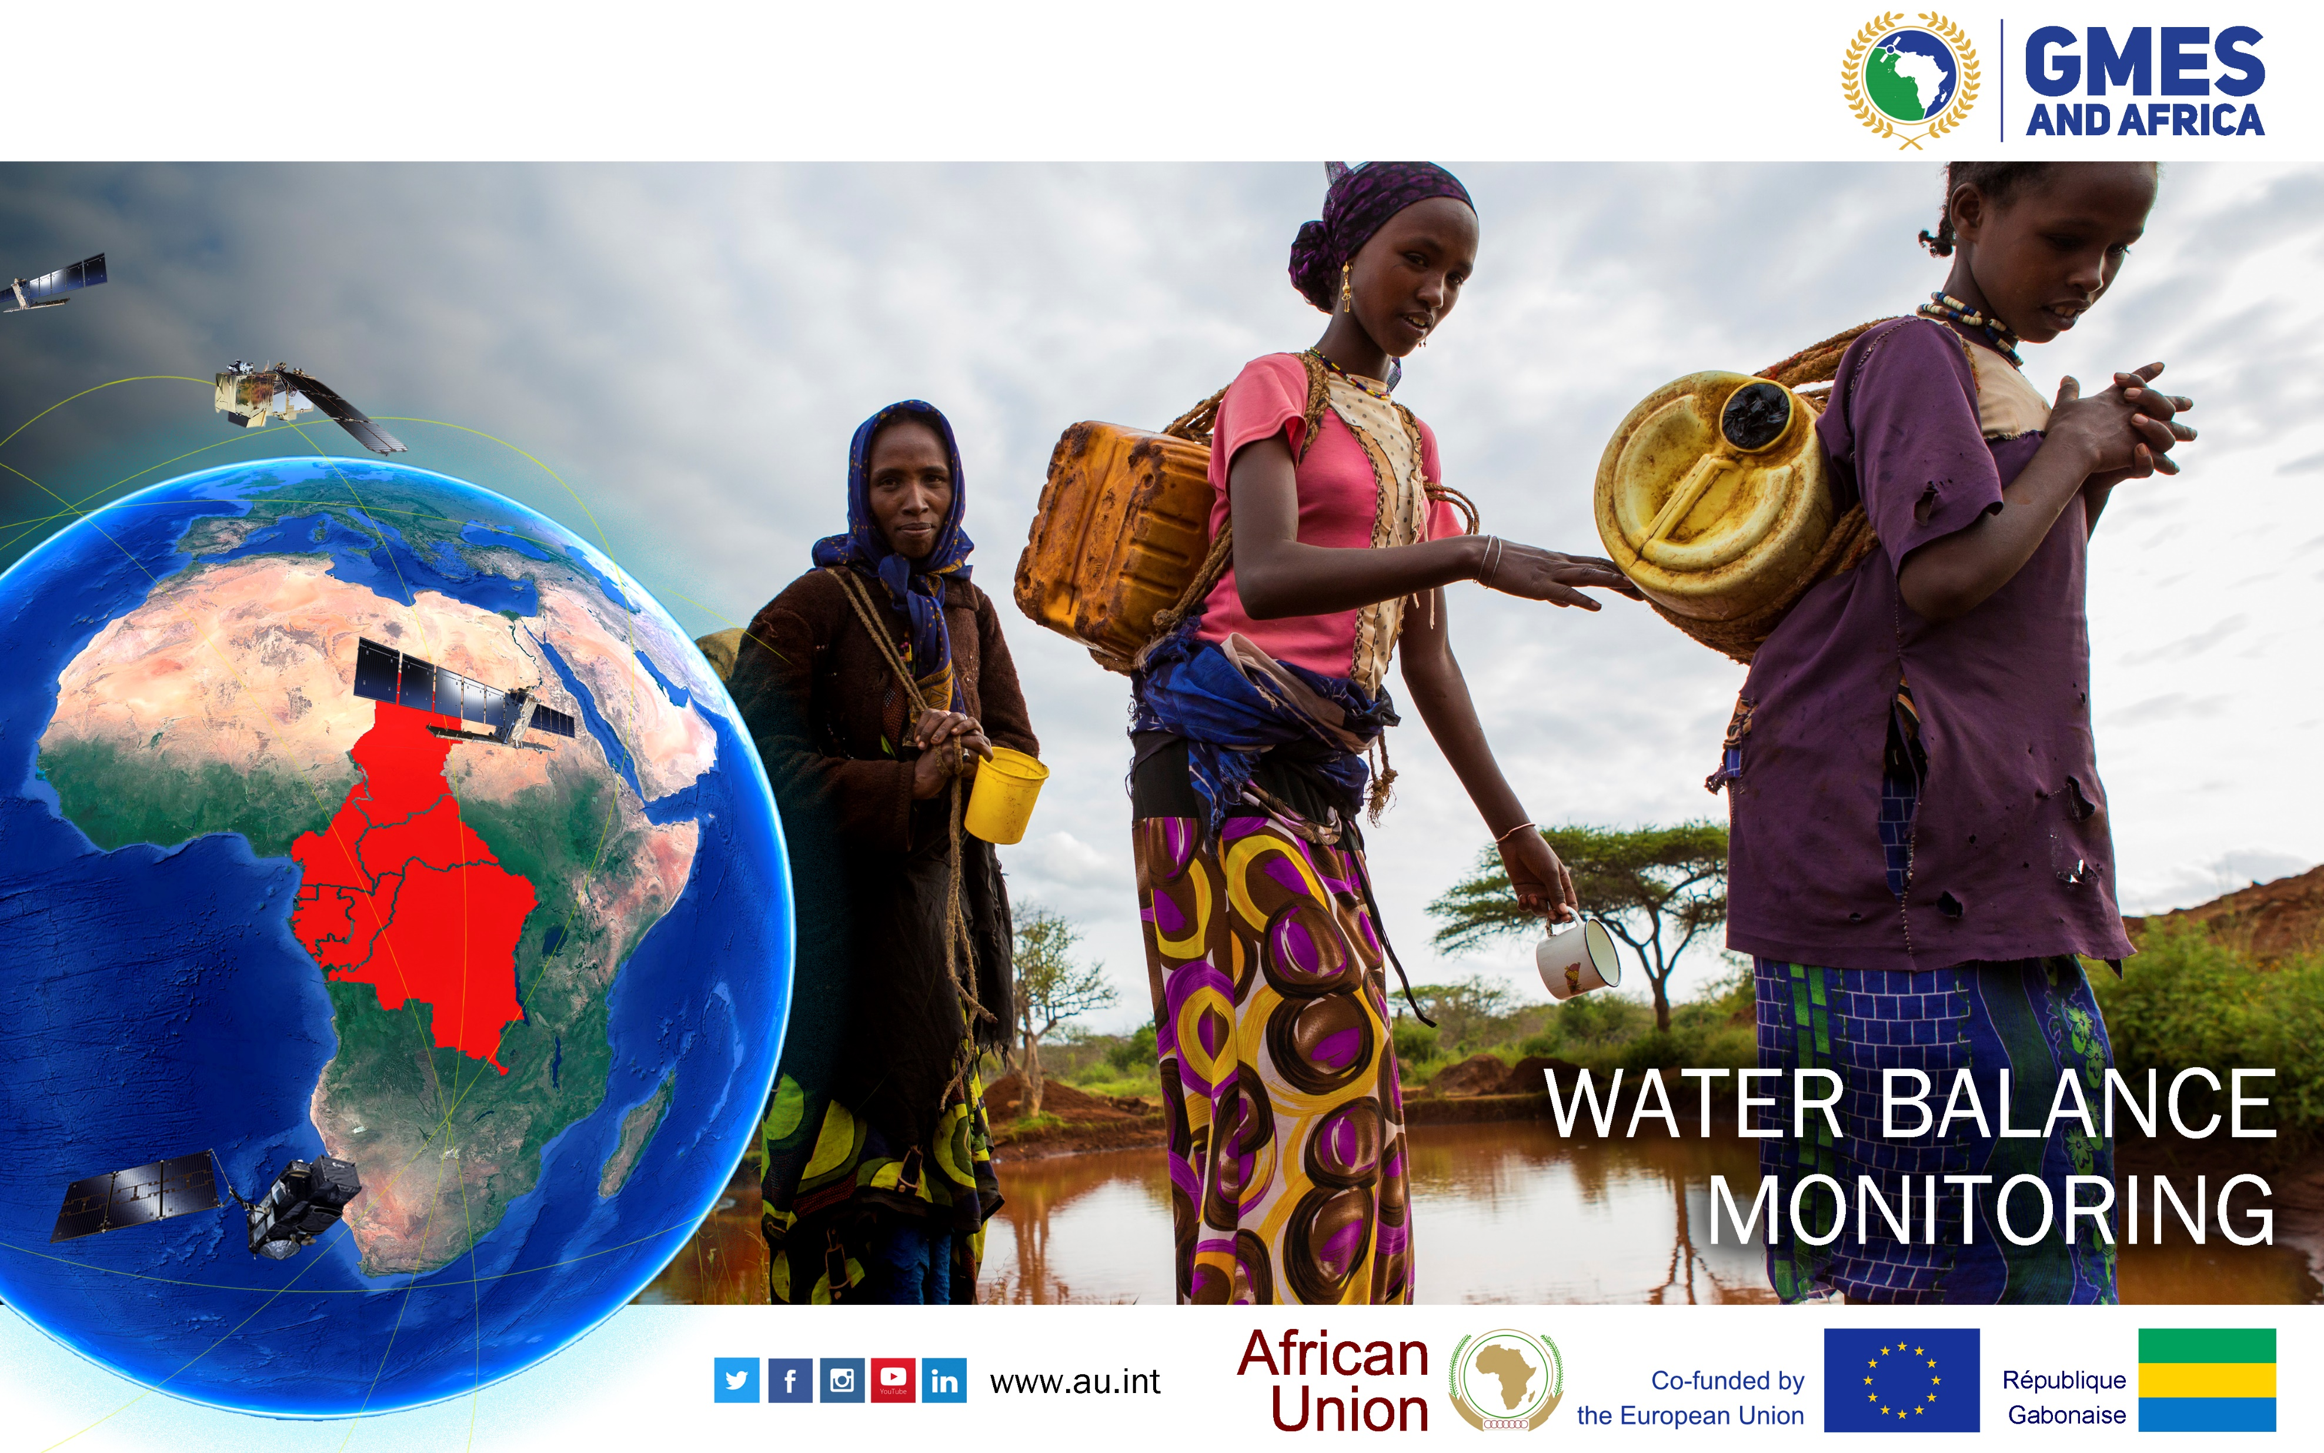

Slide 20
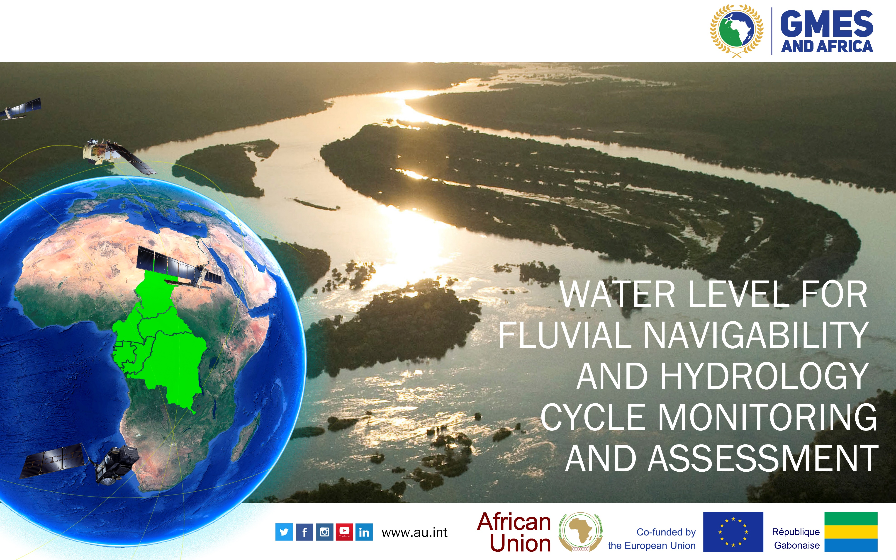

Slide 21
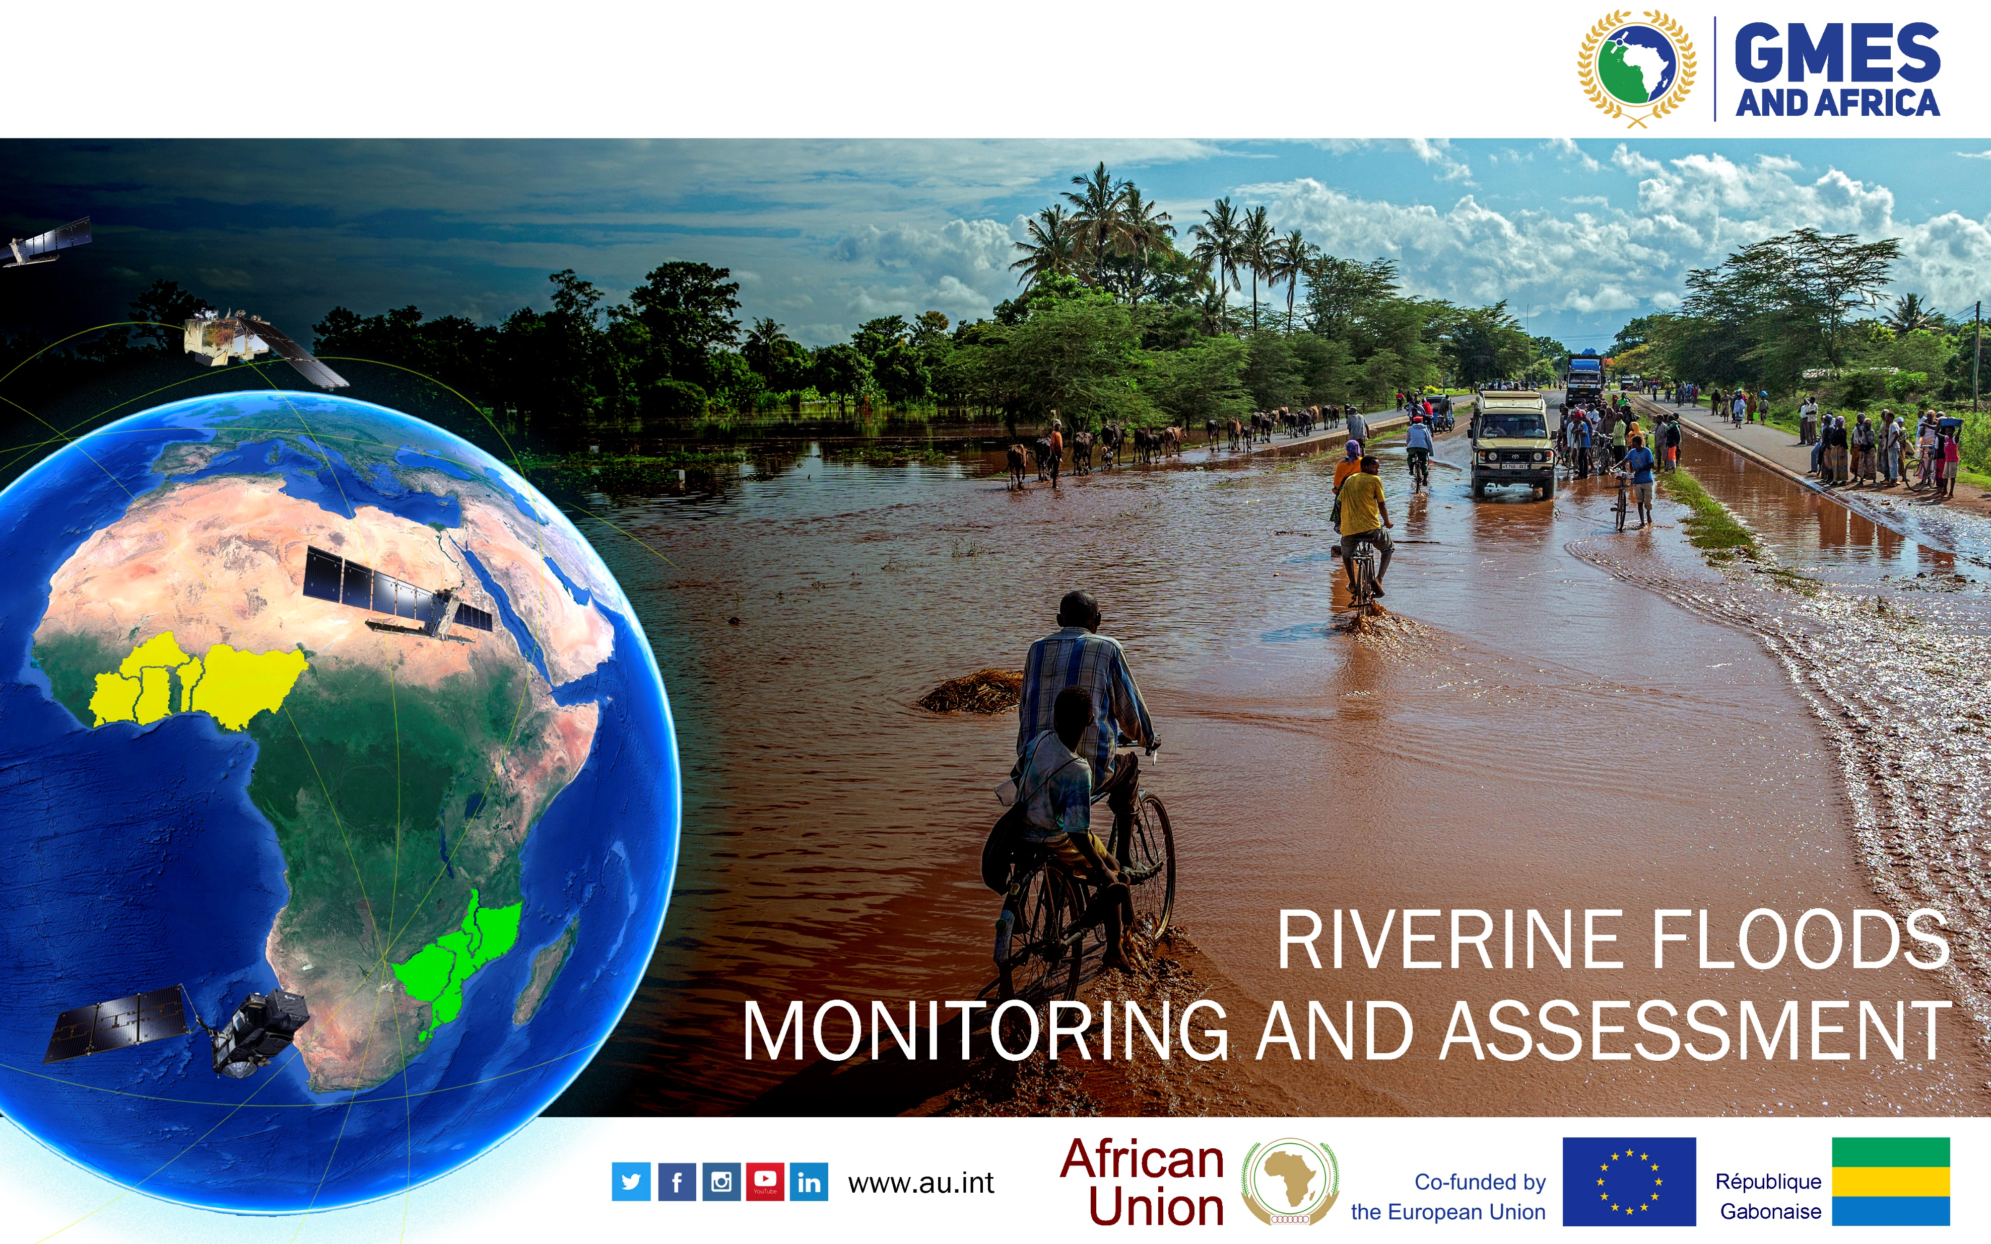

Slide 22
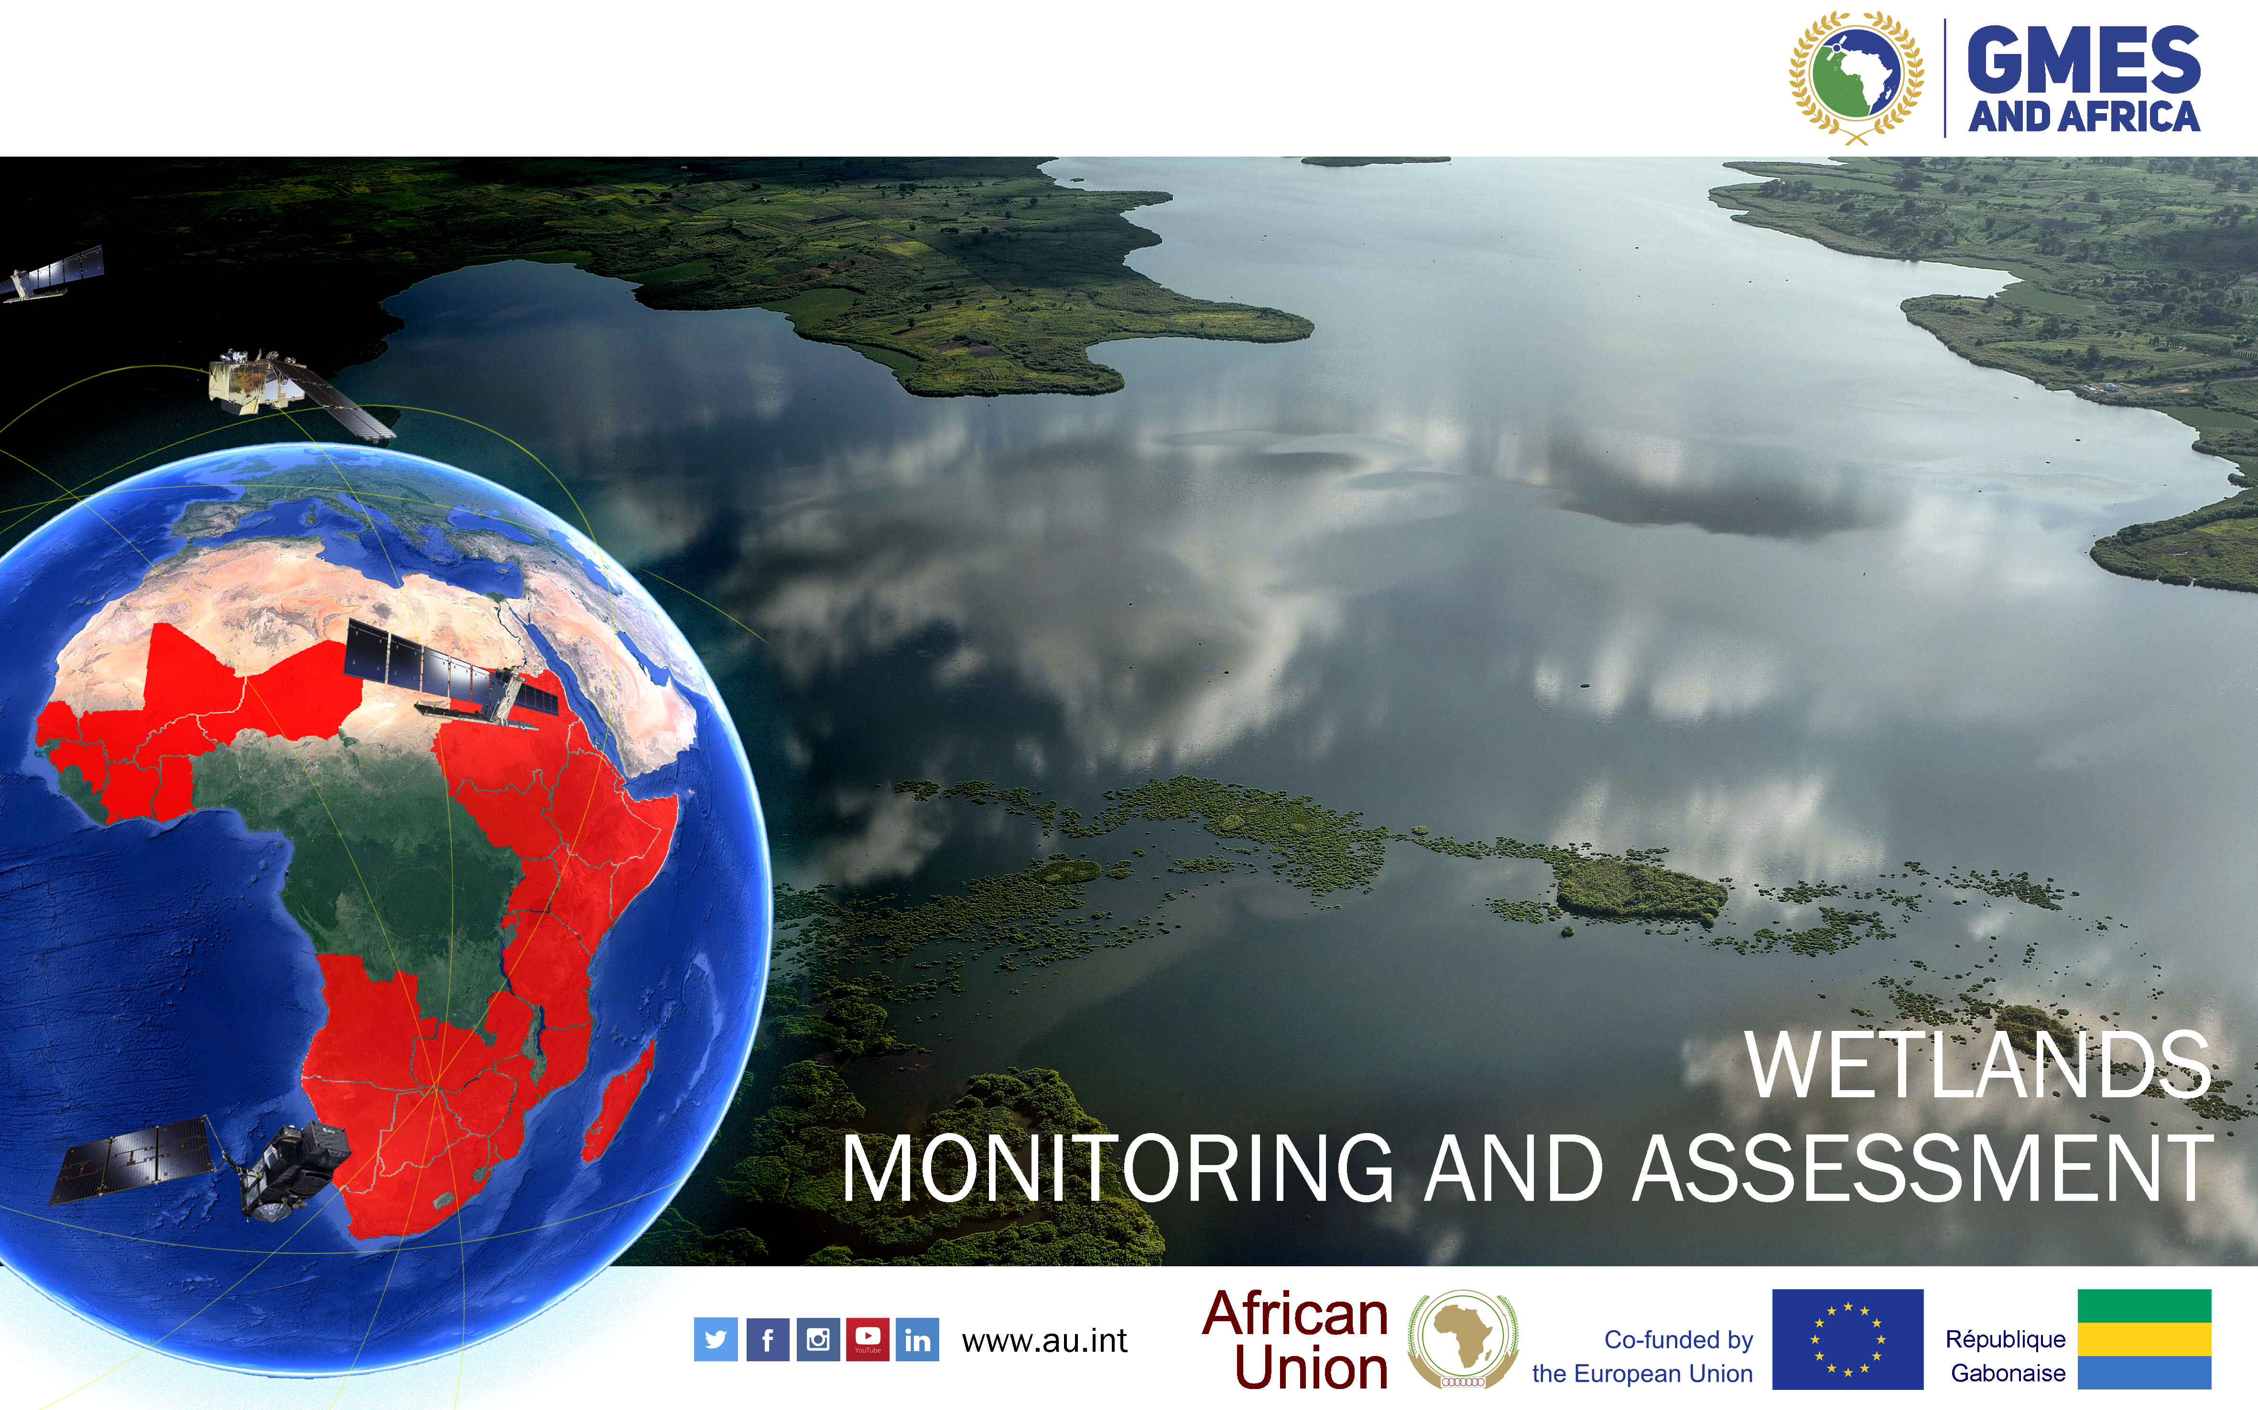

Slide 23
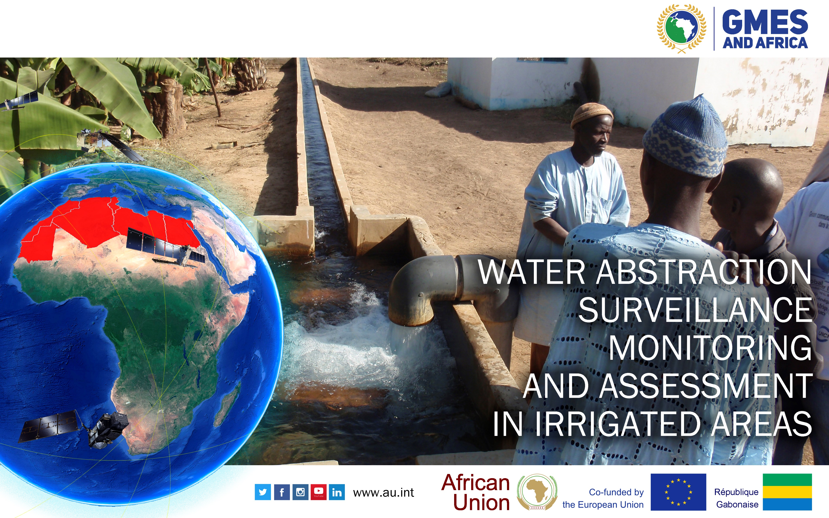

Slide 24
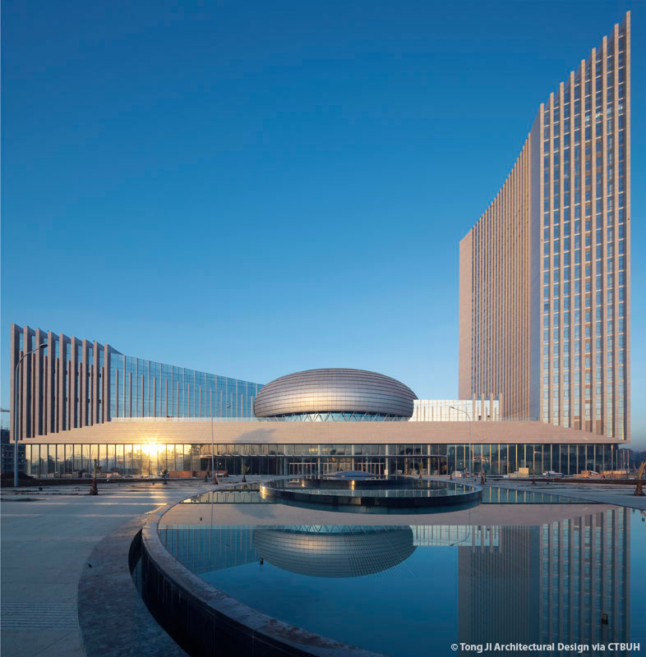

THANK YOU
AFRICAN UNION COMMISSION
Department of Education, Sciences,Technology and Innovation
Po Box 3243 | Roosevelt Avenue (Old Airport Area) | WK21K19
Addis Ababa, Ethiopia
Tel: (+251) 115517700
Fax: (+251) 115517844
Websites: WWW.AU.INT/GMESAFRICA
WWW.GMES4AFRICA.BLOGSPOT.COM
Notes:
Slide Contacts and Addresses

