Slide 1
Consultancy to Develop and Update Database on Fisheries and Aquaculture and Develop Mechanisms for Data Management
Noble K. Asare (PhD)
AU Centre of Excellence in Marine Fisheries and Coastal Zone Management
(13-15 June 2022)

Slide 2
Outline
Introducing the University of Cape Coast and The Department of Fisheries and Aquatic Sciences
  1.1. Background
  1.2. Teaching and Research
  1.3. Funded Projects
AU-IBAR Consultancy
  2.1. Introduction
  2.2. Objectives
  2.3. Work Packages
  2.4. Methodology
  2.5. Key Deliverables
  2.6. Implementation Timelines

Slide 3
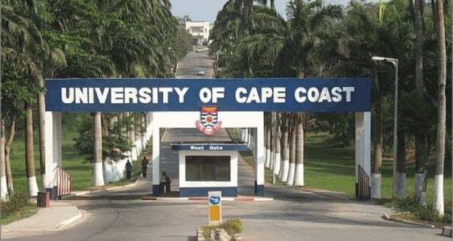
Introducing the University of Cape Coast and the Department of Fisheries and Aquatic Sciences
1.1. Background
The University of Cape Coast is a seafront University in Ghana which

Slide 4
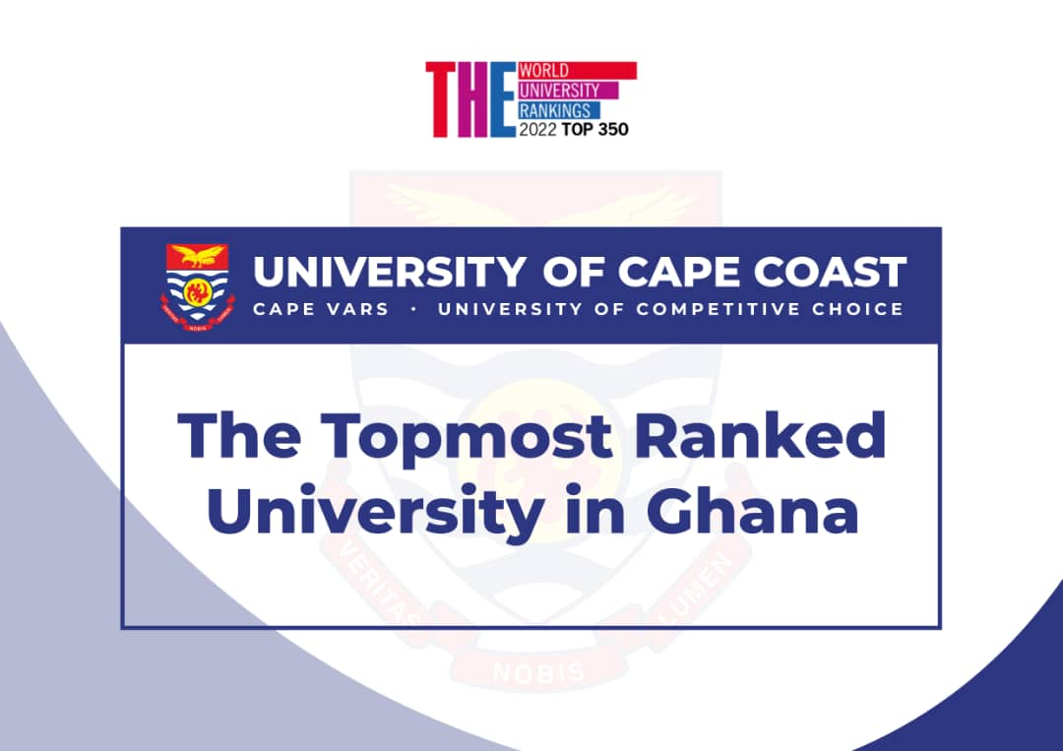
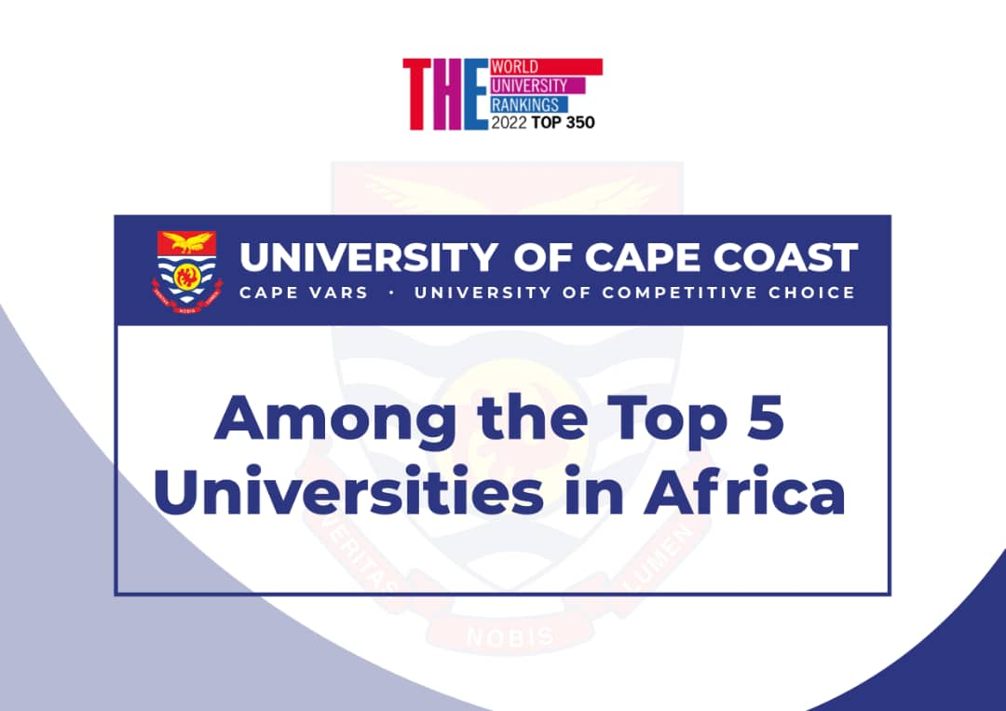
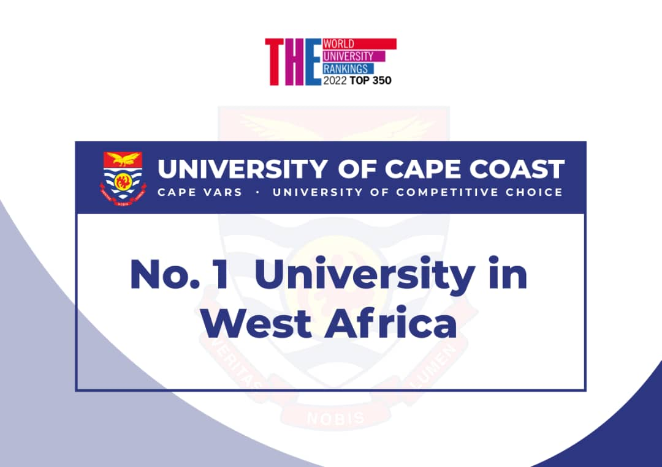
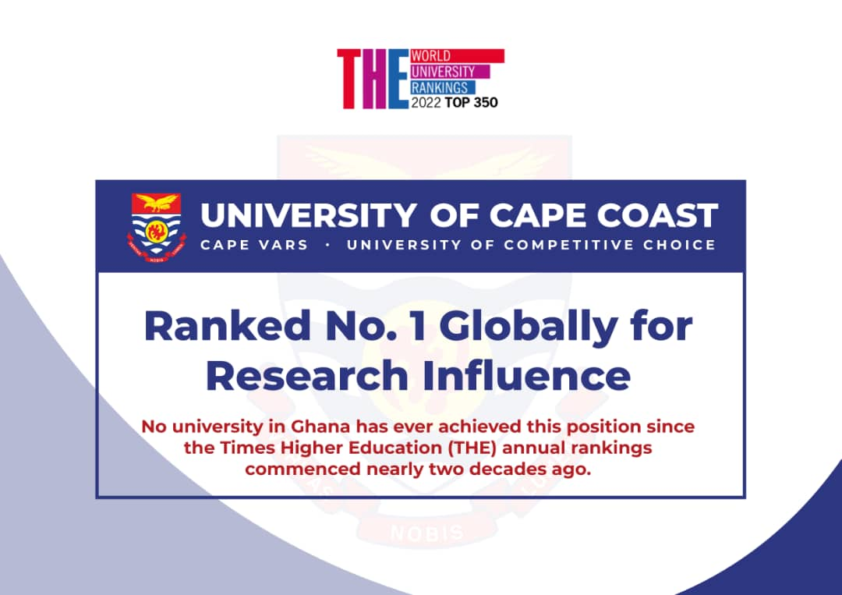
Introducing the University of Cape Coast and the Department of Fisheries and Aquatic Sciences
1.1. Background

Slide 5
Introducing the University of Cape Coast and the Department of Fisheries and Aquatic Sciences
1.1. Background
There are five colleges in the University including the College of Agriculture and Natural Sciences
DFAS is one of seven departments/Centre within the School of Biological Sciences under the College of Agriculture and Natural Sciences
The School of Biological Sciences currently has two (2) Centres of Excellence including the AU-CoE at DFAS

Slide 6
Introducing the University of Cape Coast and the Department of Fisheries and Aquatic Sciences
1.2. Teaching and Research Activities
DFAS runs nine (9) undergraduate and postgraduate academic programmes
  BSc. Fisheries and Aquatic Sciences
  MPhil. & PhD. Fisheries Science
  MPhil. & PhD. Aquaculture
  MPhil. & PhD. Integrated Coastal Zone Management
  MPhil. & PhD. Oceanography and Limnology
Currently training about 90 postgraduate students in four (4) thematic areas

Slide 7
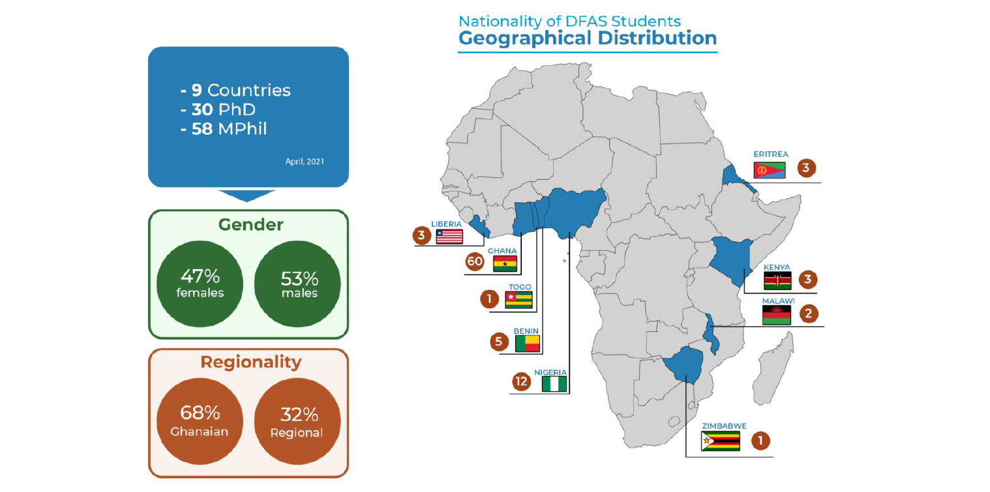
Introducing the University of Cape Coast and the Department of Fisheries and Aquatic Sciences
1.3. Teaching and Research Activities

Slide 8
Introducing the University of Cape Coast and the Department of Fisheries and Aquatic Sciences
1.2. Teaching and Research
DFAS has twelve (12) academic staff that conduct research in all 4 thematic areas
  2 Professors
  1 Associate Professors
  5 Senior Lecturers
  4 Lecturers

Slide 9
Introducing the University of Cape Coast and the Department of Fisheries and Aquatic Sciences
1.2. Teaching and Research
Has well equipped laboratories
  Fisheries and Coastal Research Laboratory
  Wet Laboratory
  Off-campus joint aquaculture facility with Ainoo-Ansah Farms

Slide 10
Introducing the University of Cape Coast and the Department of Fisheries and Aquatic Sciences
1.3. Funded Projects
Key funded projects implemented by DFAS include:
The Hotspot of Multiple Stressors: Research-Based Management of Gulf of Guinea II (2021-2023)
  Amount: US$ 800,000
  Funding agency: DANIDA
  Role of DFAS: Co-implementer
Development of bacteriophage cocktails as disease biocontrol agents for improved aquaculture productivity, food and nutrition safety in Ghana and Uganda(2018-2021)
  Amount: US$ 797,181.50
  Funding agency: AU-IBAR
  Role of DFAS: Co-implementer

Slide 11
Introducing the University of Cape Coast and the Department of Fisheries and Aquatic Sciences
1.3. Funded Projects
The Hotspot of Multiple Stressors: Research-Based Management of Gulf of Guinea I (2018-2020)
  Amount: US$ 800,000
  Funding agency: DANIDA
  Role of DFAS: Co-implementer
Fisheries and Coastal Management Capacity Building Support Project (2014-2020)
  Amount: US$ 5.5 million
  Funding agency: USAID
  Role of DFAS: Lead implementer

Slide 12
Introducing the University of Cape Coast and the Department of Fisheries and Aquatic Sciences
1.3. Funded Projects
A Public-Private Partnership to Establish a Fish Farming Training Centre of Excellence in Ghana (2014-2016)
  Amount: US$ 250,000
  Funding agency: DANIDA/World Bank/COTVET
  Role of DFAS: Lead implementer

Slide 13
Consultancy to Develop and Update Database on Fisheries and Aquaculture and Develop Mechanism for Data Management
2.1. Introduction
Despite the immense contribution of the fisheries and aquaculture sector to African countries, the sector is faced with numerous challenges that hinder its growth and development
Efforts to address these challenges led to the development of the policy framework and reform strategy for fisheries and aquaculture in Africa (PFRS)

Slide 14
Consultancy to Develop and Update Database on Fisheries and Aquaculture and Develop Mechanism for Data Management
2.1. Introduction
To address these challenges, the AU implemented the FishGov I Project with the support of the European Union
As a continuation, the FishGov 2 project was designed to focus on targeted priority areas, with an overall objective of improving food security, livelihoods and wealth creation in sustainable fisheries and aquaculture, aligned with AU Agenda 2063

Slide 15
Consultancy to Develop and Update Database on Fisheries and Aquaculture and Develop Mechanism for Data Management
2.2. Objectives
The overarching objective of this consultancy is to:
Conduct studies targeted at enhancing effective fisheries and aquaculture data management systems/practices for AU stakeholders to have access to quality knowledge products on African fisheries and aquaculture

Slide 16
Consultancy to Develop and Update Database on Fisheries and Aquaculture and Develop Mechanism for Data Management
2.2. Objectives
Key objectives are to:
establish a central repository for storage, retrieval and dissemination of relevant statistical and research data on fisheries, aquaculture and environment among others.
undertake studies to improve and update database on fisheries and aquaculture and formulate effective mechanism for efficient fisheries and aquaculture data management;
conduct training on utilization and management of the established database

Slide 17
Consultancy to Develop and Update Database on Fisheries and Aquaculture and Develop Mechanism for Data Management
2.3. Work Packages
Activities have been categorised under 4 work packages based on the expected result areas

Slide 18
Consultancy to Develop and Update Database on Fisheries and Aquaculture and Develop Mechanism for Data Management
2.3. Work Packages
WP 1
Develop and update a database on fisheries and aquaculture
Brief Description
This WP seeks to improve data accessibility through continental fisheries and aquaculture database Due to the lack of regional and continental level fisheries database, data access, harmonisationand dissemination

Slide 19
Consultancy to Develop and Update Database on Fisheries and Aquaculture and Develop Mechanism for Data Management
2.3. Work Packages
WP 2
Develop mechanisms for data management
Brief Description
This WP will define management mechanisms on the models, policies, rules, and standards that govern the data entry, retrieval, updating, storage, arrangement, integration, and use of data throughout the database

Slide 20
Consultancy to Develop and Update Database on Fisheries and Aquaculture and Develop Mechanism for Data Management
2.3. Work Packages
WP 3
Identify sources of fisheries, aquaculture, socio-economic and climate/environmental related data (research and statistics) in AU-MS
Brief Description
Aims to identify sources of fisheries, aquaculture, socio-economics and environmental/climate related data (research and statistics) from AU member states

Slide 21
Consultancy to Develop and Update Database on Fisheries and Aquaculture and Develop Mechanism for Data Management
2.3. Work Packages
WP 4
Strengthen the capacity of AU-MS on the utilization of database and data management
Brief Description
Will focus on developing training manuals and conducting training for AU-MS on the use of the database for data storage, retrieval, interpretation and online submission to the Central Data Repository

Slide 22
Consultancy to Develop and Update Database on Fisheries and Aquaculture and Develop Mechanism for Data Management
2.4. Methodology
DFAS-UCC will develop and deliver a continental fisheries and aquaculture database that serves as a data hub for AU and AU-MS, providing a technical decision-support system for activities relating fisheries and aquaculture.
This will be hosted on the AU-IBAR’s existing database infrastructure.

Slide 23
Consultancy to Develop and Update Database on Fisheries and Aquaculture and Develop Mechanism for Data Management
2.4. Methodology
WP1
The following approach will be used
Assess existing databases (incl. AU-IBAR’s ARIS data repository)
Map sample of assessed databases based on regional blocs.
Harmonize the various data structures from existing databases

Slide 24
Consultancy to Develop and Update Database on Fisheries and Aquaculture and Develop Mechanism for Data Management
2.4. Methodology
WP1
The following approach will be used
Develop holistic data model/schema for the database
Get infrastructure credentials and setup the database environment
Deploy schema on the database infrastructure

Slide 25
Consultancy to Develop and Update Database on Fisheries and Aquaculture and Develop Mechanism for Data Management
2.4. Methodology
WP1
The following approach will be used
Develop and test data collection and collation application
Connect with institutions with databases of interest to AU-IBAR

Slide 26
Consultancy to Develop and Update Database on Fisheries and Aquaculture and Develop Mechanism for Data Management
2.4. Methodology
WP2
Develop mechanisms for data entry, retrieval, storage & updating
Link the developed database to AU-IBAR Animal Resources Information Systems (ARIS) data repository

Slide 27
Consultancy to Develop and Update Database on Fisheries and Aquaculture and Develop Mechanism for Data Management
2.4. Methodology
WP3
Identify data types, forms and structure
Develop template to collate the various data types/forms and their sources
Conduct search for key institutions of AU-MS as data sources

Slide 28
Consultancy to Develop and Update Database on Fisheries and Aquaculture and Develop Mechanism for Data Management
2.4. Methodology
WP3
Liaise with regional institutions (e.g. RECs, RFBs) to identify sources of data from relevant institutions in AU-MS
Populate the template with various data types and sources

Slide 29
Consultancy to Develop and Update Database on Fisheries and Aquaculture and Develop Mechanism for Data Management
2.5. Key Deliverables
A database development environment setup on the infrastructure of AU-IBAR
A centralised continental fisheries and aquaculture database
Protocols on data entry, retrieval, database update and upgrade

Slide 30
Consultancy to Develop and Update Database on Fisheries and Aquaculture and Develop Mechanism for Data Management
2.5. Key Deliverables
A report on sources and types of fisheries, aquaculture, socio-economics and environmental related data in the five regional blocs
A survey template for receiving identifying types and sources
A training manual on database utilization
Five regional training workshops for AU-MS

Slide 31
Consultancy to Develop and Update Database on Fisheries and Aquaculture and Develop Mechanism for Data Management
2.6. Implementation Timelines

Slide 32
Consultancy to Develop and Update Database on Fisheries and Aquaculture and Develop Mechanism for Data Management
Activities | Tasks | Timelines | Status
Inception and familiarization | An inception briefing with relevant AU-IBAR staff to agree on expectations and provide clarity on any outstanding issues | 27 – 31 May 2022 | Completed
 | Familiarization with AU policy instruments and strategies relevant to this consultancy | 1 – 2 June 2022 | Completed
 | Sharing of knowledge related to the implementation of the project with relevant stakeholders including RECs, AU-MS etc. | 6 – 8 June 2022 | Initiated

Slide 33
Consultancy to Develop and Update Database on Fisheries and Aquaculture and Develop Mechanism for Data Management
Activities | Tasks | Timelines | Status
WP 1: Develop and update a database on fisheries and aquaculture | Assessment of existing database | End of June 2022 | Yet to Start
 | Mapping of sampled assessed data based on regional blocs | End of June 2022 | Ongoing
 | Harmonization of database requirements from existing databases | End of June 2022 | Yet to Start
 | Developing a data model/schema for the database | End of July 2022 | Yet to Start
 | Setting up of database infrastructure | End of July 2022 | Yet to Start

Slide 34
Consultancy to Develop and Update Database on Fisheries and Aquaculture and Develop Mechanism for Data Management
Activities | Tasks | Timelines | Status
WP 1: Develop and update a database on fisheries and aquaculture | Implementing model/schema | End of July 2022 | Yet to Start
 | Developing an application for data collection | End of August 2022 | Yet to Start
WP 2: Develop mechanisms for data management | Developing a mechanism for data entry, retrieval, storage & updating | End of August 2022 | Yet to Start
 | Linking of developed database to AU-IBAR database | End of August 2022 | Yet to Start

Slide 35
Consultancy to Develop and Update Database on Fisheries and Aquaculture and Develop Mechanism for Data Management
Activities | Tasks | Timelines | Status
WP 3: Identify sources of fisheries, aquaculture, socio-economic and climate/environmental related data (research and statistics) in AU-MS | Development of framework for data types and sources | End of June 2022 | Ongoing
 | Desktop survey to identify key institutions engaged in data collection (fisheries-aquaculture-socioeconomic-environmental/climate-related data | July-August 2022 | Yet to Start

Slide 36
Consultancy to Develop and Update Database on Fisheries and Aquaculture and Develop Mechanism for Data Management
Activities | Tasks | Timelines | Status
WP 4: Strength the capacity of AU-MS on the utilization of database and data management | Identifying participants for the training on the use of the database | End of July 2022 | Yet to Start
 | Planning five training sessions for AU member states | End of July 2022 | Yet to Start
 | Developing training materials and conducting five training sessions for AU member states | From August 2022 | Yet to Start
Language Translation | Translation of relevant training materials | 15 -31 August 2022 | Yet to Start

Slide 37
Consultancy to Develop and Update Database on Fisheries and Aquaculture and Develop Mechanism for Data Management
Activities | Tasks | Timelines | Status
Reporting | Submission of work implementation plan | 25 May 2022 | Submitted
 | Submission of inception report | 25 May 2022 | Due
 | Submission of 1st draft / interim report | End of June 2022 | Not Due
 | Submission of 2nd draft / database report | End of July 2022 | Not Due
 | Submission of final draft / technical report | 16 September 2022 | Not Due

Slide 38
END

