Slide 1

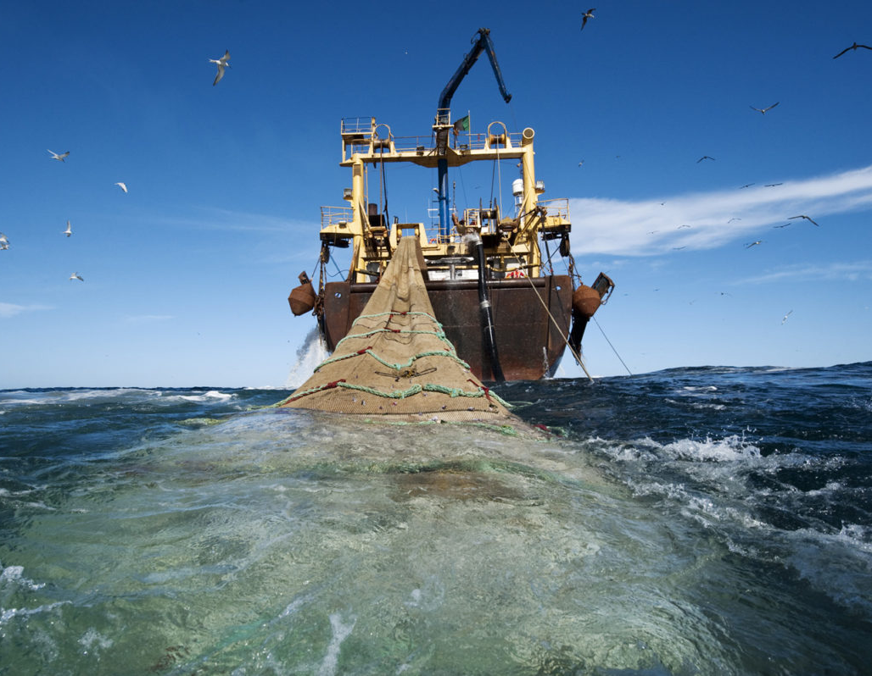
Fisheries Governance 2 Communication, Visibility & Knowledge Management
STATUS OF IMPLEMENTATION:
JUNE 2022

Slide 2

Table of Contents
Background - Overview of Communication & Visibility Strategic Focus
Part 1
Part 2
Target Audiences
Part 3
Implementation
Part 4
Measuring Success
Part 5
Follow-up Focus Areas

Slide 3
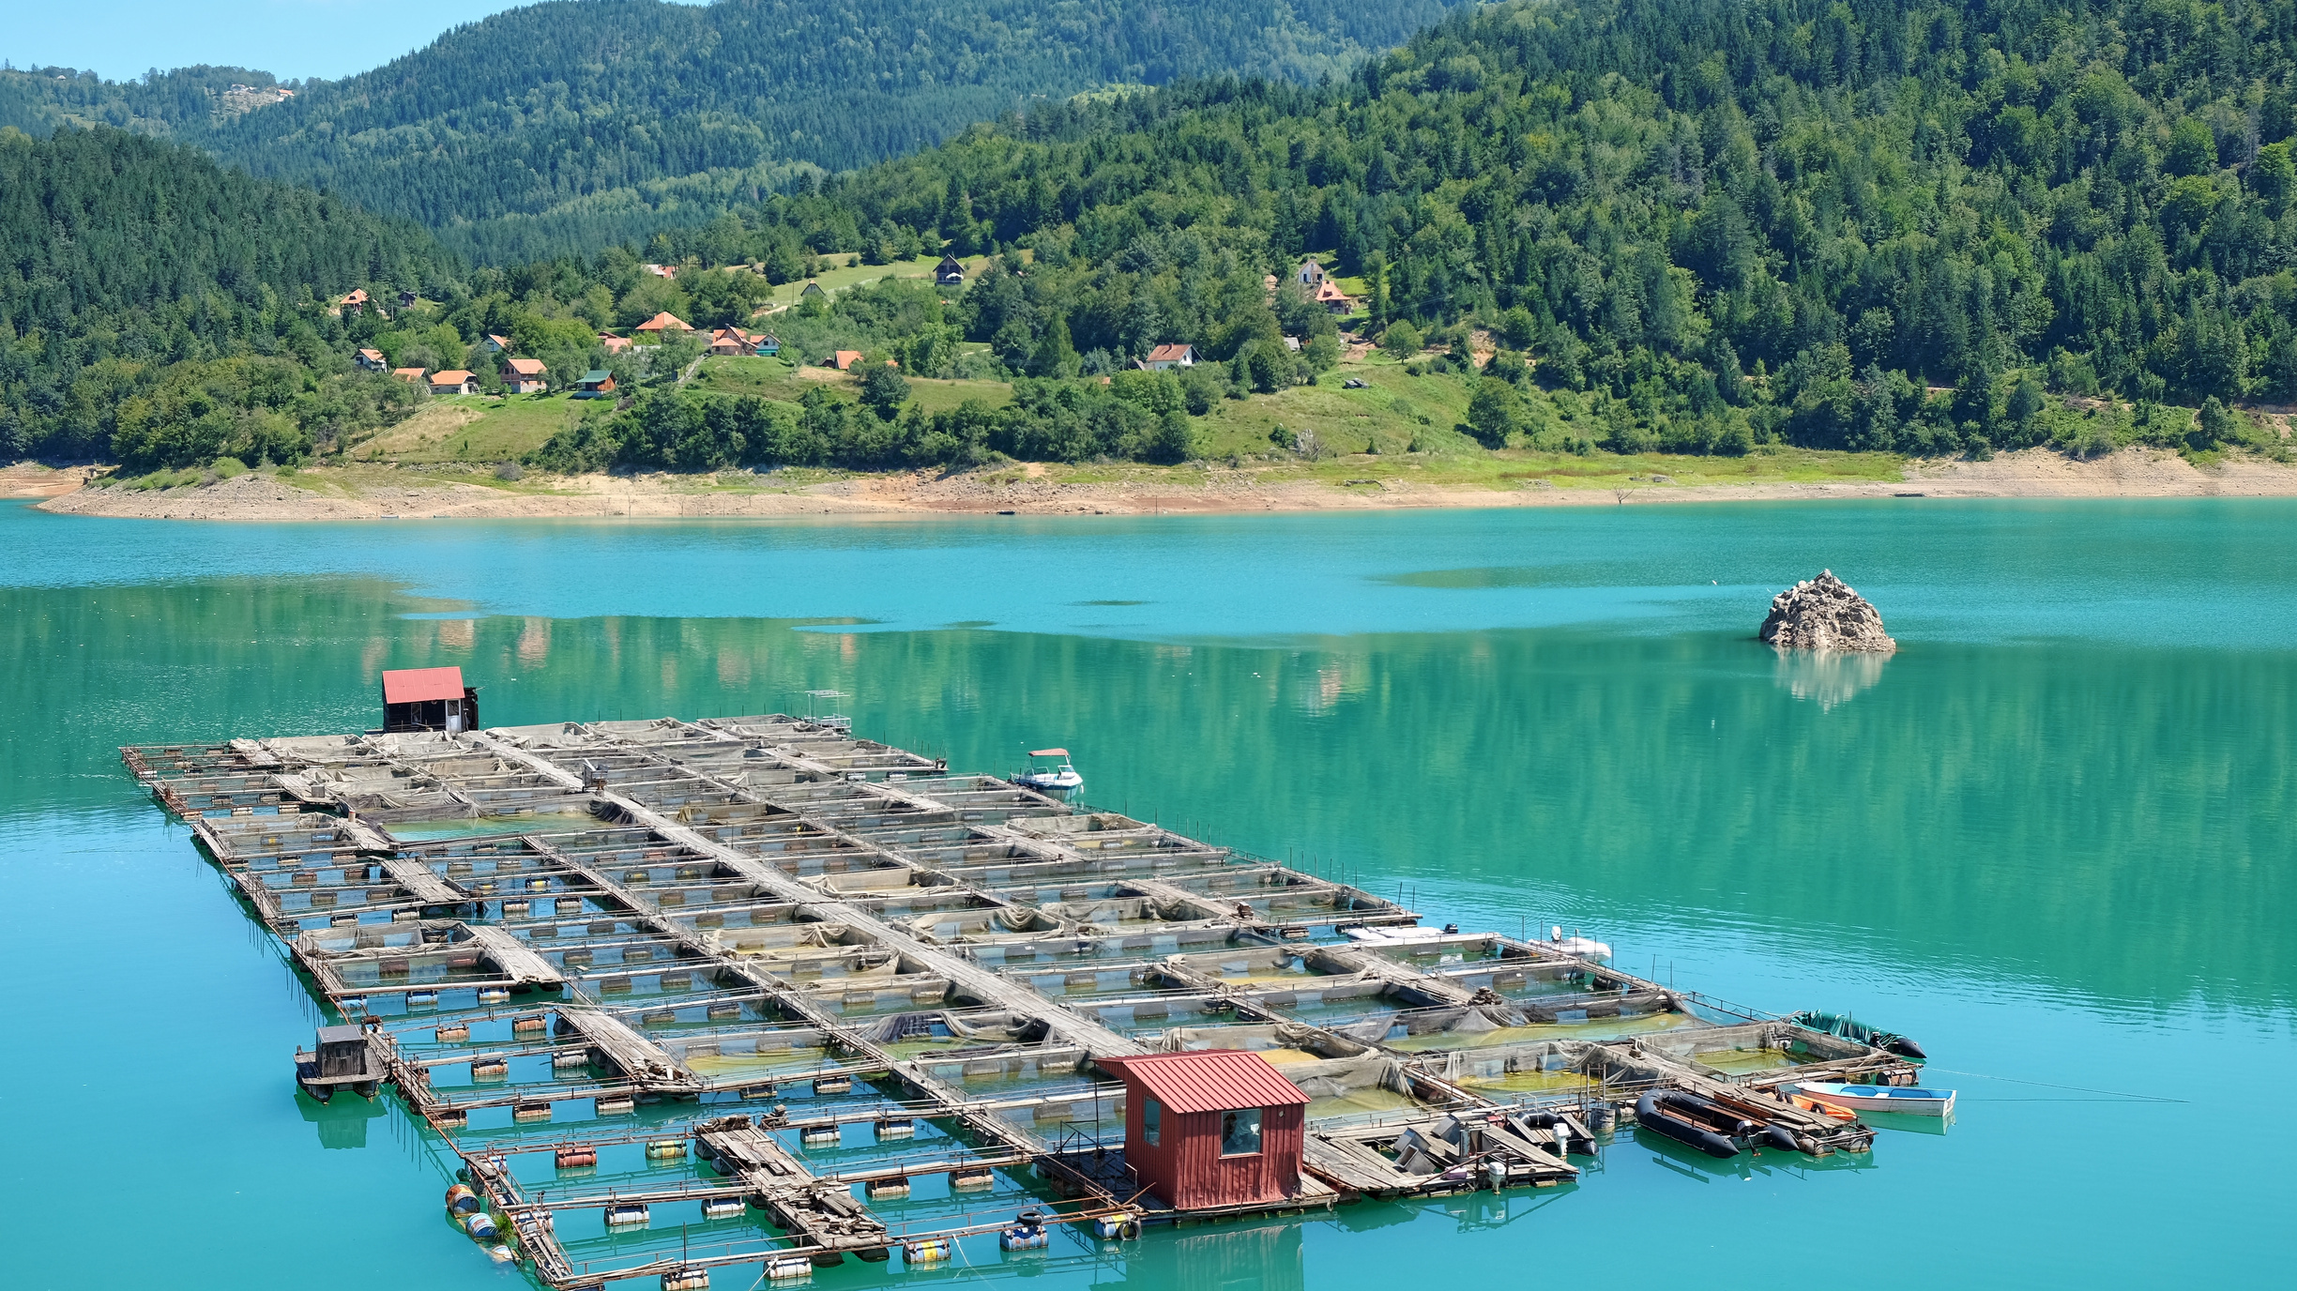
Part 1:
BACKGROUND

Slide 4

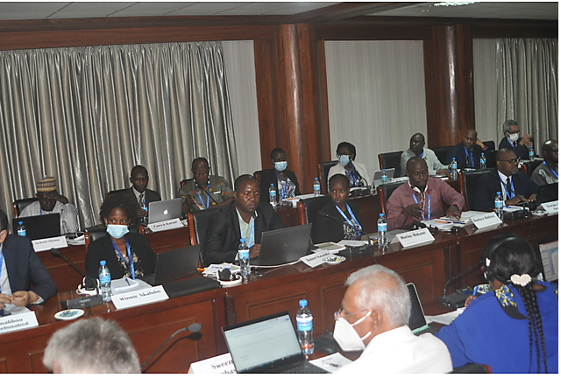
Principle:
" The CVP is based on the principle that communication is essentially about people, and how they interact, share information and work together."

Slide 5

Objectives
3
4
5
1
2
4
To inform stakeholders and beneficiaries about FISHGOV 2, the project activities and outcomes, and raise awareness about the key issues addressed.
To assure effective communication and understanding within the consortium and with other relevant actors outside the project.
To advocate for stronger and better coordination among institutions mandated with governance of the fisheries and aquaculture sector.
To promote wide understanding of FISHGOV 2
To contribute to knowledge creation and to policy and decision-making in the field of fisheries and aquaculture resources.

Slide 6
Objectives
6
7
4
To improve perception and promote behavioural change among stakeholders regarding illegal and unregulated fishing practices.
To facilitate knowledge sharing among the project (including AUC) partners, relevant external actors, and final beneficiaries.

Slide 7
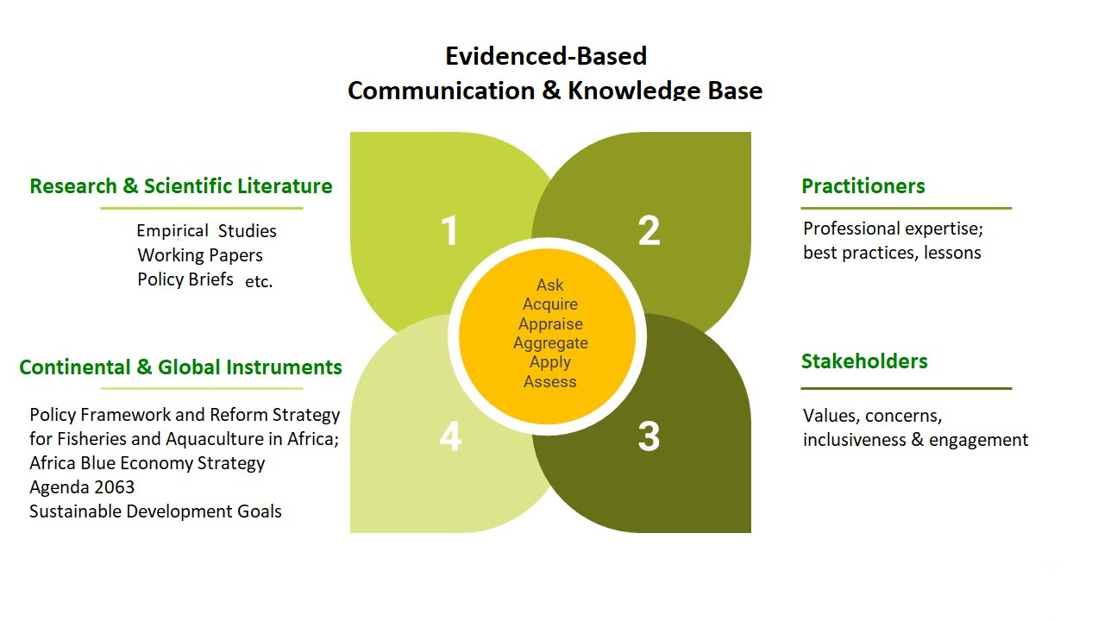

Slide 8
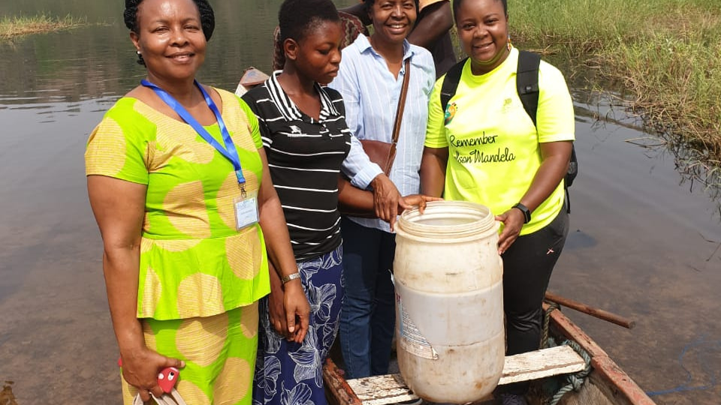
Part 2:
Target Audiences

Slide 9
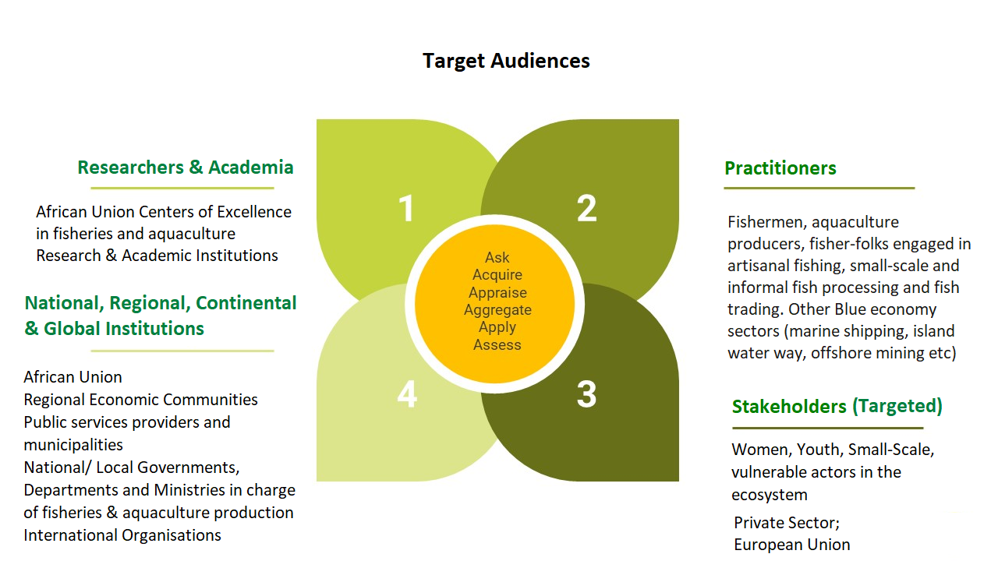

Slide 10
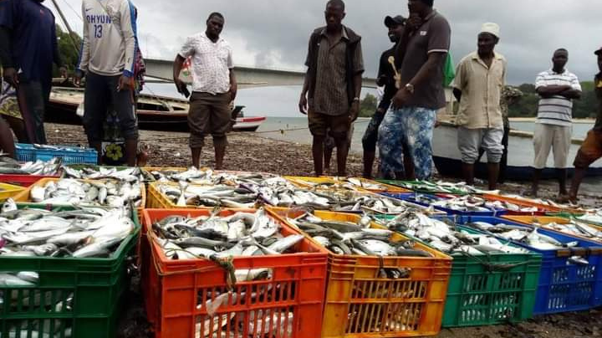
Part 3:
Implementation

Slide 11

Communication & Visibility
  Media engagement has increased; from follow-up of Zanzibar Meeting. Listserve in place and Media online corner for blogging; guidelines on branding.
  57 - MOSFA & National media houses; journalists
  External reporting on related events and issues - TV; radio; online media and newspapers
  Awareness products: generic brochure & introductory video on Fisheries Governance
  Online photo galleries - currently arranged by events
  Online Calender
  Reviews & Abstracts promotion

Slide 12
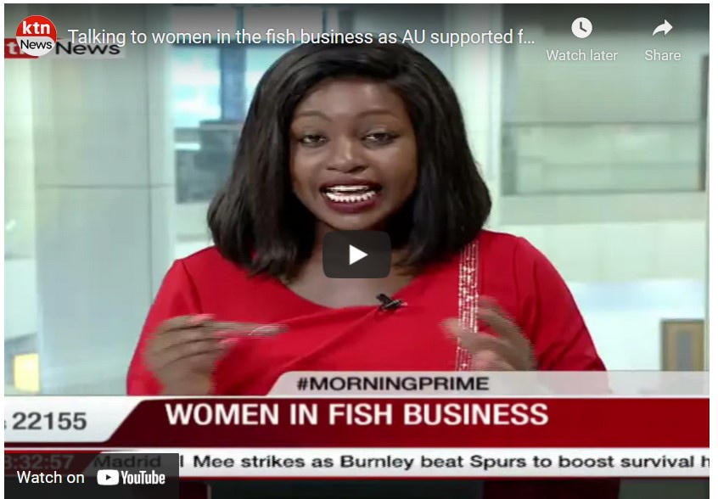
Communication & Visibility - Key Messages
Improvement in testimonial based reporting by interviewing stakeholders and coverage of activities implemented thus far.
Messages are aligned to:
  High-level goals/ Agenda 2063;
  Contribution to food and nutrition security, incomes and livelihoods of Africa’s populations and the Blue Economy.
  The coherent implementation of the Policy Framework and Reform Strategy for Fisheries and Aquaculture in Africa (PFRS)
  Strengthen the African voice in international fora

Slide 13
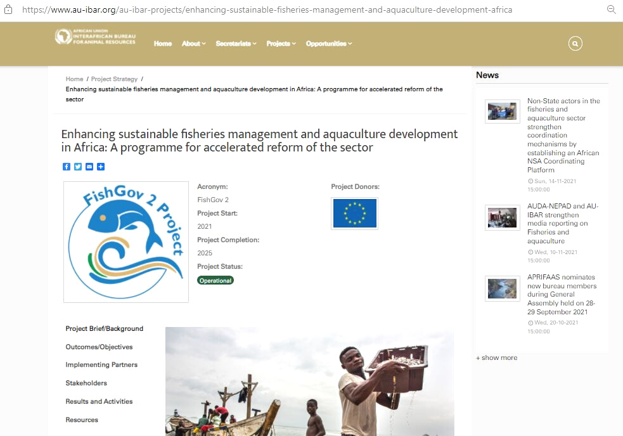
FishGov2 Microsite
https://www.au-ibar.org/au-ibar-projects/enhancing-sustainable-fisheries-management-and-aquaculture-development-africa

Slide 14
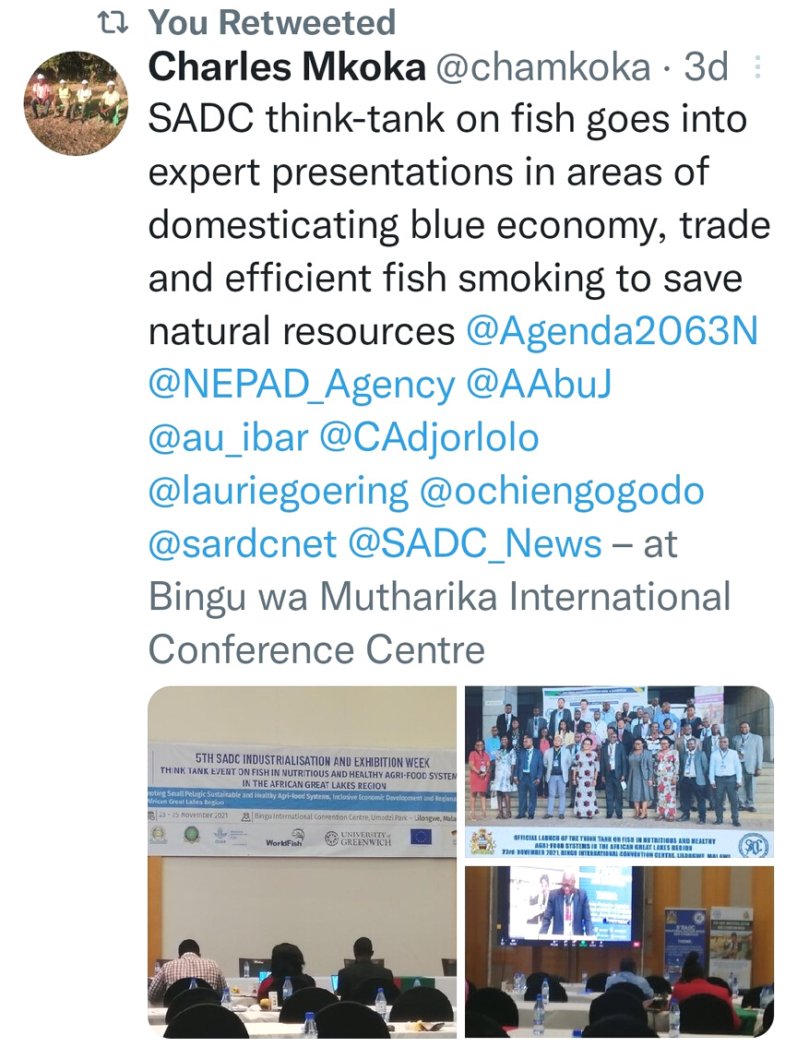
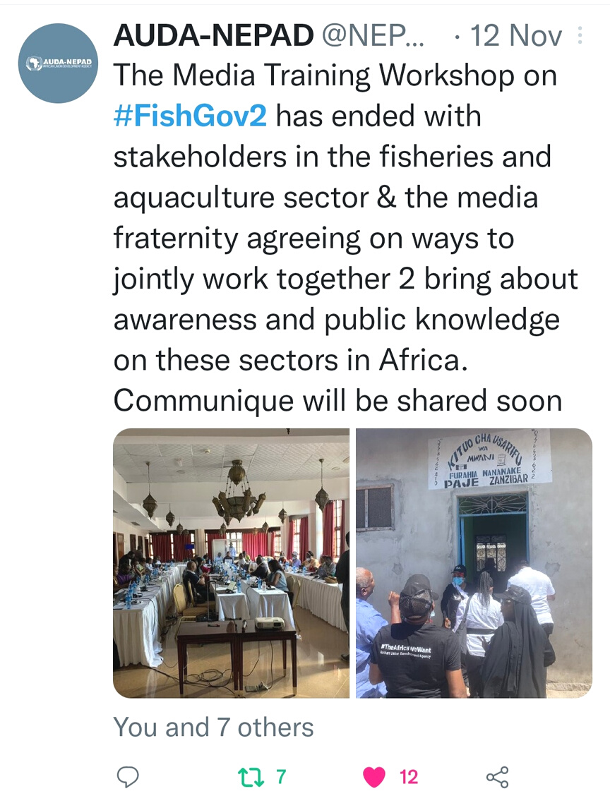
Social Media - Engage; inform; message translation; advocacy
@au_ibar
@NEPAD_Agency
#FishGov2

Slide 15

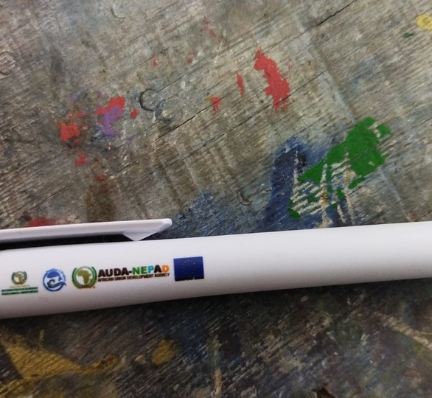
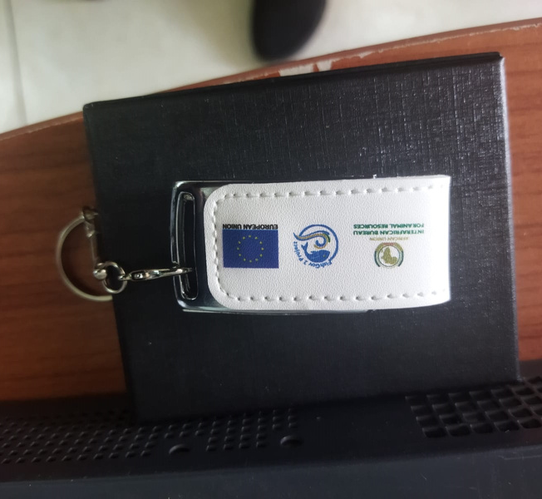
COMMUNICATION AND VISIBILITY
Visibility and Promotional Materials (i.e. Project memorabilia and collectables; EU visibility)
  Brochures; folders; memory sticks; banners
  Meeting Banners: - Technical Coordination Meeting (April 2021)
  Programme activities

Slide 16
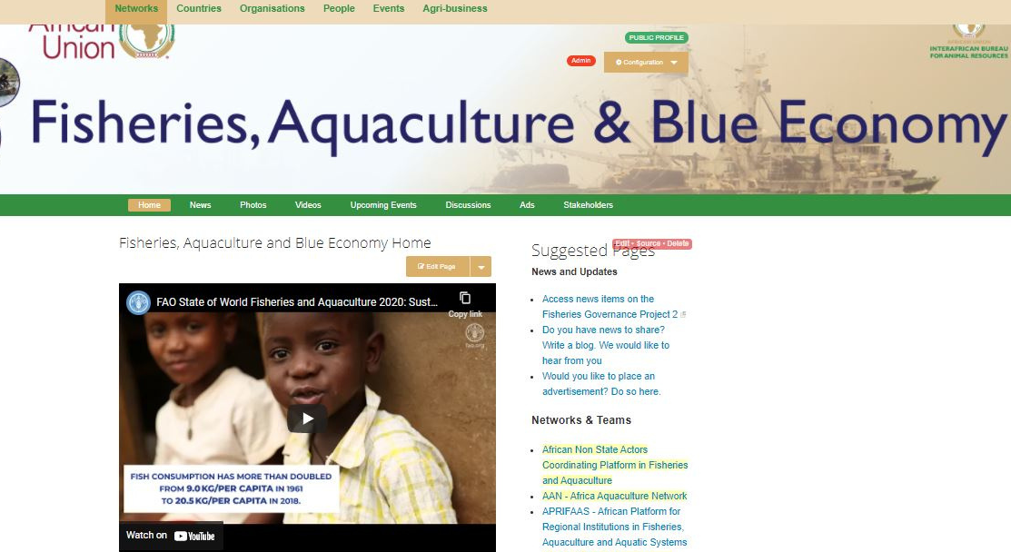
Knowledge Sharing -
External Collaboration & Coordination
  General space for Fisheries, Aquaculture & Blue Economy
  Nine AWFISHNET National Chapters have online spaces ; overaching fisheries and aqauculture, and blue economy & media; PRIFAAS - African Platform for Regional Institutions in Fisheries, Aquaculture and Aquatic Systems
  Non-State Actors
  Media Telling Stories
  Calendering in use - but needs to be promoted
  Activity-based information sharing - retention
  Project Team Spaces
  Education and Research sections
Signup @ https://networks.au-ibar.org/

Slide 17

  Listserve
  Guidelines
  Thematic Coverage
https://networks.au-ibar.org/show/media-sharing-stories/blog

Slide 18
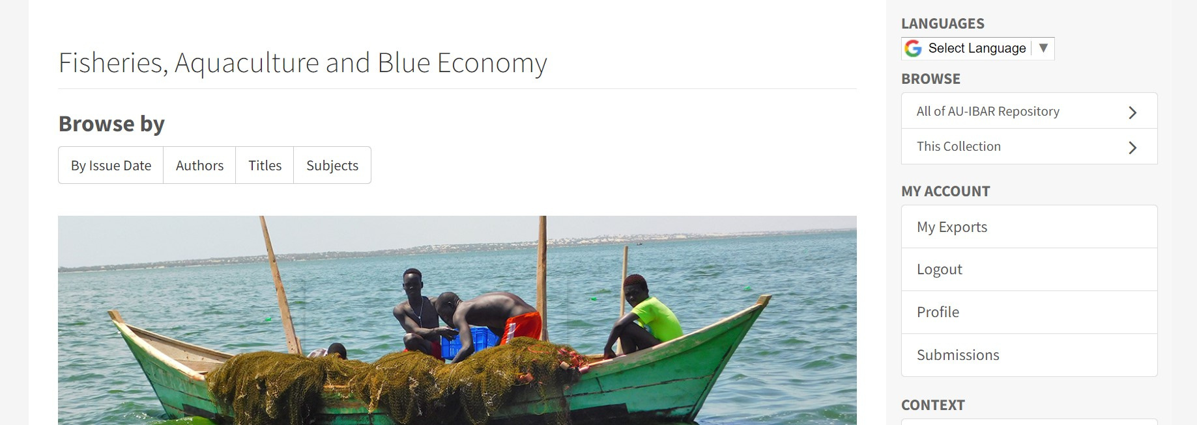
Online Repository:
1) Fisheries, Aquaculture & Blue Economy
Linked AU/ AUC Repository: http://repository.au-ibar.org/handle/123456789/1116

Slide 19





REPOSITORY ANALYTICS
80 - SUBJECT FILTERATIONS
14 - DOCUMENT/ MEDIA TYPES
107 - PUBLICATIONS
3 LANGUAGES: ENGLISH - 90%; FRENCH; ARABIC

Slide 20

Part 4:
Measuring Success

Slide 21
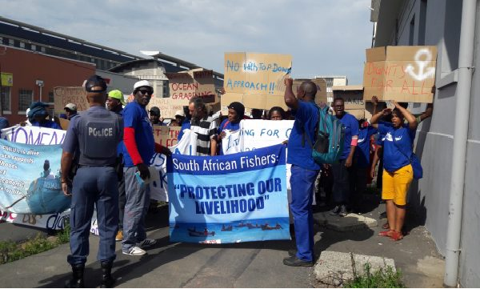




How can we gauge success?
Principle:
" The CVP is based on the principle that communication is essentially about people, and how they interact, share information and work together."

Slide 22

Development Communication —
Utilisation of Data/ Evidence & Expertise for improved Livelihoods/ Economies, transformed behaviour/ case studies.
(Lagging behind in knowledge translation)
_
Utilisation/ Promotion of FishGov 1 knowledge outputs (Literature Reviews)

Slide 23
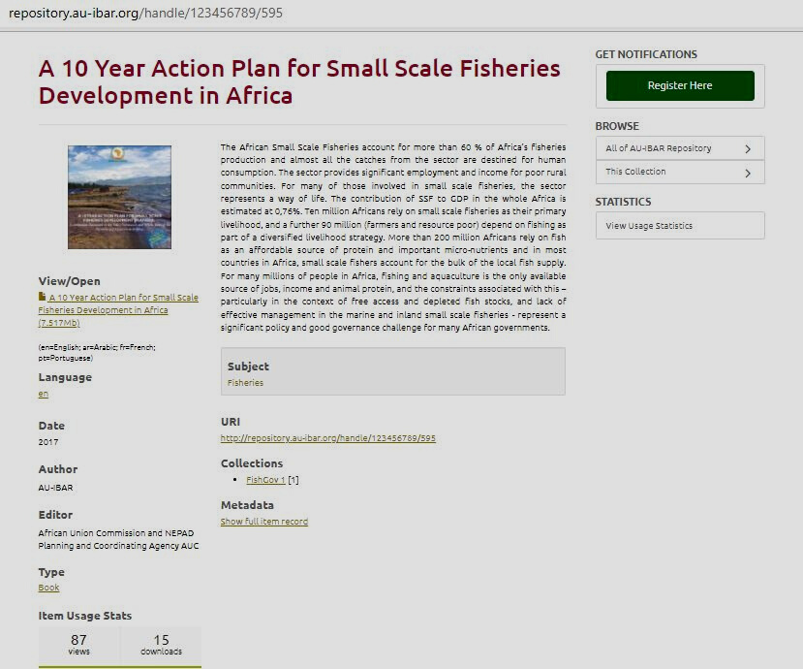
Platform Analytics
—
visits, participation, postings, downloads, engagement, linkages, onboarding, citations/ news coverage etc.

Slide 24
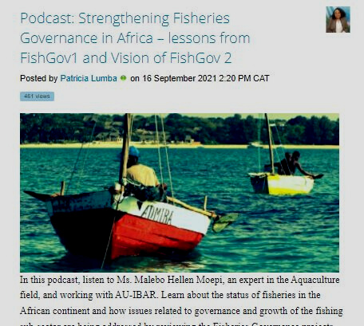
Platform Analytics
—
visits, participation, postings, downloads, engagement, linkages, onboarding, citations/ coverage

Slide 25
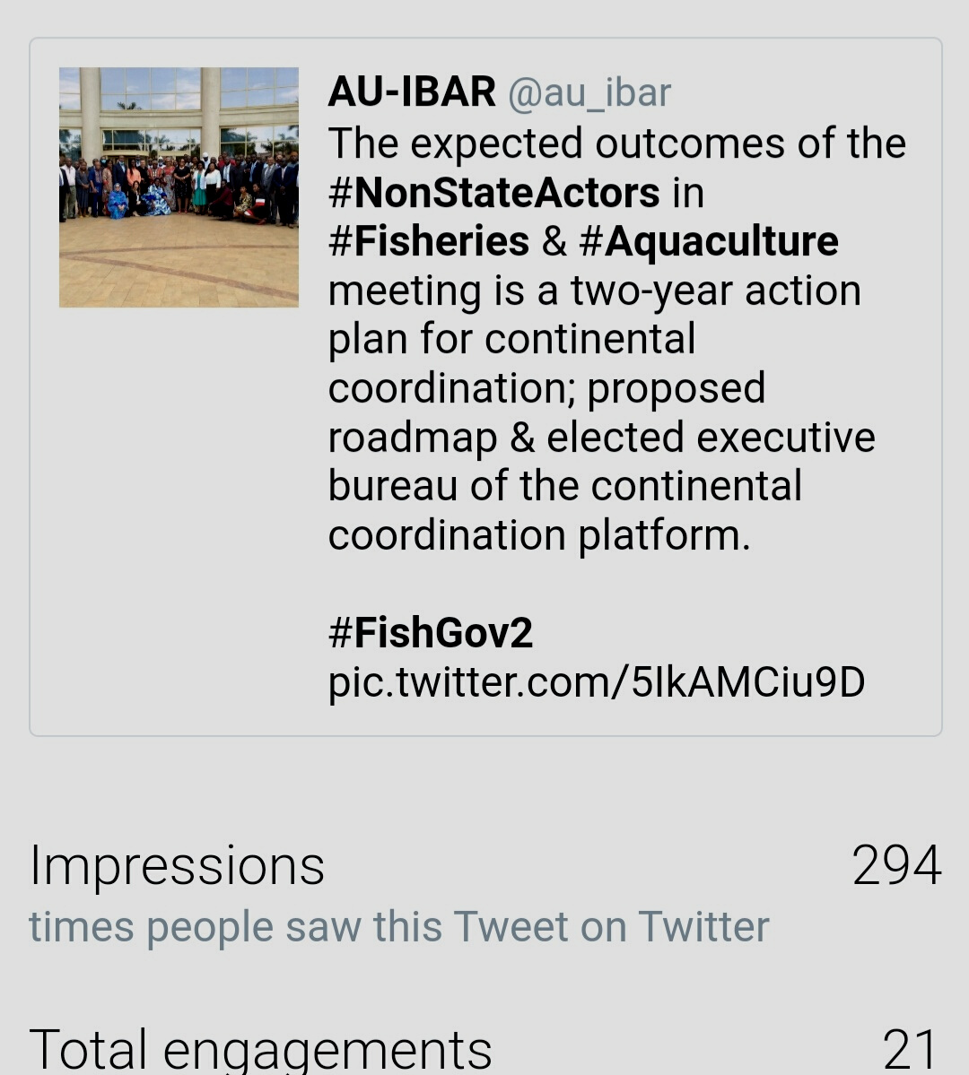
Platform Analytics
—
visits, participation, postings, downloads, engagement, linkages, onboarding, citations/ coverage

Slide 26
Part 5:
Follow-up Focus Areas/ Recommendations

Slide 27
Focus Areas - 2022
Specific project activities for stakeholders e.g. angle of advocacy for Non-State Actors
Strengthen content curation methods & dissemination : - media blogging; use of champions; MailChimp to draw from disintegrated platforms and information spaces - e.g. NSAs; media; development partners
Develop actionable outputs for various target audiences from translated knowledge products - e.g. from FishGov 1 launch of publication interviews; Use of Advocacy methods & Tools - NSA
Strengthen collaboration - e.g. calendering (Event Sharing) and engagement

Slide 28
Focus Areas - 2022
Promote more open access to various multi-lingual groups and platforms - e.g. french documents and collaborative online spaces to be multi-lingual - Systran.
Staff and stakeholder capacity strenghening and awareness on data, Communication information and collaboration tools; branding & standardisation.
Evaluation on communication and knowledge transfer usage patterns and information needs stakeholders.
Strengthen cross-stakeholder linkages and knowledge sharing.

Slide 29



Thank You
WWW.AU-IBAR.ORG
REPOSITORY.AU-IBAR.ORG
NETWORKS.AU-IBAR.ORG
WWW.NEPAD.ORG

