Slide 1



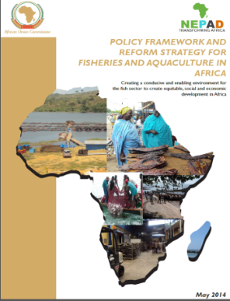



STATUS OF IMPLEMENTATION OF THE PROJECT
“CONSERVING AQUATIC BIODIVERSITY IN AFRICAN BLUE ECONOMY”
AT THE FIRST PROJECT TECHNICAL AND STEERING COMMITTEE MEETINGS
20–23 SEPTEMBER, 2022 – MOMBASA, KENYA
Assessment of Transboundary Environmental Issues Affecting Biodiversity in Selected Shared Freshwater Ecosystems Towards Formulating Harmonized Regional Strategy for Conservation of Aquatic Biodiversity and Joint Action Plans
Dr. Asmah Ruby

Slide 2
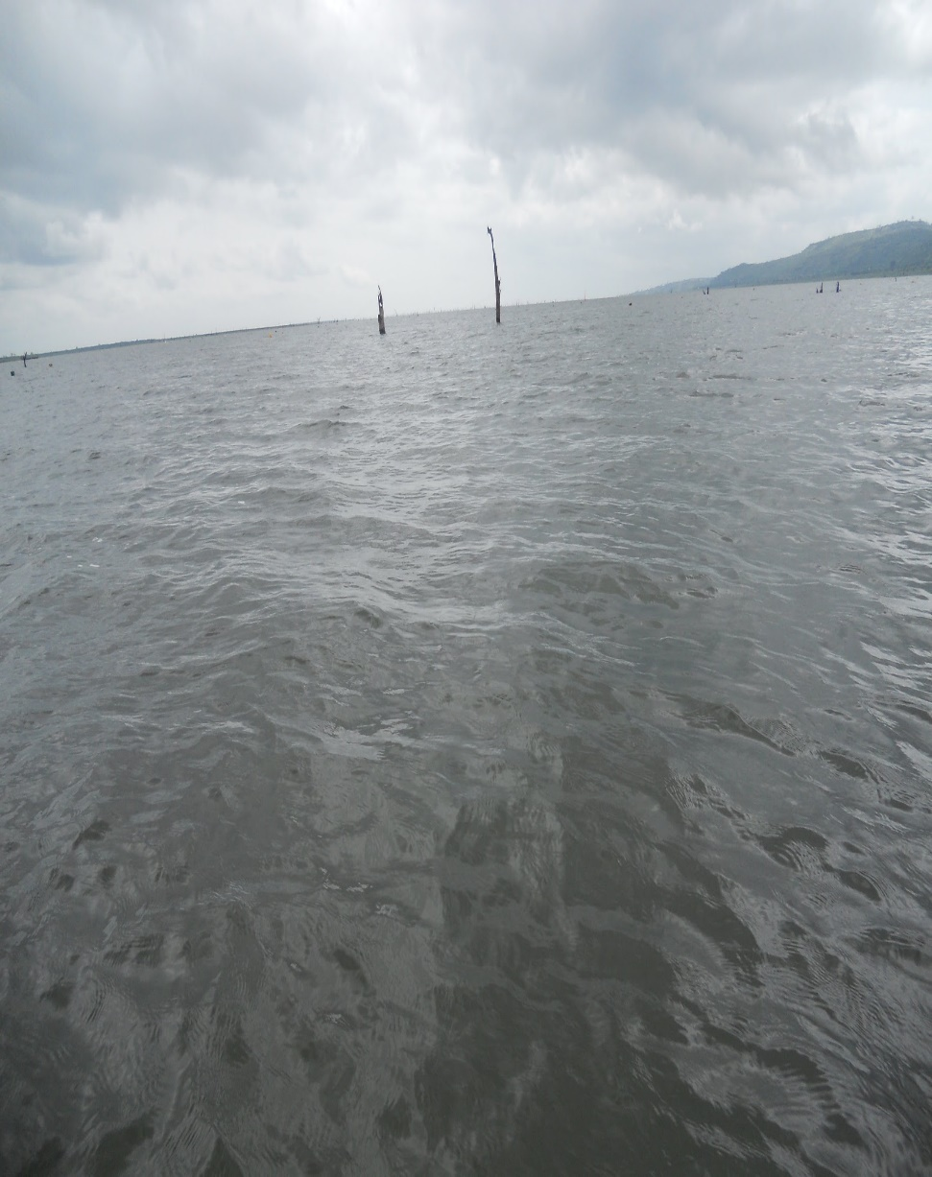
INTRODUCTION
Transboundary freshwater basin account for about 60% of global freshwater
Cuts across over 150 countries
Covers 46% of the world’s land area
Serves about 42% of the world’s population

Slide 3
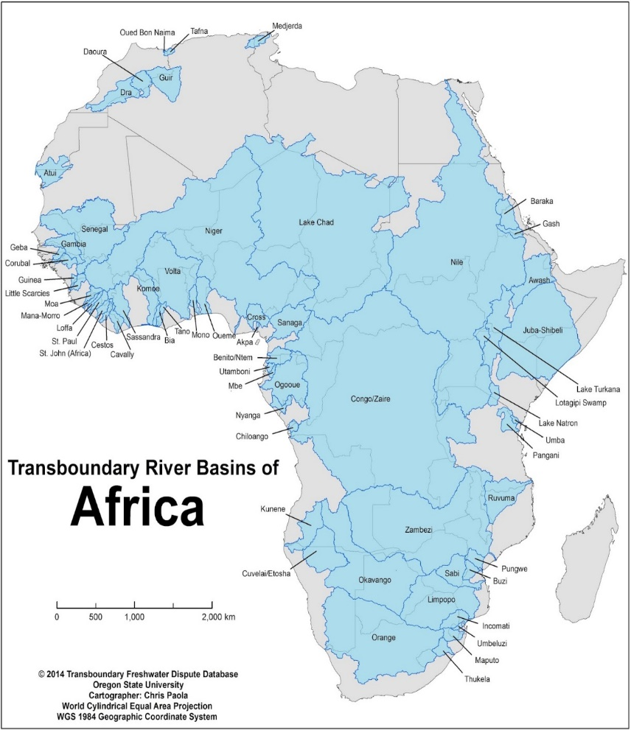
TANSBOUNDARY BASINS IN AFRICA
African Continent has 68 transboundary basins
Represents 22% of global transboundary rivers basins
Covers 64% of the continent’s land area
Serves 60% of the continent’s population
Main uses: agriculture, mining, hydropower, tourism, fishing, navigation, potable water supply

Slide 4
OBJECTIVES OF THE STUDY
The overall objective of the consultancy is to assess selected transboundary freshwater aquatic ecosystems to identify critical aquatic environmental issues and sources affecting aquatic biodiversity and develop regional protocol and strategy for conservation of aquatic biodiversity and joint action plans.

Slide 5
METHODOLOGY AND APPROACH
Overview of transboundary freshwater bodies in Africa
Selection of two transboundary freshwater ecosystems (Volta Basin and Chad Basin, for detailed assessment)
Identification of critical aquatic environmental issues affecting biodiversity
Development of framework for regional cooperation on conserving biodiversity.
The outlined activities were be achieved through:
Literature search;
Stakeholder engagements through questionnaire survey and field visits;
Preparation of management framework and protocols.

Slide 6
RESULTS FROM SURVEY
Four responses received so far
  Lake Victoria
  Lake Chad Basin
  Lake Tanganyika
  Niger River Basin
  Fisheries Committee for West Central Gulf of Guinea

Slide 7
Identified Environmental and Social Stressors
Illegal Unregulated Unreported fishing
Changing climate
Over-exploitation of freshwater resources.
Pollution from point and non-point sources
Destruction of habitats
Invasion of exotic species and emergence of diseases that affect freshwater biota especially fish.

Slide 8
Identified Environmental and Social Stressors
Artificial channeling of rivers
Weed growth
Introduction of alien species
Wetland drainage or lowered water levels for both agriculture and urban purposes
Flow modification (water obstruction and reduced flows)
Uncontrolled access

Slide 9
MONITORING OF BASIN RESOURCES
50% of respondents not involved in any monitoring
On-going monitoring activities/projects
  Rehabilitation and strengthening the Resilience of Socio-Ecological Synthesis of the Lake Chad Basin
  Reversing Ecosystem and Water Degradation in the Volta River
  Water quality and fisheries monitoring in Lake Victoria

Slide 10
EXISTING MANAGEMENT FRAMEWORK/AGREEMENTS
75% of basin respondents had some form of basin management agreement or framework.
Examples are:
  The Convention on Sustainable Management of Lake Tanganyika
  Strategic Action Programme for the Protection of Biodiversity and Sustainable Management of Natural Resources in Lake Tanganyika and its Basin
  Tripartite Interim Agreement on Water Sharing of the Incomati and Maputo Rivers (the IncoMaputo agreement)

Slide 11
CHALLENGES TO BASIN MANAGEMENT
Lack of resources to support national and regional strategies
No designated protected areas
Unregulated access to resources
Inadequate governance
Bad riparian community organizations

Slide 12
OUTLINE OF REGIONAL BIODIVERSITY STRATEGY FRAMEWORK
The strategic framework would be developed to address challenges to aquatic biodiversity conservation as reported by respondents.
These would include:
  Capacity building/enhancement at national and regional levels for structured assessments, study and evaluation of biodiversity for data and information;
  Creation/expansion of aquatic biodiversity protected areas
  Community education and awareness creation
  National/Regional budgetary allocation for biodiversity management
  Promotion of international cooperation for biodiversity management

Slide 13
NEXT STEPS
Visit to the Volta and Chad basins
Collation and analysis of additional survey data
Complete the regional strategy and framework for biodiversity in transboundary freshwater systems

Slide 14
CONCLUSIONS SO FAR
Freshwater basins in Africa play key economic roles in riparian states
Biodiversity stressors increasing in basins
Most basins have a form of management framework, but enforcement is low due to lack of committed resources
Poor and irregular monitoring of the basins resources

Slide 15

Thank You
AU-IBAR: Providing leadership in the
development of animal resources for Africa

