Slide 1






2nd Project Technical Committee Meeting
PROGRESS OF IMPLEMENTATION OF
RECOMMENDATIONS OF THE 1ST PROJECT TECHNICAL COMMITTEE MEETING FOR:
‘‘CONSERVING AQUATIC BIODIVERSITY IN THE AFRICA BLUE ECONOMY’’
13th – 14th September, 2023
Naivasha, Kenya

Slide 2
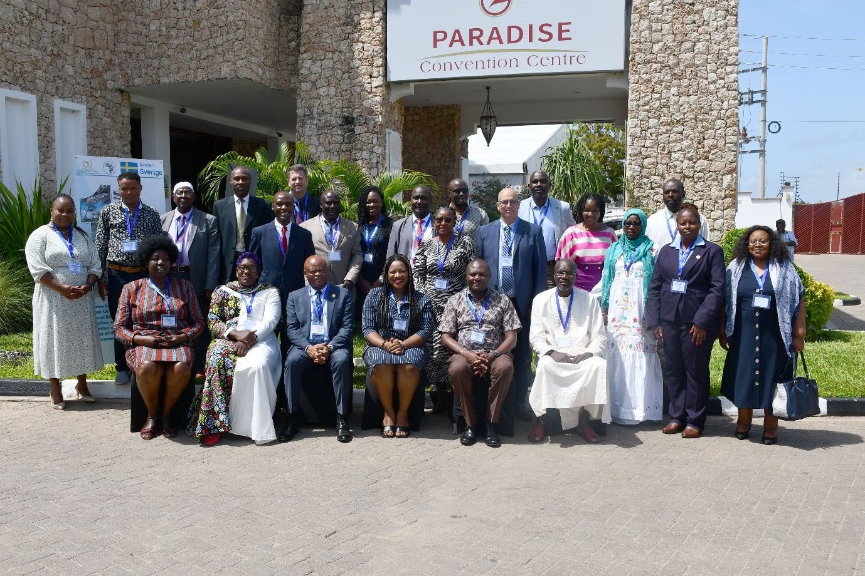
1st PTC MEETING, 20-21 MOMBASA KENYA
AU MS: Kenya, Uganda, Gabon, Egypt; RSC: Abidjan Convention and Nairobi Convention, REC : IGAD, SADC (virtual) LMEs: BCC (virtual) TP: FAO, IOC-UNESCO, WIOMSA, Swedish Embassy to the African Union; SWAM ; NGO AFMESI, NSA: AWFISHNET AU CoE: Rhodes University, SRI: COMHAFAT
AU-IBAR

Slide 3
RECOMMENDATIONS FROM THE 1st PTC
 | Recommendation | Action implemented
1 | Director of AU-IBAR should be the chair of the PTC | This recommendation has been effected the Director is now the Chairperson of the PTC
2 | Protection, conservation and management of both marine and inland water bodies should be considered as priority in the aquatic biodiversity conservation project, and the project should explore synergies with existing initiatives by BCC, SADC, Abidjan Convention, Nairobi Convention, IOC/UNESCO, PRCM, FAO, AFMESI, among other initiatives; | There is ongoing collaboration with WIOMSA on transboundary MPA; Abidjan convention on MSP; BCC and CCLME on information sharing on activities; potential for collaboration with SADC on regional MCS
10 | There is need to establish mechanisms for collaboration with partner institutions for implementation of the aquatic biodiversity project. For example, Nairobi Convention, Abidjan Convention, BCC, SADC among others;

Slide 4
RECOMMENDATIONS FROM THE 1st PTC
 | Recommendation | Action implemented
3 | There is need to support Research, Innovation and Education within the AU ABES. There is need to mobilize financial resources needed to support implementation of the BE thematic areas in particular, component on Research and Education – Building knowledge base and platforms; and Supporting adequate research in partnership with Pharmaceuticals and biotech companies that will contribute to bridging capacity gaps | Collaboration with WIOMSA on transboundary MPA; Project anticipates collaboration with UCC on climate change mitigation; Prof Fulanda from Pwani University was hired to train predetermined negotiators for effective participation in global fora relating to aquatic biodiversity and environment management Prof Jen Adetola (Ibadan University) was hired to develop a continental framework for sustainable coastal, marine and mining activities for minimal impact on aquatic and environment Prof Fulanda (Pwani University) was hired to develop national (Kenya) strategy for sustainable coastal, marine and mining activities for minimal impact on aquatic and environment Collaboration with KEMFRI to support communities on climate change mitigation

Slide 5
RECOMMENDATIONS FROM THE 1st PTC
 | Recommendation | Actions implemented
4 | The Regional Blue Economy Strategies should be aligned to the AU Africa Blue Economy Strategy (ABES) and cascaded down to AU-MS that will support institutionalization and domestication of Country needs and priorities within the Blue Economy | SADC Regional Blue Economy is aligned to ABES which can be cascaded to SADC AU member states. EAC Regional Blue Economy Strategy is aligned to ABES ECCAS Regional Blue Economy Strategy is aligned to ABES COMESA Regional Blue Economy Strategy is aligned to ABES IGAD Regional Blue Economy Strategy is aligned to ABES
5 | RECs, RFBs and RSCs among others need to seek and promote collaboration that is necessary to leverage on available resources, complement and supplement each other to cut down on research, operation and management cost; | LVFO on rolling out joint management measures for conservation of freshwater transboundary aquatic biodiversity; EU Regional Project EcoFish and IGAD on Knowledge and information sharing event; FCWC on MCS training and provision of MCS Equipment WIOMSA and Nairobi Convention on the Transboundary management of marine ecosystems between the Republic of Kenya and the United Republic of Tanzania KEMFRI/Mikoko Pamoja on climate change mitigation where restoration of Mangrove forest in degraded ecosystems is being undertaken Collaborating with Abidjan Convention on transboundary MSP Seeking collaboration with COREP on transboundary marine ecosystem management for conservation of aquatic biodiversity and environment

Slide 6
RECOMMENDATIONS FROM THE 1st PTC
 | Recommendation | Actions implemented
6 | Communities, NSAs, Private sector need to be sensitized on Blue Economy initiatives and benefits. There is need to develop tools that are required to address environmental issues. The tools could utilize EIA, SEA, Health Safeguards, among others, to ensure sustainability of the blue economy growth. There is need to scale up knowledge platforms including involvement of local and coastal community participation | A knowledge fair share on blue economy concept, African Blue economy strategy, conservation of aquatic biodiversity and environment was organized. The participants included mainly Non-State actors, private, women organizations Policy briefs developed and decimated on the following: Institutionalization of MSP Lessons and Best Practice for establishing and governing national and transboundary MPAs Communities established as a Community Resource Management Area (CREMAs) – to strengthening local communities’ participation in Mangrove conservation and restoration thus Training and Capacity building
7 | Some AU-MS need to be supported to collect data and identify existing data on institutional abilities and individual technical capabilities that will carry out MSPs | Virtual meeting, on studies conducted, was organized and MSP concept elaborated including the elements, requirements or criteria, challenges for institutionalizing national and regional MSP Supporting Togo and Benin to institutionalize MSP

Slide 7
RECOMMENDATIONS FROM THE 1st PTC
 | Recommendation | Actions implemented
8 | AU-IBAR should fast track experts needed to carry out the assignment on MCS to avoid further delays in implementing the project | This assignment has already been conducted; studies completed in (i). West, Central and Northern regions and (ii). ongoing in the East and Southern regions
9 | There is need to support Cost Benefit Analysis research required to determine the benefits of MSPs and contribute to Strategic interventions for financing of MSPs as useful planning tools for Regional entities | A related document was shared with PSC meetings last meeting on cost-benefits of MPAs
11 | There is need to expand the African Fisheries Reform Mechanism (AFRM) to engage relevant Ministries and actors in charge of aquatic environmental management | All the Activities that we conduct we involve key Ministries in charge aquatic environmental management; The LME-based institution, BCC, UNEP Bodies, Abidjan convention and Nairobi Convention participate in the GA meetings of APRIFAAS

Slide 8
RECOMMENDATIONS FROM THE 1st PTC
 | Recommendation | Actions implemented
12 | There is need to prioritize IUU with heightened awareness on the unreported and unregulated (UU) fishing | This was achieved during training on MCS, in collaboration with FCWC, where issues of unreported and unregulated fishing activities were bought to bear on participants from Benin, Cote D’Ivoire, Togo, Ghana, Liberia and Nigeria
13 | The need to build capacity of communities to support the Government Agencies and enhance MCSs (on a basis of co-management). In addition, build capacity of the AU-MS to develop inland water and aquatic institutions for Spatial Planning (SPs), in addition, AU-MS should consider using land-sea interface management tools for inclusive capacity building. And AU-IBAR should identify details of WTO commitment for capacity building on IUU fishing | Community-based MCS was included in the training course (with FCWC) for conservation of aquatic biodiversity and environmental protection The studies conducted by the project on MSP covered shared freshwater ecosystems

Slide 9
RECOMMENDATIONS FROM THE 1st PTC
 | Recommendation | Actions implemented
14 | AU-IBAR in partnership with IGAD, and other collaborating institutions should create a knowledge sharing mechanism with possibility of linking up databases to enhance sharing and dissemination of information. In addition, develop knowledge sharing platform on inland Blue Economy to bridge the knowledge gap | This was accomplished. AU-IBAR, IGAD and Eco- Fish conducted a successful Knowledge sharing fair in Mombasa The knowledge sharing platform on Inland blue economy is yet to be established ?
15 | The need to recognize that conservation of aquatic biodiversity in the Blue Economy is underpinned by some sound taxonomic studies which are required for SPs, MSPs, MPAs, EIAs, among others. | AU-IBAR established the regional gene banks including aquatic animal. Aquaculture action plan - Identify and develop selected centre(s) as regional gene bank for maintaining improved germ-plasm for selected species Dedicated session in AFRAQ 23 on aquatic animal genetics

Slide 10
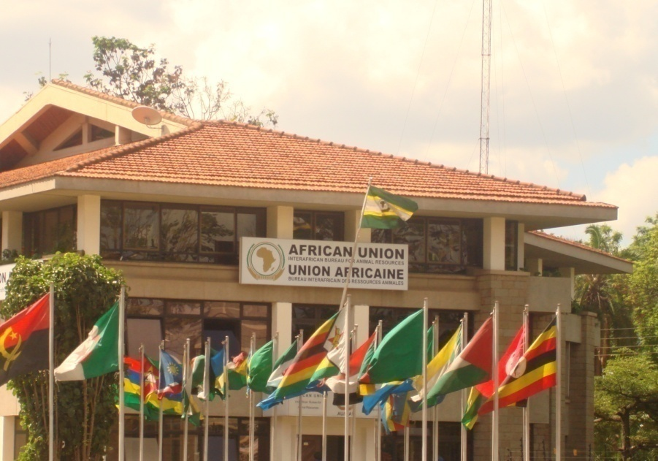
THANK YOU
Providing Leadership in the Development of Animal Resources for Africa

