Slide 1



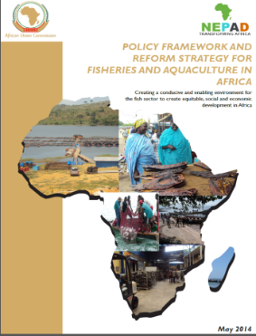

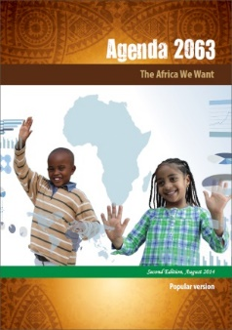

“CONSERVING AQUATIC BIODIVERSITY IN AFRICAN BLUE ECONOMY”
2nd Project Technical Committee Meeting
Project Monitoring & Evaluation Presentation
13 – 14 September 2023, Naivasha, Kenya
By:
Rasugu K. Oroko, Planning and Monitoring Officer, AU-IBAR

Slide 2
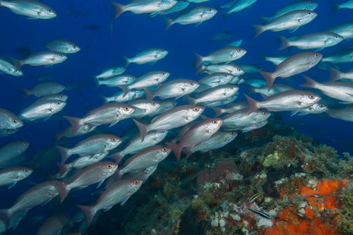
Presentation Outline
Development of Aquatic Biodiversity Project
Project Logframe
Progress towards achievement of Performance Targets
Scoping Mission to MSs Report
Recommendations & Way Forward

Slide 3
CONSERVING AQUATIC BIODIVERSITY IN AFRICAN BLUE ECONOMY WAS DEVELOPED THROUGH THE Theory of change

Slide 4
THEORY OF CHANGE – “Enhancing institutional capacity of African Union Member States and Regional Economic Communities on the
conservation and protection of aquatic biodiversity in the context of Africa Blue Economy Strategy”
PROBLEM ANALYSIS
RESPONSE TO PROBLEM
EXPECTED RESULTS
IMPACT: Sustainable conservation and utilization of aquatic biodiversity and marine environments for food, improved livelihoods and income.
EFFECTS/CONSEQUENCES:
-Livelihoods for aquatic-resource dependent population threatened due to:
-Over exploitation fisheries and other aquatic resources for food, livelihoods and income
- Environmental degradation
- Loss of aquatic biodiversity
GOAL: To enhance policy, regulatory frameworks and institutional capacities of AU member states and regional economic communities to sustainably utilize, conserve and protect aquatic biodiversity and ecosystems
OUTCOMES:
Policies and regulations for MSs and RECs are harmonized with regional and international instruments
Improved capacities for sustainable management, utilization, protection and conservation of living aquatic resources and related ecosystems
Improved coastal and marine tourism, climate change resilience, infrastructure
KEY ISSUE / PROBLEM: Weak institutions, policy, regulatory frameworks and Capacities of RECs and Member States on the utilization, conservation and protection of aquatic biodiversity and ecosystems
STRATEGIC OBJECTIVES:
To support the ratification and/or alignment of relevant international/regional instruments related to blue economy thematic areas (with specific reference to managing, protecting and conserving biodiversity);
To optimize the management, utilization, protection and conservation of living aquatic resources and ecosystems while minimizing conflicts with other blue economy sub-thematic areas;
To strengthen Coastal and Marine Tourism, Building Climate Change Resilience and Infrastructure, Managing, Protecting and Conserving Marine Ecosystems and Environment
To strengthen gender inclusivity in aquatic biodiversity conservation and environmental management
OUTPUTS:
1.1: Enforceable fisheries regulatory frameworks and effective and sustainable regional Monitoring Control and Surveillance systems developed and implemented
1.2. The establishment of national, regional and sub-regional cooperation in the aquatic biodiversity and ecosystems blue economy thematic areas supported
1.3. Capacities for rehabilitating and/ or securing threatened fishing rounds/zones, prevent land-based pollution and degradation of aquatic environments strengthened.
2.1. MSs supported to actively participate in relevant aquatic ecosystem global fora and regimes (and programmes)
2.2 Ratification and implementation by RECs and MSs of conventions and agreements - related to conservation of biodiversity from perspectives of ABES themes fisheries, shipping, coastal tourism, and offshore renewable energy supported.
3.1. Integrated and gender inclusive strategies for sustainable environmental / ecosystem management for RECs and MSs developed and domesticated.
3.2. A national and regional policy framework and action plan to balance the use of ecosystems including Implementing Ecosystem Approach management that accounts for ecological interactions including by-catches, increasing and enhancing carbon sinks through restoration of wetlands, mangroves, and seagrass developed and implemented
3.3 interventions for an integrated strategic framework for regional cooperation on sustainable coastal & marine tourism implemented
3.4 Strategies for resilient infrastructure and ecosystem services incorporating international best practices on Disaster Risk Reduction (DRR) and Carbon Sequestration to enhance climate adaptation, mitigation, resilience and standards developed and implemented
3.5 strategies for gender inclusivity in accordance with best practices for ecosystem based approach management embedded in the Blue Economy Strategy developed and implemented
CONTRIBUTING FACTORS (CAUSES):
- Weak and incoherent policies and regulations for sustainable conservation of biodiversity
- Limited human and institutional capacities to sustainably conserve biodiversity and ecosystems, including inability to deal with IUU incidences
- Weak partnerships, coordination, collaboration and stakeholder engagement at national, regional and continental levels
- Limited development, uptake and use of appropriate technologies
- Inadequate gender inclusion in the management of aquatic biodiversity and ecosystems
INSTITUTIONAL ARRANGEMENTS: AU-IBAR Established continental platforms and networks; Knowledge based institutions on aquatic biodiversity and ecosystems.
STAKEHOLDERS/BENEFICIARIES:
National: MSs; Local Communities, Fisheries and aquaculture biodiversity dependent communities Youth and Women,
Regional: RECs, Specialised Regional Institutions; Continental AUC (AU-IBAR), SIDA
PROJECT COMPONENTS: Activities as outlined in the project document

Slide 5
Project Logframe
The Project Logframe builds on the ToC’s results framework
It has performance indicators (and their baselines and targets) at impact, Outcome and Output levels
We use performance indicators to track progress of project implementation towards realization of results (Impact, Outcomes and Outputs)
The logframe has MoV and important assumptions..Conservation of aquatic biodiversity project Logframe 250823.docx

Slide 6
Progress towards Aquatic Biodiversity Project targets

Slide 7
Report on to scoping mission to Malawi, Tanzania and Uganda
A scoping mission was undertaken to Malawi, Tanzania and Uganda 31.07 – 08.08.2023
It sought to assess the implementation processes of the project and the extent to which project objectives and targets have been met, as well as collect stakeholder observations and recommendations
  Malawi: Gender-inclusion strategy + AWFISHNET
  Tanzania + Uganda: Transboundary ecosystems + AWFISHNET

Slide 8
Report on to scoping mission to Malawi, Tanzania and Uganda:
Key Findings - 1
Ratification / or alignment of instruments for the conservation of aquatic biodiversity is in progress:
  However, more needs to be done to raise awareness and advocacy - 56 have been identified, AU-IBAR was requested to prioritize instruments for impact
  With the support of the LVFO:
    Tanzania has finalized the ratification of the Port State Measures Agreement (PSMA) that seeks to eliminate IUUs; Uganda is moving towards ratification of PSMA.
    EAC is implementing the FAO International Plan of Action (IPOA) to Reduce IUUs as:
      Regional Plan of Action for the reduction of IUU (RPOA-IUU), and
      Regional Plan of Action to address capacity issues (RPOA-Capacity).
All MSs visited were implementing measures to curb unsustainable utilization of aquatic resources including the transboundary ecosystems approach and MCS systems
  they noted that conservation of transboundary ecosystem mechanisms would be strengthened through multi-stakeholder approaches

Slide 9
Report on to scoping mission to Malawi, Tanzania and Uganda:
Key Findings - 2
All MSs stressed on the importance of effective participation of women in fish enterprises and heighted the development and implementation of national gender-inclusion strategies in the conservation of aquatic biodiversity.
  Malawi appreciated the support of AU-IBAR in developing its national gender-inclusion strategy in the conservation of aquatic biodiversity; while Tanzania expressed the need to develop one and also a review of their national gender policy that was developed in 2016
Two mechanisms for active participation of MSs in Global initiatives related to aquatic biodiversity were developed and validated through a contract that was granted to NAFFIRI
MSs appreciated the exchange of learning and experience sharing through participation in various events planned by AU-IBAR

Slide 10
Recommendations1
Issue | Recommendation
Low ratification / or alignment rates of international instruments related to conservation of aquatic biodiversity | AU-IBAR and other technical partners to prioritize and facilitate awareness raising on the impotence of ratification and domestication of international instruments
Sharing of best practices | AU-IBAR to document and replicate best practices, such as LVFO role in the ratification of FAO’s instruments (RPOA-IUU, and RPOA-Capacity)
Development and implementation of national gender-inclusive strategies on conservation of aquatic biodiversity and ecosystems | Support development of the continental gender-inclusion strategy in conservation of aquatic biodiversity & ecosystems-aligned national strategies.
 | Work with existing national chapters of women working around aquatic ecosystems to implement gender-inclusion strategies
 | Support domestication of the ABES

Slide 11
Recommendations2
Issue | Recommendation
Implementation of study findings and recommendation | AU-IBAR should come up with a clear strategy for implementing / piloting of study recommendations
No exit strategy has been developed for the project to date | MSs visited recommended the development of an exit strategy to ensure the sustainability of project outcomes and benefits
Limited communication between AU-IBAR and stakeholders, particularly stakeholder inquiries | AU-IBAR must communicate effectively with stakeholders and respond to inquiries in a timely fashion.

Slide 12
Way forward
As at 31st August, 2023:
  only 45% of results have been realised (excludes studies that are yet to be translated into relevant policies, legislation and frameworks /models for piloting)
  USD 1.8M has been utilized; leaving a balance of USD 3.7M
  Budget for 3rd Work plan (Oct 23 – Oct 24) is USD 1.8M
MSs have requested:
  fast-tracking ratification /alignment of international instruments;
  pilot study recommendations;
  share best practices;
  domesticate the gender-inclusivity strategy
An exit strategy will be developed by end of Q1 2024
It is therefore recommended that the project be granted a One-Year No-Cost-Extension to allow for full implementation, using the projected post-Oct 2024 Balance of USD 1.9M.

Slide 13
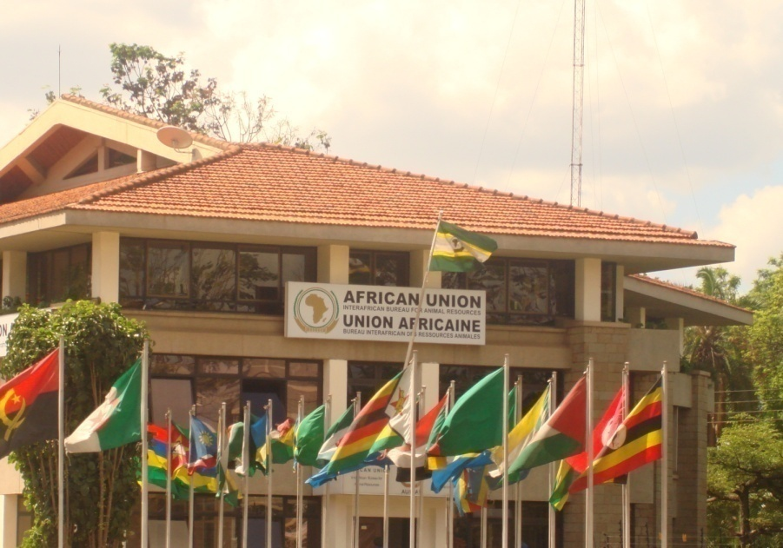
THANK YOU
Providing Leadership in the Development of Animal Resources for Africa

