Slide 1
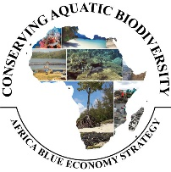


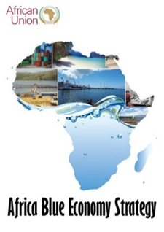
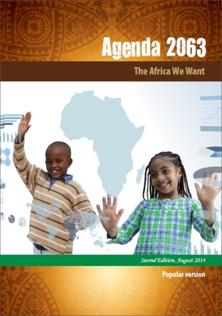

CONSERVING AQUATIC BIODIVERSITY IN AFRICAN BLUE ECONOMY
Second Project Technical Committee Meeting
PROGRESS OF IMPLEMENTATION
13-14 September 2023
Naivasha, Kenya

Slide 2
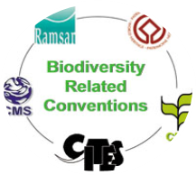
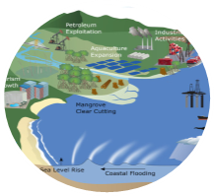
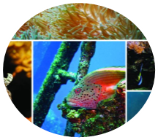
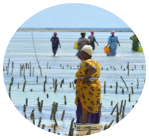
Strategic Objectives of the Aquatic Project
OBJECTIVE
To enhance the policy environment, regulatory frameworks and institutional capacities of AU Member States and Regional Economic Communities to sustainably utilize and conserve aquatic biodiversity and ecosystems.
Support AU–MS to ratify and/or align relevant International/Regional Instruments related to blue economy themes (with specific reference to protecting and conserving biodiversity)
Optimizing conservation and sustainable use of biodiversity while minimizing conflicts among blue economy sub-themes
Strengthening measures for mitigating the negative impacts of coastal and marine tourism, oil, gas, deep sea mining and climate change on aquatic biodiversity and environment
Strengthening gender inclusivity in aquatic biodiversity conservation and environmental management

Slide 3
2023 Workplan
Driving implementation of Project’s Strategic Objectives
SO1: Ratify and/or Align relevant international/regional instruments - 2 Outputs:
  Mechanisms for active participation of MSs in continental and global initiatives developed;
  Ratification and implementation of conventions and agreements supported;
SO2: Optimizing conservation and sustainable biodiversity - 3 Outputs:
  Enforceable regulatory frameworks for effective MCS systems developed;
  A framework for establishing national, regional and transboundary cooperation
  Capacities for restoring and conserving threatened aquatic biodiversity and environment strengthened.
SO3: Strengthening measures for mitigating the negative impacts of coastal and marine tourism, oil, gas, deep sea mining and climate change -2 Outputs:
  Measures for minimizing the negative impacts of climate change on biodiversity ;
  Strategies for an integrated framework for sustainable coastal and marine tourism and mining developed ;
SO4: Strengthening gender inclusivity in aquatic biodiversity conservation and environmental management-1 Output:
  Continental strategy for gender inclusivity in aquatic biodiversity and environmental management developed ;

Slide 4
SO1: Ratify and/or Align relevant international/regional instruments related to blue economy themes (with specific reference to conserving biodiversity)– USD 167730
Output/Activity | PROGRESS TO DATE
Output 1.1: Mechanisms for active participation of MSs in continental and global initiatives developed (USD 68980)
1.1:1. Enhancing effective role in regional and global aquatic biodiversity and environmental related regimes | Mechanisms for effective participation in global fora developed – relevant to conservation of aquatic biodiversity and environment management Knowledge product – Policy Note developed on mechanism for effective participation Training of predetermined negotiators to support effective participation AU MSs developed AU member states coordinated position facilitated in UN Review Conference on UN Fish Stock Agreement in May 2023, New York. The participation of Seychelles was supported to this Conference

Slide 5
SO1: Ratify and/or Align relevant international/regional instruments related to blue economy themes (with specific reference to conserving biodiversity)– USD 167730: Cont’d
Output/Activity | PROGRESS TO DATE
Output 1.2. Ratification and implementation of conventions and agreements related to conservation of aquatic biodiversity – USD 98750
1.2.1. Identify continental and global biodiversity and environmental instruments relevant to sustainable management of Africa blue economy resources | Priority continental and global instruments identified and priority actions to enhance domestication developed. Knowledge products developed – policy note on enhancing domestication Egypt, Cameroon, South Sudan, Burkina Faso supported to domesticate continental and global instruments related to conservation of aquatic biodiversity and environment management. The support to Kingdom of Eswatini pending – planned for End of September 2023

Slide 6
SO2: Optimizing conservation and sustainable biodiversity while minimizing conflicts among users of blue economy resources.– USD 1,067,600
Output/Activity | PROGRESS TO DATE
Output 2.1 Enforceable regulatory frameworks for effective and sustainable regional Monitoring Control and Surveillance (MCS) systems developed (USD 441,000)
2.1.1 Enhancing Sustainable Monitoring Control and Surveillance (MCS) Systems for conservation and protection of biodiversity: | Status of MCS systems at national and Regional levels determined Awareness enhancing workshop conducted to sensitize stakeholders on MCS systems In collaborated with FCWC, trained six member countries (Benin, Cote D’Ivoire, Ghana, Liberia, Nigeria and Togo) on MCS systems to combat IUU and for the protection of aquatic biodiversity and environment Ongoing purchase to purchase relevant MCS equipment to enhance regional capacity for MCS
2.1.2. Support the establishment of cost-effective and sustainable financial arrangements for effective regional cooperation on MCS and enforcement in selected regions | A framework for cost-effective, innovative financial systems for sustainable regional MCS systems developed for East-Southern regions of Africa; Process of identification of similar studies for West, central and Northern regions ongoing

Slide 7
SO2: Optimizing conservation and sustainable biodiversity while minimizing conflicts among users of blue economy resources.– Cont’d USD 1,067,600 –
Output/Activity | PROGRESS TO DATE
Output 2.2. A framework for establishing national, regional and transboundary cooperation on Africa Blue Economy Strategy Thematic Areas established (USD 334,900)
2.2.1. Establish regional cooperation on transboundary issues in shared aquatic ecosystems towards formulating harmonized regional frameworks on aquatic biodiversity conservation. | Framework for regional cooperation on transboundary issues for conservation of aquatic biodiversity and environment developed in shared freshwater ecosystems and marine ecosystems In collaboration with LVFO, Kenya, Uganda and Tanzania supported to develop harmonized national policy guidelines for conservation of aquatic biodiversity and environment -Lake Victoria
2.2.2. Formulate mechanisms to institutionalize Marine Spatial Planning (MSP) at national and regional levels | Guidelines for institutionalization of MSP for conservation of aquatic biodiversity and ecosystems at national and transboundary levels developed. Knowledge product developed – policy note In discussions with Abidjan Convention to support transboundary initiative between Benin and Togo

Slide 8
SO2: Optimizing conservation and sustainable biodiversity while minimizing conflicts among users of blue economy resources.–USD 1,067,600 Con’t
Output/Activity | PROGRESS TO DATE
Output 2.3. Capacities for restoring and conserving threatened aquatic biodiversity and environment strengthened.(USD 182700)
2.3.1 Support rehabilitation of depleted aquatic biodiversity and habitats | Lessons and best practices for institutionalizing MPAs at national and transboundary levels documented. Sensitization workshop conducted Knowledge product developed In collaboration with WIOMSA and Nairobi Convention, technical consultations to develop roadmap for establishing transboundary marine conservation area between Kenya and Tanzania ongoing
2.3.2 Establish Continental Centres of Excellence for capacity building on aquatic biodiversity | The process for selection of Institutions as AU Centres of Excellence in a. aquatic ecology and biodiversity conservation and b. Aquatic Ecosystems management ongoing

Slide 9
SO3. Strengthening measures for mitigating the negative impacts of coastal and marine tourism, oil, gas, deep sea mining and climate change on aquatic biodiversity and environment USD 134000
Output/Activity | PROGRESS TO DATE
Output 3.1 Measures for minimizing the negative impacts of climate change on biodiversity and environment strengthened and implemented (USD 50000)
3.1.1. Mitigate the impact of climate change on aquatic biodiversity | Studies on the negative impact of climate change on aquatic biodiversity and environment as mitigation strategies developed in Africa have been conducted and validated by stakeholders. A policy note developed The project is collaborating with KEMFRI is supporting ongoing initiatives on ‘Strengthening Conservation and Restoration of Blue Carbon Ecosystems for Community Benefits and Environmental Sustainability along Mombasa coast
OUTPUT 3.2. Strategies for an integrated strategic framework for sustainable coastal and marine tourism and mining developed (USD 84000).
3.2.1. Identify priority issues and actions for sustainable coastal and marine tourism and mining activities on aquatic biodiversity and environment and develop guidelines. | The priority issues and actions on sustainable coastal, marine tourism and mining activities identified for aquatic biodiversity conservation and environment A policy brief developed Nigeria, Kenya and Gabon to develop sustainable coastal, marine tourism and mining activities’ masterplans and regulatory frameworks for conservation of aquatic biodiversity and environment

Slide 10
SO4. Strengthening gender inclusivity in aquatic biodiversity conservation and environmental management
– USD 60000 – cont 1.
Output/Activity | PROGRESS TO DATE
Output 4.1 Continental strategy for gender inclusivity in aquatic biodiversity and environmental management developed USD 60000
4.1.1. Support development of a continental strategy for inclusion of gender in aquatic biodiversity and environmental management 4.1.1.3. Technical support to 3 AU MS to develop all inclusive and deliberate biodiversity strategies as important entry points for women’s empowerment | A continental strategy for inclusion of gender in aquatic biodiversity and environmental management was developed. A policy brief developed The Republics of Malawi and Ethiopia supported to develop gender-sensitive strategies for the conservation of aquatic biodiversity and environmental management, based on the continental strategy
Mapping of ongoing environmental based-NGOs focusing on conserving biodiversity and environment protection and technical support to strengthen gender-sensitive workplans to enhance the role of women and youth in biodiversity protection and environmental governance | In collaboration with the International Union for Conservation of Nature (IUCN), the project is supporting implementation of Gender specific activities to enhance sensitive governance structures of the Community Resource Management Area (CREMA) establishments in the Keta Lagoon Complex along the Eastern Coast of Ghana. This includes: co-funding the drafting of a clear gender disaggregated roles management plan for the CREMA and funding some gender-specific livelihoods activities in the management plan

Slide 11
Challenges and Emerging Issues
The implementation of the project continues according to the workplan but there are challenges.
The difficulty encountered in identification of suitable experts in the first year to conduct studies has hugely impacted progress in the second year.
These studies were mainly designed to inform or guide the intervention of the project in supporting regional or national institutions.
Piloting of critical outcomes of studies have therefore been delayed
Thus it is fair to state the implementation of certain activities or concluding the implementation of certain activities would certainly go beyond the current implementation period of the project.
.

Slide 12
Challenges and Emerging Issues Cont’d
Demand on the project: Whereas, the project has provided support to AU member states or collaborated with some regional institutions, there is increasing demand by AU member states and regional institutions for support to enhancing aquatic biodiversity conservation and environmental management and request for other critical areas in BE development
Forging partnerships in rolling out project outcomes: The project document acknowledged existence of other partners working in the same space with the project and thus a need for collaboration. Due to AU procedures, developing a roadmap for collaboration with institutions on implementation of activities has often proved to be a challenge resulting in some delays
Utilizing project outcomes for policy reform in conservation of aquatic biodiversity: With the finalization of various study reports, a key strategic challenge is utilization of project results for policy reform in AU member states or institutions for aquatic biodiversity conservation and environment.
The project has established that MSP has remained an academic concept in most AU MSs and regional institutions. The initiative on MSP is still at a rudimentary level and substantial support is needed to address technical and political challenges that are constraining MSP institutionalization at national and transboundary levels.
Thus project has discovered that interventions regarding transboundary issues e.g. MSP or MPAs, between two or more coastal countries, requires total political commitments or consensus between countries.
Hence it is elemental to secure interests of participating countries as a necessary condition

Slide 13
Recommendations
To expand the project scope to cover studies and implementation of recommendations in more countries and regional institutions
To allow more time for project implementation in order to consolidate achievements and also address gaps or emerging issues
To enhance political ownership through support for broader consultative processes at national and regional levels for reports that have been validated by experts
Develop addendum to factor in budget for production and dissemination of report or publications
Allow for no-cost extension of the project to ensure comprehensive implementation for the socio-economic benefits of the citizens of this continent

Slide 14
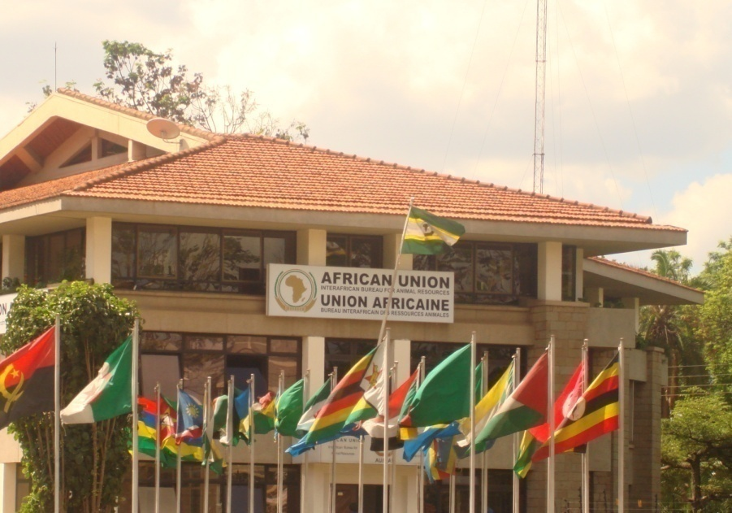
THANK YOU
Providing Leadership in the Development of Animal Resources for Africa

