Slide 1



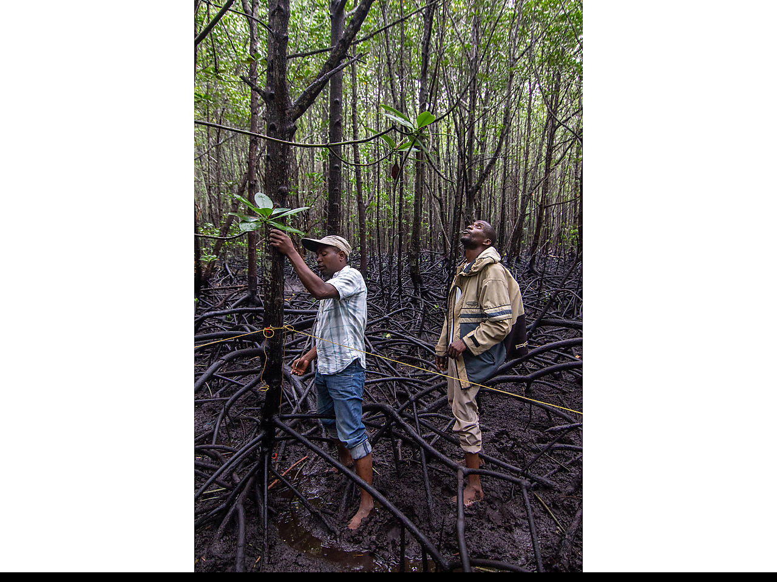
Communications & Knowledge Management Implementation Status Report
CONSERVING AQUATIC BIODIVERSITY 2ND PROJECT TECHNICAL COMMITTEE MEETING

Slide 2

The plan addresses the 4 strategic objectives aligned to the conservation and protection of aquatic biodiversity and ecosystems in the context of the Africa Blue Economy Strategy.
Ratifying and/or aligning relevant international/regional instruments related to blue economy themes (with specific reference to protecting and conserving biodiversity)
Optimizing conservation and sustainable biodiversity while minimizing conflicts among users of blue economy resources
Strengthening measures for mitigating the negative impacts of coastal and marine tourism, oil, gas, deep sea mining and climate change on aquatic biodiversity and the environment.
Strengthening gender inclusivity in aquatic biodiversity conservation and environmental management

Slide 3
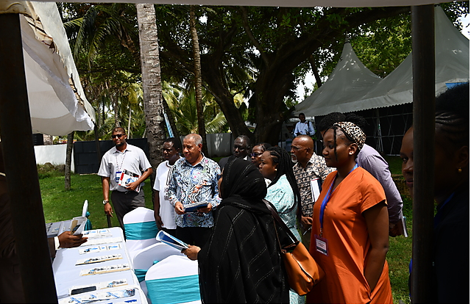
Objectives
  Raise awareness on aquatic biodiversity conservation within the context of the Africa Blue Economy Strategy.
  Advocate for aquatic biodiversity conservation (via research), policies, and best practices.
  Empower Science Communicators and partners to engage in better communication on conserving aquatic biodiversity.
  Facilitate networking and knowledge transfer among stakeholders.
  Align information resources and tools for stakeholder use.

Slide 4


The Communication Plan recognises two supporting elements supporting the three objectives. These relate to:
Communications
Knowledge Sharing
Raising public awareness on value of aquatic biodiversity by offering action perspectives to societal
stakeholders
Increasing coherence and cooperation on continent-wide biodiversity initiatives through knowledge
sharing

Slide 5
Responsibility Entities for Communications (people/ institutions)
Communication Officer
Consultants
Knowledge Management
Researchers/ Project Team
Stakeholder/ Partners
  Website management (input, maintenance,
  Photo albums database)
  Media engagement
  newsletter production,
  conference promotion and other exhibitions.
  Capacity building
  Writing,
  Editing
  Photography project management
  Promotional
  materials, synthesis reports
  Videos).
enhancing networking and knowledge sharing that aims to develop relationships and networks with, among, and between producers and
users of knowledge by providing linkages, knowledge sources, and in some cases knowledge itself.
Alll have a role
to play in communicating the projects research outputs. Researchers will work
closely with the Knowledge Management and Communication consultant(s).
Use of stakeholder platforms for joint dissemination of messages and promoting
one voice

Slide 6
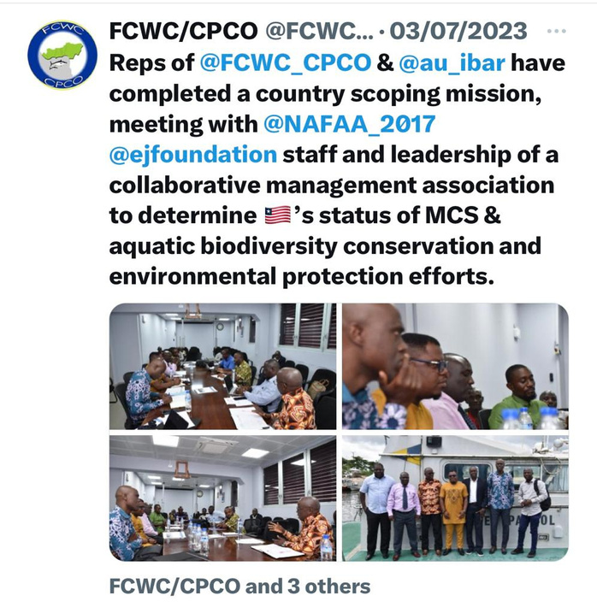
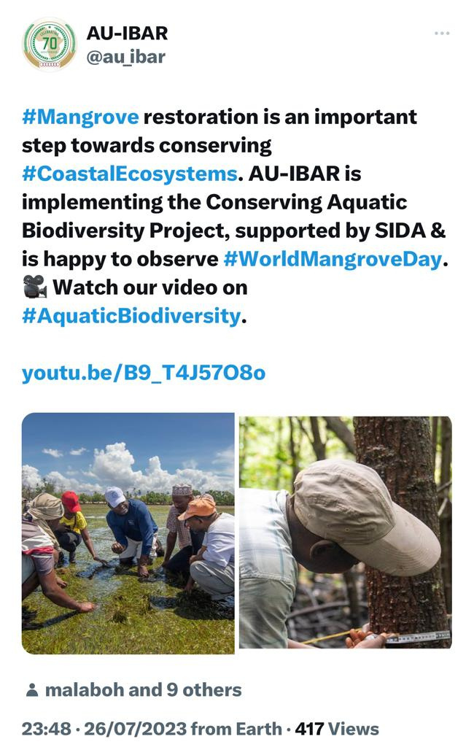
Action 1:
Identify, develop and use the right mix of communication channels and tools to promote advocacy surrounding the conservation of aquatic biodiversity issues
  Campaigns & Social Media – promoting One Voice - e.g. ACS; Knowledge Share Fair (IGAD & ECOFISH); International Day for Biological Biodiversity; World Mangrove Day
  Project Microsite
  23 - Media Engagement & partnerships
  (in-country support; including aggregators)
www.reallygreatsite.com

Slide 7
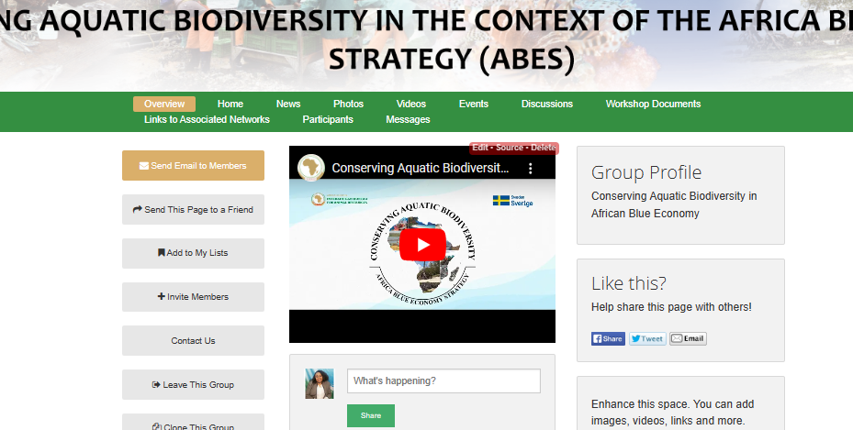
Action 1:
Identify, develop and use the right mix of communication channels and tools to promote advocacy surrounding the conservation of aquatic biodiversity issues
  E Platform
  News; blogs; calendar; documents; videos; photos; various access levels
https://networks.au-ibar.org/show/conserving-aquatic-biodiversity-in-african-blue-economy
https://networks.au-ibar.org/show/fisheries-3

Slide 8
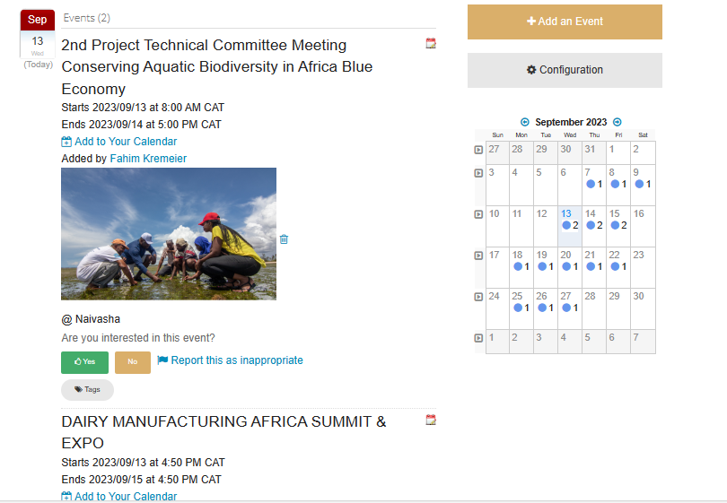
Action 1:
Identify, develop and use the right mix of communication channels and tools to promote advocacy surrounding the conservation of aquatic biodiversity issues
  Repository for Project Documents and research outputs:
  http://repository.au-ibar.org/handle/123456789/1169
  Calendaring:
  https://networks.au-ibar.org/show/au-ibar/calendar
  https://networks.au-ibar.org/show/fisheries-3/calendar
www.reallygreatsite.com

Slide 9
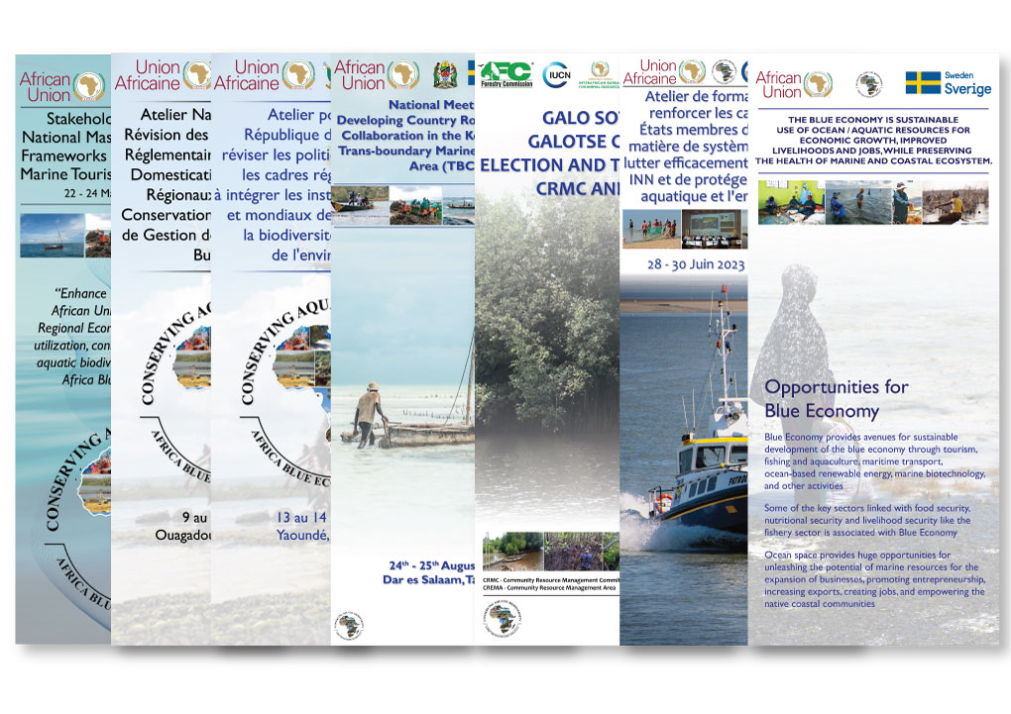
Action 1:
Identify, develop and use the right mix of communication channels and tools to promote advocacy surrounding the conservation of aquatic biodiversity issues
  Events & Visibility
www.reallygreatsite.com

Slide 10
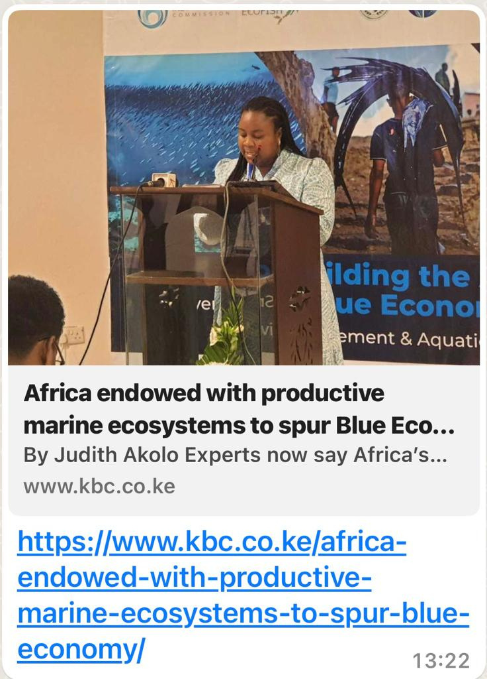
Action 2:
Develop and implement capacity building and awareness to media
partners and stakeholders on issues surrounding conserving aquatic biodiversity
Media engagement opportunities have been used as avenues to strengthen familiarisation and reporting on
aquatic biodiversity management.
  E platform used for knowledge sharing

Slide 11
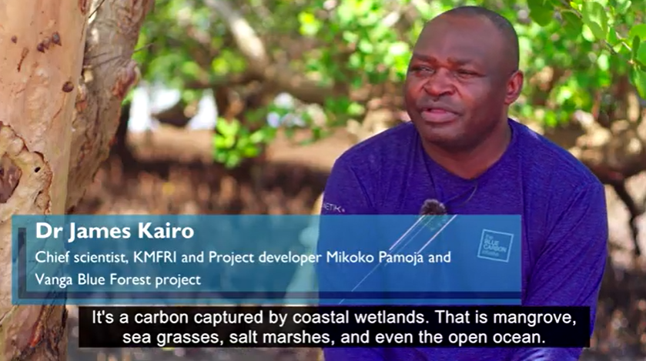
Action 3:
Upscaling of best practices on aquatic biodiversity issues
Project documentary incorporating stakeholder testimonials & best practices on aquatic biodiversity initiatives:
Fisheries Committee for the West Central Gulf of Guinea - FCWC, (Tema, Ghana);
Mikoko Pamoja (Gazi Bay, Kenya);
Transboundary Initiative and Vanga Blue Forest Filming (Vanga, Kenya);
Western Indian Ocean Marine Science Association (WIOMSA)
Kenya Marine Fisheries Institute.
Abridged version: https://www.youtube.com/watch?v=B9_T4J57O8o
12 minute version:
https://www.youtube.com/watch?v=P7i-R5y1M5Y&t=71s

Slide 12
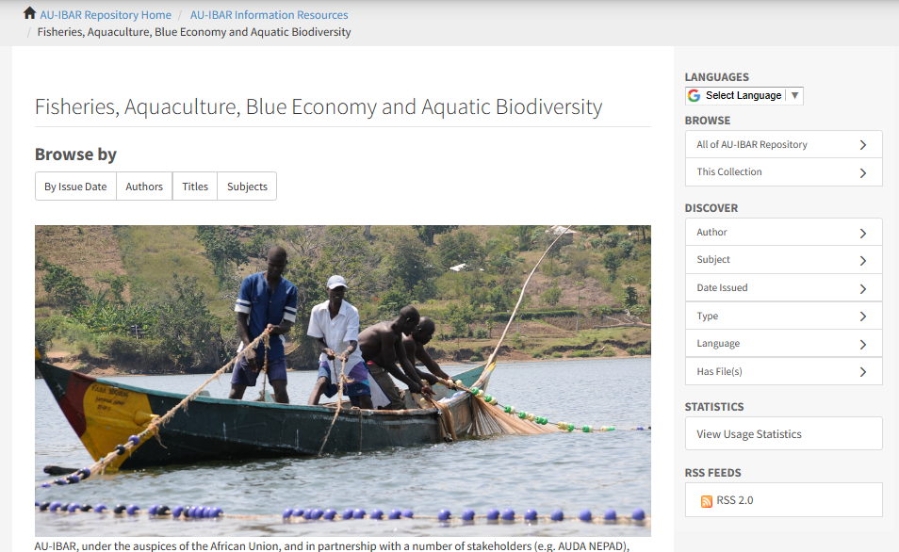
Action 4:
Strengthen networking and knowledge sharing among networks and stakeholders to ensure better collaboration on aquatic biodiversity issues
Use of AU-IBAR E Platform & Repository for:
  Calendaring
  Photo albums & workshop presentations
  Document repository
https://networks.au-ibar.org/show/conserving-aquatic-biodiversity-in-african-blue-economy
http://repository.au-ibar.org/handle/123456789/1169

Slide 13
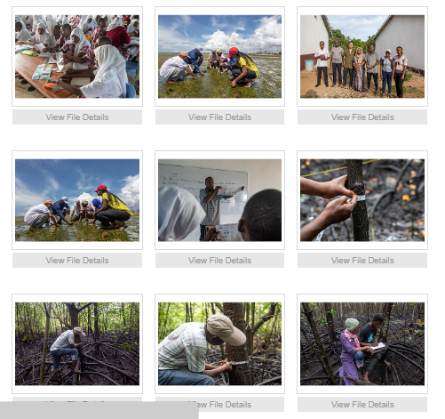
Action 5: Review communication plan annually
Did we implement actions outlined in the plan?
• Have we achieved our objectives?
• Did we reach the right audience?
• Did we use the right channels and tools?

Slide 14
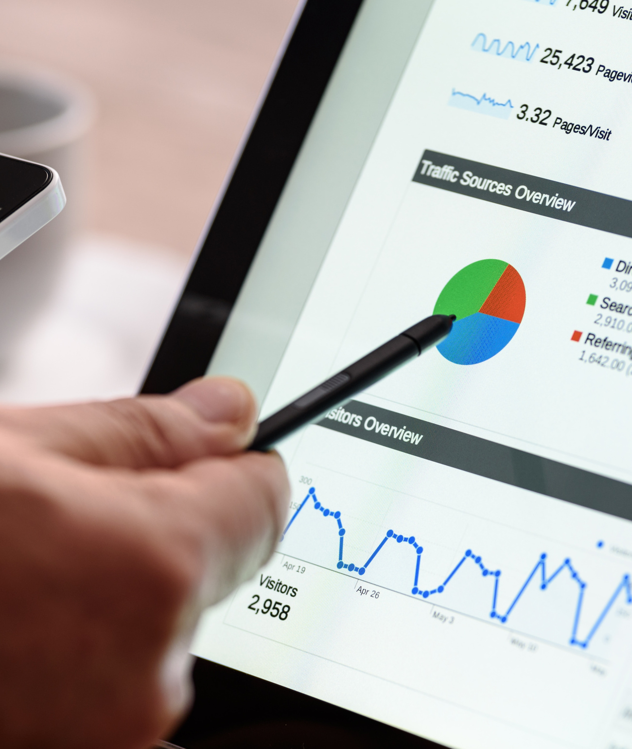
Impact
Inncrease in types dissemination channels used & users/ readers
Increase in engagement – increase in followers; media; institutions & cooperating partners & staff engagement
dissemination widened through various partnerships; such as media and institutional
One-stop information reference points for knowledge retention
However…

Slide 15
Challenges
engagement
information literacy
Lower engagement in general from the continent
Low levels of information literacy (information database searching; including media reporting – difficult concepts)
non-English language speakers
moderators & joint resources
Lower engagement from non-English language speakers
champions to engage in low-cost communication and knowledge management
www.reallygreatsite.com
Presented By : Larana Corporate

Slide 16
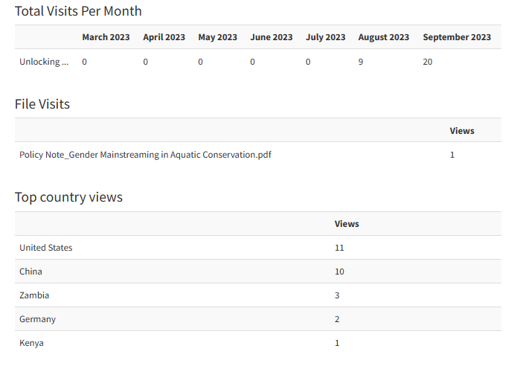
Example
analytics
View ore
www.reallygreatsite.com

Slide 17
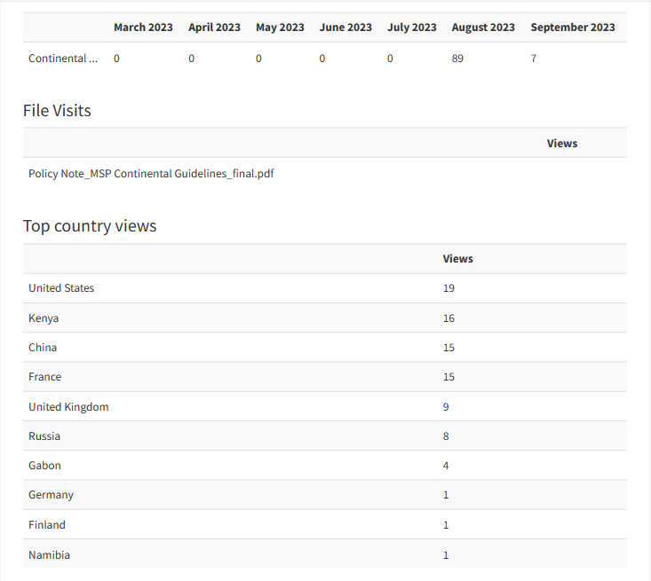
Example
analytics
View ore

Slide 18
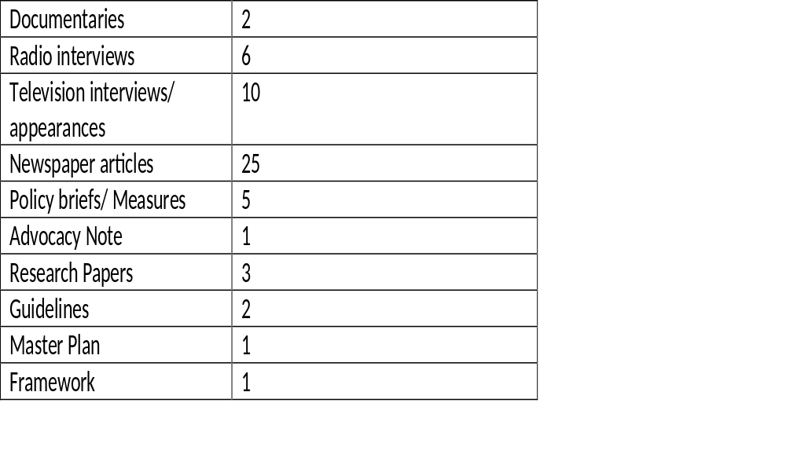
Research & communication outputs
Guidelines
3.6%
Documentaries
3.6%
Research Papers
5.4%
Radio interviews
10.7%
Policy Briefs/ Measures
8.9%
Television interviews/ appearances
17.9%
Newspaper articles
44.6%

Slide 19
Future Plans
Knowledge translation
Information literacy
audience specific localized content
Testimonials – IUCM, Community Resource Management Area (Gender/ AWFISHNET); Joint coverage – FCWC;
Briefs – newsletters
information literacy (searching in specialized information databases;; including media reporting; terminologies and glossary compilation
language Coverage
Moderators & shared resources
Identify champions to engage in low-cost communication and knowledge management initiatives and use of information platforms
undertake joint campaigns/ programmes with partners
Integrate translation modules on AU-IBAR website; encourage mechanism of knowledge sharing in French content
www.reallygreatsite.com
Presented By : Larana Corporate

Slide 20



Thank You
WWW.AU-IBAR.ORG
REPOSITORY.AU-IBAR.ORG
NETWORKS.AU-IBAR.ORG

