Slide 1
Aquatic Biodiversity Conservation and Environmental management in Transboundary Freshwater Ecosystems - Supporting national Strategies – Pilot Study in Lake Victoria shared ecosystems
Presented By:
RUKUUNYA EDWARD
LVFO, Director Fisheries Management and Development
SECOND PROJECT TECHNICAL COMMITTEE MEETING CONSERVING AQUATIC BIODIVERSITY IN AFRICA BLUE ECONOMY 13 - 14 September 2023 Naivasha, Kenya

Slide 2


Presentation Outline
A
A
Introduction
B
Supporting National Strategies
B
D
C
C
Gaps
C
D
Conclusion
Notes:
INTERNAL AUDIT: Strategy

Slide 3
Introduction
Transboundary aquatic ecosystems are water bodies that cross or border two or more countries and are shared by different jurisdictions and stakeholders.
They include rivers, lakes, wetlands, groundwater aquifers, and coastal and marine areas.
Benefits
  Water supply, Food production, Hydropower generation
  Climate regulation, Recreation, Cultural values
  Rich in diversity both flora and fauna
  Economic and strategic importance for regional integration and development

Slide 4
Introduction
Aquatic Biodiversity Conservation and Environmental management in Transboundary Freshwater Ecosystems involves managing multidimensional challenges and threats
  Pollution
  Overexploitation
  Habitat degradation
  Invasive species
  Climate change
  Conflicting interests among users and countries
  Effect on health and sustainability
  Risks to the ecological integrity and resilience of these transboundary aquatic ecosystems
  Risk to the livelihoods and security of the people who depend on them
This calls for development and implementation of Policy Measures and Strategic Actions for Conservation of Aquatic Biodiversity and Environmental Sustainability

Slide 5
Supporting National Strategies - – Tanzania, Kenya and Uganda
AUIBAR has supported and in-depth review/study that assessed transboundary freshwater ecosystems in the Africa region to help in developing a framework for management of transboundary freshwater aquatic ecosystems for conservation and joint action plans;

Slide 6
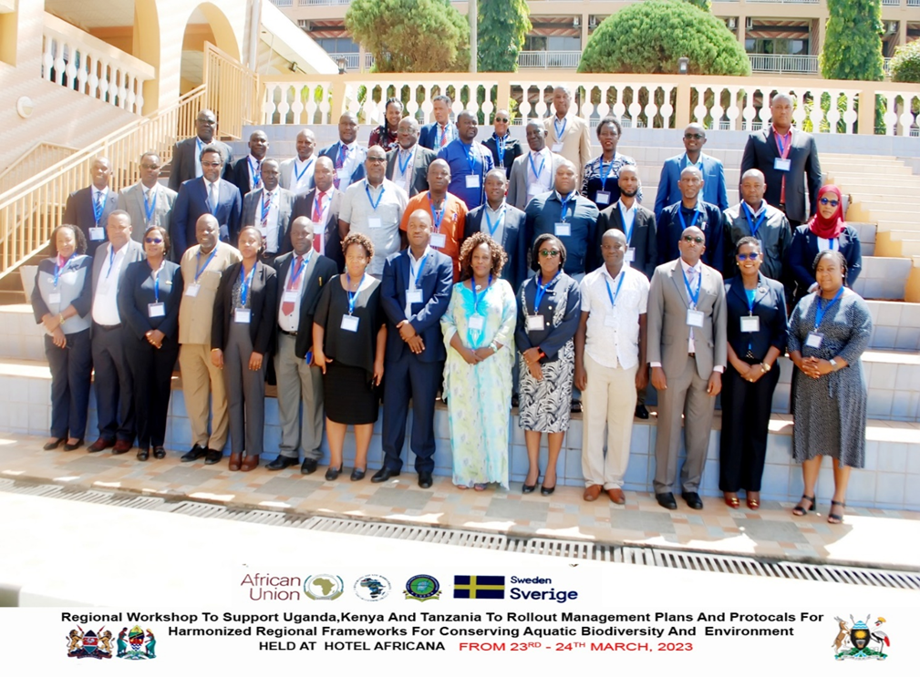
Supporting National Strategies - AUIBAR- LVFO collaboration
Supported development and roll out of policy guidelines and regulatory frameworks for the consolidated national strategy on conservation of aquatic biodiversity and environmental management

Slide 7
Supporting National Strategies - National Strategic Model
Vision
Mission
Core Values
Key Result Areas
Strategic Objectives
Strategic Goals and Actions
Proposed management strategies

Slide 8
Supporting National Strategies - National Strategic Model
Implementation and Coordination Framework
Role of Government institutions
Roles of Private sector and non-State actor
Roles of Regional Bodies
Implementation Monitoring and Evaluation
Monitoring and Evaluation Institutional Framework
Monitoring and Evaluation Reporting

Slide 9
Supporting National Strategies Vision, Mission and Core Values
Vision - Tanzania
A rich aquatic biodiversity Lake Victoria Basin for the present and future generations
Vision - Uganda
Vision Kenya
A Sustainable Aquatic Biodioversity with Improved Livelihood in the Lake Victoria Region
A sustainable freshwater biodiversity for Blue Economy development in the Lake Victoria Region

Slide 10
Supporting National Strategies Vision, Mission and Core Values
Mission - Tanzania
To enhance management of aquatic living resources and protection of the environment for a sustainable Regional economic growth, social equity and environmental integrity
Mission - Kenya
Mission - Uganda
To facilitate conservation of freshwater biodiversity for accelerated Blue Economy in Lake Victoria region.
A To reduce aquatic biodiversity losses for enhanced livelihoods in the Lake Victoria Region

Slide 11
Supporting National Strategies Vision, Mission and Core Values
Core Values - Tanzania
Participatory Approach
Social and Equity
Ecosystem Approach to Fisheries
User Pays Principle
Core Values - Uganda
Participatory Approach
Social and Equity
Ecosystem Approach to Fisheries
User Pays Principle -
Transparency and Accountability:
The Precautionary Principle:
Sustainable Development:
Human Rights and Inclusiveness: .
Collaboration and Partnership:
Core Values - Kenya
Circular economy
Environmental
Good Governance
Equity and equality in resource access
Cooperation and Partnerships
Inclusivity and Participation
Precautionary approach
Polluter pays principle
Opportunity cost

Slide 12
Gaps
There is need to validate the developed policy guidelines and regulatory frameworks for the consolidated national strategy on conservation of aquatic biodiversity and environmental management.
There is need to involve Burundi and possibly Rwanda to also have developed policy guidelines and regulatory frameworks for the consolidated national strategy on conservation of aquatic biodiversity and environmental management

Slide 13
Conclusion
More support is required to address the above gaps but also in supporting EAC Partner States in implementation of the national strategies as set in the policy frameworks

Slide 14







