Slide 1
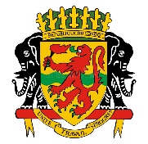
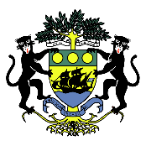

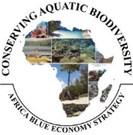

Enhancing sustainable Governance of
transboundary MPA between Rep of Gabon and
Rep of Congo
Dr. Edéya Orobiyi Rodrigue Pelebe
Dual Degree PhD in Fisheries and Aquaculture (Benin) and in Hydrobiology (Côte d’Ivoire)
MPA Consultant
Researcher, Part-Time Lecturer and International Consultant
1. Research Laboratory in Aquaculture and Aquatic Ecotoxicology, Faculty of Agronomy , University of Parakou, Benin
2. Africa Centre of Excellence in Coastal Resilience, Centre for Coastal Management, University of Cape Coast, Ghana
peleberodrigue@yahoo.fr or rodrigue.pelebe@ucc.edu.gh
07 October 2024, Mombasa, Kenya

Slide 2
Presentation Outline (1/1)
1
Rationale for the study, framework and deliverables
2
Clarification of the concept of MPAs for the study
3
Overview of MPAs in Central Africa, Congo and Gabon
4
Institutional and Governance Challenges of MPAs in Central Africa
5
The Mayumba-Conkouati Trans-boundary Park (PTMC) between Rep of Gabon and Rep of Congo
6
Key recommendations and priority actions for enhancing the implementation and governance of the PTMC
7
Cited References

Slide 3
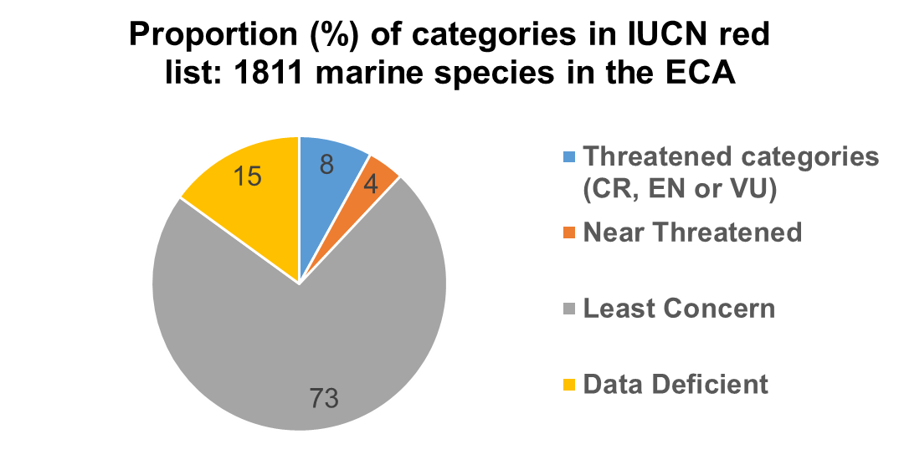
1-Rationale for the study, Framework and Deliverables (1/4)
ECA: Eastern Central Atlantic (West and Central Africa)
Pollution
Habitat degradation and loss
Climate Change
145 species
THREATS TO MARINE BIODIVERSITY
Illegal, Unreported and Unregulated (IUU) Fishing & Weak MCS capacity
Inadequate policy responses, legislation and enforcement
From Polidoro et al. (2017)

Slide 4
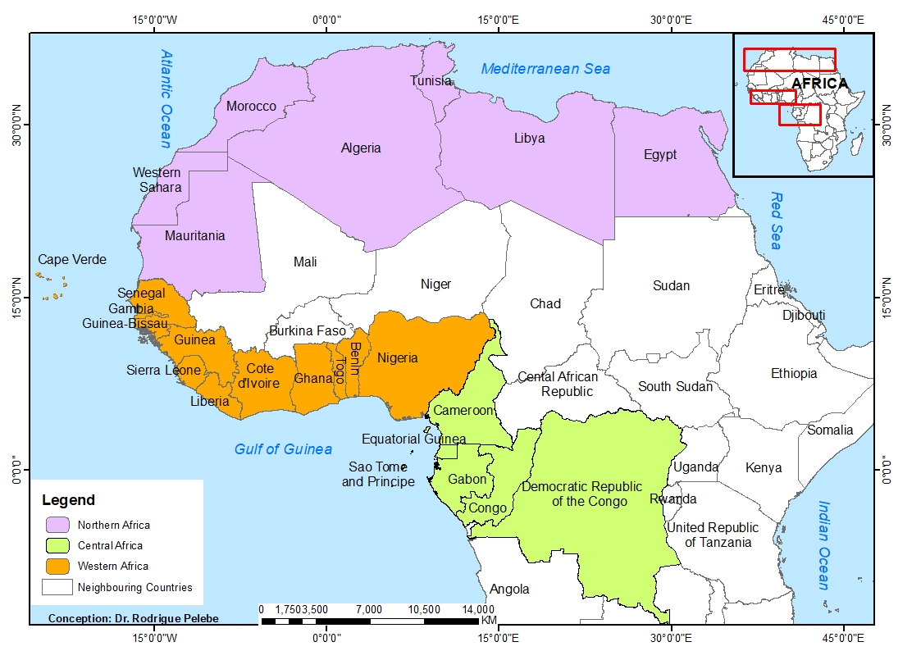
1-Rationale for the study, Framework and Delivrables (2/4)
The creation of MPAs: an important tool for the conservation of coastal, marine and fishery resources from human-induced threats (Sumaila et al., 2007; Maestroa et al., 2019)
MPAs have been established in various parts of the world including Africa (Maestroa et al., 2019)
In West, Central and Northern Africa, the implementation of the few MPAs established within EEZs in coastal counties is limited as noted by AU-IBAR
Study to: review existing MPAs, document lessons, best practices and formulate guidelines for their sustainable implementation and governance in conservation of aquatic biodiversity resources in the WCN
Map of Africa including the 25 coastal countries in the WCN Africa

Slide 5
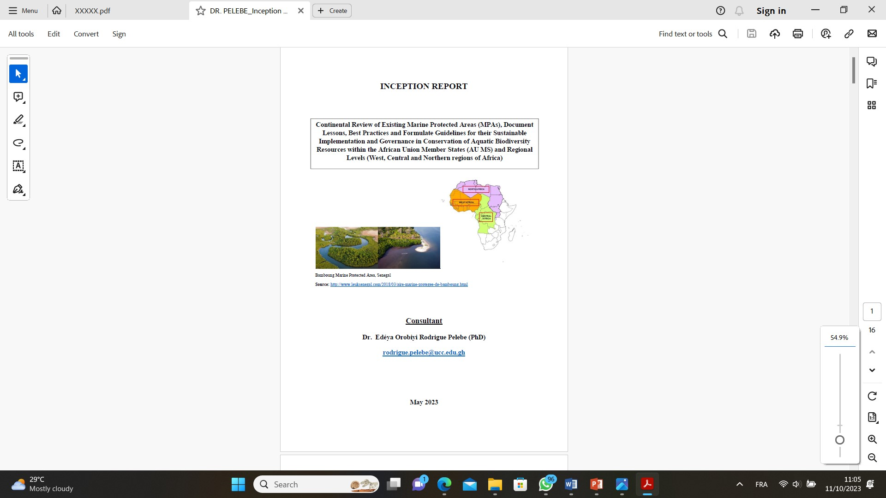
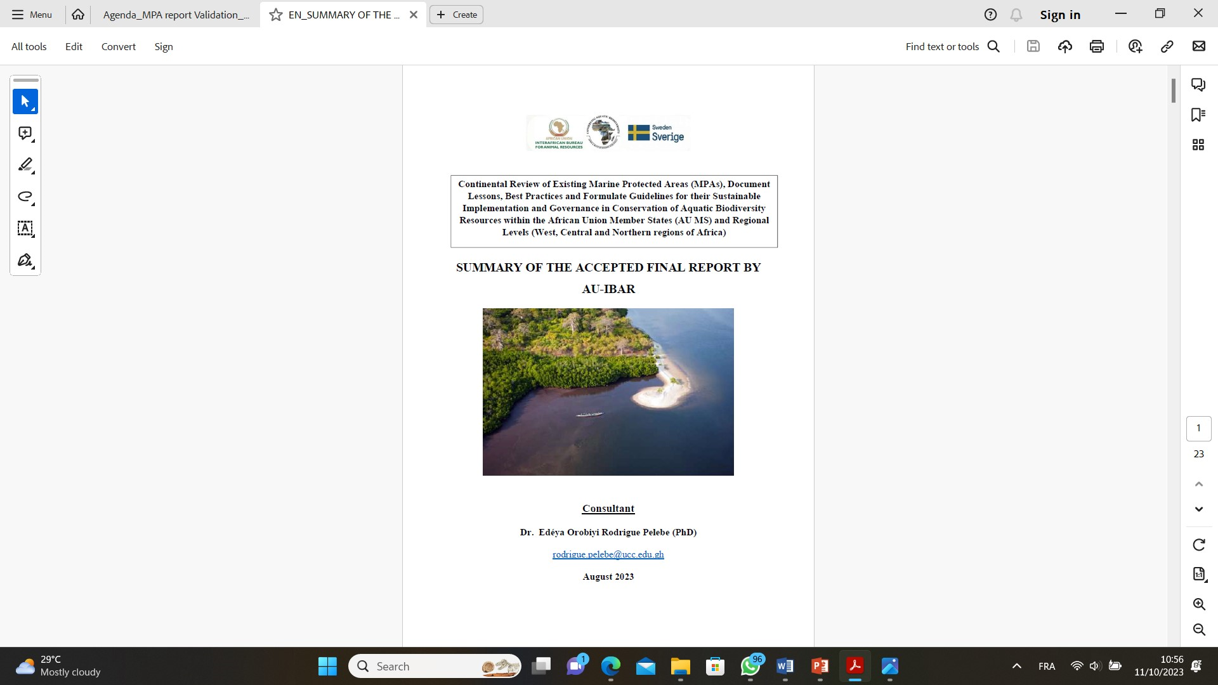
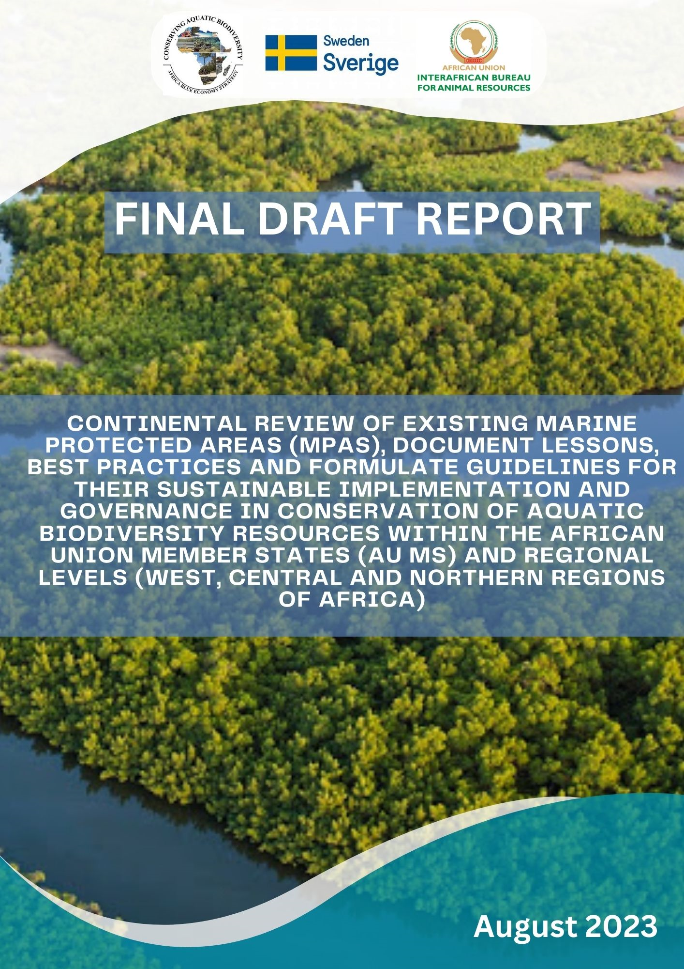
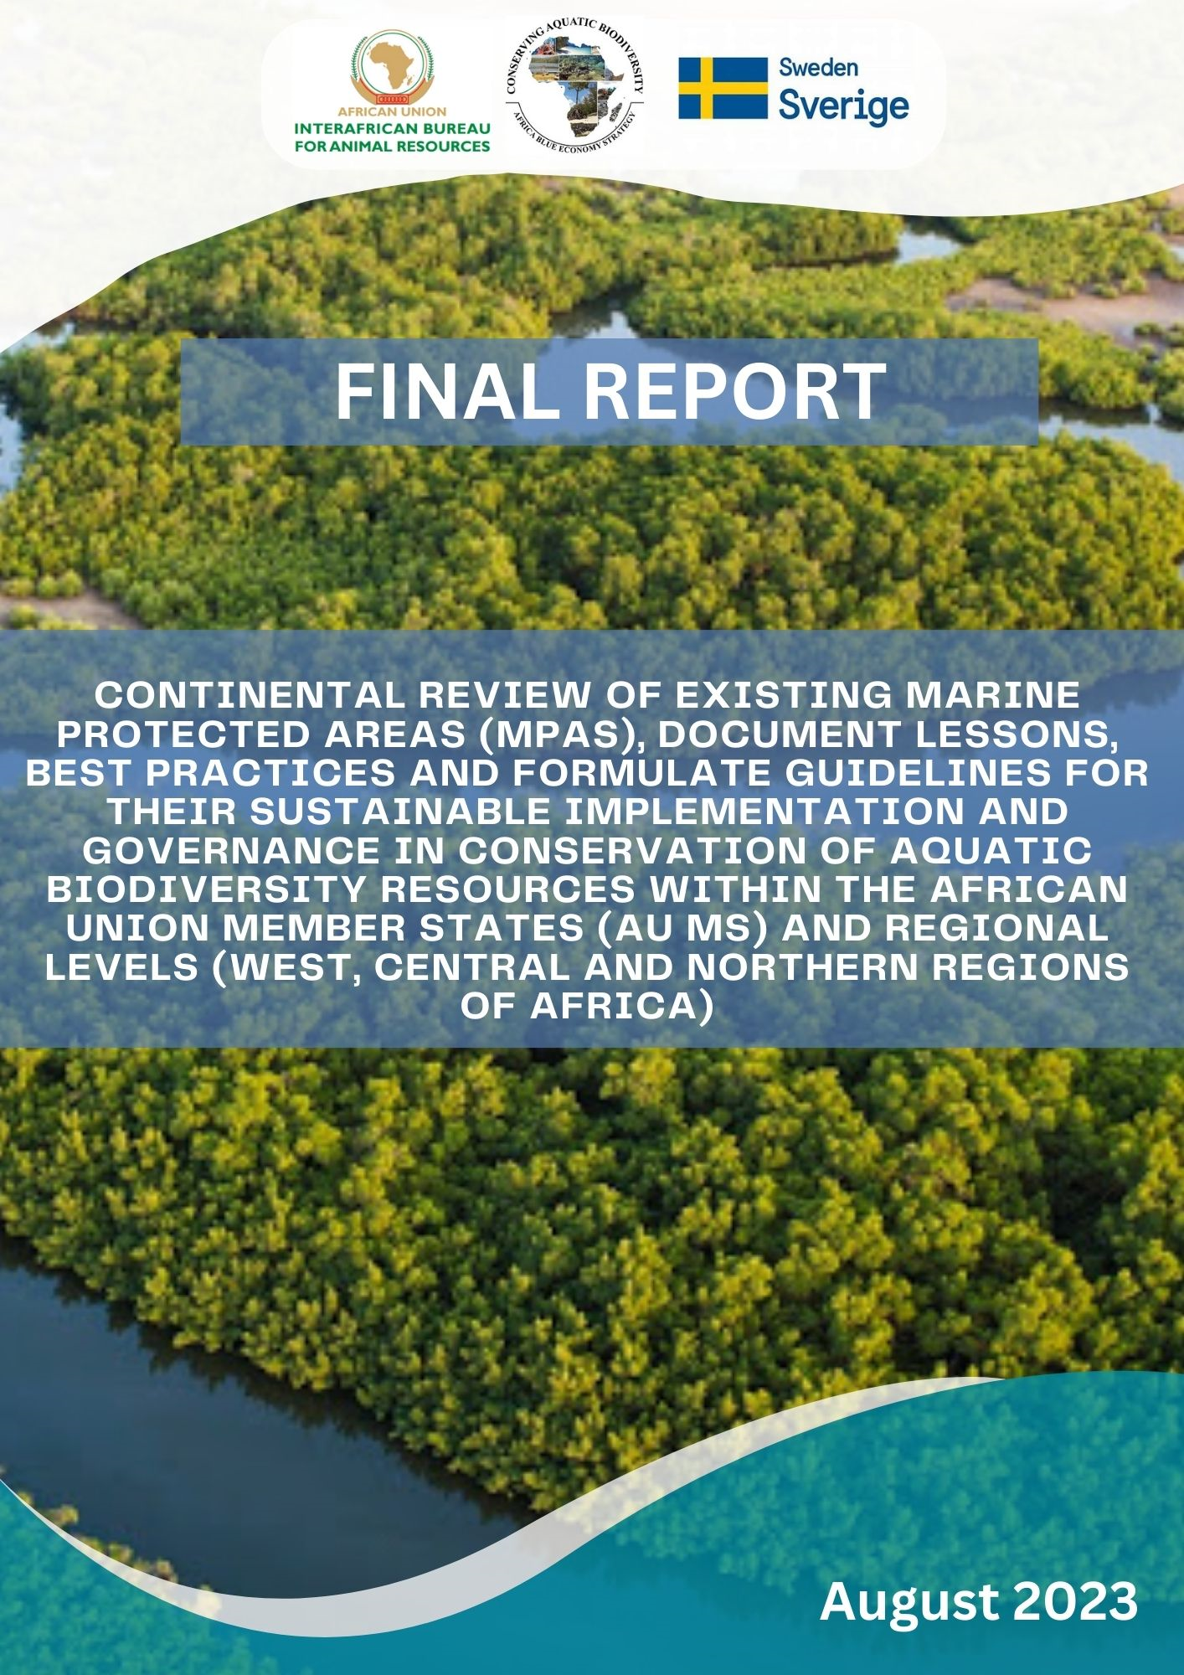
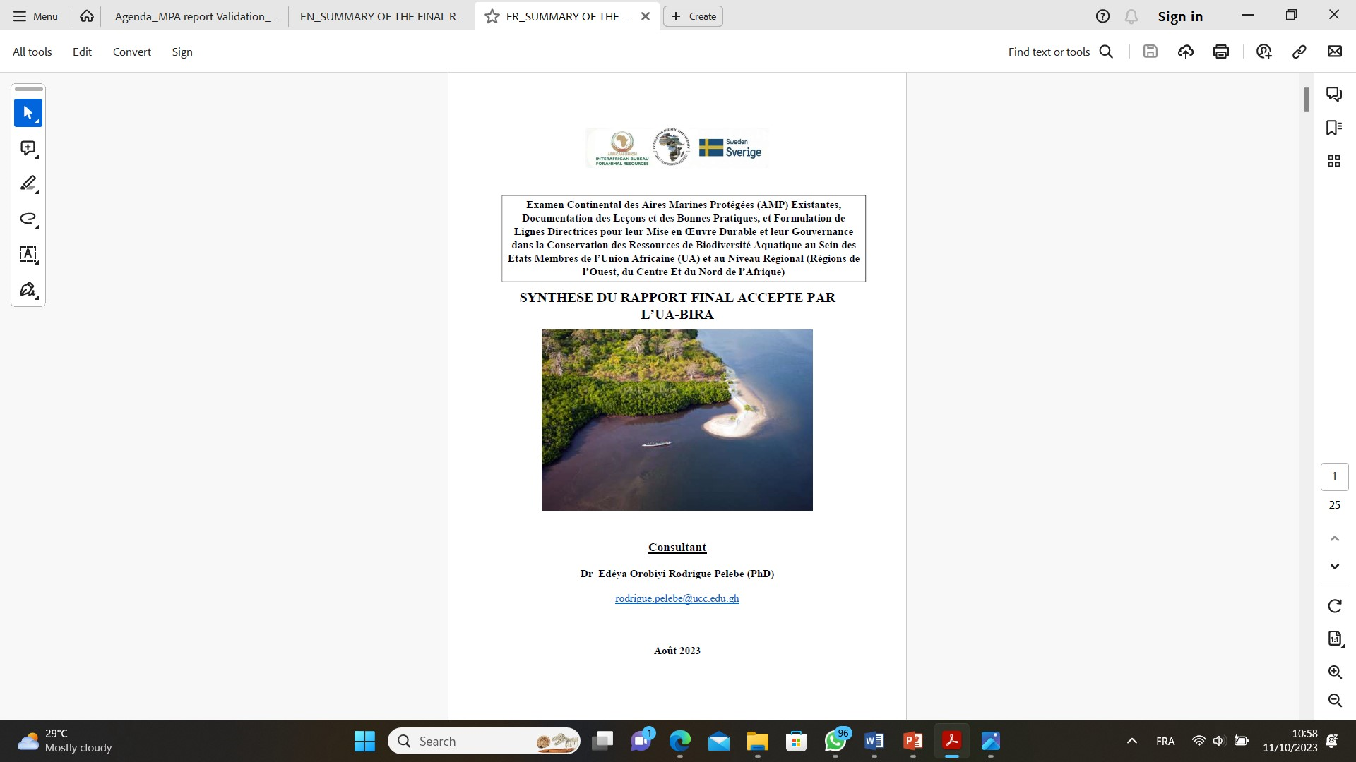
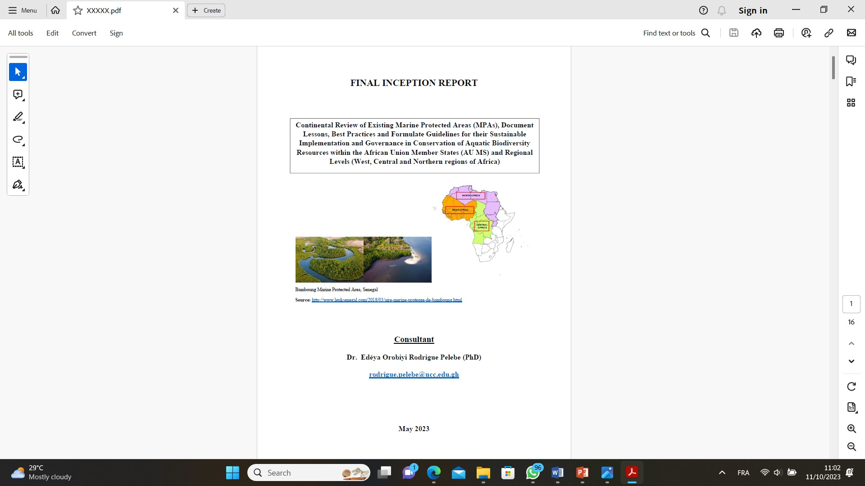
1-Rationale for the study, Framework and Delivrables (3/4)
Overall framework for the study (home-based assignment) and deliverables submitted
1.DATA COLLECTION
2. REPORTING
REVIEW BY
AU-IBAR AND CORRECTION MADE
INCEPTION MEETING WITH AU-IBAR
APPROVED BY AU-IBAR
&
VALIDATED BY CONTINENTAL STAKEHOLDERS

Slide 6
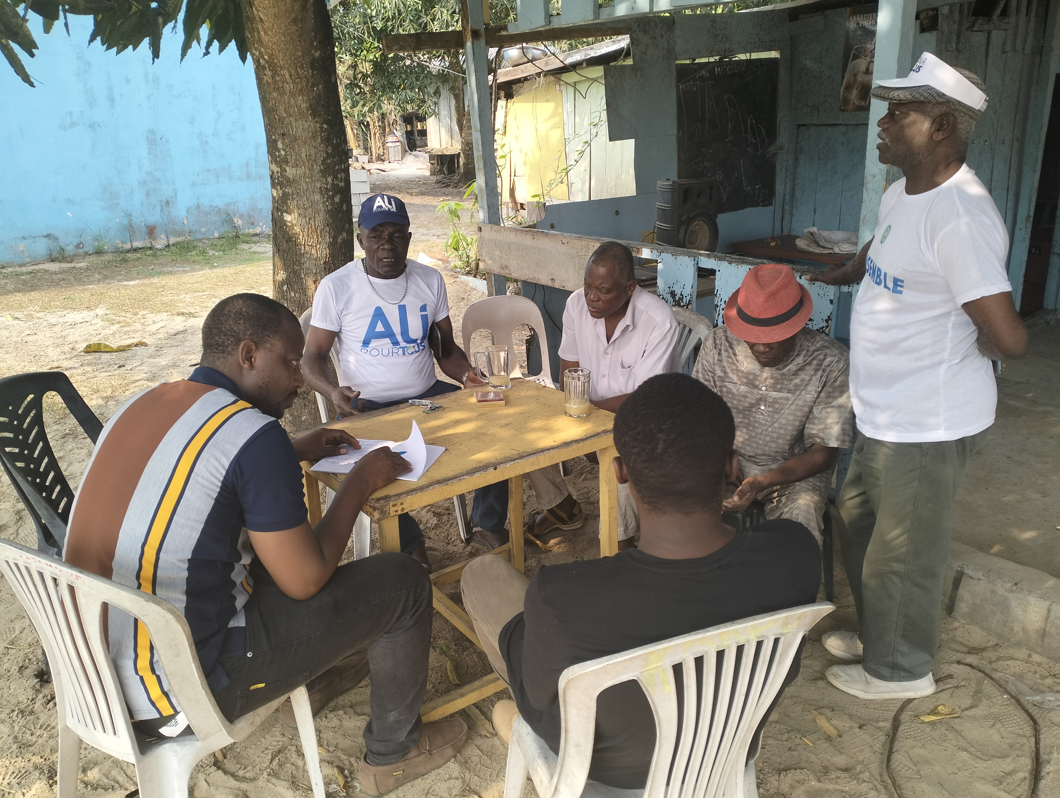
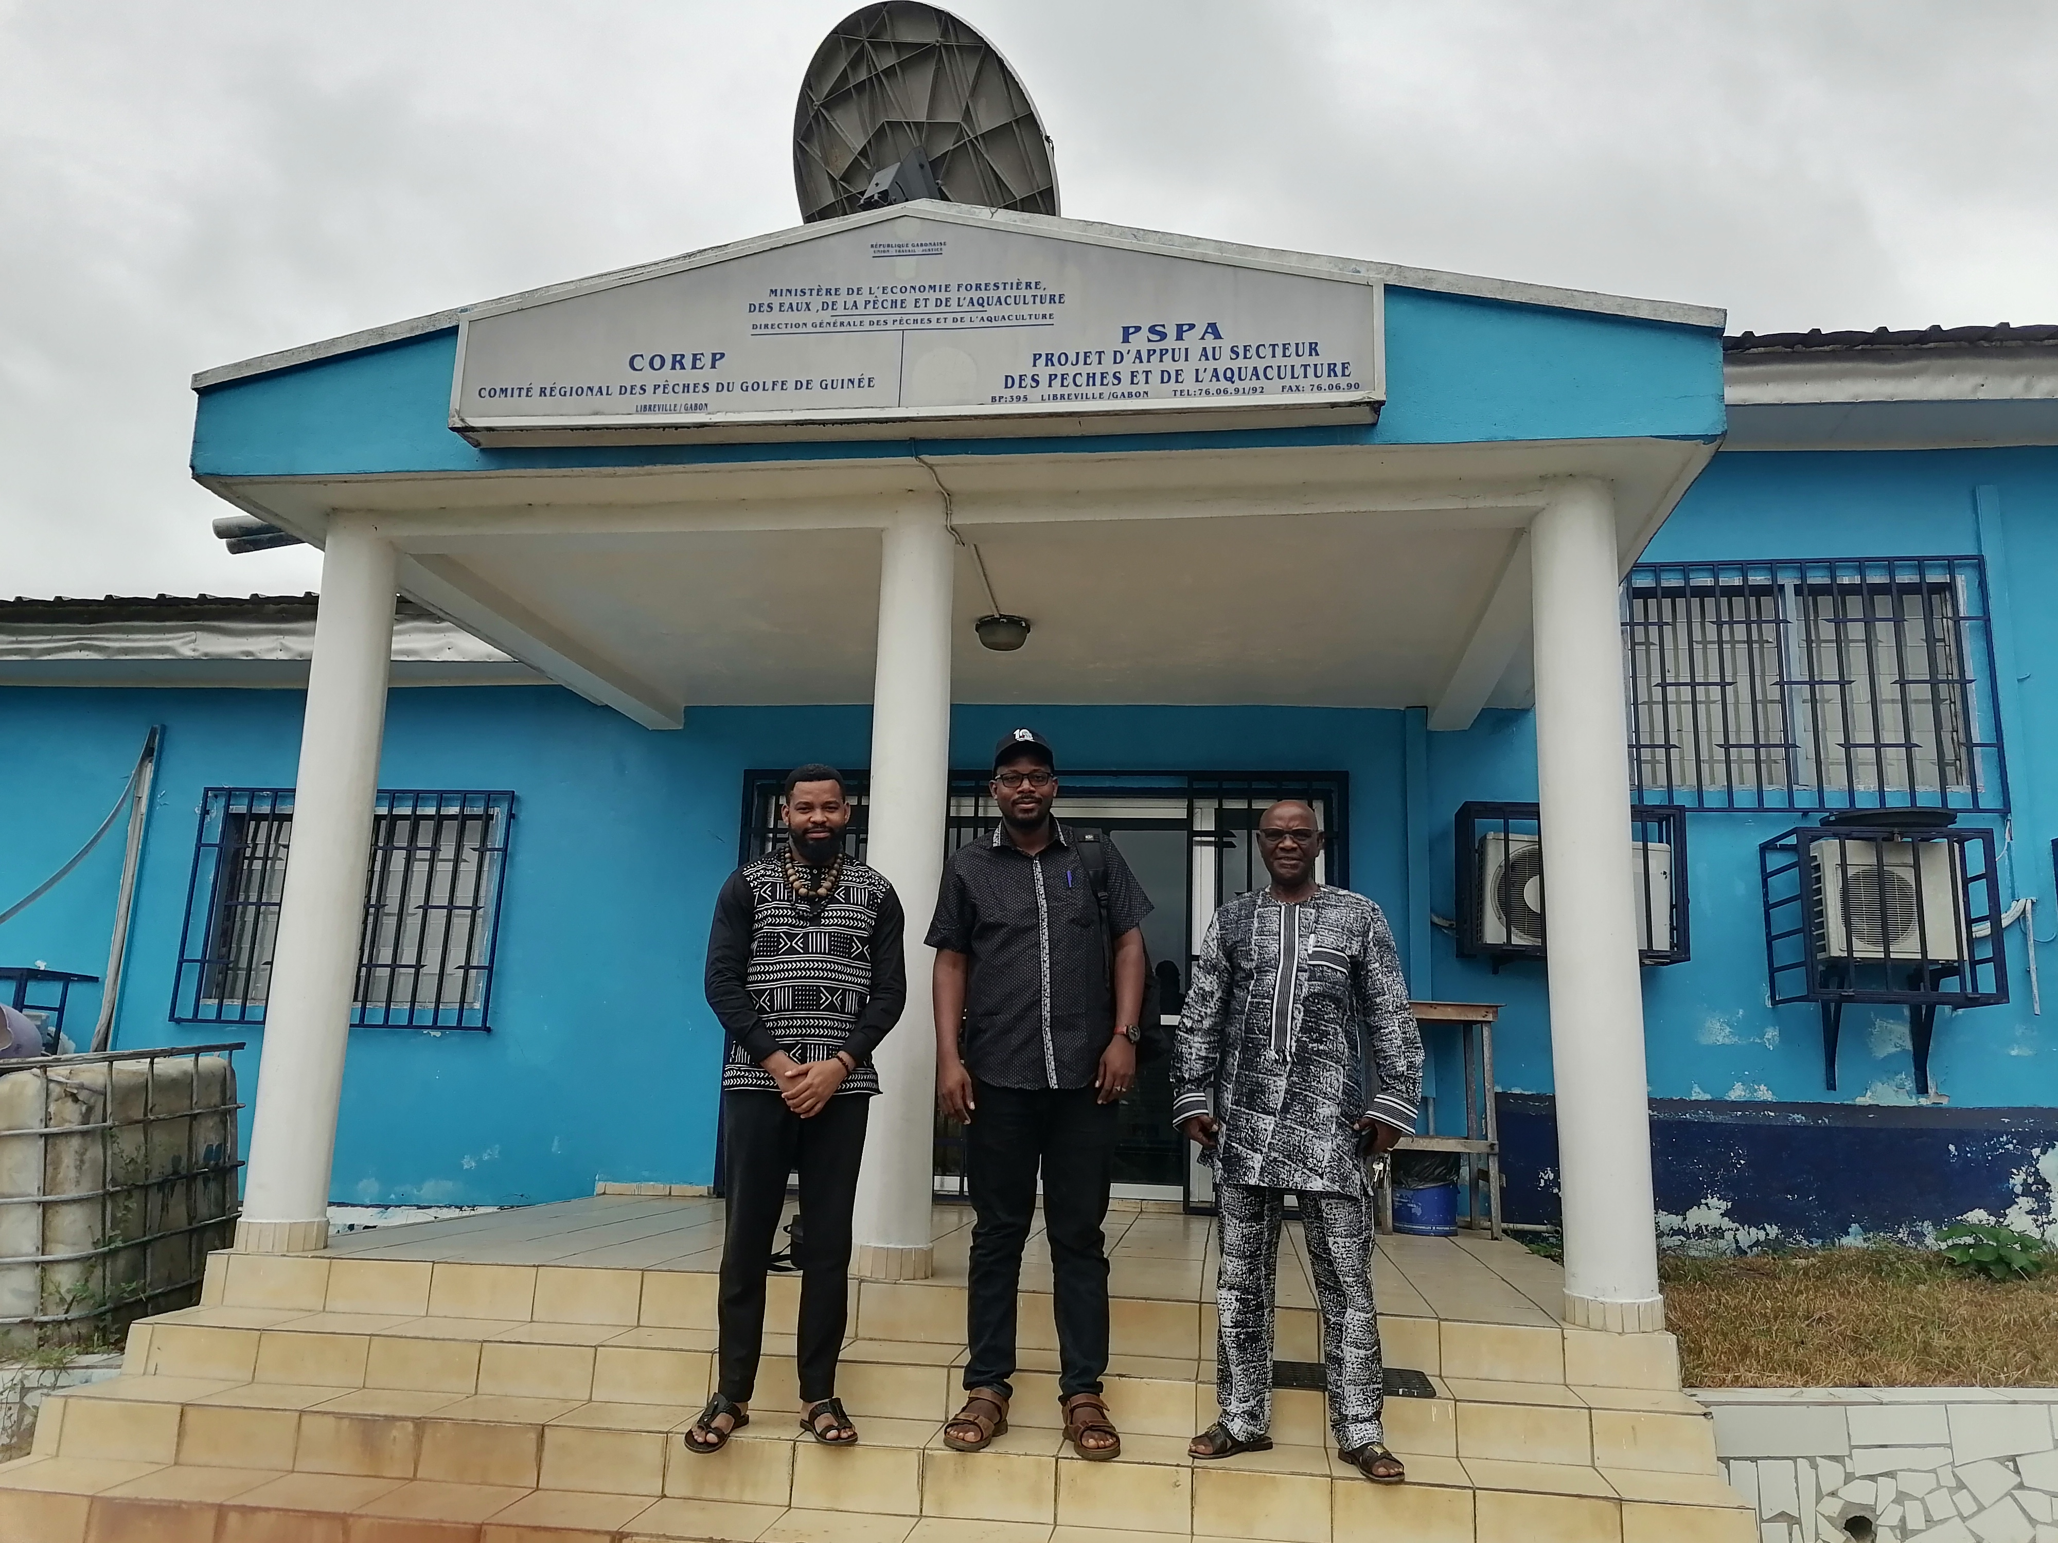
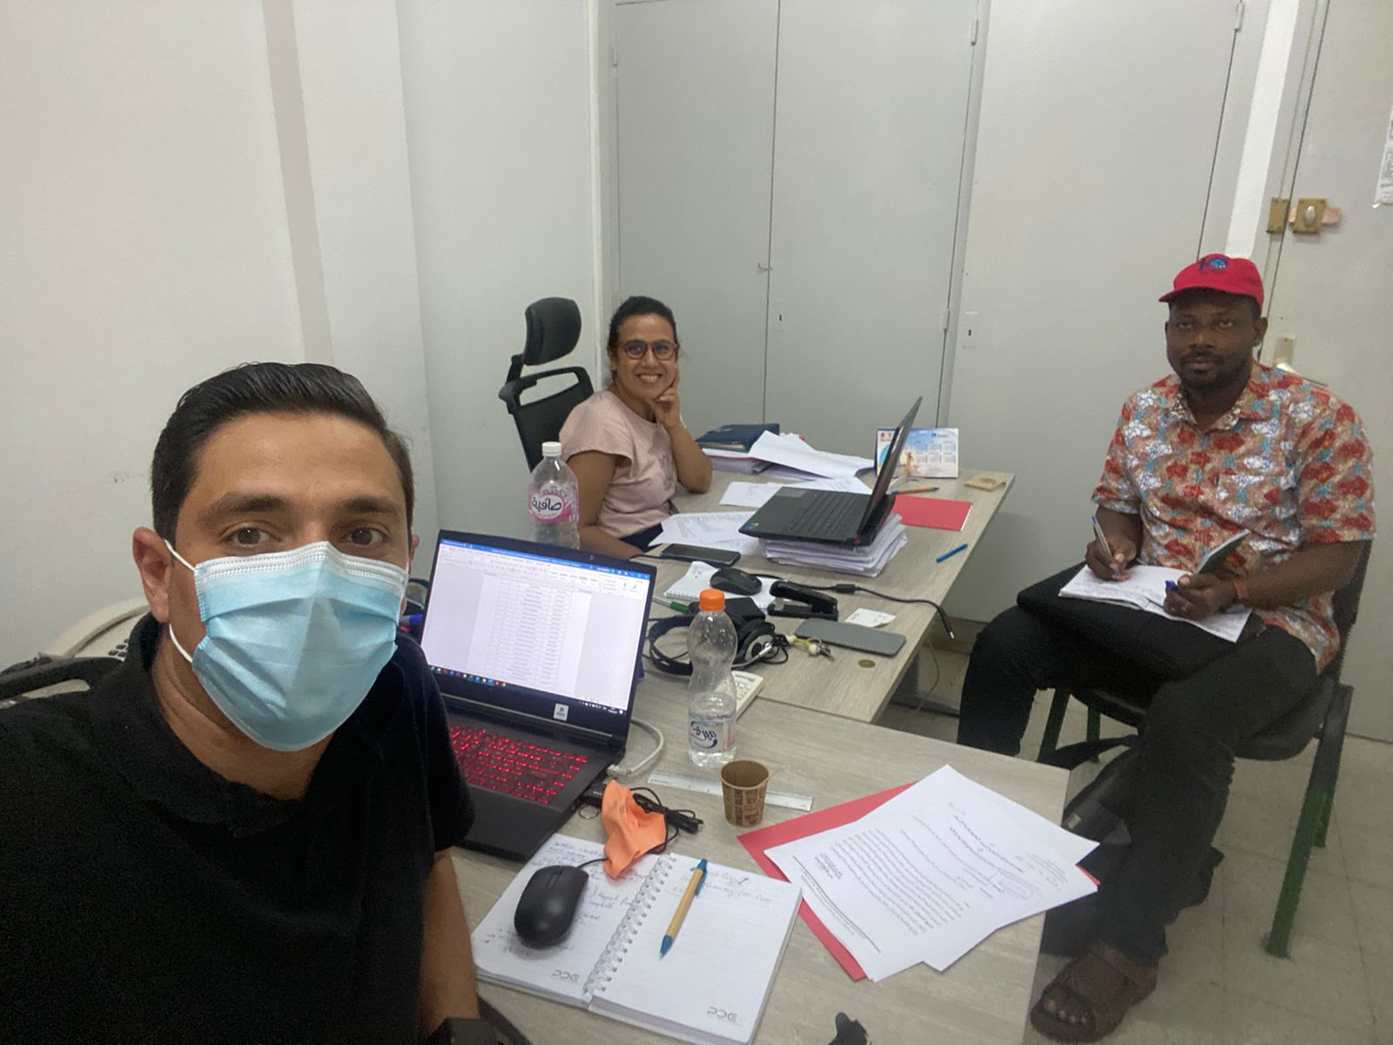
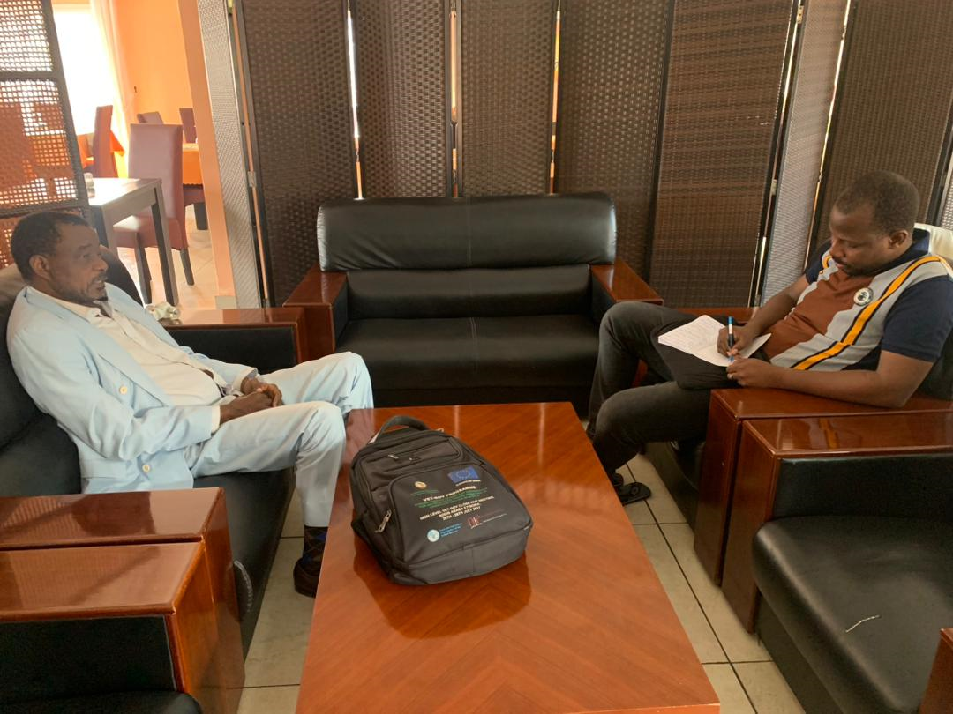
1-Rationale for the study, Framework and Delivrables (4/4)
Some photos taken during the fieldwork activities for the study
With COREP in Gabon
With fishermen in Gabon
With ECCAS in Gabon
A the Fisheries Directorate in Tunisia

Slide 7
2-Clarification of the concept of MPAs for the study (1/1)
entirely marine, containing subtidal and inter-tidal but no terrestrial habitat
MPA: any area of intertidal or subtidal terrain, together with its overlying water and associated flora, fauna, historical and cultural features, which has been reserved by law or other effective means to protect part or the entire enclosed environment (Kelleher, 1999)
terrestrial, inter-tidal and subtidal components
terrestrial and inter-tidal ecosystems only without sub-tital
For the study:
both national (within EEZ) and transboundary
2. Mainly those gazetted with an official document of establishment

Slide 8
3- Overview of MPAs in Central Africa, Congo and Gabon (1/3)
Gabon: 20 MPAs (About 26% of EEZ)
Décret n°00161/PR du 1er Juin 2017 pourtant création des Aires Protégées Aquatiques en République Gabonaise
Congo: 3 MPAs (About 12% of EEZ)
Décision de la commission congolaise de classement aires protégées, réunie en session du 29 au 31 août 2022
Target 3 - 30 x 30: Conserve 30% of Land, Waters and Seas by 2030
The Kunming-Montreal Global Biodiversity Framework

Slide 9
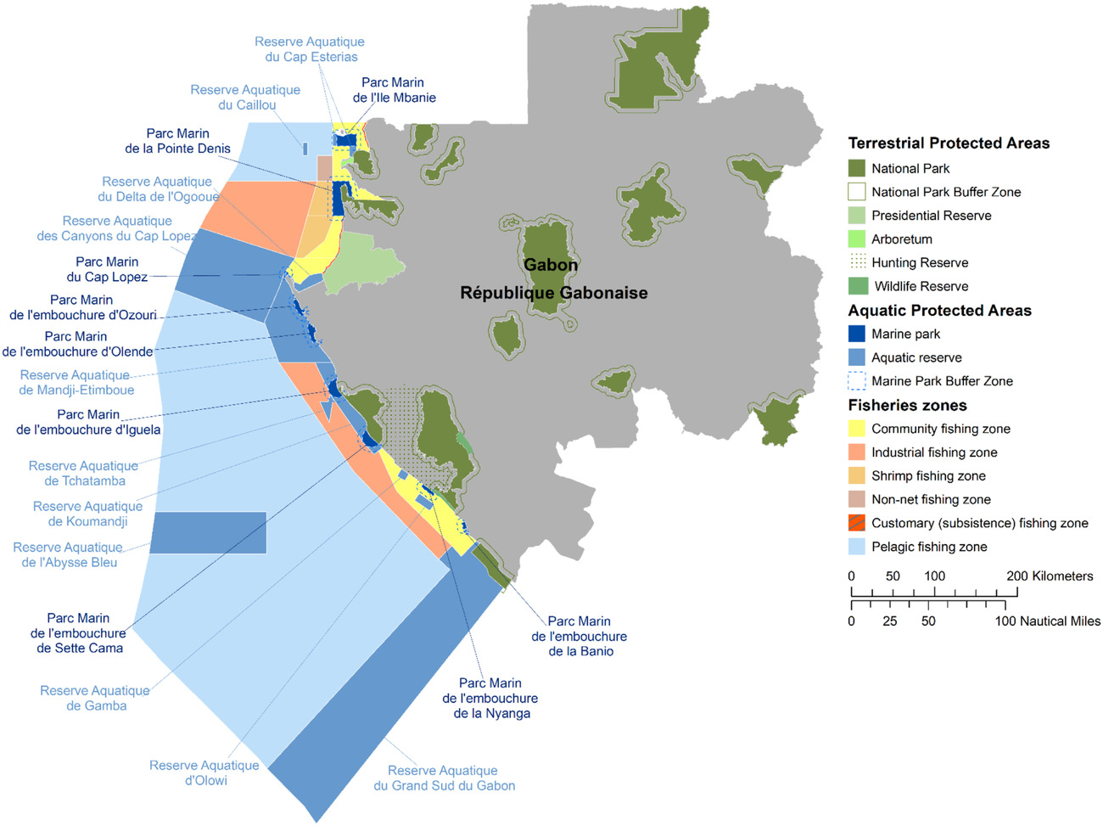
3- Overview of MPAs in Central Africa, Congo and Gabon (2/3)
MPAs in Gabon in 2017 (Metcalfe et al., 2022)

Slide 10
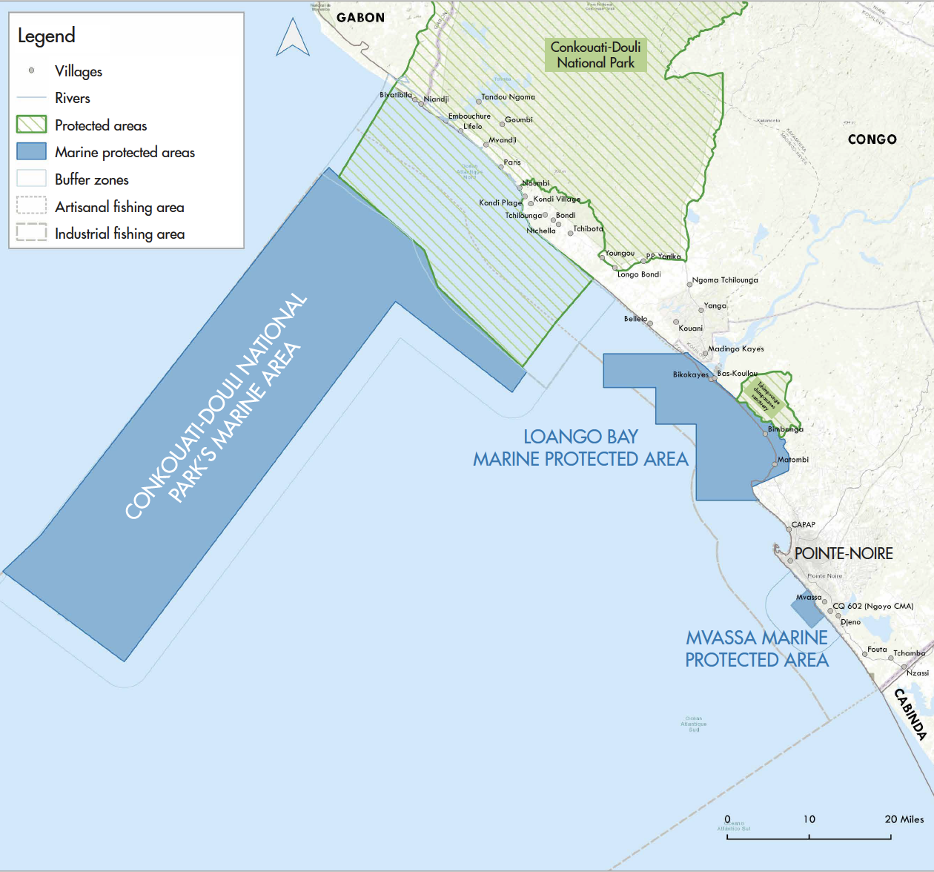
3- Overview of MPAs in Central Africa, Congo and Gabon (3/3)
MPAs in Gabon in 2022
From:
https://demaribus.net/2022/09/13/republic-of-congo-establishment-of-three-marine-protected-areas/

Slide 11

4- Institutional and Governance Challenges of MPAs in Central Africa (1/1)
Mostly lack of designated management board with legal mandate and clear roles as well as a dedicated staff
Centralised/top down model of governance is dominant
Most of MPAs do not a management plan and its implementation plan yet
The conflict resolution mechanisms are not established for most of the MPAs
Need of frameworks for monitoring MPA effectiveness at country level
Weak technical and MCS capacities for MPAs

Slide 12
5- The Mayumba-Conkouati Trans-boundary Park (PTMC) between Rep of Gabon and Rep of Congo (1/2)
Officially created by the Cooperation Agreement between the Republics of Congo and Gabon in November 2010
This agreement was not effectively implemented and the governance systems were not operationalized
 | Conkouati Douli National Park (Congo) | Mayumba National Park (Gabon),
Legal document for creation | Decree no. 99-136 bis of 14 August 1999 | Decree no. 614/PR/MEFEPEPN of 30 August 2002
Ecosystem Coverage | Terrestial, inter-didal and sub-tidal | entirely marine, containing subtidal and inter-tidal
Total Area at creation | 504950 ha (384950 ha of continental) | 97163 ha (0 ha of continental)
Current management | NGO NOé | The Wildlife Conservation Society
IUCN category | Type 2 (National park) | Type 2 (National park)
Key aquatic species and habitats | Sea turtles, dolphins, sharks, rays, whales, West African manatee, mangroves haitatats, beaches, estuaries, lagoons
Characteristics of each of the two PA forming the PTMC

Slide 13
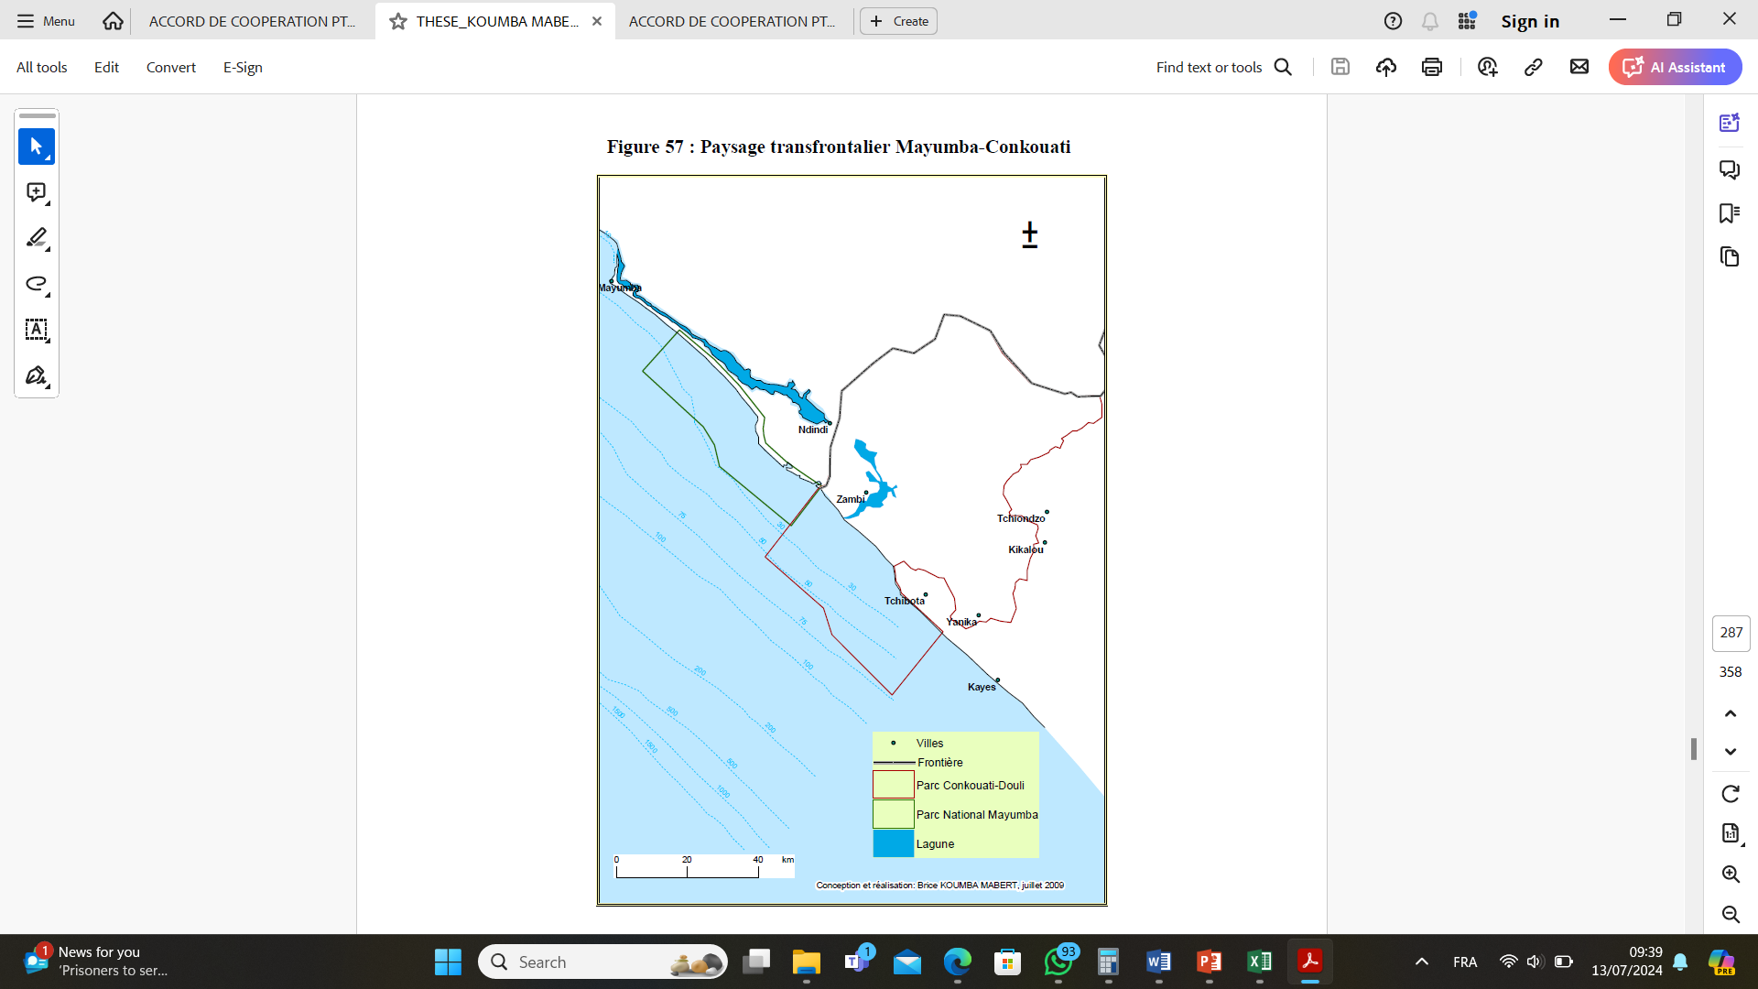
5- The Mayumba-Conkouati Trans-boundary Park (PTMC) between Rep of Gabon and Rep of Congo (2/2)
Decree no. 2023-1806, relating to the extension of the marine part of the Conkouati park for the creation of a MPA in 2023
Landscape of the Mayumba-Conkouati transboundary area
(Koumba Mabert, 2010)

Slide 14
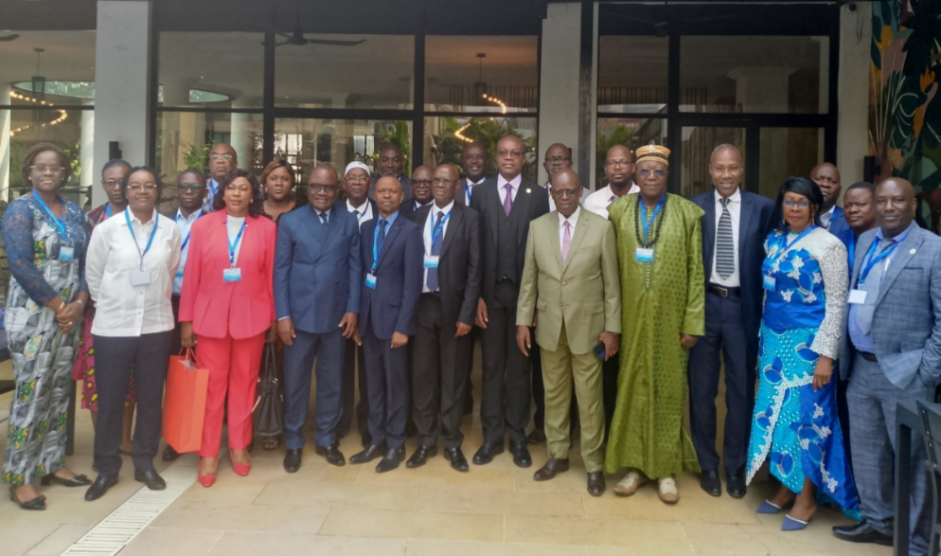
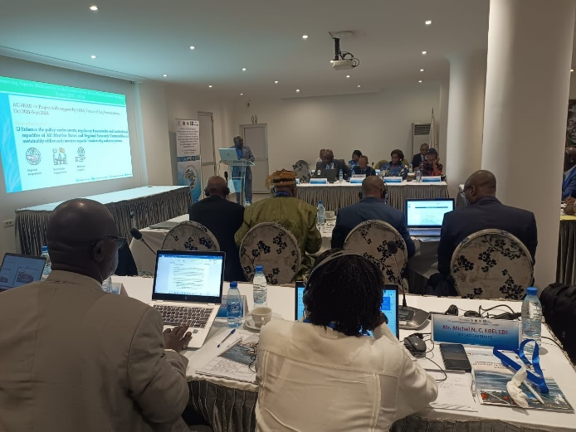
6- Key recommendations and priority actions for enhancing the implementationn and governance of the PTMC (1/2)
Harmonisation of existing regulations/Drawing up of new joint regulations specific to the TMPA;
Establishment of harmonised MCS mechanisms;
Designation/Recruitment of dedicated and qualified staff for operational activities within the TMPA;
Strengthening surveillance capacity of administrations;
Development of an inclusive management plan for the TMPA;

Slide 15
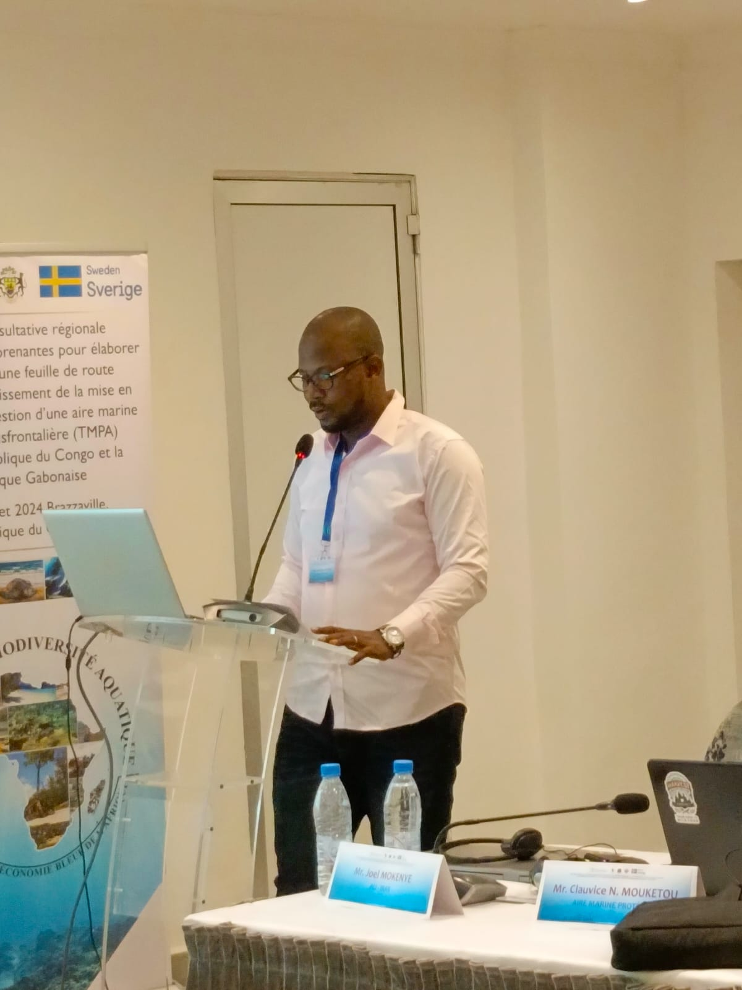
6- Key recommendations and priority actions for enhancing the implementationn and governance of the PTMC (2/2)
6. Integration of local communities in the management bodies of the TMPA;
7. Development of a framework for periodic ecological monitoring in the TMPA;
8. Development of conflict management referential with users of the TMPA;
9. Establishment of regular information sharing and sensitisation initiatives with local communities;
10. Revision of the Cooperation Agreement to include new national developments.

Slide 16
7-Cited References (1/1)
International Union for Conservation of Nature (IUCN). (2019). Protected Area Categories. Retrieved June 9, 2019, from https://www.iucn.org/theme/protected-areas/about/protected-area-categories
Kelleher G. (1999). Guidelines for Marine Protected Areas. IUCN, Gland, Switzerland and Cambridge, UK
Metcalfe K., White L., Lee M. E., 48 other authors . (2022). Fulfilling global marine commitments; lessons learned from Gabon. Conservation Letters, 15, e12872. https://doi.org/10.1111/conl.12872
Maestroa M., Pérez-Cayeiro M.A., Chica-Ruiz J.A., Reyes H. (2019). Marine protected areas in the 21st century: Current situation and trends. Ocean & Coastal Management, 171, 28-36. https://doi.org/10.1016/j.ocecoaman.2019.01.008
Koumba Mabert (2010) Gestion des zones côtières au Gabon : Etude d’appui à l’aménagement des parcs littoraux. Thèse de Doctorat en Géographie. Université de Nantes, France.
Polidaro B., Ralph G., Strongin K., 46 other authors. (2016). Red list of marine bony fishes of the eastern central Atlantic. https://doi.org/10.2305/IUCN.CH.2016.04.en
Sumaila U.R., Zeller D., Watson R., Alder J.,Pauly D. (2007). Potential costs and benefits of marine reserves in the high seas. Marine Ecology Progress Series, 345, 305-310. https://doi.org/10.3354/meps07065

Slide 17
