Slide 1







Overview of Project’s Knowledge products – to enhance implementation of Project outcomes
At the 3rd PTC of the Aquatic Biodiversity Conservation Project
7-8th October, 2024
BY: Joel Mokenye

Slide 2
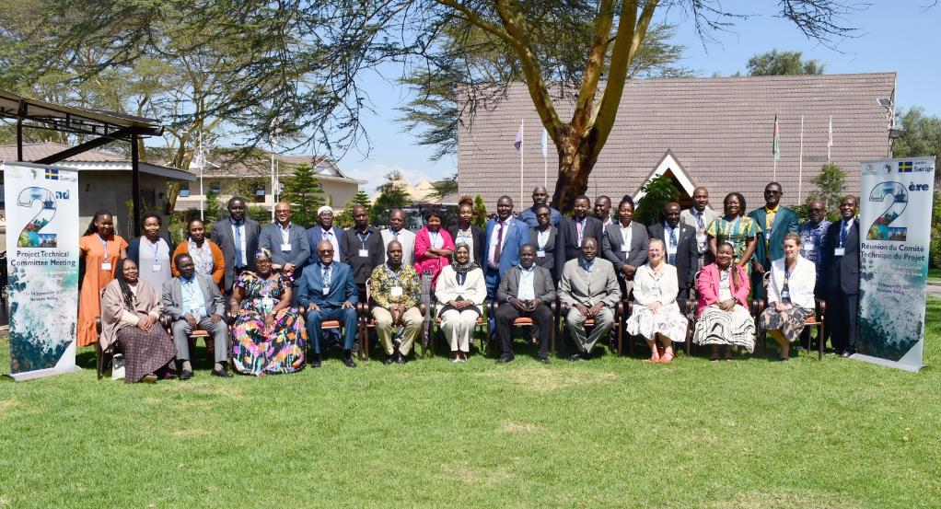
About the 2nd PTC
Family photo during the 2nd PTC, 13^{th -}14th September, 2023. Naivasha – Kenya.
AIM: The overall objective of the second PTC meeting was to inform and update the PTC members on status and progress on implementation of project activities and recommendations from the first PTC meeting as well as receive stakeholder recommendations on ongoing initiatives. .

Slide 3
The following were the key outcomes of the 2nd PTC:
The PTC expressed satisfaction and endorsed all presentations delivered at the meeting.
The PTC commended AU-IBAR for the impressive progress made so far on project implementation.
The PTC approved the recommendations herewith provided below for consideration by the PSC.
The PTC expressed gratitude to the Swedish Government for supporting implementation of the Aquatic Biodiversity Conservation Project.
The PTC endorsed a no-cost extension for the Project.

Slide 4
Project’s Knowledge products
POLICY NOTES,POLICY BRIEFS, ADVOCACY NOTES, POSITION PAPERS

Slide 5
SO 1. Support AU–MS to ratify and/or align relevant International/Regional Instruments related to blue economy themes (with specific reference to protecting and conserving biodiversity).

Slide 6
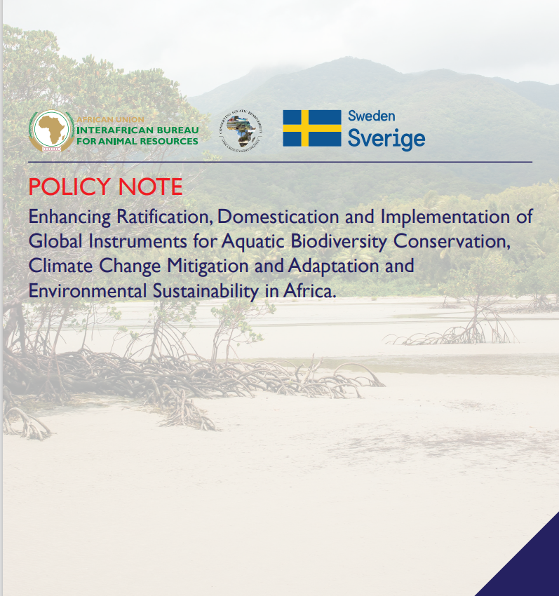
1. Policy Note on Enhancing Ratification, Domestication and Implementation of Global Instruments for Aquatic Biodiversity Conservation in Africa

Slide 7
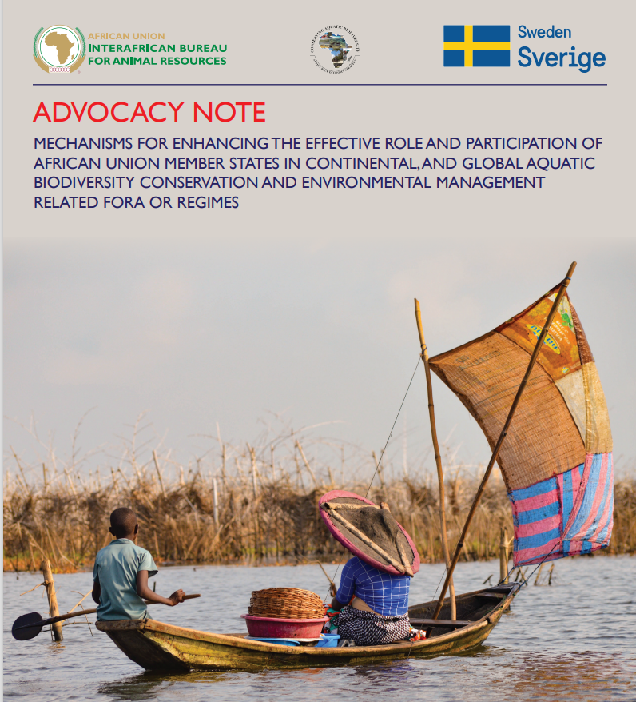
2. MECHANISMS FOR ENHANCING THE EFFECTIVE ROLE AND PARTICIPATION OF AFRICAN UNION MEMBER STATES IN CONTINENTAL, AND GLOBAL AQUATIC BIODIVERSITY CONSERVATION AND ENVIRONMENTAL MANAGEMENT RELATED FORA OR REGIMES

Slide 8
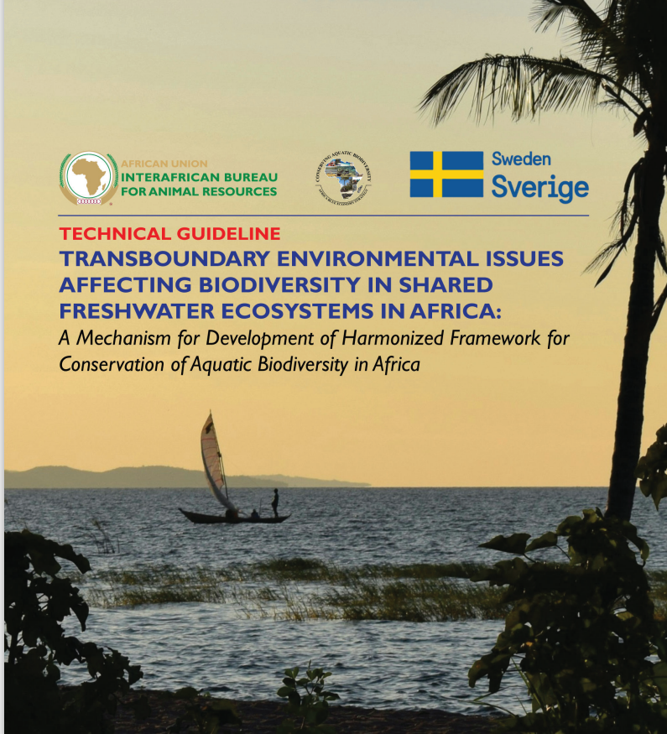
3. TRANSBOUNDARY ENVIRONMENTAL ISSUES AFFECTING BIODIVERSITY IN SHARED FRESHWATER ECOSYSTEMS IN AFRICA;

Slide 9
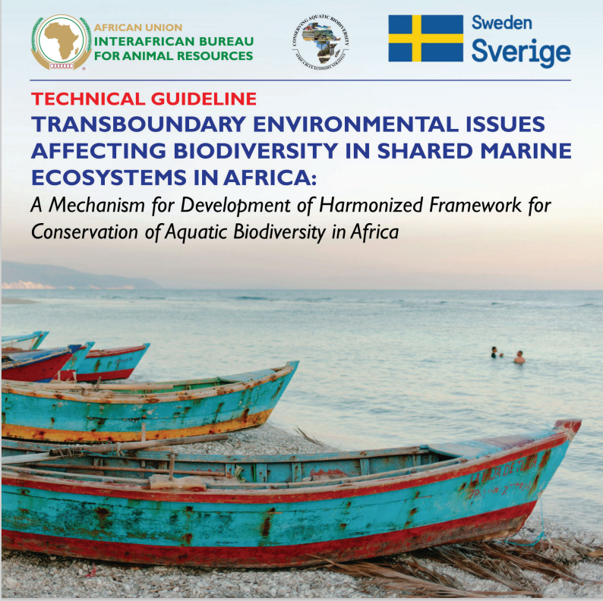
4. TRANSBOUNDARY ENVIRONMENTAL ISSUES AFFECTING BIODIVERSITY IN SHARED MARINE ECOSYSTEMS IN AFRICA:

Slide 10
SO 2. Optimizing conservation and sustainable use of biodiversity while minimizing conflicts among users of blue economy resources, (with specific reference to protecting and conserving biodiversity).

Slide 11
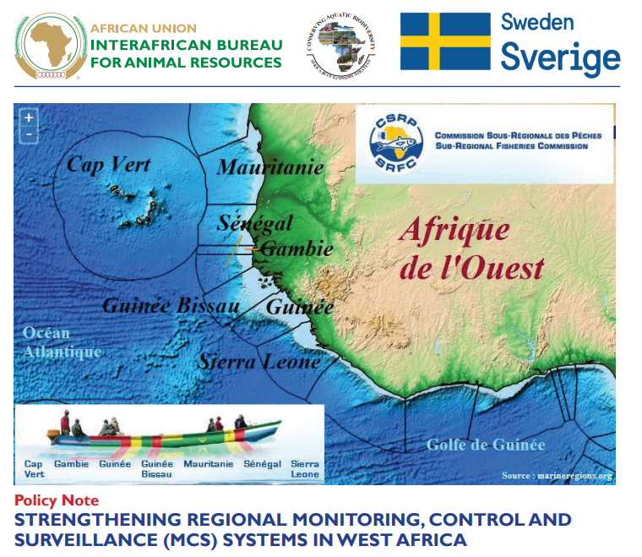
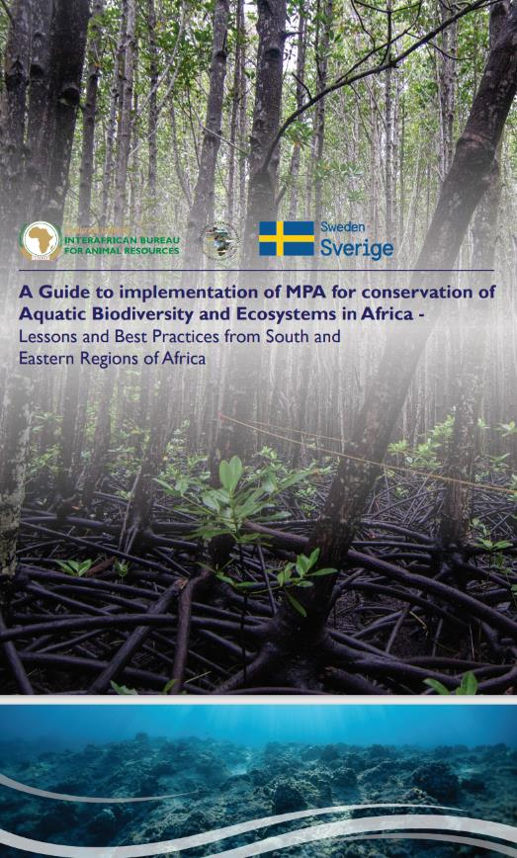
Policy note on MCS & MPA Guidelines
(b)
(a)

Slide 12

Policy Note on Continental MSP Guidelines
Objectives of the Continental MSP Guidelines:
Identifies priority actions to advance MSP in Africa including supporting AU MS to establish a legislative framework for MSP,
Developing roadmap for MSP development, building technical capacity,
Raising awareness about MSP,
Developing regional MSP guidelines,
Encouraging regular monitoring of MSP,
Establishing a sustainable financing mechanism for MSP.
(c)

Slide 13

Policy brief on Aquatic Biodiversity Hotspots in Africa
Areas of Focus:
Notable climate change impacts
Impact mitigation approaches in aquatic biodiversity hotspots e.g.
  Integrating and enhancing ecosystem-based solutions
  Mitigation mechanisms
  Adaptation mechanisms
  Inclusive Community based management and adaptive management
  Institutional strengthening e.g. policy interventions

Slide 14
SO 3. Strengthening measures for mitigating the negative impacts of coastal and marine tourism, oil, gas, deep sea mining and climate change on aquatic biodiversity and environment. .

Slide 15
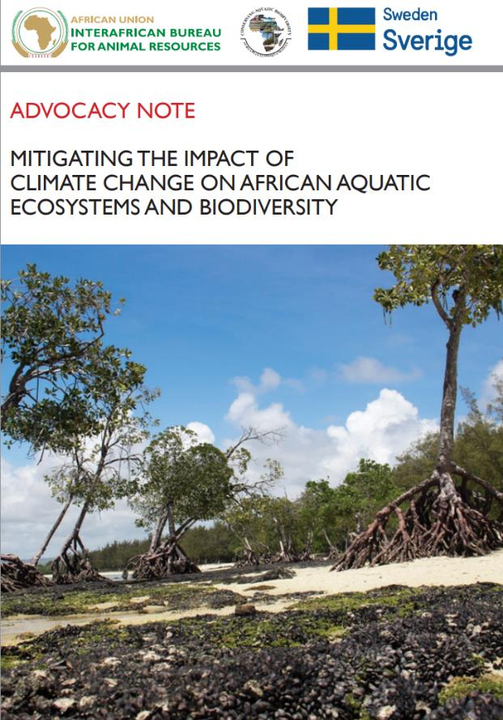
Advocacy note on mitigating impacts of Climate Change in Africa;

Slide 16
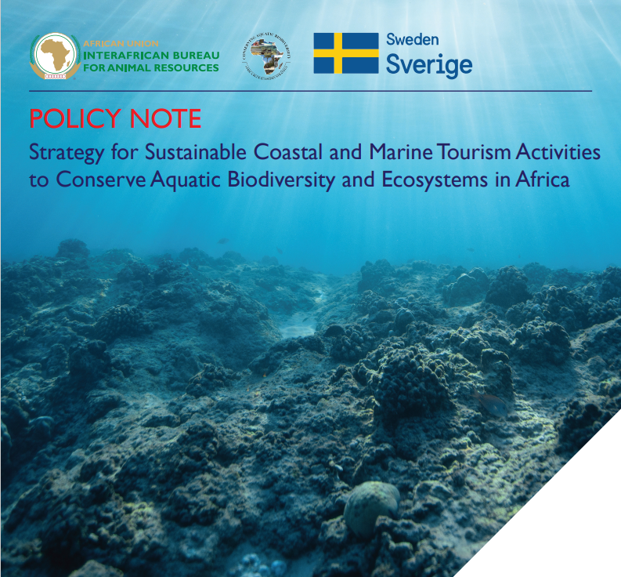
Policy note on Strategy for Sustainable Coastal and Marine Tourism Activities to Conserve Aquatic Biodiversity and Ecosystems in Africa

Slide 17

Policy note on Strategy for Sustainable Mining Activities for Conservation of Aquatic Biodiversity and Ecosystems in Africa;

Slide 18
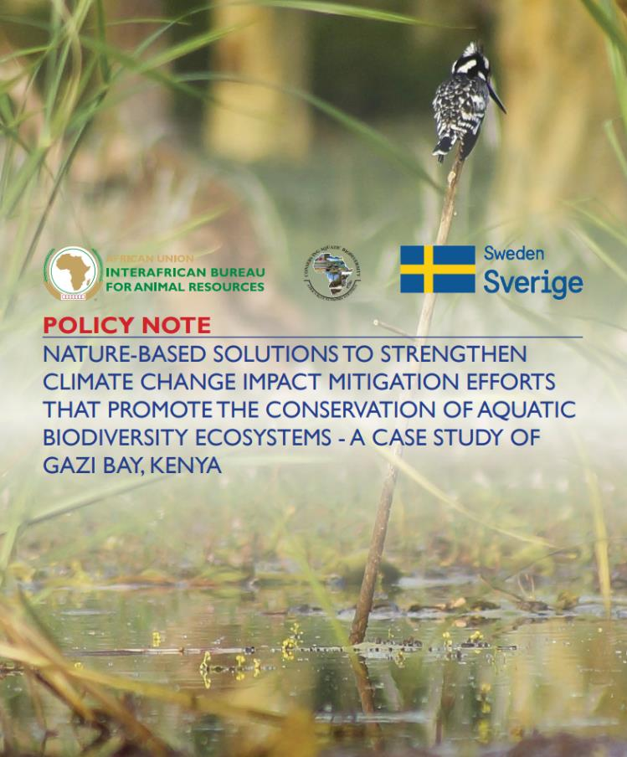
Policy note on Nature-Based Solutions to strengthen Climate Change Impact Mitigation efforts that promote the Conservation of Aquatic Biodiversity Ecosystems - A Case Study of Gazi Bay, Kenya.

Slide 19
SO 4. Strengthening gender inclusivity in aquatic biodiversity conservation and environmental management.

Slide 20

Strategy paper - Gender Mainstreaming in Aquatic Biodiversity Conservation and Environmental Management.

Slide 21

Policy brief - Enhance Capacity Building, Training and Skill Acquisition of Women and Youth in Fisheries and Aquaculture Ventures

Slide 22
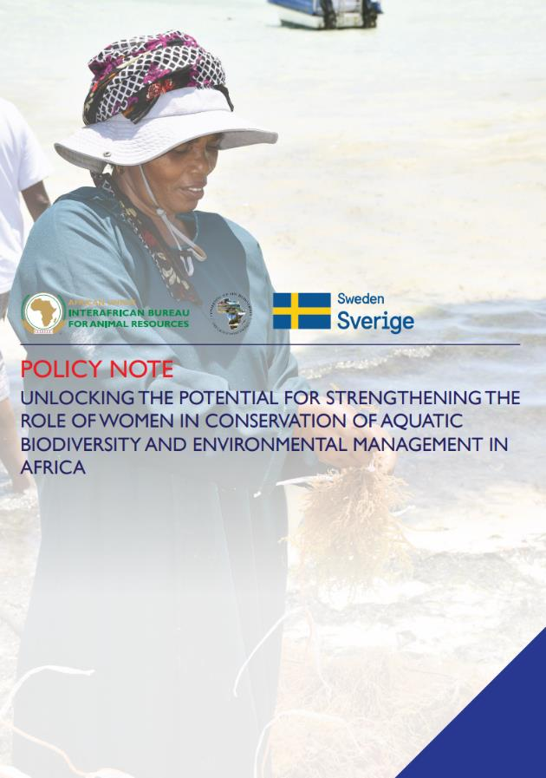
Policy Note - Unlocking the potential for strengthening the role of women in conservation of aquatic biodiversity and environmental management in Africa.

Slide 23
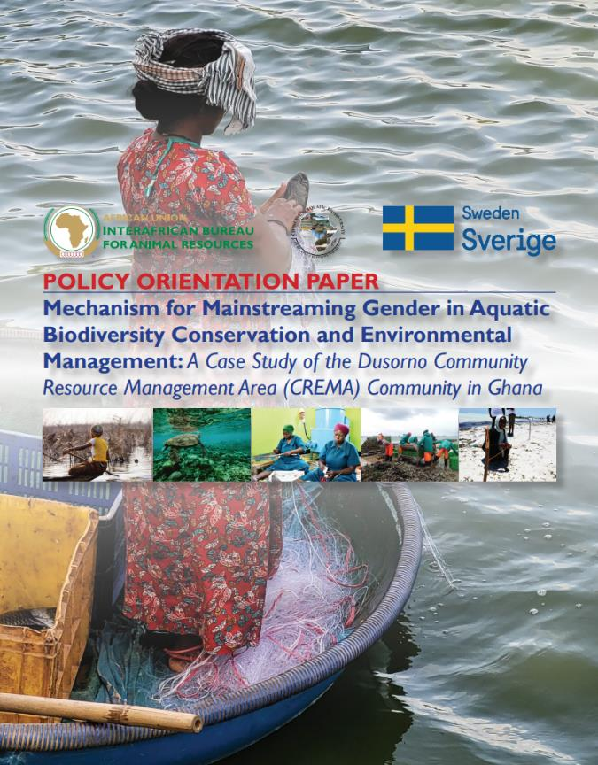
Policy Orientation Paper: Mechanism for Mainstreaming Gender in Aquatic Biodiversity Conservation and Environmental Management: A case study of the Dusorno CREMA community in Ghana.
Natural resources are managed by the Community
Alternative livelihoods e.g. Bees, Aquaculture
Mangrove Conservation for fisheries habitats and environment protection

Slide 24

Thank You
AU-IBAR: Providing leadership in the
development of animal resources for Africa

