Slide 1
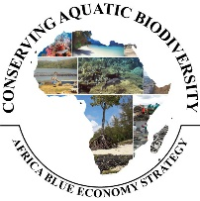


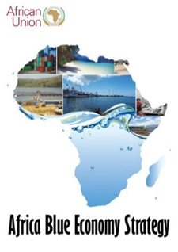
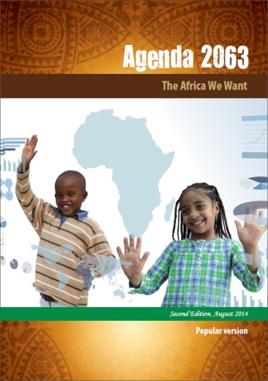

CONSERVING AQUATIC BIODIVERSITY IN AFRICAN BLUE ECONOMY
Third Project Steering Committee Meeting
9 October 2024
Mombasa, Kenya

Slide 2
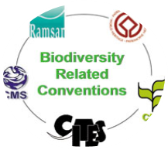
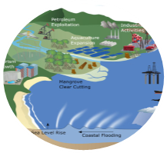
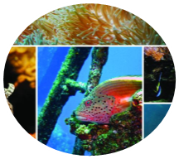
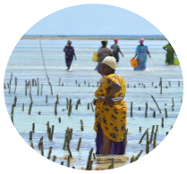
Strategic Objectives of the Aquatic Project
OBJECTIVE
To enhance the policy environment, regulatory frameworks and institutional capacities of AU Member States and Regional Economic Communities to sustainably utilize and conserve aquatic biodiversity and ecosystems.
Support AU–MS to ratify and/or align relevant International/Regional Instruments related to blue economy themes (with specific reference to protecting and conserving biodiversity)
Optimizing conservation and sustainable use of biodiversity while minimizing conflicts among blue economy sub-themes
Strengthening measures for mitigating the negative impacts of coastal and marine tourism, oil, gas, deep sea mining and climate change on aquatic biodiversity and environment
Strengthening gender inclusivity in aquatic biodiversity conservation and environmental management

Slide 3
2023 Workplan
Driving implementation of Project’s Strategic Objectives
SO1: Ratify and/or Align relevant international/regional instruments - 2 Outputs:
  Mechanisms for active participation of MSs in continental and global initiatives developed;
  Ratification and implementation of conventions and agreements supported;
SO2: Optimizing conservation and sustainable biodiversity - 3 Outputs:
  Enforceable regulatory frameworks for effective MCS systems developed;
  A framework for establishing national, regional and transboundary cooperation
  Capacities for restoring and conserving threatened aquatic biodiversity and environment strengthened.
SO3: Strengthening measures for mitigating the negative impacts of coastal and marine tourism, oil, gas, deep sea mining and climate change -2 Outputs:
  Measures for minimizing the negative impacts of climate change on biodiversity ;
  Strategies for an integrated framework for sustainable coastal and marine tourism and mining developed ;
SO4: Strengthening gender inclusivity in aquatic biodiversity conservation and environmental management-1 Output:
  Continental strategy for gender inclusivity in aquatic biodiversity and environmental management developed ;

Slide 4
2023 Workplan
Driving implementation of Project’s Strategic Objectives
SO1: Ratify and/or Align relevant international/regional instruments - 2 Outputs:
  Mechanisms for active participation of MSs in continental and global initiatives developed;
  Ratification and implementation of conventions and agreements supported;
SO2: Optimizing conservation and sustainable biodiversity - 3 Outputs:
  Enforceable regulatory frameworks for effective MCS systems developed;
  A framework for establishing national, regional and transboundary cooperation
  Capacities for restoring and conserving threatened aquatic biodiversity and environment strengthened.
SO3: Strengthening measures for mitigating the negative impacts of coastal and marine tourism, oil, gas, deep sea mining and climate change -2 Outputs:
  Measures for minimizing the negative impacts of climate change on biodiversity ;
  Strategies for an integrated framework for sustainable coastal and marine tourism and mining developed ;
SO4: Strengthening gender inclusivity in aquatic biodiversity conservation and environmental management-1 Output:
  Continental strategy for gender inclusivity in aquatic biodiversity and environmental management developed ;

Slide 5
SO1: Ratify and/or Align relevant international/regional instruments related to blue economy themes (with specific reference to conserving biodiversity)–
Output/Activity | PROGRESS TO DATE
Output 1.1: Mechanisms for active participation of MSs in continental and global initiatives developed
1.1:1. Enhancing effective role in regional and global aquatic biodiversity and environmental related regimes: UNFCC, CITES, RBS, RAMSAR, Marine Biological Diversity of Areas beyond National Jurisdiction (BBNJ Agreement) | Mechanism developed to guide effective participation in global fora– relevant to conservation of aquatic biodiversity and environment management Mechanism endorsed by AU Summit in 2024 Predetermined negotiators trained to assist AU member states for effective participation in global meetings Participated and/or sponsored participation of AU MSs to enhance effective participation or Africa’s position: Kenya, DR Congo to MSP forum in Tanzania; Kenya, Togo to UNFCCC in Abu Dhabi Seychelles to UN Review Conference on UN Fish Stock Agreement in May 2023, New York Compliance committee meeting of the Basel Convention in Geneva; Blue Economy Coordination meeting, Addis Ababa 8th Session of the OACPS – Dar Es Salaam, Tanzania

Slide 6
SO1: Ratify and/or Align relevant international/regional instruments related to blue economy themes (with specific reference to conserving biodiversity)– USD 167730: Cont’d
Output/Activity | PROGRESS TO DATE
Output 1.2. Ratification and implementation of conventions and agreements related to conservation of aquatic biodiversity – USD 98750
1.2.1. Identify continental and global biodiversity and environmental instruments relevant to sustainable management of Africa blue economy resources: | Continental assessments conducted Priority continental and global instruments identified Priority actions developed to enhance domestication of instruments related aquatic biodiversity and environmental management Based on the above:, the project has supported the following countries: Egypt, Cameroon, South Sudan, Burkina Faso, Tunisia, Uganda, Eswatini, Ghana,Djibout Exit: SEBE, RECs, RFBs, RSCs Sustainability: involvement of RECs, RSCs and other regional institutions Knowledge products developed – policy note on enhancing domestication Lessons: member states commitment at high level

Slide 7
Challenges faced when participating in relevant regional and international fora
Funding to travel to meetings;
Lack of skills for data collection and reporting;
Limited negotiation skills;
Language barrier during some technical meetings where English is the only language used;
Lack of scientific capacity;
High turnover of staff which lowers continuity;
Low responsiveness to engagements with relevant secretariats;
Inability to develop and implement local legislations that comply with relevant Conventions;

Slide 8
Strategies and actions to address the identified challenges
  Establish National consultative groups that include civil society, youth, women, and private sector
  Support relevant skills and capacity building initiatives at National level
  Support the participation of women and youth organizations in some of the International fora and regimes
  Creation of a network of experts and working groups for decision support when negotiating key issues at fora meetings
  Advocacy on the importance and benefits of the Conventions/fora to relevant Policy makers
  Support data collection initiatives to ensure the Continent has its own baseline data that can be monitored and reported on for negotiation purposes;
  Enhancing scientific capacity of representatives so they can engage better in technical discussions;

Slide 9
Key challenges raised with ratification, adoption and implementation
Lack of financial, technical capacity,
Lack of financial and technical capacity
Limited financial and technical capacity, not priority
Lack of technical capacity & cross sectoral coordination
Lack of financial, technical and cross sectoral coordination
Lack of financial, technical and cross sectoral coordination
Limited financial and technical capacity, not priority
Limited financial and technical capacity, lack of cross sectoral capacity
Limited financial and technical capacity
Limited financial and technical capacity

Slide 10
Solutions
Ratification
  Support for cross-sectoral engagement and coordination at National level in identification and adoption of key Instruments.
Adoption
  Sensitize and engage MSs on benefits; Economic and genetic benefits; Targeting the heads of MDAs
  Cross-sectoral participation and ownership through wide circulation and engagement of all stakeholders.
Implementation
Fostering good practice in implementation and management of aquatic biodiversity.
Support the development of guidelines for implementation of specific Instruments

Slide 11
SO2: Optimizing conservation and sustainable biodiversity while minimizing conflicts among users of blue economy resources.–
Output/Activity | PROGRESS TO DATE
Output 2.1 Enforceable regulatory frameworks for effective and sustainable regional Monitoring Control and Surveillance (MCS) systems developed
2.1.1 Enhancing Sustainable Monitoring Control and Surveillance (MCS) Systems for conservation and protection of biodiversity: | Status of MCS systems at national and Regional levels determined Awareness enhancing workshop conducted to sensitize stakeholders on MCS systems In collaborated with FCWC, trained six member countries (Benin, Cote D’Ivoire, Ghana, Liberia, Nigeria and Togo) on MCS systems to combat IUU and for the protection of aquatic biodiversity and environment Purchase MCS equipment to enhance regional capacity for MCS within FCWC Supported the operationalization of SADC MCS Centre
2.1.2. Support the establishment of cost-effective and sustainable financial arrangements for effective regional cooperation on MCS and enforcement in selected regions | A framework for cost-effective, innovative financial systems for sustainable regional MCS systems developed for East-Southern regions of Africa;

Slide 12
SO2: Optimizing conservation and sustainable biodiversity while minimizing conflicts among users of blue economy resources.– Cont’d–
Output/Activity | PROGRESS TO DATE
Output 2.2. A framework for establishing national, regional and transboundary cooperation on Africa Blue Economy Strategy Thematic Areas established
2.2.1. Establish regional cooperation on transboundary issues in shared aquatic ecosystems towards formulating harmonized regional frameworks on aquatic biodiversity conservation. | Frameworks for regional cooperation on transboundary issues for conservation of aquatic biodiversity and environment in shared freshwater ecosystems and marine ecosystems developed In collaboration with LVFO, Kenya, Uganda and Tanzania supported to develop harmonized national strategies for Management of transboundary freshwater ecosystems – lake Victoria In collaboration with COREP, DR Congo and Rep of Congo supported to develop harmonized national strategies for management of transboundary marine ecosystems – Gulf of Guinea
2.2.2. Formulate mechanisms to institutionalize Marine Spatial Planning (MSP) at national and regional levels | Status of MSP initiatives and usage determined Guidelines for institutionalization of MSP for conservation of aquatic biodiversity and ecosystems at national and transboundary levels developed. In discussions with Abidjan Convention, supported Benin and Togo to advance transboundary MSP initiative In discussions with WWF and Nairobi Convention, supported Mozambique, Madagascar, Comoros and Madagascar to advance the transboundary MSP process in the northern Mozambique channel

Slide 13
SO2: Optimizing conservation and sustainable biodiversity while minimizing conflicts among users of blue economy resources.–
Output/Activity | PROGRESS TO DATE
Output 2.3. Capacities for restoring and conserving threatened aquatic biodiversity and environment strengthened.
2.3.1 Support rehabilitation of depleted aquatic biodiversity and habitats | The project determined the occurrence of MPAs in the continent, implementation and governance status Documented Lessons and best practices for institutionalizing MPAs at national and transboundary levels Support to Kenya and Tanzania to develop MOU for joint management of TBCA In collaboration with WIOMSA and Nairobi Convention, supported the development of MOU between Kenya and Tanzania for joint management of Transboundary Marine Conservation Area Support to Rep of Congo and Gabon to enhance mechanisms for governance of transboundary MPA between two countries In collaboration with COREP, supported the development of roadmap for governance of transboundary MPA between Congo and Gabon
2.3.2 Establish Continental Centres of Excellence for capacity building on aquatic biodiversity | The process for assessing and identification of Institutions for selection of AU Centres of Excellence in aquatic biodiversity conservation and ecosystems management, The following institutions have been identified: University of Ghana University of Nairobi, Kenya Pwani University, Kenya: The next stage is for submission for endorsement to the AU Policy Organ

Slide 14
SO3. Strengthening measures for mitigating the negative impacts of coastal and marine tourism, oil, gas, deep sea mining and climate change on aquatic biodiversity and environment
Output/Activity |  | PROGRESS TO DATE
Output 3.1 Measures for minimizing the negative impacts of climate change on biodiversity and environment strengthened and implemented
3.1.1. Mitigate the impact of climate change on aquatic biodiversity | Impact of climate change on aquatic biodiversity documented and mitigating measures developed. Support to strengthen capacity o communities in Gazi bay on Ecosystems restoration towards conservation of aquatic biodiversity The project collaborated with KEMFRI to support ongoing initiatives on ‘Strengthening Conservation and Restoration of Blue Carbon Ecosystems for Community Benefits and Environmental Sustainability along Mombasa coast. Gazi bay communities trained on nature-based solutions for restoration of degraded ecosystems i.e. mangroves restoration Support to Zanzibar Seaweed farming to mainstream climate and environmental consideration in Sea weed farming practices The project is collaborating with Zanzibar Seaweed Culture Initiative to mainstream climate issues and environmental considerations in seaweed farming | Studies on the negative impact of climate change on aquatic biodiversity and environment as mitigation strategies developed in Africa have been conducted and validated by stakeholders. A policy note developed The project is collaborating with KEMFRI is supporting ongoing initiatives on ‘Strengthening Conservation and Restoration of Blue Carbon Ecosystems for Community Benefits and Environmental Sustainability along Mombasa coast The project is collaborating with Zanzibar Seaweed Culture to mainstream climate issues and environmental considerations in seaweed farming Exit: KEMFRI, Zanzibar seaweed culture, AUDA-NEPAD, World Bank, Kenya and Tanzania Gov’ts Sustainability: capacity building of communities in restoration of degraded habitats Lessons: collaboration with regional institutions, especially research institutions
OUTPUT 3.2. Strategies for an integrated strategic framework for sustainable coastal and marine tourism and mining developed
3.2.1. Identify priority issues and actions for sustainable coastal and marine tourism and mining activities on aquatic biodiversity and environment and develop guidelines. | The priority issues and actions on sustainable coastal, marine tourism and mining activities identified for aquatic biodiversity conservation and environment Support to Nigeria, Kenya, Gabon, Egypt and Angola states to develop masterplans to strengthen regulatory frameworks for sustainable coastal, marine tourism, mining, oil and gas exploration – to minimize impact on aquatic biodiversity and environment | The priority issues and actions on sustainable coastal, marine tourism and mining activities identified for aquatic biodiversity conservation and environment A policy brief developed Nigeria, Kenya and Gabon to develop sustainable coastal, marine tourism and mining activities’ masterplans and regulatory frameworks for conservation of aquatic biodiversity and environment

Slide 15
SO4. Strengthening gender inclusivity in aquatic biodiversity conservation and environmental management
Output/Activity | PROGRESS TO DATE
Output 4.1 Continental strategy for gender inclusivity in aquatic biodiversity and environmental management developed
4.1.1. Support development of a continental strategy for inclusion of gender in aquatic biodiversity and environmental management 4.1.1.2. Technical support to 3 AU MS to develop all inclusive and deliberate biodiversity strategies as important entry points for women’s empowerment | A continental strategy for inclusion of gender in aquatic biodiversity and environmental management developed and endorsed by AU Policy Organ. The Republics of Malawi , Ethiopia and Cote D’Ivore supported to develop gender-sensitive strategies for the conservation of aquatic biodiversity and environmental management, based on the continental strategy
4.1.1.3. Mapping of ongoing environmental based-NGOs focusing on conserving biodiversity and environment protection and technical support to strengthen gender-sensitive workplans to enhance the role of women and youth in biodiversity protection and environmental governance | In collaboration with the International Union for Conservation of Nature (IUCN), the project supported development of Gender sensitive management plans for the Community Resource Management Area (CREMA) in the coastal region of Ghana. Collaborated with the Mabuyi Development Planners to develop gender policy and action plan for environmental-based NGO working at the interface of small-scale fisheries in South Africa

Slide 16
Challenges and Emerging Issues Cont’d
Demand on the project: Whereas, the project has provided support to AU member states or collaborated with some regional institutions, there is increasing demand by AU member states and regional institutions for support to enhancing aquatic biodiversity conservation and environmental management and request for other critical areas in BE development
Forging partnerships in rolling out project outcomes: The project document acknowledged existence of other partners working in the same space with the project and thus a need for collaboration. Due to AU procedures, developing a roadmap for collaboration with institutions on implementation of activities has often proved to be a challenge resulting in some delays
Utilizing project outcomes for policy reform in conservation of aquatic biodiversity: With the finalization of various study reports, a key strategic challenge is utilization of project results for policy reform in AU member states or institutions for aquatic biodiversity conservation and environment.
The project has established that MSP has remained an academic concept in most AU MSs and regional institutions. The initiative on MSP is still at a rudimentary level and substantial support is needed to address technical and political challenges that are constraining MSP institutionalization at national and transboundary levels.
Thus project has discovered that interventions regarding transboundary issues e.g. MSP or MPAs, between two or more coastal countries, requires total political commitments or consensus between countries.
Hence it is elemental to secure interests of participating countries as a necessary condition

Slide 17
Recommendations
Allow for new Phase of the project to ensure comprehensive implementation for the socio-economic benefits of the citizens of this continent

Slide 18
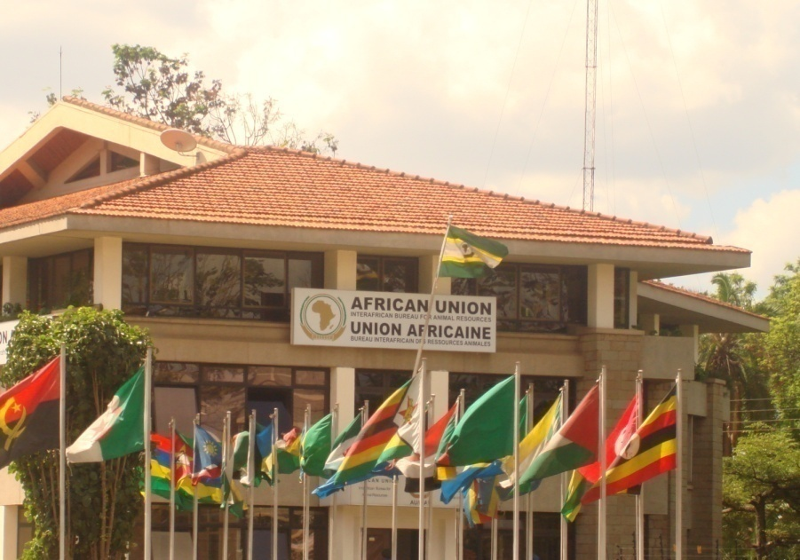
THANK YOU
Providing Leadership in the Development of Animal Resources for Africa

