Slide 1

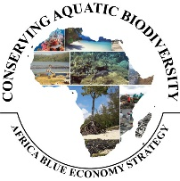


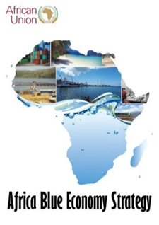
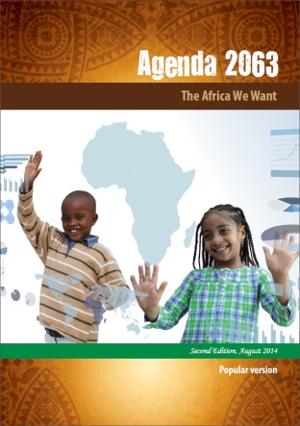
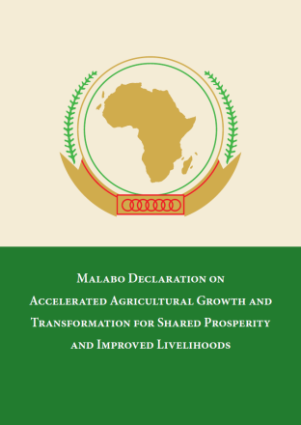
“CONSERVING AQUATIC BIODIVERSITY IN AFRICAN BLUE ECONOMY”
Status and progress of implementation of 2nd PTC meeting recommendations
at
THIRD PROJECT STEERING COMMITTEE MEETING
09th OCTOBER, 2024
MOMBASA, KENYA
By: Nadiope Eric

Slide 2
Recommendations | Progress
The PTC recommended a no-cost extension to allow the project to implement the remaining activities and address identified emerging issues. 2. The project should continue drawing synergies with existing projects and initiate new partnerships (MCS including the ACeCOR-UCC, GMES project – University of Ghana, etc. | A No-cost extension was granted for 14-months duration that would end on 14th October, 2025 The workplan was developed, with activities and budget a narrative was also developed for the no-cost extension. The project identified University as Centre of Excellency for aquatic biodiversity conservation. Established partnerships wit WWF and NC on advancing MSP in NMC; Established partnership with COREP to strengthen transboundary MPA, MCS, in Central: Established partnership with Central Secretariat to operationalize Regional MCSCC in SADC region; Collaborating with FCWC to strengthen MCS in west africa Africa that involved Benin, Cote D’Ivoire, Togo, Nigeria, Ghana and Nigeria

Slide 3
3rd PROJECT STEERING COMMITTEE MEETINGS
Recommendations | Progress
3. AU-IBAR should expand the scope of the ongoing initiative on transboundary MPA between Kenya and Tanzania to Southern Africa. 4. The Project to consider expanding the scope of MSP to other identified transboundary areas | The project expanded the scope of intervention on transboundary MPA to Central Africa; supported Gabon and Congo to enhance governance of MPA between the two countries In collaboration with World Wide Fund and Nairobi Convention, advanced the MSP process in the Northern Mozambique channel that involved Mozambique, Comoros, Madagascar and Tanzania

Slide 4
3rd PROJECT STEERING COMMITTEE MEETINGS
Recommendations | Progress
5. AU-IBAR should strengthen the capacity for Regional MCS systems in Central Africa in the no-cost extension phase. 6. The project to support additional Member States to mainstream all-inclusive gender strategies. | The project has included in the No-cost extension to strengthen Capacity of MCS personnel and environment experts for effective combat of IUU, protection of aquatic biodiversity and environment is planned in the no-cost extension Cote D’Ivoire, was supported to mainstream gender in aquatic biodiversity conservation. In addition, South Africa was supported to develop gender plan and related policy in small-scale fisheries

Slide 5
3rd PROJECT STEERING COMMITTEE MEETINGS
Recommendation | Progress
7. Capacity building for media to enhance their capacity for adequate reporting, including new tools of communication for the wider stakeholders in the no-cost phase of the project. 8. Establish a communication task force to improve local reporting and coherence of messages on aquatic biodiversity conservation and environmental management and dissemination. | Knowledge share fair has been included in the No-cost extension phase as a tool for wide dissemination of project outcomes; the use of ecosystems is also being utilized. In all project interventions at national and regional levels, media experts are hired to report on workshop proceedings; In this the capacities of media is being developed on adequate reporting issues of aquatic biodiversity conservation and ecosystems management AU-IBAR, in collaboration with World Bank, already facilitated the employment of Media Observatory for Sustainable fisheries and aquaculture (MOSFA) few years ago. The project is utilizing members of this group also to report on activities, meetings and other events related to aquatic biodiversity conservation

Slide 6

Thank You
AU-IBAR: Providing leadership in the
development of animal resources for Africa

