Slide 1



Orientation meeting
Africa Public-Private Partnership Forum in the Veterinary Domain
4th April 2024
(2:00 p.m. to 5:00 p.m. EAT)

Slide 2


Outline
Background
Some key AU-IBAR initiatives that inform and support the proposed APPP Forum
Objectives of the Orientation Meeting

Slide 3

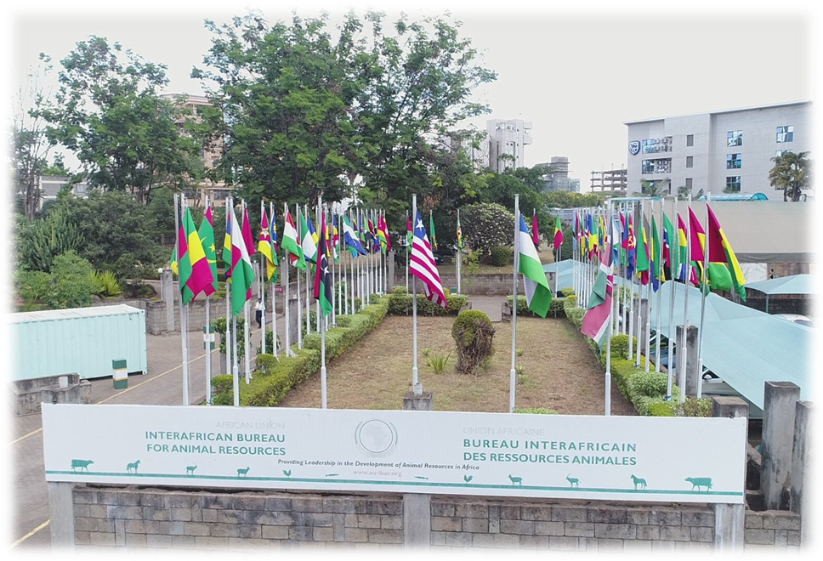
Background
AU-IBAR is Mandated to support and coordinate the sustainable development and utilization of animal resources to enhance nutrition and food security and contribute to the wellbeing and
prosperity of the people in the MSs of the AU

Slide 4
Background
WOAH and AU-IBAR), jointly spearheading the establishment of the Africa Public-Private Partnerships Forum to strengthen the veterinary domain (Background details to be elaborated by Rahul)

Slide 5

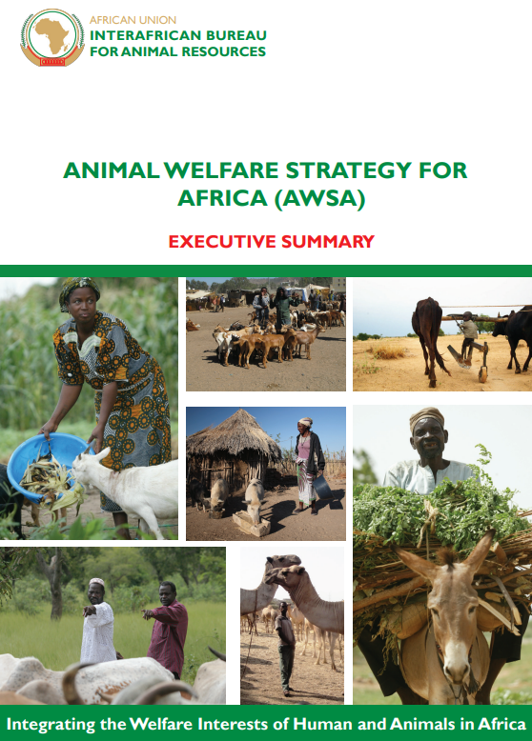
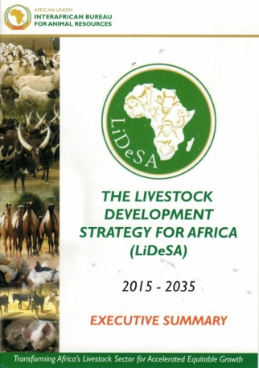
Some key AU-IBAR initiatives that inform and support the proposed APPP Forum
Continental Policy Frameworks
Initiative aligned to the LiDeSA, AHSA and AWSA
AHSA
Provides a common vision for the improvement of animal health in the continent
Among the guiding Principles for effective implementation is PPP
AWASA
AHSA and AWASA promote the implementation of WOAH International Standards on AH and AW

Slide 6
Some key AU-IBAR initiatives that inform and support the proposed APPP Forum
Networks and Coordination Mechanisms for driving key agendas:
1.The Continental Animal Health Platform of Public and Private Actors involved in AH (CAHP-Africa); A tool for African Union (AU) to provide strategic engagement of Animal Health stakeholders with its Secretariat in AU-IBAR
Objectives:
To develop and maintain coherence in the implementation of AH initiatives on the continent;
To provide strategic and technical guidance to AU, MSs and RECs in the area of animal health systems management;
To monitor general sectoral issues related to animal health and propose approaches for their integration in cooperation programmes with international partners;
To publish the State of Animal Health in Africa (SAHA) on a biennial basis.

Slide 7



Some key AU-IBAR initiatives that inform and support the proposed APPP Forum
2. African Association of Veterinary Education Establishments (2A2E-V) – critical to reforming veterinary education in the continent
3. African Association of Veterinary Statutory Bodies (2VSB) - Critical co-ordination mechanisms for reforming veterinary regulation
4. African Women In Animal Resources Farming and Agribusiness Network (AWARFA-N)-platforms to promote inclusivity
5. African Youth in Livestock, Fisheries and Aquaculture Incubators Network (AYL-FAIN) - platforms to promote inclusivity
6. Fisheries and Aquaculture networks

Slide 8
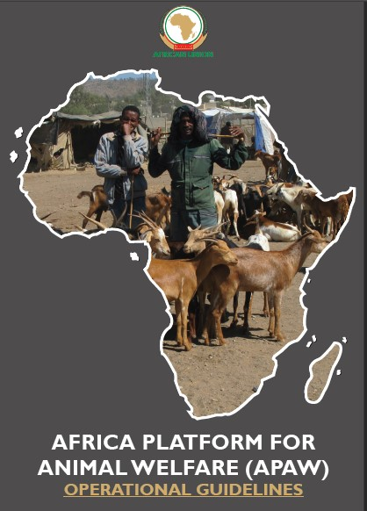
Some key AU-IBAR initiatives that inform and support the proposed APPP Forum
6. African Platform for Animal Welfare (APAW)
Support the implementation of the Animal Welfare Strategy for Africa (AWSA)
Composition:
The African General Assembly for Animal Welfare (AGAAW);
The Coordination Committee for Animal Welfare in Africa (CCAWA) and
The Secretariat
Functions:
Guide implementation and monitor progress of implementation of AWSA
Promote coordination, collaboration, information sharing and to foster partnerships on animal welfare
Promote the animal welfare agenda across the continent through participatory approaches, community engagement and ownership
Foster a holistic and multi-stakeholder approach ensuring good animal welfare practices in different contexts and situations in Africa
Provide guidance to countries and Regional Economic Communities (RECs); and stakeholders on priority intervention areas in animal welfare, based on the African context.

Slide 9
Objectives of the Orientation Meeting
The overall objective of the meeting is to shape the vision and modalities of the Africa Public-Private Partnerships Forum for Veterinary Strengthening. The meeting objectives are;
Provide a platform for stakeholders to articulate their expectations from the forum and align objectives.
Facilitate discussions to finalize the operational framework, governance structure, and participation guidelines for the forum, ensuring a cohesive and effective partnership.
Explore avenues for ensuring the long-term sustainability of the initiative, identifying potential challenges, and developing strategies to address them.

Slide 10

Thank you
African Union – InterAfrican Bureau for Animal Resources (AU-IBAR)
Kenindia Business Park, Westlands Road
P.O. Box 30786-00100 Nairobi Kenya
Website: www.au-ibar.org
Join our knowledge sharing networks: https://networks.au-ibar.org/
Access our publications: http://repository.au-ibar.org/

