Slide 1
Lessons learnt and best practices in PPPs for Research and
Development
Edward Okoth

Slide 2








PPP Integrated delivery of AH&G for impact: the case of SAPLING
Integrated delivery of technologies, knowledge & services via digitally-enabled businesses
Digitally-enabled - dairy profitability App, OFFA, ICT
Generate business & research data
VC linkage Bulk orders for input/service suppliers
Technology Packaging
SAPLING promotes integrated technologies through DFAs
DFA: a shared manager – jointly manages herds & catalyze technology demand
Animal health
Herd health package
Low productivity
How do we finance this?
Input suppliers
Check-off systems that support access to inputs & services (including DFA/extension service)
Cooperatives
Inappropriate technology
Genomic selection
Identification & promotion of tropically adapted dairy breeds
Feed & Forage
Selection & promotion of appropriate forages and feed rations
Innovative VC financing – farm operational capital & input/service providers
DFAs
Inadequate access to services
Input financing scheme
30% of milk revenue in escrow account
12-month line of credit from FI
Technology packaging = synergy
Combined effect greater than sum of separate effects
Appropriate feeding improves productivity, health & fertility
Healthier animals optimize feed resources, enhance productivity & fertility
AI/AH Technician
Low profit/loss making
Generate AI & AH data for business decision & for research

Slide 3
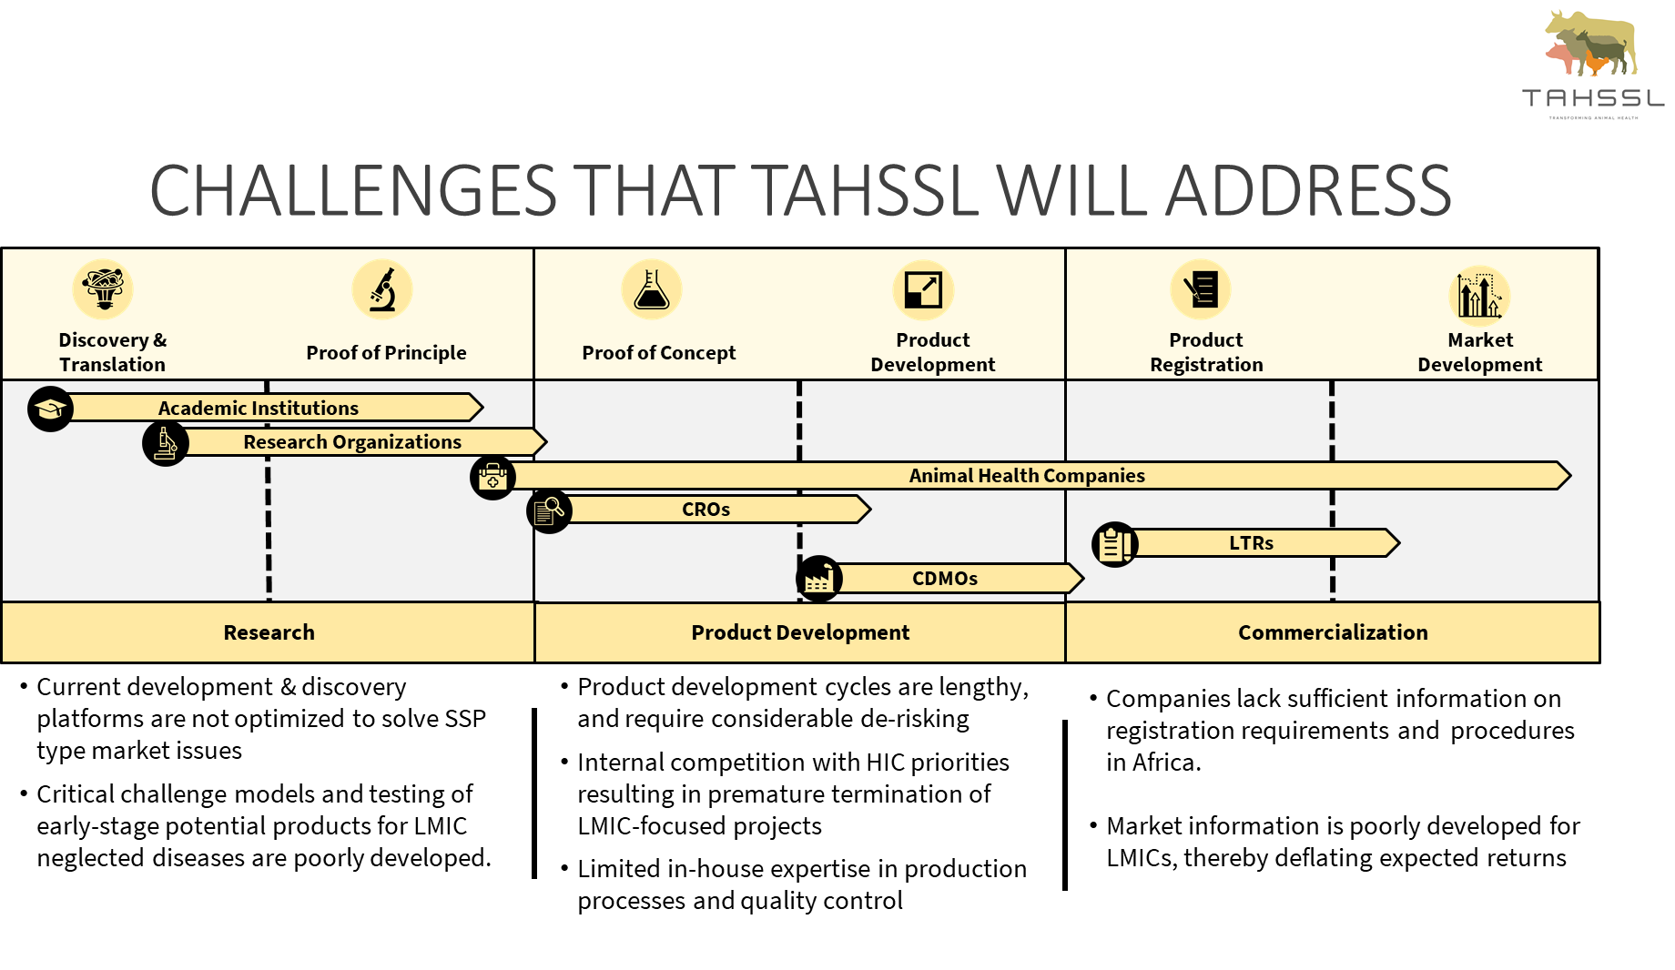
TAHSSL’s Strategic Focus & Activities
TAHSSL/CRO
TAHSSL/CRO
Animal Health companies
Research Orgs/Companies
Animal Health companies
Research Orgs/Companies
Evaluate AHP candidates – In partnership with industry and other stakeholders, identify and test specific vaccines, diagnostic assays and other animal health candidates
Establish robust animal disease models - Develop, evaluate, and standardize experimental infection models while offering high quality clinical and laboratory research expertise and infrastructure
Help clients to access market information and authorization – Generate and make available information to assist clients to register their products and provide market intelligence to enable clients make informed investment decisions
Notes:
Transforming Animal Health Solutions and Services for LMICs

Slide 4
Best practices
Identify the needs and gaps in R$D that require veterinary PPP
Co-design veterinary solutions that better meet the needs and preferences of users resulting in sustainable (supported by farmers), and higher adoption
Address limited entrepreneurship orientation among Veterinarians and AHAs
Make provisions for appropriate incentives for Private Veterinarians, AHAs, Para-veterinarians and Agrovet Dealers
Generate evidence for success or failure - Digital innovations in agriculture offer new opportunities
Harmonize regional and national policies with respect to private sector by defining roles for the public sector and private sector
Define better public vs private good with a win-win-win for all
Built the PPP case using economic and social considerations

Slide 5
THANKS

